Slide 1
Working with Different Groups
Module 3 (d)
PrEP for Adolescents

Slide 2
Myths, stereotypes, and misconceptions
What do you think of when we talk of adolescents?

Slide 3
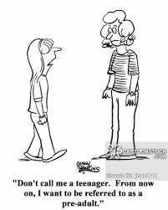
What is adolescence?
Adolescence begins with biological maturation (puberty) when young people must accomplish developmental tasks and develop a sense of personal identity. It ends when young people achieve self-sufficient adulthood as defined by society.
Not yet an adult – no longer a child

Slide 4
Definitions
Adolescents are persons between ages of 10–19
Youth between the ages of 15–24
Young people refers to this broader age band of 10–24 years (UNAIDS 2013)
Also defined within the cultural context of individual countries. The SA national youth policy 2009-2014 defines youth as any person between the ages of 14 to 35
Notes:
[Insert country specific information]

Slide 5
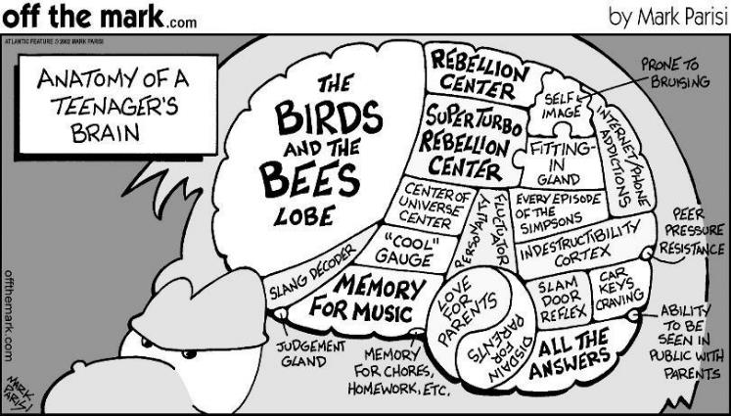
Adolescence is…
A period marked by complex changes, such as:
Rapid physical growth
Development of sexuality
Transition and changing social roles
Growth in thinking, feeling and morals
School transitions
Risk taking and experimentation
Adolescent brain

Slide 6
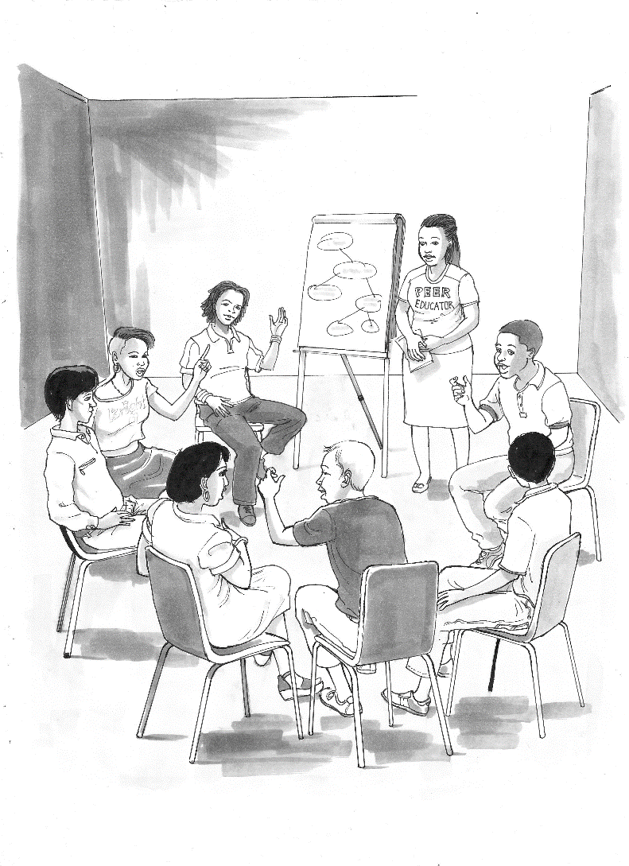
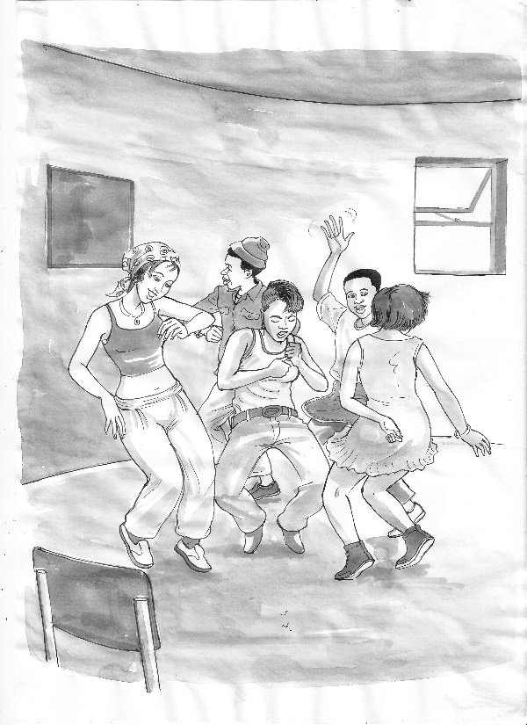
Why youth-friendly services?
Vulnerable age – time of experimentation, exploring independence
No longer a child, but not yet an adult
Physical, emotional, psychological, sexual and social changes
SRH and HIV:
  Teen pregnancy
  STIs
  HIV
  TB
Sexual awakening
Risky behaviour like drugs, alcohol, smoking
Important time for shaping patterns of behaviour and health for the future
A time of opportunity, growth and maturation – not all problematic
Important: Role models and trusted adults to guide, usher, and influence into adulthood
Notes:
Issues relating to access…
inflexible and inconvenient clinic opening times
Clinic location, distance from home and availability, and the need for money for transport
Sitting in waiting rooms with adults, some of whom may know them
The attitude of staff – receptionists, clerks and nurses – who may be rude and judgmental
Nurses who may not give enough information or clarity; lack of confidentiality, privacy and sufficient time
The physical environment which looks intimidating, clinical and unattractive
Lack of accessible information developed to address the concerns, language and level of young people, which is easy to read and relevant to their lives
Issues related to quality of care…
Barriers relating to the quality of care which may discourage youth from using the clinic or completing treatment, e.g. drug stock-outs; having to walk through a waiting room with a urine sample; etc.
Anxiety about confidentiality and privacy
Issues related to communication… …
Impatient and unsympathetic staff who do not deal well with the embarrassment or problems young people encounter
Staff with poor listening skills
Embarrassment of provider who cannot discuss issues related to sexuality and safer sex
The language used and how well the health worker explains to the patient the nature of the problem and treatment

Slide 7
Issues to consider: Risk and protective factors
Risk factors
Protective factors
poverty
peer pressure
sexual coercion
transactional sex
age-disparate relationships
teenage pregnancy
physiological vulnerability
barriers to using health services
dropping out of school
being an orphan or in a child-headed household
Contributing factors to vulnerability and prevention of HIV, teen pregnancy, STIs
youth-friendly services
positive role models
guidance from and engagement
  with parents
trusted adults
staying in school education

Slide 8
Factors to consider
Poverty
Transactional sex
HIV/ unintended and unsupported pregnancy
Drop out of school
Gender based, sex work, alcohol violence
Cause and effect –
a circular relationship

Slide 9
Factors to consider
Adolescents are not a homogenous group
  Age phases and maturation are significant (different needs for 13-year-old, 16-year-old, 19-year-old)
May be part of other key populations which adds additional layers of vulnerability
  Young key populations, young MSM, young transgender persons, young people who sell sex, and young people who inject drugs, are at particularly high risk for HIV
PrEP offers an important option in prevention

Slide 10
Legal issues
Legal framework differs from country to country
Need to take this into account when providing PrEP
Also one of the barriers to comprehensive research relating to PrEP and adolescents and young people (under 18 years)
In South Africa, for example, legal age:
  contraception 12 years
  HIV counselling and testing 12 years
  Termination of pregnancy – a woman of any age can give her consent
Notes:
[Insert country specific information]
A note abut TOP and legal age: In South Africa, the Choice on Termination of Pregnancy (CTOP) Act defines a woman as: ‘any female person of any age’. It further states that only the woman’s consent is needed for the termination of pregnancy (TOP) and in the case of a minor, only the minor’s consent is needed subject to advising such a minor to consult with the parents.

Slide 11
Barriers
What in your view are some of the most important barriers for young people using health services?
WRHI M. Pleaner. May 2016 for HPTN 082

Slide 12
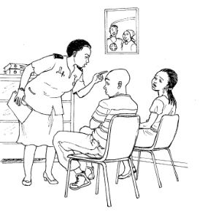
Barriers
The body of research shows that youth experience
barriers to using health services:
  Access
  confidentiality/privacy
  location of the clinic
  waiting times
  cost
And at the heart of most research
  youth-friendly staff, staff attitude
WRHI M. Pleaner. May 2016 for HPTN 082

Slide 13
Special considerations: Providing youth sensitive services
Respectful, non-judgemental
Very important to listen
Screening for STIs, TB, contraception, other NCD needs
Support to use contraception and protection against HIV
Dual protection
Frequent HIV testing (potentially every 3 months)

Slide 14
Special considerations
Challenges for young people
  Living with HIV
  Being open about sex, sexuality and sexual orientation
  Stigma
  Disclosure vs. non-disclosure
  Adherence
  Reproductive health and sexuality
  Mental health issues
  Transition to adulthood

Slide 15
Providing services to young people
What are some of the ways adolescents are stigmatised and discriminated against?
How does this affect their ability to seek healthcare?
Think about your own reaction when an adolescent requests services relating to sexual and reproductive health – contraception, STIs, HIV?
How can healthcare providers make adolescents feel more at ease in the clinic?

Slide 16
PrEP and adolescents
Interventions need to:
Involve beneficiaries in design and implementation of the intervention
Take into account the context in which the intervention is being delivered.
Address issues of stigma and discrimination
Address issues related to adherence and effective use of PrEP
Be implemented in an enabling environment, including:
  Increasing access to HIV testing and health services for PrEP and other prevention strategies
  Decriminalising key populations’ practices
  Fostering community empowerment
Pettifor A et al. Journal of the International AIDS Society 2015

Slide 17
PrEP and adolescents - Research
Several studies – but still awaiting evidence
Emerging trends:
Adherence to daily PrEP is a greater challenge for younger populations, and poor adherence associated with decreased efficacy in all PrEP trials.
Individual-level barriers include limited familiarity with antiretroviral-based prevention, stigma, product storage, and social support.
Structural challenges include healthcare financing for PrEP, clinician acceptability and comfort with PrEP delivery, and the limited availability of youth-friendly health services.
Adolescent populations are particularly vulnerable to HIV, and oral PrEP in these populations is likely to have an impact on population-level HIV incidence. The challenges of disseminating an HIV biomedical prevention tool requiring daily usage in adolescents are formidable, but addressing these issues and starting dialogues will lay the groundwork for the many other HIV prevention tools now being developed and tested. - Hosek 2016

Slide 18
Adolescent Girls & Young Women PrEP Implementation Projects
4 ongoing AGYW PrEP demo projects in sub-Saharan Africa**
14 planned AGYW PrEP demo projects in sub-Saharan Africa**
Ongoing PrEP for AGYW demo projects
Planned PrEP for AGYW demo projects
DREAMS implementing PrEP for AGYW *
5 DREAMS countries implementing PrEP for AGYW*
Uganda
Kenya
1 planned demo project
PrEP offered in DREAMS
2 ongoing demo projects
1 planned demo projects
PrEP offered in DREAMS
Malawi
2 planned demo projects
Tanzania
1 planned demo projects
* DREAMS countries implementing service delivery of PrEP; one country doing a demonstration project to assess access, retention, and uptake.
** Some projects across multiple countries.
South Africa
4 ongoing demo projects
10 planned demo projects
PrEP offered in DREAMS
Zimbabwe
3 planned demo projects
PrEP offered in DREAMS
Swaziland
PrEP offered in DREAMS
PrEPWatch.org

Slide 19
Conclusion
“PrEP could offer a highly effective, time-limited primary prevention for young key populations, if it is implemented in combination with other programs to increase access to health services and encourage reliable use of PrEP while at risk of HIV exposure.”
  What other programmes?
  How to increase access to healthcare for young people?
  How do we encourage reliable use of PrEP with young people – issues of adherence and adolescents
  Combination prevention critical
  SRH important
Pettifor A et al. Journal of the International AIDS Society 2015

Slide 20
References
M. Pleaner (Wits RHI). May 2016 Slides adapted from HPTN 082 Presentation.
Pettifor A, Nguyen N, Celum C, Cowan FM, Go V, Hightow-Weidman L. Tailored combination prevention packages and PrEP for young key populations. Journal of the International AIDS Society 2015, 18(Suppl 1):19434
Hosek, S., Celum, C., Wilson, C., Kapogiannis, B., Delany-Moretlwe, S., Bekker, L.. Preventing HIV among adolescents with oral PrEP: observations and challenges in the United States and South Africa. Journal of the International AIDS Society, North America, 19, oct. 2016. Available at: <http://www.jiasociety.org/index.php/jias/article/view/21107>. Date accessed: 01 Feb. 2017.

Slide 21

Acknowledgements
With thanks to:
The Southern African HIV Clinician Society (Michelle Moorhouse)
Wits Reproductive Health and HIV Institute (Melanie Pleaner)

