Slide 1
Working with Different Groups
Module 3 (g)
Prisoners and PrEP

Slide 2
Prisoners: Assumptions and stereotypes
What do you think of when you think of prisoners?
Would you be comfortable providing healthcare to prisoners?
What kind of stigma do you associate with prisoners?
What rights do prisoners have with regards HIV services?
Do you think PrEP is a sound prevention option for prisoners?

Slide 3
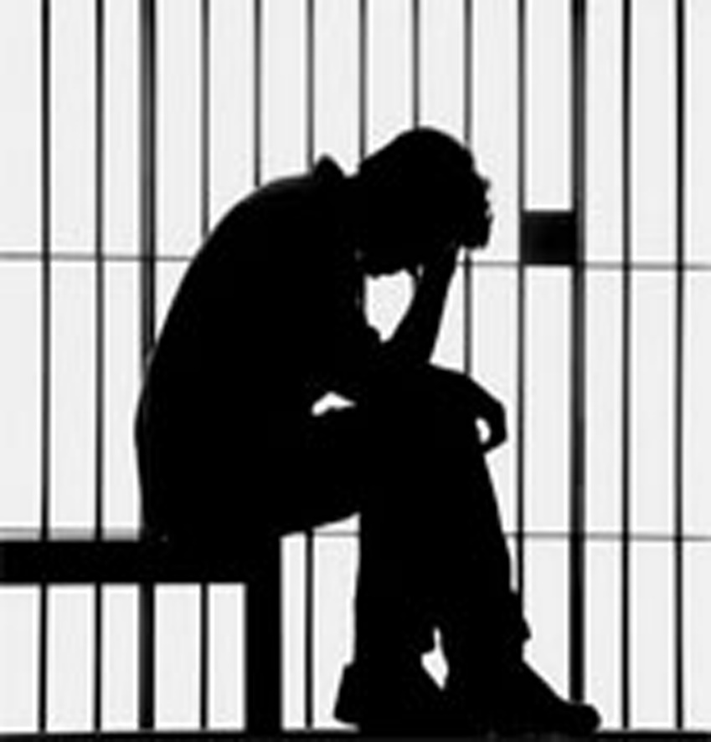
People in prison
They are vulnerable to HIV:
  Rape and lack of consensual sex
  Poor access to condoms
  Power relationships between prisoners
  Drug use
  Tattoos
  Overcrowding and violence
Coinciding sub-groups: MSM, sex workers, PWIDs
Avert.org
Notes:
https://www.avert.org/professionals/hiv-social-issues/key-affected-populations/prisoners

Slide 4
Prisoners’ rights in South Africa
Strong support for prisoners’ rights in South Africa - backed by the Constitution
A lot of advocacy work has resulted in access to healthcare and HIV services in prison
Everyone who is detained, including every sentenced prisoner, has the right to conditions of detention that are consistent with human dignity, including at least exercise and the provision, at state expense, of adequate accommodation, nutrition, reading material and medical treatment.
Section 35(2)(e) Constitution of South Africa
Davies NECG et al. PLoS ONE 2012
Notes:
[Insert country specific information]

Slide 5
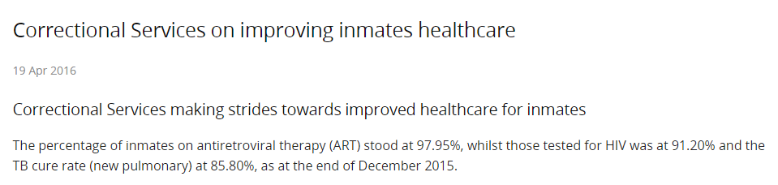
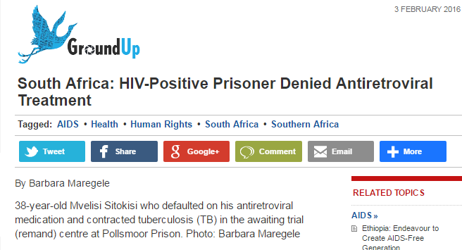
The Good News
The Not So Good News
http://www.gov.za/speeches/correctional-services-making-strides-towards-improved-healthcare-inmates-19-apr-2016

Slide 6
Prisoners – What do we know?
Very little research specifically on prisoners
  part of sub-groups in research e.g PWIDs, MSMs
Prisoners and PrEP: the primary issue relates to access to healthcare in prison, and specifically HIV prevention and treatment programmes
  Need consistent provision of ART and PrEP
TB and HIV: co-infection in prisons is high

Slide 7
References
Davies NECG, Karstaedt AS. Antiretroviral Outcomes in South African Prisoners: A Retrospective Cohort Analysis. Lama JR, ed. PLoS ONE. 2012;7(3):e33309.
http://www.gov.za/speeches/correctional-services-making-strides-towards-improved-healthcare-inmates-19-apr-2016-0000
Lancet Series: HIV and related infections in prisoners July 14, 2016

Slide 8

Acknowledgements
With thanks to:
The Southern African HIV Clinicians Society
Wits Reproductive Health and HIV Institute (Melanie Pleaner)

