Slide 1
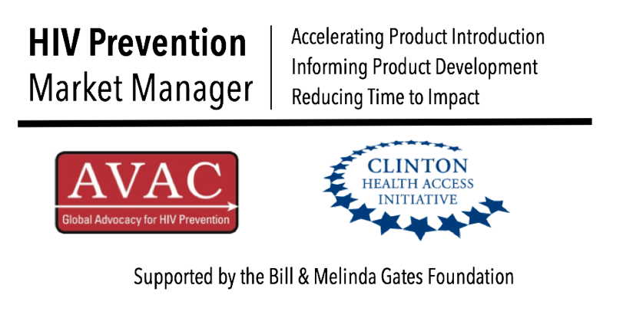
Oral PrEP Enrollment Snapshot, June 2018
AVAC tracks global PrEP use by conducting quarterly surveys of ongoing oral PrEP demonstration and implementation projects, and collecting data from manufacturers and government agencies. Trends in uptake based on this data are used to inform advocacy and product introduction efforts.
Additional information may be found on
PrEPWatch.

Slide 2
Oral PrEP Implementation: Total Program & Project Initiations* 2017-2018
Q1 2017
Q2 2017
Q3 2017
Q4 2017
Q1 2018
*Includes initiation data from ongoing demonstration and implementation projects, PEPFAR and Gilead
Notes:
Kaiser Permanente data needed for the US

Slide 3
Oral PrEP Implementation: Progress Against Targets 2017*
Target
Results
Australia outperformed targets
*Includes initiation and target data from ongoing demonstration and implementation projects, PEPFAR

Slide 4
Oral PrEP Implementation: Progress Against Targets 2018*
Target
Results
Australia outperformed targets
*Includes initiation and target data from ongoing demonstration and implementation projects, PEPFAR

Slide 5
Oral PrEP Implementation: Program Initiations 2017-2018
Notes:
PEPFAR data is collected by fiscal year
Program targets differ by country
Retention is not accounted for in this data set
Q1 2017
Q2 2017
Q3 2017
Q4 2017
Q1 2018

Slide 6
Oral PrEP Implementation: Progress Against Targets, 2017
Notes:
PEPFAR data is collected by fiscal year
Program targets differ by country
Retention is not accounted for in this data set
Targets
Results

Slide 7
Oral PrEP Implementation: Progress Against Targets, 2018
Notes:
PEPFAR data is collected by fiscal year
Program targets differ by country
Retention is not accounted for in this data set
Targets
Results

Slide 8
PrEP Initiations by Country (April 2018)
> 25,000
10,000-25,000
5,000-10,000
1,500-5,000
500-1,500
< 500
No Data
PrEP Available (No Data)
Source: AVAC Global PrEP Initiation Tracker 2018

Slide 9
PrEP Initiations by Country (April 2018)
> 25,000
10,000-25,000
5,000-10,000
1,500-5,000
500-1,500
< 500
No Data
PrEP Available (No Data)
Source: AVAC Global PrEP Initiation Tracker 2018

