Slide 1
Module 1:
INTRODUCTION TO ORAL PrEP
Version: December 2018

Slide 2
Outline of training
Module 1: Introduction to oral PrEP
Oral PrEP: the basics
What is combination prevention?
How effective is oral PrEP?
What are the differences among PrEP, PEP, and ART?
Overview of country-specific guidelines
Module 4: Oral PrEP provision for AGYW: getting started
Generating demand: reaching AGYW
Risk assessments
Addressing myths, misconceptions, and fears
Factors influencing decisions to initiate or stay on oral PrEP
Key issues to discuss with AGYW in relation to PrEP
Module 2: The provision of oral PrEP in the context of AGYW
Why oral PrEP for AGYW?
Adolescence: a dynamic time of change and transition
Providing oral PrEP in the context of adolescent- and youth-friendly services
Checking in with ourselves: our personal views and values about AGYW and oral PrEP
Unpacking youth-friendly services
Module 5: Monitoring, follow-up, and adherence support for AGYW on oral PrEP
Promoting adherence and retention for AGYW using oral PrEP
Frequently asked questions
Module 6: Wrapping up
Key take-home messages
Resources for providing oral PrEP to AGYW
Module 3: Important factors to consider when providing oral PrEP to AGYW
Combination prevention: related services and entry points to PrEP
Gathering the evidence: what have we learned about oral PrEP and AGYW?
Addendum: Initiation and clinical management of oral PrEP
Notes:
PrEP - pre-exposure prophylaxis for HIV prevention
AGYW - adolescent girls and young women

Slide 3
Oral PrEP: the basics

Slide 4
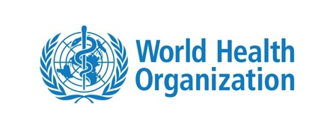
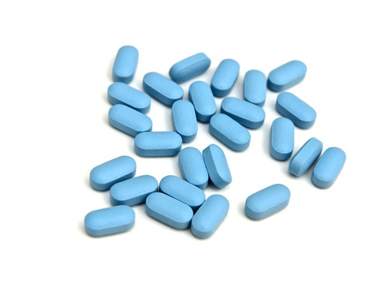
Oral PrEP
STRONG RECOMMENDATION
HIGH-QUALITY EVIDENCE
WHO recommends that oral PrEP containing TDF should be offered as an additional prevention choice for people at substantial risk of HIV infection as part of combination HIV prevention.

Slide 5
Oral PrEP (cont.)
The present guidelines support the use of TDF/FTC in combination for effective PrEP.
Truvada or oral PrEP generics (e.g., Mylan’s Ricovir-EM) are pills that contain the following two medicines:
Emtricitabine: an ARV nucleoside reverse transcriptase inhibitor (NRTI)
Tenofovir disoproxil fumarate (tenofovir DF): another ARV nucleoside reverse transcriptase inhibitor
Notes:
ARV: antiretroviral
NRTI: nucleoside reverse transcriptase inhibitor
Tenofovir (TDF) and tenofovir/emtricitabine (TDF/FTC) in a single tablet fixed-dose combination (FDC) are the oral ARV agents used in oral PrEP studies to date.
The present guidelines support the use of TDF/FTC in combination for effective PrEP. TDF-containing oral PrEP is recommended by the World Health Organization (WHO) for people at substantial risk of HIV infection.
Truvada or PrEP generics (e.g Mylan) contain the following two different medicines combined in one pill: Emtricitabine - an HIV medicine called a nucleoside reverse transcriptase inhibitor (NRTI), and tenofovir disoproxil fumarate - another HIV medicine (also an NRTI).

Slide 6
Defining substantial risk of HIV infection
Substantial risk of HIV infection is defined as HIV incidence around or higher than 3 per 100 person-years in the absence of oral PrEP (based on epidemiological context and individual risk assessment).
Identifying and offering oral PrEP to those at substantial risk leads to:
Strong epidemio-logical impact
Great individual benefit
Optimal investment in resources
Notes:
Defining substantial risk of HIV: Substantial risk of HIV infection is provisionally defined as HIV incidence around 3 per 100 person-years or higher in the absence of PrEP. HIV incidence higher than 3 per 100 person-years has been identified among some groups of men who have sex with men, transgender women in many settings, and heterosexual men and women who have sexual partners with undiagnosed or untreated HIV infection. Individual risk varies within groups at substantial risk, depending on individual behaviour and the characteristics of sexual partners. (WHO Consolidated Guidelines on the Use of Antiretroviral Drugs for Treating and Preventing HIV Infection: Recommendations for a Public Health Approach. 2nd edition. Geneva: World Health Organization; 2016.)
Inconsistent use of condoms (male or female), including an intention to use condoms during sex with some occasional omissions or accidents, increases HIV risk. Social desirability bias in reporting condom use may occur, so oral PrEP could be considered for people reporting any intercourse without a condom or concerns about their future use of condoms. For example, someone who reports a desire to stop using condoms may be already having sex without condoms.
Recently diagnosed sexually transmitted infections (STIs) are often indicators of risk for sexual acquisition of HIV. The predictive value of STI indicators varies by region, the type of STI and a person’s demographic characteristics. A new diagnosis of syphilis or genital herpes is a strong predictor of HIV risk among men who have sex with men (MSM) in most settings and among heterosexual men and women in areas of high HIV prevalence. Oral PrEP services should be prioritised; local epidemiology will be essential to guide decisions about when to offer oral PrEP and to which populations.
Requesting oral PrEP has been shown to be an indicator of substantial risk. HIV incidence among people requesting oral PrEP has been higher than expected from observational studies in the same locality. People at high risk of acquiring HIV infection who request oral PrEP tend to have greater oral PrEP uptake, adherence and retention. Clinicians should consider any request for oral PrEP seriously, especially for individuals in settings where the local epidemiology indicates likely substantial HIV risk in their population group.
People who use and/or inject drugs are often at substantial HIV risk. WHO recommends a package of effective HIV services be provided for all people who inject drugs, including harm reduction (in particular opioid substitution therapy and needle syringe programmes). When these interventions are available, the risk of HIV transmission is significantly reduced. Providing these services should be a priority.

Slide 7
Whom is oral PrEP intended for?
PrEP should be considered for people who are HIV-negative and at substantial risk of acquiring HIV infection. This includes:
Key populations such as sex workers, MSM, AGYW, users of intravenous drugs, transgender people, prisoners, and serodiscordant couples.
ANYONE who perceive themselves to be at substantial risk.
The health care provider can help individuals explore and assess their own risks, health, and commitment to effective use to determine whether PrEP is an appropriate option
Also depends on country-specific guidelines:
What is approved?
What is available in the private sector?
What is available in the public sector?
*
Notes:
*Edit info to be country specific

Slide 8
Substantial risk of HIV infection in context
Questions to consider:
What is HIV incidence in your project/service area?
Which groups would you define as being at substantial risk in your country? In your local service area/community?
Notes:
Offering oral PrEP to those who are at substantial risk, including MSM, sex workers in some countries – particularly in sub-Saharan Africa, transgender women in most regions, and adolescent girls and young women in high incident settings in southern and eastern Africa. Among serodiscordant couples, the HIV-negative partner may benefit from taking oral PrEP when the partner with the HIV infection is not virally suppressed on antiretroviral therapy (ART). Oral PrEP may also be considered for women who would like to become pregnant when they have a partner with HIV who is not virally supressed on ART or who has not been tested but is at high risk of HIV. Oral PrEP is not suitable for everyone; moreover, it is not intended for lifelong use. WHO Module 4 2017: http://apps.who.int/iris/bitstream/handle/10665/258508/WHO-HIV-2017.26-eng.pdf;jsessionid=DAD42EFA831C5C059A547FFB5C8887BF?sequence=1

Slide 9
Oral PrEP in pregnancy: guidelines vary*
TDF appears to be safe in pregnant women. However, evidence comes from studies of HIV-infected women on ART.
Among HIV-uninfected pregnant women, evidence of TDF safety comes from studies of women mono-infected with Hepatitis B Virus (HBV).
PrEP benefits for women at high risk of HIV acquisition appear to outweigh any risks observed to date.
WHO recommends continuing oral PrEP during pregnancy and breastfeeding for women at substantial risk of HIV. However, continued surveillance is needed for this population group.
Note: South African guidelines do not yet recommend oral PrEP during pregnancy and breastfeeding.
Notes:
* To date South Africa is not yet providing oral PrEP in pregnancy, whereas in other Sub-Saharan African countries they are i.e. Kenya, Namibia, Zimbabwe
HIV-negative women in serodiscordant relationships are at risk of acquiring HIV infection whilst trying to conceive through unprotected sex. Pregnancy itself is also associated with an increased risk of becoming infected with HIV. The use of oral PrEP around the time of conception and during pregnancy offers a means of protection to the uninfected partner. Unfortunately, data relating to the safety of oral PrEP specifically with regard to the developing foetus are limited, and consequently the onus is on the clinician to discuss potential risks and benefits of oral PrEP initiation or maintenance during pregnancy with the client.
Oral PrEP trials involving heterosexual women excluded pregnant women from enrollment, and those who fell pregnant during the conduct of the study were discontinued from oral PrEP. One study of 46 uninfected women in serodiscordant relationships demonstrated no adverse effects on the pregnancy or cases of HIV transmission when TDF was used around the time of conception. There are several ongoing demonstration projects that will allow women to continue oral PrEP if they fall pregnant, which will provide some data to inform future recommendations. In addition, the Antiretroviral Pregnancy Registry shows no evidence of adverse outcomes amongst infants exposed to these medications when used as antiretroviral therapy in utero.
In serodiscordant couples, the infected partner should be initiated on ART and virologically suppressed, ideally for 6 months, before any attempts to conceive.
Exposure to oral PrEP via breast milk has not been extensively studied. However, HIV-negative babies born to HIV-positive mothers on PMTCT B+ programmes and lifelong ART are exposed to TDF/FTC. The risk of HIV infection against the risk of ARV exposure to the infant should frame a discussion with a potential PrEP user who is pregnant or is planning conception.

Slide 10
What is combination prevention?

Slide 11
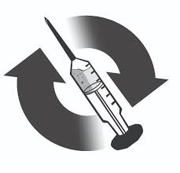
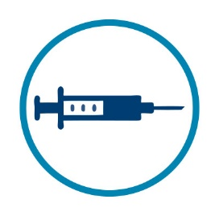
Combination prevention
HIV counselling and testing
+
re-testing
Condoms
PrEP
Counselling
Post-exposure prophylaxis (PEP)
Syringe exchange and opioid substitution
: SRH
SRH
Contraception and safer conception (preventing pregnancy and planning for healthy pregnancies)
Behavioural interventions
Healthy lifestyles
Screening and management
of STIs
Male medical circumcision
ART for partners living with HIV
PrEP is only one of several prevention options.
PrEP does not protect against pregnancy and STIs
Notes:
Points to note:
PrEP should not be promoted as a standlone prevention
PrEP is one of several prevention options.
PrEP does not protect against pregnancy and STIs

Slide 12
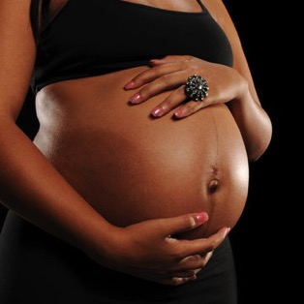
What does PrEP NOT protect against?

Slide 13
How effective is oral PrEP?

Slide 14
Evidence for Oral Tenofovir-Based Prevention in Trials and Studies
Sexual
transmission
prevention
Effect size (CI)
Partners Demo (2015) – daily oral TDF/FTC
(Women – Kenya, Uganda)
94% (85; 98)
PROUD (2015) – daily oral TDF/FTC
(MSM - UK)
86% (64; 96)
IPERGAY (2015) – on demand oral TDF/FTC
(MSM – France, Canada)
86% (40; 99)
Partners PrEP (2011) – daily oral TDF/FTC
(Discordant couples - Kenya, Uganda)
75% (55; 87)
Partners PrEP (2011) – daily oral tenofovir
(Discordant couples - Kenya, Uganda)
67% (44; 81)
TDF2 (2012) – daily TDF/FTC
(Heterosexual men and women - Botswana)
62% (22; 84)
iPrEx (2010) – daily oral TDF/FTC
(MSM - North and South America, Thailand, South Africa)
44% (15; 63)
FEMPrEP (2012) – daily oral TDF/FTC
(Women - Kenya, South Africa, Tanzania)
6% (-21; 40)
MTN 003/VOICE (2015) – daily oral TDF/FTC
(Women - South Africa, Uganda, Zimbabwe)
-4% (-49; 27)
MTN 003/VOICE (2015) – daily oral tenofovir
(Women - South Africa, Uganda, Zimbabwe)
-49% (-129; 3)
Prevention in people who
inject drugs
Bangkok Tenofovir Study (2013) –
daily oral tenofovir
(People who inject drugs - Thailand)
49% (10; 72)
-130
0
100
Effectiveness (%)
Source: Salim S. Abdool Karim, CAPRISA/FHI360

Slide 15
Oral PrEP: Efficacy and adherence
Partners PrEP³
81% adherence/
75% efficacy
Higher adherence = higher efficacy
TDF2⁴
84% adherence/
63% efficacy
iPrEx¹
51% adherence/
44% efficacy
Adherence, %
Bangkok²
67% adherence/
49% efficacy
Grant R, et al. N Engl J Med 2010
Choopanya K, et al. Lancet 2013
Baeten J, et al. N Engl J Med 2012
Thigpen M, et al. N Engl J Med 2012
HIV protection effectiveness
Trials in which the majority of participants were adherent demonstrated
HIV protection, with higher estimates of protection when more of the
population was adherent.

Slide 16
Oral PrEP: Efficacy and adherence (cont.)
Partners PrEP³
81% adherence/
75% efficacy
Lower
adherence =
lower efficacy
TDF2⁴
84% adherence/
63% efficacy
iPrEx¹
51% adherence/
44% efficacy
Adherence, %
Bangkok²
67% adherence/
49% efficacy
FEM-PrEP⁵ and VOICE⁶
≤30% adherence/
no efficacy
Grant R, et al. N Engl J Med 2010
Choopanya K, et al. Lancet 2013
Baeten J, et al. N Engl J Med 2012
Thigpen M, et al. N Engl J Med 2012
Van Damme L, et al. N Engl J Med 2012
Van der Straten A, et al. AIDS 2012
HIV protection effectiveness
Trials in which only a minority of participants were adherent did not/could not
demonstrate HIV protection.

Slide 17
Treatment as prevention: ART efficacy/adherence
Partners PrEP³
81% adherence/
75% efficacy
Higher adherence = higher efficacy
HPTN 052⁷
>95%adherence/
96% efficacy
TDF2⁴
84% adherence/
63% efficacy
iPrEx¹
51% adherence/
44% efficacy
Adherence, %
Bangkok²
67% adherence/
49% efficacy
FEM-PrEP⁵ and VOICE⁶
≤30% adherence/ no efficacy
Grant R, et al. N Engl J Med 2010
Choopanya K, et al. Lancet 2013
Baeten J, et al. N Engl J Med 2012
Thigpen M, et al. N Engl J Med 2012
Van Damme L, et al. N Engl J Med 2012
Van der Straten A, et al. AIDS 2012
Cohen M, et al. N Engl J Med 2011
HIV protection effectiveness
HPTN 052 showed that suppressive ART, from very high adherence,
nearly eliminated HIV transmission risk.

Slide 18
Oral PrEP and efficacy
Key point: Oral PrEP is highly effective if taken as prescribed.
The greater the adherence, the greater the efficacy.
In clinical trials overall, the reduction in risk of acquiring HIV was more than 90% when oral PrEP was used consistently.
Some demonstration projects have observed no new HIV infections during oral PrEP use.
Other demonstration projects have reported seroconversions associated with the use of fewer than four tablets per week among MSM and transgender women, or fewer than six tablets per week among women (WHO 2017).
Notes:
Ref: WHO Implementation tool for pre-exposure prophylaxis (PrEP) of HIV infection. Module 1: Clinical. Geneva: World Health Organization; 2017 (WHO/HIV/2017.17). Licence: CC BY-NC-SA 3.0 IGO.

Slide 19
What is the difference between PrEP, PEP, and ART?

Slide 20
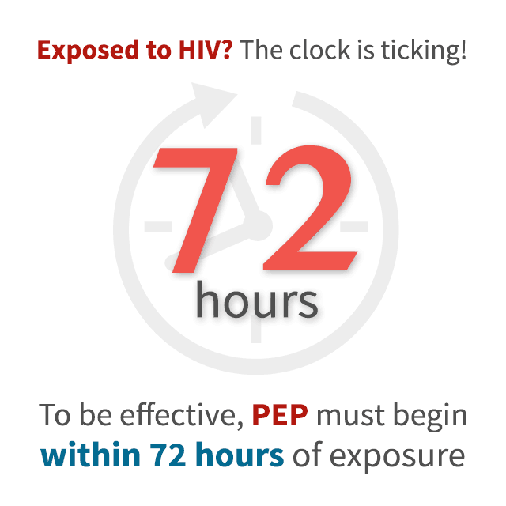
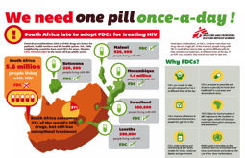
PrEP | PEP | ART
Pre-exposure prophylaxis ARV medicine taken by HIV-negative persons before exposure to HIV Prevents HIV acquisition | Post-exposure prophylaxis ARV medicine taken shortly after exposure and continued for 28 days to prevent HIV | Antiretroviral treatment Lifelong ARV treatment for people with HIV to: Minimise the effect of HIV Strengthen the immune system Reduce viral load Increase CD4 count
Notes:
Very important for the trainer to clarify the difference between PrEP, PEP, and ART, as many people get confused. Particularly in counselling, communication, peer education, training, etc.

Slide 21
Overview of country-specific guidelines*
Notes:
Insert country specific information or adapt to your audience

Slide 22
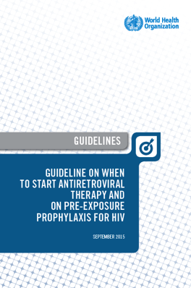
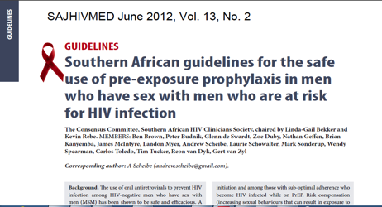
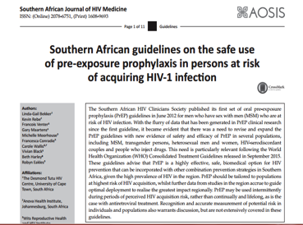
A brief history: key landmarks*
Bekker L-G et al. S Afr J HIV Med 2016
Notes:
*[Insert Country Specific Information]
The Southern African HIV Clinicians Society published its first set of oral pre-exposure prophylaxis (PrEP) guidelines in June 2012 for men who have sex with men (MSM) who are at risk of HIV infection. With the flurry of data that have been generated in oral PrEP clinical research since the first guideline, it became evident that there was a need to revise and expand the oral PrEP guidelines with new evidence of safety and efficacy of oral PrEP in several populations, including MSM, transgender persons, heterosexual men and women, HIV-serodiscordant couples and people who inject drugs. This need is particularly relevant following the World Health Organization (WHO) Consolidated Treatment Guidelines released in September 2015.

Slide 23
Oral PrEP introduction in South Africa*
TDF/FTC combination pill approved for use as oral PrEP by SAHPRA (previously known as the MCC/SA), in combination with safer sexual practices, in November 2015.
Became available at selected specialist services, demonstration and research projects looking at oral PrEP provision for MSM, AGYW, sero-discordant couples, and safer conception projects.
Phased rollout in the public sector starting with the provision of oral PrEP in selected sites for sex workers (2016), then for MSM, and more recently for universities and technical and vocational education and training colleges.
South African Medical Research Council recommended oral PrEP be provided as an additional prevention option in HIV research studies in 2018.
Notes:
*Edit info to be country specific
Additional information:
Truvada has been used for AIDS treatment since 2004.
July 2012, the US Food and Drug Administration (FDA) approved the use of daily oral FTC/TDF (Truvada) as the first PrEP agent for HIV prevention among adults at high risk.
In Nov 2015, TDF/FTC combination pill approved for use as PrEP by the South African Medicine Control Council, in combination with safer sexual practices.
2018 Medical Research Council recommends PrEP provided as an additional prevention option in HIV research

Slide 24
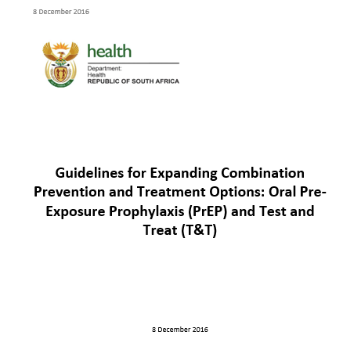
Starting and stopping oral PrEP (SA guidelines)*
PrEP guidelines in South Africa*
There is a 7-day lead-in recommended for oral PrEP to be deemed effective. During this time, additional prevention is recommended (e.g., avoiding anal or vaginal intercourse, using male or female condoms with or without lubrication).
When stopping oral PrEP, the medicine should continue to be taken for 28 days after last sexual exposure for maximum protection.
When re-starting, patients should once again have HIV testing and other screening by the health care provider. The 7-day lead-in should be repeated, as should 28 days of use after last sexual encounter when stopping.
Note: check country-specific guidelines. South Africa changed the lead in time from 20 days to 7 days in Nov 2018
Notes:
*Edit info to be country specific
Note: WHO recommends a 7 day lead-in time and many other countries have adopted this, e.g Kenya and Zimbabwe.
WHO recommends 28 days when stopping.
Ref: WHO Implementation tool for pre-exposure prophylaxis (PrEP) of HIV infection. Module 1: Clinical. Geneva: World Health Organization; 2017 (WHO/HIV/2017.17). Licence: CC BY-NC-SA 3.0 IGO.
“• Starting PrEP
Message: Additional HIV prevention measures should be taken for seven days after starting PrEP.
[PrEP provides high levels of protection in people who take PrEP medicines regularly. Time is needed to build up protective levels of the drug in the blood and other tissues. Additional HIV prevention should be taken for seven days … Ways to lower risk during this period include: adopting safer sexual practices, such as not having vaginal or anal intercourse, or using condoms for all vaginal and anal intercourse.]
• Stopping PrEP
Message: You can stop PrEP 28 days after your last possible HIV exposure.
[PrEP can be stopped 28 days after the last possible exposure to HIV. People can consider stopping PrEP if they are no longer at substantial risk of acquiring HIV infection. Ways to lower risk include: adopting safer sexual practices, such as not having vaginal or anal intercourse, or using condoms for all vaginal and anal intercourse; changing circumstances such as leaving sex work or stopping injecting drug use; or, moving to a place that has a low prevalence of HIV infection. For people in a serodiscordant relationship, HIV transmission risk is very low when the HIV-positive partner is virally supressed on ART.] “

Slide 25
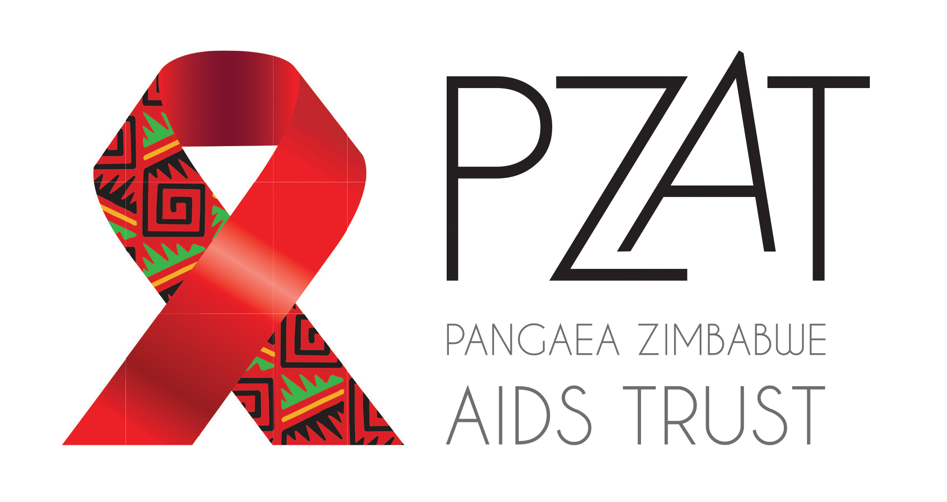
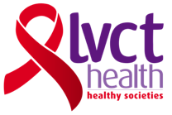
Acknowledgements
This training package was developed by the OPTIONS Consortium.
If you adapt the slides, please acknowledge the source:
Suggested citation: “OPTIONS Provider Training Package: Effective Delivery of Oral Pre-exposure Prophylaxis for Adolescent Girls and Young Women ”. OPTIONS Consortium, August 2018. https://www.prepwatch.org/prep-resources/training-materials/ (download date)
OPTIONS Consortium Partners
This program is made possible by the generous assistance from the American people through the U.S. Agency for International Development (USAID) in partnership with PEPFAR under the terms of Cooperative Agreement No. AID-OAA-A-15-00035. The contents do not necessarily reflect the views of USAID or the United States Government.

