Slide 1
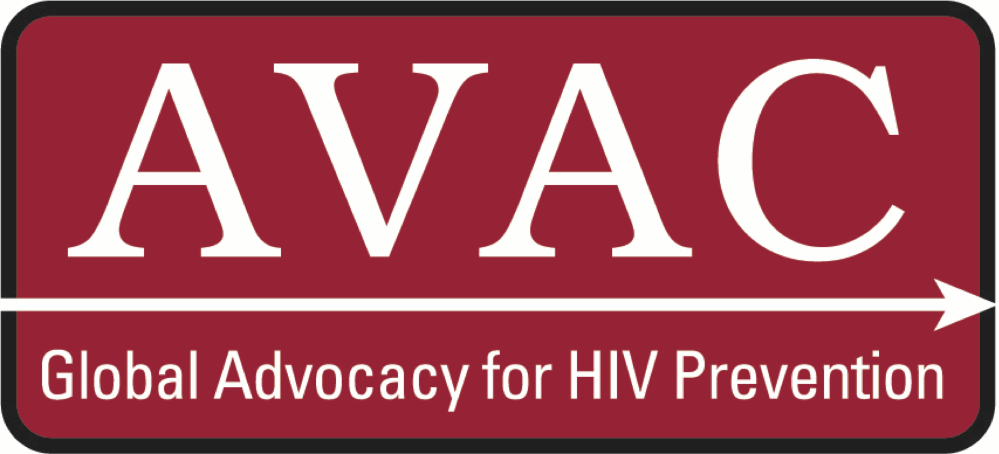
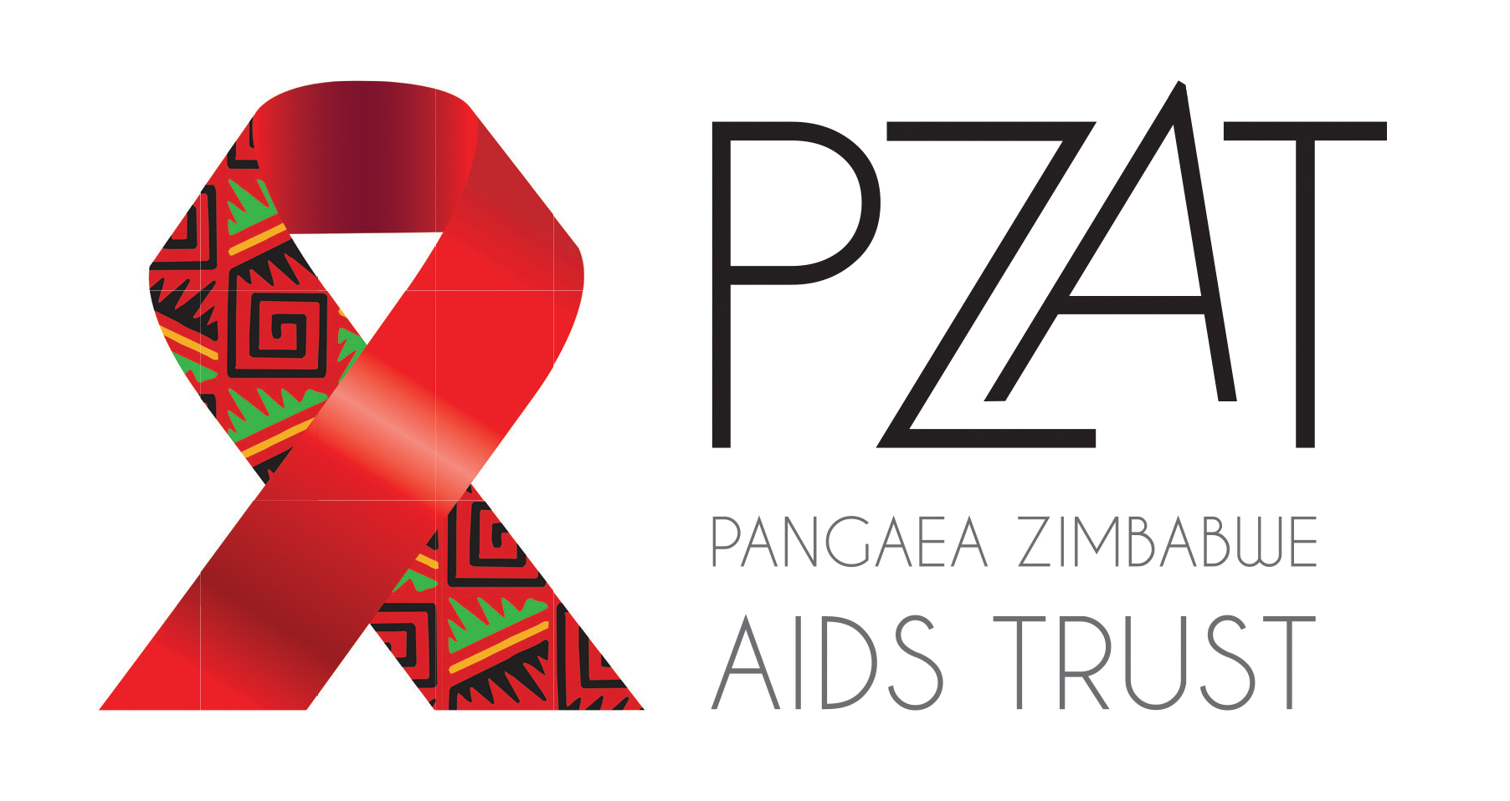
Health Care Workers’ Knowledge, Attitudes, and Practices Related to Oral PrEP Provision to Adolescent Girls and Young Women in Zimbabwe
Definate Nhamo,¹ Kayla Stankevitz ,² Imelda Mahaka,¹ Getrude Ncube,³ Taurai Bhatarasa ,³ Nicole Makahamadze,¹
Kathleen Ridgeway,² Michele Lanham,² Megan Dunbar ^{1, 2}
¹Zimbabwe Pangaea AIDS Trust, Harare, Zimbabwe; ²FHI 360, Durham, NC, USA; ³Zimbabwe Ministry of Health and Child Care, Harare, Zimbabwe
*OPTIONS refers to PrEP as the product category (inclusive of all formulations of ARV-based HIV prevention), and refers to specific products by formulation designation and/or name (e.g., oral PrEP/TDF-FTC, topical PrEP/dapivirine ring, injectable PrEP/cabotegravir, etc.).
BACKGROUND
RESULTS
RESULTS, continued
Oral pre-exposure prophylaxis (PrEP) is a new HIV prevention option within combination HIV prevention in Zimbabwe. Oral PrEP is being offered to populations at substantial risk of HIV in Zimbabwe, including adolescent girls (AG, ages 15-19) and young women (YW, ages 20-24). Health care providers (HCPs) are considered gatekeepers of new health products and interventions; HCPs’ knowledge, attitudes, and practices (KAP) will play a key role in determining the success of oral PrEP delivery in Zimbabwe.
Currently, oral PrEP is being delivered by selected programs in Zimbabwe, and plans are underway to extend oral PrEP’s availability. To inform scale-up of oral PrEP for AGYW in Zimbabwe, we assessed HCPs’ knowledge and attitudes about providing oral PrEP, focusing on provision to AGYW. The primary objectives of the study were to:
Evaluate providers’ familiarity with and knowledge of PrEP
Explore providers’ attitudes and beliefs about PrEP delivery to target populations, with a focus on AGYW
Explore providers’ views on the feasibility and acceptability of adding PrEP delivery to HIV and reproductive health services
Demographics
We enrolled 127 providers in the study, 73 (57.5%) of whom currently had responsibilities related to PrEP. Average age was 38.5 +/- 8.6 years, with two-thirds of providers being women. The majority of providers were nurses, followed by counselors and clinicians.
Providers were also asked about their perceptions of the effects of oral PrEP provision to AGs and YW (Figure 4). Many providers agreed that delivering oral PrEP to these populations would result in backlash from the community, and that AG and YW should tell their partners if they are using oral PrEP. Providers also feared that oral PrEP would promote sexual promiscuity, and many providers said it would be better to tell AGYW to abstain from sex rather than provide oral PrEP.
Figure 4
PERCENT AGREEMENT WITH STATEMENTS ON
USE OF PrEP BY AG & YW (N=127)
Providing PrEP to AG/YW would result in backlash from the community
An AG/YW should tell her partner if she is using PrEP
Knowledge
Just over three-quarters of providers were familiar with oral PrEP, while 23% had not heard of it (Figure 2). The most common sources of information were the national guidelines/policy and other healthcare workers.
Of the 98 providers who had heard of it, only 24 had received formal training on oral PrEP. Despite this, knowledge of oral PrEP was high. Providers who had heard of oral PrEP were asked 25 knowledge questions and answered on average 87% (± 8.2%) correctly. The question most commonly answered incorrectly was, “True or false? A person can stop taking PrEP when their HIV infected partner who is on ART is virally suppressed.” Only 10 providers chose the correct answer (true).
Providing PrEP to unmarried adolescent girls promotes sexual promiscuity
It is better to tell sexually active unmarried adolescent girls to abstain from sex rather than give her PrEP
METHODS
Design and sites
Cross-sectional, descriptive, mixed-methods study, including quantitative surveys and follow-up qualitative in-depth interviews (IDIs) with ongoing data analysis.
Purposively selected 26 public and private health facilities in five of Zimbabwe’s 10 provinces
At the time of data collection, 3 of 26 facilities were providing oral PrEP
Survey
Quantitative knowledge, attitudes, and practices survey administered to 127 HCPs in study facilities
9 (33%) providers currently involved in provision of oral PrEP
Cadres included doctors, nurses, pharmacists, counselors, and village health care workers
Quantitative analysis
Descriptive analyses of demographic information and data on knowledge, attitudes, and practices in STATA 13
In-depth interviews
Conducted 27 follow-up qualitative IDIs with providers who participated in the quantitative phase to gain further insight into quantitative
findings
Explored provider attitudes about providing
PrEP to AGYW
Explored provider views on the feasibility and
acceptability of adding oral PrEP to current
service delivery
Analysis is ongoing
CONCLUSIONS & RECOMMENDATIONS
Knowledge of oral PrEP is high, even among providers who haven’t been trained on delivering oral PrEP.
Training should raise awareness about the HIV risk in each of these populations and their need for PrEP and also explore providers’ discomfort with providing PrEP to some groups, such as married AGYW and AGYW with considerably older partners
Training on values clarification is recommended for HCPs to deliver health services to AGYW, including oral PrEP, in a nonjudgmental manner.
Attitudes
Overall, HCWs were accepting of providing PrEP to AGYW in a wide range of situations, though many were uncertain about providing oral PrEP to AGYW who are married or have considerably older partners (Figure 3). Providers were slightly more willing to provide PrEP to young women than they were to adolescent girls.
Figure 3 I BELIEVE PrEP SHOULD BE PROVIDED UNDER THE FOLLOWING SITUATIONS
(N=127)
If she is married
If she has a partner who is considerably older
Any AG/YW who requests PrEP
If she has a sexually transmitted infection
If she is experiencing intimate partner violence
If she is unable to use condoms consistently
If she is involved in transactional sex
If she changes sex partners frequently
Contact details:
Definate Nhamo, Pangaea Zimbabwe AIDS Trust, 27 Rowland Square, Milton Park, Harare, Zimbabwe
+263772266570
dnhamo@pzat.org
This poster was made possible by the generous support of the American people through the United States Agency for International Development (USAID) and the U.S. President’s Emergency Plan for AIDS Relief (PEPFAR). The contents are the responsibility of the authors and do not necessarily reflect the views of USAID, PEPFAR, or the United States Government
OPTIONS Consortium Partners

