Slide 1

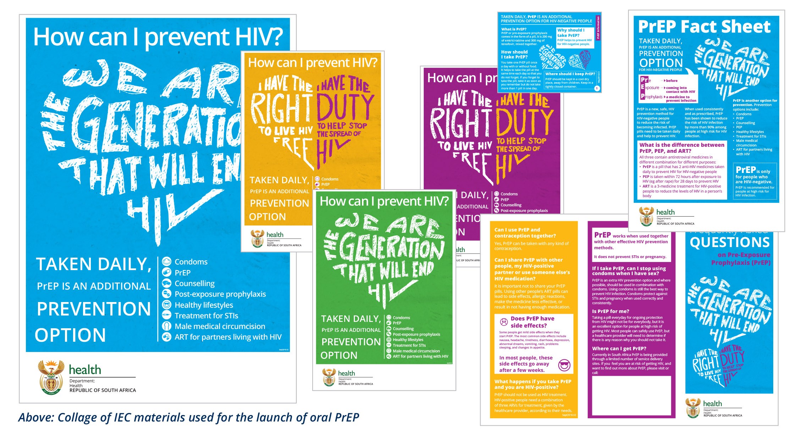












#IYKWIM… What young people really think about PrEP,
HIV services and how we talk to them
[A-AIDS2020-06421]
#IYKWIM –
If you know what I mean
Elmari Briedenhann¹, Diantha Pillay¹, Nkunda Vundamina¹, Nakita Sheobalak¹, Michele Lanham², Giuliana Morales², Saiqa Mullick¹
BACKGROUND
LESSONS LEARNED
LESSONS LEARNED
CONCLUSION / NEXT STEPS
Adolescent girls and young women (AGYW) are a priority group for oral pre-exposure prophylaxis (PrEP) in South Africa (SA). Limited insights exist regarding their decision-making to use PrEP, and what role information, education and communication (IEC) materials play in this process.
THIS IS WHERE AND WHY YOUNG PEOPLE ARE ACCESSING SERVICES.
Young people are comfortable accessing health services on campus or at partner-operated sites – non-judgmental environment.
Priority services accessed include contraceptives - especially emergency - condom procurement, STI screening and treatment, HIV testing, psychological support and treatment for “vaginal problems”.
PUBLIC HEALTHCARE FACILITIES… ONLY IF I HAVE TO!
Young people prefer accessing services through NGO-operated and campus clinics.
A need for comprehensive service delivery drives youth to public facilities.
Attitudes from healthcare providers are a barrier to accessing services at public facilities.
DON’T COMPROMISE ON CONFIDENTIALITY.
Young people require a variety of services that must be offered without compromising their confidentiality.
In some part of SA, people accessing services at public healthcare facilities are made to join specific queues which identifies the service they are accessing - this was seen as a barrier to accessing.
The biomedical benefit of PrEP is not a motivator for uptake, rather positive emotional communication paired with convenient/supportive services and the reward of “being part of something bigger than myself” resonates with young people. Communication across digital platforms is valued; in response, these platforms have been established: www.myprep.co.za and @myPrEP_SouthAfrica
on social media.
DESCRIPTION
IMPORTANT
STUFF!
Between August 2018-August 2019, the Wits RHI OPTIONS team conducted six dialogues facilitated by a communications expert. Participants were selected through peer educators, age 18-24, and categorized as PrEP current, past or never users. Sixty-one young people participated, 50 young women, 10 young men and one transgender woman.
Dialogues, conducted in a semi-structured discussion, explored PrEP knowledge, barriers to testing, intent to access services, social mobilization and perceptions of the National Department of Health Information Education and Communication (IEC) materials.
HEAR IT FOR YOURSELF!
Many young people consented to being videographed during the dialogues, they wanted you to see their faces, hear their voices and connect with them more intimately. You can access these videos by clicking the links below:
Introduction: https://youtu.be/oKLCIQuvgEo
Young people have their say: https://youtu.be/1EwKWC9hmf0
HIV testing: https://youtu.be/2uocrhkClg0
Gender-based violence: https://youtu.be/USnGPBME5Kc
HIV Risk and condoms: https://youtu.be/r7vqzZgH4ws
ENDING HIV: https://youtu.be/5Czyb-KX_c0
Receiving Information about PrEP: https://youtu.be/welGeIL0lio
JUST BECAUSE IT’S “GOOD FOR ME” DOESN’T MAKE IT DESIRABLE.
For young people who felt that daily pill-taking was a strain, the positive messaging used in the IEC materials, rather than the benefit of oral PrEP as a biomedical HIV prevention method, was perceived as encouraging and motivating continuation.
A TEST IS A TEST, SCARY, NO MATTER HOW YOU SPIN IT.
HIV testing is still feared due to the stigma associated with a positive result, as well as myths around testing.
The role of incentives for testing should not be undervalued, young people usually do not just volunteer to test.
Young people may be inspired to test if they were to see many of their peers testing, as well as senior management from their university or college.
HIV SELF-SCREENING... MAYBE, MAYBE NOT.
Privacy and removed judgment was seen as benefits of HIV self-screening.
Concerns raised in relation to receiving a positive result in the absence of support and counselling.
LESSONS LEARNED
Their words, not ours!
Young people had excellent knowledge about PrEP and HIV.
The benefit of PrEP as biomedical intervention or “good health” is not a primary motivator for uptake.
Feeling part of a movement, like We Are The Generation That Will End HIV (WATG) (which features on all SA IEC materials), encouraged feelings of ownership and stimulated interest in PrEP.
The WATG campaign was reported as promoting a sense of responsibility and hope and that it showed what could be done if we work together, participants said that they felt happy when they first saw the design and concept.
GOOD COLOUR, GOOD PHOTOS, GOOD DESIGN ….
IEC materials need to feature bright and attractive colours to be successful with young people.
Photographs should be diverse in nature.
Photographs should feature young people who look happy.
Materials targeted at AGYW, should feature male models as well as female models.
Printed materials carry a risk of stigma by association; therefore materials must be accessible online and in digital format.
The groups offered mixed responses on whether IEC materials on their own would inspire a person to initiate on PrEP.
WE NEED AN END TO STIGMA, BOTH FOR PREP AND YOUNG PEOPLE ACCESSING SRH SERVICES
WE ONLY ACCESS PUBLIC FACILITIES WHEN WE ABSOLUTELY HAVE TO…
…SPECIFICALLY FOR CONTRACEPTIVES (ESPECIALLY, EMERGENCY), STI SCREENING, PSYCHOLOGICAL SUPPORT AND “VAGINAL PROBLEMS”
HIV SELF-SCREENING REMOVES THE FEAR OF JUDGMENT BUT WHAT IF I TEST POSITIVE AND I’M ALONE
HIV TESTING IS SCARY BUT IF A LOT OF OTHERS ARE TESTING, I MIGHT TOO…
DON’T COMPROMISE ON OUR CONFIDENTIALITY – WE WILL NOT COME FOR SERVICES
NEED A LITTLE MORE DETAIL? ACCESS THE FULL TECHNICAL BRIEF HERE.
IEC MATERIALS SHOULD HAVE PHOTOS OF BOYS… BOYFRIEND MATERIAL ☺
JUST BECAUSE IT’S GOOD FOR ME… DOESN’T MAKE ME WANT IT!
Author affiliatioNs
¹ Wits Reproductive Health and HIV Institute, Johannesburg, South Africa
² FHI 360, Durham, North Carolina, USA
Acknowledgments
We would like to acknowledge all the incredible young women and men who took part in this dialogue and helped us to better understand their world.
https://www.fhi360.org/projects/optimizing-prevention-technology-introduction-schedule-options-consortium
This poster was made possible by the generous support of the American people through the United States Agency for International Development (USAID) and the U.S. President’s Emergency Plan for AIDS Relief (PEPFAR). The contents are the responsibility of the authors and do not necessarily reflect the views of USAID, PEPFAR, or the United States Government
OPTIONS Consortium Partners

