Slide 1
Using the HEAlthy Relationship Assessment Tool (HEART) Training Presentation H.24

Slide 2
What is the HEART?
HEART stands for “HEAlthy Relationship Assessment Tool.” It can be filled out on paper or on a tablet by a lay counselor or suitably trained staff member to sensitively:
Understand whether a woman might expect SUPPORT, RESISTANCE, or VIOLENCE from a partner if she uses PrEP
Determine the type of counseling that can help a woman safely and effectively use PrEP to protect herself against HIV
Determine a woman’s need for further counseling and support services for intimate partner violence

Slide 3
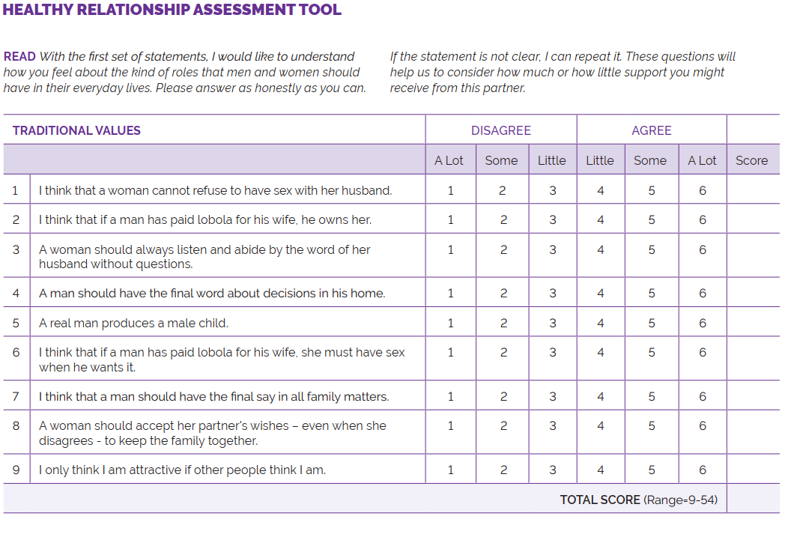
The HEART has paper- and computer-based versions
Notes:
During this training, we will practice with a paper-based tool.
This will enable you to provide some feedback on:
The instructions
The flow of questions
Using the information to guide counseling
We will then develop a version that collects information on a tablet.
This version will calculate the score automatically.
You will receive additional training on the tablet version.

Slide 4
Let’s look at the HEART
What you will notice first:
Simple instructions for you, including asking clients to think about their main sexual or intimate partner when responding to questions
Visual diagram to guide responses that can be shared with clients
Five sections that cover: (1) traditional values, (2) partner support, (3) partner abuse and control, (4) partner resistance to HIV prevention, and (5) HIV prevention readiness
Each section has multiple questions (from 5–10)
Some questions are scored from 1–6, while others are scored from 6–1; this will be explained shortly
A box on the last page shows how to score each section (on a computer or tablet, scores will calculate automatically)

Slide 5
Responses in the HEART
FIRST ASK
“Do you generally Disagree or Agree?”
THEN ASK
“How much? A lot, somewhat, or a little?”
Notes:
Whether the tool is paper-based or on a tablet, women will be asked to use this response scale to when they answer each item.
We want women to use the full scale. If a woman ALWAYS chooses Disagree A Lot or Agree A Lot, you might ask her whether there are any items that she feels less strongly about.

Slide 6
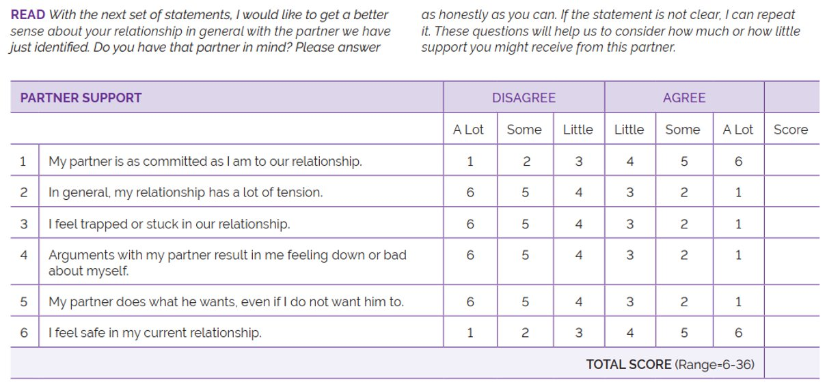
Some items are worded positively; others are not
Rows 2–5 are scored 6 (disagree a lot) to 1 (agree a lot)
Rows 1 and 6 are scored from 1 (disagree a lot) to 6 (agree a lot)
Notes:
Sometimes it helps to change the way that questions are worded. This makes people think more about the question before they answer. It may keep people from providing “rote” answers.
But, in the end, we want the final summary score to be meaningful. That is, if someone has a high total score on “Partner Support,” then the answers to their questions point to positive aspects. Look at item 2 – a higher score means more agreement with being able to tell a partner about one’s own opinion. Look at item 3 – a higher score means more disagreement with feeling tension in the relationship.
Simply circle the right verbal response (i.e., Disagree a lot) and then transfer the value to the far right column.

Slide 7
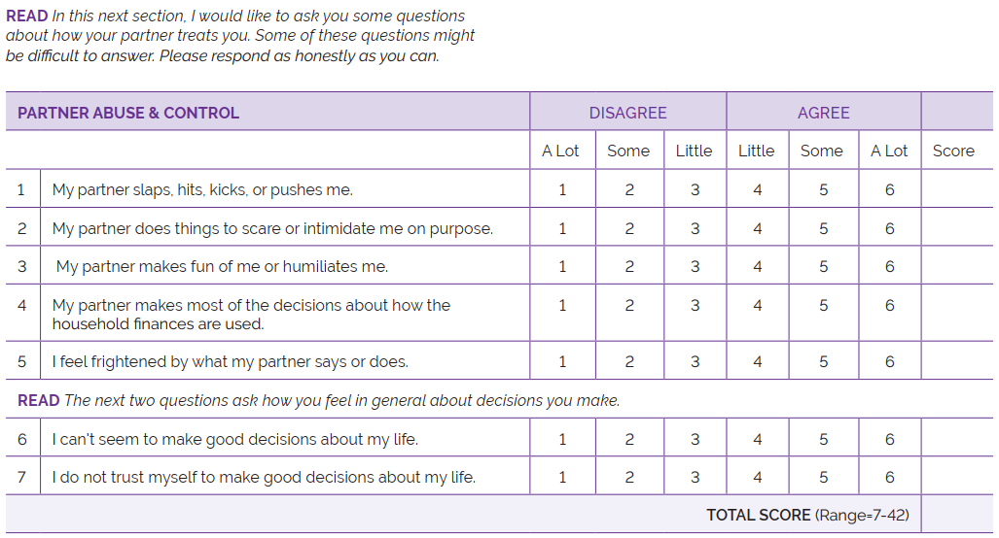
Filling out the form
Based on the client’s response, circle the score
Write the score for each item in the last column
If someone refuses to answer a question, leave it blank*
Add all scores for the TOTAL SCORE for each section
3
4
5
5
3
5
5
30
Notes:
If a tablet or laptop is not available for completing or scoring the HEART, complete the “Traditional Values,” “Partner Abuse and Control,” and ”Partner Support” sections of the HEART on paper. None of the questions in those sections should be skipped.
You can also complete the “Partner Resistance to HIV Prevention” and “HIV Prevention Readiness” sections, but they are not required.
*A “No Response” option should be recorded if a client refuses to respond to a specific question. Do NOT offer this option to a client. It is only to be used when a client is unwilling to provide a response to a specific question.

Slide 8
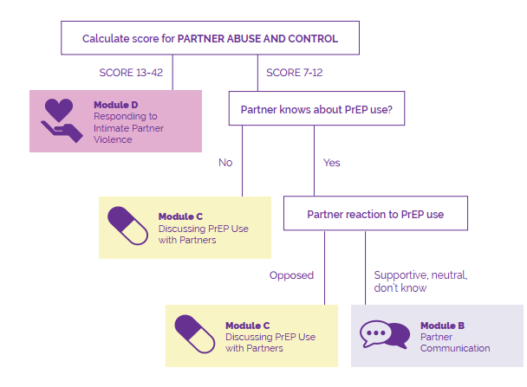
Aligning the scores to the modules
Refers to Partner Abuse and Control section of the HEART
Notes:
If the total score for “Partner Abuse and Control” is 13–42, Responding to Intimate Partner Violence (Module D) is recommended for this client.
If the total score for “Partner Abuse and Control” is 7–12 AND the client’s response to the question “Partner knows about PrEP use?” was:
NO (her partner does not know that she is taking PrEP) then Discussing PrEP Use with Partner (Module C) is recommended for this client.
YES (her partner knows she is taking PrEP for HIV prevention), AND the “Partner reaction to PrEP use” was:
Opposed, then Discussing PrEP Use with Partners (Module C) is recommended for this client.
Supportive, neutral, or she doesn’t know, then Partner Communication (Module B) is recommended for this client.
If the total score for “Partner Abuse and Control” is less than 13 but the client discloses some form of partner abuse or control to the counselor, the counselor can decide to offer Responding to Intimate Partner Violence (Module D).

Slide 9
Aligning the scores to the modules
The final decision about which module to use (B, C, or D) will be made after you complete Module A.
During Module A, listen for additional information about her relationship that will help you decide which counseling module (B, C, or D) to use.
If time is extremely limited, complete only the Partner Abuse and Control section of the HEART.
Notes:
Example: If the HEART recommends Discussing PrEP Use with Partners (Module C) or Partner Communication (Module B) but the client talks about abusive or controlling behaviors by her partner during Module A, you can decide to offer Responding to Intimate Partner Violence (Module D) instead.

Slide 10
Questions?
… and your thoughts?

