Slide 1
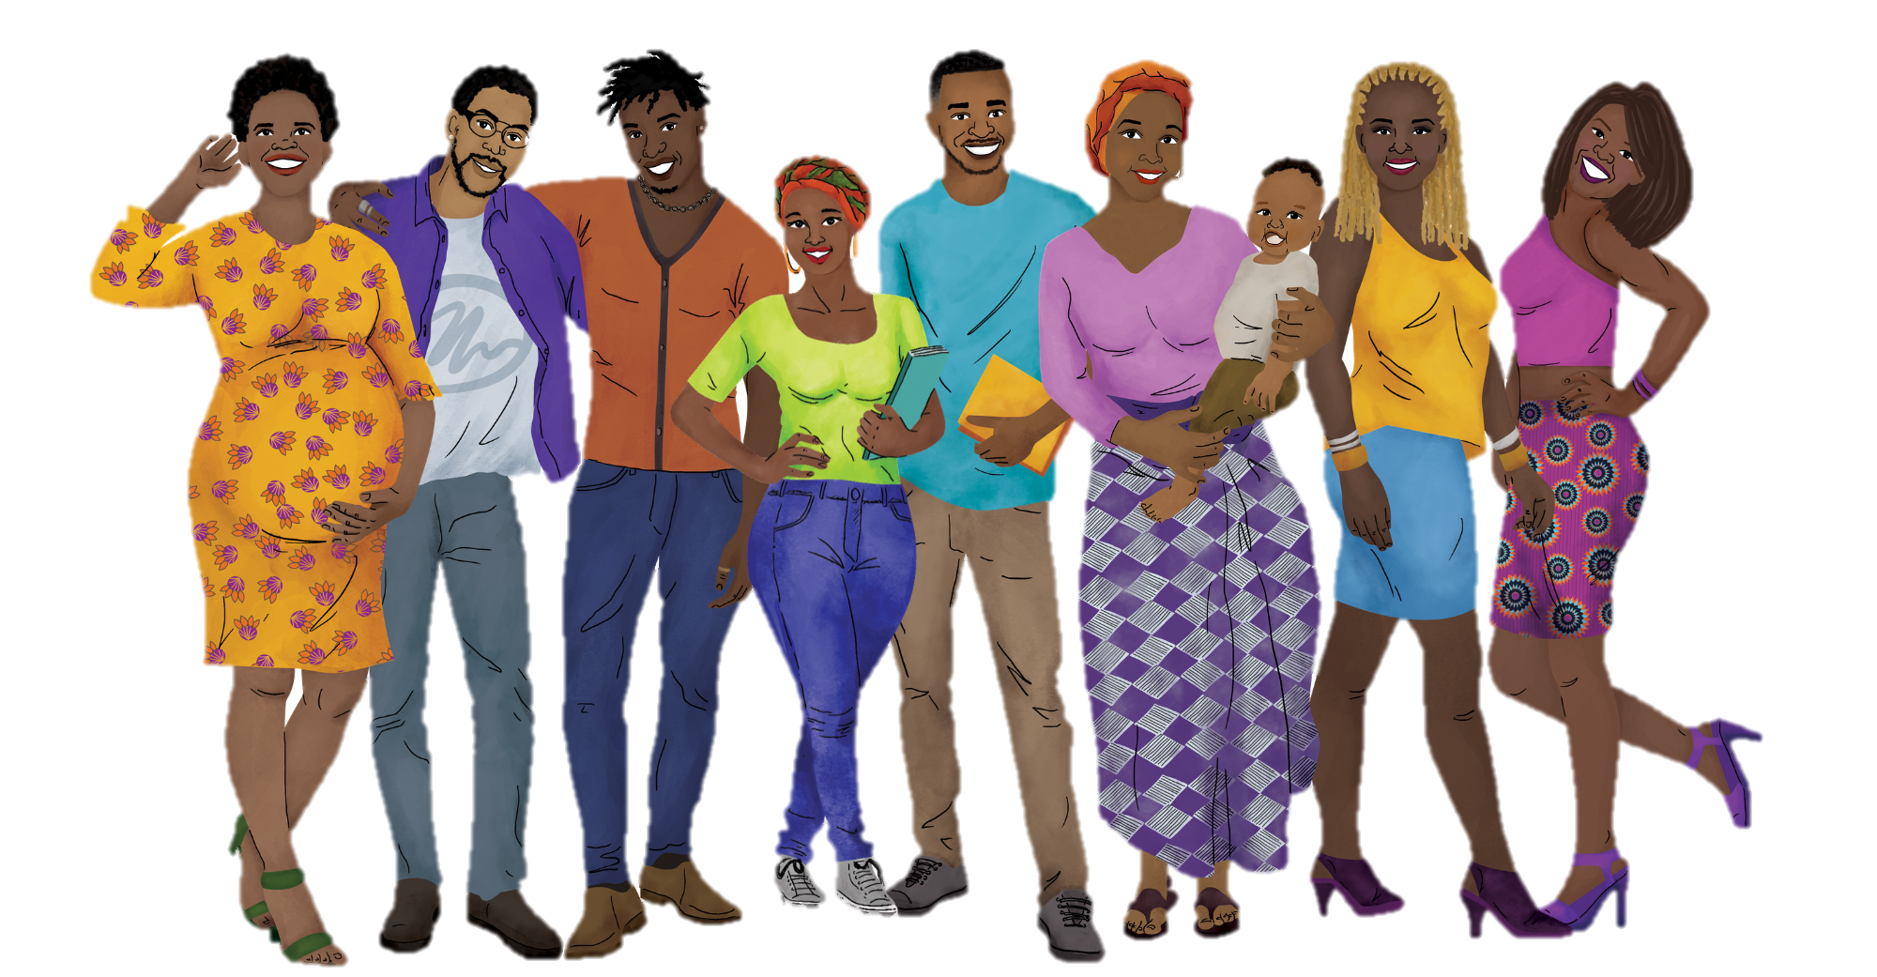
HIV Prevention Ambassador Trainers’ Workshop:
CHALLENGING SITUATIONS ACTIVITY

Slide 2
Challenging
Situations
Overview

Slide 3
Overview
This slide deck is a supplemental resource for the challenging situations activity. It is meant to be used during the mentorship team session on Day 3. In this slide deck, you will find:
1 | Four mini case studies/challenges related to participant support.
2 | Four mini case studies/challenges related to social and group dynamics.

Slide 4
Participant
Support

Slide 5

Participant Support: Challenge 1
HIV+
Diagnoses
One of your training participants was
recently diagnosed with HIV. You notice that she becomes visibly upset during training sessions.
How might you have prevented this from
becoming a challenge?
What strategies might you use to respond
to this challenge?

Slide 6
Participant Support: Challenge 2
Gender-Based
Violence
During your training, a participant
discloses that they have experienced or are currently experiencing gender-based violence at home.
How might you have prevented this from
becoming a challenge?
What strategies might you use to respond
to this challenge?

Slide 7
Participant Support: Challenge 3
Trigger
Warnings
A participant becomes noticeably
defensive or angry during a session.
How might you have prevented this from
becoming a challenge?
What strategies might you use to respond
to this challenge?

Slide 8
Participant Support: Challenge 4
COVID-19
Outbreaks
Several hours into your training, you are
informed that three of your participants
have tested positive for COVID-19.
How might you have prevented this from
becoming a challenge?
What strategies might you use to respond
to this challenge?

Slide 9
Social/Group
Dynamics

Slide 10

Group Dynamics: Challenge 1
Power
Dynamics
Your group of training participants
includes AGYW that are in school and out of school. You notice that those who are out of school are hesitant to contribute to discussion.
How might you have prevented this from becoming a challenge?
What strategies might you use to respond
to this challenge?

Slide 11
Group Dynamics: Challenge 2
Personal
Conflicts
Two participants have a prior personal
conflict that they bring into the training. Their personal conflict interferes with their ability to focus on the material and it negatively impacts group learning.
How might you have prevented this from becoming a challenge?
What strategies might you use to respond
to this challenge?

Slide 12
Group Dynamics: Challenge 3
Personal
Beliefs
A participant disagrees with the
material or instruction presented during your
training due to personal beliefs.
How might you have prevented this from becoming a challenge?
What strategies might you use to respond
to this challenge?

Slide 13
Group Dynamics: Challenge 4
Competing
Priorities
Several of your participants have
childcare responsibilities and need to bring their babies and young children with them to the training. During a session, several babies start to cry.
How might you have prevented this from
becoming a challenge?
What strategies might you use to respond
to this challenge?

Slide 14
Acknowledgments
This resource is made possible by the generous support of the American people through the U.S. President's Emergency Plan for AIDS Relief (PEPFAR) and the U.S. Agency for International Development (USAID) and through the terms of cooperative agreements 7200AA19CA00002 and 7200AA19CA00003. The contents are the responsibility of the EpiC project and the RISE project and do not necessarily reflect the views of PEPFAR, USAID, or the U.S. Government.
Suggested Citation:
Weber A, Mamvuto T, Nhamo D, Regeru RN, Jeckonia P, Kiruki M, Mireku M, Bishopp C, Moreau L, Tutegyereize L, Makufa C, Plourde K, Shilomboleni M, Neliwa P, Murungu J. HIV prevention ambassador trainers’ workshop: Challenging situations activity. Washington, DC: Collaboration for HIV Prevention Options to Control the Epidemic (CHOICE); 2021.

Slide 15
Thank You

