Slide 1




KENYA
Dapivirine ring situation and delivery channel analysis
April 2021
PROMISE Preparing for Ring Opportunities through Market Introduction Support and Knowledge Exchange

Slide 2

Introduction
This analysis can support introduction of the dapivirine ring (the ring) in Kenya across two dimensions:
  Considering and prioritizing delivery channels for the ring
  Identifying critical steps for ring introduction, including opportunities to build on the introduction and scale-up of oral PrEP
This analysis is based on several inputs including secondary research and interviews with key stakeholders in Kenya
This analysis can be used by policymakers, implementers, and others planning for introduction of the ring and other biomedical HIV prevention methods in Kenya
This analysis was developed in late 2020 and early 2021 by members of the PROMISE collaboration through Envision FP
Similar analyses for several other countries and a summary of results across countries will be available on PrEPWatch.org

Slide 3
Key findings
As a woman-controlled and long-acting HIV prevention option, key stakeholders interviewed for this analysis recognize that the dapivirine ring (the ring) can be an important complement to other HIV prevention methods in Kenya.
Kenya has had a national rollout of oral PrEP and HIV self-testing (HIVST), both of which have established systems and yielded lessons for policy development, planning, supply chain, provider training, demand creation, and monitoring that can be leveraged for introduction of the ring.
In addition, an ongoing initiative to integrate HIV prevention and other sexual and reproductive health (SRH) services, will provide a good foundation for ring introduction beyond HIV channels to reach HIV negative women; there is widespread recognition that it will be important to deliver the ring outside of HIV-specific channels to better reach those who need it.
Other delivery channels that are high priority for ring introduction include non-governmental organization (NGO) clinics and social franchises and ongoing NGO programs for adolescent girls and young women (AGYW). Drug shops and pharmacies may also be a high priority channel depending on how the ring is classified by the Pharmacy and Poisons Board (PPB), which will determine where and how the ring can be made available.
Stakeholders expect that the ring will be introduced via a demonstration project, building on oral PrEP rollout and focused on counties with high HIV incidence among AGYW.

Slide 4
Context for the dapivirine ring
Delivery channels for the dapivirine ring
Dapivirine ring introduction planning
Sources

Slide 5
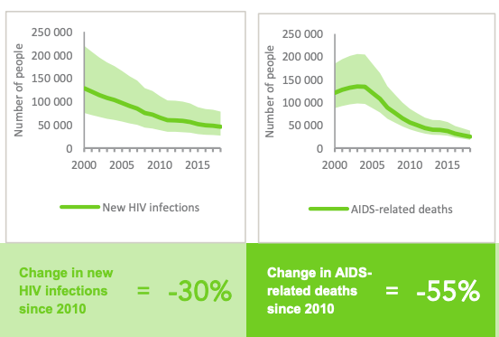
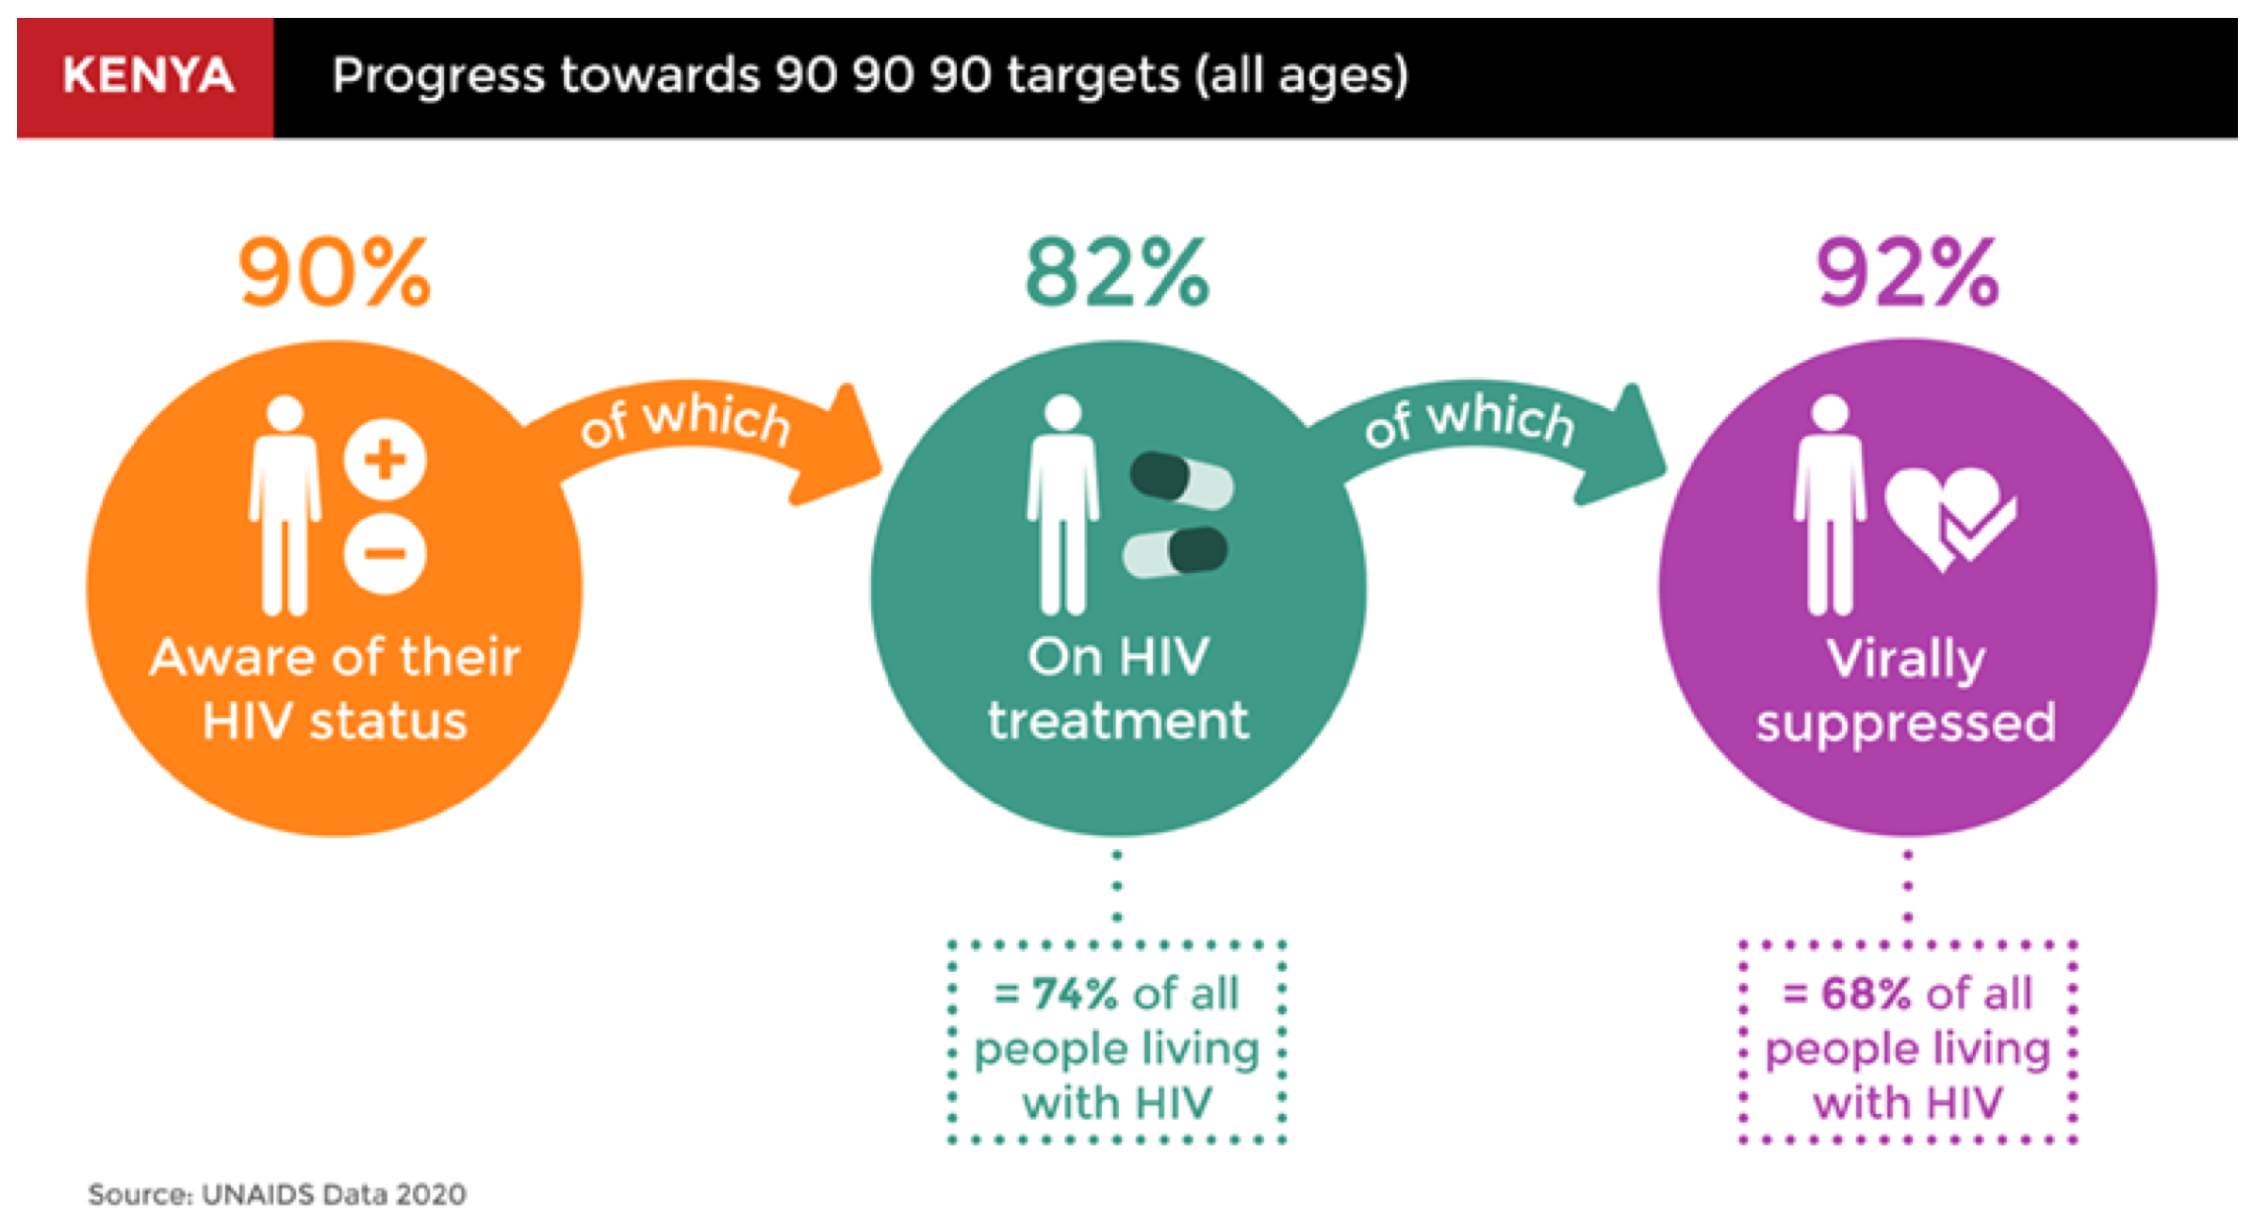
Context
Kenya has made significant progress on HIV prevention
Kenya has had significant success in reducing HIV incidence and prevalence. New infections have fallen dramatically in recent years from 106,000 annual new infections in 2014 to 36,000 in 2019. This is the result of significant investments in HIV treatment and prevention. Kenya has nearly reached the 90-90-90 goals and has scaled-up HIV testing, prevention, and treatment programs over the past five years, including the recent introduction of oral PrEP and HIVST.
HIV incidence and prevalence trends, 2000 – 2018
Progress towards 90-90-90 goals, age 15 – 64, 2018
Sources: UNAIDS Estimates (2020)

Slide 6
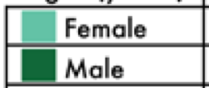
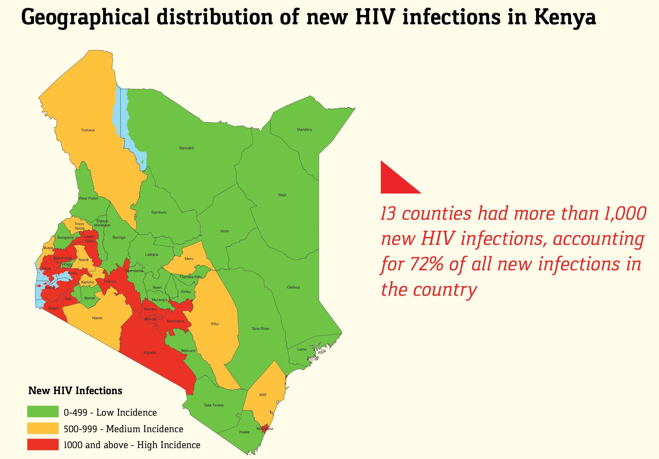
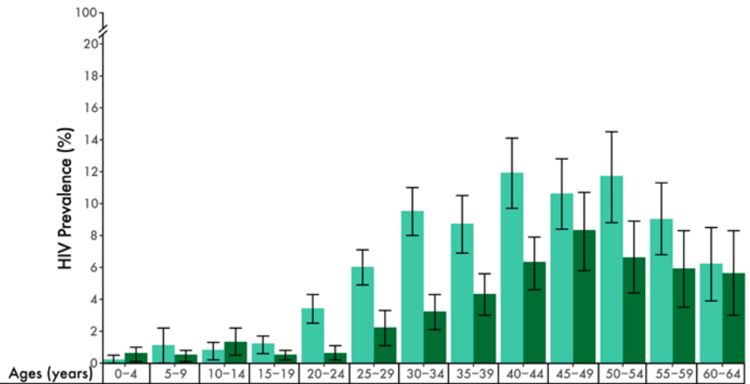
Context
HIV risk for women in Kenya remains high
Kenya has the third-largest HIV epidemic in the world with 1.3 million adults living with HIV and 36,000 new infections per year among adults. Women are disproportionately impacted by the disease in Kenya – HIV prevalence is twice as high among women (6.6%) than it is among men (3.1%). New infections are largest among key populations (KPs), who account for ~30% of new infections, and adolescent and young people aged 15 – 24, who account for ~50% of new infections. Incidence is also highly concentrated by geography.
HIV prevalence by gender, 2018
HIV incidence by county, 2020
13 counties had more than 1,000 new HIV infections, and account for 72% of all new infections.
HIV prevalence is nearly
3x higher among women than men aged 20-34.
Sources: Preliminary KENPHIA 2018 Report (NASCOP; 2020), Kenya AIDS Strategic Framework II (NACC, 2021)

Slide 7
Context
Oral PrEP rollout in Kenya
Kenya introduced oral PrEP in 2017 and it is now widely available in ~2,000 facilities across all 47 counties and is free for all people at substantial ongoing risk of infection with HIV, including female sex workers (FSW), men who have sex with men (MSM), serodiscordant couples, people who inject drugs (PWID), and AGYW. As of early 2021, Kenya had over 30,000 PrEP users.
Number of PrEP users, 2017 – 2021
PrEP is available at HIV treatment sites (comprehensive care centers or CCCs) and testing/prevention centers as well as settings aimed to reach specific populations at high-risk, including drop-in centers (DiCES) for key populations and safe spaces for adolescents. These channels account for over 90% of PrEP service delivery.
In addition to the national government program, a number of large donor-funded projects supported initial rollout and scale-up of oral PrEP, including the Partners Scale-Up Project for serodiscordant couples, the Jilinde project for FSW, MSM, and AGYW, and the DREAMS project for AGYW.
Serodiscordant couples and FSW have largely driven PrEP uptake, accounting for 50% and 25% of PrEP users respectively; policies supporting PrEP for AGYW were introduced later
In addition, Kenya has also had a national rollout of HIVST, including pilot projects to deliver HIVST in pharmacies, through private sector online channels (e.g., Kasha), and via vending machines.
Source: NASCOP (February 2021)

Slide 8
Context
The ring will be an important new HIV prevention method for women
Key findings from stakeholder consultations
As a woman-controlled and long-acting HIV prevention option, the ring is an important complement to other HIV prevention methods in Kenya.
There is an opportunity to learn from the approach to family planning (FP) to inform an approach to delivering a portfolio of biomedical HIV prevention options.
The ring may be particularly appropriate for AGYW, who are at substantial risk for HIV, but often have challenges advocating for condom use, prefer not to take a daily pill, are seeking a more discreet option, and/or want to avoid oral PrEP side effects.
There is significant opportunity to build from the experience with oral PrEP to introduce the ring – for example, policies have been developed that could accommodate the ring and a Committee of Experts (CoE) for HIV testing and PrEP already exists that could also guide ring introduction.
The ring also presents new opportunities, specifically integration with FP services, distribution in non-clinical settings, and the opportunity to reposition PrEP in a more appealing, less stigmatized way (e.g., as a healthy lifestyle choice, rather than HIV prevention).

Slide 9
Context for the dapivirine ring
Delivery channels for the dapivirine ring
Dapivirine ring introduction planning
Sources

Slide 10
Delivery Channels
Potential delivery channels for the ring
The ring could be made available across a diverse range of channels. This section includes a high-level assessment of the potential to deliver the ring across nine different health care delivery channels in Kenya.
Women’s health delivery channels
Description
Public sector HIV services
Departments in public sector facilities offering HIV testing and antiretroviral therapy (ART) services, managed by national and county ministries of health (MoH), including adolescent-friendly service points, KP-friendly CCCs and DiCES
Public sector
Public sector FP services
Departments in public sector facilities offering FP services
Maternal & child health services (MCH)
Departments in public sector facilities offering antenatal care (ANC) services for pregnant women, postnatal care (PNC), immunizations, and other services, including prevention of mother-to-child transmission of HIV (PMTCT)
Work / school-based services
Programs that offer HIV counseling and testing services (HTS) at select worksites and HTS and HIV treatment in tertiary education settings
Private for profit
Commercial healthcare
Incudes private doctors, clinics, and hospitals that provide health services to individuals who pay out-of-pocket or use health insurance; examples include Avenue Healthcare, Aga Khan, and Gertrude’s Clinics
Drug shops and pharmacies
Includes large pharmacy networks and small stores, some are managed by trained healthcare workers (HCWs); major networks include GoodLife, PharmNet, and the Pharmaceutical Society of Kenya, which reaches 10-15% of pharmacies
NGO clinics / social franchises
Private not-for-profit facilities, including clinics managed by NGOs and social franchises, that offer SRH services at subsidized rates; major networks include MS-Kenya, PSK Tunza, KMET, DKT, and FHI GoldStar
Private not for profit
Private facilities affiliated with religious institutions, including church networks and mission hospitals that provide subsidized/free services with a large presence in rural communities
Faith-based organizations (FBOs)
NGO programs for AGYW
Donor-funded, NGO-led programs that provide HIV and other services to AGYW, including DREAMS and other programs (e.g., AGYW safe spaces)

Slide 11
Delivery Channels
Delivery channels differ by access and capacity
Delivery channels were assessed along six criteria: three assessing the channel’s reach to women at-risk for HIV and three assessing the channel’s capacity to deliver the ring. The following slides include details on the assessment findings.
Assessment criteria
1
ACCESS: To what extent does this channel reach women at-risk of HIV?
2
CAPACITY: What capacity is already in place to support ring delivery?
Factor | Definition
Reach | Channel provides SRH services for women and girls vulnerable to HIV.
Affordability | Services provided through this channel are affordable for women and girls vulnerable to HIV with a range of income levels.
Product portfolio | Other products that are relevant to women and girls vulnerable to HIV (e.g., HIV testing, oral PrEP, FP) are offered through this channel.
Factor | Definition
HIV counseling and testing services (HTS) | Channel currently offers HIV counseling and testing services.
HCW capacity | Channel has HCW on-staff who can initiate ring use and support follow-up.
Private space | Channel has private space for women to initiate and insert ring for the first time.
Rating key
Channel reaches high numbers of women at-risk for HIV
Sites consistently have infrastructure, capacity needed to deliver the ring
Channel reaches some segments of women at-risk for HIV
Some sites have the infrastructure, capacity needed to deliver the ring
Channel does not reach many women at-risk for HIV
Sites rarely have the infrastructure, capacity needed to deliver the ring

Slide 12
Delivery channel access assessment
Delivery Channels
1
 | Reach | Affordability | Product portfolio
 |  |  | HTS | PrEP | FP
Public sector HIV services | 85% of the health facilities offer HTS Typical HIV services (e.g., CCCs) do not effectively reach HIV-negative women Some health facilities have introduced youth-friendly centers that offer combination SRH services that are typically donor-funded and supported by NGO partner | Service typically provided for free by most facilities, otherwise costs might be incurred for some treatment not supported by grants or subsidised by government (e.g., laboratory tests)
Public sector FP services | 85% of facilities sampled offered FP services Of Kenya’s 6.2M women using contraception, 60% (3.7M) access services via the public sector (e.g., government hospital, health center, or dispensary) | Services are generally offered for free, although some facilities charge service or registration fees (~USD 1 per visit for injectables) |  | Limited pilot projects
MCH services | 81% of facilities offer ANC services Over 90% of pregnant women receive ANC services from a skilled provider, although only 50% of Kenya’s 1.6M annual deliveries occur in a public facility | Services are generally offered for free, although some facilities charge service or registration fees (~USD 1 per visit for injectables) |  | Limited pilot projects
Work- and school-based | Limited reach, but offer a channel to reach users who do not go to clinics Workplace programs for HIVST could incorporate the ring | Cost varies, but costs are typically covered by general school fees or health insurance
Commercial healthcare | Large presence in larger cities and towns, including in informal settlements 427 facilities and over 3K private provider practices across Kenya Over 1M visits per year for all populations | Service fees typically expensive for most Kenyans Short-acting contraceptive products cost USD 1 – 3 and an IUD insertion can cost up to USD 75
Pharmacies | More than 40% of contraceptive users obtain contraceptives at pharmacies At least 1.2M visits per year for all populations, primarily urban Facilities located in areas of high HIV incidence ~5K pharmacies total (2K are registered, 3K are unregistered) | Relatively affordable for many Kenyans Short-acting contraceptive products cost USD 1 – 3 HIVST kits are USD 1.5 – 4.5 in a subsidized program run by PSK – the full market price would be $9 at current volumes | Limited; PSK HIV-ST pilot project | Limited pilot projects
NGO clinics / social franchises | Relatively small client base, but aligned to areas of HIV incidence 352 facilities nationally (7% of all private facilities) in urban and peri-urban Over 500k visits per year for all populations with presence in almost all counties Uptake of oral PrEP has not been widespread | Affordable low-cost/free services Short-acting contraceptive products cost USD 1 – 3 and IUDs cost USD 5 – 20
FBOs | 1,030 facilities (14% of private health facilities); ~800k visits per year for all populations FBOs are largely rural and peri-urban areas Unattractive SRH/FP service point for women and girls – only 2% of women who access contraception do so via FBOs | Affordable low-cost/free services Short-acting contraceptive products cost USD 1 – 3
NGO programs for AGYW | Small client base, but effectively reached AGYW in limited PrEP rollout (e.g., Jilinde Project) Estimated ~ 50 sites are currently supported by implementing partners to provide oral PrEP | Services offered for free

Slide 13
Delivery channel capacity assessment
Delivery Channels
2
 | HTS | HCW capacity | Private space
Public sector HIV services | Most frequent channel for HTS, at health facilities or mobile sites | Provision of a vaginally inserted product would be new, and stakeholders have raised questions about HCW comfort | Services have private spaces
Public sector FP services | FP clinics account for a small percentage of HIV testing Studies suggest that ~50% of FP clinics regularly perform HIV tests for clients | Provision of the ring aligns well to provision of FP services and FP providers will have experience with vaginally-inserted products Previous experience (e.g., in the PrIYA Project) demonstrate the effective delivery and uptake of oral PrEP at ANC and PNC services via a dedicated PrEP nurse in FP/MCH clinics | Services have private spaces
MCH services | Over 90% of women who have given birth in the past 5 years received an HIV test at an ANC visit | Previous experience (e.g., in the PrIYA Project) demonstrate the effective delivery and uptake of oral PrEP at antenatal care and postnatal care services via a dedicated PrEP nurse in FP/MCH clinics | Services have private spaces
Workplace and school-based | Programs are primarily focused on HIV testing and counseling | School-based programs do provide HIV treatment and FP services and would be well-positioned to provide the ring | School-based services have private spaces Workplace programs only have semi-private spaces
Commercial healthcare | 50% of all commercial providers provide HIV testing services | While commercial providers have significant availability, they typically do not invest in training on new HIV prevention methods or best practices for adolescent-friendly service delivery | Women feel comfortable accessing HIV testing services due to perceived confidentiality
Pharmacies | Most do not provide HIV testing on-site, but some do offer HIV self-test kits | With training, drug shop operators and pharmacists can offer counseling on FP methods and refer clients for services Can provide refills but lack of patient follow up support | About 250 of ~5K registered pharmacies have private consultation rooms Demonstrations and/or initiation information for other products provided with the package (e.g., in a booklet with links to a website or videos)
NGO clinics / social franchises | Significant experience and expertise in providing HTS on-site (for example, PSK Tunza conducts > 100k HIV tests/year) Strong expertise in integrating HIV testing and FP services for women and girls | Have HCWs on-site that could prescribe the ring and support adherence, with strong expertise in providing services to women and girls Advanced patient tracking systems support strong follow-up and referral for testing/monitoring | Investment in privacy, facilities support observation of guidelines
FBOs | Recent expansion of HTS Five-year (2011-2016) CDC and PEPFAR funded scale-up of HIV services among Kenyan FBOs led to a 4x increase in HIV testing, reaching ~3 million people in 5 years | Limited capacity to prescribe the ring/monitor adherence Sense of stigma and judgment from health care providers is a challenge for SRH services | Appointments are held in a private or semi-private space
NGO programs for AGYW | These programs are designed to offer comprehensive SRH services, including HIV testing | Well trained HCWs, specifically to support judgment-free SRH services for AGYW | Services have private spaces

Slide 14
Prioritizing delivery channels for the ring
Delivery Channels
Bringing together the access and capacity dimensions allows us to assess delivery channels against both criteria
The channels in the upper right corner have both high capacity to deliver the ring and high access to women and AGYW at high risk for HIV who would benefit from the ring
Channels in the upper left have less capacity to deliver the ring, but have high access to high-risk populations
Channels in the lower right have less access to high-risk, HIV negative populations but have high capacity to deliver the ring
Channels in the lower left have neither the capacity or reach to effectively deliver the ring
Delivery channel prioritization
High access, low capacity > Channels for information & referrals | High access, high capacity > Priority for ring delivery
Low access, low capacity > Deprioritize for ring delivery | Low access, high capacity > Lower priority for ring delivery
Drug shops and pharmacies
Public sector FP services
Public sector MCH services
NGO clinics / social franchises
Work- and school-based services
NGO programs for AGYW
Public sector HIV services
Access assessment
Commercial healthcare
Faith-based organizations
Capacity assessment

Slide 15
Priority delivery channels for the ring
Delivery Channels
High priority channels for the ring
Public sector FP and MCH services have the best reach to women and girls at substantial risk for HIV and high capacity to effectively deliver the ring. While these channels most effectively reach HIV negative women and girls, ring delivery through these channels requires new systems, processes, and capacities. The process to integrate HIV prevention and SRH services in Kenya is underway, led by the national HIV Prevention/SRH services integration sub-committee, which includes membership from both the National AIDS & STIs Control Program (NASCOP) and the Department of Reproductive and Maternal Health as well as representatives of partners in their respective Committees of Experts (CoEs), and could support ring introduction and rollout.
NGO clinics/social franchises and NGO programs for AGYW are a second priority as an immediate delivery channel where the ring could be introduced, where existing PrEP implementation has been successful in reaching HIV negative AGYW at substantial risk.
Pharmacies are also a high-potential channel for referrals and potentially for ring distribution, depending on the regulatory classification of the ring. This would be particularly helpful in positioning the ring as a complement to oral PrEP.
Work/school-based programs reach fewer women and girls, but they can more effectively reach and support those who do not regularly frequent clinics for services and who would not be reached by targeted NGO-run programs.
Lower priority channels for the ring
While PrEP was initially introduced in HIV channels (e.g., CCCs, DiCES), there is widespread recognition that these channels did not effectively reach general population women and AGYW with HIV prevention services. However, services that are designed to be adolescent-friendly will be good channels for the ring. In addition, emerging self-care channels, such as or the HIV self-testing vending machine that is currently being tested, could provide interesting opportunities to add the ring in the event it does not require a prescription from a physician.
Commercial healthcare / private providers can be a good complement to public sector or NGO services, but have less reach and typically invest less in provider sensitization and training than other channels.
Faith-based organizations serve few women access SRH services at FBOs, this channel is relatively low-priority for the ring.

Slide 16
Context for the dapivirine ring
Delivery channels for the dapivirine ring
Dapivirine ring introduction planning
Sources

Slide 17

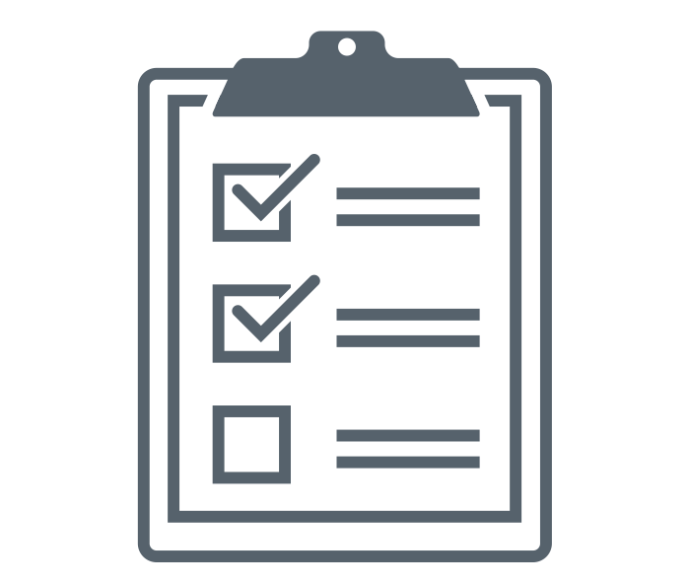
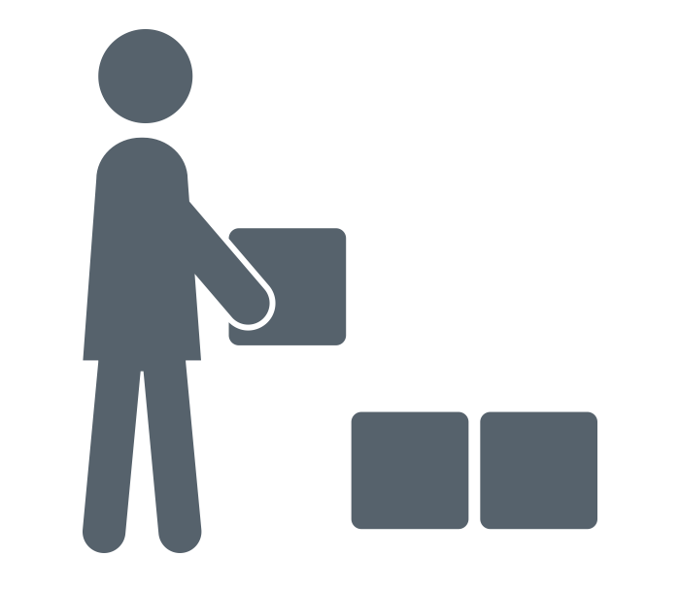
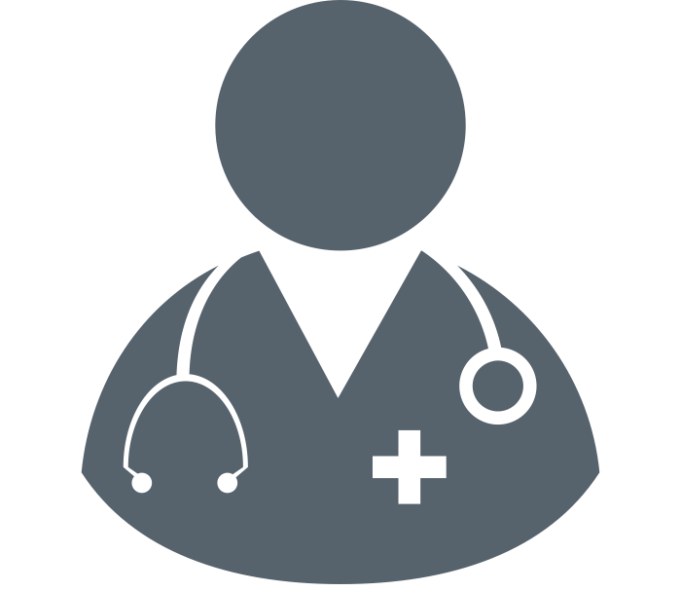

Ring introduction framework
Ring Introduction
This value chain framework has been used across countries to support planning for oral PrEP introduction. It has been adapted for the ring to identify necessary steps for ring introduction and scale-up across five major categories and across priority delivery channels. It can also be used to track progress towards ring introduction by different partners.
Value Chain for Dapivirine Ring
PLANNING &
BUDGETING
SUPPLY CHAIN MANAGEMENT
RING DELIVERY
PLATFORMS
UPTAKE &
EFFECTIVE USE
MONITORING
National and county plans are established to implement dapivirine ring guidelines for priority end user populations | Dapivirine ring is available and distributed in sufficient quantity to meet projected demand via priority delivery channels | Dapivirine ring is delivered by trained healthcare workers in priority delivery channels to effectively reach end users | End users know about and understand the ring and are able to seek, initiate, and effectively use the ring | The ring is effectively integrated into national, county, sub-county, facility, community, and program level monitoring systems

Slide 18
Kenya ring introduction situation analysis
Ring Introduction
This framework highlights critical elements of ring introduction and assesses the current state across these elements in Kenya.
PLANNING &
BUDGETING
SUPPLY CHAIN MANAGEMENT
DELIVERY
UPTAKE &
EFFECTIVE USE
MONITORING
 | Convene new or existing technical working group/ subcommittee for the ring
 | Identify target populations for ring use
 | Engage community stakeholders to inform planning for ring rollout
 | Develop impact, cost and/or cost-effectiveness analyses to inform ring planning
 | Include the ring in national HIV prevention and other relevant plans (e.g., FP)
 | Develop implementation plan and budget to guide initial ring introduction and scale-up
 | Register the ring and include the ring on the national essential medicines list
 | Update supply chain guidelines and logistics systems to include the ring
 | Establish monitoring, demand forecasting, and distribution systems to avoid stock-outs
 | Issue standard clinical guidelines for delivery and use of the ring
 | Dedicate resources to conduct regular HIV tests, initiate ring use, and support refills
 | Develop materials and conduct trainings for health care workers on the ring
 | Establish referral systems to link clients from other channels to sites dispensing the ring
 | Integrate support for partner communication and intimate partner violence (IPV)
 | Develop and implement demand creation strategies that include ring promotion
 | Address social norms/stigma to build community and partner acceptance of ring use
 | Develop information and tools for clients to guide product choice and support ring use
 | Support adherence and continuation for ring users
 | Develop and communicate plans for sanitary disposal of used rings
 | Establish monitoring tools to support data collection and analysis on ring use
 | Establish systems for pharmacovigilance and to monitor drug resistance
 | Conduct implementation science research to inform policy and scale-up
COLOR KEY
Anticipate easy integration with PrEP
Will require new effort, but no anticipated challenges
An area that will
require significant consideration

Slide 19
Ring Introduction
Kenya situation analysis summary findings
Summary findings from the Kenya situation analysis are below, with details included on the following slides.
PLANNING &
BUDGETING
SUPPLY CHAIN MANAGEMENT
DELIVERY
UPTAKE &
EFFECTIVE USE
MONITORING
The ring can build upon existing efforts to integrate HIV prevention and SRH services, led by NASCOP and the Department of Reproductive and Maternal Health
The ring will build on experiences with oral PrEP and HIV self-testing rollout and relevant policies, led by the HTS/PrEP CoE
Stakeholders expect the ring to be introduced via demonstration projects with a focus on counties with high HIV incidence among AGYW
The ring will need to be included in funding requests for PEPFAR and Global Fund, alongside oral PrEP, as well as for other donors
Several dimensions will determine how the ring will be managed in the supply chain, specifically classification of the ring by the PPB and the extent to which the ring is integrated into non-HIV supply chains for public sector services
As a baseline, the ring can be integrated into supply chain systems and tools for antiretrovirals (ARVs) following the model for oral PrEP
Private sector channels, including not-for-profit and for-profit channels, procure commodities from manufacturers or wholesalers, who would need to stock the ring
The ring is being included in the current revision of HIV prevention guidelines
The classification of the ring and other factors will determine delivery options, including frequency of HIV testing and acceptability of HIV self-testing – particularly relevant in Kenya, which has scaled-up HIVST
The ring will need to be incorporated into various provider trainings and related materials, including provider training on HIV prevention including PrEP and SRH services
Kenya HIV services already include standard screening for IPV, which could be used for the ring
The ring will require general awareness-raising campaigns that reach all communities
Community stakeholders and peer educators will need to be continuously trained to serve as educated ambassadors and advocates
Key messages that speak to the primary concerns of relevant stakeholders, particularly potential users of the ring, must be developed. For example, concerns around interference with sex and menstrual hygiene
The ring can be easily integrated into monitoring and evaluation (M&E) systems and tools for oral PrEP managed by NASCOP
An outstanding question is the extent to which the ring could be integrated into M&E systems for other public sector services (e.g., FP)
Kenya’s electronic medical records system could support more integrated M&E and should be updated to include the ring
Pharmacovigilance for the ring can be integrated into systems for oral PrEP, managed by the PPB

Slide 20
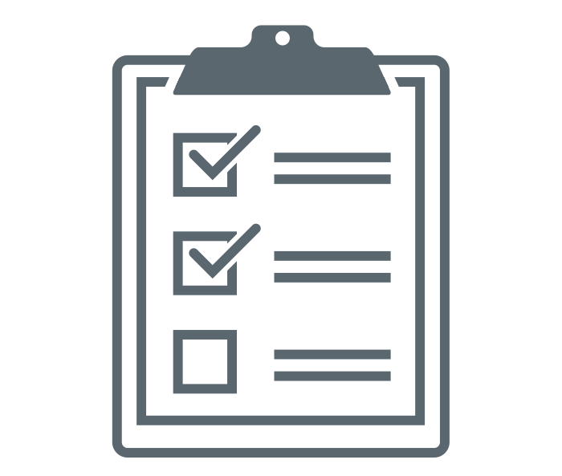
Planning & budgeting key steps
PLANNING & BUDGETING
 |  | What is needed to introduce the ring | Relevant Stakeholders | Considerations
 | Convene new or existing technical working group / subcommittee for the ring | Ring introduction will likely be led by NASCOP and the HTS/PrEP CoE, with existing six sub-committees (operations and service delivery, M&E, commodity security, communications and advocacy, research and impact evaluation, and resource mobilization and financing) In addition, the Reproductive and Maternal Health CoE will be critical and could join the HTS/PrEP CoE as a joint CoE for discussions about the ring – an HIV prevention/SRH services integration subcommittee has been established and the ring could be included in that ongoing dialogue | NASCOP National AIDS Control Council (NACC) HTS/PrEP CoE National Reproductive and Maternal Health Services Unit (RMHSU) Reproductive and Maternal Health CoE County Health Management Team, including County AIDS and STI Coordinators (CASCOs) and SRH Coordinators | Significant ongoing work to scale up oral PrEP and HIVST and integrate HIV prevention and SRH services provides a foundation for ring introduction but also requires time and attention from a small group of relevant stakeholders
 | Identify target populations for ring use | PrEP implementation has been defined broadly for “populations at substantial risk” Stakeholders expect the ring will be a “niche” product that will help to fill gaps in current use of HIV prevention options for those who cannot effectively use oral PrEP, especially AGYW |  | While the ring may be made available to all at substantial risk, initial implementation will likely be focused on AGYW
 | Engage community stakeholders to inform planning for ring rollout | With PrEP rollout, engagement of religious leaders and parents for younger PrEP users was critical to allay fears and build buy-in Stakeholders expect additional effort will be needed for the ring, as a new product form
 | Develop impact, cost and/or cost-effectiveness analyses to inform ring planning | Several analyses costed the implementation of PrEP (e.g., IPCP) Rollout scenarios developed by OPTIONS supported prioritization among counties for more focused rollout of oral PrEP and could be applied to the ring |  | The cost of the ring remains an outstanding question
 | Include the ring in national HIV prevention and other relevant policies and plans | The ring will need to be included in several HIV-focused plans, including: (1) the Kenya AIDS Strategic Framework (just revised), and (2) the HIV Prevention Revolution Roadmap under Strategic Direction 1 for Reducing New HIV infections (to be revised in 2021) The ring will need to be included in county HIV Prevention strategies In addition, to support integration with family planning, the ring will need to be included in the following: (1) National Reproductive Health and HIV and AIDS Integration Strategy, (2) Minimum Package for Reproductive Health (RH) and HIV Integrated Services, and (3) National Sexual Reproductive Health and Rights, HIV, Sexual Gender Based Violence and Tuberculosis Integration Framework 2018 – 2022 Several county and facility readiness assessments may also need to be adapted to include the ring |  | A critical effort will be to work with priority counties to support introduction of the ring in their plans and budgets
 | Develop implementation plan and budget to guide initial ring introduction and scale-up | Likely will start with a demonstration project to introduce the ring where oral PrEP is being delivered, with a focus on counties with high HIV incidence among young people and inclusion in ongoing HIV/SRH service integration initiatives Secure funding for ring implementation, including from PEPFAR, Global Fund, and national and county-level domestic resources |  | Limited funding for oral PrEP has been a limiting factor and some elements of the oral PrEP program are underfunded – this may be a challenge for the ring
Text in blue indicates key steps related to diverse delivery channels

Slide 21
Supply chain management key steps
SUPPLY CHAIN MANAGEMENT
 |  | What is needed to introduce the ring | Relevant Stakeholders | Considerations
 | Register the ring and include the ring on the national essential medicines list | The PPB must approve the ring for use in Kenya For distribution across diverse channels, the ring will need to be classified as safe for self-administration. Recent experiences with contraceptive products and with HIVST provide lessons learned: Discussions between NASCOP and PPB, with input from CoEs, will help guide classification HIVST recently approved for distribution directly to consumers via retail stores with evidence of safety and a system for monitoring and a website for users to report concerns or issues The ring will need to be included as part of Kenya’s Essential Medicines List (KEML) | PPB NASCOP HTS/PrEP CoE RMHSU Reproductive and Maternal Health CoE | An outstanding question is how the ring will be classified by the PPB To support self-administration, additional information would likely need to be packaged with the ring (e.g., information booklet, link to a website or hotline)
 | Update supply chain guidelines and logistics systems to include the ring | Oral PrEP is managed via the ARV logistics management information system (LMIS), including donor-funded stocks KEMSA distributes PrEP commodities to over 3K HIV treatment sites (~500 directly, then ~2.5K satellite sites that receive ARVs from primary sites); sites that did not provide ARVs were linked with ARV sites for procurement Pharmacies and private providers procure products directly from commercial distributors | KEMSA County and sub-county pharmacists | An outstanding question is to what extent the ring would need to be integrated into the FP supply chain to be delivered in FP settings
 | Establish monitoring, demand forecasting, and distribution systems to avoid stock-outs | Oral PrEP is managed alongside other ARVs and is included in the annual National Quantification Report for HIV & AIDS commodities Regular commodity management tools that will need to incorporate the ring include pharmacy daily registers (electronic at most facilities) and facility consumption requests (completed monthly and submitted each quarter) | KEMSA County and sub-county pharmacists | Forecasting for PrEP was challenging as a new product with quickly evolving dynamics (e.g., client drop-offs) and similar dynamics are expected for the ring
Text in blue indicates key steps related to diverse delivery channels

Slide 22
Ring delivery platforms key steps
DELIVERY PLATFORMS
 |  | What is needed to introduce the ring | Relevant Stakeholders | Considerations
 | Issue standard clinical guidelines for delivery and use of the ring | The ring will be included in Guidelines on Use of Antiretroviral Drugs for Treating and Preventing HIV Infection in Kenya based on adaptation of WHO guidance For delivery in FP channels, the ring will need to be included in the National Family Planning Guidelines for Service Providers | NASCOP HTS/PrEP CoE RMHSU Reproductive and Maternal Health CoE | Collaboration will be required across departments to support development of guidelines for the dapivirine ring
 | Dedicate resources to conduct regular HIV tests, initiate ring use, and support refills | Different models of ring delivery may be tested; for example, NASCOP is experimenting with a vending machine for HIVST that could accommodate the ring For provision in FP or maternal and child health settings, models might include: a 'kiosk' approach where an FP provider also provides the ring; a 'supermarket approach' where an FP provider refers a client to a PrEP provider for provision of the ring within the same visit; or an FP provider refers to another site for ring provision
 | Dedicate resources to conduct regular HIV tests, initiate ring use, and support refills |  |  | An outstanding question is what frequency of HIV testing will be required for ring users and whether HIV self-tests could be used with the ring (HIVST is not currently used for oral PrEP)
 | Develop materials and conduct trainings for health care workers on the ring | The ring can be incorporated into existing training for oral PrEP – for example, the “Toolkit for Health Service Providers” (NASCOP) There is a training package currently being developed for the integration of HIV prevention and SRH services (“Integrating Reproductive Health and HIV Care and Treatment Services A Toolkit for Service Providers”), which will provide an opportunity to include the ring To reach pharmacists and private providers, the ring would need to be integrated into continuing medical education Additional materials for providers include a risk assessment screening tool, PrEP initiation flow chart/job aid, provider counseling guidance, and an FAQ Ongoing provider supervision and mentorship will also be critical, and the ring should be incorporated into the supervision support tool used by county governments to conduct ongoing service quality, monitoring, and improvement The ring can also be incorporated into pre-service training, with support from NASCOP and the Department of Reproductive and Maternal Health | NASCOP RMHSU Kenya Pharmacists Association (for pharmacists) Kenya Medical Association (for private providers) Kenya Institute of Curriculum Development (for pre-service training) County and Sub-County Quality Improvement teams (for ongoing supervision) | While NASCOP employs an e-learning platform (ECHO) used for oral PrEP, they found in-person learning more effective Inclusion of the ring in pre-service training would help reach a broader cohort of providers, but requires a longer time horizon
 | Establish referral systems to link clients from other channels to sites dispensing the ring | A strong referral network between different facility and community-based services will be important to support ring access and delivery
 | Integrate support for partner communication and intimate partner violence (IPV) | Kenya guidelines currently include screening for IPV and referrals for support in all HIV service delivery Strategies to engage male partners via demand creation or couples-counseling could also be considered | NASCOP HTS/PrEP CoE
Text in blue indicates key steps related to diverse delivery channels

Slide 23
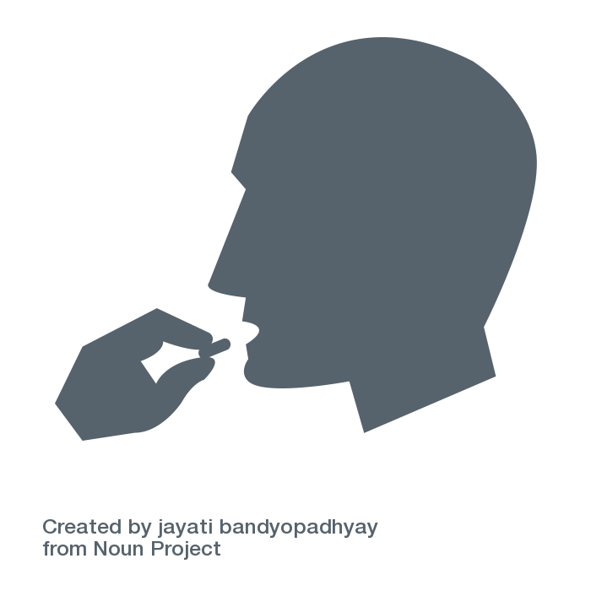
Uptake and effective use key steps
UPTAKE AND EFFECTIVE USE
 |  | What is needed to introduce the ring | Relevant Stakeholders | Considerations
 | Develop and implement demand creation strategies that include ring promotion | Formative research to confirm barriers and facilitators of ring uptake will be helpful The ring could be included in the National Combination Prevention Communication Strategy (in development as of December 2020) The ring could be included in ongoing oral PrEP demand creation programs As a branded pharmaceutical product, direct-to-consumer promotion of the ring will require written permission from the Kenya PPB | NASCOP RMHSU Development partners (donors) County Health Management Teams Implementing partners NACC | It has been difficult to maintain sufficient attention and resources for demand creation for oral PrEP and the ring will face a similar challenge
 | Address social norms/stigma to build community and partner acceptance of ring use | Strategies to address community and partner acceptance of ring use should be included in the National Combination Prevention Communication Strategy Existing community and partner engagement activities for oral PrEP can incorporate the ring, including the HIV Prevention Ambassadors training and implementation tools | NASCOP NACC RMHSU County Health Management Teams Implementing partners | Buy-in from male community leaders will be critical; identifying women in leadership to advocate to male counterparts can be effective
 | Develop information and tools for clients to guide product choice and support ring use | Key messages that speak to the primary concerns of relevant stakeholders, particularly potential users of the ring, must be developed. For example, concerns around interference with sex and menstrual hygiene Existing oral PrEP tools and materials can be expanded to include information about all forms of PrEP, including the ring | NASCOP NACC RMHSU County Health Management Teams Implementing partners
 | Support adherence and continuation for ring users | Resources will be required to sustain ring-awareness campaigns beyond initial rollout The existing oral PrEP support group model can be expanded to include ring users, with a focus on ring ‘champions’ for testimonials to demystify and build acceptance of the ring Healthcare worker training should be focused not only on clinical skills, but also on how to provide empathetic, client-centered adherence support | NASCOP RMHSU County Health Management Teams Implementing partners | Campaigns need to last longer than a few months and be adaptable to reach low-tech and rural areas
 | Develop and communicate plans for sanitary disposal of used rings | Messaging on ring disposal (e.g., to deter sharing of rings, guidance on the ring’s effectiveness beyond the 28-day timeframe) will need to be included in client education activities, materials, and tools Guidance on ring disposal should also be included in provider training materials | NASCOP RMHSU County Health Management Teams Implementing partners
Text in blue indicates key steps related to diverse delivery channels

Slide 24
Monitoring key steps
MONITORING
 |  | What is needed to introduce the ring | Relevant Stakeholders | Considerations
 | Establish monitoring tools to support data collection and analysis on ring use | Kenya’s national health information system (KHIS Aggregate) collects data across the health system As an HIV prevention method, the ring will primarily be integrated with existing oral PrEP M&E data collection and reporting tools including: (1) Clinical Encounter Card used for a single clinical visit, (2) Daily Activity Register used at the facility level to catalog services delivered, (3) the PrEP register to document details for PrEP users, and (4) the PrEP summary tool, a monthly report on PrEP services from health facilities to NASCOP The ring could also be integrated into FP M&E registers, which currently allow reporting disaggregated by FP method Broader efforts to integrate M&E across HIV, FP, and ANC/maternal health public health services are underway with introduction of an Electronic Medical Records (EMR) system, starting at select health facilities – the EMR currently includes oral PrEP and event-driven PrEP; the ring could also be included as an option For the private sector, oral PrEP is currently delivered via well-established partners who are included in county-level M&E, however there is no monitoring for smaller clinics or pharmacies | NASCOP HTS/PrEP CoE Research and Monitoring & M&E Sub-Committee NASCOP M&E Managers RMHSU M&E Managers County Health Records Information Officers (CHRIOs) Sub-County Health Records Information Officers (SCHRIOs) | As an ARV, the ring will likely be included in HIV prevention monitoring tools, which may cause friction to offer the ring in other channels Updating M&E tools and redistributing them to health facilities can be a long process Support for implementation of updated M&E tools happens in close partnership between the national government, county and sub-county governments, and implementing partners For oral PrEP, implementation preceded the development of M&E systems; for the ring, M&E systems development will likely be faster as it can build on the oral PrEP experience
 | Establish systems for pharmacovigilance and to monitor drug resistance | Pharmacovigilance systems are managed by the PPB, independent from the health systems information system Tracking and reporting for PrEP occurs with other ARVs and includes adverse reactions or events, suspected poor quality medicines, and drug reactions County Health Management Teams, Sub-County Health Management Teams and healthcare facility staff will need to be oriented to the reporting of seroconversion/adverse drug reactions to the ring | PPB | Pharmacovigilance is largely conducted via end user reporting
 | Conduct implementation science research to inform policy and scale-up | For introduction of oral PrEP, the NASCOP HTS/PrEP CoE Research and M&E Sub-Committee defined a research agenda with key questions to be answered – a similar approach would work well for the ring, especially to inform early demonstration/pilot projects in 2021 – 2022 A new area of focus will be monitoring of method switching between oral PrEP and the ring The ring could also be included in the Kenya Population-based Impact Assessment (KENPHIA) (oral PrEP was included in 2018) | NASCOP NASCOP HTS/PrEP CoE Research and M&E Sub-Committee RMHSU Reproductive and Maternal Health CoE
Text in blue indicates key steps related to diverse delivery channels

Slide 25
Emerging questions about the ring
Key stakeholder questions
What is the acceptability of the ring for Kenyan women and their partners? How comfortable are women with using the ring? Can male partners feel the ring during sexual intercourse?
How much will the ring cost? If it will not be given for free, what would be a sustainable price? Will the funding for the ring take away from oral PrEP?
How will women be identified to participate in a demonstration study? Would women already using oral PrEP who have tried and stopped using oral PrEP be an appropriate target group? Will the ring result in a decrease in oral PrEP use?
What will be seen in terms of method switching between oral PrEP and the ring over time? What reasons will drive method switching? How often will people switch between methods? What is the best way to track method switching?
How safe is the ring to use for pregnant and breastfeeding women?
What will adherence look like for women aged below 21 years? In trials thus far, adherence in this group to the ring has been shown to be low.
What will uptake and use look like in key populations, particularly FSWs?
Is it beneficial to use both oral PrEP and the ring? What happens if you use both but aren't consistent with the use of one?
What kind of support will be required for continued use of the ring?
How will women use the ring during menstruation? What messaging will be effective to support consistent ring use?

Slide 26
Context for the dapivirine ring
Delivery channels for the dapivirine ring
Dapivirine ring introduction planning
Sources

Slide 27
Interview List
The following organizations were consulted in the development of this analysis:
NASCOP
National Reproductive and Maternal Health Services Unit (RMHSU)
PS Kenya
Pharmaceutical Society of Kenya
University of Manitoba
Jhpiego
FHI 360
LVCT Health
Living Goods
Waci Health

Slide 28
Select desk review sources
Sources
PrEP Roll Out in a National Public Sector Program: The Kenyan Case Study, Masyuko et al, November 2018
Kenya AIDS Strategic Framework II: Sustain Gains, Bridge Gaps, and Accelerate Progress, Kenya Ministry of Health, 2020
Framework for the Implementation of Pre-Exposure Prophylaxis of HIV in Kenya, NASCOP Kenya, 2017
Kenya HIV Prevention Revolution Road Map, NACC Kenya, June 2014
Kenya Oral PrEP Timeline, NASCOP, 2017
The Time for PrEP is Now: The Journey to Scaling Up Oral Pre-Exposure Prophylaxis in Kenya, Jilinde Project, June 2017
Sources of Family Planning – Kenya, SHOPS Plus Project, November 2018
Key Role of Drug Shops and Pharmacies for Family Planning in Urban Kenya and Nigeria, Corroon, et al., 2016.
Kenya Demographic and Health Survey, 2014
Kenya Private Health Sector Assessment, World Bank, 2010
Strengthening the integration of family planning and HIV services at the community level in Kenya, The Evidence Project, March 2020
Applying Lessons from Family Planning to HIV Prevention Product Introduction, HIV Prevention Market Manager Project, October 2018
Integration of HIV Prevention and Sexual Reproductive Health Services in Kenya, HIV Prevention Market Manager Project, February 2020

Slide 29




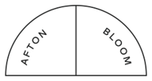



Thank You!
For more information, please visit:
https://www.ipmglobal.org/our-work/our-products/dapivirine-ring
https://www.prepwatch.org/about-prep/dapivirine-ring/
PROMISE is made possible by the generous support of the American people through the U.S. Agency for International Development (USAID) and the U.S. President's Emergency Plan for AIDS Relief (PEPFAR) through the terms of cooperative agreement AID-OAA-A-15-00045. The contents are the responsibility of Envision FP and do not necessarily reflect the views of USAID, PEPFAR, or the U.S. Government.
PROMISE Implementing Partners

