Slide 1
Training for Providers on the Use of Oral Pre-exposure Prophylaxis for the Prevention of HIV
Facilitator Background Materials
Review these slides prior to using these materials

Slide 2
Introduction to Training Materials
These training materials
May need to be modified for use if national guidelines do not align with WHO guidance as of March 2022
Can be used to train providers in-person or virtually
Are broken into Sections which should take approximately 2 hours each, additions to any Section, especially Section 5 which includes the M&E training, will add time to the training and you should plan accordingly
To prepare to use these training materials
Select co-facilitator(s)
Adjust (if needed) to match national guidelines
Review activity instructions and prepare for activities as needed
Review ‘Notes’ section on all slides and address action items which start with “Facilitator:”
Review all slides for any formatting errors that may result from different software versions

Slide 3
Co-facilitation
It is recommended that those training using these materials choose a co-facilitator or even a few
Ideally the facilitation pair or team will bring different experiences and perspectives to the training
It is recommended that one facilitator be a trained healthcare provider (doctor, nurse, etc.) and another be a representative of a key population who may have PrEP use experience themselves

Slide 4
In-person Activity Instructions
Activity | Instructions
Poll ~3 minutes | Option 1: Have participants raise paper with their answer Materials: A piece of A4 paper cut into four sections, each with a single letter (A, B, C, D). Instructions for participants to make this are included in the training or these can be pre-printed and cut out Options 2: Have participants move to the corner of the room and stand near the letter (A, B, C, D) that corresponds with the answer Materials: Piece of paper taped in each corner of the room with an A in one corner, a B in another, and so on with C, and D
Discuss 5+ minutes | Have participants turn to the person next to them. Everyone should be in a pair or, if needed, a group of three. Discuss the prompt with their partner(s) Discuss together as a large group For longer discussions, have a notetaker to capture ideas for sharing.
For other activities (role plays or scenarios) see instruction slide for virtual or in-person training preceding the activity.

Slide 5
Virtual Activity Instructions
Activity | Instructions
Poll ~3 minutes | Option 1: If there is time to prepare prior, use the poll function in whichever virtual platform you are using (Zoom, Skype, Teams, etc.) There are also platforms for polls using external sites, such as Mentimeter Option 2: Have participants come off mute and share their selection Facilitators can call on people or use a random method for selecting participants to answer Option 3: Ask participants to put their selected answer in the chat If using Zoom, having participants send the answer to ONLY you may increase participation
Discuss 5+ minutes | Option 1: Ask participants to come off mute and share their thoughts Encourage use of the chat functions Option 2: For longer discussions, using the Breakout Room function in Zoom (or whichever platform being used) Send participants into breakout rooms in groups of 2 or 3 Put the discussion prompt in the chat
For other activities (role plays or scenarios) see instruction slide for virtual or in-person training preceding the activity.

Slide 6
In-Person: Items Needed for this Training
Used all days:
Registration sheet
Nametags
Computer equipment: projector, screen, computer with cables to connect to projector, power sources for everything, notepads and pens for participants (if they are being provided)
Markers (be sure that markers won’t bleed through the flipchart before writing on it on the wall or on any surface where it won’t wash off)
Flipchart (one piece labeled Parking Lot and another labeled Training Feedback put on the wall)
Piece of paper taped in each corner of the room with an A in one corner, a B in another, and so on with C, and D

Slide 7
In-Person: Items Needed for this Training
Section 1 (Introduction and Module 1):
For each participant: blank piece of paper to make poll answer cards, copy of pre-training assessment,
Section 2 (Modules 1 & 2):
For each participant: Copy of Screening for Initiation of Oral PrEP form
Section 3 (Modules 2 & 3)
For each participant: Copy of slides with counseling messages
Section 4 (Modules 3 & 4)
Section 5 (Modules 5, 6, & 7):
For each participant: Copy of post-training assessment, copy of training evaluation form

Slide 8
Virtual: Items Needed for this Training
Used all days:
Registration sheet (to keep track of attendance and participation if desired)
Zoom or other virtual meeting account
Computer, computer charger

Slide 9
Virtual: Items Needed for this Training
Section 1 (Introduction and Module 1):
Section 2 (Modules 1 & 2):
For each participant, sent via email prior to the session: Screening for Initiation of Oral PrEP form (form found on slide 7)
Section 3 (Modules 2 & 3)
For each participant, sent via email prior to the session: Slides with counseling messages
Section 4 (Modules 3 & 4)
Section 5 (Modules 5, 6, & 7)

Slide 10
Assumptions About Timing
To systematically break this training into five 2-hour segments, developers assumed:
Content slides = 1 minute
Polls = 2 minutes
Discuss activities = 5 minutes (unless otherwise noted)
Other activities = time varies and is noted on slides
Any modifications to the content, time spent on activities beyond their current estimated allocations, and extensive breaks for additional discussion will adjust the timing. People move at different paces and that’s okay. Adjusting the training to have a full two days may be best and is left to your discretion.

Slide 11
Section Divider #1

Slide 12
Oral Pre-exposure Prophylaxis Training for Providers on the Use of Oral Pre-exposure Prophylaxis for the Prevention of HIV in [COUNTRY]
[Facilitator 1 Name, Facilitator 1 Organization, Facilitator 1 Title]
[Facilitator 2 Name, Facilitator 2 Organization, Facilitator 2 Title]
Notes:
Facilitator: Fill in missing content in red

Slide 13
In-Person Welcome!
If you haven’t already-
Please sign the registration sheet.
Please make a name tag for yourself.
Notes:
Facilitator: Delete this slide if you're conducting the training virtually

Slide 14
Virtual Welcome!
Please name yourself “properly” in the platform. Instructions on how to name yourself are below:
Notes:
Facilitator: If conducting the training virtually, add instructions here on how participants should name themselves. Delete this slide if you're conducting the training in-person.

Slide 15
Introductions
Take a minute (and only one, please!) to tell us:
Your name
The name of your organization
Your position there
A personal fact about yourself. Could be:
Something about your family
Something you like to do
Favorite food

Slide 16
Asking questions
Notes:
Facilitator: Add instructions on how people should ask questions throughout the session. Do you want them to simply speak up? Raise hands? Write in the chat? Put them on a "parking lot"?

Slide 17
Discuss
What do you hope to get out of this training?

Slide 18
Oral PrEP-Specific Competencies
After completing this training, you will be able to:
Answer essential questions about oral PrEP
Assess individual exposure to HIV
Identify candidates who meet the criteria for oral PrEP initiation
Educate and counsel oral PrEP candidates and users
Conduct initial and follow-up visits for oral PrEP users
Utilize oral PrEP monitoring and evaluation tools
Notes:
Facilitator: If this training qualifies for continuing education credits in your setting, consider adding information about that after this slide

Slide 19
Training Background
This training is meant to provide the comprehensive clinical background providers need in order to implement oral PrEP programming.
Providers implementing oral PrEP may also need training on:
Gender and sexuality
Providing first-line support for gender based and intimate partner violence as well as referrals
HIV testing and counseling

Slide 20
Training Overview
1
Oral PrEP Basics
2
Oral PrEP Screening
3
Oral PrEP Initial and Follow-Up Visits
4
Monitoring and Managing Oral PrEP Use: Creatinine, Seroconversion, and Stigma
5
Event-Driven PrEP (ED-PrEP)
6
Oral PrEP Monitoring and Evaluation Tools
7
Evaluation and Resources

Slide 21
In-Person Sample Training Agenda Outline- Day 1
Time |  | Topic | Presenter/Facilitator
9:00-11:00 | 2 hours | Section 1 (Introduction and Module 1)
11:00-11:15 | 15 mins | Break
11:15-1:15 | 2 hours | Section 2 (Modules 1 & 2)
1:15-2:15 | 1 hour | Lunch
2:15-4:15 | 2 hours | Section 3 (Modules 2 & 3)
4:15-4:30 | 15 mins | Debrief
Notes:
Facilitator: Delete this slide if you're conducting the training virtually

Slide 22
In-Person Sample Training Agenda Outline- Day 2
Time |  | Topic | Presenter/Facilitator
9:00-11:00 | 2 hours | Section 4 (Modules 3 & 4)
11:00-11:15 | 15 mins | Break
11:15-1:15 | 2 hours | Section 5 (Modules 5, 6, & 7)
1:15-2:15 | 1 hour | Lunch
Notes:
Facilitator: Delete this slide if you're conducting the training virtually

Slide 23
Virtual Training Agenda Outline
Notes:
Facilitator: Delete this slide if you're conducting the training in-person. It is encouraged that virtual training take place over several days, completing a single section each day. Whatever you decide, insert your agenda for the entire training here

Slide 24
Discuss-Ground Rules
Be punctual.
Keep client stories confidential.
Respect people’s rights to have differing opinions.
Be an active participant in all training activities.
Limit cell phone use if you find it disruptive for you or think it might be for others.
Ask questions—ask, ask, ask.
Let others finish speaking before responding or commenting.
Are there other ground rules that should be added?

Slide 25
A Note on Terminology
Throughout the training, you may hear terms or phrases that are unfamiliar to you. To be more precise and not contribute to the stigmatization of people living with HIV or those who may benefit from HIV prevention products, we have made a few language shifts:
Serodifferent instead of serodiscordant: This change reinforces that while the HIV status of people can be different, it does not put them in discord. It is completely okay for people to have different HIV serostatuses.
Removing the term “risk” and “risky”: The terms have many different definitions and may stigmatize certain behaviors, impose labels on clients, or stigmatize living with HIV itself.
It’s vital that clients be able to talk to providers free of judgment so providers can better serve them.
Using new terms is tough, and it’s okay to make mistakes. Feel free to try out some of these new terms during the next couple of days.

Slide 26
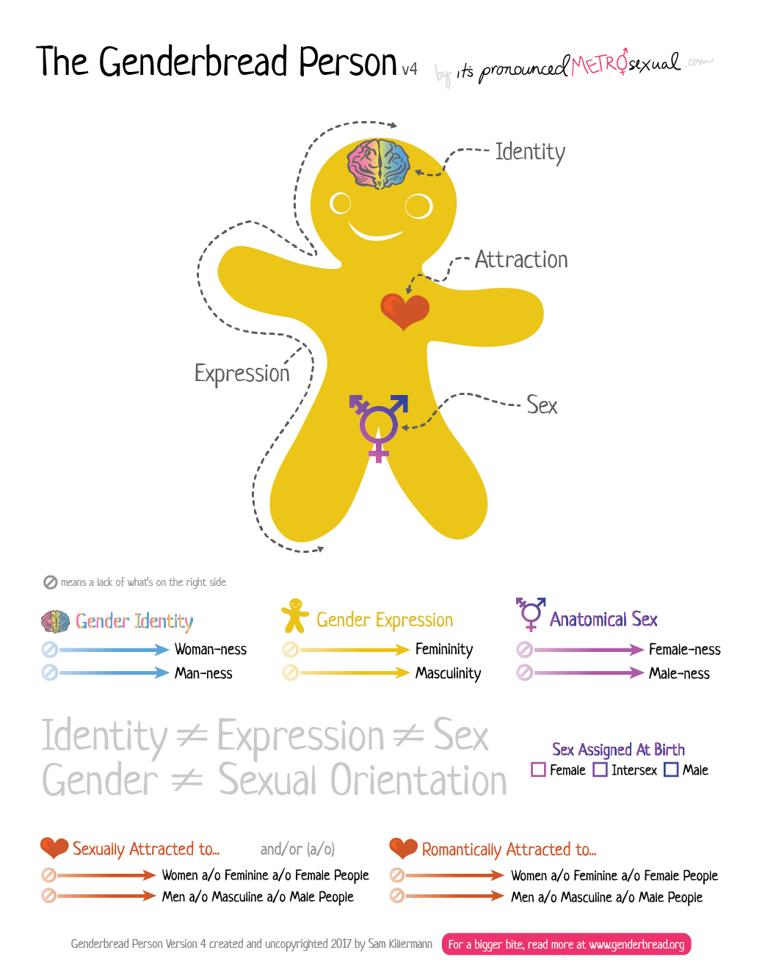
Refresh on Gender Terminology
https://www.genderbread.org/resource/genderbread-person-v4-0

Slide 27
Another Note on Terminology
The training will also use two phrases to speak about different ways of using oral PrEP. These phrases are used because they are more precise in that they allow us to speak more clearly about how PrEP works in people with different bodies without confusing gender and sex assigned at birth.
People assigned male at birth (AMAB):
Typically includes: Cisgender* men, Transgender women, Some non-binary individuals
People assigned female at birth (AFAB):
Typically includes: Cisgender* women, Transgender men, Some non-binary individuals
*Cisgender is a term used to describe a person whose sense of personal identity and gender corresponds with their sex assigned at birth. E.g., Cisgender women were assigned female sex at birth and identify as women.

Slide 28
A Note on Content
This training reflects WHO guidance through March 2022, including guidance presented in October 2021 which is expected to be formally released in 2022

Slide 29
In-person Pre-Training Assessment
The purpose of this assessment is to find out what you know about implementing oral PrEP. Your answers will help adjust this training to your needs and compare your growth from now to the post-training assessment.
Do not worry if you do not know some or all of the answers. Try your best!
Remember to include your name on your pre-assessment.
Please hand your assessment forms to me when you are finished.
You will have approximately 20 minutes to complete the assessment.
Notes:
Facilitator: Delete this slide if you're conducting the training virtually. If you’re conducting the training in-person, create a pre-training assessment for participants by putting all of the poll questions into a single document and prepare this prior to the training.

Slide 30
Virtual Pre-Training Assessment
The purpose of this assessment is to find out what you know about implementing oral PrEP. Your answers will help adjust this training to your needs and compare your growth from now to the post-training assessment.
Do not worry if you do not know some or all of the answers. Try your best!
You will have approximately 20 minutes to complete the assessment.
Notes:
Facilitator: Delete this slide if you're conducting the training in-person. If you’re conducting the training virtually, create a pre-training assessment for participants by putting all of the poll questions into a single poll or into a online survey like Google Forms, Survey Monkey, etc.

Slide 31
Discuss- Pre-Training Assessment
How did you feel about the questions in the pre-training assessment?
Were the questions easy or difficult? Why or why not?
Why did you answer the way you did?

Slide 32
Preparing for Poll Questions
Throughout the training there will be poll questions
Using your notebook paper, label a piece each with A, B, C, and D like seen to the right
When then a poll question comes on the screen, find the letter the corresponds with your answer and hold it up
If people need to get up and move, we may move to the corners of the room with the corresponding letters
A
B
C
D
Notes:
Facilitator: Delete this slide if you’re conducting the training virtually. If you’re conducting the training in-person, decide whether to have participants make these during the session or to have them printed and prepared prior to the training

Slide 33
Module 1
1
Oral PrEP Basics
2
Oral PrEP Screening
3
Oral PrEP Initial and Follow-Up Visits
4
Monitoring and Managing Oral PrEP Use: Creatinine, Seroconversion, and Stigma
5
Event-Driven PrEP (ED-PrEP)
6
Oral PrEP Monitoring and Evaluation Tools
7
Evaluation and Resources

Slide 34
Module 1 Learning Objectives
After completing Module 1, participants will be able to:
Define oral PrEP and describe the need for oral PrEP
Differentiate oral PrEP from post-exposure prophylaxis (PEP) and antiretroviral therapy (ART)
Identify people with substantial likelihood for HIV acquisition
Identify key populations (KPs) for oral PrEP at the local level
Explain the relationship between oral PrEP effectiveness and adherence
State the key reasons oral PrEP is needed
Specify the oral PrEP regimens approved by the World Health Organization (WHO)
Identify concerns regarding oral PrEP implementation.
Explain the risks and benefits of oral PrEP.

Slide 35
Combination Prevention
Structural
Behavioral
Biomedical
Policies
Laws
Regulatory environment
Culture
Education
Counseling
Stigma reduction
Harm reduction
Adherence interventions
HIV testing
Condoms
Voluntary medical male circumcision (not applicable in all settings)
Prevention of vertical transmission*
Treatment of STIs
Treatment as prevention
Post-exposure prophylaxis (PEP)
Pre-exposure Prophylaxis (PrEP)
Combination prevention is a mix of biomedical, behavioral, and structural interventions that decrease the likelihood of HIV acquisition.
*the term vertical transmission is used in place of mother to child transmission

Slide 36
Discuss
What do you know about PrEP?

Slide 37
Pre-Exposure Prophylaxis
PrEP is the use of ARVs by people who are HIV negative to prevent the acquisition of HIV before exposure to the virus.
Pre
Before
Exposure
Activity that can lead to HIV acquisition
Prophylaxis
Prevention

Slide 38
Discuss
What PrEP options are you aware of?

Slide 39
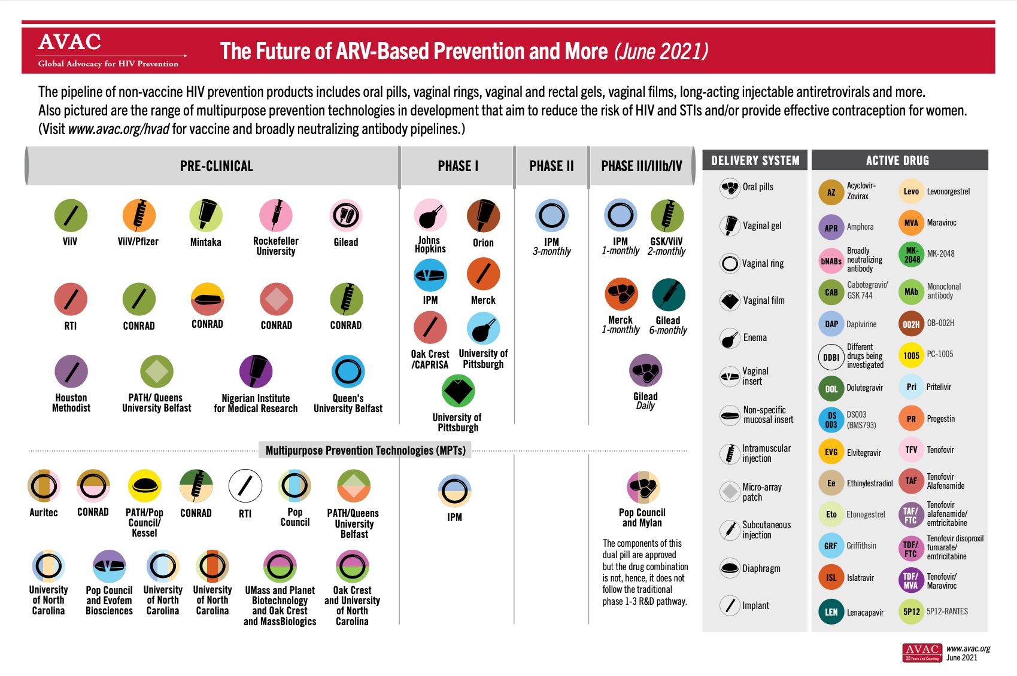
PrEP Options Expanding
Tenofovir based oral PrEP and the dapivirine vaginal ring are the only PrEP methods currently (February 2022) recommended by the WHO.
There are many new options in development
It is expected that the WHO will make recommendations on long acting cabotegravir injections in 2022
Our training focuses on oral PrEP

Slide 40
Oral PrEP Regimens
PrEP Method | How is it taken? | Who is it for? | What is it for?
Daily oral PrEP | One pill is taken daily | All populations | Preventing HIV acquisition during all types of exposures
Event-driven (ED) PrEP | Two pills are taken 2-24 hours before sex and then a pill each following day until two days after last potential sexual exposure | People assigned male at birth not using exogenous hormones | Preventing HIV acquisition during SEXUAL EXPOSURES ONLY
*Exogenous hormones are those which are not produced by the body itself and are often ingested and/or injected. This may be common for those taking hormones for gender affirming hormone therapy.

Slide 41
Global Progress of Oral PrEP
2012: FDA approval in the United States
2015: WHO recommendation
2018: Adolescents included in oral PrEP recommendations in the United States
[YEAR]: Approval in [COUNTRY]
Background:
The drugs used in current oral PrEP regimens recommended by the WHO are not new drugs. They were around before 2012 and were and are used in combination with other drugs for the treatment of HIV infection.
This training reflects WHO guidance through March 2022, including guidance presented in October 2021 which is expected to be formally released in 2022
Notes:
Facilitator: Fill in missing content in red

Slide 42
Poll Question
Is the following statement true or false? ‘Drugs used for oral PrEP are new drugs.’
True
False

Slide 43
Poll Question - Answer
Is the following statement true or false? ‘Drugs used for oral PrEP are new drugs.’
True
False
The drugs used in current oral PrEP regimens recommended by the WHO are not new drugs. They were around before 2012 and were and are used in combination with other drugs for the treatment of HIV.
While these drugs might be new in some countries for use as PrEP, they are not new drugs.

Slide 44
Global Expansion of Oral PrEP
By January 2022, an estimated 1.8 million people had taken oral PrEP, across more than 90 countries.¹
National guidelines exist in a growing number of countries
Regional guidelines from:
European AIDS Clinical Society
Southern African HIV Clinicians Society
Australasian Society for HIV, Viral Hepatitis and Sexual Health Medicine
https://www.prepwatch.org/resource/global-prep-tracker/

Slide 45
Discuss
What is PEP and when should it be used?

Slide 46
Post-Exposure Prophylaxis (PEP)
PEP is short-term antiretroviral treatment to reduce the likelihood of HIV acquisition after potential exposure, either occupationally or nonoccupationally—for instance, through sex.
Post
After
Exposure
Activity that can lead to HIV acquisition
Prophylaxis
Prevention
http://www.who.int/hiv/topics/prophylaxis/en/

Slide 47
Similarities and Differences
When called upon, tell whether the item is about oral PrEP, PEP, or both.
1. Used by people without HIV | Oral PrEP, PEP, or both?
2. Started before potential exposure and continued after potential exposure | Oral PrEP, PEP, or both?
3. Use ARVs to prevent HIV acquisition | Oral PrEP, PEP, or both?
4. Typically the combination of two ARVs | Oral PrEP, PEP, or both?
5. Available from providers by prescription | Oral PrEP, PEP, or both?
6. Started after potential exposure | Oral PrEP, PEP, or both?
7. Effective when taken correctly and consistently | Oral PrEP, PEP, or both?
8. Taken for 28 days only | Oral PrEP, PEP, or both?
9. Can be used as long as potential HIV exposure exists | Oral PrEP, PEP, or both?
10. Typically a combination of three ARVs | Oral PrEP, PEP, or both?

Slide 48
Similarities and Differences
1. Used by people without HIV. | Oral PrEP, PEP, or both?
2. Started before potential exposure and continued after potential exposure | Oral PrEP, PEP, or both?
3. Use ARVs to prevent HIV acquisition | Oral PrEP, PEP, or both?
4. Typically the combination of two ARVs | Oral PrEP, PEP, or both?
5. Available from providers by prescription | Oral PrEP, PEP, or both?
6. Started after potential exposure | Oral PrEP, PEP, or both?
7. Effective when taken correctly and consistently | Oral PrEP, PEP, or both?
8. Taken for 28 days only | Oral PrEP, PEP, or both?
9. Can be used as long as potential HIV exposure exists | Oral PrEP, PEP, or both?
10. Typically a combination of three ARVs | Oral PrEP, PEP, or both?
Both
Oral PrEP
Both
Oral PrEP
Both
PEP
Both
PEP
Oral PrEP
PEP

Slide 49
Similarities and Differences
When called upon, tell whether the item is about HIV treatment, oral PrEP, or both
1. Used by people without HIV | Treatment, oral PrEP, or both?
2. Started before potential exposure and continued after potential exposure | Treatment, oral PrEP, or both?
3. User takes ARVs to prevent their own HIV acquisition | Treatment, oral PrEP, or both?
4. Typically the combination of two ARVs | Treatment, oral PrEP, or both?
5. Available from providers by prescription | Treatment, oral PrEP, or both?
6. User takes ARVs to prevent HIV transmission to others | Treatment, oral PrEP, or both?
7. Effective when taken correctly and consistently | Treatment, oral PrEP, or both?
8. Taken for life | Treatment, oral PrEP, or both?
9. Taken during periods of potential exposure to HIV, not lifelong for most | Treatment, oral PrEP, or both?
10. Typically a combination of three ARVs. | Treatment, oral PrEP, or both?
11. Used by people living with HIV | Treatment, oral PrEP, or both?

Slide 50
Similarities and Differences
1. Used by people without HIV | Treatment, oral PrEP, or both?
2. Started before potential exposure and continued after potential exposure | Treatment, oral PrEP, or both?
3. User takes ARVs to prevent their own HIV acquisition | Treatment, oral PrEP, or both?
4. Typically the combination of two ARVs | Treatment, oral PrEP, or both?
5. Available from providers by prescription | Treatment, oral PrEP, or both?
6. User takes ARVs to prevent HIV transmission to others | Treatment, oral PrEP, or both?
7. Effective when taken correctly and consistently | Treatment, oral PrEP, or both?
8. Taken for life | Treatment, oral PrEP, or both?
9. Taken during periods of potential exposure to HIV, not lifelong for most | Treatment, oral PrEP, or both?
10. Typically a combination of three ARVs. | Treatment, oral PrEP, or both?
11. Used by people living with HIV | Treatment, oral PrEP, or both?
Oral PrEP
Oral PrEP
Oral PrEP
Oral PrEP
Both
HIV Treatment
Both
HIV Treatment
Oral PrEP
HIV Treatment
HIV Treatment

Slide 51
Why We Need Oral PrEP
Global annual HIV infections have remained close to 2 million for several years, declining in recent years.
HIV incidence remains high among key and made vulnerable populations: people who inject drugs (PWID), sex workers (SWs), transgender people (TG), and men who have sex with men (MSM) despite increasing access to HIV prevention.
Oral PrEP provides an additional prevention intervention to be used together with existing interventions like condoms and harm reduction for PWID.
Modelling shows that increased use of oral PrEP reduces HIV incidence
Notes:
Select studies that show impact of PrEP on reductions in new cases of HIV:
https://www.aidsmap.com/news/jul-2018/prep-use-linked-fewer-new-hiv-infections-us-states#:~:text=But%20some%20notable%20differences%20were,group%20in%20an%20unadjusted%20analysis.
https://www.aidsmap.com/news/jan-2022/big-increase-recent-prep-users-among-new-hiv-cases-largest-uk-clinic-reports
https://www.sciencedirect.com/science/article/abs/pii/S2352301821000746?dgcid=author

Slide 52
Local HIV Epidemiology
[AVAILABLE PREVALENCE DATA]
[AVAILABLE INCIDENCE DATA]
Most new infections are happening among [POPULATIONS] These populations are an appropriate focus for oral PrEP.
Source: [DATA SOURCE]
Notes:
Facilitator: Fill in missing content in red and insert data visual

Slide 53
Key and Priority Populations
KPs are groups of people who are disproportionately affected by HIV due to certain behaviors and are made particularly vulnerable through marginalization and structural factors such as stigma, discrimination, violence, human right violations, and criminalization—all of which contribute to a lack of access to health services.
In [COUNTRY], KPs include [KP GROUPS].
Priority populations (PPs) are groups of people specific to a region or country who are disproportionately affected by HIV; they may or may not experience some of the same challenges to accessing health services as KPs.
In [COUNTRY], PPs include [PP GROUPS].
Notes:
Facilitator: Fill in missing content in red

Slide 54
Discuss
Who can summarize why we need oral PrEP for HIV prevention?

Slide 55
Evidence Oral PrEP Works
PrEP efficacy was measured in:
11 randomized control trials (RCTs) comparing oral PrEP with placebo
three RCTs comparing oral PrEP with no oral PrEP (e.g., delayed oral PrEP or “no pill”)
three observational studies
Multiple demonstration projects worldwide
Oral PrEP was effective in reducing HIV acquisition—most effective in studies with high adherence
Quantifiable drug in plasma increased efficacy estimates to 74–92%

Slide 56
Discuss
How would you define adherence?

Slide 57
Defining Adherence
Adherence to drugs means that an individual is taking prescribed medications correctly and consistently. It involves taking the correct drug in the correct dose:
With consistent frequency (the same number of times per day)
At a consistent time of day
Adherence with follow-up means that clients attend all scheduled clinic visits and observe all required protocols, including:
Clinic and lab assessments
Prescription refills
Note: Oral PrEP can be used intermittently to align with periods of increased exposure to HIV and is not expected to be lifelong whereas HIV treatment is lifelong and necessary for people living with HIV to stay healthy. Since oral PrEP use is not anticipated to be lifelong, long-term continuation or extending length of oral PrEP use (persistence) may not be appropriate for all clients. The term “effective use” is sometimes used when speaking about oral PrEP and involves taking oral PrEP correctly during periods of potential HIV exposure. Effective use is ultimately what will prevent HIV.

Slide 58
Oral PrEP Efficacy Depends on Adherence
Taken as prescribed, oral PrEP works!
Highest oral PrEP effectiveness was in trials with oral PrEP use of more than 70% (risk ratio = 0.30, 95% confidence interval: 0.21–0.45, P<0.001 compared with placebo).*
Quantifiable drug in plasma increased efficacy estimates of oral PrEP to 74–92%
* Fonner VA, Dalglish SL, Kennedy CE, et al. Effectiveness and safety of oral HIV pre-exposure prophylaxis (PrEP) for all populations: A systematic review and meta-analysis. AIDS 2016(30):1973-1983. doi:10.1097/QAD.0000000000001145.

Slide 59
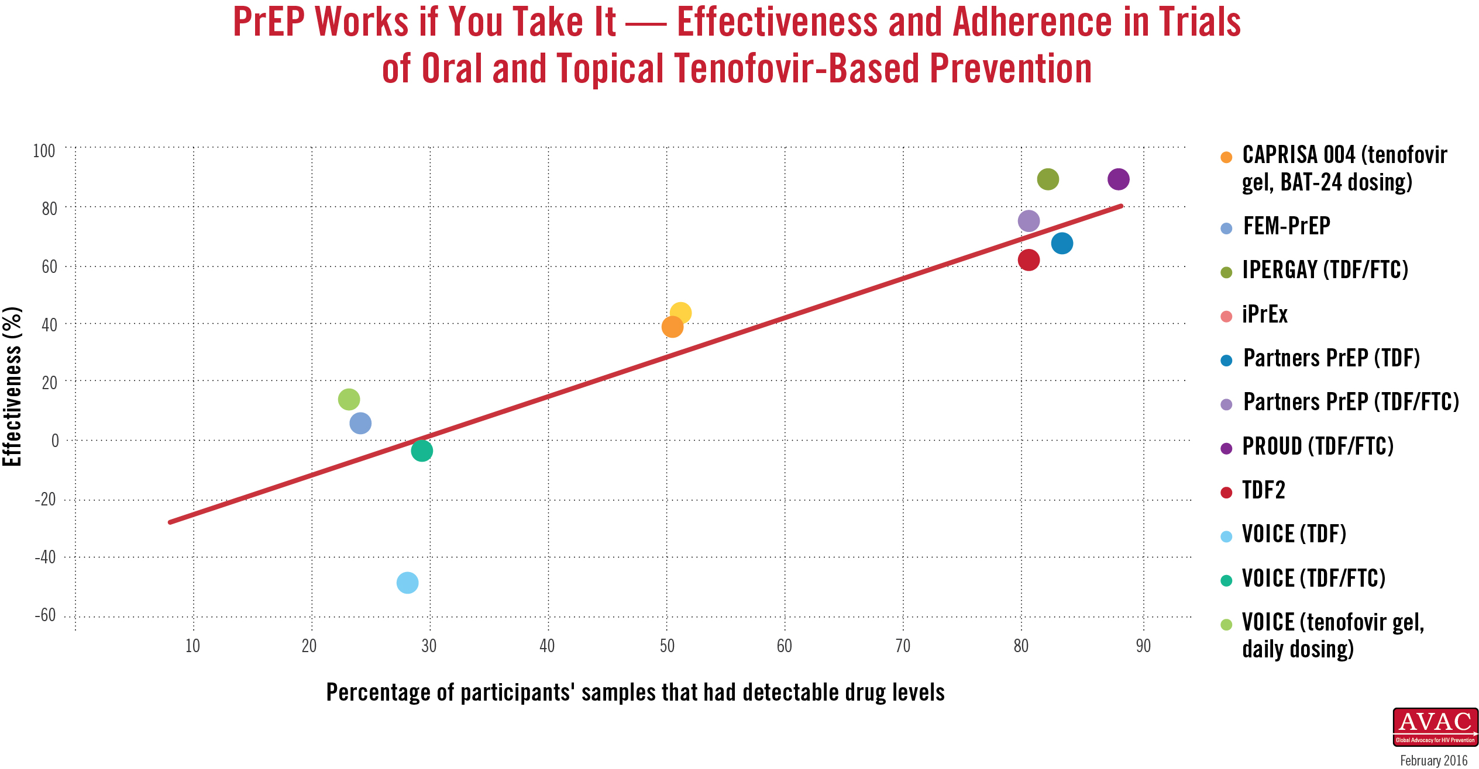
Oral PrEP Efficacy Depends on Adherence
The higher the percentage of participant samples with detectable oral PrEP drug levels, the greater the efficacy.

Slide 60
ARVs Recommended for Oral PrEP
The World Health Organization (WHO) recommends that the following ARVs be considered for daily oral PrEP:
Only TDF/FTC or TDF/3TC should be used for event-driven oral PrEP (ED-PrEP)
In [COUNTRY], [APPROVED DRUGS FOR ORAL PREP] are approved for use for PrEP. The drug primarily used for oral PrEP in [COUNTRY] is [DRUG PRIMARILY USED FOR ORAL PREP]
Combined tablet of emtricitabine (FTC) 200 mg/tenofovir disoproxil fumarate (TDF) 300 mg
2. Combined tablet of lamivudine (3TC) 300 mg/TDF 300 mg
3. Single-agent TDF 300 mg (Note the limited evidence on the use of TDF alone for PrEP for MSM.)
WHO. Consolidated Guidelines on the Use of Antiretroviral Drugs for Treating and Preventing HIV Infection. Recommendation for a Public Health Approach, 3rd edition. Geneva: World Health Organization; 2021.
Notes:
Facilitator: Fill in missing content in red

Slide 61
Poll Question
Which of the following is not a WHO-recommended regimens for oral PrEP?
Tenofovir/emtricitabine (TDF/FTC)
Tenofovir/lamivudine (TDF/3TC)
Tenofovir/emtricitabine + efavirenz (TDF/FTC) + (EFV)
Tenofovir (TDF)

Slide 62
Poll Question - Answer
Which of the following is not a WHO-recommended regimens for oral PrEP?
Tenofovir/emtricitabine (TDF/FTC)
Tenofovir/lamivudine (TDF/3TC)
Tenofovir/emtricitabine + efavirenz (TDF/FTC) + (EFV)
Tenofovir (TDF)
TDF/FTC, TDF/3TC, and TDF are recommended drugs by the WHO for oral PrEP. In [COUNTRY], [APPROVED DRUGS FOR ORAL PREP] are approved for use for PrEP. The drug primarily used for oral PrEP in [COUNTRY] is [DRUG PRIMARILY USED FOR ORAL PREP]
Notes:
Facilitator: Fill in missing information in red

Slide 63
Starting and Stopping Oral PrEP
Population (s) |  | Starting Oral PrEP | Stopping Oral PrEP
People assigned male at birth using PrEP to prevent HIV acquisition during sex who are not using estradiol-based exogenous hormones | *Often includes: -cisgender men -transgender women who are not using estradiol-based exogenous hormones -non-binary people assigned male at birth who are not using estradiol-based exogenous hormones | Take a double dose two to 24 hours before potential sexual exposure, regardless of whether the intention is to use daily PrEP or ED-PrEP. Ideally, this loading dose should be taken closer to 24 hours before potential exposure. | Take a single dose daily for two days after the last potential exposure, regardless of whether the individual is using daily or ED-PrEP.
People using oral PrEP to prevent HIV acquisition from nonsexual exposures People assigned female at birth People assigned male at birth who are using estradiol-based exogenous hormones | *Often includes: -anyone who shares injection related materials -cisgender women -transgender men -non-binary people assigned female at birth --transgender women who are using estradiol-based exogenous hormones -non-binary people assigned male at birth who are using estradiol-based exogenous hormones | Take a single dose daily for seven days before potential exposure. | Take a single dose daily for seven days after last potential exposure.
*This is provided to support interpretation of this guidance. Starting and stopping oral PrEP should be based on factors in the first column.

Slide 64
Section Divider #2

Slide 65
Oral PrEP Side Effects
Evidence from the iPrEx open-label extension (OLE) study and RCTs shows that approximately 10% of participants experienced side effects, which included:
Gastrointestinal (GI) side effects (nausea, flatulence, diarrhea, abdominal pain, and vomiting), headaches, and skin problems or itching
These are typically mild and do not persist for more than a month but can influence adherence so it is important that clients are counseled on these and their transient nature.
Creatinine elevation: typically reversible
Loss of bone mineral density: recovers after stopping oral PrEP

Slide 66
Oral PrEP Side Effects-Creatinine Clearance
Very few people who initiate TDF-based oral PrEP experience clinically significant renal impairment.
Increased risk of grade 1+ and grade 2+ events among oral PrEP users, but adverse events, particularly grade 2+ events, were rare, non-progressive, and resolved with PrEP discontinuation.
Pooling data from 15 countries found that less than 1% of people screened for PrEP initiation had an estimated creatinine clearance of <60ml/min and fewer than 3% experienced a clinically significant decline in estimate creatinine clearance of <60ml/min after initiation
>80% of individuals with a clinically significant creatinine clearance of <60ml/min and available data returned to normal creatinine levels at their next measurement
Schaefer, Robin and da Costa Leite, Pedro Amparo and Silva, Ronaldo and Karim, Quarraisha Abdool and Akolo, Christopher and Caceres, Carlos F. and Dourado, Inês and Green, Kimberly and Hettema, Anita and Hoornenborg, Elske and Jana, Smarajit and Kerschberger, Bernhard and Mahler, Hally and Matse, Sindy and McManus, Hamish and Molina, Jean-Michel and Reza-Paul, Sushena and Azwa, Iskandar and Shahmanesh, Maryam and Taylor, Doug and Vega-Ramírez, Hamid and Veloso, Valdiléa G. and Baggaley, Rachel and Dalal, Shona, Kidney Function in Oral Pre-Exposure Prophylaxis Users: A Systematic Literature Review and Individual Patient Data Meta-Analysis. Available at SSRN: https://ssrn.com/abstract=3899107 or http://dx.doi.org/10.2139/ssrn.3899107

Slide 67
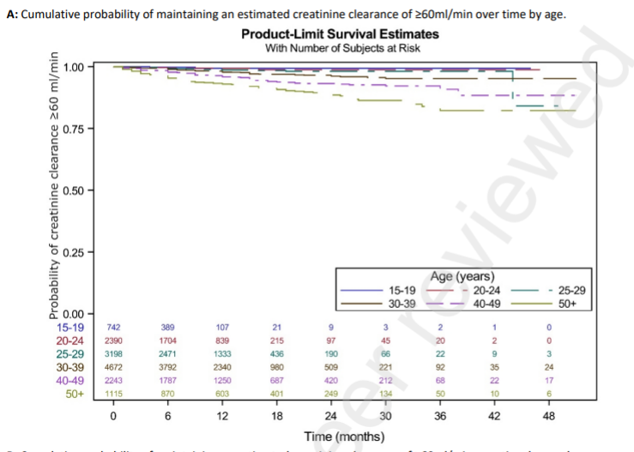
Oral PrEP Side Effects-Creatinine Clearance
Building on this evidence, we will discuss later who should be prioritized for creatinine clearance monitoring where it is available.
Schaefer, Robin and da Costa Leite, Pedro Amparo and Silva, Ronaldo and Karim, Quarraisha Abdool and Akolo, Christopher and Caceres, Carlos F. and Dourado, Inês and Green, Kimberly and Hettema, Anita and Hoornenborg, Elske and Jana, Smarajit and Kerschberger, Bernhard and Mahler, Hally and Matse, Sindy and McManus, Hamish and Molina, Jean-Michel and Reza-Paul, Sushena and Azwa, Iskandar and Shahmanesh, Maryam and Taylor, Doug and Vega-Ramírez, Hamid and Veloso, Valdiléa G. and Baggaley, Rachel and Dalal, Shona, Kidney Function in Oral Pre-Exposure Prophylaxis Users: A Systematic Literature Review and Individual Patient Data Meta-Analysis. Available at SSRN: https://ssrn.com/abstract=3899107 or http://dx.doi.org/10.2139/ssrn.3899107

Slide 68
Poll Question
Is the following statement true or false? ‘Clients who experience gastrointestinal side effects usually report that they last for many months.’
True
False

Slide 69
Poll Question - Answer
Is the following statement true or false? ‘Clients who experience gastrointestinal side effects usually report that they last for many months.’
True
False
If clients do experience gastrointestinal side effects, they are typically mild and do not persist for more than a month.

Slide 70
Will Oral PrEP Encourage People to Use Condoms Less Often or to Have More Sexual Partners (i.e., ‘Risk Compensation’)?
There was no evidence of this in clinical trials, where participants received regular counseling, screening, and access to condoms and lubricants.
Ideally, clients will be supported in using combination prevention and have ongoing access to free STI testing and treatment, condoms, and lubricants.
Having an STI or getting an STI should not prevent someone from starting PrEP

Slide 71
Will Oral PrEP Lead to More HIV Drug Resistance?
HIV drug resistance (HIVDR) in oral PrEP users was rare in both clinical trials and real-world implementation.
HIVDR occurred mostly in cases where the person had undiagnosed HIV when starting oral PrEP.
In Module 2 we will speak about how to assess for PEP indication and signs and symptoms of acute HIV infection (AHI) to minimize the possibility of HIVDR
HIVDR will not occur when adherence to oral PrEP is high and HIV seroconversion does not occur.
In Module 3 we will speak about how to support client adherence to minimize the possibility of HIVDR
Providers must support and monitor adherence and teach oral PrEP users to recognize signs and symptoms of AHI
Notes:
Updated WHO Guidance on Laboratory Monitoring for PrEP and the GEMS Project’s HIV Drug Resistance Monitoring Webinar: https://www.prepwatch.org/in-practice/virtual-learning-network/#:~:text=Updated%20WHO%20Guidance%20on%20Laboratory%20Monitoring%20for%20PrEP%20and%20the%20GEMS%20Project%E2%80%99s%20HIV%20Drug%20Resistance%20Monitoring

Slide 72
Does Oral PrEP Prevent Other STIs?
Oral PrEP only prevents HIV and does not prevent syphilis, gonorrhea, chlamydia, human papilloma virus (HPV) or other STIs.
While contraceptive methods prevent pregnancy, only condoms prevent other STIs and pregnancy.
Combination prevention includes quality counseling and access to condoms and lubricants.

Slide 73
Poll Question
Is the following statement true or false? ‘Oral PrEP prevents a variety of STIs.’
True
False

Slide 74
Poll Question - Answer
Is the following statement true or false? ‘Oral PrEP prevents a variety of STIs.’
True
False
Oral PrEP only prevents HIV. It does not prevent other STIs.

Slide 75
Oral PrEP Use with Alcohol and Other Recreational Drugs
There is no known evidence that using drugs or other substances affects the safety or effectiveness of oral PrEP.
However, alcohol and other recreational drugs could make the user forget to take oral PrEP.
Providers should ask clients about their alcohol and other recreational drug use, discuss if the client feels it might affect their ability to use oral PrEP effectively, and develop an individualized plan to support adherence.
Clients with a history of substance abuse should be referred for appropriate support services.

Slide 76
Oral PrEP Use During Pregnancy or Breastfeeding
Existing safety data support the use of oral PrEP in people who are pregnant or breastfeeding who have substantial likelihood of HIV acquisition.
WHO guidelines state that there is no safety-related rationale for disallowing or discontinuing oral PrEP use during pregnancy and breastfeeding
Oral PrEP does not prevent pregnancy.
Source: World Health Organization, Preventing HIV during Pregnancy and Breastfeeding in the Context of PrEP. Technical Brief. Geneva: WHO; 2016. Licence: CC BY-NC-SA 3.0 IGO. http://apps.who.int/iris/bitstream/handle/10665/255866/WHO-HIV-2017.09-eng.pdf;jsessionid=83E136DD1FF52102C689748845E57A07?sequence=1.
Notes:
Several systematic reviews have evaluated TDF safety in pregnant women with chronic hepatitis B and TDF safety in pregnant women living with HIV.
The Partners Demonstration Project evaluated outcomes from 30 participants who elected to continue oral PrEP throughout pregnancy and found no greater frequency of adverse pregnancy outcomes or restricted infant growth when compared to participants who elected to discontinue oral PrEP during pregnancy. The findings support use of oral PrEP during pregnancy.
WHO considers oral PrEP a valuable component of a combination prevention package for people who are HIV negative and pregnant or breastfeeding, along with screening for acute infection, adherence counseling, safety monitoring and HIV retesting every 3 months, in addition to other HIV prevention options, including condoms.

Slide 77
Poll Question
Is the following statement true or false? ‘Oral PrEP is safe to use during pregnancy and breastfeeding.’
True
False

Slide 78
Poll Question - Answer
Is the following statement true or false? ‘Oral PrEP is safe to use during pregnancy and breastfeeding.’
True
False
Oral PrEP can be safely used during pregnancy and breastfeeding. Existing safety data support the use of oral PrEP in people who are pregnant or breastfeeding who have substantial likelihood of HIV acquisition and WHO guidelines state that there is no safety-related rationale for disallowing or discontinuing oral PrEP use during pregnancy and breastfeeding.

Slide 79
Oral PrEP Use with Other Medications
TDF, FTC and 3TC do not have interactions with most commonly used medicines and can be safely taken at the same time as antidepressants, antibiotics, tuberculosis or malaria medicines.
However, TDF is closely related to adefovir, a medicine used to treat hepatitis B virus infections; therefore, TDF and adefovir should not be used together.
Detailed drug–drug interactions can be investigated by using the database maintained by the University of Liverpool at http://www.hiv-druginteractions.org/checker##table-view-wrap or the database provided by the University of California, San Francisco at http://hivinsite.ucsf.edu/interactions.
Pharmacists Module from WHO Oral PrEP Implementation Tool

Slide 80
Oral PrEP Use with Hormonal Contraceptives
Oral PrEP does not affect the efficacy of hormonal contraceptives nor do hormonal contraceptives affect the efficacy of oral PrEP.
Taking oral PrEP and hormonal contraceptives together does not make either less effective.
Notes:
For more information:
https://www.who.int/news/item/29-08-2019-who-revises-recommendations-on-hormonal-contraceptive-use-for-women-at-high-hiv-risk
http://echo-consortium.com/

Slide 81
Oral PrEP Use with Gender Affirming Hormone Therapy
Oral PrEP drugs do not raise or lower levels of gender-affirming hormones.
Hormones taken by transgender women appear to slightly lower levels of the PrEP drug tenofovir, but not enough to affect the efficacy of daily PrEP.
Hormones taken by transgender men do not appear to raise or lower levels of PrEP.
ED-PrEP is not recommended for anyone assigned female at birth. It is also not recommended for people assigned male at birth who are using estradiol-based exogenous hormones.
https://www.aidsmap.com/about-hiv/interactions-between-prep-and-gender-affirming-hormone-therapy

Slide 82
Poll Question
Oral PrEP is safe to use with:
Hormonal contraception but not alcohol and other recreational drugs, gender affirming hormones, or antibiotics
Alcohol and other recreational drugs but not hormonal contraception, gender affirming hormones, or antibiotics
Alcohol and other recreational drugs, hormonal contraception, gender affirming hormones, and antibiotics
Antibiotics but alcohol and other recreational drugs, hormonal contraception, or gender affirming hormones

Slide 83
Poll Question - Answer
Oral PrEP is safe to use with:
Hormonal contraception but not alcohol and other recreational drugs, gender affirming hormones, or antibiotics
Alcohol and other recreational drugs but not hormonal contraception, gender affirming hormones, or antibiotics
Alcohol and other recreational drugs, hormonal contraception, gender affirming hormones, and antibiotics
Antibiotics but alcohol and other recreational drugs, hormonal contraception, or gender affirming hormones
Oral PrEP can be safely used with hormonal contraception, alcohol and other recreational drugs, antibiotics, and gender affirming hormones.

Slide 84
Module 1 Summary
Having completed Module 1, participants can now:
Define oral PrEP and describe the need for oral PrEP
Differentiate oral PrEP from post-exposure prophylaxis (PEP) and antiretroviral therapy (ART)
Identify people with substantial likelihood for HIV acquisition
Identify key populations (KPs) for oral PrEP at the local level
Explain the relationship between oral PrEP effectiveness and adherence
State the key reasons oral PrEP is needed
Specify the oral PrEP regimens approved by the World Health Organization (WHO)
Identify concerns regarding oral PrEP implementation.
Explain the risks and benefits of oral PrEP.
Notes:
Facilitator: Fill in missing information in red

Slide 85
Module 2
1
Oral PrEP Basics
2
Oral PrEP Screening
3
Oral PrEP Initial and Follow-Up Visits
4
Monitoring and Managing Oral PrEP Use: Creatinine, Seroconversion, and Stigma
5
Event-Driven PrEP (ED-PrEP)
6
Oral PrEP Monitoring and Evaluation Tools
7
Evaluation and Resources

Slide 86
Module 2 Learning Objectives
After completing Module 2, participants will be able to:
Name the main criteria for oral PrEP use
Explain how to assess for PEP indication and potential AHI
Identify clients who may benefit from PrEP use due to substantial likelihood for HIV acquisition
Name the contraindications for oral PrEP
Develop questions to encourage conversation about a client’s potential exposures to HIV
Use the standard form to screen clients for oral PrEP use criteria

Slide 87
Building Rapport with the Client is Key!
Introduce yourself
Ask the client what they prefer to be called
Be sensitive, inclusive, nonjudgmental, and supportive
Frame questions in terms of people’s behavior rather than their identities
Start with open-ended questions and requests and get more specific if you need to
Instead of starting with “In the last six months, have you had vaginal or anal sex without a condom?” start with “Tell me about your sex life.”
If the client brings up a life issue outside of HIV, be prepared with some referrals to local services

Slide 88
What questions can you ask a client to build rapport?

Slide 89
Additional Factors You May Ask About
Other aspects of a person’s situation may increase their likelihood for HIV acquisition. To better understand the client’s context and what could inform their desire or need for oral PrEP, consider the following prompts after rapport has been established:
Have you…
Received money, housing, food, or gifts in exchange for sex?
Been forced to have sex against your will?
Been physically assaulted by anyone, including a sex partner?
Used recreational or psychoactive drugs?
Been required to leave your home?
Moved to a new place?
Lost your job?
If you ask about these components, you should be prepared to provide support and referrals, as necessary.

Slide 90
Discuss
What are the criteria for oral PrEP use?

Slide 91
Criteria for Oral PrEP Use
Clients must be:
HIV negative
Not indicated for PEP or suspected of having AHI
At substantial likelihood for HIV acquisition
Free from contraindications for oral PrEP

Slide 92
Criteria for Oral PrEP Use
Clients must be:
HIV negative
Not indicated for PEP or suspected of having AHI
At substantial likelihood for HIV acquisition
Free from contraindications for oral PrEP

Slide 93
HIV Testing and Counseling
HIV testing must be done using national guidelines and algorithms. Ideally, using rapid HIV tests at point of care
Sometimes HIV testing and counseling happens before or after a client is otherwise screened for and referred for oral PrEP- this is fine as long as the client is confirmed HIV negative before starting oral PrEP
HIV testing on the same day of PrEP initiation is recommended and reduces time clients spend in the clinic
In situations where clients are tested elsewhere and then referred for PrEP initiation, providers can use their best clinical judgement in accepting that result instead of retesting

Slide 94
National HIV Testing Algorithm
Notes:
Facilitator: Insert national testing algorithm

Slide 95
HIV Testing and Counseling
If the test result is reactive, do not initiate oral PrEP and immediately initiate the person on/refer for ART.
If the test result is inconclusive, defer oral PrEP initiation and follow the national algorithm until a definitive HIV test result

Slide 96
Poll Question
Is the following statement true or false? 'HIV testing and counseling must always happen on the same day that a client starts oral PrEP.'
True
False

Slide 97
Poll Answer
Is the following statement true or false? 'HIV testing and counseling must always happen on the same day that a client starts oral PrEP.'
True
False
Same-day testing is recommended but not required.

Slide 98
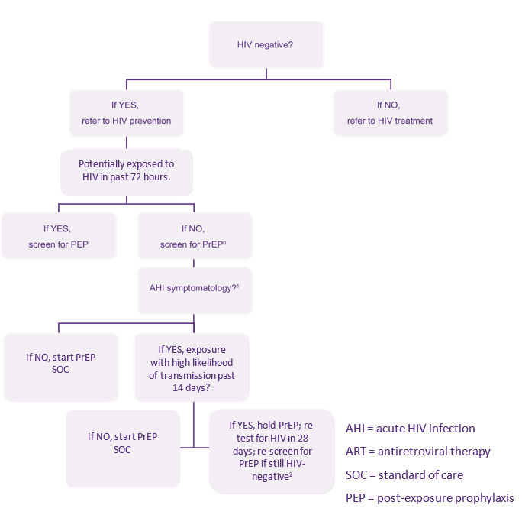
Criteria for Oral PrEP Use
Algorithm to assess for AHI, PEP indication, and oral PrEP potential
Clients must be:
HIV negative
Not indicated for PEP or suspected of having AHI
At substantial likelihood for HIV acquisition
Free from contraindications for oral PrEP
The figure on the right illustrates the process through which clients may be identified as potential candidates for PrEP initiation after HIV testing and before further screening is conducted.
Notes:
⁰ An answer of “NO” to question “Potentially exposed to HIV in past 72 hours?” means no potential past exposure to HIV at all or potential HIV exposure that was 73+ hours ago.
¹Signs/symptoms mimicking acute HIV infection (sore throat, fever, sweats, swollen glands, mouth ulcers, headache, rash, muscle aches) are commonly due to illnesses other than HIV; providers need to use discretion in determining whether the symptomatology is consistent with HIV or may be explained by an alternative cause.
²If HIV testing which can reliably detect HIV given these clients’ potential exposures and timeframes is available, PrEP may be started earlier than 28 days, if results are non-reactive. Clinician may consider fully suppressive ART during 28-day interim if waiting 28 days to retest for HIV.
Developed by Jhpiego in collaboration with Jared Baeten (University of Washington) and Rachel Baggaley (WHO).

Slide 99
Algorithm to Assess for PEP Indication, AHI, and Oral PrEP Potential
⁰ An answer of “NO” to question “Potentially exposed to HIV in past 72 hours?” means no potential past exposure to HIV at all or potential HIV exposure that was 73+ hours ago.
¹ Signs/symptoms mimicking acute HIV infection (sore throat, fever, sweats, swollen glands, mouth ulcers, headache, rash, muscle aches) are commonly due to illnesses other than HIV; providers need to use discretion in determining whether the symptomatology is consistent with HIV or may be explained by an alternative cause.
² If HIV testing which can reliably detect HIV given these clients’ potential exposures and timeframes is available, PrEP may be started earlier than 28 days, if results are non-reactive. Clinician may consider fully suppressive ART during 28-day interim if waiting 28 days to retest for HIV.
Algorithm developed by Jhpiego in collaboration with Jared Baeten (University of Washington) and Rachel Baggaley (WHO) and adapted

Slide 100
Assess for PEP Indication
Providers should assess whether a client had an exposure to HIV in the past 72 hours.
If a client reports an exposure to HIV in the past 72 hours, the client should be screened for eligibility for PEP instead of oral PrEP and provided PEP/linked to PEP services.
After 28 days of PEP, the client may be directly transitioned from PEP to oral PrEP without a gap, if still HIV-negative and if the client otherwise meets the criteria for oral PrEP use

Slide 101
Discuss
What is AHI? What are the signs and symptoms? How is it related to PEP?

Slide 102
Assess for AHI
AHI is the early phase of HIV disease characterized by an initial burst of viremia.
AHI develops within two to four weeks of someone acquiring HIV.
Approximately 40–90% of AHI clients experience ‘flu-like’ symptoms.
These symptoms are not specific to HIV but occur in many other viral infections.
Clients with AHI can be asymptomatic.
During AHI, antibodies might be absent or be below the level of detection.
HIV testing using rapid tests might be negative.

Slide 103
Assess for AHI
AHI can be diagnosed using ‘direct’ viral tests such as HIV RNA or HIV antigen testing.
In the absence of HIV RNA and antigen testing, if the client has symptoms of AHI AND has been exposed to HIV in the 14 days prior to the test, defer oral PrEP for four weeks, and repeat the HIV serological test after four weeks to reassess HIV status. In this case, the client is suspected to have AHI.
Never start a client on oral PrEP if AHI is suspected.

Slide 104
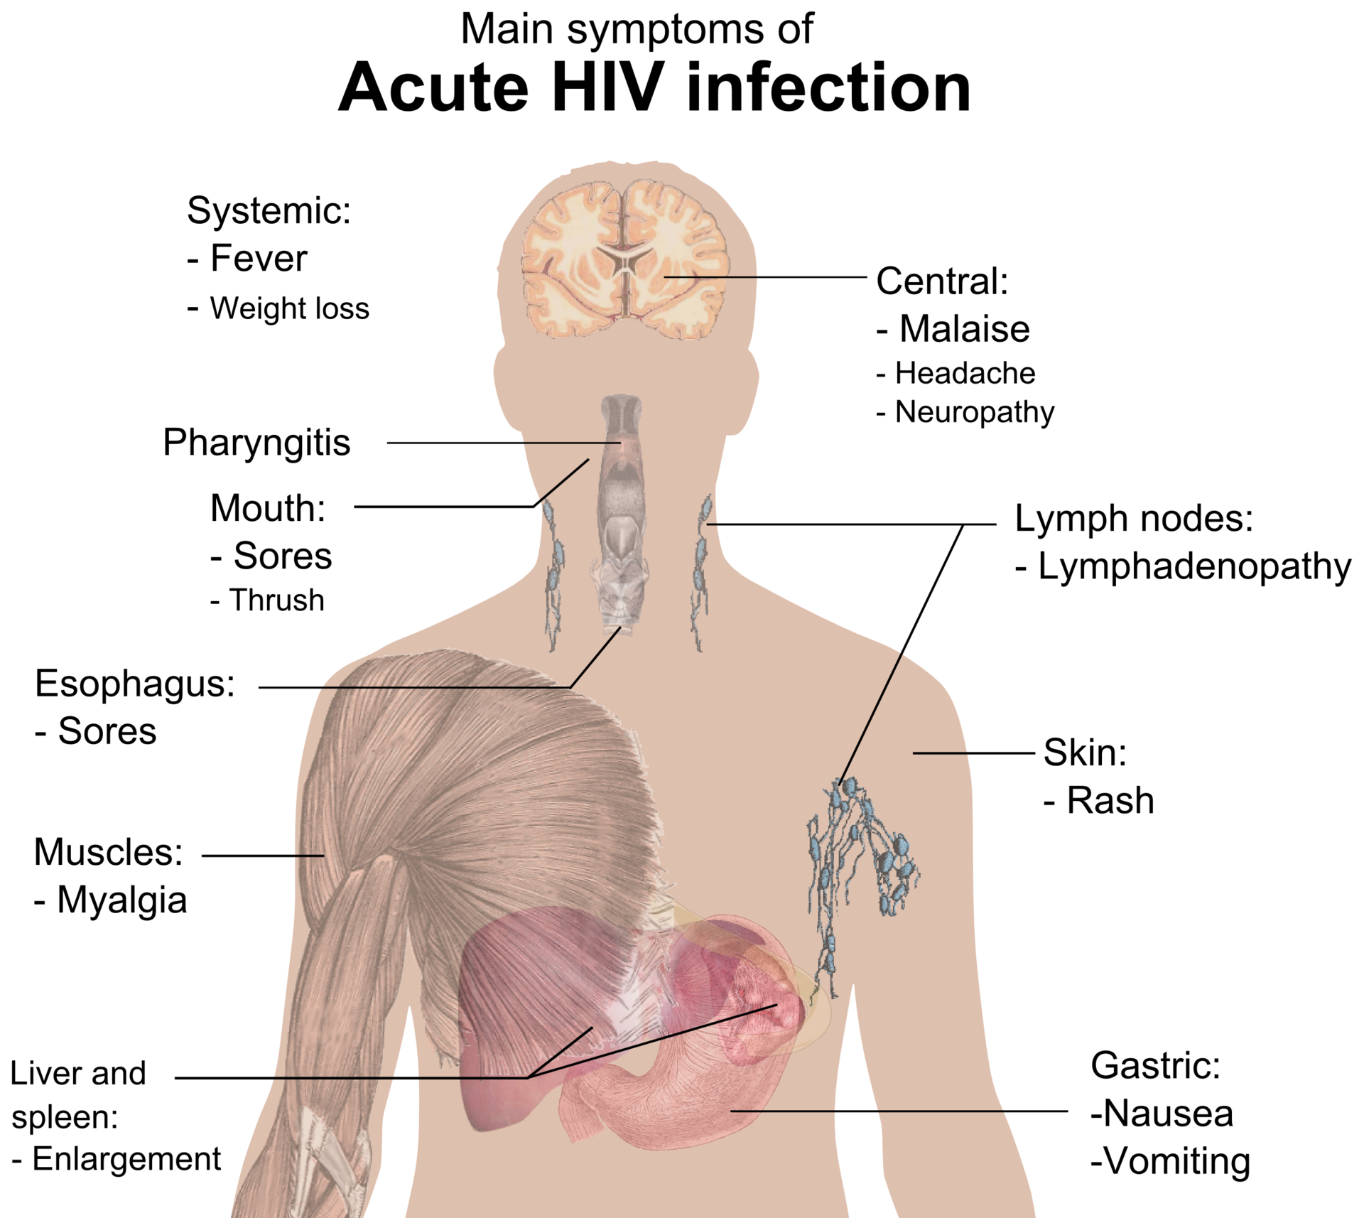
Main Symptoms of Acute HIV Infection
Source: Medical Gallery of Mikael Häggström, 2014.

Slide 105
Assess for AHI
Assessing for AHI reduces the likelihood of a client with undiagnosed HIV from starting an antiretroviral treatment that would not be fully suppressive
Starting a client with HIV on the drugs used for oral PrEP could result in HIVDR

Slide 106
Discuss
Why must providers assess for AHI before prescribing oral PrEP?

Slide 107
Criteria for Oral PrEP Use
Clients must be:
HIV negative
Not indicated for PEP or suspected of having AHI
At substantial likelihood for HIV acquisition
Free from contraindications for oral PrEP

Slide 108
Discuss
What behaviors or medical history might indicate that a client has a substantial likelihood for HIV acquisition?

Slide 109
Who is at Substantial Likelihood of HIV Acquisition?
Clients who are:
Requesting oral PrEP
Behaviorally indicated

Slide 110
Clients Requesting Oral PrEP
Requesting PrEP has been shown to be an indicator of substantial exposure to HIV.
Clients who request PrEP should be counseled on and offered PrEP if they meet the other criteria to begin PrEP use.

Slide 111
Clients Behaviorally Indicated
Clients who report any of the following in the past six months should be counseled on and offered oral PrEP if they meet the other criteria for oral PrEP initiation:
Vaginal or anal sex without condoms with:
more than one partner
a partner with substantial likelihood of HIV acquisition*
a partner living with HIV who has not been on effective** HIV treatment
Having an STI (based on lab test, syndromic STI treatment, or self report).
Using PEP
Sharing of injection material and/or equipment
*Exploring potential HIV exposures of client’s partners may be particularly important for adolescent girls and young women, partners of key populations, and people who are pregnant or breastfeeding.
**On ART for less than 6 months or has inconsistent or unknown adherence

Slide 112
Risk Assessments
Risk assessment questions to identify behavioral indication can aid in identifying clients who may benefit from PrEP use should not be used to ration PrEP or as the only criteria for determining whether someone can take PrEP.
Risk assessments are considered tools and should not be required. If someone asks for PrEP then they should be given PrEP, regardless of whether a risk assessment is completed or what the result of the risk assessment was.

Slide 113
Discuss
What questions can you ask a client to assess their potential exposures to HIV?
Keep in mind that you must ask about clients’ sexual/drug use behaviors, their partners’ sexual/drug use behaviors, aspects of being part of a serodifferent couple, and other aspects of their situation—for example, their current life circumstances.

Slide 114
Group Discussion-Debrief
What were some of the questions you produced?
Did the questions meet the criteria we discussed before the activity about how to build rapport with clients?

Slide 115
Assessing Client’s Potential Exposures to HIV
While providers want the answers to questions similar to the ones on the right, clients may be reluctant to share this information without feeling safe with their provider
Answers to some of these questions may also come up in standard HIV testing and counseling
During the past six months:
Have you had vaginal or anal sex without condoms?
If yes: Have you had vaginal or anal sex without a condom with more than one partner?
If yes: Have you had vaginal or anal sex without a condom with a partner who may be exposed to HIV? Have you had vaginal or anal sex without a condom with a partner living with HIV and who you don’t know to be on effective HIV treatment?
Have you been diagnosed with an STI or had symptoms of an STI?
Have you used PEP?
Have you injected drugs or hormones using shared injection material or equipment?
*On ART for less than 6 months or has inconsistent or unknown adherence

Slide 116
Oral PrEP for Serodifferent Couples
If clients do not have HIV and know they have a partner living with HIV- oral PrEP can be used to prevent HIV acquisition if the partner living with HIV is not known to have a durably* suppressed viral load.
Oral PrEP should be considered if:
The client without HIV is not sure of their partner’s adherence to treatment or if the client has other sexual partners besides the partner on treatment
The client without HIV is aware of gaps in their partner’s treatment adherence
The couple is not communicating openly about treatment adherence and viral load test results.
*Durable viral load suppression is when a person living with HIV has had a suppressed viral load for 6 months or more.

Slide 117
Questions to Help Identify Serodifferent Couples Who May Benefit from Oral PrEP Use
Is your partner taking ART for HIV treatment?
Has your partner been on sustained ART for more than 6 months?
Do you regularly discuss your partner’s adherence to HIV treatment
Do you know your partner’s last viral load? What was the result? And when was the testing done?
Do you wish to have a child with your partner?
Are you and your partner consistently using condoms?

Slide 118
Poll Question
Oral PrEP should not be offered as part of a comprehensive HIV prevention package for:
Men who have sex with men
Individuals with potential HIV exposure in the past 72 hours
People who inject drugs
HIV negative individuals in serodifferent relationships where the partner living with HIV is not on effective ART

Slide 119
Poll Question - Answer
Oral PrEP should not be offered as part of a comprehensive HIV prevention package for:
Men who have sex with men
Individuals with potential HIV exposure in the past 72 hours
People who inject drugs
HIV negative individuals in serodifferent relationships where the partner living with HIV is not on effective ART
Men who have sex with men, people who inject drugs, and HIV negative individuals in serodifferent relationships where the partner living with HIV is not on effective ART are all potential candidates for oral PrEP use if they have potential exposures. People with exposure in the past 72 hours should not be referred to PrEP and should be referred to PEP instead.

Slide 120
Criteria for Oral PrEP Use
Clients must be:
HIV negative
Not indicated for PEP or suspected of having AHI
At substantial likelihood for HIV acquisition
Free from contraindications for oral PrEP
Notes:
⁰ An answer of “No” to the question “Exposed to HIV past 72 hours?” means no known past exposure to HIV at all or known HIV exposure that was 73+ hours ago.
¹ Signs/symptoms mimicking acute HIV infection (sore throat, fever, sweats, swollen glands, mouth ulcers, headache, rash, muscle aches) are commonly due to illnesses other than HIV; providers need to use discretion in determining whether the symptomatology is consistent with HIV or whether an alternative cause may explain them.
² PrEP standard of care: clinical eligibility screening and risk assessment per WHO/national guidelines, e.g., creatinine clearance, medical history, hepatitis screening
³ If HIV nucleic acid amplification testing (NAAT) is available, PrEP may be started earlier than 28 days if the client is NAAT negative; the clinician may consider fully suppressive ART in the 28-day interim if the client must wait 28 days to re-test for HIV.

Slide 121
Assess for Contraindications for Oral PrEP Use
Oral PrEP should NOT be provided to people with:
HIV-positive test result using the national HIV testing algorithm
Known exposure to HIV in the past 72 hours (offer PEP)
Symptoms of AHI AND potential exposure within the past 14 days (defer 28 days weeks and retest)
Drug allergy to any component of the drugs being used for oral PrEP
Inability to commit to adhere to oral PrEP and to attend scheduled oral PrEP clinical visits
Creatinine clearance less than 60 mL/min (if known)
Already discussed
Quite uncommon
Discussed during counseling

Slide 122
Creatinine clearance less than 60 mL/min
Since TDF can be associated with a small decrease in estimated creatinine clearance early during oral PrEP use, oral PrEP is not indicated if creatinine clearance is < 60ml/min when it is known.
Screening for creatinine clearance is not required at initiation so this contraindication would only apply to clients who have a known creatinine clearance < 60ml/min.

Slide 123
Criteria for Oral PrEP Use Summary
Clients must be:
HIV negative
Not indicated for PEP or suspected of having AHI
At substantial likelihood of HIV acquisition
Free from contraindications for oral PrEP
Notes:
⁰ An answer of “No” to the question “Exposed to HIV past 72 hours?” means no known past exposure to HIV at all or known HIV exposure that was 73+ hours ago.
¹ Signs/symptoms mimicking acute HIV infection (sore throat, fever, sweats, swollen glands, mouth ulcers, headache, rash, muscle aches) are commonly due to illnesses other than HIV; providers need to use discretion in determining whether the symptomatology is consistent with HIV or whether an alternative cause may explain them.
² PrEP standard of care: clinical eligibility screening and risk assessment per WHO/national guidelines, e.g., creatinine clearance, medical history, hepatitis screening
³ If HIV nucleic acid amplification testing (NAAT) is available, PrEP may be started earlier than 28 days if the client is NAAT negative; the clinician may consider fully suppressive ART in the 28-day interim if the client must wait 28 days to re-test for HIV.

Slide 124
Poll Question
Which of the following is a contraindication for oral PrEP use?
Creatinine levels over 60mL/min (if known)
Known exposure to HIV in the past 72 hours
Hepatitis B infection
Being pregnant or breastfeeding

Slide 125
Poll Question - Answer
Which of the following is a contraindication for oral PrEP use?
Creatinine levels over 60mL/min (if known)
Known exposure to HIV in the past 72 hours
Hepatitis B infection
Being pregnant or breastfeeding
Known exposure to HIV in the past 72 hours is a contraindication for oral PrEP use and client should be counseled on PEP if available. A, C, and D are not contraindications for oral PrEP use.

Slide 126
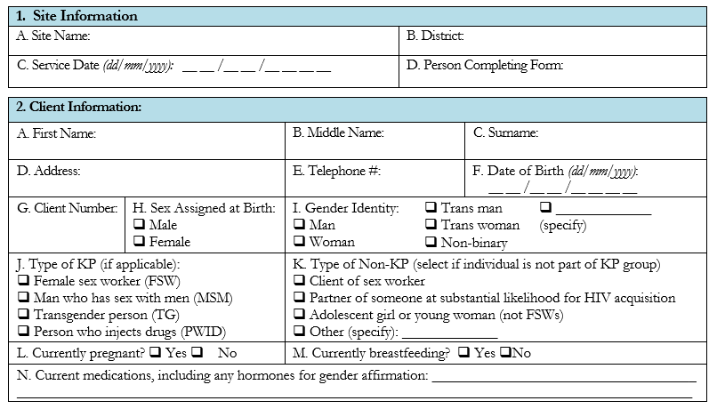
Screening for Initiation of Oral PrEP
Using a standard form can ensure that screening is consistent and well documented.
This form is for completion AFTER HIV testing
Notes:
Facilitator: Ideally, this form will be used for training and for M&E. If this form will not be used, you can still use this for training purposes or revise the training to include forms that will be used in your setting. The form can be downloaded from slide 7.

Slide 127
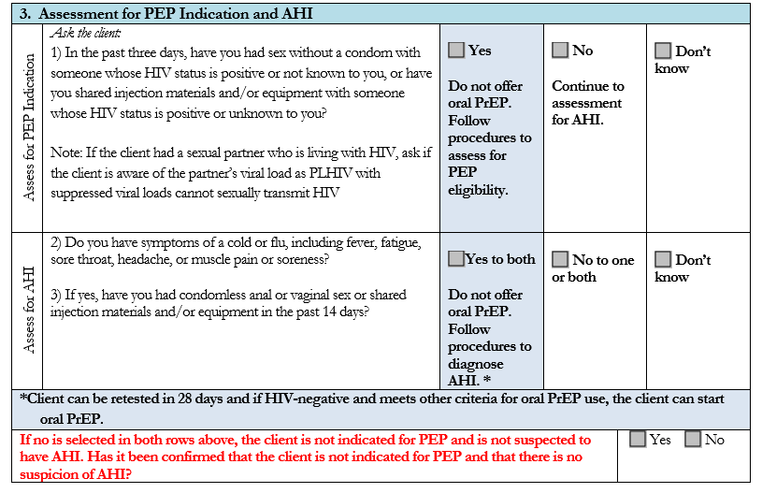
Screening for Initiation of Oral PrEP

Slide 128
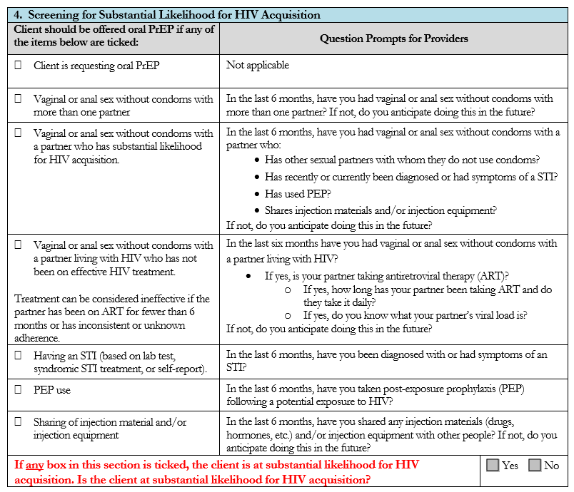
Screening for Initiation of Oral PrEP

Slide 129
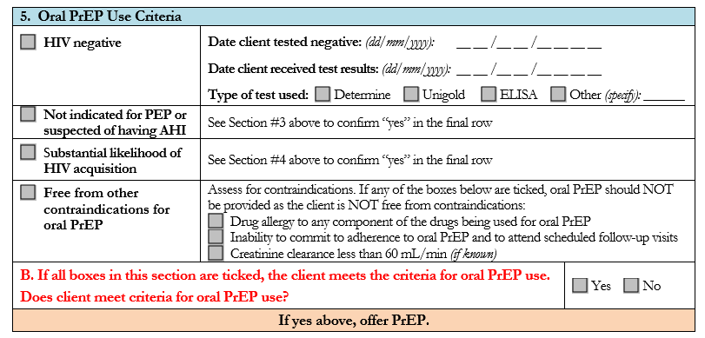
Screening for Initiation of Oral PrEP

Slide 130
Clinical Scenario 1
Joseph, a 22-year-old cisgender* man, presents at the clinic because he is interested in starting oral PrEP. He reports using condoms sometimes during sex with partner who is a cisgender man living with HIV. His partner has been on ART for four years. His most recent viral load from “a few months ago” was reported as 1200 copies/mL (not virally suppressed). Their last condomless sex was four weeks ago. Joseph is in good health and takes no medications. His rapid HIV antibody test today is negative.
Is Joseph a candidate for oral PrEP?
Why or why not?
Do you need more information?
*Cisgender is a term used to describe a person whose sense of personal identity and gender corresponds with their sex assigned at birth. E.g., Cisgender women were assigned female sex at birth and identify as women.
Notes:
Facilitator: Consider using names that are common in the training setting

Slide 131
Using the Screening Form
Let’s go through the screening form with the first scenario.
Joseph, a 22-year-old cisgender man, presents at the clinic because he is interested in starting oral PrEP. He reports using condoms sometimes during sex with partner who is a cisgender man living with HIV. His partner has been on ART for four years. His most recent viral load from “a few months ago” was reported as 1200 copies/mL (not virally suppressed). Their last condomless sex was four weeks ago. Joseph is in good health and takes no medications. His rapid HIV antibody test today is negative.
Notes:
Facilitator: Consider using names that are common in the training setting

Slide 132
Using the Screening Form
Joseph, a 22-year-old cisgender man, presents at the clinic because he is interested in starting oral PrEP. He reports using condoms sometimes during sex with partner who is a cisgender man living with HIV. His partner has been on ART for four years. His most recent viral load from “a few months ago” was reported as 1200 copies/mL (not virally suppressed). Their last condomless sex was four weeks ago. Joseph is in good health and takes no medications. His rapid HIV antibody test today is negative.
Notes:
Facilitator: Consider using names that are common in the training setting

Slide 133
Using the Screening Form
Joseph, a 22-year-old cisgender man, presents at the clinic because he is interested in starting oral PrEP. He reports using condoms sometimes during sex with partner who is a cisgender man living with HIV. His partner has been on ART for four years. His most recent viral load from “a few months ago” was reported as 1200 copies/mL (not virally suppressed). Their last condomless sex was four weeks ago. Joseph is in good health and takes no medications. His rapid HIV antibody test today is negative.
Notes:
Facilitator: Consider using names that are common in the training setting

Slide 134
Clinical Scenario 2
Marie, an 18-year-old cisgender* woman, comes to the clinic because she feels sick and thinks she might have HIV. She reluctantly explains that, during the past year, she has been having sex for money to support her two children. Some of her partners have used condoms, and others have not. She does not know whether her partners have HIV. Marie reports that she has been feeling rundown and sick for the past few weeks. Her rapid HIV antibody test today is negative.
Is Marie a candidate for oral PrEP?
Why or why not?
Do you need more information?
*Cisgender is a term used to describe a person whose sense of personal identity and gender corresponds with their sex assigned at birth. E.g., Cisgender women were assigned female sex at birth and identify as women.
Notes:
Facilitator: Consider using names that are common in the training setting

Slide 135
Clinical Scenario 3
Geraldine is a 30-year-old cisgender* woman. She presents at the clinic because she has heard she can get drugs that will prevent her from getting HIV. She suspects her husband has been injecting drugs, as he has needle marks on his arms. Geraldine is not able to talk openly about his drug use. She reports her husband has not been tested. Geraldine’s rapid HIV antibody test today is negative.
Is Geraldine a candidate for oral PrEP?
Why or why not?
Do you need more information?
*Cisgender is a term used to describe a person whose sense of personal identity and gender corresponds with their sex assigned at birth. E.g., Cisgender women were assigned female sex at birth and identify as women.
Notes:
Facilitator: Consider using names that are common in the training setting

Slide 136
Section Divider #3

Slide 137
In-person Role Play: Screening (40 minutes)
Now I will break you into pairs to role-play the scenarios.
If your group ends up with three people, two people can share the role of provider once to ensure everyone gets experience using the screening form
For the second scenario, select who will be the client and the provider. You will switch for the third scenario:
Client–will use the scenario to help them answer the questions, if asked something not in the scenario, it can be made up
Provider–will use the screening form to help them screen the client to start PrEP
Assume the client has already tested negative for HIV.
The provider should make sure to build some rapport with the client and ask them questions to determine if they meet the criteria for PrEP use
You will have 15 minutes to run through the second scenario, five minutes to discuss in your group after. Then switch roles in your group. You will have 15 minutes to run through third scenario and five minutes to discuss in your group after.
We will come together after running through both scenarios and debrief as a group.
Notes:
Facilitator: Delete this slide if you're conducting the training virtually

Slide 138
Virtual Role Play: Screening (40 minutes)
Now I will put you into pairs in breakout rooms to role-play the scenarios. I will copy and paste the scenarios and instructions in the chat.
If your group ends up with three people, two people can share the role of provider once to ensure everyone gets experience using the screening form
For the second scenario, select who will be the client and the provider. You will switch for the third scenario:
Client–will use the scenario to help them answer the questions, if asked something not in the scenario, it can be made up
Provider–will use the screening form to help them screen the client to start PrEP
Assume the client has already tested negative for HIV.
The provider should make sure to build some rapport with the client and ask them questions to determine if they meet the criteria for PrEP use
You will have 15 minutes to run through the second scenario, five minutes to discuss in your group after. Then switch roles in your group. You will have 15 minutes to run through third scenario and five minutes to discuss in your group after.
We will come together after running through both scenarios and debrief as a group.
Notes:
Facilitator: Delete this slide if you're conducting the training in-person

Slide 139
Text to copy into chat if conducting training virtually
If your group ends up with three people, two people can share the role of provider once to ensure everyone gets experience using the screening form
For the first scenario, select who will be the client and the provider. You will switch for the second scenario:
Client–will use the scenario to help them answer the questions, if asked something not in the scenario, it can be made up
Provider–will use the screening form to help them screen the client to start PrEP
Assume the client has already tested negative for HIV.
The provider should make sure to build some rapport with the client and ask them questions to determine if they meet the criteria for PrEP use
You will have 15 minutes to run through the first scenario, five minutes to discuss in your group after. Then switch roles in your group. You will have 15 minutes to run through second scenario and five minutes to discuss in your group after.
We will come together after running through both scenarios and debrief as a group.
Scenario 2: Marie, an 18-year-old cisgender* woman, comes to the clinic because she feels sick and thinks she might have HIV. She reluctantly explains that, during the past year, she has been having sex for money to support her two children. Some of her partners have used condoms, and others have not. She does not know whether her partners have HIV. Marie reports that she has been feeling rundown and sick for the past few weeks. Her rapid HIV antibody test today is negative.
Scenario 3: Geraldine is a 30-year-old cisgender* woman. She presents at the clinic because she has heard she can get drugs that will prevent her from getting HIV. She suspects her husband has been injecting drugs, as he has needle marks on his arms. Geraldine is not able to talk openly about his drug use. She reports her husband has not been tested. Geraldine’s rapid HIV antibody test today is negative.
Notes:
Facilitator: Consider using names that are common in the training setting

Slide 140
Role Play: Clinical Scenario 2
Marie, an 18-year-old cisgender* woman, comes to the clinic because she feels sick and thinks she might have HIV. She reluctantly explains that, during the past year, she has been having sex for money to support her two children. Some of her partners have used condoms, and others have not. She does not know whether her partners have HIV. Marie reports that she has been feeling rundown and sick for the past few weeks. Her rapid HIV antibody test today is negative.
*Cisgender is a term used to describe a person whose sense of personal identity and gender corresponds with their sex assigned at birth. E.g., Cisgender women were assigned female sex at birth and identify as women.
Notes:
Facilitator: Consider using names that are common in the training setting

Slide 141
Role Play: Clinical Scenario 3
Geraldine is a 30-year-old cisgender woman. She presents at the clinic because she has heard she can get drugs that will prevent her from getting HIV. She suspects her husband has been injecting drugs, as he has needle marks on his arms. Geraldine is not able to talk openly about his drug use. She reports her husband has not been tested. Geraldine’s rapid HIV antibody test today is negative.
*Cisgender is a term used to describe a person whose sense of personal identity and gender corresponds with their sex assigned at birth. E.g., Cisgender women were assigned female sex at birth and identify as women.
Notes:
Facilitator: Consider using names that are common in the training setting

Slide 142
Clinical Scenario 2 Role-Play Debrief (10 minutes)
Marie, an 18-year-old cisgender* woman, comes to the clinic because she feels sick and thinks she might have HIV. She reluctantly explains that, during the past year, she has been having sex for money to support her two children. Some of her partners have used condoms, and others have not. She does not know whether her partners have HIV. Marie reports that she has been feeling rundown and sick for the past few weeks. Her rapid HIV antibody test today is negative.
Based on the role-play, how would you complete Section 5 of the form?
What did you learn by doing this role-play?
What worked best? Why?
What was most challenging? Why?
How could you address the challenges? What strategies would you use?
Notes:
Facilitator: Consider using names that are common in the training setting

Slide 143
Clinical Scenario 3 Role-Play Debrief (10 minutes)
Geraldine is a 30-year-old cisgender woman. She presents at the clinic because she has heard she can get drugs that will prevent her from getting HIV. She suspects her husband has been injecting drugs, as he has needle marks on his arms. Geraldine is not able to talk openly about his drug use. She reports her husband has not been tested. Geraldine’s rapid HIV antibody test today is negative.
Based on the role-play, how would you complete Section 5 of the form?
What did you learn by doing this role-play?
What worked best? Why?
What was most challenging? Why?
How could you address the challenges? What strategies would you use?
Notes:
Facilitator: Consider using names that are common in the training setting

Slide 144
Module 2 Summary
Having completed Module 2, participants can now:
Name the main criteria for oral PrEP use
Explain how to assess for PEP indication and potential AHI
Identify clients who may benefit from PrEP use due to substantial likelihood for HIV acquisition
Name the contraindications for oral PrEP
Develop questions to encourage conversation about a client’s potential exposures to HIV
Use the standard form to screen clients for oral PrEP use criteria

Slide 145
Module 3
1
Oral PrEP Basics
2
Oral PrEP Screening
3
Oral PrEP Initial and Follow-Up Visits
4
Monitoring and Managing Oral PrEP Use: Creatinine, Seroconversion, and Stigma
5
Event-Driven PrEP (ED-PrEP)
6
Oral PrEP Monitoring and Evaluation Tools
7
Evaluation and Resources

Slide 146
Module 3 Learning Objectives
After completing Module 3, participants will be able to:
Specify the essential components for the initial oral PrEP visit
Deliver key counseling messages for the initial oral PrEP visit
Specify the essential components for follow-up oral PrEP visits
Deliver key counseling messages for follow-up oral PrEP visits
Explain how oral PrEP is prescribed and dispensed for both daily and ED PrEP

Slide 147
Initial Oral PrEP Visit Essential Components
HIV testing and counseling
Oral PrEP screening (as discussed in module 2)
Counseling
Prescription

Slide 148
Oral PrEP Counseling Principles
Oral PrEP counseling should be based on the following principles:
Client-driven or client centered, based on client needs, resources, and preferences; understanding social and cultural context is critically important to recognizing client needs.
Based on a foundation of respect and including an open and honest relationship between provider and client
Recognition that behavior change is not easy, and human beings are not perfect
Validation and normalization of client concerns, seeking to affirm and encourage client efforts, and not prescriptive or judgmental
Identification of small wins and achievable next steps in reducing exposure to HIV and/or making pill-taking easier
Inclusion of contingency planning when common barriers are encountered

Slide 149
Oral PrEP Counseling is Client Centered
The terms “client driven” or “client centered” refer to seeing clients as the expert on their own lives. The counselor serves as a guide to assist in setting and reaching goals.
Client-centered counseling emphasizes respecting an individual’s experiences and choices.
The approach can increase a client’s motivation to use oral PrEP correctly because it addresses clients’ perceptions about the consequences of nonadherence vs. adherence.
Client driven counseling helps clients identify the factors that influence their behaviors and develop strategies to reduce any barriers.
In health care settings, addressing barriers may mean acknowledging and redressing the imbalance in power between the providers of services and those seeking services.

Slide 150
Discuss (5 minutes)
What topics about oral PrEP do you think need to be discussed when counseling someone during an initial oral PrEP visit?
Notes:
Before the client starts oral PrEP, you should counsel the client (this is the last of the suggested procedures from the previous slide).
This initial counseling should focus on these areas.

Slide 151
Topics for Initial Oral PrEP Counseling
Sexual behaviors
Alcohol and drug use
Plan for preventing HIV and other STIs
Prevention needs and interest in and willingness to take oral PrEP
Mental health

Slide 152
Topics for Initial Oral PrEP Counseling
Experience of gender-based violence (GBV), including intimate partner violence (IPV).
Provide appropriate GBV and IPV response, including first-line support and referral where necessary, and support clients to identify ways to effectively use and continue oral PrEP. (Clients experiencing GBV, including IPV, should not be prohibited from receiving oral PrEP if they can effectively use it.)
Key messages on oral PrEP

Slide 153
Potential Prompts for Discussing Sexual Behavior at Initial Oral PrEP Visits
What has been going on for you sexually over the past couple of months?
How much of the time did you use condoms?
What has made it easier to use condoms during sex? What has made it more difficult?
What concerns do you have about your sexual activities?
What is your motivation for considering to take oral PrEP?
How might taking oral PrEP impact your sexual activity?
Adapted from: World Health Organization. WHO Implementation Tool for Pre-Exposure Prophylaxis (PrEP) of HIV Infection. Module 3: Counsellors. Geneva: WHO; 2017. License: CC BY-NC-SA 3.0 IGO.

Slide 154
Potential Prompts for Discussing Alcohol and Other Drug Use at Initial Oral PrEP Visits
Have you used alcohol or any other recreational drugs in the past six months?
If so, which ones (e.g., alcohol, opioids, stimulants, cannabis)?
And how did you use them (smoking, orally, injecting)?
When did you last use them (and which ones)?
How often do you typically use alcohol or other recreational drugs (once a year, once a month, once a week, once a day—or more frequently)?
Has your use of these ever been a problem for you? [Note: Referral to drug services may be appropriate if locally available.]
Do you think your drug use may increase your exposure to HIV?
How do you think your use may affect your ability to take oral PrEP effectively?
Adapted from: World Health Organization. WHO Implementation Tool for Pre-Exposure Prophylaxis (PrEP) of HIV Infection. Module 3: Counsellors. Geneva: WHO; 2017. License: CC BY-NC-SA 3.0 IGO.

Slide 155
Potential Prompts for Discussing the Client’s Plan for Preventing HIV and Other STIs at Initial Oral PrEP Visits
In what ways are you reducing your exposure to HIV and other STIs now?
What steps have you considered for the future?
You are reducing your likelihood for getting HIV by deciding to take oral PrEP. Let’s talk about how oral PrEP fits into your exposure reduction efforts.
What other ideas or plans, if any, do you have for staying HIV and STI negative?
Adapted from: World Health Organization. WHO Implementation Tool for Pre-Exposure Prophylaxis (PrEP) of HIV Infection. Module 3: Counsellors. Geneva: WHO; 2017. License: CC BY-NC-SA 3.0 IGO.

Slide 156
Key Counseling Messages About Oral PrEP
Topic | Key Messages
What is oral PrEP? | Oral PrEP is one of several HIV prevention options and, where possible, should be used in combination with condoms and other prevention methods. Oral PrEP does not protect against other STIs or prevent unintended pregnancy.
Oral PrEP works if taken as prescribed. | For oral PrEP to be effective, you must take oral PrEP as prescribed, which for most people is every day throughout their time of potential exposure and for some days before and after potential exposures.

Slide 157
Key Counseling Messages About Oral PrEP
Topic | Key Messages
Oral PrEP is not for life. | You should take oral PrEP for as long as you feel you may be exposed to HIV. Some people only need to take oral PrEP during certain times in their lives, while others have an ongoing need.
Starting and stopping oral PrEP | Regimen for all clients using oral PrEP to prevent HIV acquisition from non-sexual exposures, all clients AFAB and for clients AMAB who are using estradiol-based exogenous hormones Oral PrEP must be taken daily and should be used for at least seven consecutive days before it is considered effective. It must be continued for 7 days after the last potential exposure.

Slide 158
Poll Question
Is the following statement true or false? ‘Once started, oral PrEP is to be taken for life.’
True
False

Slide 159
Poll Question - Answer
Is the following statement true or false? ‘Once started, oral PrEP is to be taken for life.’
True
False
Oral PrEP use is often cyclical and rarely lifelong. A goal of oral PrEP counseling is to support clients in using oral PrEP effectively only during periods of potential exposure to HIV.

Slide 160
Key Counseling Messages About Oral PrEP
Topic | Key Messages
Starting and stopping oral PrEP | Daily PrEP regimen for clients AMAB using oral PrEP to prevent HIV acquisition from sexual exposures and who are not using estradiol-based exogenous hormones Start daily oral PrEP with a loading dose of two pills at PrEP initiation and delay sex for at least two hours, at which time drug levels will be sufficient to prevent HIV acquisition from sexual exposures. Continue taking one pill of PrEP at the same time daily. To discontinue, continue one pill of PrEP daily until two days after the last potential sexual exposure.

Slide 161
Key Counseling Messages About Oral PrEP
Topic | Key Messages
Starting and stopping oral PrEP | ED-PrEP regimen for clients AMAB using oral PrEP to prevent HIV acquisition from sexual exposures and who are not using estradiol-based exogenous hormones Start ED-PrEP with a loading dose of two pills taken two to 24 hours before having sex to ensure drug levels are maximally effective. Continue taking one pill daily at the same time as the loading dose until two days after the last potential sexual exposure. This process should be repeated for each period of potential exposure to HIV.

Slide 162
Discuss (5 minutes)
What are some common reasons for low adherence?
Think of reasons associated with the individual, the medication, and reasons related to the health system.

Slide 163
Some Reasons Clients May Struggle with Adherence
Not convinced oral PrEP is needed
Does not believe oral PrEP works or is working
Does not like taking pills
Has experienced side effects; wishes to avoid side effects
Has experienced stigma while taking oral PrEP
Does not believe it is necessary to take every day
Does not want to take with alcohol or other drugs
Wishes to avoid others witnessing pill taking
Has concerns about partner’s finding out about their oral PrEP use
Forgot to take pill
Forgot to refill prescription
Has competing priorities (e.g., employment, childcare)
Has difficulty with personal organization and scheduling
Affected by depression or other unaddressed mental illness
Cannot afford oral PrEP medication, laboratory tests, or other costs
Does not want to come to the health care facility (or cannot afford to do so)
Dissatisfied with health care provider interactions
No place to store medication
Unaddressed substance use issues, especially dependence on alcohol or other drugs
Insufficient food to take pills

Slide 164
Discuss (5 minutes)
What can providers do to promote and support adherence?

Slide 165
Lessons from ART Programs
How Health Providers Can Positively Influence Adherence
Facilitate accurate knowledge and understanding of medication benefits and requirements
Express confidence in the effectiveness of oral PrEP
Prepare for and manage side effects
Identify social support
Build self-efficacy for adherence
Support identification of a routinized daily schedule that includes regular pill taking
Maintain an open line of communication with oral PrEP clients
Work with client to explore all barriers and discuss potential solutions

Slide 166
Key Counseling Messages About Oral PrEP
Topic | Key Messages
Ways to support adherence | Daily oral PrEP can be taken any time of day, with or without food. If you forget a dose of daily oral PrEP, take it as soon as you remember. Some people find it easy to remember to take their oral PrEP when they integrate it into a daily routine and take it the same time each day. For example, you could take oral PrEP when you brush your teeth (either in the morning or evening), or when watching a favorite TV show or listening to a favorite radio program. It is helpful to pair taking oral PrEP with a routine that makes you feel good. Do you anticipate any challenges with taking PrEP as prescribed that maybe I can work with you to find solutions for? (Providers should explore and emphasize adherence and pill-taking reminders specific to everyone. This may be an appropriate time to explore gender and intimate partner violence.)

Slide 167
Key Counseling Messages About Oral PrEP
Topic | Key Messages
Ways to support adherence | ED-PrEP can be taken any time of day 2-24 hours before sex, with or without food. If you forget to dose properly before or after having sex without a condom, you should contact me as soon as possible within 72 hours. You may find it easy to remember to take your oral PrEP if you integrate a daily reminder into your schedule to take time to consider whether you may have sex and take the loading dose or take follow-up doses as needed. For example, you could consider whether you need to take oral PrEP when you brush your teeth (either in the morning or evening), or when watching a favorite TV show or listening to a favorite radio program. It is helpful to pair thinking about oral PrEP with a routine that makes you feel good. Do you anticipate any challenges with taking PrEP as prescribed that maybe I can work with you to find solutions for? (Providers should explore and emphasize adherence and pill-taking reminders specific to everyone. This may be an appropriate time to explore gender and intimate partner violence.)

Slide 168
Potential Prompts for Discussing Effective Use at Initial Oral PrEP Visits
Do you have any experience taking a medicine daily?
What is your experience taking a medicine daily?
Are you now taking any medication on a daily, long-term basis?
When you have taken medicines in the past, how did you remember to take them? What helps you remember to take your pills?
What is your plan for taking your PrEP pill daily? (adjust question for ED-PrEP users who will not take it daily)
What will you do if you are away from home for a night or more?
What will you do if you miss a dose of your oral PrEP?
What is your understanding of possible oral PrEP side effects? How will you cope with side effects if you have them?
Adapted from: World Health Organization. WHO Implementation Tool for Pre-Exposure Prophylaxis (PrEP) of HIV Infection. Module 3: Counsellors. Geneva: WHO; 2017. License: CC BY-NC-SA 3.0 IGO.

Slide 169
Poll Question
Counseling to support oral PrEP adherence should include:
A client-centered approach
Identification of barriers to taking oral PrEP
Identification of client-specific strategies to use oral PrEP effectively
Integration of condom use
All of the above

Slide 170
Poll Question – Answer
Counseling to support oral PrEP adherence should include:
A client-centered approach
Identification of barriers to taking oral PrEP
Identification of client-specific strategies to use oral PrEP effectively
Integration of condom use
All of the above
Counseling is important to encourage effective use of oral PrEP and the approach should be comprehensive. Counseling to support oral PrEP adherence should include a client-centered approach, identification of barriers to taking oral PrEP, identification of client specific strategies to use oral PrEP effectively, and integration of condom use.

Slide 171
Additional Strategies to Support Adherence
Use a pill box
Take (or consider taking, if using ED-PrEP) oral PrEP pills with other daily medicines or routines (teeth brushing, watching a TV show, listening to a radio show)
Use a phone alarm
Mark doses taken on a calendar
Have more support from a partner, a family member, or a friend.
Remembering motivations to take oral PrEP pills
Taking first pill(s) in while with provider

Slide 172
Poll Question
Counseling to support oral PrEP use and adherence may be provided by:
Pharmacists
Nurses
Lay counselors
Peer workers
All of the above

Slide 173
Poll Question – Answer
Counseling to support oral PrEP use and adherence may be provided by:
Pharmacists
Nurses
Lay counselors
Peer workers
All of the above
Counseling to support oral PrEP use and adherence may be provided by pharmacists, nurses, lay counselors, or peer workers.

Slide 174
Key Counseling Messages About Oral PrEP
Topic | Key Messages
Oral PrEP and alcohol or other recreational drugs | Taking oral PrEP while you are using alcohol or other recreational drugs will not hurt you. However, alcohol or other recreational drugs may cause you to forget to take your oral PrEP, so be sure to take it in advance of substance use.

Slide 175
Key Counseling Messages About Oral PrEP
Topic | Key Messages
Oral PrEP, pregnancy, and breastfeeding | Oral PrEP does not prevent pregnancy. To avoid unintended pregnancy, use a contraceptive method. Taking oral PrEP while you are pregnant or breastfeeding will not hurt you or your baby. Because HIV can be transmitted during pregnancy and breastfeeding, taking oral PrEP during this time prevents both you and your baby from acquiring HIV. You can use oral PrEP throughout pregnancy and breastfeeding. Note to providers: Assess fertility intentions and offer family planning, as appropriate. Offer oral PrEP to people who are pregnant or breastfeeding who have high likelihood of HIV acquisition as a priority after all the risks and benefits have been explained to the client.

Slide 176
Key Counseling Messages About Oral PrEP
Topic | Key Messages
Oral PrEP and other medications | Oral PrEP is safe and effective. It can be taken with hormonal contraceptives, gender-affirming hormones, and other medications.
No STI protection other than HIV | Oral PrEP does not prevent any other STIs. To prevent other STIs, use a condom correctly whenever you have sex. If you experience any of the following items, they could be signs that you may have an STI and you should see me or another provider as soon as possible and abstain from sexual contact if you can: bumps, warts, swilling, redness, rash or severe itching on or near your genitals, mouth, or anus discharge from the penis or discharge from the vagina that has a bad odor, causes irritation or is a different color/amount than usual or bleeding that is not your period

Slide 177
Poll Question
Counseling messaging on oral PrEP and pregnancy and breastfeeding should include:
Oral PrEP does not prevent pregnancy
Information about where contraception can be received
Oral PrEP can be safely used while pregnant or breastfeeding
All of the above

Slide 178
Poll Question - Answer
Counseling messaging on oral PrEP and pregnancy and breastfeeding should include:
Oral PrEP does not prevent pregnancy
Information about where contraception can be received
Oral PrEP can be safely used while pregnant or breastfeeding
All of the above
Taking oral PrEP while pregnant or breastfeeding will not hurt the client or their baby, but oral PrEP does not prevent pregnancy. Offer oral PrEP to people who are pregnant or breastfeeding who have high likelihood of HIV acquisition as a priority after all the risks and benefits have been explained to the client.

Slide 179
Key Counseling Messages About Oral PrEP
Topic | Key Messages
Side effects | More than 90 percent of people will not experience any side effects. Those who do will experience only mild side effects, including: Gastrointestinal symptoms (diarrhea and nausea, decreased appetite, abdominal cramping, and flatulence) Dizziness Headaches Most of those side effects disappear within one month. However, your health care provider can help you manage them.

Slide 180
Key Counseling Messages About Oral PrEP
Topic | Key Messages
Other ways to lower exposure to HIV | To lower your exposure to HIV: Use condoms and lubricant consistently Access PEP as early within 72 hours as possible if there is a potential exposure to HIV Engage in nonpenetrative sex, including mutual masturbation Receive screening, diagnosis, and treatment for other STIs If in a serodifferent partnership, ensure the partner living with HIV has been on effective ART for at least six months, has an undetectable viral load, and remains adherent to ART Receive voluntary medical male circumcision Reduce your number of sexual partners Access drug harm reduction and treatment services

Slide 181
Key Counseling Messages About Oral PrEP
Topic | Key Messages
Switching between HIV prevention options | It is okay to start oral PrEP and decide later that you want to use another option to prevent HIV infection, like condoms. Many people switch between methods as their needs change. I am here to help you make the best decision for you.

Slide 182
Poll Question
Is the following statement true or false? 'It is possible to switch between HIV prevention options.'
True
False

Slide 183
Poll Question - Answer
Is the following statement true or false? 'It is possible to switch between HIV prevention options.'
True
False
It is okay for a client to start oral PrEP and decide later that they want to use another option to prevent HIV infection, like condoms. Many people switch between methods as their needs change. The role of the provider is to help the client make the best decision for them.

Slide 184
Key Counseling Messages About Oral PrEP
Topic | Key Messages
Importance of follow-up visits | It is important that you attend follow-up visits for the following reasons: To verify your HIV status and, if positive, be referred for ART. Between now and your next visit if you experience sore throat, fever, sweats, swollen glands, mouth ulcers, rash, or muscle aches please contact me or come back here for a follow-up visit. To reduce your likelihood of drug resistance if you have acquired HIV To get support on adherence and managing side effects, and to address other concerns you may have Do you have any upcoming travel, or do you anticipate any other challenges with coming back for regular visits that we can discuss and maybe I can help you make a plan for?

Slide 185
Key Counseling Messages About Oral PrEP
Topic | Key Messages
Missed daily oral PrEP dose (ED-PrEP considerations are covered in Module 5) | If you forget to take a pill or miss a dose, take it as soon as you remember. For example, if you usually take oral PrEP in the morning but realize at 10 p.m. or the next day that you forgot, it is okay to take your pill then and resume your usual schedule the following morning. If you forget more than once a week, come back here or contact someone here and we can discuss what to do.
Partner disclosure | People have different reasons for sharing or not sharing their oral PrEP use with their partner(s). Generally, those who can disclose their oral PrEP use with their partners are able to use it more effectively. If you’d like, we can discuss your thoughts on sharing or not sharing your oral PrEP use together. If you chose not to tell your partner, we can also discuss your plan if your partner happens to learn about your oral PrEP use.

Slide 186
Key Counseling Messages About Oral PrEP
Topic | Key Messages
Discontinuing PrEP Use | As we already discussed, oral PrEP use is typically not for life. How long you use oral PrEP may vary, and you may start and stop oral PrEP depending on potential HIV exposures during different periods of your life, including changes in your relationships or behaviors. Ideally, if you want to stop oral PrEP use indefinitely, you will let me know. If you decide to restart PrEP later, you can always come back, and we can discuss that. Note: Providers, be sure to inform clients about any post-exposure use of oral PrEP that is needed for their chosen method to effectively stop oral PrEP use. Encourage ongoing links to appropriate HIV prevention and contraceptive services, as well as the use of other HIV prevention strategies, as needed. Clients with hepatitis B infection should be referred to relevant management/treatment services since stopping oral PrEP may have implications for management of hepatitis B infection.

Slide 187
Section Divider #4

Slide 188
In-person Role Play: Screening and Counseling (40 minutes)
Now I will break you into pairs to role-play the scenarios.
If your group ends up with three people, two people can share the role of provider once to ensure everyone gets experience using the screening form
For the fourth scenario, select who will be the client and the provider. You will switch for the fifth scenario:
Client–will use the scenario to help them answer the questions, if asked something not in the scenario, it can be made up
Provider–will use the screening form to help them screen the client to start PrEP while also providing the counseling messages we have discussed
Notes for providers:
Assume the client has already tested negative for HIV.
You want to make sure you build some rapport with the client and ask them the important information to determine if they meet the criteria for PrEP use.
After screening for PrEP, deliver key counseling messages to clients
Notes for clients:
Feel free to make up the answers to questions your provider asks that is not covered in the scenario.
Make sure you answer so that you meet the criteria for PrEP use.
You will have 15 minutes to run through the fourth scenario, five minutes to discuss in your group after. Then switch roles in your group. You will have 15 minutes to run through fifth scenario and five minutes to discuss in your group after.
We will come together after running through both scenarios and debrief as a group.
Notes:
Facilitator: Delete this slide if you're conducting the training virtually

Slide 189
Virtual Role Play: Screening and Counseling (40 minutes)
Now I will put you into pairs in breakout rooms to role-play the scenarios. I will copy and paste the scenarios and instructions in the chat.
If your group ends up with three people, two people can share the role of provider once to ensure everyone gets experience using the screening form
For the fourth scenario, select who will be the client and the provider. You will switch for the fifth scenario:
Client–will use the scenario to help them answer the questions, if asked something not in the scenario, it can be made up
Provider–will use the screening form to help them screen the client to start PrEP while also providing the counseling messages we have discussed
Notes for providers:
Assume the client has already tested negative for HIV.
You want to make sure you build some rapport with the client and ask them the important information to determine if they meet the criteria for PrEP use.
After screening for PrEP, deliver key counseling messages to clients
Notes for clients:
Feel free to make up the answers to questions your provider asks that is not covered in the scenario.
Make sure you answer so that you meet the criteria for PrEP use.
You will have 15 minutes to run through the fourth scenario, five minutes to discuss in your group after. Then switch roles in your group. You will have 15 minutes to run through fifth scenario and five minutes to discuss in your group after.
We will come together after running through both scenarios and debrief as a group.
Notes:
Facilitator: Delete this slide if you're conducting the training in-person

Slide 190
Text to copy into chat if virtual
For the fourth scenario, select who will be the client and the provider. You will switch for the fifth scenario:
Client–will use the scenario to help them answer the questions, if asked something not in the scenario, it can be made up
Provider–will use the screening form to help them screen the client to start PrEP while also providing the counseling messages we have discussed
Notes for providers:
Assume the client has already tested negative for HIV.
You want to make sure you build some rapport with the client and ask them the important information to determine if they meet the criteria for PrEP use.
After screening for PrEP, deliver key counseling messages to clients
Notes for clients:
Feel free to make up the answers to questions your provider asks that is not covered in the scenario.
Make sure you answer so that you meet the criteria for PrEP use.
You will have 15 minutes to run through the fourth scenario, five minutes to discuss in your group after. Then switch roles in your group. You will have 15 minutes to run through fifth scenario and five minutes to discuss in your group after.
We will come together after running through both scenarios and debrief as a group.
Clinical Scenario 4: Anne, a cisgender* female sex worker, is interested in starting oral PrEP. She sometimes uses condoms during sex with commercial clients but never with her long-term partner, whose HIV status is unknown. She had a negative HIV test six months ago and wants to avoid HIV acquisition. She is using an injectable hormonal contraceptive as she used to forget to take oral contraceptives every day. She has had no potential exposures to HIV in the past two weeks and has been feeling great the past few weeks.
Clinical Scenario 5: Esther is a transgender woman. She is in good health, and her HIV test result is negative. Esther reports that she is in a relationship with a cisgender man who tested HIV negative last year and she also has sex with other people. Esther has had no exposure I the past 14 days but this is uncommon for her as she normally does not use condoms. Esther has heard of PrEP but isn’t sure it is right for her.
Notes:
Facilitator: Consider using names that are common in the training setting

Slide 191
Clinical Scenario 4
Anne, a cisgender* female sex worker, is interested in starting oral PrEP. She sometimes uses condoms during sex with commercial clients but never with her long-term partner, whose HIV status is unknown. She had a negative HIV test six months ago and wants to avoid HIV acquisition. She is using an injectable hormonal contraceptive as she used to forget to take oral contraceptives every day. She has had no potential exposures to HIV in the past two weeks and has been feeling great the past few weeks.
*Cisgender is a term used to describe a person whose sense of personal identity and gender corresponds with their sex assigned at birth. E.g., Cisgender women were assigned female sex at birth and identify as women.
Notes:
Facilitator: Consider using names that are common in the training setting

Slide 192
Clinical Scenario 5
Esther is a transgender woman. She is in good health, and her HIV test result is negative. Esther reports that she is in a relationship with a cisgender man who tested HIV negative last year and she also has sex with other people. Esther has had no exposure I the past 14 days but this is uncommon for her as she normally does not use condoms. Esther has heard of PrEP but isn’t sure it is right for her.
Notes:
Facilitator: Consider using names that are common in the training setting

Slide 193
Clinical Scenario 4 Role-Play Debrief (10 minutes)
Anne, a cisgender* female sex worker, is interested in starting oral PrEP. She sometimes uses condoms during sex with commercial clients but never with her long-term partner, whose HIV status is unknown. She had a negative HIV test six months ago and wants to avoid HIV acquisition. She is using an injectable hormonal contraceptive as she used to forget to take oral contraceptives every day. She has had no potential exposures to HIV in the past two weeks and has been feeling great the past few weeks.
Based on the role-play, how would you complete Section 5 of the form?
How did it feel delivering the counseling messages? Were all the messages relevant for everyone?
What did you learn by doing this role-play?
What worked best? Why?
What was most challenging? Why?
How could you address the challenges? What strategies would you use?
Notes:
Facilitator: Consider using names that are common in the training setting

Slide 194
Clinical Scenario 5 Role-Play Debrief (10 minutes)
Esther is a transgender woman. She is in good health, and her HIV test result is negative. Esther reports that she is in a relationship with a cisgender man who tested HIV negative last year and she also has sex with other people. Esther has had no exposure I the past 14 days but this is uncommon for her as she normally does not use condoms. Esther has heard of PrEP but isn’t sure it is right for her.
Based on the role-play, how would you complete Section 5 of the form?
How did it feel delivering the counselling messages? Were all the messages relevant for everyone?
What did you learn by doing this role-play?
What worked best? Why?
What was most challenging? Why?
How could you address the challenges? What strategies would you use?
Notes:
Facilitator: Consider using names that are common in the training setting

Slide 195
Initial Oral PrEP Visit Essential Components
HIV testing and counseling
Oral PrEP screening (as discussed in module 2)
Counseling
Prescription

Slide 196
Prescribing Oral PrEP at Initiation (Daily and ED-PrEP)
Clients who have some medication supply in reserve tend to show better adherence.
At initiation, client could be prescribed
a single bottle and scheduled for a one-month follow-up visit, or
multiple bottles and scheduled for a one-month or three-month follow-up visit
A one-month follow-up visit is ideal to provide counseling on effective use, address any side effects, and rule out AHI at initiation. This can be decided in consultation between the provider and the client.
Schedule the client’s next visit a week before the pill supply will run out based on daily use, at least every three months.

Slide 197
Initial Oral PrEP Visit Optional Components (if available)
Hepatitis B screening (if available, can be delayed and conducted once at or within 3 months of initiation)
Hepatitis C screening (if available, can be delayed and conducted once at or within 3 months of initiation)
Screening, diagnosis, and treatment for STIs (if available)
Pregnancy testing and provision of contraceptives (if available)
Screening for mental health and substance abuse disorders and provision of supportive services or referrals as needed (if available)
Provision of or referral to GBV, including IPV services
Provision of or referral to voluntary medical male circumcision (VMMC) services
Screening for and treatment of noncommunicable diseases
And more!
Remember, oral PrEP should still be provided even if these services are not available, or the client is unable or does not wish to access these services

Slide 198
Poll Question
Is the following statement true or false? ‘Oral PrEP can only be provided if screening, diagnosis, and treatment of STIs is also available.’
True
False

Slide 199
Poll Question- Answer
Is the following statement true or false? ‘Oral PrEP can only be provided if screening, diagnosis, and treatment of STIs is also available.’
True
False
Ideally, clients are provided screening, diagnosis, and treatment of STIs alongside oral PrEP services, but it is not required.

Slide 200
Oral PrEP Follow-Up Visits
Clients on oral PrEP require regular visits with the health provider.
The suggested follow-up visit schedule is:
A month after initiating oral PrEP
Every three months thereafter
Outside of regular follow-up visits, clients should also consult their providers if they experience adverse events, side effects, or signs or symptoms of AHI.

Slide 201
Follow-up Oral PrEP Visit Essential Components
HIV testing and counseling
Assessments
To identify challenges with adherence and provide support
To identify clients exposed to HIV in the past 72 hours
To identify clients who may have AHI
Oral PrEP counseling
Prescription refill

Slide 202
HIV Testing and Counseling
Repeat HIV testing is needed to inform decisions on whether to continue or discontinue oral PrEP.
Repeat HIV testing using national guidelines
One month after starting oral PrEP (suggested)
Every three months thereafter
Remember the limitation of serological tests during AHI in the “window” period from HIV infection to detection of antibodies.

Slide 203
Follow-up Oral PrEP Visit Essential Components
HIV testing and counseling
Assessments
To identify challenges with adherence and provide support
To identify clients exposed to HIV in the past 72 hours
To identify clients who may have AHI
Oral PrEP counseling
Prescription refill

Slide 204
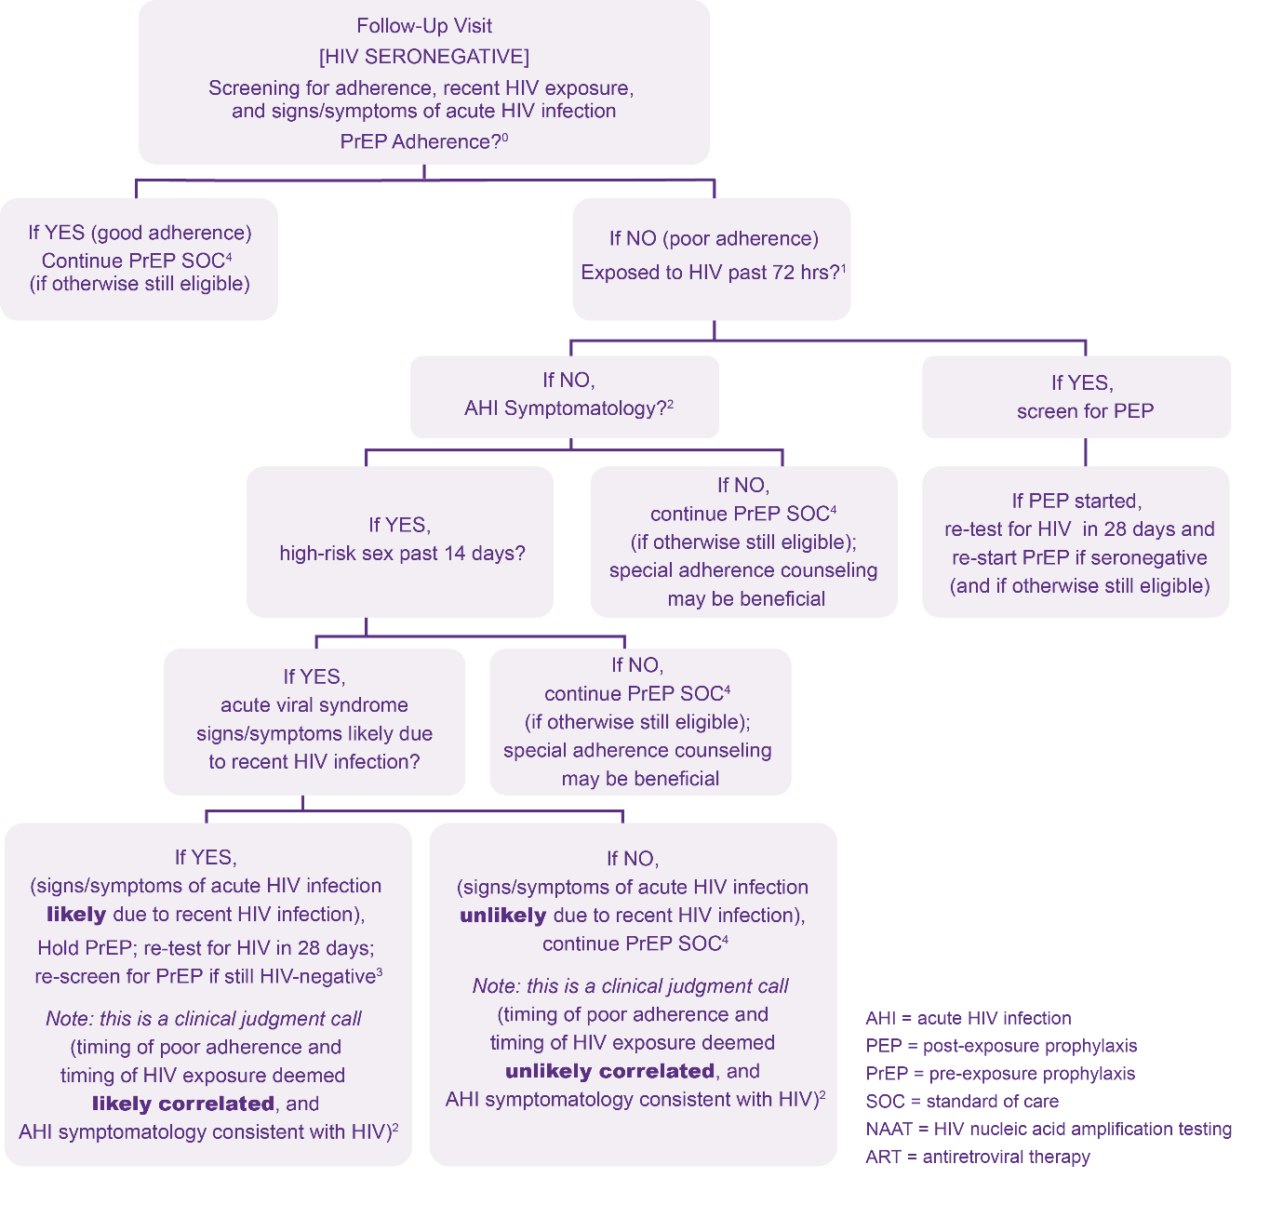
Algorithm to Assess for PEP Indication and AHI at Oral PrEP Follow-up Visits
0 If adherence was so poor as to constitute PrEP discontinuation, consider the client as restarting oral PrEP
1 An answer of “No” to question “Exposed to HIV past 72 hours?” means no known past exposure to HIV at all or known HIV exposure was 73+ hours ago.
2 Signs/symptoms mimicking acute HIV infection (sore throat, fever, sweats, swollen glands, mouth ulcers, headache, rash, muscle aches) are commonly due to illnesses other than HIV; providers need to use discretion in determining whether the symptomatology is consistent with HIV, or whether an alternative cause may explain them.
3 If HIV testing which can reliably detect HIV given these clients’ potential exposures and timeframes is available, PrEP may be started earlier than 28 days, if results are non-reactive. Clinician may consider fully suppressive ART during 28-day interim if waiting 28 days to retest for HIV.
Algorithm developed by Jhpiego in collaboration with Jared Baeten (University of Washington) and Rachel Baggaley (WHO) and adapted

Slide 205
Assessing Oral PrEP Adherence
Monitoring oral PrEP use and adherence is important.
It is essential that the monitoring be done in an open-ended and nonjudgmental manner.
A neutral assessment of adherence allows for a constructive discussion that can support the client in finding solutions to adherence challenges.
Take a neutral approach to adherence behavior to support the client in finding solutions to adherence challenges
If adherence is poor, the client should be assessed for PEP indication and symptoms of AHI

Slide 206
Discuss (5 minutes)
What questions would you ask to assess their adherence to oral PrEP?

Slide 207
Assessing Oral PrEP Adherence
Normalize adherence challenges:
“Many people have trouble remembering to take a pill, especially when starting a new medication. Has this happened to you?”
Ask about difficulties adhering, not nonadherence:
“Tell me about any difficulties you have had in taking your pill.”
Instead of:
“Have you missed doses of your medication?”

Slide 208
Algorithm to Assess for PEP Indication and AHI at Oral PrEP Follow-up Visits
0 If adherence was so poor as to constitute PrEP discontinuation, consider the client as restarting oral PrEP
1 An answer of “No” to question “Exposed to HIV past 72 hours?” means no known past exposure to HIV at all or known HIV exposure was 73+ hours ago.
2 Signs/symptoms mimicking acute HIV infection (sore throat, fever, sweats, swollen glands, mouth ulcers, headache, rash, muscle aches) are commonly due to illnesses other than HIV; providers need to use discretion in determining whether the symptomatology is consistent with HIV, or whether an alternative cause may explain them.
3 If NAAT is available, PrEP may be started earlier than 28 days if the client is NAAT negative; the clinician may consider fully suppressive ART in the 28-day interim if the client must wait 28 days to retest for HIV.
4 PrEP standard of care
Algorithm developed by Jhpiego in collaboration with Jared Baeten (University of Washington) and Rachel Baggaley (WHO) and adapted

Slide 209
Assessing for PEP Indication and AHI
Like during the initiation visit, clients should be assessed for PEP indication and AHI during follow-up visits if they report poor adherence to their oral PrEP prescription

Slide 210
Poll Question
If PEP started, retest for HIV in ___ days and re-start on PrEP if seronegative (and if otherwise still eligible)
7
14
28
30

Slide 211
Poll Question - Answer
If PEP started, retest for HIV in ___ days and re-start on PrEP if seronegative (and if otherwise still eligible)
7
14
28
30
For clients who have been exposed to HIV in the past 72 hours and started on PEP, retest for HIV in 28 days and restart on PrEP if the client is seronegative and otherwise still eligible based on other criteria.

Slide 212
Follow-up Oral PrEP Visit Essential Components
HIV testing and counseling
Assessments
To identify challenges with adherence and provide support
To identify clients exposed to HIV in the past 72 hours
To identify clients who may have AHI
Oral PrEP counseling
Prescription refill

Slide 213
Oral PrEP Counseling at Follow-up Visits
In addition to the key messages and counseling topics discussed at initiation:
Assess for side effects (and manage as needed)
Remind oral PrEP users of how to use oral PrEP effectively (starting and stopping)
Discuss whether there is ongoing exposure to HIV and whether they feel continued oral PrEP use is necessary

Slide 214
Oral PrEP Discontinuation
Ideally, clients should inform their service provider when they want to discontinue oral PrEP. Providers should discuss the options of when to discontinue oral PrEP with their clients.
Oral PrEP can be stopped for the following reasons:
Client request
Positive HIV test (clients who seroconvert while on oral PrEP should be linked to care and initiated on ART in line with national guidelines)
Safety concerns, such as eGFR <60mls/min (if known)
No longer at substantial likelihood of HIV acquisition
Persistent side effects which are not manageable
Decision to switch to another HIV prevention strategy or method
Notes:
A variety of other life changes may prompt a person to stop oral PrEP, including:
A partner with HIV on ART gets and maintains a suppressed viral load
A relationship becomes mutually monogamous.
Sex work or injection drug use stops.
Other behaviors that potentially expose them to HIV change.

Slide 215
Oral PrEP Discontinuation
For all clients using oral PrEP to prevent HIV acquisition from non-sexual exposures, all clients AFAB and for clients AMAB who are using estradiol-based exogenous hormones
One pill must be continued daily for 7 days after the last potential exposure.
For clients AMAB using oral PrEP to prevent HIV acquisition from sexual exposures and who are not using estradiol-based exogenous hormones
One pill must be continued daily for 2 days after the last potential sexual exposure.

Slide 216
Poll Question
Oral PrEP should not be discontinued if:
The health care worker decides independently that it is no longer right for the client.
The estimated creatinine clearance decreases to <60 ml/min as confirmed by a similar result on a different sample on a different day
The client requests to discontinue
The client tests receives an HIV positive test result

Slide 217
Poll Question – Answer
Oral PrEP should not be discontinued if:
The health care worker decides independently that it is no longer right for the client.
The estimated creatinine clearance decreases to <60 ml/min as confirmed by a similar result on a different sample on a different day
The client requests to discontinue
The client tests receives an HIV positive test result
Oral PrEP should be discontinued if the estimated creatinine clearance decreases to <60 ml/min as confirmed by a similar result on a different sample on a different day, the client requests to discontinue, and/or the client receives an HIV positive test result. The opinion “it is no longer right” by the health care worker should not be a reason for discontinuation; this could be biased and not in the best interest of the client.

Slide 218
Follow-up Oral PrEP Visit Essential Components
HIV testing and counseling
Assessments
To identify challenges with adherence and provide support
To identify clients exposed to HIV in the past 72 hours
To identify clients who may AHI
Oral PrEP counseling
Prescription refill

Slide 219
Prescribing Oral PrEP at Follow-up Visits (Daily and ED-PrEP)
At follow-up visits, clients should receive multiple bottles of PrEP.
At the one-month follow up visit prescribe 3 bottles. At a three month follow up visit
Prescribe 3 bottles for clients using daily oral PrEP
Prescribe 3 minus the number of full bottles the client has at home for clients who may use ED-PrEP. Clients should have enough pills between visits should they use oral PrEP daily.
If the client prefers fewer bottles because they lack a place to discretely or safely store it, fewer bottles can be prescribed/dispensed
Schedule the client’s next visit a week before the pill supply will run out based on daily use, at least every three months.

Slide 220
Poll Question
In the following scenarios, fill in the blanks to match the correct PrEP use with the correct prescription refill at a 3-month follow-up visit
A = two bottles, B = three bottles
A = three bottles, B = three minus the number of bottles the client has at home
A = three minus the number of bottles the client has at home, B = three bottles
A = four bottles, B = two bottles
PrEP use | 3 month follow-up visit
Client is taking daily oral PrEP | Prescribe ___A___
Client has used ED-PrEP | Prescribe ___B___

Slide 221
Poll Question
In the following scenarios, fill in the blanks to match the correct PrEP use with the correct prescription refill at a 3-month follow-up visit
A = two bottles, B = three bottles
A = three bottles, B = three minus the number of bottles the client has at home
A = three minus the number of bottles the client has at home, B = three bottles
A = four bottles, B = two bottles
PrEP use | 3 month follow-up visit
Client is taking daily oral PrEP | Prescribe ___A___
Client has used ED-PrEP | Prescribe ___B___

Slide 222
Follow-up Oral PrEP Visit Optional Components (if available)
Hepatitis B screening (if available, can be delayed and conducted once at or within 3 months of initiation)
Hepatitis C screening (if available, can be delayed and conducted once at or within 3 months of initiation)
Screening, diagnosis, and treatment for STIs (if available)
Pregnancy testing and provision of contraceptives (if available)
Screening for mental health and substance abuse disorders and provision of supportive services or referrals as needed (if available)
Provision of or referral to GBV, including IPV services
Provision of or referral to voluntary medical male circumcision (VMMC) services
Screening for and treatment of noncommunicable diseases
Creatinine clearance (if available, based on several factors)
Remember, oral PrEP should still be provided even if these services are not available, or the client is unable or does not wish to access these services.

Slide 223
Screening for Creatinine Clearance (if available)
Population | Baseline | Follow-up
Individuals 29 years and younger with no kidney-related comorbidities | Optional | If not conducted or if baseline test is normal, follow-up is optional until 30 years of age or if kidney-related comorbidities develop. If conducted, and baseline test result is <90 mL/min, conduct follow-up screening every six to 12 months, if available.
Individuals 30–49 years with no kidney-related comorbidities | Conduct once within one to three months of oral PrEP initiation, if available. | If baseline test is normal, further screening is optional until age 50 or kidney-related comorbidities develop. If baseline test result is <90 mL/min, conduct follow-up screening every six to 12 months, if available.
Individuals 50 years and older -OR- Individuals of any age with kidney-related comorbidities -OR- Individuals with previous creatinine screening of <90 mL/min | Conduct once within one to three months of oral PrEP initiation, if available. | Conduct follow-up screening every six to 12 months, if available.

Slide 224
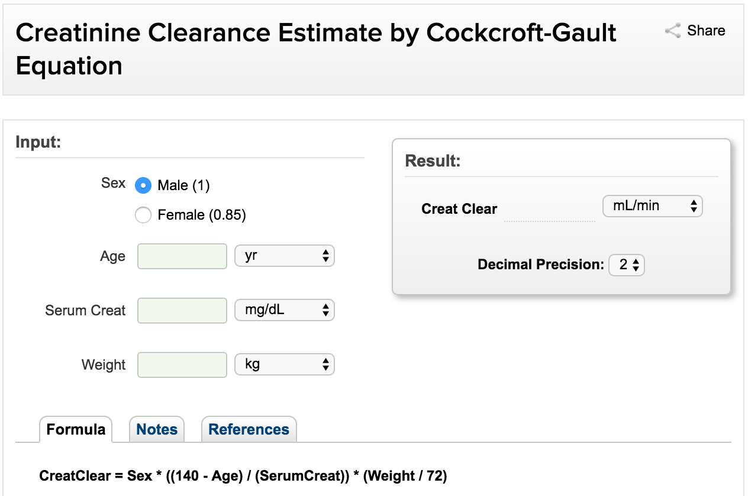
Screening for Creatinine Clearance (if available)
Estimated CrCl = [140-age (years)] x weight (kg) x f where f=1.23 for men and 1.04 for women / [72 x serum creatinine (μmol/L)]
PrEP is not indicated if creatinine clearance is < 60ml/min.
http://reference.medscape.com/calculator/creatinine-clearance-cockcroft-gault

Slide 225
Restarting Oral PrEP Use
Not all follow-up visits will be first time initiation visits- some may be restart visits
Clients can and should use oral PrEP when they need it
Restart visits have the same components of regular follow-up visits.
If available, providers may assess creatinine clearance levels within 1-3 months of restarting oral PrEP for clients 30-49 years who have never received creatinine clearance screening and for clients who have not received a creatinine clearance screening in the preceding 6-12 months who:
Are 50 years or older,
Have kidney-related comorbidities, or
Had a previous creatinine clearance less than 90mL/min.
Screening for all other clients remains optional.

Slide 226
Poll Question
Is the following statement true or false? ‘Creatinine clearance monitoring is a required component of follow-up visits for all clients.’
True
False

Slide 227
Poll Question- Answer
Is the following statement true or false? ‘Creatinine clearance monitoring is a required component of follow-up visits for all clients.’
True
False
Creatinine clearance is not required for any client at initiation or follow-up but certain individuals may benefit from monitoring as previously discussed.

Slide 228
Module 3 Summary
Having completed Module 3, participants can now:
Specify the essential components for the initial oral PrEP visit
Deliver key counseling messages for the initial oral PrEP visit
Specify the essential components for follow-up oral PrEP visits
Deliver key counseling messages for follow-up oral PrEP visits
Explain how oral PrEP is prescribed and dispensed for both daily and ED PrEP

Slide 229
Module 4
1
Oral PrEP Basics
2
Oral PrEP Screening
3
Oral PrEP Initial and Follow-Up Visits
4
Monitoring and Managing Oral PrEP Use: Creatinine, Seroconversion, and Stigma
5
Event-Driven PrEP (ED-PrEP)
6
Oral PrEP Monitoring and Evaluation Tools
7
Evaluation and Resources

Slide 230
Module 4 Learning Objectives
After completing Module 4, participants will be able to:
Explain how to manage creatinine elevation
Explain how to manage seroconversion
Develop strategies to minimize oral PrEP stigma

Slide 231
Monitoring Creatinine Elevation
Approximately 1 in 200 oral PrEP users may develop an elevation of serum creatinine.
Defined as a 50% increase above baseline or an elevation above the normal range
Reminder: Renal impairment is defined as having an estimated creatinine clearance of <60 ml/min.
Creatinine elevations have usually reversed after stopping oral PrEP.
It is important to monitor transient creatinine elevation and be alert for signs of chronic or severe renal insufficiency.
Since creatinine elevation is so uncommon- screening for creatinine clearance is optional and based on availability for all populations

Slide 232
Managing Creatinine Elevation
Stop oral PrEP if creatinine elevation is confirmed on a separate specimen on a separate day and if estimated creatinine clearance decreases to <60 ml/min.
After oral PrEP is stopped, creatinine should be checked for another one to three months, and oral PrEP can be restarted if eGFR returns to > 60 ml/min.
Consider additional causes and management of creatinine elevations if:
Creatinine elevation reaches more than three times the baseline
Renal function or creatinine elevations do not return to normal levels within three months of stopping oral PrEP
Common causes of chronic or severe renal insufficiency include: diabetes mellitus, uncontrolled systemic hypertension, hepatitis C infection, liver failure, and pre-eclampsia during pregnancy.

Slide 233
Poll Question
Is the following statement true or false? 'Elevation of serum creatinine is extremely common among oral PrEP users.'
True
False

Slide 234
Poll Question – Answer
Is the following statement true or false? 'Elevation of serum creatinine is extremely common among oral PrEP users.'
True
False
Serum creatinine elevations are not common. Approximately 1 in 200 oral PrEP users may develop an elevation of serum creatinine.

Slide 235
Seroconversion on Oral PrEP
In clinical trials, the level of effectiveness in preventing HIV acquisition was strongly correlated with adherence.
HIV acquisition can be prevented with effective use of oral PrEP.
HIV seroconversion after prescribing oral PrEP can occur if oral PrEP is not used correctly, or if HIV acquisition was undiagnosed at the time of oral PrEP initiation.
As discussed, counseling should include information to help oral PrEP users recognize AHI signs and symptoms, which should prompt a clinic visit without delay.

Slide 236
Managing Seroconversion
If a person using oral PrEP tests positive for HIV, oral PrEP should be stopped immediately and the person referred for prompt initiation of HIV treatment.
Transition from oral PrEP to HIV treatment without a gap to avoid the possibility of resurgence in viral load, immunological injury, and secondary transmissions.
Tracking seroconversion is important in informing gaps in care and in identifying needs for increased outreach to oral PrEP clients if adherence is an issue.

Slide 237
Minimizing Oral PrEP Stigma
Confidentiality is essential in oral PrEP services.
People may face stigma if their oral PrEP use becomes known.
Oral PrEP use can exacerbate stigma if others mistakenly consider oral PrEP
To be evidence of irresponsible behavior or stigmatized behavior
To be HIV treatment
Stigma will decrease oral PrEP uptake and adherence among people who would otherwise benefit from it.
Presenting oral PrEP to communities as a responsible choice that prevents HIV acquisition will increase the impact of oral PrEP, will prevent cases of HIV acquisition, and can help reduce stigma.
Key populations, who often face stigma and discrimination in many settings, may need additional support to overcome stigma related to oral PrEP use.

Slide 238
Discuss
What are possible strategies to minimize the stigma that your oral PrEP clients may face?

Slide 239
Module 4 Summary
Having completed Module 4, participants can now:
Explain how to manage creatinine elevation
Explain how to manage seroconversion
Develop strategies to minimize oral PrEP stigma

Slide 240
Section Divider #5
Notes:
Facilitator: As it stands, this section is 84 minutes, not 120 minutes. If the M&E content extends beyond 36 minutes, additional training time will be needed.

Slide 241
Module 5
1
Oral PrEP Basics
2
Oral PrEP Screening
3
Oral PrEP Initial and Follow-Up Visits
4
Monitoring and Managing Oral PrEP Use: Creatinine, Seroconversion, and Stigma
5
Event-Driven PrEP (ED-PrEP)
6
Oral PrEP Monitoring and Evaluation Tools
7
Evaluation and Resources

Slide 242
Module 5 Learning Objectives
After completing Module 5, participants will be able to:
Define ED-PrEP and feel familiar with the evidence for ED-PrEP efficacy
Identify candidates for ED-PrEP
Explain how to effectively take ED-PrEP and switch between daily oral PrEP and ED-PrEP
Describe advantages and disadvantages of ED-PrEP
Consider programmatic changes needed to implement ED-PrEP
Describe key counseling messages for ED-PrEP clients

Slide 243
Video from the Netherlands (4 minutes)
Video Available at: https://mantotman.nl/en/everything-about-sex/hiv-and-stis/prep/how-use-prep-safely

Slide 244
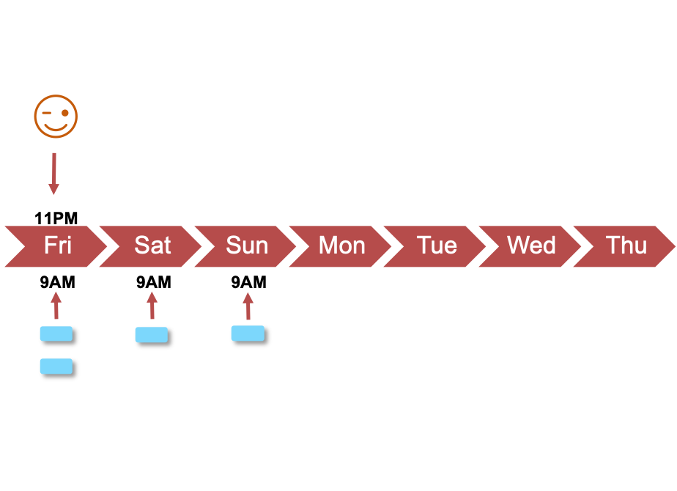
Event-Driven PrEP (Simplified)
Event-Driven PrEP (ED-PrEP) is an additional dosing regimen for HIV prevention during sex for people AMAB who do not use estradiol-based exogenous hormones where:
-Two pills of TDF/FTC (or TDF/3TC) are taken
2 to 24 hours before sex (the loading dose) followed by
-One pill 24 hours after the loading dose (the 3rd pill),
followed by
-One more pill 24 hours after the 3rd pill (the 4th pill)*
ED-PrEP may also be referenced as “on-demand,” “event-based,” or “intermittent” PrEP or “2+1+1”
*If a client has sex on the days following the loading dose, a client should continue taking one pill each day until two days after the last potential sexual exposure
= sex

Slide 245
Poll Question
What is ED-PrEP?
An additional dosing regimen for adolescent girls and young women
A PrEP regimen designed for all users of oral PrEP
An additional dosing regimen for men who have sex with men only
An additional dosing regimen for HIV prevention during sex for people AMAB who do not use estradiol-based exogenous hormones

Slide 246
Poll Question – Answer
What is ED-PrEP?
An additional dosing regimen for adolescent girls and young women
A PrEP regimen designed for all users of oral PrEP
An additional dosing regimen for men who have sex with men only
An additional dosing regimen for HIV prevention during sex for people AMAB who do not use estradiol-based exogenous hormones
ED-PrEP, or event-driven PrEP, is an additional dosing regimen for people AMAB who do not use estradiol-based exogenous hormones and want to use oral PrEP to prevent their own HIV acquisition during sex

Slide 247
Evidence for ED-PrEP Efficacy and Implementation
Author, Year | Setting | Key Findings
Molina, et al., 2015 IPERGAY RCT | France and Canada | Likelihood of HIV acquisition reduced by 86% among participants randomized into the ED-PrEP group Likelihood of HIV acquisition reduced by 97% during the open label extension
Molina, et al., 2017 Prevenir observational study | France | No new HIV acquisitions were reported in the ED-PrEP group and the daily oral PrEP group More than half (53%) of participants preferred ED-PrEP over daily PrEP
Cornelisse, et al., 2019 PrEPX Australian demonstration study | Australia | High level of interest in ED-PrEP was strongly associated with having sex infrequently and concerns about long-term toxicity
Zimmermann, et al., 2019 Jongen et al., 2020 Amsterdam PrEP demonstration project (AMPrEP) | USA | Participants have several motives for choosing a regimen to meet their priorities and needs for prevention, including changing exposure contexts, perceived or actual self-efficacy around adherence, and impacts of oral PrEP on well-being. Adherence to ED-PrEP was significantly higher for sexual encounters with casual sex partners, suggesting participants use ED-PrEP when they are most likely to be exposed to HIV.

Slide 248
Evidence for ED-PrEP Efficacy and Implementation
In October 2021 WHO presented anticipated guidance that despite evidence for the effectiveness of ED-PrEP being mostly among MSM that they would recommend it for all people AMAB who do not use estradiol-based exogenous hormones for HIV prevention during sex.
Rationale: ED-PrEP is effective for cisgender men who have sex with men regardless of sexual positioning and there’s no reason to believe it would not be effective for cisgender men having sex with individuals from other populations. Effectiveness is assumed to be similar for individuals assigned male at birth not using estradiol-based exogenous hormones (such as for gender affirming hormone therapy).

Slide 249
Appropriate Clients for ED-PrEP
ED-PrEP is only recommended for preventing HIV acquisition during sex among people AMAB who do not use estradiol-based exogenous hormones
ED-PrEP may be most suitable for these clients who:
Finds ED-PrEP more convenient
Have infrequent sex (for example, having sex two days or fewer per week on average)
Can plan for sex at least two hours in advance, or who can delay sex for at least two hours
Evidence to support ED-PrEP use among other populations is limited at this time.

Slide 250
Poll Question
ED-PrEP is recommended for preventing HIV acquisition for people AMAB who don’t use estradiol-based exogenous hormones during which of the following behaviors?
Sex
Sharing equipment while injecting drugs
All of the above

Slide 251
Poll Question – Answer
ED-PrEP is recommended for preventing HIV acquisition for people AMAB who don’t use estradiol-based exogenous hormones during which of the following behaviors?
Sex
Sharing equipment while injecting drugs
All of the above
ED-PrEP is only recommended for preventing HIV acquisition during sex for people AMAB who don’t use estradiol-based exogenous hormones.

Slide 252
Dosing Scenario 1 – Sex One Time
On Friday night, John plans to invite a guy he met on Grindr over to his place and to have anal sex. He takes two pills (the loading dose) of PrEP at 9 a.m. Friday and has sex at 11 p.m. Friday. He takes a third pill at 9 a.m. Saturday and a fourth at 9 a.m. Sunday.
Fri
Mon
Tue
Thu
Sat
Sun
Wed
Note:
ED-PrEP users should take two pills two to 24 hours before having sex and take one pill each day for the two days following sex
11PM
9AM
9AM
9AM
= sex
Notes:
Facilitator: Consider using names that are common in the training setting

Slide 253
Poll Question
How many hours before sex should ED-PrEP users take the loading dose of oral PrEP when using ED-PrEP?
One hour
Two to 24 hours
48 hours
72 hours

Slide 254
Poll Question – Answer
How many hours before sex should ED-PrEP users take the loading dose of oral PrEP when using ED-PrEP?
One hour
Two to 24 hours
48 hours
72 hours
To use oral PrEP effectively on an ED regimen, users must be sure to take the loading dose at least two hours before having sex and as many as 24 hours before sex.

Slide 255
Dosing Scenario 2 – Sex on Multiple Consecutive Days
Mark’s wife is going to away to visit her family on Friday and coming back on Sunday night. Mark sometimes has sex with another woman, who he is planning to hang out with on Friday and Saturday night. Mark takes two pills (the loading dose) on Friday morning. He has sex Friday night and takes one pill on Saturday morning. Saturday night he has sex again and then again early Sunday morning. Mark takes one pill of PrEP on Sunday, Monday, and Tuesday mornings at 9 a.m.
Fri
Sat
Sun
Mon
Thu
Tue
Wed
Note:
ED-PrEP users who have sex over multiple days should continue taking one pill each day for two days after the last time they had sex.
11PM
10PM
4AM
9AM
9AM
9AM
9AM
9AM
= sex
Notes:
Facilitator: Consider using names that are common in the training setting

Slide 256
Dosing Scenario 3 – Sex on Multiple Nonconsecutive Days
Willow has a date on Friday night and hopes to have sex. She is a trans woman who does not take hormones and uses ED-PrEP. She takes two pills Friday morning before having sex on Friday night. On Saturday and Sunday, she takes another pill each day. On Sunday, she meets up with her date again, and they have unplanned sex, so she continues taking a pill each day on Monday and Tuesday.
Fri
Sat
Sun
Mon
Thu
Tue
Wed
Note:
ED-PrEP users who have sex on nonconsecutive days while still taking ED-PrEP should continue taking one pill each day for two days after the last time they had sex.
11PM
10PM
1PM
9AM
9AM
9AM
9AM
9AM
= sex
Notes:
Facilitator: Consider using names that are common in the training setting

Slide 257
Poll Question
If sex continues over multiple consecutive or nonconsecutive days while taking the follow-up doses, ED-PrEP users should continue taking a pill each day until ___ days after the last time they had sex.
1
2
3
4

Slide 258
Poll Question – Answer
If sex continues over multiple consecutive or nonconsecutive days while taking the follow-up doses, ED-PrEP users should continue taking a pill each day until ___ days after the last time they had sex.
1
2
3
4
ED-PrEP users should always take a pill each day until 2 days after the last time they had sex.

Slide 259
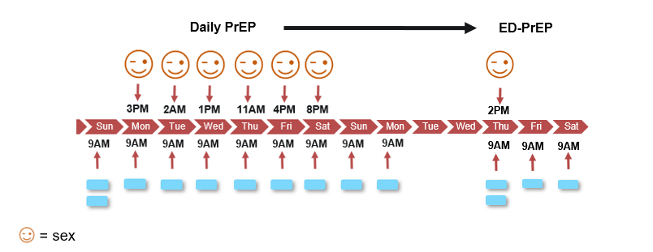
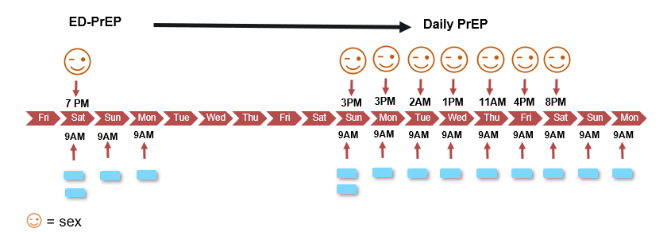
Switching Between ED-PrEP and Daily PrEP
ED-PrEP users may and should switch between using ED-PrEP and daily PrEP. Changes may be due to changes in relationship status, sexual partner(s), frequency and predictability of sex, or when a client’s preferred dosing option changes.
To transition from ED-PrEP to daily oral PrEP, a client should continue daily dosing after the last exposure. Daily dosing would continue until sex becomes less frequent or more predictable again, or for as long as the client prefers the daily dosing option.
To transition from daily oral PrEP to ED-PrEP, a client should stop daily dosing two days after last potential sexual exposure then start following the ED-PrEP regimen until sex becomes more frequent or less predictable.

Slide 260
Dosing Scenario 4 – Switching from ED-PrEP to Daily PrEP
Alex has been taking ED-PrEP for several months. Next week, he plans to go to a nearby city to sell sex and make some money. Alex isn’t always able to negotiate condoms with his clients so decides to switch to daily PrEP. Alex takes two pills (loading dose) of PrEP on Sunday and then continues taking a pill each day he’s working. He has sex several times throughout the week with different clients. On Saturday night, Alex has sex, and on Sunday he heads home. Alex takes PrEP on Sunday and Monday and then can stop taking PrEP if he wants.
ED-PrEP
Daily PrEP
7 PM
3PM
3PM
2AM
1PM
11AM
4PM
8PM
Fri
Sat
Sun
Mon
Tue
Wed
Thu
Fri
Sat
Sun
Mon
Tue
Wed
Thu
Fri
Sat
Sun
Mon
9AM
9AM
9AM
9AM
9AM
9AM
9AM
9AM
9AM
9AM
9AM
9AM
= sex
Notes:
Facilitator: Consider using names that are common in the training setting

Slide 261
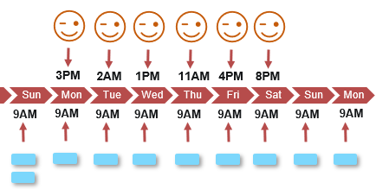
Dosing Scenario 5 – Switching from Daily PrEP to ED-PrEP
Back at home, Alex plans to meet up with a regular partner on Thursday afternoon and is switching back to ED-PrEP. He takes two pills at 9 a.m. Thursday and one pill each day on Friday and Saturday mornings and then can stop taking PrEP until he thinks he will have sex again.
Daily PrEP
ED-PrEP
2PM
Mon
Tue
Wed
Thu
Fri
Sat
9AM
9AM
9AM
= sex
Notes:
Facilitator: Consider using names that are common in the training setting (same as previous scenario)

Slide 262
Poll Question
To transition from daily oral PrEP to ED-PrEP, a client should stop daily dosing __________ last potential sexual exposure then start following the ED-PrEP regimen.
One day after
Two days after
Three days after
Four days after

Slide 263
Poll Question - Answer
To transition from daily oral PrEP to ED-PrEP, a client should stop daily dosing __________ last potential sexual exposure then start following the ED-PrEP regimen.
One day after
Two days after
Three days after
Four days after
ED-PrEP users may and should switch between using ED-PrEP and daily PrEP. Changes may be due to changes in relationship status, sexual partner(s), frequency and predictability of sex, or when a client’s preferred dosing option changes. When switching from daily oral PrEP to ED-PrEP, a client should stop daily dosing two days after last potential exposure. When switching from ED-PrEP to daily oral PrEP, a client should continue daily dosing after the last exposure.

Slide 264
Dosing Scenario 6 – Planned Sex Does Not Occur
On Friday night, Chris has plans to meet up with a regular sex partner. He takes two pills (the loading dose) of PrEP at 9 a.m. At 5pm, his partner writes that he won’t be able to meet with Chris that evening but can see Chris the following weekend. Chris doesn’t take the follow-up doses.
Fri
Mon
Tue
Thu
Sat
Sun
Wed
Note:
If sex doesn’t occur when planned, ED-PrEP users don’t need to take the follow-up doses.
9AM
9AM
9AM
= no sex
Notes:
Facilitator: Consider using names that are common in the training setting

Slide 265
Follow-up Visits* for ED-PrEP users
Each follow-up visit has the same components as that for daily oral PrEP plus:
Additional counseling messages (to be discussed later)
Follow-up visits should occur on the same schedule as clients taking daily oral PrEP
Previously, chronic hepatitis B infection was a contraindication for ED-PrEP use. In October 2021, WHO indicated that this contraindication is being removed, therefore hepatitis B screening is no longer required.
*Follow-up visits are visits where procedures other than drug dispensation takes place.

Slide 266
Poll Question
Is the following statement true or false? ‘Screening for hepatitis B is necessary to begin an ED-PrEP regimen.’
True
False

Slide 267
Poll Question – Answer
Is the following statement true or false? ‘Screening for hepatitis B is necessary to begin an ED-PrEP regimen.’
True
False
The need to screen ED-PrEP users for hepatitis B is outdated guidance from the WHO. It is no longer a contraindication for ED-PrEP use.

Slide 268
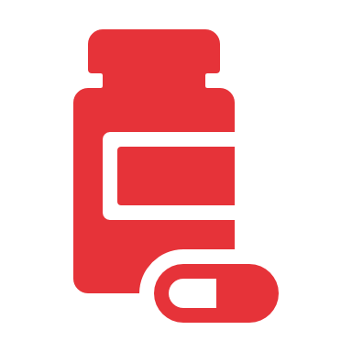
ED-PrEP Drug Dispensing
If clients are using ED-PrEP, their pill supply may last longer. Clients should be instructed on how to check bottles for expiration dates and be informed to not take expired pills.
Initiation: Dispense one bottle if having a one-month follow-up visit. Dispense three bottles if only having quarterly appointments
Follow-up visits:
Clients may not always need a full refill at each follow-up visit.
Clients should have enough pills between visits should they need to use PrEP daily.
Dispense [number of months until next visit] – [number of full and unopened bottles client has at home]

Slide 269
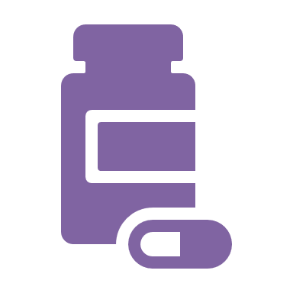
ED-PrEP Drug Dispensing Scenario
Kofi has been using ED-PrEP. He comes back for his three-month follow-up appointment and plans to continue using oral PrEP. Kofi has one unopened bottle of oral PrEP at home, and his next appointment is in three months.
How many bottles should Kofi be given?
[number of months until next visit] – [number of full and unopened bottles client has at home] = number of bottles to dispense
3 (months) – 1 (bottle at home) = 2 bottles to be dispensed

Slide 270
Poll Question
How much oral PrEP should be dispensed at follow-up visits for people using ED-PrEP?
One bottle each visit
One bottle per month until the next visit
Do not dispense if client has unopened bottles at home
One bottle per month until the next visit minus the number of full/unopened bottles the client has at home

Slide 271
Poll Question – Answer
How much oral PrEP should be dispensed at follow-up visits for people using ED-PrEP?
One bottle each visit
One bottle per month until the next visit
Do not dispense if client has unopened bottles at home
One bottle per month until the next visit minus the number of full/unopened bottles the client has at home
It is important that ED-PrEP users have enough oral PrEP drugs to switch between ED and daily use as needed.

Slide 272
Counseling ED-PrEP Users
In addition to the counseling messages discussed earlier:
Discuss client’s sex life to see if daily or ED-PrEP might be appropriate for the client
Discuss advantages and disadvantages of ED-PrEP
Explain how to use ED-PrEP
Effective use
Starting and stopping oral PrEP
What do to about missed doses
How to effectively switch between daily and event-driven

Slide 273
Key Counseling Messages (Potential ED-PrEP Users Only)
Topic | Key Messages
Selection of daily oral PrEP or ED-PrEP | Your choice between taking daily PrEP or ED-PrEP depends upon the frequency and predictability with which you have sex, as well as your preferences. ED-PrEP may be more appropriate if you find it more effective and convenient, have infrequent sex (for example, less than two times per week on average), and are able to plan for sex at least two hours in advance or delay sex for at least two hours. You may wish to transition between daily and ED-PrEP use according to your circumstances. Note to providers: PrEP providers and clients eligible for ED-PrEP should determine together whether daily PrEP or ED-PrEP may be most appropriate by discussing the frequency and predictability of sex and asking about dosing preferences. These clients will benefit from hearing all the counseling messages related to ED-PrEP before deciding.

Slide 274
Key Counseling Messages (Potential ED-PrEP Users Only)
Topic | Key Messages
Advantages to using ED‑PrEP | ED-PrEP has these potential advantages: It may require you to take fewer pills. It may be more convenient if you can typically plan when you might have sex It may make it easier for you to keep using PrEP.

Slide 275
Key Counseling Messages (Potential ED-PrEP Users Only)
Topic | Key Messages
Disadvantages to using ED‑PrEP | ED-PrEP also has these potential disadvantages: You will need to plan before sex. You must remember to take all doses in the correct way. If you are not truly HIV negative when you start PrEP, you may be more likely to develop resistance to the drugs used for oral PrEP. Therefore, it’s very important that you come back for your one-month follow-up visit. There is no evidence that ED-PrEP prevents HIV acquisition from non-sexual exposures.

Slide 276
Discuss
Simon is considering whether ED or daily PrEP might be right for him. What questions might you ask Simon to help him decide?
Notes:
Facilitator: Consider using names that are common in the training setting

Slide 277
Key Counseling Messages (Potential ED-PrEP Users Only)
Topic | Key Messages
Effective use | Messaging for clients: It is very important for you to take follow-up doses at the same time of day you took the loading dose. For ED-PrEP to be effective, take PrEP according to the dosing schedule prescribed. Note to providers: Walk through basic regimen with client (2+1+1) Provide client with information, education, and counseling (IEC) materials showing some different scenarios for ED-PrEP use

Slide 278
Key Counseling Messages (Potential ED-PrEP Users Only)
Topic | Key Messages
Starting and stopping oral PrEP | You must first take two pills two to 24 hours before having sex to get the maximum efficacy. This is the “loading dose.” If possible, taking it as close to 24 hours before sex is best. One pill should then be taken daily at the same time as the loading dose until two days after the last potential exposure during sex. This process should be repeated for each period of potential exposure to HIV. Note to providers: When counseling clients on starting and stopping ED-PrEP, clients may benefit from job aids with visual representations of how doses should be taken over time in different scenarios.

Slide 279
Discuss
Simon isn’t worried about taking the loading dose for ED-PrEP because he is able to plan sex. He is a bit worried that he may forget the post-sex dosing.
What strategies would you recommend to help Simon remember his post-sex pills?
It’s also possible that ED-PrEP may not be for Simon, what questions would you ask him determine if daily dosing may be more appropriate?
Notes:
Facilitator: Consider using names that are common in the training setting

Slide 280
Key Counseling Messages (Potential ED-PrEP Users Only)
Topic | Key Messages
Delayed loading dose | If it is less than two hours before you plan to have sex, take the loading dose and try to delay sex until two hours after the loading dose. However, if you do NOT take the loading dose at least two hours before sex and cannot delay sex you could: Use a condom and lubricant. Have other types of sex that come with no or nearly no likelihood of HIV acquisition (oral sex, mutual masturbation, etc.). If you did not use a condom, you may be a candidate for a 28-day course of PEP (per the national guidelines).

Slide 281
Key Counseling Messages (Potential ED-PrEP Users Only)
Topic | Key Messages
Missed ED‑PrEP dose(s) | If you miss an ED-PrEP dose (loading or post-sex), you may be a candidate for a 28-day course of PEP per the national guidelines. Note to providers: Because the timing and type of the sexual event will vary for each client in relation to the timing of the missed dose(s), such cases will require individual adjudication and best clinical judgment.

Slide 282
Key Counseling Messages (Potential ED-PrEP Users Only)
Topic | Key Messages
Switching between ED‑PrEP and daily PrEP | Messaging for clients: To transition from ED-PrEP to daily oral PrEP: You should continue taking PrEP every day after your last exposure. You should continue this daily dosing until sex becomes less frequent or more predictable again, or for as long as you prefer the daily dosing option. To transition from daily oral PrEP to ED-PrEP: You should stop daily dosing two days after the last potential exposure and then start following the ED‑PrEP regimen until sex becomes more frequent or less predictable. Note to providers: Because the frequency and predictability of sex may vary over time, the best PrEP dosing option for a client may also vary over time.

Slide 283
Poll Question
Is the following statement true or false? ‘Individuals using ED-PrEP can come less frequently to follow-up visits.’
True
False

Slide 284
Poll Question – Answer
Is the following statement true or false? ‘Individuals using ED-PrEP can come less frequently to follow-up visits.’
True
False
All oral PrEP users should return for follow-up visits with the same frequency to ensure they get the support they need to use oral PrEP effectively and to monitor for potential seroconversion.

Slide 285
Module 5 Summary
Having completed Module 5, participants can now:
Define ED-PrEP and feel familiar with the evidence for ED-PREP efficacy
Identify candidates for ED-PrEP
Explain how to take ED-PrEP effectively
Describe advantages and disadvantages of ED-PrEP
Consider programmatic changes needed to implement ED-PrEP
Describe key counseling messages for ED-PrEP clients

Slide 286
Module 6
1
Oral PrEP Basics
2
Oral PrEP Screening
3
Oral PrEP Initial and Follow-Up Visits
4
Monitoring and Managing Oral PrEP Use: Creatinine, Seroconversion, and Stigma
5
Event-Driven PrEP (ED-PrEP)
6
Oral PrEP Monitoring and Evaluation Tools
7
Evaluation and Resources

Slide 287
Module 6 Learning Objectives
After completing Module 6, participants will be able to:
Identify the oral PrEP M&E tools used in [COUNTRY]
Correctly complete all oral PrEP M&E tools
Notes:
Facilitator: Fill in missing content in red. More than any other aspect of programming, M&E will vary drastically from country to country. Before this training, speak with relevant stakeholders on M&E for PrEP and have them prepare this section to walk participants through the relevant tools and forms.

Slide 288
Discuss
What are the possible entry points or ways a client could be referred to or introduced to oral PrEP?

Slide 289
Entry Points for Oral PrEP
HIV testing (the most common)
Testing for STIs
Sexual and gender-based violence services
Harm reduction and other drug treatment services
Antenatal services
Gynecology and reproductive services
Referred from emergency room or hospital staff
So many more
All points of entry into PrEP services should use the oral PrEP M&E tools

Slide 290
Module 6 Summary
Having completed Module 6, participants can now:
Identify the oral PrEP M&E tools used in [COUNTRY]
Correctly complete all oral PrEP M&E tools

Slide 291
Module 7
1
Oral PrEP Basics
2
Oral PrEP Screening
3
Oral PrEP Initial and Follow-Up Visits
4
Monitoring and Managing Oral PrEP Use: Creatinine, Seroconversion, and Stigma
5
Event-Driven PrEP (ED-PrEP)
6
Oral PrEP Monitoring and Evaluation Tools
7
Evaluation and Resources

Slide 292
Oral PrEP Specific Competencies
Having completed this training, participants can now:
Answer essential questions about oral PrEP
Assess individual exposure to HIV
Identify candidates who meet the criteria for oral PrEP initiation
Educate and counsel oral PrEP candidates and users
Conduct initial and follow-up visits for oral PrEP users
Utilize oral PrEP monitoring and evaluation tools

Slide 293
In-person Post-Training Assessment
The objective of this post-training assessment is to find out what you know about implementing oral PrEP and how much your knowledge and skills have improved since the pre-training assessment.
Results of the pre-training and post-training assessments will also help improve future trainings.
Remember to include your name on your assessment.
You have 20 minutes to complete the assessment.
Notes:
Facilitator: Delete this slide if you're conducting the training virtually. If you’re conducting the training in-person, create a post-assessment for participants by printing copies of pre-training assessment with a new title of "post-training assessment".

Slide 294
Virtual Post-Training Assessment
The objective of this post-training assessment is to find out what you know about implementing oral PrEP and how much your knowledge and skills have improved since the pre-training assessment.
Results of the pre-training and post-training assessments will also help improve future trainings.
You have 20 minutes to complete the assessment.
Notes:
Facilitator: Delete this slide if you're conducting the training in-person. If you’re conducting the training virtually, create a post-training assessment for participants by putting all of the poll questions into a single poll or into a online survey like Google Forms, Survey Monkey, etc.

Slide 295
Training Evaluation
Please take a few minutes to complete this Training Evaluation Form.
We welcome your honest feedback to help us improve future trainings.
Your evaluation will be confidential. You do not need to include your name.
You have 10 minutes to complete the assessment.
Notes:
Facilitator: You can use the sample training evaluation found on the next two slides. If conducting the session in-person, this can be copied into a document and printed. If conducting the session virtually, this can be made into a poll in the same way the pre and post-training assessments were.

Slide 296
Sample Training Evaluation Form (copy and paste into another document to format and print)
TRAINING EVALUATION FORM
Instructions: Please rate the following statements on a scale from 1 to 5
 | Strongly Disagree | Disagree | Neither Agree Nor Disagree | Agree | Strongly Agree
1. The training objectives were clear. | 1 | 2 | 3 | 4 | 5
2. This training met my expectations. | 1 | 2 | 3 | 4 | 5
3. The technical level of this training was appropriate. | 1 | 2 | 3 | 4 | 5
4. The pace of this training was appropriate. | 1 | 2 | 3 | 4 | 5
5. The trainers were engaging (i.e., interesting). | 1 | 2 | 3 | 4 | 5
6. The information I learned in this training will be useful to my work. | 1 | 2 | 3 | 4 | 5
7. I am confident that after this training, my facility will be able to implement oral PrEP for all eligible candidates. | 1 | 2 | 3 | 4 | 5

Slide 297
Sample Training Evaluation Form (copy and paste into another document to format and print)
Instructions: How helpful were each of the training modules to you and your work? If you have specific comments, please write them on the next page.
 | Not Helpful |  |  |  | Very Helpful
Module 1: Oral PrEP Basics | 1 | 2 | 3 | 4 | 5
Module 2: Oral PrEP Screening | 1 | 2 | 3 | 4 | 5
Module 3: Oral PrEP Initial and Follow-Up Visits | 1 | 2 | 3 | 4 | 5
Module 4: Monitoring and Managing Oral PrEP Use: Creatinine, Seroconversion, and Stigma | 1 | 2 | 3 | 4 | 5
Module 5: Event-Driven PrEP | 1 | 2 | 3 | 4 | 5
Module 6: Oral PrEP Monitoring and Evaluation Tools | 1 | 2 | 3 | 4 | 5
Open Answer Questions:
What was the best part of this training?
How could we improve this training?
Other comments:

Slide 298
Note on Resources
The content in this training is based on WHO recommendations and anticipated guidance as of 15 March 2022
Due to the evolving nature of evidence for and recommendations on oral PrEP implementation, many if not all the resources mentioned on the following slides do not reflect the latest guidance as of 15 March 2022
Notes:
Facilitator: You can choose to go over some of the resources on the following slides or not.

Slide 299
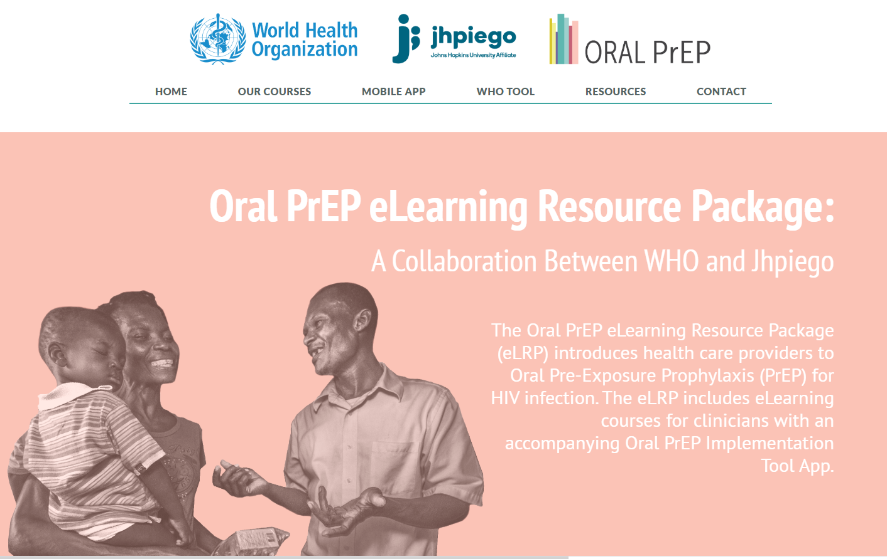
WHO/Jhpiego Oral PrEP eLearning Course Includes Daily and ED-PrEP
The Oral PrEP eLearning course created through a collaboration between WHO and Jhpiego is a self-paced, free eLearning course available at hivoralprep.org.
The training prepares clinicians to provide both daily oral PrEP and ED-PrEP.

Slide 300
Resources for Providers
World Health Organization. Consolidated Guidelines on HIV Prevention, Testing, Treatment, Service Delivery and Monitoring: Recommendations for a Public Health Approach. Geneva: WHO; 2021. Consolidated guidelines on HIV prevention, testing, treatment, service delivery and monitoring: recommendations for a public health approach (who.int)
World Health Organization. Consolidated Guidelines on the Use of Antiretroviral Drugs for Treating and Preventing HIV Infection: Recommendations for a Public Health Approach. 2nd edition. Geneva: WHO; 2016. http://www.who.int/hiv/pub/arv/arv-2016/en/. Accessed January 11, 2019.
World Health Organization. PrEP. Geneva: WHO; 2018. http://www.who.int/hiv/topics/prep/en/://www.who.int/hiv/topics/prep/en/. Accessed January 11, 2019.
UNAIDS. Oral Pre-Exposure Prophylaxis: Putting a New Choice in Context. Geneva: UNAIDS; 2015. http://www.unaids.org/sites/default/files/media_asset/UNAIDS_JC2764_en.pdf. Accessed January 11, 2019.
PrepWatch. http://www.prepwatch.org/.
Centers for Disease Control and Prevention. Pre-Exposure Prophylaxis (PrEP). http://www.cdc.gov/hiv/risk/prep/. Accessed January 11, 2019.
Fonner VA, Dalglish SL, Kennedy CE, et al. Effectiveness and safety of oral HIV preexposure prophylaxis for all populations. AIDS. 2016; 30(12): 1973-1983. doi: 10.1097/QAD.0000000000001145.
Glidden DV, Amico KR, Liu AY, et al. Symptoms, side effects and adherence in the iPrEx open-label extension. Clin Infect Dis. 2016; 62(9):1172-1177. https://doi.org/10.1093/cid/ciw022.
The Fenway Institute. PrEP Clinical Study Data Sheet. http://www.projectinform.org/pdf/prepstudydata.pdf. Accessed October 5, 2016.
World Health Organization. Review: Safety of Tenofovir PrEP in Pregnant and Breastfeeding HIV-Negative Women and Their Infants. http://emtct-iatt.org/wp-content/uploads/2016/08/WHO-TDF-pregnancy-Lynne-Mofenson.August-21-2016.pdf. Accessed October 5, 2016.
UNAIDS. M&E Guidelines: M&E of Key Populations at Higher Risk for HIV. Geneva: UNAIDS; 2018. http://www.unaids.org/en/dataanalysis/monitoringandevaluationguidance.

Slide 301
Resources for Oral PrEP Users
CDC, Division of HIV/AIDS Prevention, National Center for HIV/AIDS, Viral Hepatitis, STD and TB Prevention. Take Charge of Your Health. http://www.cdc.gov/hiv/pdf/risk_PrEP_TalkingtoDr_FINALcleared.pdf.
Please PrEP Me. What Is PrEP? http://www.PleasePrEPMe.org/resources. Accessed January 11, 2019.
PrEP Facts: Rethinking HIV Prevention and Sex. https://www.facebook.com/groups/PrEPFacts/.
PrEP Project. What Is Prep? http://www.whatisprep.org. Accessed January 11, 2019.
Terrence Higgins Trust. What Is Prep? http://www.iwantprepnow.co.uk. Accessed January 11, 2019.

Slide 302
Resources on ED-PrEP
French NGO AIDES
PrEP Guide (English Version)
PrEP Guide (French Version)
PrEP Pharmacist Guide (in French)
PrEP User Brochure (English Version)
Australian NGO Thorne Harbour Health Video
Australian NGO PrEP Access Now
Australian PrEP Guidelines
Australian Decision Making in PrEP Tool
San Francisco AIDS Foundation ED-PrEP Page
New York City Department of Health
California Department of Health
Coalition Plus Video in Bambara and French
I-Base in the UK

Slide 303
Selected Research on ED-PrEP
Saberi, P., Scott, H.M. On-Demand Oral Pre-exposure Prophylaxis with Tenofovir/Emtricitabine: What Every Clinician Needs to Know. J GEN INTERN MED 35, 1285–1288 (2020). https://doi.org/10.1007/s11606-020-05651-2. https://pubmed.ncbi.nlm.nih.gov/31965523/
Molina JM, Capitant C, Spire B, et al. On-Demand Preexposure Prophylaxis in Men at High Risk for HIV-1 Infection. New Engl J Med. 2015;373(23):2237–2246. https://www.ncbi.nlm.nih.gov/pubmed/26624850
Molina JM, Charreau I, Spire B, et al. Efficacy, safety, and effect on sexual behaviour of on-demand pre-exposure prophylaxis for HIV in men who have sex with men: an observational cohort study. Lancet HIV. 2017;4(9):E402-E410. https://www.ncbi.nlm.nih.gov/pubmed/28747274
Jongen, V., Hoornenborg,E., Van Den Elshout, M., Coyer, L., Davidovich, U., De Vries, H., Prins, M., Schim Van Der Loeff, M. Using a Mobile App and Dried Blot Spots to Assess Adherence to Event-Driven PrEP [abstract]. In: CROI; March 8-11, 2020; Boston, Massachusetts.1031. https://www.croiconference.org/abstract/using-a-mobile-app-and-dried-blot-spots-to-assess-adherence-to-event-driven-prep/
Cornelisse, V. J., Lal, L., Price, B., Ryan, K. E., Bell, C., Owen, L., & Wright, E. J. (2019, July). Interest in switching to on-demand HIV Pre-Exposure Prophylaxis (PrEP) among Australian users of daily PrEP: an online survey. In Open forum infectious diseases (Vol. 6, No. 7, p. ofz287). US: Oxford University Press.https://www.ncbi.nlm.nih.gov/pmc/articles/PMC6612821/pdf/ofz287.pdf
Siguier M, Mera R, Pialoux G et al. First year of pre-exposure prophylaxis implementation in France with daily or on-demand tenofovir dosiproxil fumarate/emtricitabine. J Antimicrob Chemother 2019 Sept 1,XXXXXXX
Durant-Zaleski I, Mutuon P, Charreau et al. Costs and benefits of on-demand HIV preexposure prophylaxis. AIDS 2018 Jan2;32(1):95-102.xxxxxxx
Noret M, Balavoine S, Pintado C et al. Daily or on-demand oral tenefovir disoproxil fumarate/emtricitabine forHIV preexposure prophylaxis: experience from a hospital-based clinic in France. AIDS 2018 Sept 24;32(15):2161-2169.XXXXX

Slide 304
Acknowledgement
Portions of this training were originally developed by ICAP at Columbia University in collaboration with the U.S. Centers for Disease Control and Prevention (CDC), with funding from the U.S. President’s Plan for AIDS Relief (PEPFAR) under the terms of cooperative agreement #U2GGH000994. Its contents are solely the responsibility of the authors and do not necessarily represent the views of the U.S. Government. Other portions were originally developed by individuals affiliated with the United States Agency for International Development (USAID) and the CDC.
Original content has been updated with support from USAID and PEPFAR through the Meeting Targets and Maintaining Epidemic Control (EpiC) project to align with new information about oral PrEP and its implementation. The contents are the responsibility of the EpiC project and do not necessarily reflect the views of USAID, PEPFAR, or the United States Government. EpiC is a global cooperative agreement (7200AA19CA00002) led by FHI 360 with core partners Right to Care, Palladium International, Population Services International (PSI), and Gobee Group.

