Slide 1
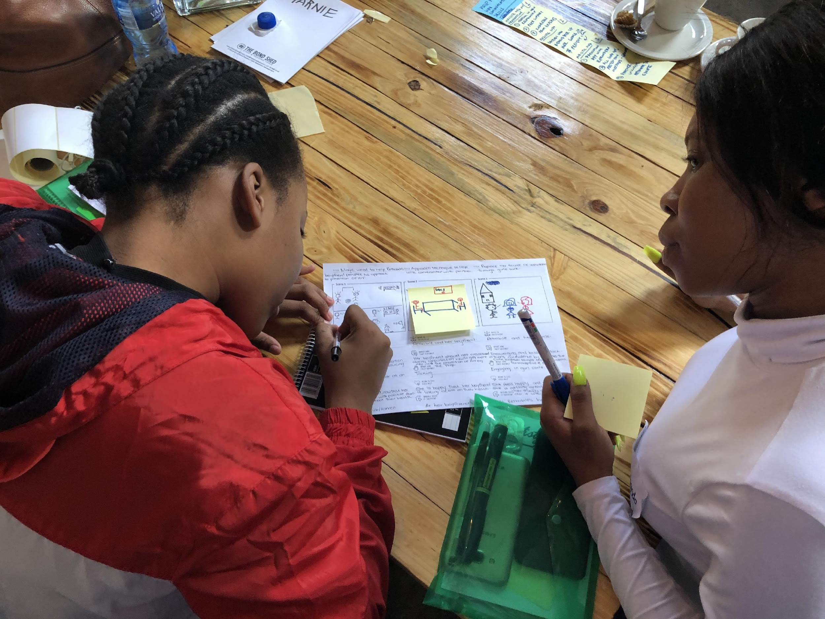
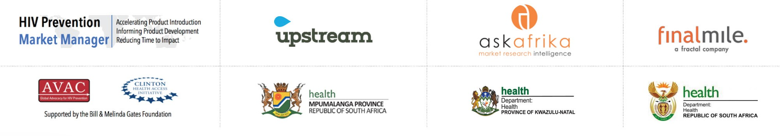
Breaking the Cycle of Transmission
Creating relevance through relationships:
An integrated Behavioral Science and Human-Centered Design approach to increase adoption and sustained use of HIV prevention among adolescent girls and young women (AGYW) at high-risk of HIV.
South Africa, August 2017 – April 2021

Slide 2
Contents
2
The Challenge
Comprehensive Approach
Understanding AGYW Decision-Making
Finding Solutions: The Pilot
Pilot Effectiveness
Implications for HIV Prevention and beyond

Slide 3
The Challenge
CREATING RELEVANCE THROUGH RELATIONSHIPS 3
Poor adoption of HIV prevention behavior & products
Why are so many HIV prevention interventions ineffective with this population?
Lead with HIV prevention products.
Designed with a test and treat mindset.
Delivered as one-size-fits-all.
Treat AGYW needs and preferences as static, instead of dynamic and context dependent.
Optimized for discrete health decisions rather than supporting prevention habit formation.
Frame prevention rewards as negative and long term (e.g. avoid dying later)
AGYW at high risk for HIV are not sustaining HIV prevention behaviors.
Notes:
The challenge we set out to address with this work was poor adoption of HIV prevention behavior & products among AGYW at high risk for HIV.
Unfortunately, the typical way the sector approaches this challenge reinforces rather than alleviates the barriers these AGYW face.
Leading with HIV prevention products
Test and treat mindset
One size fits all solutions
No appreciation for changing context
Optimized for single decisions rather than habit formation
Negative frame

Slide 4
Nulla quis sem at nibh elementum imperdiet. Duis sagittis ipsum.
Comprehensive Approach
CREATING RELEVANCE THROUGH RELATIONSHIPS 4
Two locally led project phases that integrated human-centred design methodologies and engaged over 3,500 stakeholders.
PHASE 1:
HUMAN-CENTERED & BEHAVIORAL RESEARCH
PHASE 2:
HUMAN-CENTERED DESIGN & PILOTING
What did we learn from AGYW?
How might we translate these insights to create impact?
Qualitative
research
Quantitative
research
Discrete Choice
Methodology
Strategic objectives
HCD
Design Aids
Pilot development and deployment
267 AGYW
Highest prevalence provinces (KZN & MPU)
135 influencers
Male partners
Matriarchal figures
Community Health Workers
Nurses
1987 AGYW
5 KZN districts
2 MPU districts
1002 AGYW
5 KZN districts
2 MPU districts
Refined intervention opportunities with SANAC and Technical Working Group.
Optimized content outputs based on stakeholder needs with 12 stakeholders
(donor, IPs & government).
Co-Created concepts with 60 AGYW & IPs.
Refined 1 concept with AGYW, ANOVA, and TBHIV Care.
Piloted with 158 AGYW from KZN & Gauteng
Project outcomes:
Stakeholder needs defined for research outputs
AGYW’s Journey toward HIV Prevention
AGYW Segments
Progression factors and distribution specific to segment and stage
Product preferences specific to segment and stage
Intervention opportunities specific to segment and stage
Foundational Design Aid
Prioritization Design Aid
Intervention Design Aid
Classification Design Aid
Relationship Workshop
22 additional intervention concepts
Notes:
The complexity of this challenge required a comprehensive approach…
No other project has been as comprehensive as this one. We engaged over 3,500 stakeholders and produced:
Qualitative insights about AGYW and stakeholders.
AGYW Journey to HIV prevention
Segments
Preferred product attributes
HCD Design Aids for stakeholders based on sector needs
Intervention concepts
Pilot intervention

Slide 5
Nulla quis sem at nibh elementum imperdiet. Duis sagittis ipsum.
Comprehensive Approach
CREATING RELEVANCE THROUGH RELATIONSHIPS 5
Who were the partners involved?
Partner
AVAC
Final Mile
Upstream Thinking
Ask Afrika
Anova
TBHIV Care
Afrika Tikkun
Advisory Board
Expertise
Stakeholder Engagement; link to PMM and advocacy
Behavioral Science
HCD & Innovation
Research Fielding
IP / Co-creator of Pilot
IP / Co-creator of Pilot
Recruiting
Guidance
Advisory Board
Govt: National Dept of Health (NDOH), KZN DOH, Mpumalanga DOH, SANAC
Donors: USAID, CDC, The Global Fund, WHO
IP: NACOSA, TBHIV Care, Right to Care, ANOVA, Community Media Trust, Health Systems Trust, AIDSFONDS
Notes:
The team was comprised of organizations with distinct expertise, guided by the Advisory Board, a collection of key informants from implementers & civil society.

Slide 6
Nulla quis sem at nibh elementum imperdiet. Duis sagittis ipsum.
Findings: AGYW Decision-Making
CREATING RELEVANCE THROUGH RELATIONSHIPS 6
Relationship goals are relevant, not HIV prevention.
The majority of AGYW are not ready to adopt HIV prevention for three reasons:
Programs lead with risk and health, not relationships with partners, which are more important to AGYW at this stage of life.
Many AGYW prioritize the needs and preferences of others over their own.
There is a gap in positive influencers for AGYW within the HIV prevention ecosystem.
Most adolescent girls and young women (AGYW) at high risk are not ready for HIV prevention.
48%
think they are at lower risk of contracting HIV compared to their peers
62%
are not ready for prevention methods
Notes:
Now I’d like to highlight a few key findings from our work:
Today, the sector is not reaching the majority of the market with prevention interventions. 62% are not ready for prevention methods.
Why is this?
There is a problem with relevance. Programs fail when they lead with risk and health. AGYW are focused on their relationship goals, not HIV Prevention. 48% think they are at lower risk than their peers.
AGYW prioritize the needs of others over their own.
There is a lack of positive influencers for AGYW, and plenty of negative ones.
What if we could get this part of the market engaged and ready for HIV prevention products and services?

Slide 7
Nulla quis sem at nibh elementum imperdiet. Duis sagittis ipsum.
Findings: AGYW Decision-Making
CREATING RELEVANCE THROUGH RELATIONSHIPS 7
Sexual health is not relevant until the ‘big flip’
‘pre-flip’
‘post-flip’
AGYW are on a journey to achieving their relationship goals.
Sexual health is only relevant to them in the later stages of this journey.
EXTERNALLY FOCUSSED
62% of AGYW prioritise the needs of others in their relationships.
‘big flip’
INTERNALLY FOCUSSED
38% of AGYW prioritize their sexual health in relationships.
OBJECTIVE 1:
Help these AGYW form the intent to develop healthy prevention habits in sexual relationships.
OBJECTIVE 2:
Help these AGYW establish and sustain healthy prevention habits.
1
2
3
4
5
Shaping
my opinions
Seeing
HIV differently
Recalibrating
Embedding
healthy habits
Evolving
routines to life changes
how to manage partners
“We’re afraid that if we use a condom when we have sex
with a boy, he will leave you.”
- Adolescent girl in Mpumalanga
“I protect myself all the time and if it happens that I don’t agree with my partner that means nothing will happen. I abstain.”
- Young woman in Mpumalanga
Notes:
There is a “big flip” of mindset that happens along the AGYW journey to healthy sexual relationships.
During this transition, AGYW shift from prioritizing the needs of others, to prioritizing their own.
Until that mindset is reached, sexual health and HIV prevention are not relevant to AGYW.
Only after they reach the “big flip” can they form and sustain healthy habits.
For the majority of the market, our challenge is helping them get to the “Big Flip” so they’ll be ready for HIV prevention.

Slide 8






Findings: AGYW Decision-Making
CREATING RELEVANCE THROUGH RELATIONSHIPS 8
Distinct segments driven by their relationship goals
AGYW segments differ in their sexual decision-making power, risk perception and emotional response toward HIV.
There is no magic bullet for prevention product attributes.
  Need to provide options so AGYW have flexibility to adapt to changing relationships and contexts.
Lifestyle
Lulu
Affirmation
Ayabonga
Respect
Rethabile
28%
30%
42%
One-size fits all solutions don’t work because AGYW are not all the same, even within the same demographics.
Prioritizes functional or material needs
Looks for emotional support, validation, and understanding
Looks for equity and being heard
"Yes, I have multiple partners, but I have many needs. I also deserve to have an iphone and have a weave. Yes, I got it the way I got it, but I don’t care what people think."
“It’s difficult, what if he leaves me if I suggest/insist on using condoms? I love him these days... it’s hard to start a new relationship from scratch. This one knows me already and he understands things, like my curfew at home. Someone else might not be able to understand.”
“He can buy alcohol that can fill up the whole table and other things for all I care. But this is my body and future, so no, I won’t.
If I sleep with him, tomorrow he calls another girl - then who will get sick? It’s me, not those girls..."
Notes:
AGYW experience the journey toward healthy relationships differently based on their relationship goals.
There are 3 distinct segments that differ by the goals they are trying to achieve through sexual relationships.
One-size fits all solutions and demographic segmentation don’t work because AGYW are not all the same.

Slide 9
Foundational Research package
Segmentation Profiles
  Guidelines for providers to identify AGYW by segment
15 quantitatively prioritized AGYW challenges
22 program concepts co-designed with AGYW and providers
Discrete Choice Modelling output of prevention product attributes by segment
Intervention Design Tool (with Idea Starters)
Pilot deployment kit: discussion guides, collateral, and “Story of Pilot” report
Focused on early stage AGYW challenges:
Help AGYW to...
Finding Solutions: Pilot Objective
CREATING RELEVANCE THROUGH RELATIONSHIPS 9
2
Prioritization
Design Aid
Help AGYW progress through the journey
Pilot goals:
Prove that we could help AGYW progress through the journey
Improve relevance for HIV prevention products
Support the development of a prevention ecosystem.
Help AGYW to…
Visual map to prioritize problems across the AGYW journey to healthy sexual relationships, identify gaps, and opportunities for current programming.
Which problems
should we focus on?
The Pilot was designed to progress AGYW past the “Big Flip”
prioritise the needs of others in their relationships
‘big flip’
prioritize their sexual health in relationships
1
2
3
4
5
Focused on participants
in stage 1 - most AGYW are stuck here
Notes:
Based on the insight foundations we just talked about, we set out to generate intervention concepts to pilot.
The primary goal of this pilot was to progress AGYW in their journey past the “Big Flip.”
Doing so would create relevance for HIV prevention, and support the development of a prevention ecosystem.

Slide 10
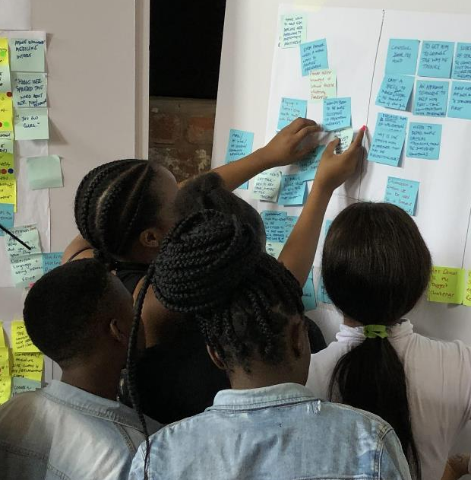
Finding Solutions: Philosophy
CREATING RELEVANCE THROUGH RELATIONSHIPS 10
Engage stakeholders to solution against findings
Design solutions with AGYW and stakeholder ecosystem using journey, segments, and habit model.
3 Day Ideation Workshop
60 AGYW, + IPs
Produced 22 Intervention Concepts
Notes:
This approach was different because…
First, we engaged the stakeholder ecosystem to prioritize and focus the effort based on findings and stakeholder context.
Then we ideated directly with AGYW on these high priority challenges.

Slide 11
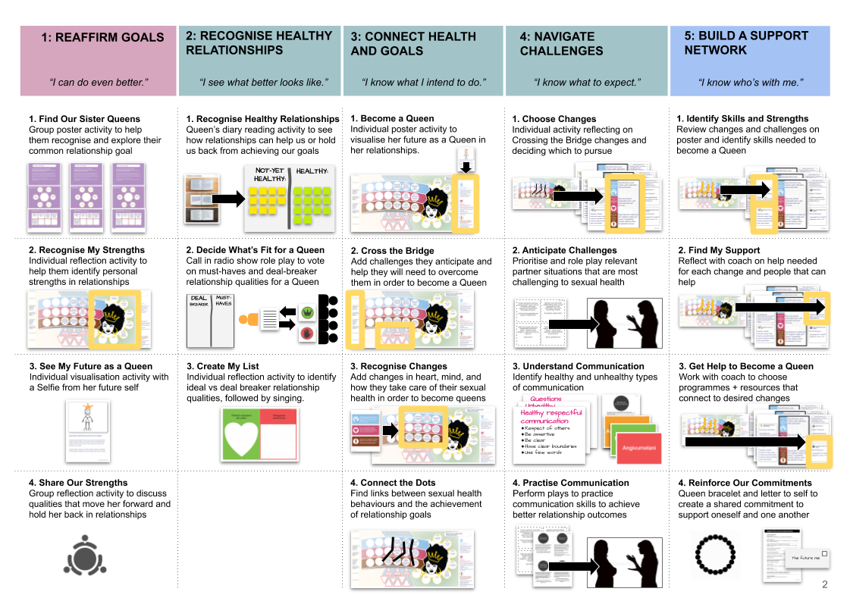
Finding Solutions: Relationship Workshop
CREATING RELEVANCE THROUGH RELATIONSHIPS 11
Short and effective programme to prepare the market for prevention (5 sessions over 5 weeks).
2: RECOGNISE HEALTHY RELATIONSHIPS
“I know who’s with me.”
“I can do even better.”
“I see what better looks like.”
“I know what I intend to do.”
“I know what to expect.”
1: REAFFIRM GOALS
3: CONNECT HEALTH AND GOALS
4: NAVIGATE CHALLENGES
5: BUILD SUPPORT NETWORK
Notes:
Of the concepts we generated with AGYW and stakeholders, we worked with BGMF and the Advisory Board to choose the Relationship Workshop for piloting.
Shorter compared to other structural programs, the Workshop is comprised of intensive and impactful one day sessions, once a week over 5 weeks.
Organized by segment, The Workshop is structured to start with relationship goals and work towards relevance of sexual health with interactive activities that build on one another.
Different from didactic programs, facilitators help participants arrive at their own conclusions and priorities, culminating in commitments to behavior change.

Slide 12
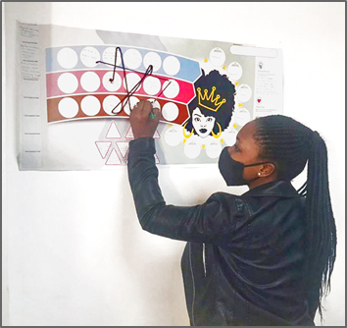
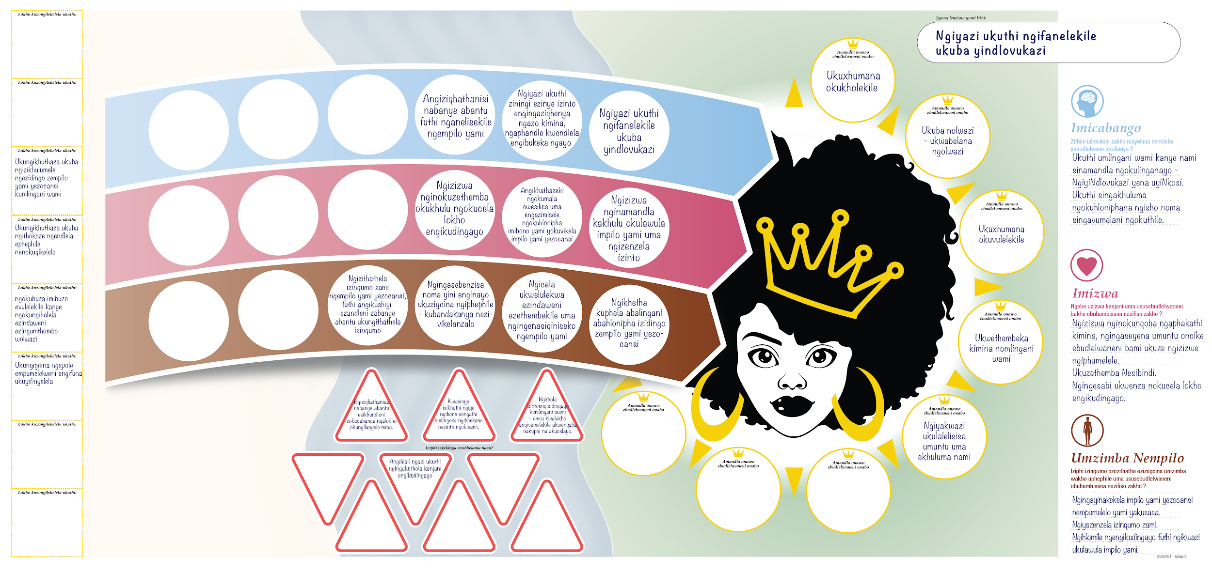
Finding Solutions: Relationship Workshop
CREATING RELEVANCE THROUGH RELATIONSHIPS 12
Designed for engagement to make sexual health relevant to AGYW.
Notes:
Designed for engagement, the program leverages custom design thinking tools using metaphors to help participants visualise the future Queen they want to become and their path to get there.
These interactive approaches help move AGYW to a point where sexual health becomes relevant to them.

Slide 13
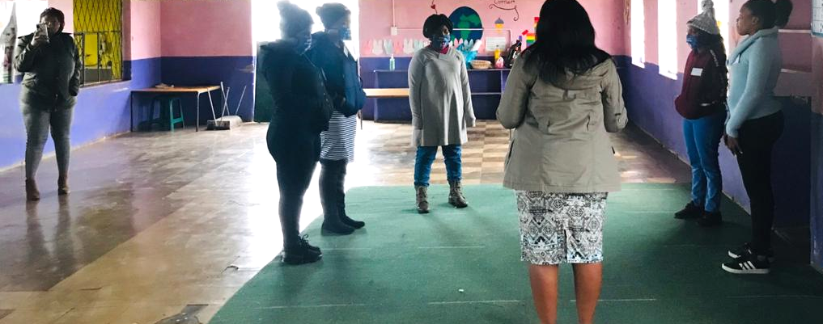
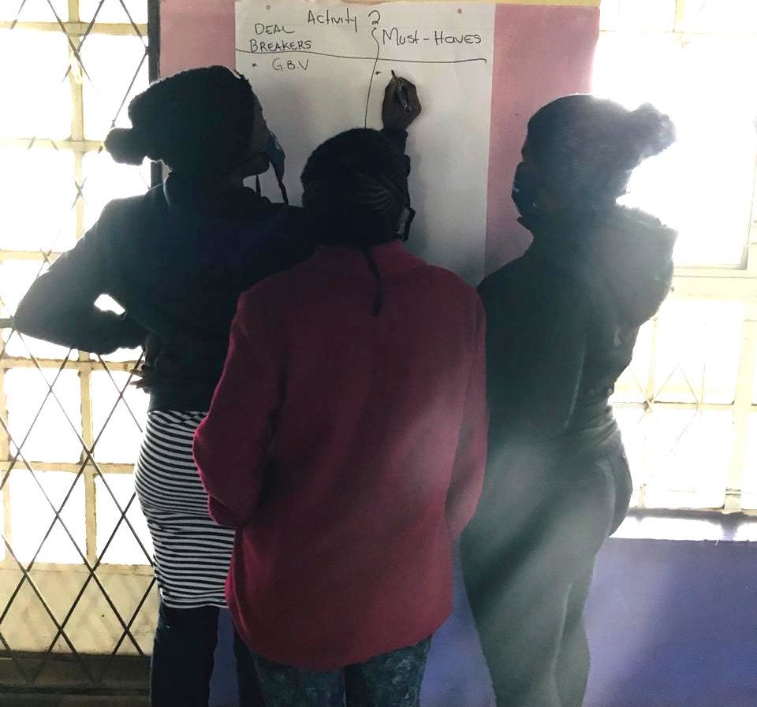
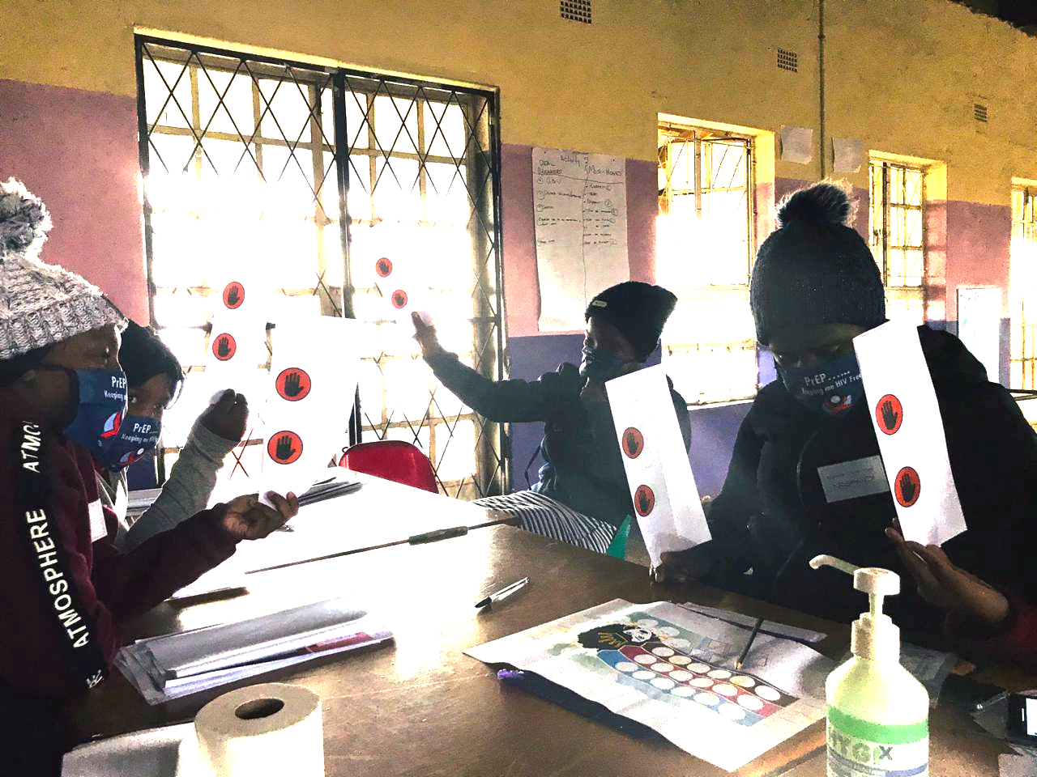
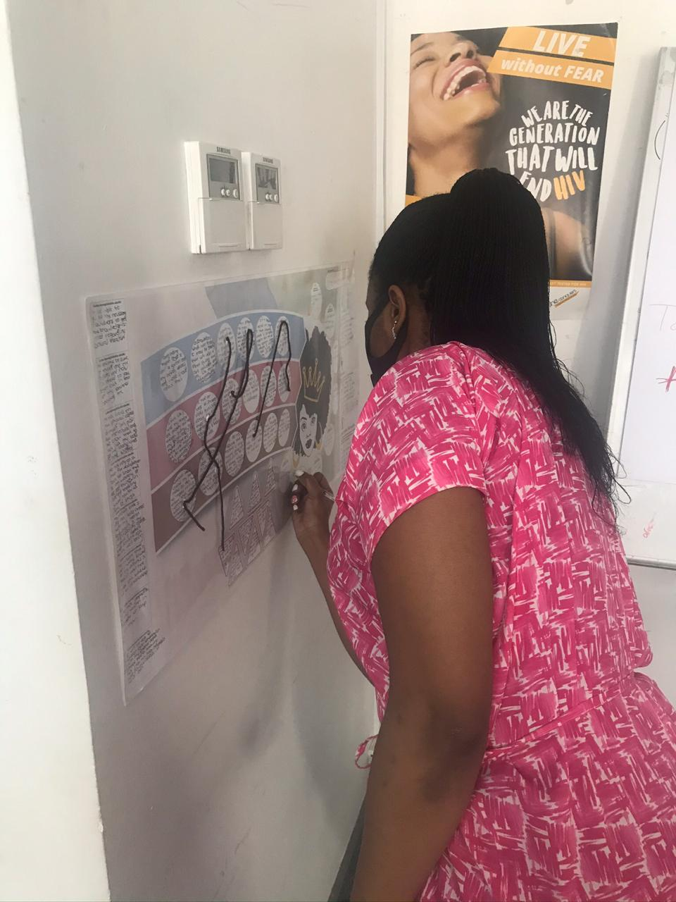
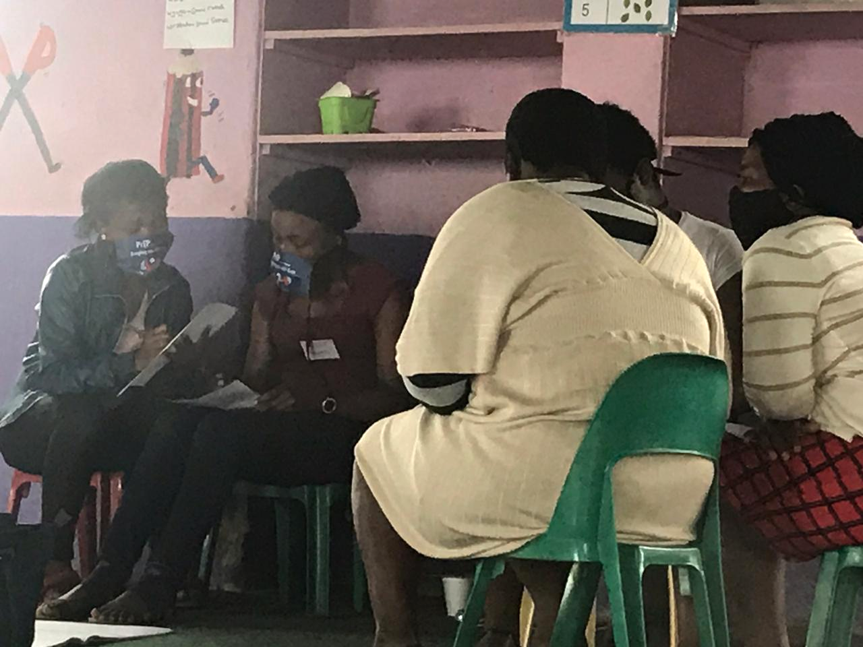
Finding Solutions: New approaches to engage AGYW
CREATING RELEVANCE THROUGH RELATIONSHIPS 13
Role playing to build communication skills in a rural community venue.
Exploring relationship “must-haves” and “deal breakers.”
13
Voting on relationship attributes during a mock call-in radio show.
Filling out “Crossing the Bridge” poster.
Reviewing diary entries from AGYW with shared goals.
Notes:
Grouped by segment, participants are engaged in group storytelling activities (like role play) and individual reflective activities to help them discover what matters to them and changes they want to make.

Slide 14
Pilot effectiveness
CREATING RELEVANCE THROUGH RELATIONSHIPS 14
The Pilot increased Product Market Readiness
Results in healthier communication styles, behaviors, and habits.
Journey progression equals healthy mindset change.
“I've changed who I was the past years to who I am this year because of the workshop that I attended.”
- Participant, Relationship Workshop
“Now I can speak for myself. Now I know that if I want to use a condom I can without anybody stopping me.”
- Participant, Relationship Workshop
AGYW progressed in their journey
to healthy sexual relationships; progression was durable over time.
Journey Stage Progression:
More than half progressed from Stage 1.
1
2
3
4
5
71%
Lifestyle Lulu
54%
Respect Rethabile
prioritise the needs of others in their relationships
‘big flip’
prioritize their sexual health in relationships
Nearly half reached the “big flip”
and are ready for prevention.
1
2
3
4
5
51%
Lifestyle Lulu
46%
Respect Rethabile
Notes:
Now, let me share with you the results of The Pilot.
The pilot was effective because it help AGYW progress in their journey, and that progression was durable over time.
More than half of participants progressed beyond stage 1, and nearly half reached the “big flip” and are ready for prevention.
The pilot was successful in bringing about this mindset shift that results in healthier communication, behaviors, and habits.

Slide 15
Pilot effectiveness
Increased relevance and preference for HIV services
End of Workshop
3 months later
INTEREST IN PrEP
Increased interest in PrEP.
Increased likelihood of testing.
Increased likelihood of asking partner to get tested.
82% of Respect Rethabiles
100% of longitudinal study participants
97% of Lifestyle Lulus
51% very interested in trying PrEP (end line)
74% of longitudinal study participants
LIKELIHOOD OF TESTING (SELF REPORTED)
65% of Respect Rethabiles
77% of longitudinal study participants
71% of Lifestyle Lulus
LIKELIHOOD OF ASKING PARTNER TO GET TESTED
70% of Respect Rethabiles
92% of longitudinal study participants
74% of Lifestyle Lulus
Notes:
The pilot increase relevance of HIV Prevention and intent towards key behaviors, helping to establish/reinforce healthier mindsets:
These resulted in increased interest in PrEP, likelihood of testing, and likelihood of asking partner to get tested.

Slide 16
Pilot effectiveness
CREATING RELEVANCE THROUGH RELATIONSHIPS 16
End of Workshop
3 months later
Increased prevention behaviors
PrEP INITIATION
Respect Rethabiles
Higher proportion of longitudinal study participants in stage 4/5 reported PrEP initiation
COMMUNICATION WITH PARTNER ABOUT RELATIONSHIP
Increased PrEP initiation, testing, partner testing, and family planning / SRH.
Increased communication with partner about their relationship.
Increased communication with partner about sex.
Produced more returns for advice and referrals than other programmes.
85% of longitudinal study participants
Respect Rethabiles
COMMUNICATION WITH PARTNER ABOUT SEX
87% of longitudinal study participants
Respect Rethabiles
SERVICES RECEIVED (Respect Rethabile) | Data Abstraction (n=125) | Longitudinal Self-Report (n=39)
Tested for HIV | 31% | 69%
Partner Tested for HIV | -- | 54%
Family Planning/SRH | 6% | 46%
PrEP* | 19% | 36%
Notes:
The Pilot increased prevention behaviors:
increased PrEP initiation, testing, partner testing, and family planning.
There were also important self-reported changes in relationship dynamics:
Increased communication with partners about their relationship, and about sex.
According to IPs, the pilot produced more “returns” for advice and referrals than other programs.

Slide 17
Pilot effectiveness
CREATING RELEVANCE THROUGH RELATIONSHIPS 17
Created a lasting sense of Sisterhood
Successful creation of a safe, trusting environment of Sisterhood
Facilitators modeled supportive, non-judgmental relationships and healthy communication styles
Establishment of WhatsApp groups for communication outside of sessions critical to building trust
Small group sizes and one on one support from facilitators were also important factors
Maintenance of relationships with participants (WhatsApp, meetups) and continued mentorship from facilitators at 3 months post-Workshop
“I am a person who doesn’t like to talk… but wow…my facilitators, I could express my feelings and know I wouldn’t be judged. It was very comforting.”
- Participant (Lifestyle Lulu)
Facilitators and other participants became trusted confidants that filled an unmet need for social support.
“What motivated me was that even at home I do not have that one person I can talk to, so when I got here… I found sisters from outside.”
-Participant (Respect Rethabile)
Notes:
The Pilot created a lasting sense of sisterhood among participants and facilitators, filling an unmet need for social support.
Small group size, activities, and facilitation were designed to create a safe, trusting environment to foster relationship building.
Facilitators avoided judgment and modeled healthy communication.
WhatsApp groups helped to build and maintain relationships between sessions and continued months after Workshop ended.

Slide 18
Pilot effectiveness
CREATING RELEVANCE THROUGH RELATIONSHIPS 18
Demonstrated need for Prevention Ecosystem
The Relationship Workshop sustained AGYW engagement.
Many participants expressed that they didn’t want the Relationship Workshop to end.
Mean number
of sessions attended:
4.4
Increased interest in further support to achieve relationship goals.
Increased advice and support seeking after workshop.
0
1
2
3
4
5
End of Workshop
3 months later
INTEREST IN FURTHER SUPPORT TO ACHIEVE RELATIONSHIP GOALS
74% of Respect Rethabiles
95% of longitudinal study participants
93% of Lifestyle Lulus
100% of longitudinal study participants
FURTHER ADVICE OR SUPPORT SEEKING POST WORKSHOP
29% from facilitators
87% of longitudinal study participants
24% from friends /participants
20% from peer educators/health workers
Notes:
One last point about the Pilot’s effectiveness:
The Pilot demonstrated the need for a prevention ecosystem.
Indicators of this need -
Increased interest in further support to achieve their relationship goals.
The Workshop sustained high engagement, and many participants didn’t want the Workshop to end.
Increased advice and support seeking behaviors after the Workshop.

Slide 19
Implications for HIV Prevention & Beyond
CREATING RELEVANCE THROUGH RELATIONSHIPS 19
Scaling Relationship Workshop
Enhance broader market readiness strategy to prepare AGYW to adopt and sustain HIV prevention methods.
Optimize the Workshop for scale, appeal to wider AGYW audiences across geographies, and AGYW considered at “lower risk.”
Create marketing events and activities to eliminate pilot recruitment bottleneck.
Extend the impact of the program to other programs within the IP organization.
Integrate programs easily into AGYW’s lives
Provide options for timing, locations, and transportation.
The Relationship Workshop could be applied across geographies to create demand at scale.
Notes:
Now we’ll talk about the broader applicability of this work.
The first thing that could be done to leverage this work is to deploy the Relationship Workshop at scale. This effort would help to prepare the market and create a pipeline for uptake of products and services across geographies and risk categories.
To attract participants at scale, the Workshop should be marketed with events and experiences that are targeted for each segment, and made easy to attend.

Slide 20
Implications for HIV Prevention & Beyond
CREATING RELEVANCE THROUGH RELATIONSHIPS 20
Operational mindset shift
Personalization by segment is feasible, useful and has the potential to produce outsize impact.
Hybrid digital and in-person implementation approach leads to better engagement and sustainable behavior change
Facilitators / peer educators must serve as positive role models (“Real Talk Auntie”)
IPs need support through change management.
  Communication
  Buy-in from current staff
  Staffing
The Pilot demands a change in mindset from implementers,
not just AGYW.
Notes:
IPs wishing to implement the Relationship Workshop should be aware that doing something different requires a change in mindset from themselves, not just AGYW.
The Pilot proved that personalization by segment is not only feasible, but highly effective.
Hybrid digital and in-person approach meets AGYW where they are and supports behavior change better than either method alone.
Facilitators must embody the Real Talk Auntie support role, not just impart information.
This change in approach requires effective internal communication, buy-in from current staff, and skillful facilitation.

Slide 21

Implications for HIV Prevention & Beyond
CREATING RELEVANCE THROUGH RELATIONSHIPS 21
2
Prioritization
Design Aid
How has this work been used to create impact?
The following organizations have applied the insights and pilot findings to date:
SANAC - Core Services & Risk assessment tool
WINDYBROW / LEFIKA / ANOVA - Segmentation Quiz & Relationship Workshop
NACOSA - Workshop for third segment, Offline game based segmentation tool, Imagine programme
Visual map to prioritize problems across the AGYW journey to healthy sexual relationships, identify gaps, and opportunities for current programming.
BMGF, national government, NGOS and smaller CBOS all recognize the value and have adapted it to their constituent needs, capacity, and infrastructure.
Which problems
should we focus on?
Relationship Workshop
Recognised by Fast Company:
World Changing Ideas of 2021 for Health
Notes:
This work has been widely accepted, has garnered awards, and has been adapted to constituent needs, capacity and infrastructure.
The following organizations have applied these insights and pilot findings to date:
SANAC is working on core services & a Risk Assessment tool based on the segments.
WINDYBROW / LEFIKA / ANOVA created a segmentation quiz and deployed the Relationship Workshop.
NACOSA deployed a workshop for the third segment, created an offline game based segmentation tool, and developed the “Imagine” program based on this work. We’ll show you what this looks like.

Slide 22


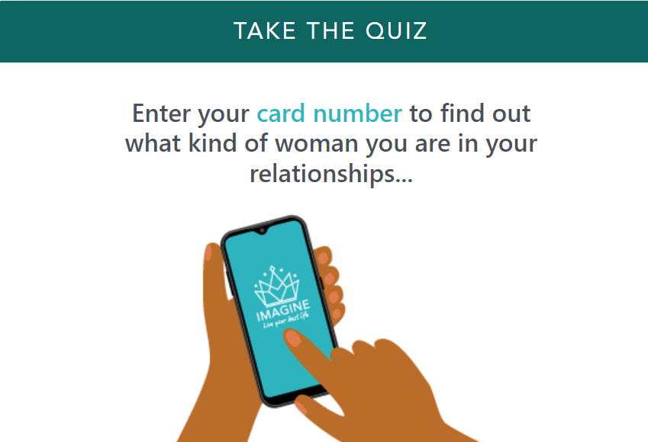
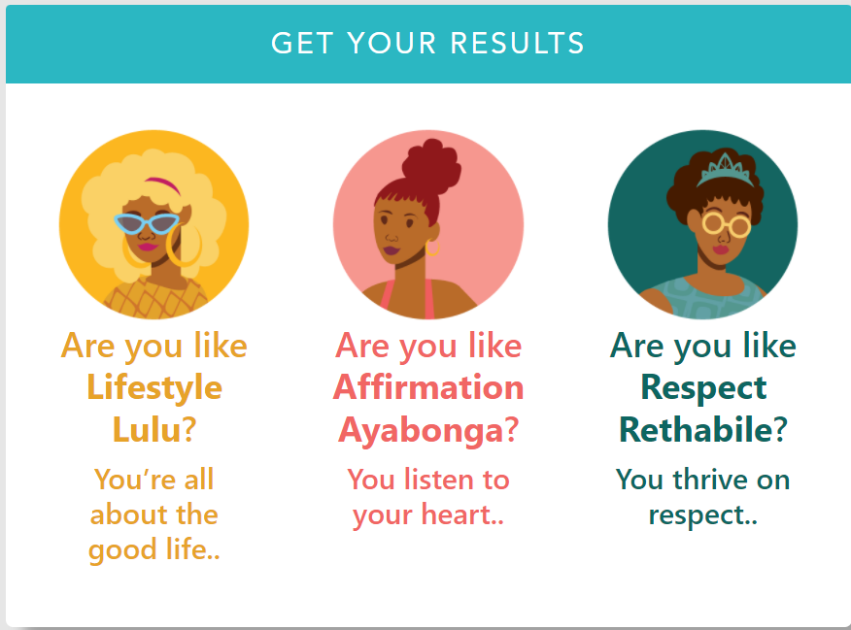


Implications for HIV Prevention & Beyond
CREATING RELEVANCE THROUGH RELATIONSHIPS 22
This work is foundational to “Imagine” programme.
Lifestyle
Network
NACOSA leveraged insights and concepts from this work to create ‘Imagine.’
Segmentation
Quiz
‘Real Talk Auntie’
/ Safe Space
Notes:
NACOSA incorporated the approach into the new “Imagine” program, considered a key intervention in the HIV prevention space.
The goal was to test social impact bond based on programs found to be effective (rephrase?)
The intent is to increase relevance of all services by ensuring use of AGYW segment lens.
NACOSA leveraged the insights and concepts from this body of work to design the program.

Slide 23
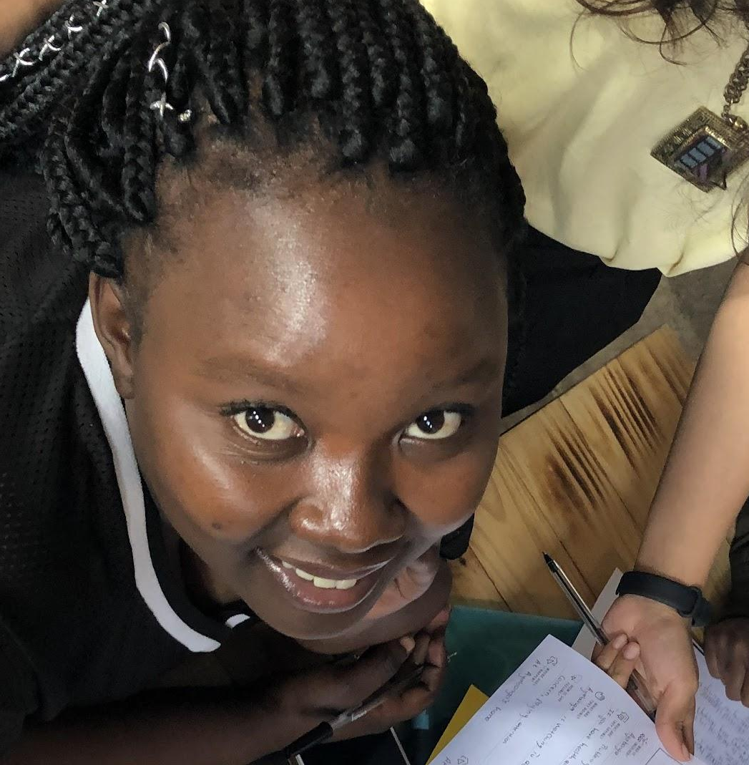
Implications for HIV Prevention & Beyond
CREATING RELEVANCE THROUGH RELATIONSHIPS 23
How can this work impact
the health system?
Support development of Prevention Ecosystem so future products have a chance to be successful.
Integrate approach beyond HIV:
Leverage relationship goals and prevention habit frame for other health interventions such as Family Planning
Notes:
Here are the top things that you can do as an organization to impact the health system based on this work.
Support the development of a prevention ecosystem to ensure success of product introductions.
Integrate this approach into programmes beyond HIV, such as family planning.
Apply the lenses of:
Relationship goals
Prevention habit frame

