Slide 1
Rollout Scenarios Analysis for the Introduction of the PrEP Ring
PLAN 4 RING TOOLKIT

Slide 3
Overview
Purpose of this tool
As countries consider the dapivirine vaginal ring (the PrEP ring, or the ring), a major decision is how and where the ring should be introduced relative to oral pre-exposure prophylaxis (PrEP).
The Rollout Scenarios Tool can be used by policymakers or others supporting policy development for the PrEP ring to define an approach to phased rollout.
The tool uses existing data, including data on HIV incidence and oral PrEP use, to develop an analysis that prioritizes subnational regions (e.g., provinces, states, districts, or counties) for PrEP ring rollout and defines several scenarios for rolling out the ring.
While countries have largely found this analysis to be useful, it does not replace a robust modeling exercise that can provide more accurate estimates and comparisons of impact and cost.

Slide 4
PrEP Ring Scenario Rollout
Overview of contents
The analysis is conducted in three steps:
Data Collection
Data Analysis
Scenario Development
1
2
3
Step 1: Data collection
Gather data inputs on HIV incidence and oral PrEP use at the subnational level for use in the analysis.
See slide 4
Step 2: Data analysis
Analyze the collected data using the framework and charts provided in this tool.
See slides 5–7
Step 3: Scenario development
Prioritize delivery channels for the PrEP ring based on the assessment and plan for next steps.
See slides 8–9
An example of the analysis completed for Kenya in 2021 is included on slides 11–13.

Slide 5
Step 1: Data Collection
Data inputs for rollout scenarios analysis
Below is a list of “must have” data and “nice to have” data to collect for the rollout scenarios analysis. Data should be collected at the subnational level (e.g., state, district, province, county level). Please note that all the data are specific to women, because the PrEP ring is designed for vaginal use.
Note that a pre-formatted Excel sheet for data collection can be found here.
“Must have” data for each subnational region:
New HIV infections (All women | AGYW)
Current oral PrEP users (All women | AGYW)
Presence of key oral PrEP rollout projects (e.g., DREAMS)
Population (All women | AGYW)
HIV incidence rate (All women | AGYW)
“Nice to have” data for each subnational region:
HIV testing/knowledge of HIV status – If this is a factor that varies widely across regions, it can be helpful to consider because regions with higher HIV testing rates will be more “ready” to introduce the ring.
Oral PrEP discontinuation rate – If this is a factor that varies widely across regions, it can be helpful to consider because regions with high oral PrEP discontinuation may benefit from the ring as an alternative option.
Modern contraceptive use rate – If this is a factor that varies widely across regions, it can be informative because family planning services are likely to be a good channel for ring delivery.

Slide 6
Step 2: Data Analysis Framework
This framework is organized around two major dimensions; however, each dimension can be customized as needed.
Rollout Scenario Framework: Plot subnational regions along two axes: HIV incidence and size of key populations, as described below. Circle size can represent the absolute number of new HIV infections.
HIV Incidence
1
This determines a region’s need for investment in new HIV prevention solutions, including the ring, and prioritizes counties for ring rollout.
Regions with higher HIV incidence are higher priority for ring rollout.
Plot subnational regions along the X-axis by HIV incidence (i.e., rate of new HIV infections among women or AGYW).
2
Plot subnational regions along the Y-axis by current oral PrEP uptake. This determines how a region should roll out the PrEP ring.
In regions with high oral PrEP uptake, the PrEP ring can be integrated into existing systems, processes, and channels developed for the rollout and scale-up of oral PrEP.
In regions with low oral PrEP uptake, the ring may provide a complementary option that can be delivered through alternative channels to expand the reach of biomedical HIV prevention to populations that do not or cannot access oral PrEP.
Oral PrEP uptake

Slide 7
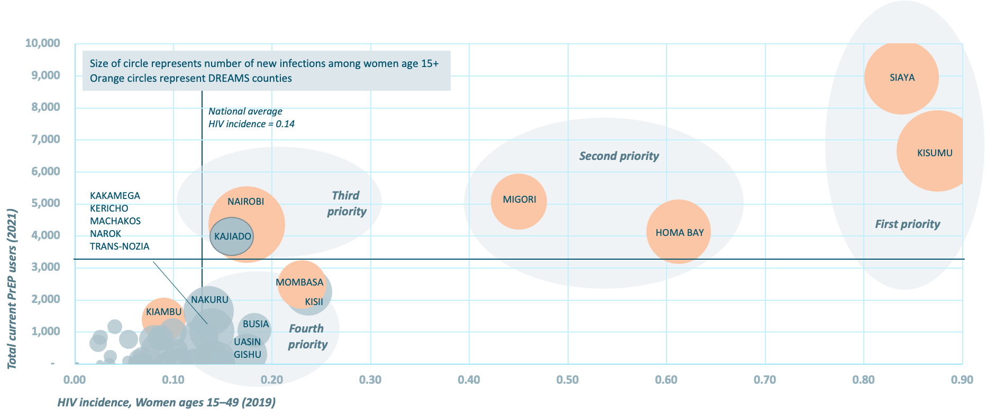
Step 2: Data Analysis Example
Below is an example of the analysis output. Greater detail is included on slides 13 and 14.

Slide 8
Step 2: Data Analysis Chart
The chart below can be completed for the rollout scenario analysis.
Right click on the chart to “Edit Data in Excel” and copy data from the data collection spreadsheet into the file.
The columns include the name of the subnational region, HIV incidence data (X axis), PrEP use data (Y axis), and data on the annual number of new HIV infections (bubble size).
This will produce a bubble chart (see further examples on slides 12–14).
Total Current PrEP Users
HIV Incidence

Slide 9
Step 3: Regional Assessment
When completed, the analysis will sort regions into four categories that can inform the rollout scenarios.
Define thresholds for each quadrant based on the distribution of regions along the chart. Identify which subnational regions fall into each quadrant.
Moderate priority
Roll out the PrEP ring in these regions by building on oral PrEP rollout in regions where ring introduction does not require significant additional investment.
High priority
Prioritize introduction of the ring in these regions, largely building on processes and systems developed for oral PrEP rollout and scale-up.
Total Current PrEP Users
Low priority
Deprioritize these regions for initial ring rollout when resources are limited.
High priority
Prioritize introduction of the ring in these regions but explore new channels that will complement existing oral PrEP delivery points to expand the reach of HIV prevention delivery to new users.
HIV Incidence

Slide 10
Step 3: Scenario Development
Based on the analysis, consider several scenarios that could guide the rollout of the PrEP ring. Three possible scenarios are included below, but these should be customized to reflect what is most relevant based on a country’s context.
Scenario | Description | Regions | Number of regions | Size of target population | Percentage of new HIV infections
Scenario 1 Prioritize counties with high HIV incidence among adult women and large PrEP programs. | Roll out the ring where oral PrEP is already widely available in counties with high incidence among adult women (age 15+). | List regions that fit this scenario. | List # of regions. | Calculate total size of target population in regions in this scenario. | Calculate the percentage of new HIV infections in regions in this scenario.
Scenario 2 Prioritize all counties with high HIV incidence among adult women, regardless of oral PrEP use. | Roll out the ring in counties with high incidence among adult women (age 15+), regardless of the size of oral PrEP rollout.
Scenario 3 Prioritize counties with large numbers of new HIV infections among adult women. | Roll out the ring in counties with large numbers of new HIV infections in adult women (age 15+).

Slide 11
Example: Kenya
The following slides show an example of the rollout scenario analysis for Kenya conducted in 2021.

Slide 12
Kenya Rollout Scenarios Overview
 | First priority | Second priority | Third priority | Fourth priority | Total
Scenario 1 Prioritize counties with high HIV incidence among adult women and large PrEP programs. | 2 counties 23% (4,539) annual new infections among women age 15+ | 2 counties 15% (2,847) annual new infections among women age 15+ | 2 counties 14% (2,787) annual new infections among women age 15+ | N/A | 6 counties 52% (10,173) annual new infections among women age 15+
Scenario 2 Prioritize all counties with high HIV incidence among adult women, regardless of oral PrEP use. | 2 counties 23% (4,539) annual new infections among women age 15+ | 2 counties 15% (2,847) annual new infections among women age 15+ | 4 counties 22% (4,407) annual new infections among women age 15+ | 8 counties 19% (3,789) annual new infections among women age 15+ | 15 counties 71% (13,962) annual new infections among women age 15+
Scenario 3 Prioritize counties with large numbers of new HIV infections among adult women. | 3 counties 35% (6,833) annual new infections among women age 15+ | 2 counties 15% (2,847) annual new infections among women age 15+ | 3 counties 12% (2,403) annual new infections among women age 15+ | 4 counties 12% (2,260) annual new infections among women age 15+ | 12 counties 73% (14,343) annual new infections among women age 15+

Slide 13
Kenya Rollout Scenarios – Counties
 | Description | First priority | Second priority | Third priority | Fourth priority
Scenario 1 Prioritize counties with high HIV incidence among adult women and large PrEP programs. | Roll out the ring where oral PrEP is already widely available in counties with high incidence among adult women (age 15+). | Kisumu Siaya | Homa Bay Migori | Kajiado Nairobi | N/A
Scenario 2 Prioritize all counties with high HIV incidence among adult women, regardless of oral PrEP use. | Roll out the ring in counties with high incidence among adult women (age 15+), regardless of the size of oral PrEP rollout. | Kisumu Siaya | Homa Bay Migori | Kajiado Kisii Mombasa Nairobi | Busia Kakamega Kericho Machakos | Nakuru Narok Trans-Nozia Uasin Gishu
 |  |  |  |  | ** These counties have low PrEP uptake but high HIV incidence among women and could be a good fit for the ring, with delivery through complementary channels.
Scenario 3 Prioritize counties with large numbers of new HIV infections among adult women (age 15+). | Roll out the ring in counties with large numbers of new HIV infections in adult women (age 15+). | Kisumu Nairobi Siaya | Homa Bay Migori | Kisii Mombasa Nakuru | Kajiado Kakamega Kiambu Uasin Gishu

Slide 14
Scenarios 1 and 2
Prioritize counties with high HIV incidence among adult women (age 15+)
SIAYA
National average
HIV incidence = 0.14
Second priority
KISUMU
Third
priority
KAKAMEGA
KERICHO
MACHAKOS
NAROK
TRANS-NOZIA
NAIROBI
MIGORI
First priority
KAJIADO
HOMA BAY
Total current PrEP users (2021)
MOMBASA
NAKURU
KISII
KIAMBU
Fourth
priority
BUSIA
UASIN
GISHU
HIV incidence, Women ages 15–49 (2019)

Slide 15
Scenario 3
Prioritize counties with large numbers of new HIV infections among adult women (age 15+)
Orange circles represent DREAMS counties
SIAYA
Second priority
KISUMU
MIGORI
First
priority
KAJIADO
HOMA
BAY
NAIROBI
Total current PrEP users (2021)
KISII
MOMBASA
Third
priority
NAROK
KIAMBU
NAKURU
Fourth
priority
UASIN
GISHU
KAKAMEGA
New HIV infections among women age 15+ (2019)

