Slide 1
Situation Analysis for the Introduction of the PrEP Ring
PLAN 4 RING TOOLKIT
Blank templates from Situation Analysis Overview

Slide 3
HIV in [Country]
High-level summary of HIV in country and general trends for new infections by population groups in recent years
KEY STATISTICS¹
HIV prevalence in adults (aged 15–49) and young people (aged 15–24)
National prevalence for adults, adolescents, and key populations
Data on the current state of and recent trends in prevalence
HIV incidence in adults (aged 15–49) and young people (aged 15–24)
National incidence for adults, adolescents, and key populations
Data on the current state of and recent trends in incidence
2
Sources: (1) Source; (2) Source

Slide 4
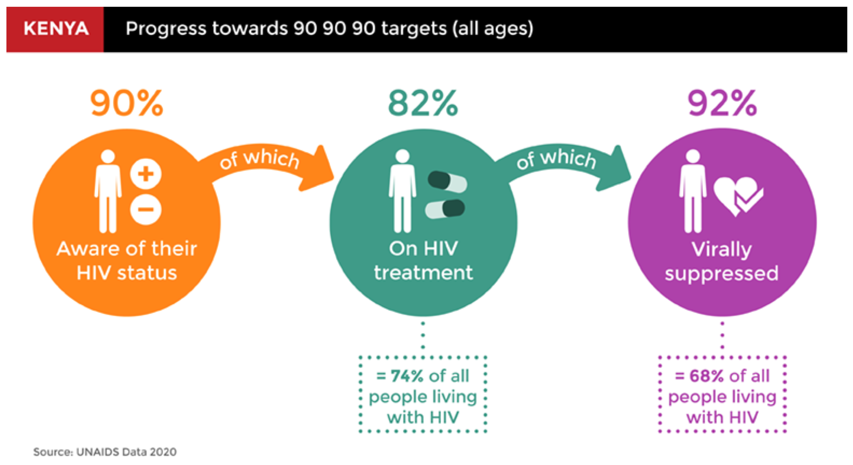
HIV in [Country]
National HIV Prevention Response
xxxxx
Xxxxx
xxxxx
KEY STATISTICS (2021)1
xxxxx
xxxxx
xxxxx
Sources: (1) Source

Slide 5
End-user Populations for the Ring
 | Adolescent girls (e.g., 10-19 years) | Young women (e.g., 19-24 years) | Serodifferent couples | Female Sex Workers | People Who Inject Drugs | Other
Key indicators
Priorization
Quesitons

Slide 6
Oral PrEP Rollout in [Country]
KEY MILESTONES FOR ORAL PrEP INTRODUCTION¹
xxxxx
Xxxxx
xxxxx
Number of PrEP users, 2017–2021
Sources: (1) Source

Slide 7
Oral PrEP Rollout — Lessons Learned
What worked well
xxxxx
Xxxxx
xxxxx
What was challenging
xxxxx
Xxxxx
xxxxx

Slide 8
Selected Desk Review Sources
Sources

Slide 9
Stakeholder Map for the Ring
 | Currently involved
 | Potential/future involvement
Type | Organization(s) | Role in PrEP ring Introduction | Planning & budgeting | Supply chain mgmt | Ring delivery platforms | Uptake & effective use | Monitoring
Governmental organizations
Development and implementing partners
Civil society organizations and community-based organizations
Private sector and/or community-based providers
Bilateral organizations and funders

Slide 10
Interview Outreach List
Organization | Interviewee(s) | Areas to probe across the PrEP Ring Introduction Framework | Status | Interview date
Organization 1 | Name | Planning & budgeting, supply chain management, monitoring | Outreach sent | Pending
Organization 2 | Name | Planning & budgeting, delivery platforms, uptake & effective use | Scheduling | Feb 2, 2022
Organization 3 | Name | Delivery platforms, uptake & effective use | Completed | Jan 5, 2022

Slide 11
Detailed PrEP Ring Introduction Framework
PLANNING &
BUDGETING
SUPPLY CHAIN MANAGEMENT
PrEP RING DELIVERY PLATFORMS
UPTAKE &
EFFECTIVE USE
MONITORING
 | Plans, systems, and processes to support service integration across priority delivery channels, including reproductive health/family planning and private sector providers/pharmacies
 | Convene new or existing subcommittee or task team within HIV prevention or PrEP technical working group.
 | Identify focus populations for ring use and set targets for ring use.
 | Engage community stakeholders to inform planning for ring rollout.
 | Develop impact, cost and/or cost-effectiveness analyses to inform ring planning.
 | Include the ring in national HIV prevention and other relevant plans (e.g., FP).
 | Develop implementation plan and budget to guide ring introduction and scale-up.
 | Register the ring and include the ring on the national essential medicines list.
 | Update supply chain guidelines and logistics systems to include the ring.
 | Conduct forecasting and/or quantification exercises to guide procurement of the ring.
 | Establish procurement, commodity monitoring, and distribution systems to avoid stock-outs.
 | Issue standard clinical guidelines for delivery and use of the ring.
 | Dedicate resources to conduct regular HIV tests, initiate ring use, and support refills.
 | Develop materials and conduct trainings for health care workers on the ring.
 | Establish referral systems to link clients from other channels to sites dispensing the ring.
 | Integrate support for partner communication and intimate partner violence (IPV).
 | Develop and implement demand creation strategies that include ring promotion.
 | Address social norms/stigma to build community and partner acceptance of PrEP.
 | Develop information and tools for clients to guide product choice and support ring use.
 | Support effective use and continuation for ring users.
 | Develop and communicate plans for sanitary disposal of used rings.
 | Establish monitoring tools to support data collection and analysis on ring use.
 | Establish systems for pharmacovigilance and to monitor drug resistance.
 | Conduct implementation science research to inform policy and program.
COLOR KEY
Opportunity to easily build on oral PrEP rollout
Will require new effort, but no anticipated challenges
Requires significant consideration specifically for the PrEP ring

Slide 12
Summary Findings Across the Framework
PLANNING &
BUDGETING
SUPPLY CHAIN MANAGEMENT
PrEP RING DELIVERY PLATFORMS
UPTAKE &
EFFECTIVE USE
MONITORING
Finding 1 | Finding 2 | Finding 3 | Finding 4 | Finding 5
Opportunities for easy introduction
Finding 1 | Finding 2 | Finding 3 | Finding 4 | Finding 5
Areas that need consideration

Slide 13
Planning & Budgeting
PLANNING &
BUDGETING
Key steps and considerations
 |  | What is needed to introduce the PrEP ring & other key considerations
 | Convene a new or existing subcommittee or task team within the HIV prevention or PrEP technical working group. | Refer to P1a & P1b in the Question Bank and include details on: Plans for a task force or TWG to lead PrEP ring introduction Timelines and/or milestones for key decisions Plan for participation of stakeholders from other relevant areas (e.g., FP, MCH)
 | Identify focus populations for ring use and set targets for ring use. | Refer to P2a & P2b in the Question Bank and include details on: Plans for end-user populations for the ring (e.g., population groups, targets set, etc.)
 | Engage community stakeholders to inform planning for ring rollout. | Refer to P3a & P3b in the Question Bank and include details on: Key lessons on community engagement from oral PrEP rollout (e.g., effective ways to authentically engage community members and hear their perspectives) Plans for engaging community stakeholders on PrEP ring introduction
 | Develop impact, cost, and/or cost-effectiveness analyses to inform ring planning. | Refer to P4 in the Question Bank and include details on: Existing analyses for oral PrEP Plans for cost-effectiveness analyses for the ring rollout
 | Include the ring in national HIV prevention and other relevant plans (e.g., FP). | Refer to P5a & P5b in the Question Bank and include details on: Key HIV prevention strategies/plans that will need to incorporate the ring; how these strategies/plans currently incorporate oral PrEP Other strategies/plans that could include the PrEP ring (e.g., plans for SRH, adolescent health, or self-care)
 | Develop implementation plan and budget to guide initial ring introduction and scale-up. | Refer to P6a & P6b in the Question Bank and include details on: Plans/timelines for introduction and scale-up of the PrEP ring Integration of the PrEP ring in HIV prevention budgets and donor requests Sources of financial resources to support PrEP ring procurement and introduction activities

Slide 14
Supply Chain Management
SUPLY CHAIN MANAGEMENT
Key steps and considerations
 |  | What is needed to introduce the PrEP ring & other key considerations
 | Register the ring and include the ring on the national essential medicines list. | Refer to S1a, S1b, & S1c in the Question Bank and include details on: Current situation/timeline for the regulatory approval of the ring Considerations for inclusion of the ring on national essential medicines lists and other key procurement and supply chain systems Considerations of how scheduling and/or classification of the ring upon approval may enable or inhibit delivery of the ring in nonclinical channels (e.g., pharmacies, community-based settings)
 | Update supply chain guidelines and logistics systems to include the ring. | Refer to S2 in the Question Bank and include details on: Existing systems, processes, and lessons learned from oral PrEP introduction Expected differences for the PrEP ring, as a new product form that has not previously been procured What is needed to include the PrEP ring in supply chain systems for other delivery channels (e.g., FP, MCH, private sector)
 | Conduct forecasting and/or quantification exercises to guide procurement of the ring. | Refer to S3 in the Question Bank and include details on: Plans for ring demand forecasting and quantification Key stakeholders engaged in demand forecasting and quantification Expected challenges and/or unknowns
 | Establish procurement, commodity monitoring, and distribution systems to avoid stock-outs. | Refer to S4 in the Question Bank and include details on: Plans for procurement, commodity monitoring, and distribution for the ring Relevant stakeholders involved Potential barriers and/or challenges to distributing the PrEP ring to non-HIV channels

Slide 15
PrEP Ring Delivery Platforms
PrEP RING DELIVERY PLATFORMS
Key steps and considerations
 |  | What is needed to introduce the PrEP ring & other key considerations
 | Issue standard clinical guidelines for delivery and use of the ring. | Refer to D1a and D1b in the Question Bank and include details on: Current state of and lessons learned from clinical guidelines for oral PrEP Plans/timelines for clinical guidelines for the PrEP ring
 | Dedicate resources to conduct regular HIV tests, initiate ring use, and support refills. | Refer to D2a, D2b, & D2c in the Question Bank and include details on: Lessons learned from oral PrEP rollout Potential opportunities/barriers for the introduction of the ring Required resources for successful ring rollout Considerations for other channels (e.g., access to HIV tests)
 | Develop materials and conduct trainings on the ring for health care workers. | Refer to D3a, D3b, D3c, & D3d in the Question Bank and include details on: Materials and models for provider training on oral PrEP and plans to integrate the PrEP ring Opportunities to train other health care providers on the PrEP ring Plans to engage and train health care providers on vaginally inserted methods and how to communicate and support decision-making about multiple methods Considerations to train health care providers in non-HIV channels
 | Establish referral systems to link clients from other channels to sites dispensing the ring. | Refer to D4a, D4b, & D4c in the Question Bank and include details on: Existing referral systems for oral PrEP (e.g., from non-HIV channels such as FP and/or from HTS)
 | Integrate support for partner communication and intimate partner violence (IPV). | Refer to D5 in the Question Bank and include details on: Existing screening and supportive services for oral PrEP users experiencing IPV and potential to extend services to PrEP ring users Opportunities to integrate considerations for vaginally inserted methods into existing IPV support

Slide 16
Uptake & Effective Use
UPTAKE & EFFECTIVE USE
Key steps and considerations
 |  | What is needed to introduce the PrEP ring & other key considerations
 | Develop and implement demand creation strategies that include ring promotion. | Refer to U1a and U1b in the Question Bank and include details on: Lessons learned from oral PrEP rollout Existing campaigns, materials, etc., developed for oral PrEP that could include the PrEP ring Plan for demand creation for the ring or other SRH products that can be relevant for creation of materials for the ring (e.g., moon cup, diaphragm, internal condom, etc.)
 | Address social norms/stigma to build community and partner acceptance of PrEP. | Refer to U2a & U2b in the Question Bank and include details on: Key areas of concern for stigma/social norms Lessons learned from oral PrEP rollout or other SRH products Effective methods to address stigma/social norms for the PrEP ring
 | Develop information and tools for clients to guide product choice and support ring use. | Refer to U3a & U3b in the Question Bank and include details on: Existing information and tools for clients developed for oral PrEP that could include the PrEP ring Plan/timelines to adapt materials for ring introduction Need to create materials and/or approaches to supporting end-user choice among options
 | Support effective use and continuation for ring users. | Refer to U4a & U4b in the Question Bank and include details on: Lessons learned from oral PrEP adherence and continuation Key opportunities/challenges for the ring
 | Develop and communicate plans for sanitary disposal of used rings. | Refer to U5a & U5b in the Question Bank and include details on: Plans/timelines for communication on ring disposal

Slide 17
Monitoring
MONITORING
Key steps and considerations
 |  | What is needed to introduce the PrEP ring & other key considerations
 | Establish monitoring tools to support data collection and analysis on ring use. | Refer to M1a, M1b, & M1c in the Question Bank and include details on: Current systems and indicators for monitoring oral PrEP delivery at the facility, regional, and national levels Opportunities to include the PrEP ring in monitoring tools alongside oral PrEP Opportunities/barriers to integrating the ring into monitoring systems for FP and other non-HIV services and/or to linking private sector delivery to public sector monitoring systems
 | Establish systems for pharmacovigilance and to monitor drug resistance. | Refer to M2 in the Question Bank and include details on: Current plans for pharmacovigilance for oral PrEP and plans to integrate the PrEP ring Considerations for pharmacovigilance if the PrEP ring is approved for use without a prescription (e.g., need to create a hotline, include information with the PrEP ring package)
 | Conduct implementation science research to inform policy and program. | Refer to M3 in the Question Bank and include details on: Plans for demonstration projects and/or key implementation science questions for initial, phased PrEP ring rollout Plans for ongoing implementation science research to inform programming of the PrEP ring in future years

Slide 18
Remaining Key Questions
PLANNING &
BUDGETING
SUPPLY CHAIN MANAGEMENT
PrEP RING DELIVERY PLATFORMS
UPTAKE &
EFFECTIVE USE
MONITORING
Question 1 Question 2 Question 3 | Question 1 Question 2 Question 3 | Question 1 Question 2 Question 3 | Question 1 Question 2 Question 3 | Question 1 Question 2 Question 3

