Slide 1
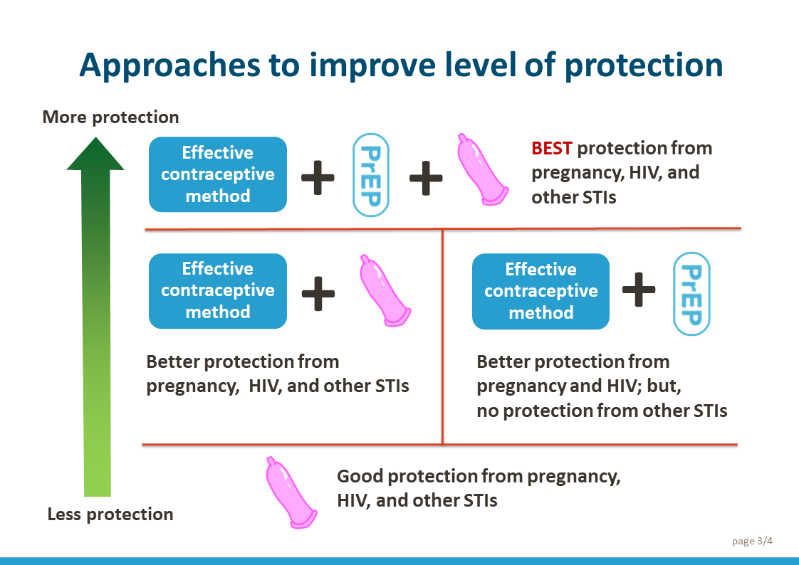
Counseling about oral PrEP in family planning (FP) settings: A job aid for FP providers
Client wants to initiate a contraceptive method
Client continuing contraceptive method use; came for follow-up
Help client to make a voluntary, informed choice of contraceptive method
Assess client satisfaction; address any concerns; provide contraceptive method as needed (resupply, re-injection, or new)
Assess risk of STI/HIV exposure per national guidelines (or WHO global guidelines); for return client, assess if behaviors or circumstance have changed since last visit; establish the need to prevent STI/HIV infection in addition to pregnancy
Describe behaviors and circumstances that may increase risk of STI/HIV exposure (see reverse side, Box 1). Ask client:
Do any of these situations apply to you?
AND
Do you think you need STI/HIV prevention for some other reason?
Describe approaches to preventing STIs/HIV and pregnancy (show client the visual aid on page 3 while describing the approaches):
Help client to make an informed choice of the approach to prevent STIs/HIV (see reverse side, Box 2). Considerations:
Need for partner engagement
Need for privacy
Ability to take pills daily
Possibility of partner violence
Yes to any one question; increased risk
If interested in PrEP:
Ask what client knows about it
Provide information as needed (see reverse side, Box 3); as indicated, offer PrEP onsite or through referral
No to both questions; no increased risk
Proceed with rest of FP visit
page 1/4

Slide 2
Box 1: Use national guidelines (where available) to assess risk of STI/HIV exposure
Box 2: Facilitate informed choice of STI/HIV prevention approaches
Box 3: Provide information about oral PrEP
In general, a person who experienced any of these in the last 3 months may be at increased risk of STI/HIV exposure:
Had sex without a condom with one or more partners:
whose HIV status is not known.
who may have been exposed to HIV due to sexual or injection drug using behavior.
Has been diagnosed or treated for an STI or has had symptoms to indicate a possible STI.
Has used emergency contraception (which implies sex without a condom).
Used or wanted to use PrEP or post-exposure prophylaxis (PEP) due to possible HIV exposure.
Has shared injection drug material and/or equipment.
Had sex without a condom with partner who has HIV and:
is not on antiretroviral therapy (ART).
is on ART but not taking medications daily.
has been on ART for less than six months.
still has a high viral load (or viral load is not known).
Questions to ask client when making an informed choice:
If you do not know your partners’ HIV status, would you be able to discuss it with them?
How do you feel about talking to your partner(s) about oral PrEP?
How do you feel about talking to your partner(s) about condom use?
Do you think you and your partner(s) will have access to and be willing to use condoms every time you have sex?
How do you think your partner(s) may feel about you taking oral PrEP? Would they support you?
Do you have reasons to fear a violent reaction from your partner(s)?*
If you must hide your PrEP use from your partner(s), will you be able to store and take your pills without their knowledge?
Do you think you can remember to take a PrEP pill every day?
Key messages:
PrEP stands for Pre-Exposure Prophylaxis; prophylaxis means prevention of disease.
PrEP allows individuals who may be exposed to HIV to remain HIV-free.
PrEP combines two different antiretroviral drugs in one pill. These are two of the same drugs that are commonly used as part of ART to treat HIV.
To prevent HIV infection, one pill should be taken every day, even on days when the person does not have sex.
PrEP is highly effective if taken correctly. However, 7 days of continuous use are needed for it to become effective.
A client must test negative for HIV before PrEP is started.
PrEP users must come for follow-up visits with a provider one month after starting PrEP and every three months thereafter. An HIV test is done during every visit.
PrEP is safe to use during pregnancy and breastfeeding, and with contraception. PrEP does not make hormonal contraceptives less effective.
For the first few weeks, PrEP may cause mild side effects such as nausea, abdominal cramps, and headaches.
PrEP is not for people living with HIV, people with symptoms suggestive of acute HIV infection, or people with poor kidney function.
PrEP does not prevent other STIs. Consider using condoms in addition to PrEP.
PrEP users can stop PrEP anytime they feel there is no more risk of HIV exposure. To stop safely, continue taking PrEP for 7 days after your last possible exposure to HIV.
* If client is at risk of, or reports partner violence, refer for care as needed. Clients who experience partner violence should not be prohibited from using PrEP. Providers should help them consider how to use it safely.
October 2022
page 2/4

Slide 3


Approaches to improve level of protection
More protection
Effective contraceptive method
+
+
BEST protection from pregnancy, HIV, and other STIs
+
+
Effective contraceptive method
Effective contraceptive method
Better protection from pregnancy, HIV, and other STIs
Better protection from pregnancy and HIV; but, no protection from other STIs
Good protection from pregnancy, HIV, and other STIs
Less protection
page 3/4

Slide 4
Instructions for using the visual aid: Approaches to improve level of protection
An important responsibility of FP providers is helping clients decide how they can prevent pregnancy, HIV, and other STIs and what approach will work best for them. This visual aid can help explain the available options. Show the visual aid to the client when describing how various approaches provide less or more protection.
Condoms alone provide good protection from pregnancy as well as from HIV and other STIs, but only if used consistently and correctly every time you have sex. This requires access to condoms. It also requires that a partner be willing to use a condom. Unless you can negotiate condom use with every partner, this approach may not provide the desired protection. In addition, it is not as effective for pregnancy prevention as some other contraceptive methods. [Use the method effectiveness chart to discuss which methods are more effective at preventing pregnancy.]
Using an effective contraceptive method and a condom provides better, more reliable protection from pregnancy. However, while a condom offers protection from HIV/STIs, it depends on a partner’s willingness to use it and you may or may not have control over it (even if you use a female condom, partner engagement is still required).
Using an effective contraceptive method (other than a condom) and taking a PrEP pill provides better protection from pregnancy and HIV. The advantage is that you can control how consistently you take PrEP to ensure reliable HIV protection; however, it doesn’t protect from other STIs.
Finally, using an effective contraceptive method in combination with a condom and oral PrEP provides the best protection from pregnancy, HIV, and other STIs—even though reliable STI protection still depends on your access to and partner’s willingness to use a condom.
Clients who come for FP services rely on providers to create a supportive environment where they can openly discuss their concerns.
When counseling clients, focus on helping them consider what is possible for them to control given their individual circumstances and decide which approach best suits them. The questions in Box 2 on page 2 are designed to help clients consider what is possible in their individual situation. If counseling partners together, adapt the questions as needed.
Support from partners improves contraceptive continuation and may also improve correct and consistent use of PrEP—encourage partner engagement if it’s possible and safe for the client.
October 2022
page 4/4

