Slide 1
Building community acceptance for PrEP use among adolescent girls & young women in east and southern Africa
Evidence & experience review | 2022

Slide 2
Table of contents
1
Purpose and Approach
Theoretical Framework for the Review
2
Understanding the Influence of Community
3
Promising Interventions to Build Community Acceptance
4
5
Intervention Deep Dives (PrEP & Sector Adjacent)
6
Annex

Slide 3
Acronyms
AGYW | Adolescent Girls and Young Women
AIDS | Acquired Immunodeficiency Syndrome
ARH | Adolescent Reproductive Health
ART | Antiretroviral Therapy
BMGF | Bill & Melinda Gates Foundation
CA | Community Activist
CBPR | Community-Based Participatory Research
CIFF | Children's Investment Fund Foundation
EECO | Expanding Effective Contraceptive Options
FP | Family Planning
GBV | Gender-Based Violence
GEM | Gender-Equitable Men
GMP | Grandmother Project
HCD | Human-Centered Design
HCW | Healthcare Worker
HH | Household
HIV | Human Immunodeficiency Virus
HS | Husbands’ Schools
IEC | Information, Education and Communication
IPV | Intimate Partner Violence
LMIC | Low- and Middle-Income Countries
NGO | Non-Governmental Organisation
NN | Ni Nyampinga
PrEP | Pre-Exposure Prophylaxis
PSI | Population Services International
RCT | Randomized Control Trial
RH | Reproductive Health
RMA | Reaching Married Adolescents
SBC | Social and Behavior Change
SCI | Soul City Institute
STF | Straight Talk Foundation
STI | Sexually Transmitted Infections
TDF | Theoretical Domains Framework
TOC | Theory of Change
USAID | United States Agency for International Development

Slide 4
1
Purpose and approach

Slide 5
Purpose of the review
The purpose of this document is to review evidence that can be used to inform the design of interventions to generate community acceptance of women and girls’ use of PrEP products, with a particular focus on sexual partners, parents and peers. This includes potential inclusion within the CATALYST study, under the MOSAIC Project. The following questions are explored in the review:
1.
At what stage of the user journey for PrEP products is the influence of parents, peers and partners most important? What support do AGYW seek from these influencers?
What factors/determinants (e.g. attitudes, beliefs, norms) drive community acceptance for the use of PrEP by women and girls? What can sector-adjacent literature (e.g., HIV prevention, HIV treatment, reproductive healthcare) tells us about other potential factors/determinants that drive community acceptance among these influencers?
2.
3.
What interventions have shown promise in building community acceptance for use of HIV and reproductive healthcare services? What data have suggested these interventions are promising?
This review is focused on cisgender adolescent girls and young women. It is critical for further work to better understand how community acceptance for transgender AGYW can be addressed to ensure equitable access to PrEP services.

Slide 6
The review process
Desk Review: Examining the peer-reviewed and grey literature on community acceptance for sexual and reproductive healthcare services, including PrEP. The review explored the potential role of key influencers, facilitators and barriers to supporting PrEP use among AGYW, and promising interventions for adaptation.
Action Tank: Convening implementers, Ministries of Health, young people and funding partners to review the evidence, capture programmatic learnings, identify further evidence gaps, and identify specific opportunities for intervention adaptation.
Throughout this document, insights and feedback from the Action Tank are delineated from desk review findings by their red font color. Additional slides have been added to capture other Action Tank discussions such as key gaps in our understanding of influencers and relevant intervention insights.

Slide 7
Desk review
This desk review looks at evidence and promising programs from the HIV sector (prevention, treatment and care) and ‘sector-adjacent’ fields which include other areas of reproductive healthcare (family planning, maternal health). This review did not follow PRISMA guidelines for a systematic review and should not be considered as such.
Peer-Reviewed Literature | Grey Literature
We screened 468 peer-reviewed articles; 57 met the criteria for inclusion and were reviewed | We screened 22 project websites, including 18 contraceptive sites, two social behavior change (SBC) omnibus sites and two HIV/PrEP websites to identify program write-ups, toolkits and presentation briefs
Inclusion Criteria: Sub-Saharan Africa Interventions implemented and/or published between 2010-2022 Key Search Terms: Community acceptance OR community support OR parental support OR partner support OR provider support AND PrEP OR HIV OR reproductive health OR contraception OR family planning AND factors OR determinants OR barriers OR intervention OR projects | Selection Criteria: Published between 2015-2021 Sites identified by a recent literature review conducted by the USAID Expanding Effective Contraceptive Options (EECO) Project that explored SRH products and services’ access for AGYW. This review referenced relevant implementer websites, including: Jhpiego, Breakthrough Action, Engender Health, JHUCCP, Pathfinder, JSI, Passages Additional implementer websites that included links to project material included: COMPASS, Breakthrough Research, MSI and PSI, AVAC and Options Interventions recommended by MOSAIC country teams who were consulted for additional inputs based on their expertise in the HIV prevention field

Slide 8
Action Tank
To ensure that the findings reflected the most up-to-date learnings in the field, the preliminary desk review findings were refined and expanded in an April 2022 Action Tank.
What? | Why? | Who? | When and How?
Identify the most important gaps in our understanding of the desired role for AGYW key influencers, and the factors that drive their behavior | Inform the design of a potential partner/parent qualitative sub-study within CATALYST | MOSAIC implementing partners Ministries of Health from Kenya, Uganda, Eswatini, Lesotho, Zambia and Zimbabwe Young girls from South Africa and Zimbabwe Funding partners including USAID, CIFF and Global Fund A detailed participant list is included in Section 5 | Eight hours of remote consultation on 26 and 27 April 2022
Distill key insights from existing PrEP interventions targeting these influencers, which should be reflected in future efforts to drive demand for PrEP (e.g., under MOSAIC and other investments) | Inform demand generation activities under MOSAIC and, potentially, other PrEP investments
Capture the key elements of “sector-adjacent” interventions which offer promising opportunities to learn from & adapt within PrEP programs targeting AGYW

Slide 9

This review focuses on community acceptance among partners, peers and parents/caregivers
Reviewed literature suggests that AGYW consider sexual partners, peers, and parents to be the most immediately influential for SRH decision-making and/or the most preferred for support*. The literature also suggests that each has a different role in this influence. This review will focus on these preferred primary influencers and the factors that impact their acceptance of AGYW’s use of RH services.
Primary influencers (individuals with consistent, direct contact with AGYW, who AGYW identify as preferred influencers)
Boys and men who are their intimate partners Parents and/or caregivers, especially cohabiting mothers Female peers, both users and non-users of PrEP
Other influencers (individuals who influence AGYW often through social rules, norms, services etc., but who may not have daily interaction with them)
Community leaders, including religious and cultural leaders are important stakeholders – influencing norms, resources and AGYW’s access to reproductive healthcare services and information – but they do not typically directly engage with AGYW on these topics and they are not preferred sources of information. Healthcare workers, both facility and community-based across all sectors, play a significant role in AGYW’s access to information and services about PrEP, but they were not always identified by AGYW as their ‘preferred’ source of information because they feel providers are often hostile or stigmatizing.
NOTE: ‘Support’ is defined differently in the literature. When possible, this review will note these definitions and how they were defined by AGYW.

Slide 10
A note on healthcare workers
Healthcare workers were not prioritized in the review given existing documentation about how they directly influence AGYW access to PrEP. However, further work is needed to understand how AGYW access to PrEP is mediated by the influence of community acceptance on healthcare worker behavior.
It is important to note that community acceptance of PrEP influences providers’ willingness and ability to provide services to youth.
Recently, the CHOICE Project identified the following insight about health providers in Nigeria as they relate to AGYW and PrEP service delivery:
A provider’s job is tough and the one consistent motivating factor is the respect they get
from the community because of the job they do. As a result, providers fear community backlash and lack of respect if they are believed to be encouraging ‘immoral’ behavior among youth by talking to them about sex. (6)
As we work to understand how community acceptance drives behavior among AGYW, it will be important to consider separate work to examine how these same community factors influence providers and their delivery of services to AGYW.

Slide 11
2
Theoretical framework for the review

Slide 12
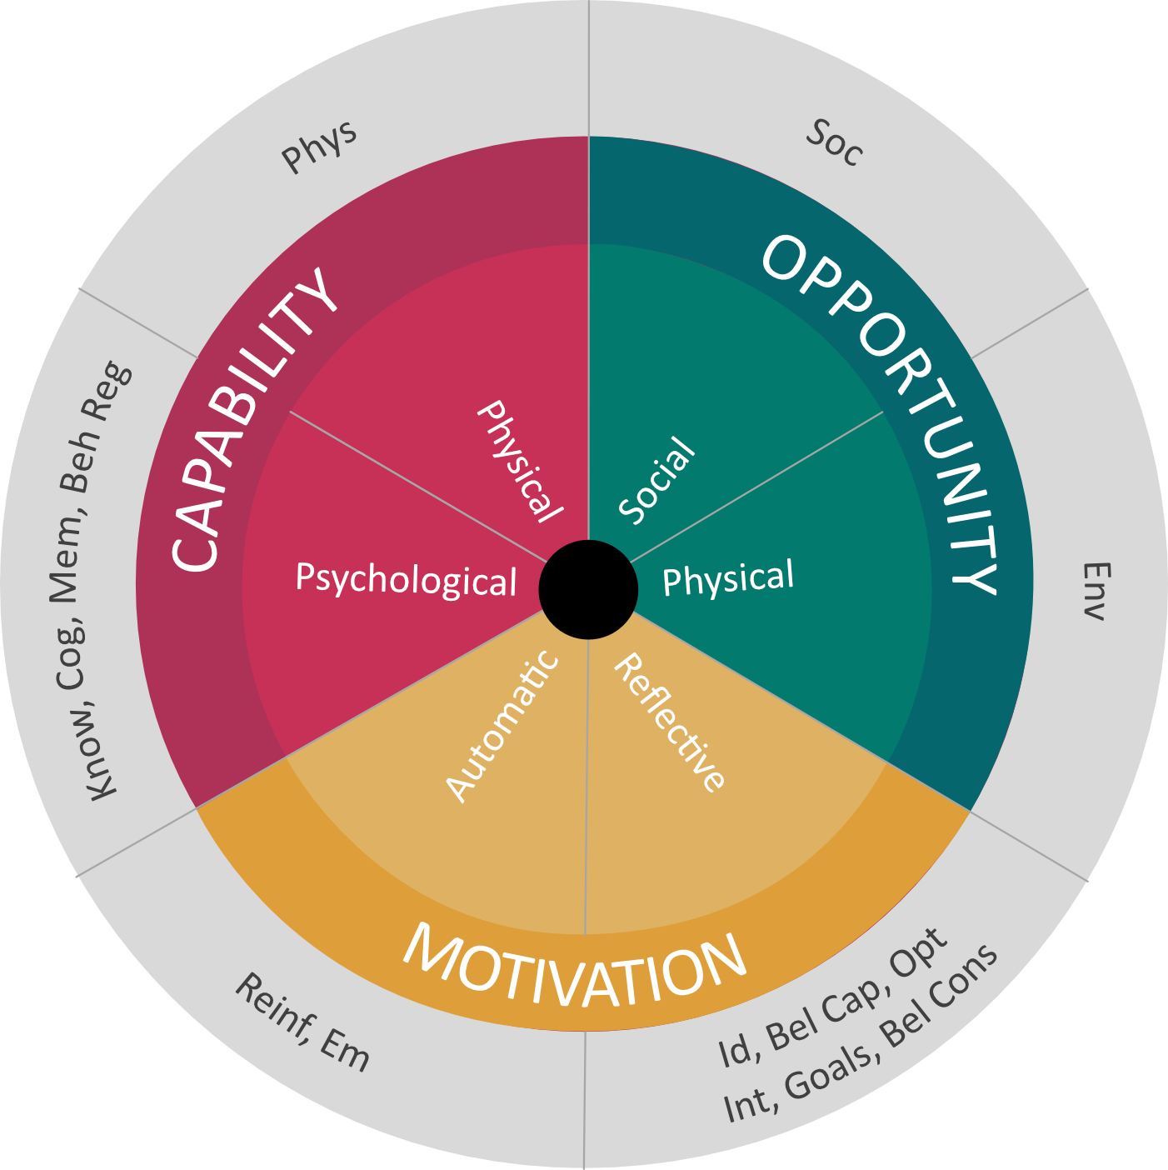
The review is organized by the Theoretical Domains Framework
The Theoretical Domains Framework (TDF) was developed
by a collaboration of behavioral scientists and implementation researchers who identified theories relevant to implementation and grouped constructs from these theories into domains. It was originally published in 2005 and updated in 2012 after being validated. It updates and builds
on the COM-B framework, adding more up-to-date understanding
of the drivers of human behavior.
Sources of behavior
TDF Domains
Soc – Social influences
Env – Environmental context and resources
Id – Social/professional role and identity
Bel Cap – Beliefs about capabilities
Opt – Optimism
Int – Intentions
Goals – Goals
Bel Cons – Beliefs about consequences
Reinf – Reinforcement
Em – Emotion
Know – Knowledge
Cog – Cognitive and interpersonal skills
Mem – Memory, attention and decision processes
Beh Reg – Behavioural regulation
Phys – Physical skills
Source: Atkins, L. Francis, J, Islam, R. et al. A guide to using the Theoretical Domains Framework of behavior change to investigate implementation problems. Implementation Sci 12, 77 (2017). Https://doi.org/10.1186/s13012-017-0605-9.

Slide 13
Definition of the TDF Pillars, as applied in the review
Each domain of the TDF framework is defined by a set of constructs. The table below defines all TDF Constructs.
Capability | Opportunity | Motivation
Knowledge: The extent to which an individual is aware of something leading to understanding of informed action. * Physical, cognitive, interpersonal skills (skills): An individual’s ability or proficiency specific to a behavior. * Memory, attention, decision processes: The ability to retain information, focus selectively on aspects of the environment, and choose between two or more alternatives. * Behavioral regulation: Anything aimed at managing or changing objectively observed or measured actions. * | Social influences: Interpersonal processes that can cause a person to change their thoughts, feelings or behaviors. These influences may include injunctive and descriptive norms, and tangible or emotional aid provided by one individual or group to an individual by members in one's social network or community. * ** Environmental context and resources: Any circumstance of a person’s situation or environment that discourages or encourages the development of skills and abilities, independence, social competence and adaptive behavior. ** | Beliefs about capability: Acceptance of the truth about an ability, talent or facility that a person can put to constructive use. Includes: self-efficacy, beliefs, self-esteem. ** Social/professional role and identity: A coherent set of behaviors and displayed personal qualities of an individual in a social or work setting. Includes: self-confidence, professional confidence, group identity. ** Optimism: The confidence that things will happen for the best, or that desired goals will be attained. ** Beliefs about consequences: Acceptance of the truth, reality, or validity about outcomes of a behavior in a given situation. Includes an individual’s belief that positive or negative things will result if he/she performs a behavior. ** Reinforcement: Punishment, consequences, sanctions for performing an undesired behavior or not performing a desired behavior; and reinforcement and incentives for performing the desired behavior. ** Intentions: A conscious decision to perform a behavior or a resolve to act in a certain way. ** Goals: Desired outcomes or end states that an individual wants to achieve. For example, goal setting, action planning. ** Emotion: A natural, instinctive state of mind resulting from one’s circumstances, mood or relationship with others. **
* Michie S, van Stralen M, and West R. (2011). The behavior change wheel: A method for characterizing and designing behavior change interventions. Implementation Science 6:42
** Source of Definitions: Source: Atkins, L. Francis, J, Islam, R. et al. A guide to using the Theoretical Domains Framework of behavior change to investigate implementation problems. Implementation Sci 12, 77 (2017). Https://doi.org/10.1186/s13012-017-0605-9.

Slide 14
3
Understanding the influence of community
1) AT WHAT STAGE OF THE USER JOURNEY FOR PrEP PRODUCTS IS THE INFLUENCE OF PARENTS, PEERS AND PARTNERS MOST IMPORTANT? WHAT SUPPORT DO AGYW SEEK FROM THESE INFLUENCERS?
2) WHAT FACTORS/DETERMINANTS (E.G. ATTITUDES, BELIEFS, NORMS) DRIVE COMMUNITY ACCEPTANCE FOR THE USE OF PrEP BY WOMEN AND GIRLS? WHAT CAN SECTOR-ADJACENT LITERATURE TELL US ABOUT OTHER POTENTIAL FACTORS/DETERMINANTS THAT DRIVE COMMUNTY ACCEPTANCE AMONG THESE INFLUENCERS?

Slide 15
Using a high-level adoption process to understand TDF constructs
The literature indicates that AGYW want preferred primary influencers to take specific supportive actions to help them as they move through the adoption process for HIV & reproductive healthcare products and services. This review uses a simplified adoption process adapted from literature that examined the oral PrEP adoption journey. The review examines:
The potential actions AGYW seek from influencer at each stage of adoption; and
The specific constructs from the TDF which may alter the influencer’s behavior. This is mapped for each
primary influencer – male partners, peers and parents.
Awareness
Evaluation
Uptake
Early Use (0-3 months)
Persistence (>3 months, pause, restart)
Discontinuation

Slide 16
AGYW desire primary influencers to play several roles in facilitating PrEP use
The literature suggests that AGYW seek different types of support from different influencers, at different times in their process of PrEP adoption. These roles are outlined in more detail, according to the PrEP adoption process, later in the deck.
Influencer | The Role AGYWs Desire/Expect Influencer to Play
 | Sexual advice (10) | Experience sharing (10) | Effective use support, reminders, financial and transport support (10, 18, 24, 31) | Emotional support/ approval (10) | Clinical advice (10)** | Challenge stigma re: adolescent sexuality, promote access to health services (10)
Sexual Partners | X |  | X | X
Peers | X | X | X | X |  | X
Parents |  | X | X | X |  | X
**Clinical advice was not sought from the identified influencers. This information was sought from healthcare workers. This population was not included in the review.

Slide 17
Factors influencing community acceptance and the TDF
Through literature review and action tank discussion, we sought to identify which constructs of the theoretical domains framework (TDF) most frequently impact key influencer behaviors that facilitate PrEP use. These constructs are noted in GOLD in the table below. Specific factors are examined by influencer group later in this report. However, many of the factors influencing acceptance were consistent across audiences, particularly related to knowledge, social influences and beliefs about consequences of oral PrEP or contraceptive product use.
Capability | Opportunity | Motivation
Knowledge: The extent to which an individual is aware of something leading to understanding of informed action. (1) | Social influences: Interpersonal processes that can cause a person to change their thoughts, feelings or behaviors. These influences may include injunctive and descriptive norms, and tangible or emotional aid provided by one individual or group to an individual by members in one's social network or community. (1,2)* | Beliefs about capability: Acceptance of the truth about an ability, talent or facility that a person can put to constructive use. Includes: self-efficacy, beliefs, self-esteem. (2)
 |  | Social/professional role and identity: A coherent set of behaviors and displayed personal qualities of an individual in a social or work setting. Includes: self-confidence, professional confidence, group identity. (2)
Physical, cognitive and interpersonal skills (skills): An individual’s ability or proficiency specific to a behavior. (1)
 |  | Optimism: The confidence that things will happen for the best or that desired goals will be attained. (2)
 |  | Beliefs about consequences: Acceptance of the truth, reality, or validity about outcomes of a behavior in a given situation. Includes an individual’s belief that positive or negative things will result if he/she performs a behavior. (2)
Memory, attention, decision processes: The ability to retain information, focus selectively on aspects of the environment, and choose between two or more alternatives. (2) | Environmental context and resources: Any circumstance of a person’s situation or environment that discourages or encourages the development of skills and abilities, independence, social competence and adaptive behavior. (2) | Reinforcement: Punishment, consequences, sanctions for performing an undesired behavior or not performing a desired behavior; and reinforcement and incentives for performing the desired behavior. (2)
 |  | Intentions: A conscious decision to perform a behavior or a resolve to act in a certain way. (2)
 |  | Goals: Desired outcomes or end states that an individual wants to achieve. For example, goal setting, action planning. (2)
Behavioral regulation: Anything aimed at managing or changing objectively observed or measured actions. (2) |  | Optimism: The confidence that things will happen for the best or that desired goals will be attained. (2)
 |  | Emotion: A natural, instinctive state of mind resulting from one’s circumstances, mood or relationship with others. (2)
*NOTE: the literature is not clear on whether the influential norms could be better defined as ‘injunctive’ or ’descriptive’ in nature.
Notes:
1. Michie S, van Stralen M, and West R. (2011). The behavior change wheel: A method for characterizing and designing behavior change interventions. Implementation Science 6:42
2. Source of Definitions: Source: Atkins, L. Francis, J, Islam, R. et al. A guide to using the Theoretical Domains Framework of behavior change to investigate implementation problems. Implementation Sci 12, 77 (2017). Https://doi.org/10.1186/s13012-017-0605-9.

Slide 18
PRImary influencers
PARTNERS
PARENTS & CAREGIVERS
PEERS

Slide 19
Male partners
Male partners were the most frequently mentioned influencer of PrEP decision-making. Fear of disrupting this relationship can limit PrEP use, but where present, supportive male partners play a critical role in facilitating PrEP use.
AGYW’s male sexual partners are age mates and ‘older’ men. (4) These may include “hidden” partners who are not open about their relationships with AGYW, but heavily influence their behavior.
There are strong power imbalances within relationships, and men often “determine the morals in a relationship”. This includes controlling the health-seeking behavior of female partners, including perceptions and uptake of PrEP.
Male sexual partners (along with peers) are AGYW’s main source of information and advice on sexual matters and play a significant role in AGYW adoption and adherence to HIV prevention and family planning services. This role may differ based on the nature of the relationship, existence of intimate partner violence, level of agency, age disparity and the extent to which the relationship is transactional. (13, 34, 40, 41) Action Tank participants described men as “determining the morals in the relationship”.
For women to access family planning, HIV prevention products, or HIV treatment, they may need to seek permission and funds from their male partners. (8, 22, 27) However, partners are often silent on these issues, and AGYW are often reluctant to initiate discussions about PrEP use, HIV testing, and contraception with intimate partners due to concerns about causing conflict and/or threats of physical violence, withdrawal of financial support, decreased trust, or breakup of relationship or marriage. These concerns can limit uptake and drive discontinuation. (9, 24, 26, 27, 30, 35, 36, 44)
A study conducted in Luanda, Angola found that apart from a woman‘s sense of self-efficacy and the perceived accessibility of contraceptives, perceived husband’s/partner’s approval, is the one variable strongly & positively associated with current modern contraceptive use. (29)
Positive results of PrEP disclosure to male partners (when received positively) include social support and pill reminders. (11, 30, 16, 18, 36-38) Some male partners provide financial support for AGYW’s use of HIV and reproductive healthcare services. (27)
Male partners’ literacy and elevated educational level are associated with more openness to discussion and use of family planning. (2, 4)

Slide 20
Male partners in the adoption process
The summary table below depicts the actions AGYW desire of their male partners as identified in the literature, particularly recent work from human-centered design approaches. These actions are mapped against typical stages in the PrEP adoption process. Each behavior is further described with identified influencing factors for each behavior.
 | Awareness | Uptake and Evaluation | Early Use (0-3 months) | Persistence (>3 mos., pause, restart) | Discontinuation
Desired Action(s) of Male Partners | Speak with their male peers in support of PrEP use | Communicate openly, actively support use and offer financial support; speak with their male peers in support of PrEP use | Emotional support, adherence support (reminder); speak with their male peers in support of PrEP use | Emotional support, communicate openly, financial support, adherence support; speak with their male peers in support of PrEP use | Support method switching
TDF Influencing Male Partner Action |  | Capability (knowledge, skills) Opportunity (social influences) Motivation (emotion, belief about consequences) | Capability (knowledge) Motivation (emotion, belief about consequences) | Motivation (emotion, belief about consequences)
Action Tank discussion underscored the presence of “positive deviants” who are supportive of their partner’s PrEP use and may advocate within their own communities to improve attitudes toward PrEP. Little is known about these men and what drives their supportive actions.

Slide 21
Facilitators of male partner support for PrEP use
The review suggests that for male partners to accept AGYW’s use of HIV and reproductive healthcare products/services, they need: correct knowledge, effective couple communication, and to feel like their actions are supported by their peers.
Capability | Opportunity | Motivation
Knowledge (awareness): of contraceptive methods and HIV prevention are important facilitators of acceptance: The access of male partners to credible sources of information related to HIV prevention and contraception (aside from AGYW explanations), like face-to-face consultations with providers and IEC materials, assist in their acceptance of the product/service (11, 12, 15, 18); access to and understanding of this information is currently limited in most settings Male partners who are engaged by providers to provide feedback on SRH products/services reported feeling more “included” and supportive of PrEP | Social influences: Social support regarding sexual health and services experienced by male partners in their relationships with AGYW can facilitate acceptance of AGYW sexual health product use: Open and honest communication between intimate partners about matters of sexual health, HIV prevention and family planning (1, 5, 21) AGYW report a need for their male partners to hear supportive information about PrEP from their male peers Male support groups have successfully changed attitudes toward reproductive healthcare services | Social/professional role and identity: attitudes about women’s roles, decision-making power: A project evaluation of ‘husband schools’ indicated that better informed male partners and improved acceptance of women’s decision-making power and agency within the household and relationships contributes to improved contraceptive access (15)
Good communication skills and a healthy relationship play a role in willingness to discuss HIV and reproductive healthcare with their partner: Effective communication and support from partners improves couples’ HIV prevention, status disclosure, and treatment (1, 13, 21, 29) | Social influences: Social support experienced by male partners, peers, and parents in the community can increase support of healthy behaviors: A study conducted in South Africa found that increased social cohesion (trust and connectedness experienced in communities) is associated with higher levels of positive health behaviors like HIV testing by community members (19) | Beliefs about consequences: Positive beliefs about consequences male partners have regarding AGYW’s use of sexual health products: The belief that HIV prevention is important in case of unforeseen circumstances in which AGYWs are victim to sexual violence (16, 17) Belief that PrEP can increase sexual pleasure may facilitate uptake

Slide 22
Barriers to male partner support for PrEP use
Literature suggests that incorrect knowledge, belief in negative consequences and social norms are the dominant factors which may impede partner support for PrEP use among AGYW.
Capability | Opportunity | Motivation
Knowledge (awareness): Incorrect knowledge about oral PrEP: Skepticism of oral PrEP’s efficacy (23) Conflating oral PrEP and HIV treatment; suspicion that PrEP users are HIV-positive (7, 22, 23, 30) Belief that all PrEP users are female sex workers Distrust of HIV prevention drugs or the clinical trial process due to associations with ‘foreigners’ and ‘westerners’ (18, 24) Distrust of PrEP coming from the government or ruling party (22) Belief in potential negative side effects for men (44) A lack of communication skills among couples can inhibit SRH product acceptance and uptake (9, 21) | Social Influences including restrictive gender roles and norms inhibit male partner acceptance of AGYW’s use of sexual health products: Men in Africa are often the authority and decision-maker in households and relationships (8, 22, 27) Men may be seen as having the right and duty to produce offspring and therefore view family planning as in conflict with that responsibility; women face pressure from relatives and husbands to bear children (2, 32) Decisions to use condoms or other contraception are usually led by the male partner. AGYW feel powerless in persuading partners to use contraception due to fearing their partner will leave them, conflict, loss of financial support (especially if pregnant), and/or violence (4, 5, 9, 20) Belief that AGYW’s access to HIV prevention and contraception encourages sexual behavior or that women who access PrEP are promiscuous or sex workers (12, 17, 23, 25) In a study amongst South African couples, both men and women perceived infidelity as ubiquitous in their social context and were therefore unable to discuss HIV risk and prevention without suspicions of infidelity. This impacted their ability to openly and effectively discuss strategies to prevent HIV (28) | Social/professional role and identity: Male social roles, driven by norms, can restrict support: Men may take on the role of the ‘protector’ and seek to protect their partners from HIV prevention technologies that they perceive as potentially causing harm (12) Beliefs about consequences: Belief that product use will lead to negative health or social outcomes: Belief that PrEP or contraception may cause infertility (2, 22) Belief that contraception decreases available labor in the home and therefore is counterproductive to household income (2) Belief that oral PrEP is harmful to health, has detrimental side effects, or may cause HIV infection (7, 11, 18, 22, 23) Belief that contraception interferes with God’s plan for fruitfulness (2) Emotion: Including beliefs male partners have about infidelity and relationship distrust: Male partners express concern that HIV prevention and contraception promotes unfaithfulness of AGYW and encourages them to have multiple partners because they no longer need be concerned about acquiring HIV or they suspect existing infidelity (11, 12, 18) There is the belief that there should be trust and fidelity in committed relationships, so contraception is not needed. Therefore, it is often normative to use condoms in casual sexual relationships and less so in serious relationships, even when one partner (more often the male partner) or both are engaging in sexual activity outside of the relationship. Accordingly, suggested use of contraception and HIV prevention in a committed relationship are associated with distrust in one’s partner (4, 9, 17, 20, 28, 45) Trust is often associated with the length of a relationship, discouraging PrEP use in long-term relationships

Slide 23
Key gaps in our understanding of male partners
(identified in the Action Tank)
Action Tank participants reflected on the literature review findings and their programmatic experiences to identify key gaps in our understanding of male partner engagement for the support of PrEP use among AGYW. This list is not comprehensive, but represents critical gaps identified by implementers and Ministries of Health.
Overarching
Who are the “positive deviants” who support PrEP use? How are they supportive and what drives these behaviors? How do AGYW want partners to be engaged in initial awareness building around PrEP? How do partners want to be engaged to support PrEP use? Particularly “hidden partners” of AGYW such as religious leaders, teachers, etc.
Capability | Opportunity | Motivation
What facilitates good relationship communication where AGYW feel comfortable approaching their partners about difficult topics? | What are the most critical norms impacting men’s support for PrEP use (e.g. social norm diagnosis), particularly those influencing supportive behavior? How might these be redefined/leveraged to increase male support of PrEP use? Who are the main referents for partners (e.g. whose opinions are meaningful when they are considering what the “community” thinks)? Who do partners look to for information? | How are decisions about healthcare-seeking made within relationships? How do these vary for PrEP, versus other health behaviors? How do specific relationship factors influence PrEP use? E.g. the length of relationship, type of partner, etc.

Slide 24
Parents and caregivers
Despite their strong influence, most AGYW don’t actively seek reproductive health information from their parents for fear of being considered promiscuous.
Parents report significant anxiety about raising children in a time of significant social change, particularly related to technology.
Since most adolescents still live at home and are financially reliant on their parents, parents have a strong influence on adolescent motivations, decisions, and behaviors relating to health. (11, 23)
Programmers report a strong AGYW desire for parents to equip them with “confidence and self-esteem”, which can facilitate informed choices about PrEP; many youth report that parents diminish their confidence through their judgement.
There is often a difference between the norms and expectations that parents place upon their own children (e.g. no sex before marriage) and their own lived experience (e.g. teen pregnancy); this can also manifest in an expectation for a child to be a “good girl” but also bring home financial support for the family after a date.
Parents are NOT a preferred source of PrEP or contraceptive information or support, because young people believe their parents would link PrEP to sexual initiation and early engagement in sexual activity. (23, 27)
Youth may still feel obligated to disclose PrEP use for various reasons, including: to reduce the risk of inadvertent disclosure, to adhere to social norms related to respect of their elders, to explain the presence of products or repeated clinic use, or because in some locations, it is required by health providers. (10)
Perceived stigma impacts disclosure. AGYW who experience stigma from household members and male partners find maintaining a PrEP or HIV treatment schedule challenging as they attempt to hide medication usage. This can lead to early discontinuation. (11, 23, 30, 31)
Notes:
In-laws were not reflected in the literature in the case of AGYW

Slide 25
Parents and caregivers
However, AGYW consider parents, especially mothers, highly influential in their health decision-making. The review found several potential roles for parents and caregivers.
Studies suggest a few potential roles for parents:
  One project indicated that if parental support for PrEP is offered, it would ideally include: having conversations about initiation and effective use, providing reminders, helping AGYW manage side effects, helping AGYW maintain adequate nutrition, and helping them to disclose to other family members so they don’t have to hide PrEP use. (10)
  Parental ‘support’ for contraceptive services was described as including: openly discussing reproductive health development and helping young girls get referrals to clinical services for SRH care. (For some, the mother’s role is particularly significant because most AGYW value mothers’ advice for a range of problems.)
  Programmers report that it is often easy for parents to articulate what they don’t want their children to do around sexual health, but much harder to articulate what they DO want them to do.
Several studies noted that if AGYW disclose PrEP use, their mother’s support will impact effective use:
  In one study amongst AGYW in South Africa and Kenya, mother’s support is cited as particularly important to AGYW in PrEP adherence. (30)
  In a PrEP study from South Africa, a lack of support from mothers was most often described as negatively affecting oral PrEP adherence among AGYW. (11)
  If disclosed to, AGYW saw parents as a source of emotional support, helping them to manage side effects, and provide reminders. (10)
  “Many girls fear talking to their parents, but in the end their mothers end up being extremely helpful in connecting them to clinics.”

Slide 26
Parents & caregivers in the user journey
The summary table below depicts the actions AGYW desire of their parents or caregivers as identified in the literature. These actions are mapped against typical stages in the PrEP adoption process. Each behavior is further described with identified influencing factors for each behavior.
 | Awareness | Uptake and Evaluation | Early Use (0-3 months) | Persistence (>3 mos., pause, restart) | Discontinuation
Desired Action(s) |  | Voice approval, give consent, refer for service | Voice approval, consent, refer for service | Actively support adherence (reminders, storage), communicate openly about support for PrEP use, provide transport, money for services | Support method switching
Factors Influencing Action |  | Capability (knowledge) Opportunity (social influences) Motivation (beliefs about consequences) | Opportunity (social influences, stigma, social support) Motivation (beliefs about consequences) | Capability (knowledge) Opportunity (social Influences, social support, stigma)

Slide 27
Facilitators of parental support for PrEP use
Knowledge about HIV prevention, strong communication skills and social support facilitate parental support.
Capability | Opportunity | Motivation
Communication skills play a role in willingness to discuss HIV and reproductive health products: Parents indicate that they are more likely to discuss PrEP with their children if they have the right communication skills and if they have a close and open relationship with their child (11) Knowledge of sexual health information, products and services for AGYW can facilitate support: The access of parents to credible sources of information related to HIV prevention and contraception (aside from AGYW explanations), like face-to-face consultations with providers and IEC materials, assist in their acceptance (11, 12, 18) This knowledge is particularly important because parents are often expected to be the support of AGYW initiating PrEP | Social influences: Social support experienced by parents in the community can increase support of healthy behaviors: A study conducted in South Africa found that increased social cohesion (trust and connectedness experienced in communities) is associated with higher levels of positive health behaviors like HIV testing by community members (19) Social influences including vocal support for HIV prevention (including PrEP use) from traditional and religious leaders | Goals: Parents want a great future for their children (this includes not re-living their own childhood challenges/traumas); remaining HIV-negative is often a part of that “better future”, especially for parents living with HIV

Slide 28
Barriers to parental support for PrEP use
Taboos around sex and beliefs in negative consequences of product use are strong barriers to acceptance.
Capability | Opportunity |  | Motivation
Knowledge of sexual health information, products and services for AGYW can limit support when it is incorrect: Conflating oral PrEP and HIV treatment; suspicion that PrEP users are HIV-positive (7, 22, 23, 30) Parents lack reliable, accurate information on PrEP Lack of strong communication skills. Parents and AGYW often want one another to “know” about SRH issues, but without having an explicit conversation; parents report that they lack the skills, resources and safe space to engage in these discussions Parents report a lack of knowledge about reproductive healthcare issues and few skills in how to start these discussions with their children; there are few resources available to address these challenges | Social influences: It is socially taboo to discuss sexual health with caregivers in many settings: AGYW disclosure of PrEP use to fathers is less common than mothers, and typically only discussed when the father is the primary caregiver (10). In Zimbabwe, some fathers believe it is inappropriate or taboo to discuss sex with daughters. (10) AGYW fear disclosing use of SRH products to parents because they do not wish them to know they are sexually active or think them promiscuous (10, 16, 23) Social influences including a lack of parental role models demonstrating open conversation and support around SRH issues | Social influences including stigma and gender norms limit parent acceptance of AGYW’s use of sexual health products and services: Belief that AGYW should not be sexually active outside of marriage, that doing so is shameful to the family/community and impacts AGYW’s marriage prospects Belief that AGYW’s access to HIV prevention and contraception encourages sexual behavior or women who access PrEP are promiscuous or sex workers (12, 17, 18, 23, 25, 30) Traditional leaders and religious leaders who advocate for abstinence and judge sexual behavior Environmental influences including a lack of physical proximity/residence to facilitate discussion | Beliefs about capability: Belief they lack the ability to have SRH discussions with their children Parents knowledge/skills/efficacy to initiate the discussions Beliefs about consequences: Belief that product use will lead to negative health or social outcomes: Belief that oral PrEP is harmful to health, has detrimental side effects, or may cause HIV infection (7, 11, 18, 22, 23)

Slide 29
Key gaps in our understanding of parents & caregivers
(identified in the Action Tank)
Action Tank participants reflected on the literature review findings and their programmatic experiences to identify key gaps in our understanding of partner and caregiver engagement for the support of PrEP use among AGYW. This list is not comprehensive, but represents critical gaps identified by implementers and Ministries of Health.
Overarching
How do parents want to be involved in supporting HIV prevention? What is culturally acceptable? How does each culture define a “great parent”? How is this assessed?
Capability | Opportunity | Motivation
What information do parents want in order to engage in SRH discussions with their children (e.g. relevant content by age)? What do SRH discussions look like now? What influences PrEP users to disclose (or not), and what positive elements might be integrated into interventions? What guidance do parents want about how to initiate and continue these discussions? Can broader health discussion be an entry point to broader SRH and HIV prevention discussion? What practical tools can support parents to access the necessary information and engage in sexual health discussions with their children? Which of these can be used incrementally to slowly drive increased discussion? | What are the most critical norms impacting parent/caregiver support for PrEP use (e.g. social norm diagnosis), particularly those influencing supportive behavior? How might these be redefined/leveraged to increase support of PrEP use? What drives social cohesion among parents? How does shame disrupt social cohesion and challenge parents? Who do parents look to for parenting information, support and advice? Who do they listen to? Who is the ideal “role model” for parents? What needs to be in the broader environment to support parents? In what environments do parents feel most comfortable participating in interventions about PrEP-related discussions with AGYW? Which other actors do parents trust to speak with their youth about SRH and HIV prevention? Is there a role for these actors in structured discussion? | What is the idealized vision of how parents would like to see their children initiate and engage in a sexual life? What is the “next best” option if the “ideal” journey is not achieved? What motivates the desire for their children to have a “different life”? What drives this “idealized” version of what their child should do, versus their own experience as a child? What are parents’ pain points? What are they most concerned about? Where do they feel most confident as a parent?

Slide 30
Peers
Peers (same-sex friends, same-generation relatives) are a primary source of SRH information and can have significant influence along the PrEP journey.
Friends and same-generation relatives are important sources of sexual advice for AGYW, and are a preferred source of PrEP and contraception knowledge – more so than parents. (13, 23, 27) Information sharing from peers is also used to fill gaps in information not share by providers, e.g. basic anatomy. (41, 42, 43)
Peer support is primarily provided to AGYW by same-gender contacts, with the exception of romantic partners. Girls seek support from friends, particularly during early use and persistent use phases of PrEP adoption. (13,30, 41, 42)
Peers can influence PrEP use positivity and negatively. AGYW find peer support, seeing peers use PrEP themselves, and the presence and advocacy of other AGYW PrEP users at clinics, to be facilitators for PrEP uptake and adherence (30, 42). Conversely, a PrEP trial in South Africa found that many young women participants were deterred from adherence by the example of their peers’ nonadherence. (7)
Some research points to stigma and a lack of support from friends as NOT negatively affecting PrEP use as much as described for other social groups (partners and family members). Supportive friends, however, encouraged respondents with pill reminders. (11)
Conversely, a study conducted amongst young people in Uganda, Zimbabwe and South Africa found that when friends and peers disapproved of PrEP, adolescents and young people perceived PrEP as unlikely to be used. (23)
Peers want to be engaged in decisions around demand generation and service delivery. “Nothing about us, without us!”

Slide 31
Peers in the user journey
The summary table below depicts the actions AGYW desire of their peers as identified in the literature. These actions are mapped against typical stages in the PrEP adoption process. Each behavior is further described with identified influencing factors for each behavior.
 | Awareness | Uptake and Evaluation | Early Use (0-3 months) | Persistence (>3 mos., pause, restart) | Discontinuation
Desired Action(s) | Share information; advocate for PrEP (champion PrEP as a lifestyle option, advocate for supportive policy at the national level) | Advocate for PrEP, share information about experience | Share information about experience; provide support to facilitate disclosure to parents or partners; facilitate PrEP delivery at the community level | Actively encourage adherence (especially via support groups), share knowledge and information on experience, give advice, tips, referrals; provide support to facilitate disclosure to parents or partners; facilitate PrEP delivery at the community level
Factors Influencing Action | Capability (knowledge) Opportunity (social influences, social support and stigma) | Opportunity (social influences, social support and stigma) Motivation (beliefs about consequences) | Opportunity (social influences, social support and stigma) | Motivation (beliefs about consequences)

Slide 32
Facilitators to peer support for PrEP use
Community social support and personal experience positively influence peer support.
Capability | Opportunity | Motivation
Product information/knowledge can facilitate peer support but requires skill and training. Peers need “preparation, training and skills-building” around how to deliver peer support and should be included in existing health facility structures When AGYW PrEP users advocate for and share information about PrEP with their peers at the clinic, AGYW are encouraged to use PrEP (30) | Social Influences: Social support experienced by peers in the community can increase support of healthy behaviors: Seeing AGYW using PrEP themselves facilitates peer support of PrEP (30) A study conducted in South Africa found that increased social cohesion (trust and connectedness experienced in communities) is associated with higher levels of positive health behaviors like HIV testing by community members (19) Seeing influencers who young people identify with supporting PrEP use | Beliefs about consequences: Understanding the potential impact of PrEP on AGYW health can motivate peers Beliefs about capability: Feeling empowered to make decisions about one’s sexuality; feeling supported to make decisions at their own pace Emotion: Personal experience, such as recent HIV infection, can motivate peers to share their experience with others to shift behaviors (47)
Note: The initial literature search was limited in its findings on behavioral drivers of support among peers. This may be due to the search terms, as well as limited documentation of what influences AGYW to promote PrEP with peers (versus use it themselves). Work is ongoing to address this gap.

Slide 33
Barriers to peer support for PrEP use
Stigma and incorrect knowledge are barriers to peer support for PrEP use.
Capability | Opportunity | Motivation
Knowledge (awareness): Incorrect knowledge about oral PrEP: Skepticism of oral PrEP’s efficacy (23) Conflating oral PrEP and HIV treatment; suspicion that PrEP users are HIV-positive (7, 22, 23) Distrust of HIV prevention drugs or the clinical trial process due to associations with ‘foreigners’ and ‘Westerners’ (18, 24) Lack of knowledge about how to access PrEP | Social influences including stigma and negative misconceptions limit peer acceptance of AGYW’s use of sexual health products and services Low social cohesions can limit implementation of in-person support clubs Fear of how healthcare workers will respond to PrEP use/support Environmental context and resources: Demands on their time and limited financial resources limited AGYW attendance at peer support groups (46, 47) Delivery points with limited accessibility or high stigma (e.g. clinics administering HIV treatment) | Beliefs about consequences: Belief that product use will lead to negative health or social outcomes: Belief that oral PrEP is harmful to health, has detrimental side effects, or may cause HIV infection (7, 11, 18, 22, 23) Belief that PrEP promotes promiscuity Goals: Focus on risk/responsibility to motivate PrEP use, rather than relationships and future desires

Slide 34
Key gaps in our understanding of peers
(identified in the Action Tank)
Action Tank participants reflected on the literature review findings and their programmatic experiences to identify key gaps in our understanding of peer engagement for the support of PrEP use among AGYW. This list is not comprehensive, but represents critical gaps identified by implementers and Ministries of Health.
Overarching
What motivates AGYW to support their peers to access PrEP? What aids them? What deters them? How can we segment peers to improve our engagement? E.g. age, type of relationship, etc.
Capability | Opportunity | Motivation
What resources do peers need to undertake their roles effectively? | How can peers who use PrEP be encouraged/empowered to share their experience and be vocal in the community to create more acceptances/norms change? | What are the goals and beliefs that motivate AGYW to promote PrEP with their peers?

Slide 35
4
Promising Interventions to Build Community Acceptance
3) WHAT INTERVENTIONS HAVE SHOWN PROMISE IN BUILDING COMMUNITY ACCEPTANCE FOR THE USE OF HIV AND REPRODUCTIVE HEALTHCARE SERVICES? WHAT DATA HAVE SUGGESTED THESE INTERVENTIONS ARE PROMISING?

Slide 36
Identification of interventions
Informed by the above analysis, we sought to identify interventions that successfully built community acceptance among the primary influencers – partners, parents and caregivers, and peers.
Interventions were prioritized if:
  They were implemented, or for which results were documented, in peer-reviewed or grey literature between 2011-present
  Primarily intended to improve health outcomes for youth or young adults in LMIC (primarily in sub-Saharan Africa)
  Included some form of evaluation (no evaluation quality criteria were included due to the overall limited evaluation of these programs)
  Focused on HIV prevention, treatment and care or ‘adjacent’ areas (e.g. reproductive health, maternal and child health, and gender-based violence prevention)
Most interventions can only be deemed as ‘promising’ because they had not been completely evaluated for causal links between exposure and intermediate impact (change in Capability, Opportunity or Motivation) or behavioral outcome. We’ve defined promising as those interventions with some evaluation data either at intermediate or behavioral outcome level, and/or documented anecdotal learnings or documented feedback from participants indicating some observed change in their lives or communities. Where more robust evaluation data are available, it is noted.

Slide 37

The identified interventions offer opportunity for adaptation (presented at the Action Tank)
What is adaptation?
“Intentional modification(s) of an evidence-informed intervention, in order to achieve a better fit between an intervention and a new context.”*
Why adapt?
There is a lot to learn from past, current and ongoing programs from other sectors
Many similar issues with ASRH/contraceptive interventions, youth clinics, engaging parents, etc.
If done well, adaptation can save resources and time
*Source: Adapting New Interventions to new contexts – the ADAPT guidance. Moore, G. et al. BMJ 2021; 374:n1679 http://dx.doi.org/10.1136/bmj.n1679
Notes:
Definition of Adaptation (BMJ)
Why adapt (Guide to Adaptation)
Adaptation vs. Fidelity (Guide to adaptation)
Key Questions to ask/process (guide to adaptation, summary of key steps)
ADAPT Model (source) Assess, Decide, Administration, Production, topical experts, integration, training, testing
The HIV prevention sector, with its focus on AGYW has an opportunity to learn from past, current and ongoing programs from other sectors

Slide 38
Key questions when considering adaptation
(presented at the Action Tank)
Key Questions | Considerations
Do we adapt? | Are there evidence-based interventions that fit our issue, context and target population?
What could we adapt from? | Which interventions are likely to have the best fit with target population, context and theoretical base? What are the potential barriers/mismatches with our needs, goals and capacity, and the interventions we might adapt from?
What elements would we adapt? What is core vs. what can be adapted without impacting effect? | Intervention procedures (e.g. location, recruitment, delivery, staff makeup) Participants (e.g. different target population) Context and cultural relevance Dosage (e.g. number, length of sessions) Content (e.g. topics, services)

Slide 39
What we found
8 PrEP-specific interventions were identified as promising (or intended for evaluation); 4 of these were presented within the Action Tank
27 sector-adjacent interventions were shortlisted for relevance based on the selection criteria; the ‘Intervention Catalogue’ summarizes these interventions
11 interventions (PrEP-specific and sector-adjacent) were presented for a “deep dive” analysis within the Action Tank; these deep dive presentations are presented in Section 5 of this report
NOTE: We organized the analysis by key influencer: ‘peers’, ‘male partners’ and ‘parents/caregivers’. Most parent/caregiver programs targeted families and primarily mothers, who are the preferred source of support by AGYW. Some programs did target entire families or grandparents. We included interventions that targeted youth (male and female adolescents and young adults) with the intent of encouraging peer support as ‘peer’ interventions, even if the primary intent of the intervention was not solely focusing on the peers of the primary audience.

Slide 40
PrEP-specific intervention catalogue
A variety of PrEP interventions were reviewed, but only those with explicit activities targeting parents, peers or partners were included in the catalogue. Interventions denoted by a red asterisk (*) were presented at the Action Tank. Detailed overviews of those interventions are available in Section 6 of this document.
Project Name, Location | Influencer | Focus | Why it Matters | Evaluated?
Bridges to Scale – Jilinde (Kenya) * | Peers | Implementation science for high-risk populations, including a one-county focus on AGYW. Media, partner and parent engagement | Community intervention to normalize PrEP use among peers and parents which was associated with increased PrEP uptake among AGYW | Program data showed increased AGYW initiation after the intervention was implemented
Chagua PrEP, Chagua Life Campaign – LVCT (Kenya) * | Peers & parents | Increasing demand for PrEP among AGYW and increasing parent and female caregiver support | Reaches audiences through peer outreach and other community mobilization activities. Chagua PrEP includes activities targeting female caregivers and male partners | Yes. An LVCT Health site saw increases in AGYW visits, PrEP use, and PrEP continuation
OPTIONS HIV Prevention Ambassador Training (Zimbabwe)* | Peers | OPTIONS training to enhance AGYW peer ambassador knowledge and skill | Offered youth-friendly education modules to build the capacity of AGYW to participate in oral PrEP programming, demand creation, and awareness raising, and to in turn improve oral PrEP uptake and continuation among their peers | Yes. Oral PrEP uptake increased more than 30% among adolescent girls and young women in a Zimbabwe district
Project PrEP, Wits RHI (South Africa) * | Peers & parents | Leverages different channels (households/community structures, schools, etc.) to facilitate PrEP access by AGYW and community buy-in to encourage the normalization of HIV prevention and AGYW access to RH services | Project PrEP employs various tactics and channels, including community engagement and various social mobilization activities, the use of digital health technologies and traditional media. Includes a strong parental engagement component | Planned evaluation
LEARN (Young Women Lead, Evidence, Advocate, Research, Network) | Peers | LEARN was a two-year project that aims to promote an HIV prevention agenda informed by meaningful participation of adolescent girls and young women in research in Kenya and Uganda | Learn had three components that incorporated peers: peer and community mobilization, qualitative research led by AGYW, peer-led local advocacy | LEARN conducted a research study to explore the knowledge, views and preferences of AGYW about PrEP to inform implementation. No intervention evaluation data found
V Campaign (South Africa, Zimbabwe) | Peer | Engage girls to promote PrEP among their peers using in-person parties, social media, etc. | Rooted in a rigorous human-centered design and critical insights that “word of mouth can make you or break you” | Qualitative research informed design but no rigorous evaluation of implementation
Parent Caregiver Module | Parents & caregivers | Engage parents & caregivers to support PrEP use | Integration of PrEP within existing family strengthening programs | Not yet implemented
Gen-N | Peers, parents, partners | A campaign to support oral PrEP in Nigeria | Seeks to drive community acceptance of HIV prevention and normalize the behavior | Not yet implemented

Slide 41
Sector-adjacent intervention catalogue (1/5)
Sector-adjacent interventions were reviewed from the HIV prevention, HIV treatment, reproductive health and gender-based violence prevention fields. Interventions denoted by a red asterisk (*) were presented at the Action Tank. Detailed overviews of those interventions are available in Section 6 of this document.
Project Name, Location | Influencer | Focus | Why it Matters | Additional information
Becoming One (Uganda) | Male partners | The program leverages the influence and role of faith leaders to support couples and promote more equitable, violence-free relationships. Utilized couples training, bible teachings and a WhatsApp group | A randomized controlled trial showed that Becoming One led to a reduction in both women’s experience and men’s perpetration of violence, among other positive outcomes | Web link: https://prevention-collaborative.org/programme-examples/becoming-one/?cat_id=19&scat_id=46%20(scroll%20down%20to%20programm%20examples)
Community-Based Action Teams – COMBAT (Ghana) | Male partners | The COMBAT intervention aimed to: reduce the incidence of GBV; protect women’s rights via state and community structures; and raise public awareness about GBV | A quasi-experimental study showed that the program reduced women’s reported experiences of sexual IPV, but no statistically significant reduction in physical IPV | Web link: https://prevention-collaborative.org/programme-examples/combat/?cat_id=19&scat_id=60
Community Mobilization for HIV prevention and Gender Norms, (South Africa) | Male partners | Community mobilization to modify negative gender norms using GEM scale | Some documented changes in normative beliefs among men | Web link: n/a Citation: Pettifor, Audrey, et al. "Community mobilization to modify harmful gender norms and reduce HIV risk: results from a community cluster randomized trial in South Africa." Journal of the International AIDS Society, vol. 21, no. 7, 2018, p. e25134.
Emanzi Program (Uganda) | Male partners | The program’s goal was to improve reproductive health outcomes by promoting men’s health behaviors. Emanzi aimed to increase couples’ communication, improve relationships, and promote shared decision-making | An evaluation found that six months after the program, men still believed in and practiced shared responsibility, shared decision-making, and couple communication. The majority of the Emanzi groups continued to meet after the program ended | Web link: https://knowledgesuccess.org/2020/05/28/engaging-men-as-partners-addressing-harmful-gender-norms-and-increasing-use-of-reproductive-health-services/
Indashyikirwa (Rwanda) | Male partners | Designed to reduce levels of intimate partner violence, improve the response to survivors, and shift social norms. Included couples training, community-based activism, and support to survivors | A cluster RCT showed that Indashyikirwa reduced both women’s reported experiences and men’s reported perpetration of violence | Web link: https://prevention-collaborative.org/programme-examples/indashyikirwa/?cat_id=19&scat_id=46%20(scroll%20down%20to%20programm%20examples)

Slide 42
Sector-adjacent intervention catalogue (2/5)
Project Name, Location | Influencer | Focus | Why it Matters | Additional Information
Partners Plus, (South Africa) | Male partners | Increase male involvement in pregnancy, HIV prevention, couple sessions to reduce conflict, improve communication | Focus on male partners, demonstrated impact of an intervention to enhance communication & HIV knowledge among pregnant couples | Web link: n/a Citation: Jones, D. L., et al. "Reducing the risk of HIV infection during pregnancy among South African women: A randomized controlled trial." AIDS Care, vol. 25, no. 6, 2013, pp. 702-709
Passages (Niger, DRC, Uganda) * | Male partners | Multi-country USAID-funded project to address gender and social norms that impact family planning and reproductive health | Impact in Niger and Uganda; documented change in male support of partners’ and joint decision-making | See Action Tank presentation in Section 6 of this document
PROMUNDO Program H (12+ countries including Rwanda and Ethiopia) * | Male partners | Multi-country; gender equality & violence prevention using interactive groups and social marketing campaigns | Long-running, well-documented impact on changing gender norms and male behaviors toward girls and women | See Action Tank presentation in Section 6 of this document
Promundo Brandebereho (Rwanda) | Male partners | A fatherhood and couples’ intervention to transform gender norms around masculinity and fatherhood, and to increase male engagement in reproductive health, equal caregiving, and violence prevention | An RCT evaluation found that Bandebereho substantially reduced rates of both intimate partner violence and harsh punishment against children, among other positive outcomes | Web link: https://prevention-collaborative.org/programme-examples/bandebereho/?cat_id=19&scat_id=46
SHARE (Uganda) | Male partners | The program mobilizes the community to change attitudes and norms that increase the risk of IPV and HIV | A cluster RCT showed that the program reduced women’s reported experience of physical and sexual IPV, and was associated with a decrease in HIV incidence and an increase in HIV disclosure | Web link: https://prevention-collaborative.org/programme-examples/share/?cat_id=19&scat_id=60
Unite for a Better Life (Ethiopia) | Male partners | The program is a gender-transformative initiative aimed to reduce IPV and HIV in Ethiopia. It is a group-based intervention that follows the format of a coffee ceremony | Evaluation showed that the men’s program reduced both men’s reported perpetration and women’s reported experience of violence. There were improvements in joint decision-making and reduced HIV risk behaviors | Web links: https://prevention-collaborative.org/programme-examples/unite-for-a-better-life/?cat_id=19&scat_id=46%20(scroll%20down%20to%20programm%20examples)

Slide 43
Sector-adjacent intervention catalogue (3/5)
Project Name, Location | Influencer | Focus | Why it Matters | Additional Information
Reaching Married Adolescents (RMA) (Niger) | Male partners, other community | Research project nested in IMPACT. To increase access to contraceptive services among married adolescent girls with a focus on community influencers | Theory of change based approach that evaluated community level impacts on contraceptive uptake and influence on men’s engagement; documented dose exposure required to elicit impact | Web link: https://www.pathfinder.org/publications/interventions-to-reach-married-adolescents-for-increased-contraceptive-use-in-niger/
MTV Shuga (Kenya, Nigeria, South Africa) | Male partners, peers | MTV Shuga is a television series and behavior change campaign that addresses topics like family planning, STI prevention, HIV, and gender-based violence | MTV Shuga has strong evaluation data showing that the series increases HIV prevention behaviors and improves attitudes towards GBV among young people | Web link: https://www.mtvstayingalive.org/news/new-research-finds-young-people-s-positive-changes-in-behaviour-are-significantly-linked-to/ https://www.comminit.com/global/content/experimental-evaluation-mtv-shuga-changing-social-norms-and-behaviours-entertainment-edu
OBULAMU? (Uganda) | Male partners, peers | OBULAMU? (How’s Life?) is an integrated set of health communication interventions targeting HIV infection, total fertility, maternal and child mortality, malnutrition, malaria and tuberculosis | The health communication intervention was organized on a life-stage approach. Evaluation found increases in condom use with at least one non-marital, non-cohabiting partner in the last six months among other positive results | Web links: https://pdf.usaid.gov/pdf_docs/PA00TDP5.pdf https://www.health.go.ug/project/obulamu/
Imbadu Ekhaya (South Africa) | Parents & caregivers | Six-session intervention to improve HIV prevention, with a focus on parenting skills, ARH, communication | Limited implementation found that youth and parents report increases in adolescent reproductive healthcare communication; youth indicated parents were more open to talk about sexuality | Web link: n/a Citation: Armistead, Lisa, et al. "Preliminary results from a family-based HIV prevention intervention for South African youth." Health Psychology, vol. 33, no. 7, 2014, pp. 668-676.
Let’s Talk (South Africa) | Parents & caregivers | RCT workplace intervention to improve parent engagement with younger adolescents about HIV prevention and ARH | Increased parents’ comfort in discussing adolescent health and HIV demonstrated via robust evaluation | Web link: https://letstalk.org.za
Our Family Our Future (South Africa) | Parents & caregivers | Pilot RCT to examine depression and links to STI and HIV risk behavior with parent child interaction | Youth scored parent interaction more positively after intervention | Web link: n/a Citation: Kuo, Caroline, et al. "Acceptability, Feasibility, and Preliminary Efficacy of a Resilience-Oriented Family Intervention to Prevent Adolescent HIV and Depression: A Pilot Randomized Controlled Trial." AIDS Education and Prevention, vol. 32, no. 1, 2020, pp. 67-81.

Slide 44
Sector-adjacent intervention catalogue (4/5)
Project Name, Location | Influencer | Focus | Why it Matters | Additional Information
READY (Kenya) | Parents & caregivers | Family and church-based intervention for adolescents and caregivers in rural Kenya with a focus on improving family relationships to communicate about HIV | Documented changes in male involvement in family decision-making | Web link: https://sites.globalhealth.duke.edu/evepuffer/ready-kenya/ Citation: Puffer, Eve S., et al. "A church-based intervention for families to promote mental health and prevent HIV among adolescents in rural Kenya: Results of a randomized trial." Journal of Consulting and Clinical Psychology, vol. 84, no. 6, 2016, pp. 511-525.
Grandmother’s Project (Senegal) | Caregivers | Community development, participatory, social network intervention targeting social change; engages range of influencers, primarily led by grandmothers to promote girls’ rights and well-being | Unique example of extended family engagement; impact on community and social norms for girls’ health & empowerment | Web link: https://www.comminit.com/social_norms/content/girls-holistic-development-ghd-programme
Girl Effect (multiple including Rwanda, Nigeria, etc.) * | Peers | Multi-channel and community interventions to aid access to health and economic information among young girls | Long-running, seeks to address individual and community norms and encourages peer social support | See Action Tank presentation in Section 6 of this document
Shujaaz (Kenya, Tanzania) | Peers | Multi-channel communication platform implemented in Kenya and Tanzania targeting male and female youth | Unique branded approach. Seeks change in social norms, social justice and health behaviors. Some documented impact data | Web link: https://www.shujaazinc.com/about-us/our-research/
Soul City Project (South Africa) | Peers | HIV prevention project addressing information, myths, misconception. Centered around popular TV series and community dialogues | Long-running program with documented impact in changes in norms at peer and community level | Web link: www.soulcity.org.za/about-us/history Citation: Le Tape, André R., et al. "The relevance of the content of an HIV and AIDS social intervention programme for the youth in the Northern Cape, South Africa." African Journal of AIDS Research, vol. 18, no. 3, 2019, pp. 234-243.
Thetha Nami, (South Africa) | Peers | Used community-based participatory research (CBPR) to improve peer-led support, improve self-efficacy for HIV prevention | Recently evaluated peer intervention | Web link: n/a Citation: Shahmanesh, Maryam, et al. "Thetha Nami : Participatory development of a peer-navigator intervention to deliver biosocial HIV prevention for adolescents and youth in rural South Africa." 2021.

Slide 45
Sector-adjacent intervention catalogue (5/5)
Project Name, Location | Influencer | Focus | Why it Matters | Additional Information
A360 (multiple including Tanzania, Ethiopia, etc.) * | Peers, caregivers | HCD designed multi-country intervention to increase contraceptive demand and access among girls, and encourage community and parent support | Promising branded approach; some preliminary data on increasing parent support | See Action Tank presentation in Section 6 of this document
Straight Talk Foundation (Uganda) * | Peers, caregivers | Multi-media (print, radio) intervention in Uganda. Providing information, awareness and skills to parents and youth re: adolescent health | Long-running communication program targeting adults and youth with evaluation data | See Action Tank presentation in Section 6 of this document
IMPOWER/YMOT (Kenya) | Peers, partners | School-based sexual violence prevention intervention in Nairobi, Kenya. Economic empowerment training for girls with masculinity/positive bystander training for boys | Documented impact in norms among men related to IPV | Web Link: https://www.ujamaa-africa.org/campaign-1-1?rq=impower Citation: Kågesten, Anna E., et al. "Young People’s Experiences With an Empowerment-Based Behavior Change Intervention to Prevent Sexual Violence in Nairobi Informal Settlements: A Qualitative Study." Global Health: Science and Practice, vol. 9, no. 3, 2021, pp. 508-522
Sasa! and SASA! Together (Uganda) | Peers, partners | Community mobilization to prevent violence and reduce HIV risk with focus on power/power inequality in relationships | Focus on men and IPV, long-running intervention with strong evaluation data | Web Link: https://prevention-collaborative.org/programme-examples/sasa/?cat_id=20&scat_id=50

Slide 46
PARTNERS
Intervention insights by influencer
PARENTS & CAREGIVERS
PEERS

Slide 47
Identification of influencer intervention insights
(generated in the Action Tank)
HOW TO READ THIS SECTION
All insights are drawn from Action Tank discussions. Content in green text reflects insights drawn directly from PrEP-specific interventions.
PrEP-Specific Interventions | Sector-Adjacent Interventions
Project PrEP Wits Reproductive Health and HIV Institute, South Africa Chagua PrEP LVCT Health, Kenya Jilinde Jhpiego, Kenya HIV Prevention Ambassadors FHI360, PZAT, Zimbabwe Gen-N, Generation Negative Jhpiego, Nigeria The CHOICE Parent Module FHI 360, Global | Kuwa Mjanja (A360) PSI, Tanzania Straight Talk Straight Talk Foundation, Uganda Ni Niyampinga Girl Effect, Rwanda Project H Promundo, Global Husband Schools Passages Project, West Africa
Detailed slides on these interventions are available in a separate deck.
Action Tank participants conducted an in-depth review of 6 PrEP interventions and 5 sector-adjacent interventions
In small groups, participants identified key elements that could be applicable in intervention design for key influencers of PrEP users
Insights were identified in three key areas: core principles for working with the influencer group, key approaches for engaging the group and needs for environmental support.

Slide 48
Cross-cutting influencer intervention insights
Across influencers, Action Tank participants identified several key elements underpinning successful community engagement interventions, including the importance of “wrap-around support” and careful targeting.
Engaging influencers provides “wrap-around support” for AGYW. Have specific activities targeting these influencers, and use a diversity of methods to engage them.
Focus on support. AGYW require encouragement to use PrEP, affirmation of their decision and social support to cope with challenges. Focus on building the capability, opportunity and motivation of influencers to offer this support by starting conversations with AGYW or otherwise signaling their support for PrEP use among AGYW.
Primary influencers (parents, peers, partners) are all deeply influenced by their broader community. Interventions need to engage policy makers, media and key opinion leaders (especially religious leaders) to give primary influencers the “permission” to engage in these discussions.
Carefully consider targeted messages and communication channels to reach primary influencers. Messages must speak directly to the facilitators and barriers that impact influencer support for PrEP (these are different than messages targeting AGYW directly!). Experience shows that a diversity of channels can be used, depending on context and audience, including community discussions, roadshows, edutainment, posters, videos, support groups, radio, etc.
Influencer engagement needs investment. Any PrEP demand generation must include messages and engagement targeted at these influencers. This engagement needs to be properly resourced. Without their engagement, AGYW-focused activities will be unsuccessful.

Slide 49
Male partner intervention insights
Core Principles
Adapt! SRH interventions (such as the Husband Schools) offer significant promise, but will require adaptation to align with PrEP target audiences (e.g. younger male partners of AGYW).
Key Engagement Approaches | Building Wrap-Around Support
Male support groups show impact across SRH interventions. Support groups offer an opportunity to provide information about PrEP, but also, more importantly, to explore norms around masculinity in a safe space. Critically, these spaces directly challenge the social isolation that is often driven by masculinity norms. However, these group discussions do sometimes require additional one-on-one spaces for conversation on sensitive issues. Create space to practice/rehearse having difficult conversations. This can be via support groups or via one-on-one discussions. Practice helps men engage in difficult discussions that may run contrary to social norms, or which present new challenges for relationships (e.g. discussing PrEP use). Facilitators of activities for male engagement, such as male support groups, need to be selected carefully in order to drive transformative discussions. These facilitators can act as role models (who are often lacking for men, and should be individuals who men/boys look up to and trust. Formative research is critical for identifying these individuals. Dual facilitation, including both a male and female facilitator, can promote gender equality and provide another perspective during groups discussions. Facilitator training needs to be rigorous with plenty of practice undertaking difficult discussions around social norms. Ensure campaign materials reflect a diversity of partners. In Kenya, inclusion of older men engendered more conversation about the diversity of male partners and their role in PrEP adoption, including ‘sponsor culture’. | Provide wrap-around support for norms change. Men need to see support for social norm change in their broader community, outside of small group discussions or one-on-one engagements. Wrap-around support in the community is critical, and may include broader communication campaigns, policy change and engagement of health structures. Interventions can include elements that engage men to support these types of environmental changes, but this should be carefully tailored to local context. Men should be engaged to build knowledge in their own communities. Programmers report that girls want to see their partners speaking about PrEP with their male peers. However, demand generation activities rarely target male partners or engage as advocates for PrEP within their own communities. This is a significant missed opportunity.

Slide 50
Parent/caregiver intervention insights (1/2)
Core Principles
Empathy is paramount. These are difficult conversations. It can be helpful for parents to reflect on their own difficulties navigating SRH issues at this stage in their life. This paves the way for mothers to talk more effectively with daughters. Sharing stories is a powerful intervention for building empathy and facilitating open discussion. Focus on adolescence – not sex! Connection is key. Parents do not want to engage first with their daughter’s status as “sexually active” but with their daughters as young people with desires worth supporting. As part of this, focus on adolescent health – don’t single out PrEP. This continues to make the conversation approachable for parents by “dressing the topic” to make them more acceptable/accessible. Root intervention delivery IN the community by working with local community organizations, rather than external organizations. Extend this through all elements of the intervention – book a local venue, caterer, etc. Build a supportive environment. Map critical community norms that impact parents, particularly those that may give parents “freedom” to see SRH discussions as normal and positive, rather than a risk. This requires working closely with community leaders to get buy-in (e.g. traditional leaders, religious leaders) Take time to map the underlying factors that make parents hesitant to support PrEP use (e.g. religious beliefs) Ensure respect of cultural and religious dynamics. Engage religious leaders to address concerns and build buy-in, and engage them in interventions to help give parents the permission to participate in these discussions (e.g. Project PrEP Mother/Grandmother Prayer Days)

Slide 51
Parent/caregiver intervention insights (2/2)
Key Engagement Approaches | Building Wrap-Around Support
Engage parents directly, but carefully consider how to set parents at ease. Parents need dedicated engagement to build their knowledge and skills to support PrEP use, but a diversity of engagement models is a requirement. Some parents may desire a group setting, but others may seek large events or one-on-one discussions – especially in instances of low social cohesion. Formative research can be particularly important here. Include opportunity for 1:1 follow-up in group events. In South Africa, tea time provided the ideal opportunity for these informal direct engagement opportunities leveraging a cultural practice. Mothers/grandmothers were supportive in group discussions, and shared deeper concerns/fears in 1:1 settings, allowing targeted interventions to address barriers. Create platforms to facilitate parent connection and learning. Parent support groups provide an opportunity to build knowledge about PrEP and strengthen communication skills. DREAMS has strong experience with such programs. Interventions focus on facilitating discussion between parents to build capability, opportunity and motivation to support PrEP use, e.g. Mother/Grandmother Prayer Days, parent/caregiver discussions, small one-on-one discussions. These intervention do not include AGYW, but focus on working directly with parents to address RH knowledge, communication skills and beliefs about their capability to engage with their children. Make content digestible, relatable, practical and time bound. Keep in mind that parental engagement is often limited by their own challenges (e.g. economic, time). Ask parents what will work for them. Reflect influencers in materials. In Kenya, posters including pictures of actual parents in the community worked well. | Engage policy makers to build surrounding support. Policy makers can drive norms that discourage SRH discussions. A special address or event with policy makers to discuss young people and RH can build increased support for parents. This support can also strengthen the sustainability of interventions. Transform parents into advocates. Mothers/aunties are “often the best ones positioned to reach those who play negative roles in young people’s lives regarding PrEP”. Sector-adjacent models suggest that existing community-based health groups can be used to champion sensitization of their peers to promote parent/AGYW discussions.

Slide 52
Peer intervention insights
Core Principles
Intervention experience underscores the importance of peers. In Kenya, Jilinde found that AGYW uptake is highest through peer referral. Engaging young people to mobilize their own community is powerful. Peer interventions must be implemented with meaningful youth partnership and the stories of young people should be front and center. Co-create with peers to ensure peer messages resonate with AGYW. Interventions should be “youth-designed, youth-focused, youth-driven, and youth-presented”. Insert a listening space for peers to give feedback to programmers to improve/adapt approaches to peer support
Key Engagement Approaches | Building Wrap-Around Support
Peer interventions, such as PrEP Ambassadors, work to improve knowledge (especially around PrEP efficacy), support decision-making, address social norms and build confidence for peers who will promote PrEP use with other AGYW. Gain framing is particularly important in successful peer engagement to facilitate positive discussions among peers about how PrEP can make their lives better and strengthen their relationships. Young people will not engage with risk-based messaging. Social media is a particularly important channel for peers. Peers can be engaged to support AGYW via a diversity of models. Promising interventions have been implemented via support groups, youth clubs, and comprehensive sex education in schools. | Peers need support from their communities. Engage with community stakeholders and influencers to address social influences that may act as barriers to their engagement. This includes targeting the same social norms that often impact AGYW adoption of PrEP.

Slide 53
5
Intervention deep dives:
PrEP and sect0r-adjacent experience
THE ACTION TANK PROVIDED AN OPPORTUNITY TO PROVIDE IN-DEPTH INFORMATION ABOUT A SUB-SET OF THE IDENTIFIED PREP AND SECTOR-ADJACENT INTERVENTIONS. PRESENTATIONS DECKS ARE INCLUDED IN THE FOLLOWING SLIDES, WITH RELEVANT CONTACT INFORMATION.

Slide 54
Criteria for intervention deep dives
The selection of interventions for deep dive presentations was based on the following considerations.
Geographic Diversity Interventions were selected to represent a diversity of geographies across Africa
Replicability/Scalability Interventions were prioritized if they demonstrated potential to be implemented at scale or to be replicated across geographic settings
Evaluation Data Interventions had documented evaluation data to demonstrate impact on intermediate
outcomes or behavior
Influencer Diversity Interventions were selected to represent all primary influencers included in the review

Slide 55
PARTNERS (3)
Prep -specific
Intervention deep dives
PARENTS & CAREGIVERS (5)
PEERS (2)

Slide 56
Summary of PrEP Interventions
During the Action Tank, 6 of the identified PrEP intervention were presented in detail, representing all influencer groups.
HIV Prevention Ambassador Training for AGYW (FHI 360 & PZAT; peers)
Chagua PrEP, Chagua Life Campaign (LVCT Health; partners & parents/caregivers)
Jilinde Project
(Jhpiego; partners & parents/caregivers)
Project PrEP
(Wits RHI; parents/caregivers)
Gen N – Generation Negative
(Jhpiego; peers, partners & parents/caregivers)
The CHOICE Parent Module
(FHI 360; parents/caregivers)

Slide 57
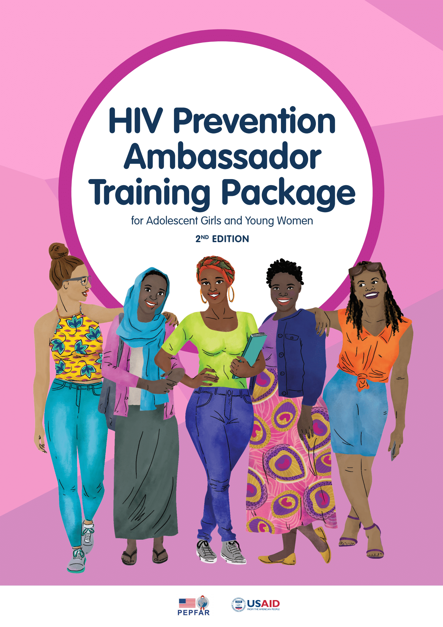
HIV Prevention Ambassador Training for AGYW
Shyla Napier, FHI 360
Amogelang (Sasha) Kekana, Wits RHI
Havana Mtetwa, PZAT
Takudzwa Mamvuto, PZAT

Slide 58


Intervention Overview
The HIV Prevention Ambassador Training for Adolescent Girls and Young Women prepares young people to become ambassadors who share information and support their communities in the uptake of PrEP through interactive activities, discussion, and action planning
The original training was designed with cisgender adolescent girls and young women in mind, but the training can be used with trans or nonbinary people as well
1st edition was created in 2019 and updated in 2021
Developed by:
  LVCT Health
  Wits Reproductive Health and HIV Institute,
  PZAT
  AVAC
  Collective Action
  FHI 360 US, Uganda, & Zimbabwe
Notes:
2nd bullet: Since it was made public in 2019, there have been 854 downloads of the original training package in at least 36 different countries – including countries in Africa, the Caribbean, Central Asia, East Asia, Europe, and the Pacific.
3rd bullet- The Ambassador trainings were developed with the help of…
On the right side its an example of two tools that was created by the team located in the PrEP method section in the 2nd edition of the ambassador training.

Slide 59
Intervention Theory of Change
Capability
Improves knowledge and skills around HIV prevention and PrEP
Training supports development of decision-making skills that are then shared with peers.
Opportunity
Addresses social norms and improves emotional support for AGYW
Ambassadors create action plans to influence their environments
Motivation
Training knowledge gives ambassadors confidence.
The ambassador role uplifts these AGYW as professionals in their community.
A foundation of sexual health and rights:
  Everyone has the right to influence programming and policies that impact their lives
Best practice in youth engagement:
  Youth should be involved in programming and are key leaders, especially for their peers
Builds skills, and knowledge, and confidence among AGYW ambassadors, who build skills and knowledge amongst their peers and influence their communities
Notes:
V/O
The training is built on a foundation of sexual health and rights, and best practice in youth engagement. Overall, the training works to improve capability, opportunity, and motivation for AGYW’s PrEP use on two levels: directly with ambassadors, and also with the peers that ambassadors influence and support through their work.

Slide 60
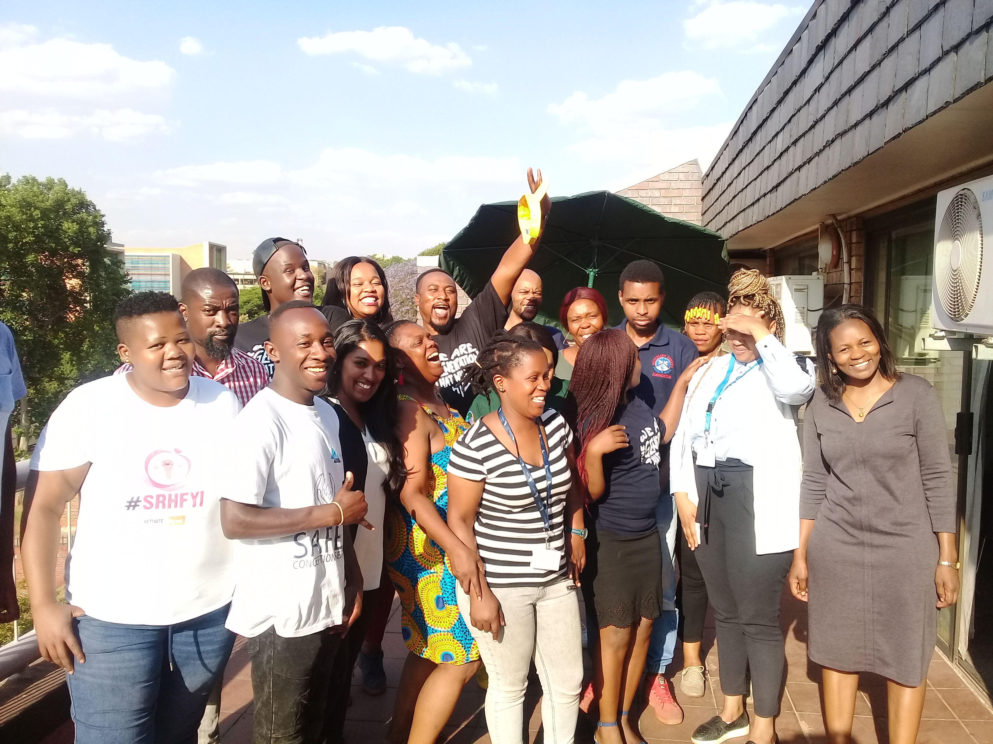
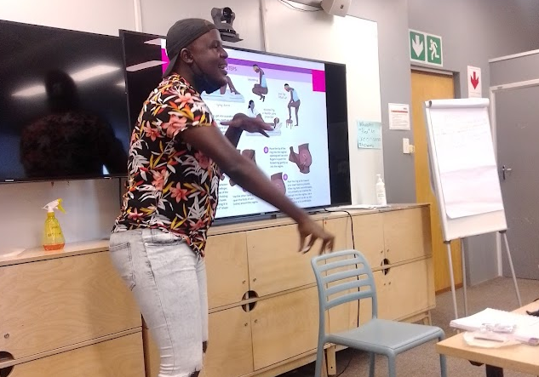
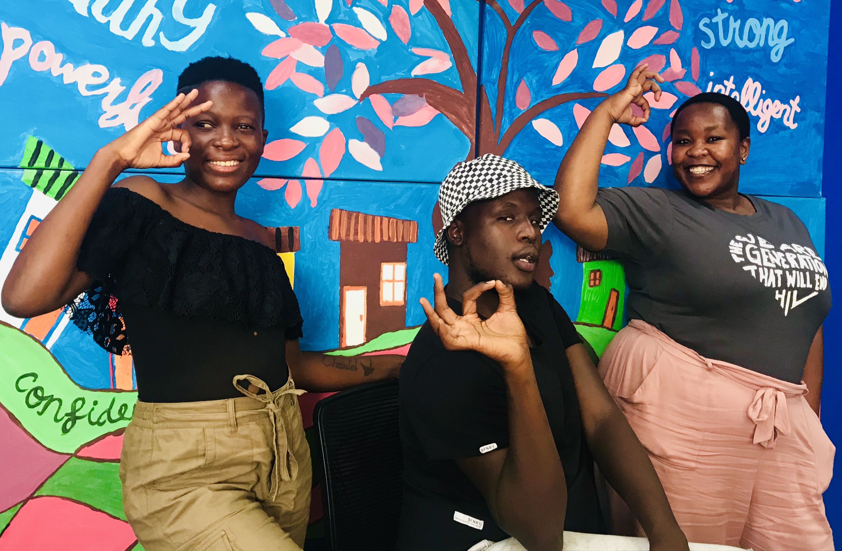
Intervention Description
What it means to be an HIV Prevention Ambassador
What I love about being an HIV Prevention Ambassador
Training and supporting ambassadors
Managing the online Ambassador training portal
Engaging
Educating
Empowering
My favourite AT session
Rates of GBV in SA are very high and this plays a big role in the high rates of HIV
1 in 5 women in South Africa experience physical abuse from the partners
Gender Inequality & Violence
Notes:
Hi everyone, my name is Amogelang Sasha Kekana and I have been an HIV Prevention Ambassador since 2019. I am going to share my experience being an ambassador. I became an HIV ambassador while I was working as a Health Promoter for B-Wise Health, a National Department of Health initiative aimed at improving access to sexual and reproductive health services and information for young people. Being an ambassador has assisted me in terms of increasing my knowledge and strengthening my skills to effectively engage my peers and provide accurate information. I currently support ambassadors through a WhatsApp group and help them set up their own ambassador groups that meet monthly.
What it means to be an Ambassador: Ambassadors and their roles are different for each organization or community. As for me, I provide training to new ambassadors, support to current ambassadors and also manage the online ambassador training.
What do I love about being an Ambassador: Being an ambassador allows me to engage my peers about issues that affect us such as gender-based violence. I love being an ambassador because I’m able to educate and empower my peers to make informed decisions about their sexual and reproductive health and self-care needs.
My favorite AT session: Over the last few years, there’s been an alarming increase in the rates of GBV in South Africa as 1 in 5 women experience physical abuse from the partners and I’m aware of the devastating cycle that GBV makes because it is both a driver and a consequence of the high rate of HIV among my peers. My favorite session in the ambassador toolkit is the one on Gender Inequality and Violence. During this session I hear how participants respond to questions about gender norms and how these influence the behavior and experiences of both women and women. This helps me understand just how deep-rooted gender norms are. For instance in a recent training, I heard how some male partners think it’s ok to beat their female partners if they feel disrespected. As an ambassador I’m always looking for opportunities to create healthy norms that will empower us as a generation and set a new standard for those coming after us. The ambassador training is a step towards creating those healthy norms and it give me hope that we can in some small way, disrupt existing harmful norms.

Slide 61
Field testing the Ambassador Training: Mazowe
Small, rapid non-research field test in Mazowe, Zimbabwe collecting knowledge change among ambassadors, PrEP uptake data, and qualitative inputs from ambassadors
Gender | Age |  |  |  |  | Total
 | 20–24 | 25–29 | 30–24 | 35–39 | 40+
Female | 6 | 4 | 1 | 2 | 1 | 14
Male | 2 | 0 | 0 | 0 | 1 | 3
Total | 8 | 4 | 1 | 2 | 2 | 17
*Information about participants’ sexual orientation and sex assigned at birth were not collected
Notes:
The 17 ambassadors who participated in the field test ranged in age from 21 to 41 years, with the exception of one 55-year-old woman. Three ambassadors identified as male, and the rest identified as female. The 55-year-old woman was included in the training due to her influence among AGYW in the community, who come to her for advice on health and other issues. Information about the ambassadors’ sexual orientation and sex assigned at birth were not collected.

Slide 62
Field testing the Ambassador Training: Mazowe
Pre- and post-test responses showed an approximate 24% improvement in oral PrEP knowledge among ambassadors, from an average of 17 out of 29 correct answers (59%) to 24 our of 29 correct answers (83%) to knowledge questions
Oral PrEP uptake by AGYW increased by 59% at the original facilities after the training
Trained ambassadors also supported the initiation of PrEP service delivery at 10 new facilities. Five new ambassadors were trained in early 2020 to help cover all facilities in the district.

Slide 63
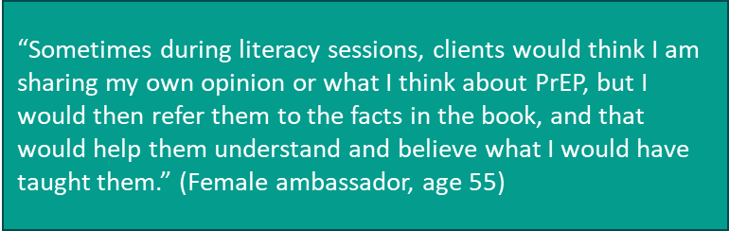
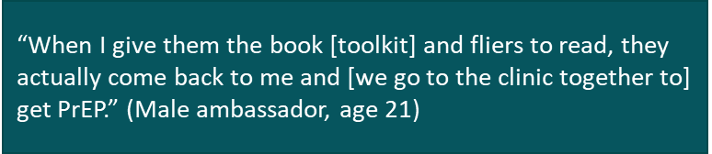
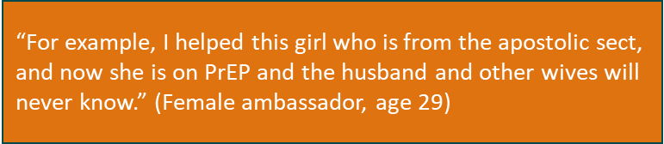
Field testing the Ambassador Training: Mazowe
Qualitative discussions were carried out with ambassadors at six weeks and four months following the training.
Knowledge gained increased their confidence and helped expand the number of AGYW they were able to connect with and refer for oral PrEP initiation.
Ambassadors reported making regular phone calls and home visits to support AGYW with continuation.
Two ambassadors recounted using their new, in-depth oral PrEP knowledge to support four AGYW to reinitiate oral PrEP after they had stopped taking it due to side effects.

Slide 64
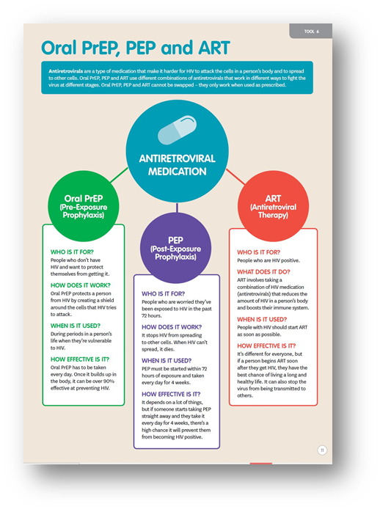
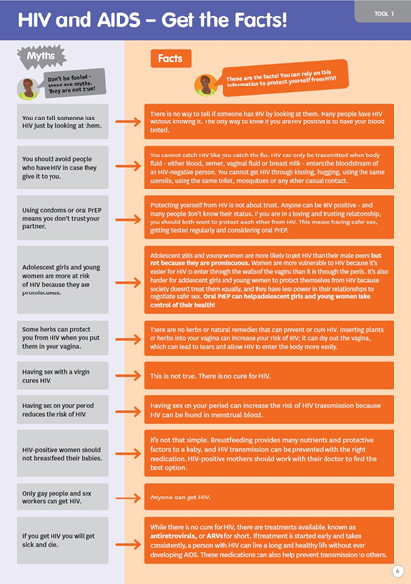
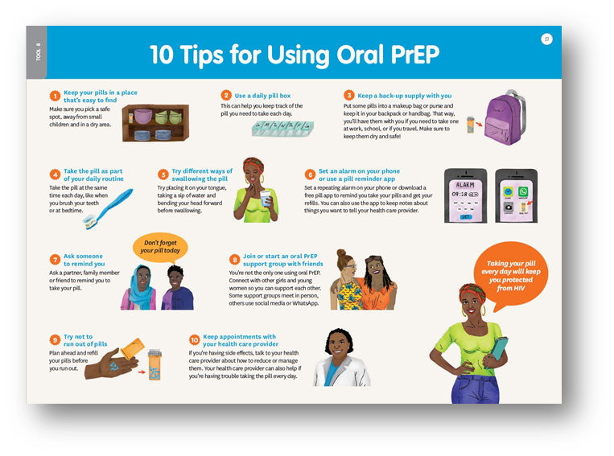
Field testing the Ambassador Training: Mazowe
The most commonly used tools at the 4-month point were:
  those that differentiate PrEP, post-exposure prophylaxis and antiretroviral therapy;
  provide tips for consistently using oral PrEP;
  dispel myths about HIV.

Slide 65
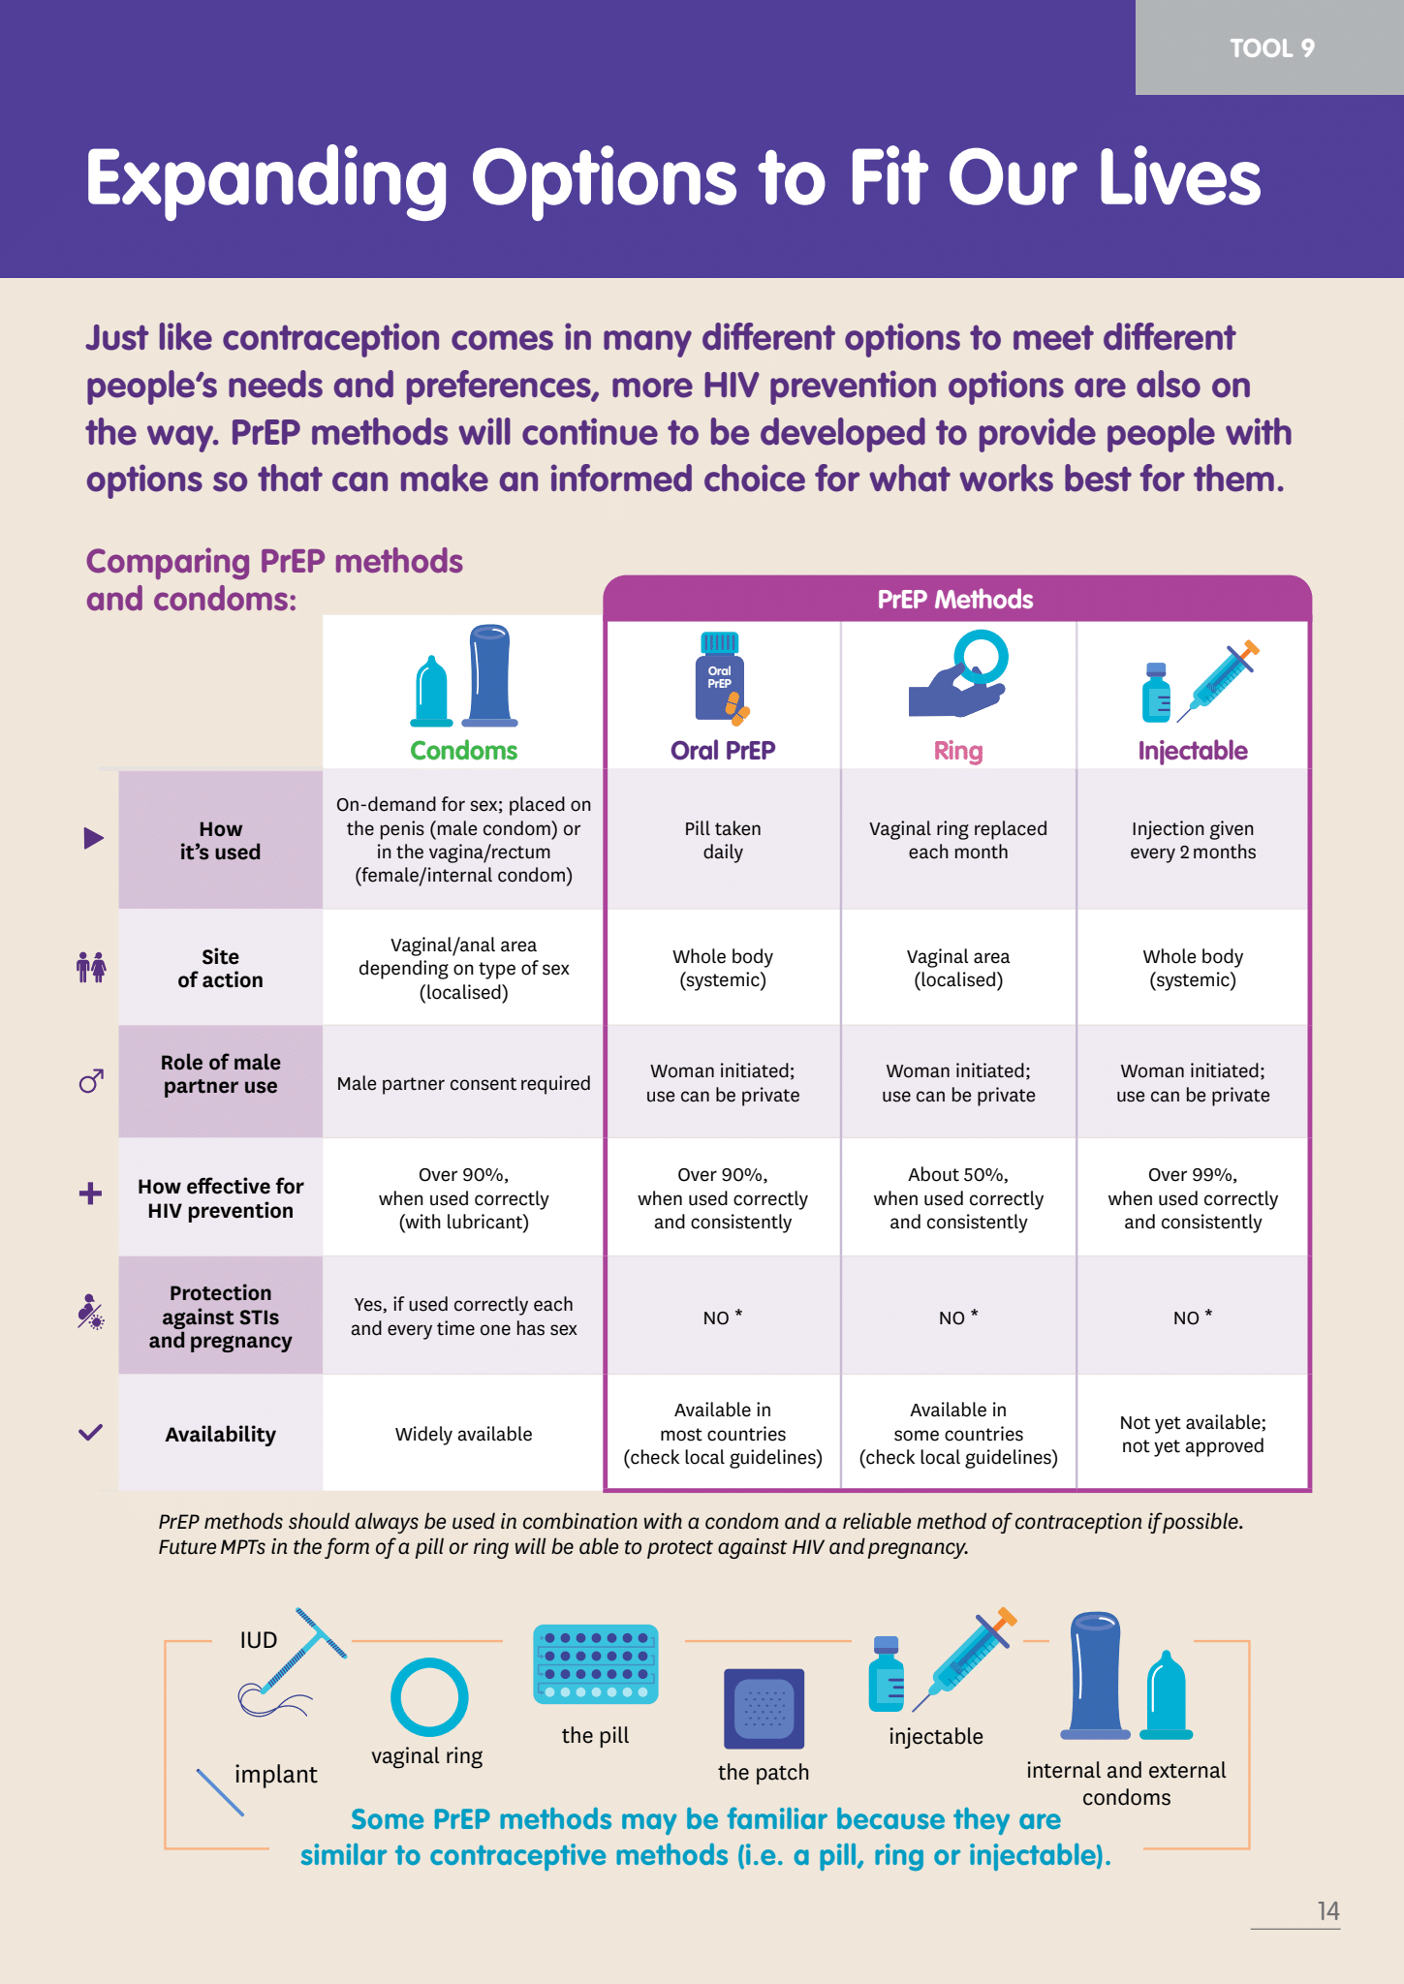
What’s Next
3rd edition updates
  To include CAB PrEP
  Companion module to address support for gender-based violence survivors and AGYW peers using PEP
  Facilitation suggestions to be flexible and relevant for more AGYW and young people
2023: Formal evaluation of the 3rd edition and companion module planned as part of CATALYST
Notes:
CAB-PrEP will be a brand new section and maybe even a tool
Companion module to address support for gender-based violence survivors and will address AGYW peers using PEP
inclusivity and Changing the vulnerability for unmet needs of an individual and using more empowering language will update it throughout the package.
And the Facilitation suggestions will be more flexible and relevant for more AGYW and young people.
Lastly the formal evaluation of the 3rd edition and companion module planned as part of CATALYST in the year of 2023

Slide 66
Amogelang (Sasha) Kekana, Takudzwa Mamvuto, Shyla Napier , Havana Mtetwa ,Niyibeshaho Marie Merci, Morgan Garcia
Notes:
-experiences and intervention of AT

Slide 67
OPTIONS
Chagua PrEP, Chagua Life Campaign
Patriciah Jeckonia, LVCT Health

Slide 68









Chagua PrEP, Chagua Life Campaign Overview
Goal: To increase awareness and access to Oral PrEP by AGYW in Kiambu County
Target audience
  Primary – AGYW
  Secondary – male partners, martriachs and health care providers
  Location of project and implementation period (years)
    Campaign was implemented in June 2019 – Dec 2020 under OPTIONS project implanted 2015 - 2020
Project partners & funders
  Funded by PEPFAR,
  Partners – CHMT, IPs, Advocates, NASCOP
Consortium Partners

Slide 69
SBC strategy process
Understanding the situation
Situation analysis (prioritized factors)
Target audience(s)
Setting priorities and objectives
Positioning
Activity objectives
Developing messages and approaches
Activity mix
Behavioral objective(s)
Monitoring progress
M&E plan (indicators)
Key messages

Slide 70
Behaviour change model (COM-B)
What factors have been associated with PrEP use among priority audiences?
Capability
Motivation
Use PrEP daily during seasons of risk
Opportunity
Adapted from: Michie S., Atkins L., West, R. (2014). The behaviour change wheel: A guide to designing interventions. London: Silverback Publishing. www.behaviourchangewheel.com
Notes:
Applying the Capability, Opportunity, Motivation, Behaviour (COM-B model), we can explore what factors have been found to be important determinants of PrEP use
Capability - Individuals are more likely to use PrEP if:
It is affordable for them.
They are aware of and have correct knowledge about PrEP
Opportunity - Individuals are more likely to use PrEP if they:
Feel services are accessible
Believe providers will treat them well
Believe it is common among others in their reference group
Individuals are less likely to use PrEP if they:
Fear it could associate them with HIV (HIV-related stigma)
Fear it could associate them with homosexual activity (homophobia)
Motivation - Individuals are more likely to use PrEP if they:
Believe they are at-risk of HIV infection
Believe it is for people like them
Believe PrEP is effective
Feel it is possible to take it daily
Individuals are less likely to use PrEP if they:
Prefer to use other HIV prevention methods (such as condoms)
Worry about the likelihood of side effects

Slide 71
Determinants relevant to AGYWs in Kiambu County
Capability
Opportunity
Motivation
Knowledge
Service provider skills and attitudes
Social support
Beliefs
Self-efficacy

Slide 72
Intervention Description
The SBC intervention began in June 2019 – February 2020
Analysis of HIV data for Kiambu together with the county health management team
Community dialogues held with AGYW, male partners (20 – 50years) and matriarchs
Co-creation of key messages, campaign and hashtags
Development of SBC materials and testing
The Chagua PrEP, Chagua Life campaign was launched in Kiambu County, Kenya, in November 2019 with the aim of increasing PrEP uptake in public health facilities across the county.
This campaign featured a DREAMS youth ambassador as the lead character

Slide 73
Intervention Description
LVCT Health team partnered with a creative agency and came up with two approaches.
  One was campaign influenced by a tele-novella style that followed a fictional AGYW character across various situations including romantic relationships and friendships.
  The other was a social-media focused campaign designed to highlight conversations between AGYW and their parents.
Based on feedback from community dialogues with AGYW, LVCT Health ultimately combined the two approaches. A character called Nimo was created but also incorporated the conversational and social media elements of the second approach.
Channels used included radio, social media and distribution of posters at community sites, through CBOs and Ambassadors

Slide 74
Social media #
Hashtags
  #ChaguaPrEPChaguaLife
  #HIVPrEP
  #prevention
  #PrEP
  #HIV
  #UHC
  #LCPrEPKe
  #MaishaHealthynaPrEP
  #choosetostaynegative

Slide 75
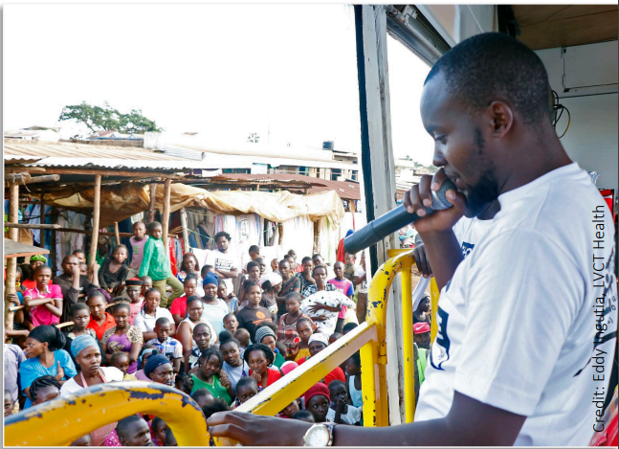
Chagua PrEP, Chagua Life Campaign
Chagua PrEP, Chagua Life road show campaign

Slide 76
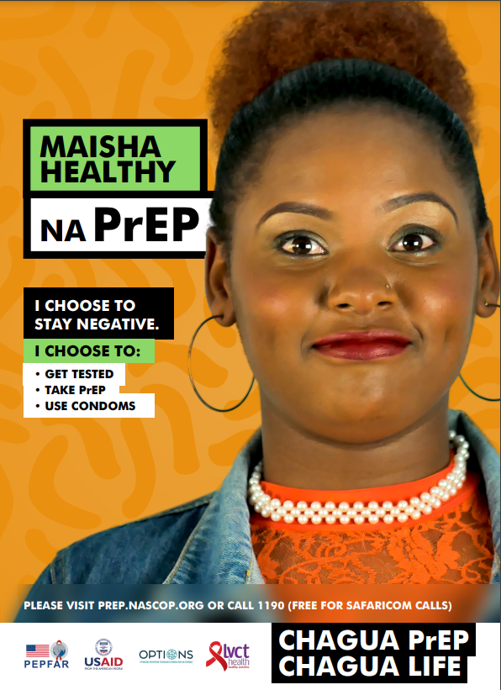
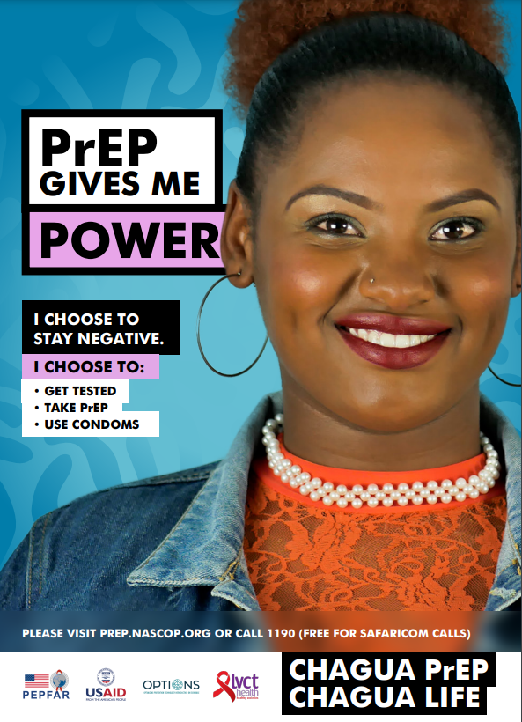
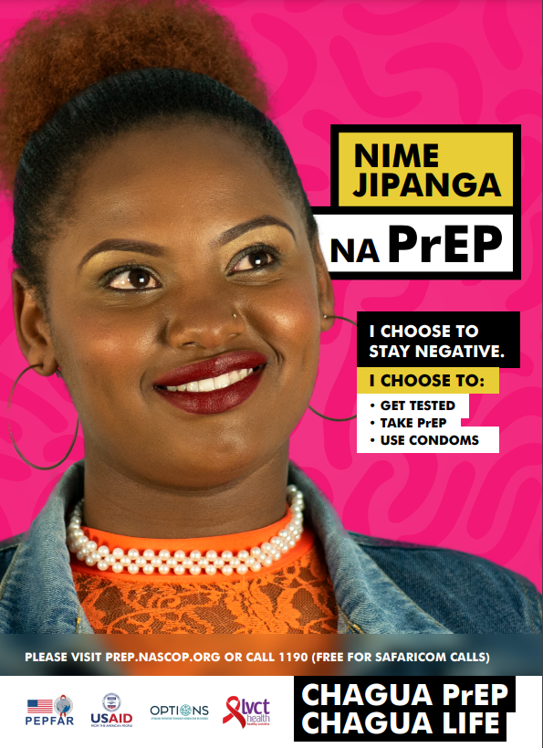
ChaguaPrEPChaguaLife Campaign materials

Slide 77
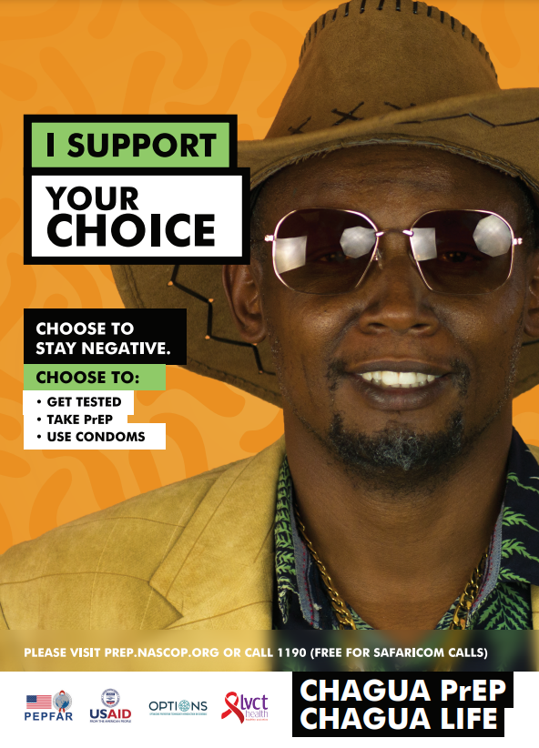
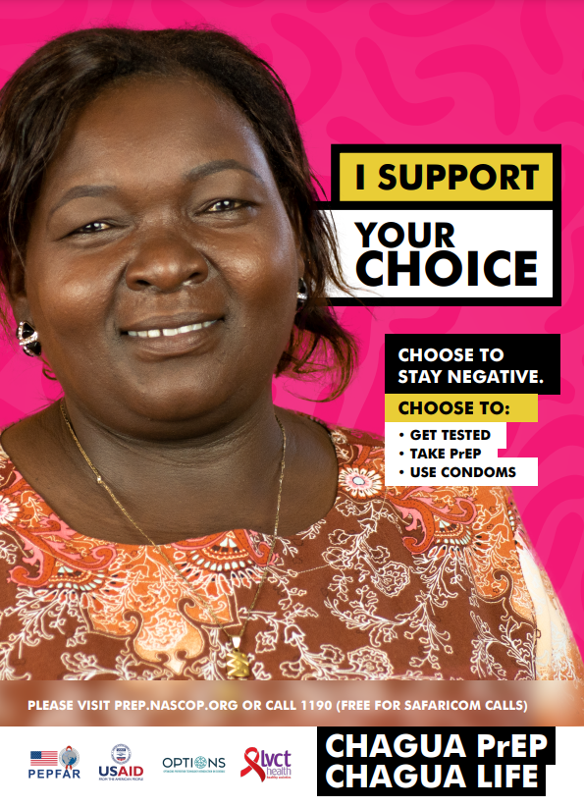
ChaguaPrEPChaguaLife Campaign materials
Sponsor Poster
Key influencer poster

Slide 78
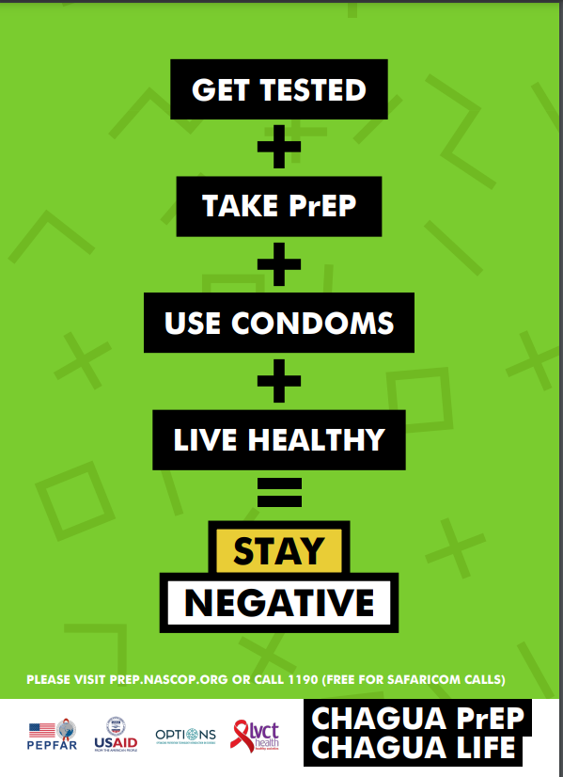
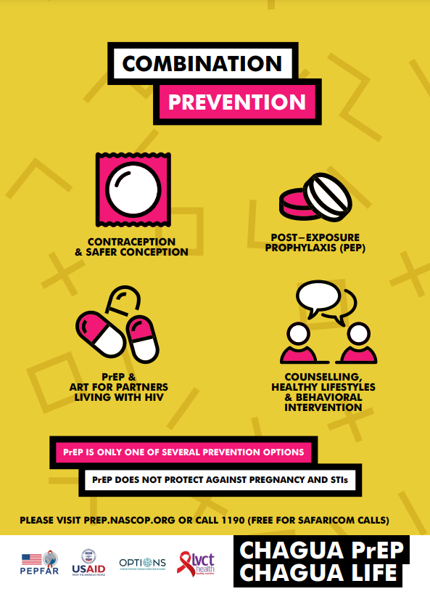
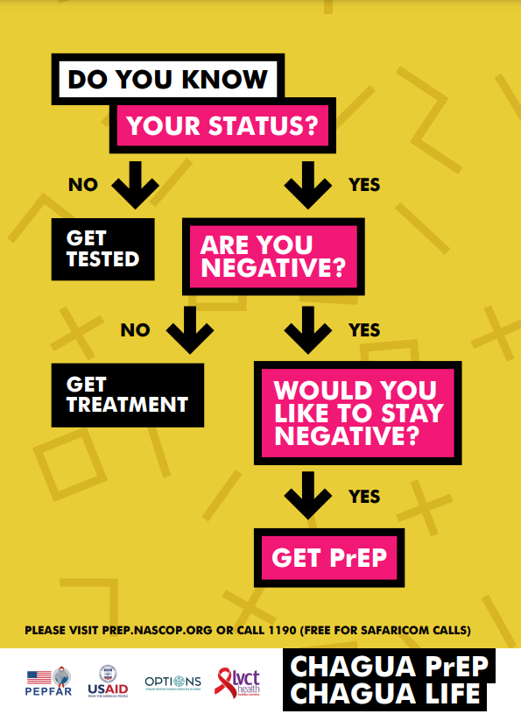
ChaguaPrEPChaguaLife Campaign materials

Slide 79
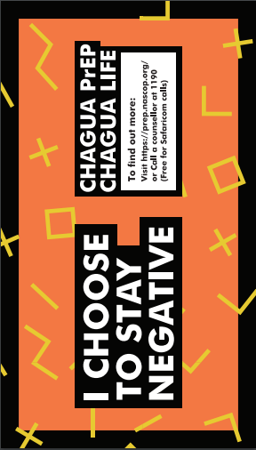
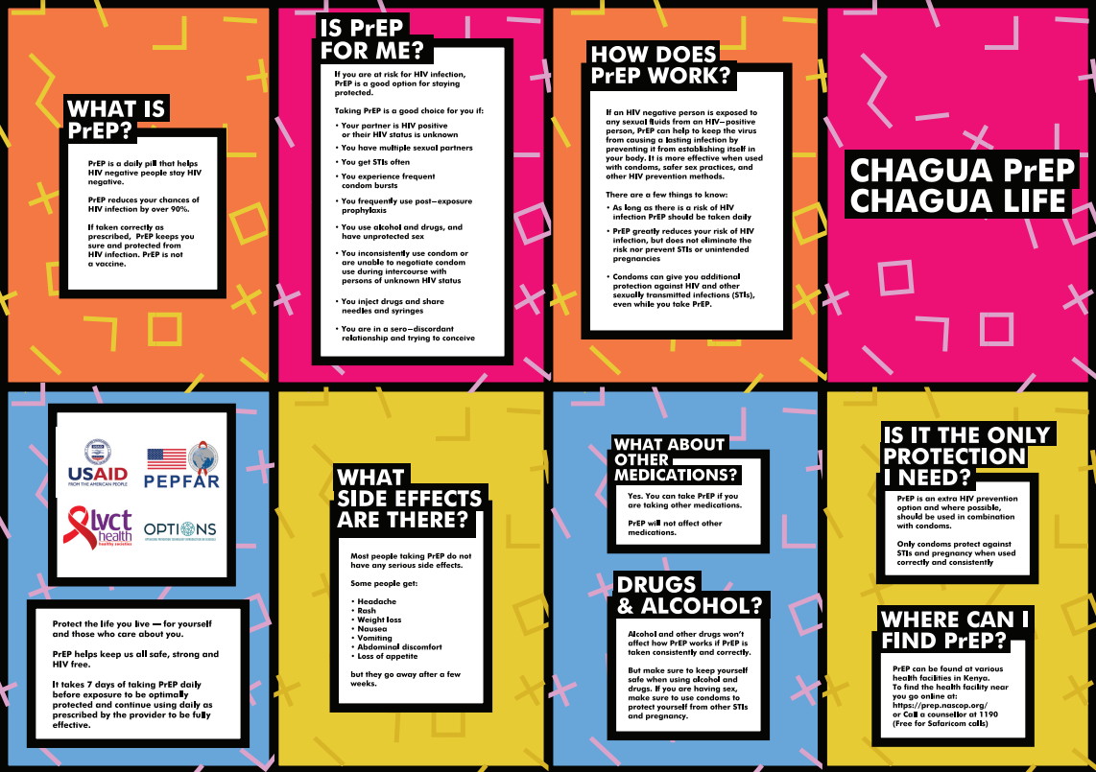
ChaguaPrEPChaguaLife Campaign materials
Others:
6 Videos
2 Radio ads
Social media cards
T-shirts
Wrist bands
https://www.prepwatch.org/chagua-prep/

Slide 80
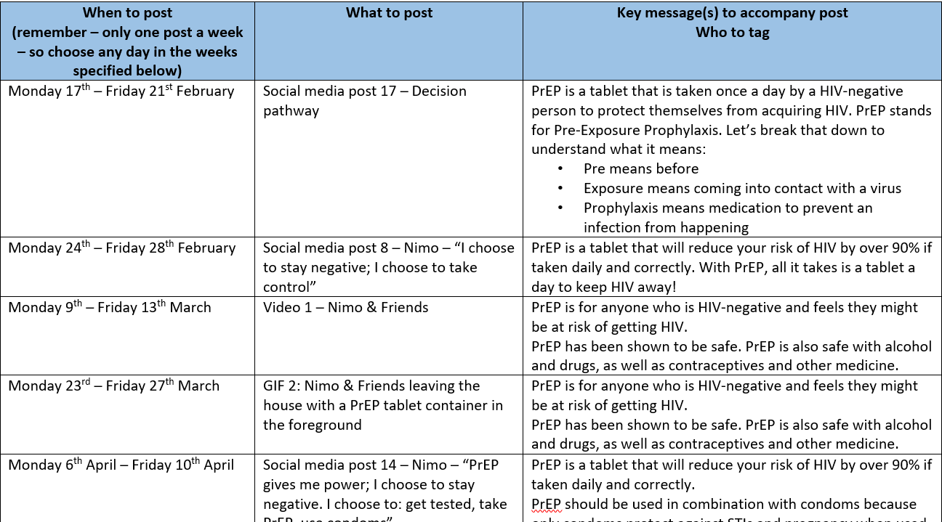
Dissemination plan developed

Slide 81
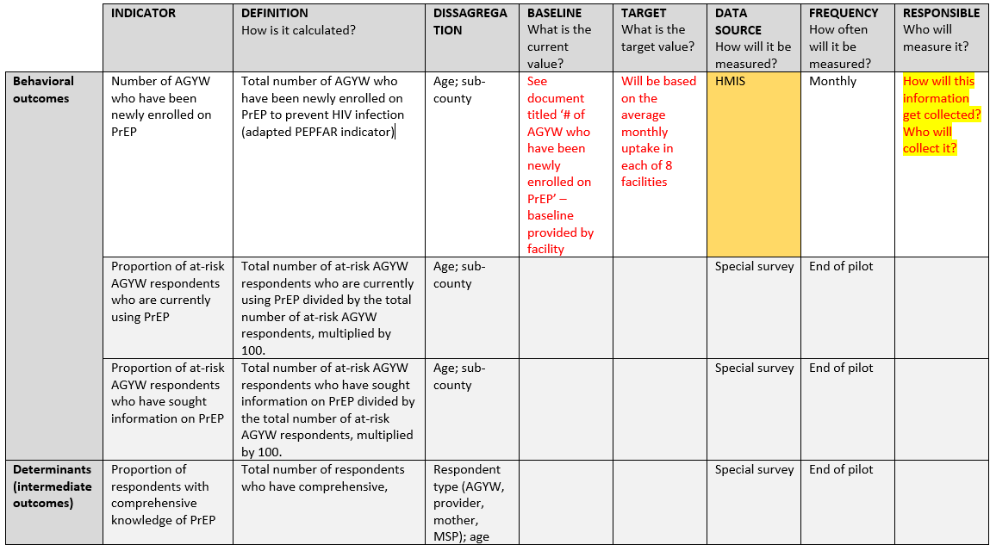
M&E plan

Slide 82
Results and Implications for the Field
LVCT Health’s One2One digital platform saw a doubling in PrEP queries to their hotline during the month when PrEP was launched and the roadshows were held (over 100k people reached)
During the first three months of the Chagua PrEP, Chagua Life campaign, an LVCT Health site providing services to AGYW in Kiambu saw increases in PrEP-eligible AGYW visiting the site and in PrEP use and continuation among AGYW clients (the number of the site’s AGYW clients continuing to use PrEP rose from 2 to 29)

Slide 83
What’s Next
Use the learnings to inform demand creation for other HIV prevention products
Strengthen M&E data collection

Slide 84
THANKS email: patriciah.jeckonia@lvcthealth.org

Slide 85
Jilinde Project
Lessons from PrEP Scale-Up in Kenya
Daniel Were, Jhpiego-Kenya

Slide 86
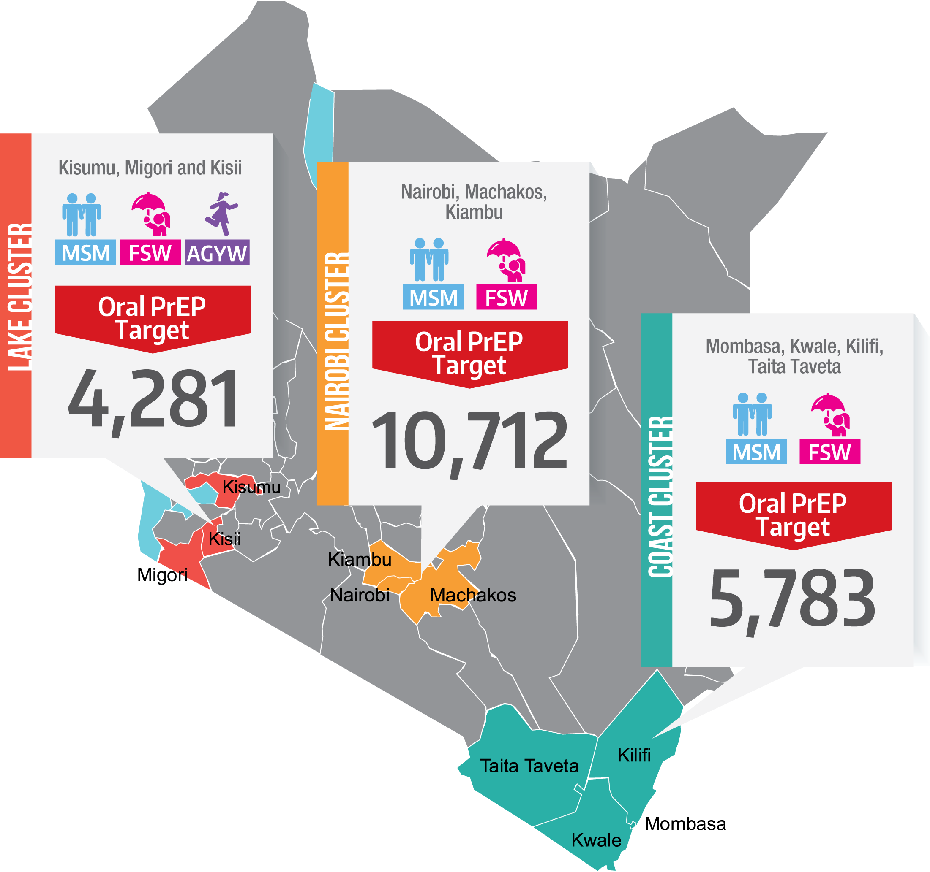
Intervention Overview
Goal: To norm PrEP and create an enabling environment facilitative of PrEP uptake and continuation
Target audience: General population
Period: July 2016-Sept. 2021
Project partners: Jhpiego, PSK, Avenir Health, ICRH, NASCOP
Donor: Bill & Melinda Gates Foundation

Slide 87
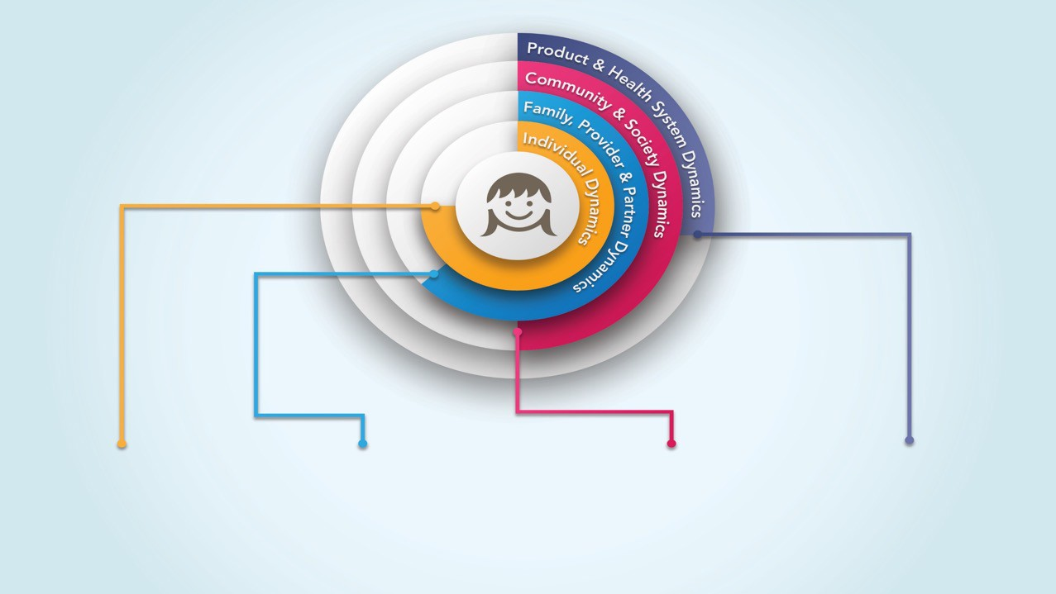
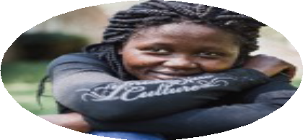
Conceptual Framework
Key Domain: Opportunity
“There is no such thing as an individual decision to use PrEP”
AGYW do not internalize risk
Risk perception not determinant
Low agency and self- efficacy
Parents are not informed about PrEP
Partners fear girls taking PrEP are HIV+ or promiscuous
Providers feel morally conflicted to offer PrEP to AGYW
HIV and ART stigma persists
Myths and misinformation
Low PrEP awareness
Apathy to HIV interventions
Tensions about youth sexuality
Negative clinic experience
Long distance to health facilities
Product packaging and labeling

Slide 88
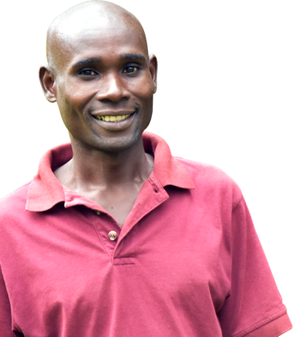

Excerpts
“I’m really worried of this drug, PrEP, the children will become promiscuous. She will just be having sex with different men to get money...”
(58 year old, parent of AGYW)
“My mother told me I have taken those drugs because I want to be a prostitute, so that even if I sleep with men, I don’t get the disease…”
(22 year old, AGYW PrEP user)
Notes:
Findings obtained through 11 FGDs and 18 IDIs with 86 AGYW; 14 IDIs with parents of AGYW, 1 FGD with partners of AGYW and 1 FGD with providers

Slide 89

Jilinde’s Community Engagement Strategy: Intensified messaging to create positive perception & norm PrEP
Structural Environment (MoH, service providers)
Community (Sex partners, parents, community leaders, peers)
AGYW
Stakeholder support
Provider champions, AGYW stakeholders’ meetings, sub county/county review meetings, joint supportive supervision with MoH
Awareness, social support, acceptance of PrEP
Mass media: Regional & local radio
Mid media: Road shows, van interrupts, community theatre
Community events: CHV led dialogue - Community dialogue days, local administration meetings, community meetings, household visits, churches, bodaboda dens, mining sites, parents’ meetings
Knowledge and self-efficacy
Reach through interpersonal communication, targeted events, targeted IEC materials, user support phone calls and SMS
Household survey conducted in November 2018: 45.2% of people in Migori County had not heard about PrEP; 93.7% expressed willingness to support an AGYW to use PrEP; This informed the holistic approach
Notes:
Reach through Community dialogue days, road shows, van interrupts, radio, local administration meetings, community meetings, bodaboda (Motorcycle riders) dens, mining sites

Slide 90
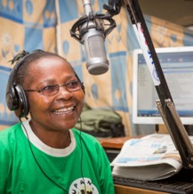

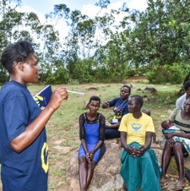

Journey towards making PrEP a social norm
1
Above the Line
Radio: activations & sponsorships
Social media
2
Below the Line
Promotional events & AGYW targeted events
Community theatre, road shows, van interrupts
IPC – Implemented by AGYW PEs
General Population and targeted posters, fliers, brochures, branded merchandise (T-shirts, vests, wristbands, purses/ sling bags, banners)
3
IEC Materials

Slide 91
Results
We conducted a post-test only quasi-experimental evaluation of awareness and demand creation interventions
  Household survey to establish levels and determinants of PrEP awareness
Retrospective analysis of routine program data

Slide 92
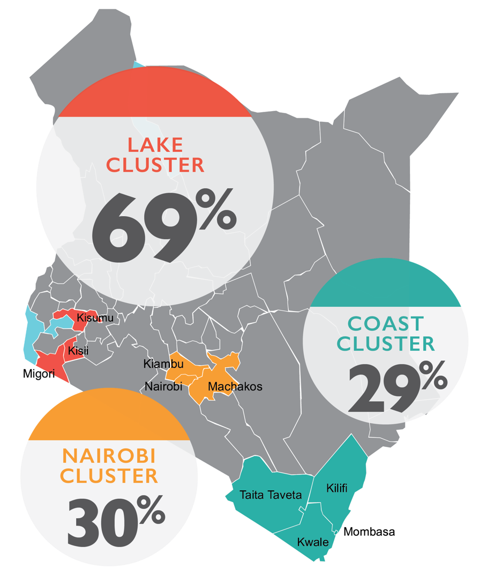
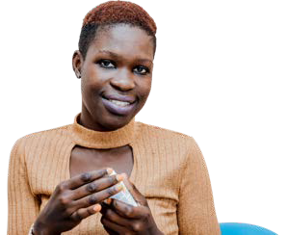
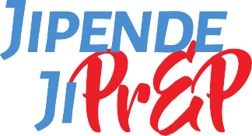


Improved PrEP Awareness in Migori County from 55% in 2018 to 71% in 2021
Sources of PrEP information
• Media (42.6%)
Health personnel (33.6%)
Interpersonal (26.2%)
Community (11.5%)
• Other (4.9%)
₁%
4
exposed to
*Findings from Jilinde project’s demand creation evaluation

Slide 93



AGYW PrEP Uptake is highest through peer referral (Routine program data)
# number of clients using this entry point
Entry point
% of clients using this entry point
Peer networks
50%
(2,343)
Community outreaches
18%
(843)
Within the facility
32%
(1,499)
Total
100%
(4,685)

Slide 94
Optimization of Interventions to improve AGYW PrEP uptake
Community engagement, revamped demand creation & diversified delivery platforms optimized to improve uptake

Slide 95
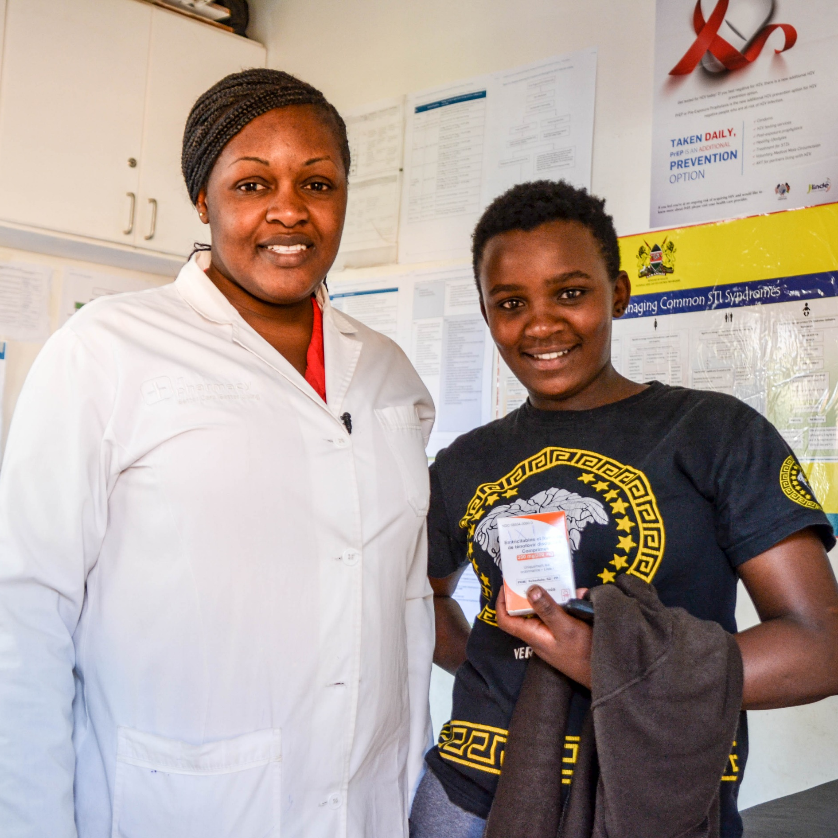
Key Lessons & Implications
Communities are receptive to PrEP but sustained awareness (surround sound) is essential to incrementally norm PrEP
AGYW require affirmation of their decision to use PrEP and social support to cope with the challenges (e.g. side effects, myths, stigma and discrimination)
Media and opinion leaders strongly influence public perceptions; sensationalized negative coverage generates apprehension towards PrEP
Differentiated messaging that resonates with diverse stakeholder groups enhances support for PrEP

Slide 96
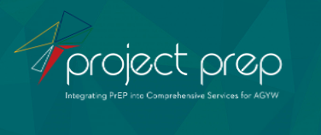
Project PrEP
Engaging parents to support AGYW on their oral PrEP journey
Nakita Sheobalak, Wits RHI

Slide 97



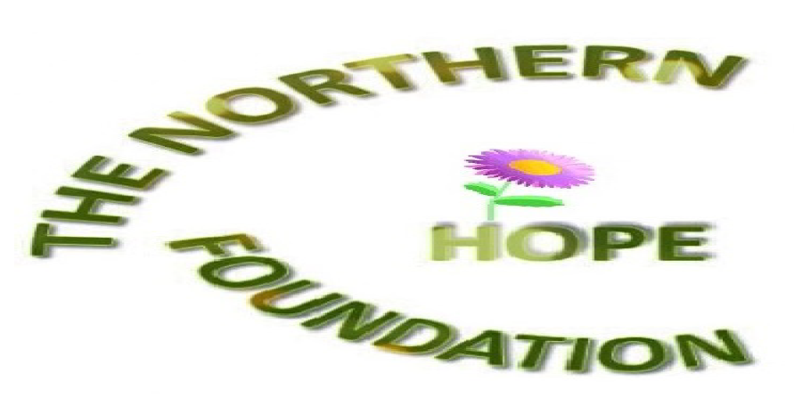
Intervention overview
Project PrEP aims to improve the understanding of uptake and continuation of PrEP among AGYW and vulnerable groups in real world settings and inform delivery models for service integration into comprehensive sexual and reproductive health services. Social mobilisation for community entry is a vital component of the Project PrEP implementation approach.
The goal of the intervention was to meaningfully engage parents/caregivers of AGYW (through a variety of tactics) to encourage support and approval of their daughters' health-seeking behaviours, specifically HIV prevention services; and equip parents/caregivers on how to support AGYW in the continued use of oral PrEP.
Project PrEP is implementing in four clusters across three provinces in South Africa, each cluster contains 2 facilities, each supported by 1 mobile clinic: Tshwane – Gauteng, Mthatha and Gqeberha – Eastern Cape and eThekwini – Kwazulu-Natal.
The parent/caregiver intervention as discussed in this deck was implemented in Tshwane, Gauteng.
The intervention was specifically designed for and implemented with parents and caregivers of AGYW in Tshwane, South Africa.
Government Partner
Funder
CBO partner

Slide 98
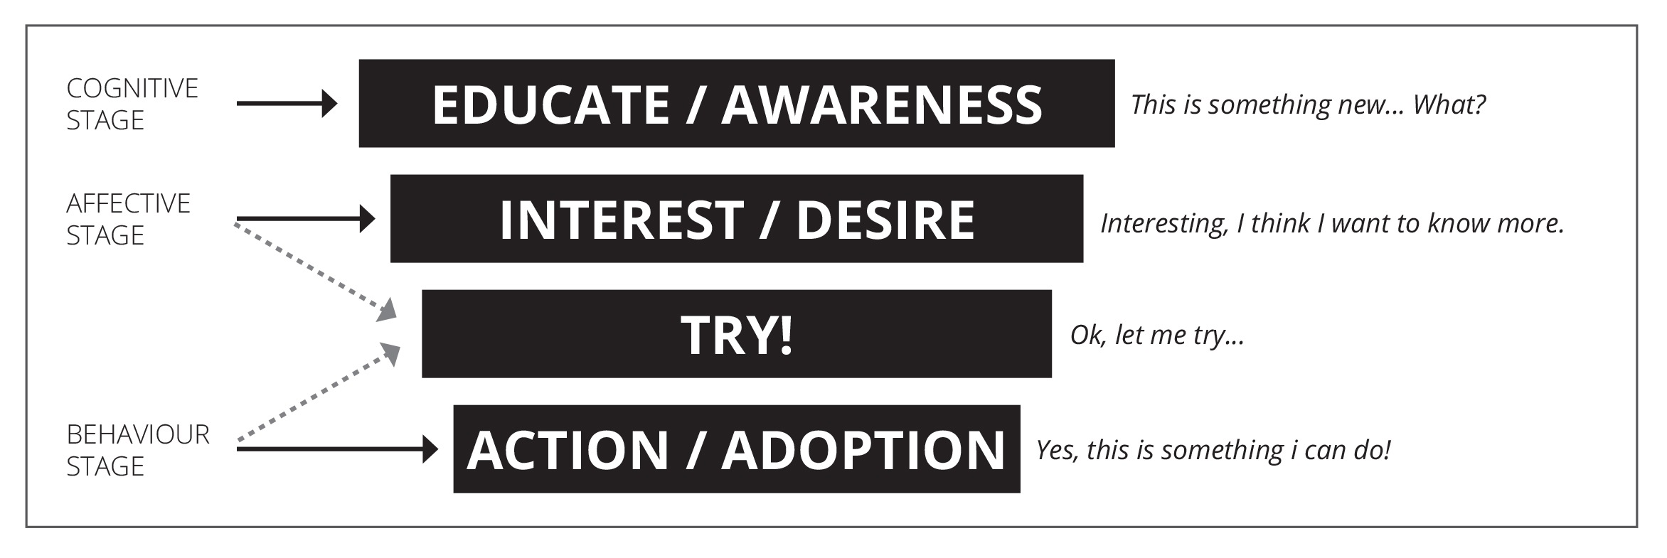
Intervention approach
The project recognises the
need for innovative approaches to
reach these audiences.
Social mobilisation for community entry, specifically ongoing engagement with key influencers in the lives of AGYW is treated as a priority.
The model is underscored by meaningful youth engagement, credibility and trust and a holistic approach that places communities at the centre.
The Eita! Model conceptualised by Project PrEP
Capability
Opportunity
Motivation
Knowledgeable: Equipping parents with evidence about HIV infection and unintended pregnancy, including the potential drivers of these. Further sharing knowledge in relation to SRHR and the benefit of AGYW who are able to access such services.
Skills: Practical guidance on how to converse with AGYW about HIV prevention and how to support health-seeking behaviours.
Social influences: Connecting the concept of religion and morality with health, protection and church-endorsed actions. Engaging churches to address the topic of HIV prevention among AGYW with parents and caregivers.
Environmental context and resources: Churches and religious leaders who encourage parents and caregivers to support efforts of HIV prevention in the lives of their children.
Beliefs about capability: Parents/caregivers understanding the context of HIV in SA and embracing their ability to support their children in navigating the epidemic.
Social/professional role and identity: Identifying with a church and/or religion that embraces the empowerment and upliftment of youth, especially in relation to HIV prevention.
Beliefs about consequence: Understanding that supporting AGYW in their HIV prevention and RH journey will result in positive experiences.
Emotion: Supporting the natural instinct of parent/caregivers to protect and support their children.
Format:
MOTHER DIALOGUE PRAYER DAYS
SOCIAL MEDIA
PARENT/ CAREGIVER DIALOGUES
Notes:
Describe the project’s organizing framework, theory of change, or other guiding framework to achieving behavior change.
Include to the extent known, the determinants addressed according to the theoretical domains framework ((see slides 7-9 for information about this framework)
Provide a high level overview of the intervention format (e.g. group discussions, social media, mass media, etc.)

Slide 99
Surround sound engagement with Tshwane parents and caregivers
A HOLISTIC INTERVENTION
WHAT? | BY WHOM? | FOR HOW LONG? | WHAT WAS SAID? | WHAT DID IT LOOK LIKE?
Parent/ Caregiver dialogues | Scripts developed collaboratively with programmers and site-level staff, adapted based on CBO feedback – all staff trained on oral PrEP and community sensitisation. CBOs responsible for mobilising parents/caregivers in the community to attend. CBOs also trained. | Ongoing – Project PrEP aims to have at least 2 parent dialogues per quarter in all its implementing clusters. | Highlighted the rising number of AGYW HIV infections and unintended pregnancy, and the potential reasons. Focussed on the opportunity for parents to be agents of positive change in their children’s lives. | Dialogue script (used as guidance) Comfortable community space and catering provided by CBO.
Tshwane mother and grand-mother prayer day | CBO briefed to approach local church forums to mobilise religiously observant mothers and grandmothers. Scripts collaboratively developed with programmers and site-level staff. Staff and CBOs trained on need for engaging parents to overcome this obstacle to uptake and continuation. | Prayer days/other special events: If major obstacles to initiation or continuation emerge in a specific cluster these are strategically designed to challenge the obstacle. | Incorporated prayer for HIV prevention, those infected and affected by HIV. Discussed supporting AGYW to access SRH services including oral PrEP to reduce high incidence in the community for that cohort. Requested support to encourage service uptake. | Dialogue script used as guidance. Took place in churches during services designed for this intervention. Catering provided by CBO.
Social media for Tshwane parents | Social media posts were inspired by parent/caregiver engagements and developed by head office staff. | Project PrEP shared 12 posts on MyPrEPSouthAfrica's Facebook page for 1 month and was boosted among male and females aged (18-65+) in all Project PrEP's clusters, including Tshwane. Only 6 posts were boosted for a period of 5 days @ R300-R500 each. | Messages encouraged parents to talk about PrEP and empowered them to teach young women how to prevent HIV. The call to action directed people to either chat via Facebook messenger or to visit the myprep.co.za website. | Posts were designed using a graphic and a short headline in English and vernacular. Posts were shared on Facebook and designed with minimal text so that it captures the mobile audience effectively.
Notes:
Describe the intervention elements in detail. We are interested in details that would facilitate adaptation so please include information such as:
Who implemented the activity (e.g. demographics, training, etc.)
The frequency/length of the activity (e.g. overall campaign or length of a specific session)
Detailed content of the intervention (e.g. what were the specific topics covered in small group discussion and how were they covered)
Include sample materials for review (embedded in the presentation or available for sharing in small group meetings)

Slide 100
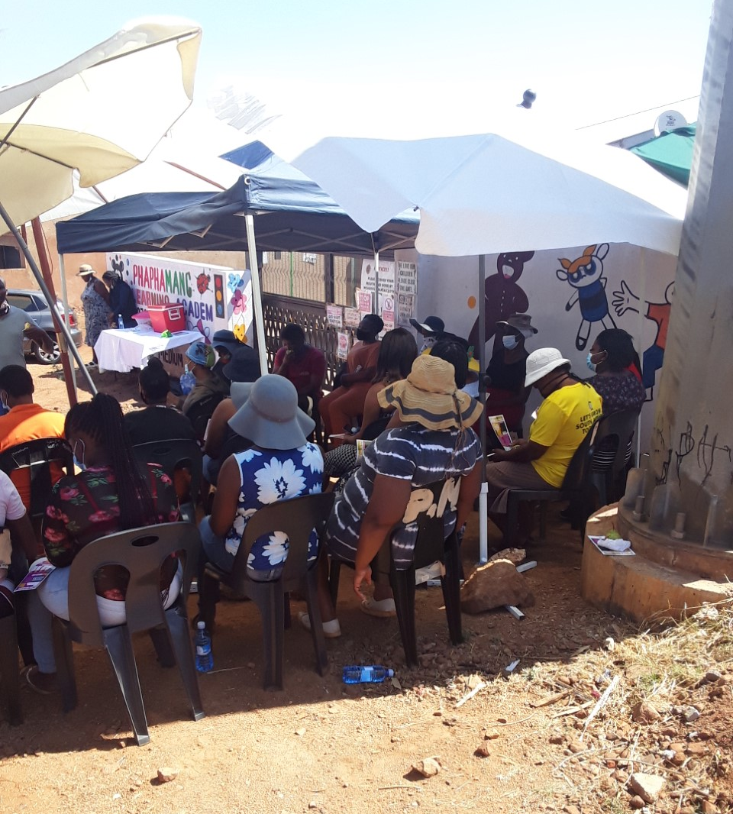

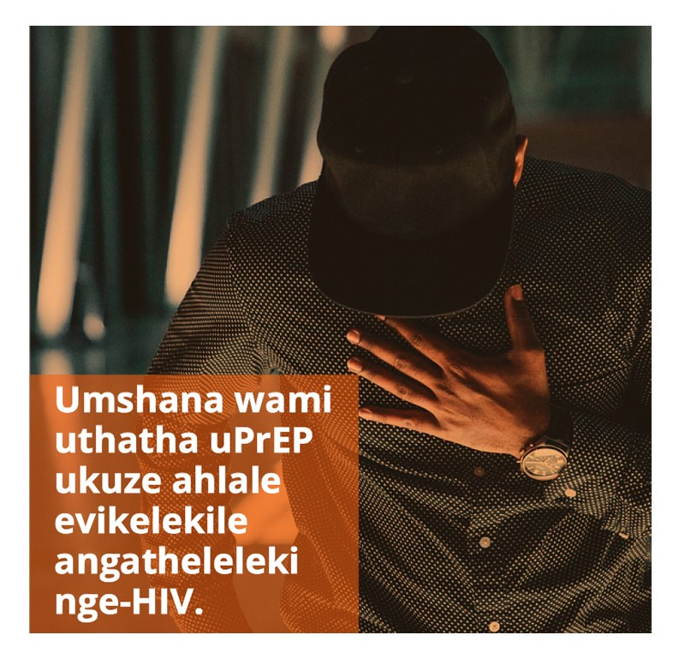
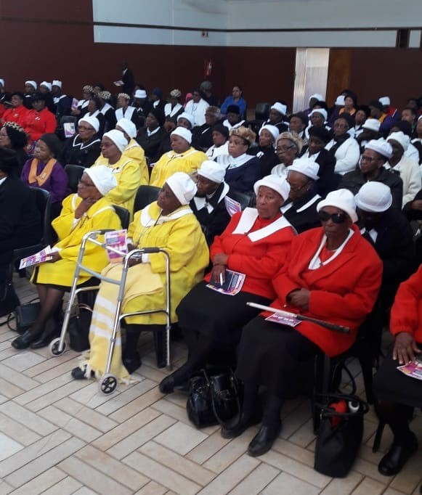
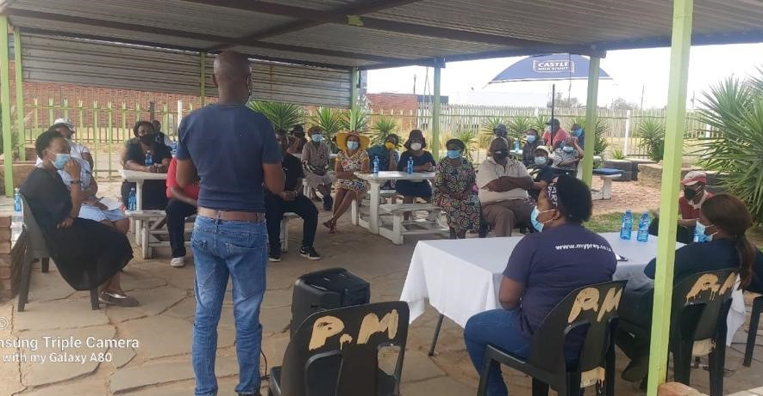
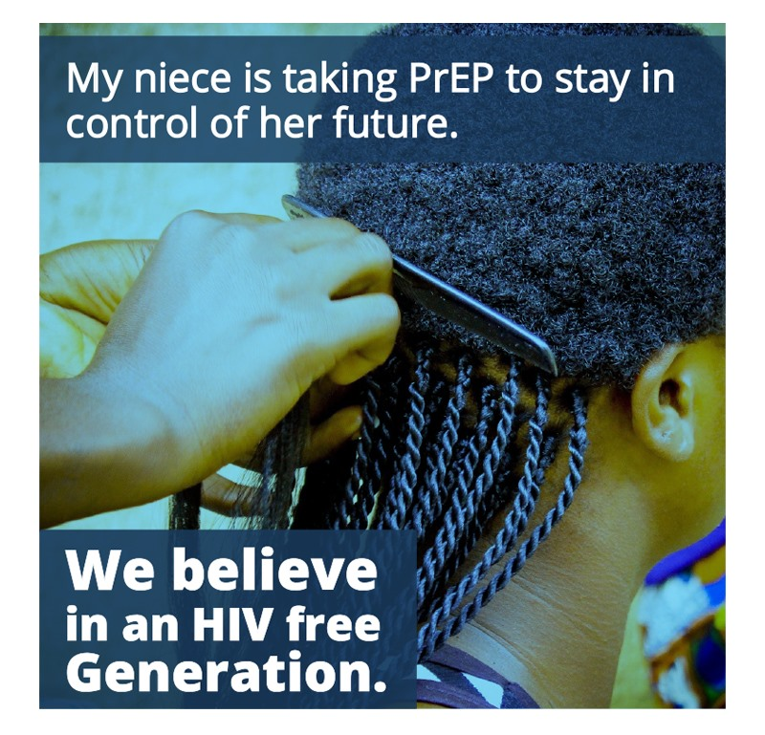
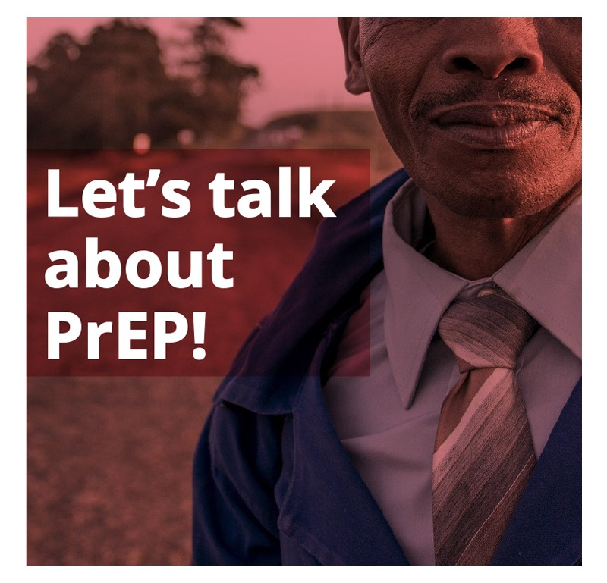
Parent dialogues, prayer days & social media

Slide 101
Results and implications for the field
Monitoring and evaluation:
Dialogues and prayer day attendance is captured on project registers and verified through group photos and videos. Emerging themes, ideas, FAQs and concerns are noted for reporting purposes and to address any potential gaps.
Facebook analytics for each specific post is collected and analysed over a 28-day period. Reach is often quite high, but engagement is more effective as a contributing factor to behaviour change.
Mother’s prayer days:
Each prayer day (3) reached up to 100 parents/caregivers and were facilitated by church leaders and project team. Parents and caregivers discussed AGYW RH and HIV prevention topics in detail and made the connection between empowered AGYW and religious beliefs.
Parent/caregiver dialogues:
Supported by a targeted radio campaign, printed materials and social media, 447 parents were reached through 9 dialogues in a more intimate and smaller space.
Facebook:
Posts targeted at parents/caregivers were specifically boosted to reach this audience across all clusters. The average post reached
approximately 1637 parents in Tshwane and engagement per post was calculated at 88 during a 28-day period.
“When I was young, no-one spoke of these things. But now we know and our daughters don’t have to make the same mistakes and they don’t have to live with what we’ve had to live with.”
Mother of AGYW during a Sunday Dialogue
In some instances, parents were hesitant to engage deeply in a group setting but did commit to supporting their daughters to access services. After the dialogues, parents routinely approached the team during tea time (vital to create engagement opportunities) to ask further questions and advice on how to further support their daughters.
Approaches will be formally evaluated through surveys, FGDs and IDIs.
“What is PrEP?”
"Nice"
"Is PrEP only used by females?"
"I am listening carefully"
"My prep❤️"
Comments on social media posts

Slide 102
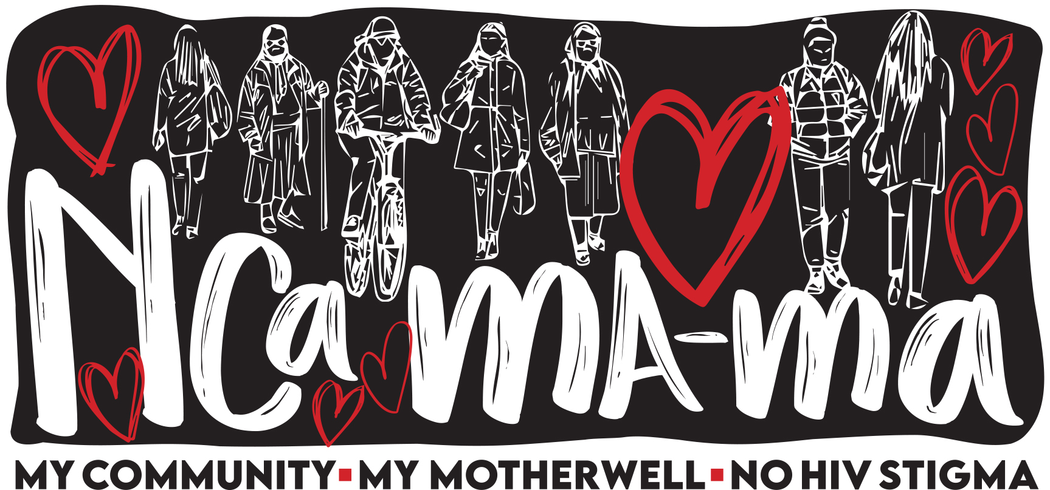
What’s Next
Continued engagement with parents/caregivers through social media with targeted campaigns across Facebook, Instagram and twitter.
These campaigns will occur for 1 week every quarter and invite parents to join the conversations, talk to experts and leaders in the community.
Campaigns will also feature “testimonials” of parents who have supported their daughters to either try or continue on oral PrEP.
Mother/daughter dialogues are planned for the rural area of Mthatha – these dialogues are facilitated through communities and participants mobilized by community leaders.
Community radio campaigns in all clusters, specifically targeted at starting and holding a
conversation with parents/caregivers.
Nca-Mama campaign in Gqeberha, Eastern Cape. The community of Motherwell is often referred to as Mama, which also means mother. The word Nca means to like, appreciate or love. A series of dialogues will take place to advocate for an end to HIV stigma and normalize HIV prevention among AGYW and the communities they live in. The dialogues will also be supported by “decorating community spaces” with this phrase.
These dialogues are referred to as the Mamzo-Nana dialogues. Mamzo is a term of endearment for a mother while Nana loosely translates to “my baby”. This phrase was conceptualised by AGYW and young women from Mthatha.

Slide 103

Gen N
HIV Negative Generation
Manya Dotson, Jhpiego

Slide 104







Intervention Overview
Goal: Use HCD-Lite to develop Demand Generation strategies and activities to increase use of PrEP by at-risk AGYW
Target: Influential community members and parents and caretakers of AGYW, Healthcare workers, AGYW
Nigeria: April-November 2021
CHOICE Project
Notes:
Today we are going to quickly introduce you to Gen-N.
Gen-N is a campaign to finally destigmatize HIV services and drive towards An HIV Negative Generation.
It was co-designed with young women and healthcare providers and community members in Nigeria.
This campaign has not yet been fully rolled out or evaluated, but we are hoping that our process will give you ideas and that these materials will inspire you.
We also want to encourage everybody to treat these like “prototypes” see what people think about them and see how they might work in your context.
Gen N is a brand, a wish and a promise.
GenN is the power of what is possible when we work together.
EVERYONE has a role to play in Gen-N as a user of HIV services, or a supporter of those who use services
WE are creating:
A generation of healthcare heroes who have the power to protect people by advising and supporting their decision making—Providers who are respected for their leading role in driving towards an HIV-free generation.
A generation of young people who have the confidence to enjoy life’s sweetest moments while keeping their relationships strong and HIV-Free.
And a generation of parents and community leaders who know the world is changing fast and are ready to support the young people in their lives in creating an HIV-Free future.

Slide 105
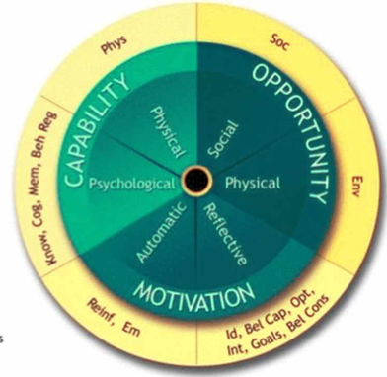
Theory of Change
Assumptions
Influential adults want to protect young people
(reflective motivation)
Therefore IF…
Adults can GAIN status by supporting young people to seek health services
Then
AGYW will be supported to use PrEP—materially and socially (capability)
Young people’s behavior impacts parents’ status in the community (Social + Reflective)
Adults can help protect without being seen to encourage youth sexuality
Adults are given specific actions that make support explicit and visible
Most adults feel “parental” toward AGYW (Social)
AGYW sexuality outside of the context of marriage is seen negatively (Social)
PrEP supports a COLLECTIVE good of an HIV-Negative Nigeria
Taking PrEP is framed as a RESPONSIBLE action
Providers will feel more comfortable prescribing PrEP
And
AGYW use of PrEP will increase
Persuasion Techniques
Signing a contract
Authority
Optimism Bias
Framing
Value Attribution
Storytelling
Status

Slide 106
How we did it: HCD-Lite
Take the Best:
Address the Rest:
Adaptation + Evolution to incorporate recent insights + Localize
Iterate + Test:
Generation Aspire: Social movement
JiPrEP: Self-love
Leverage relationship prioritization
Developmental science: immediate benefit, Pro-social
Inspire explicit community + provider support
Run activities and adapt to address pain points
Sent Social media posts over WhatsApp to AGYW advisors
V: Lifestyle + power
9ja Girls: Feel special
Tried the Community Dialogue session in several diverse communities
De-emphasize risk
Communicate emotional benefits
Jilinde community dialogue model
Lesotho Community Values Clarification exercise
Lesotho parent video

Slide 107








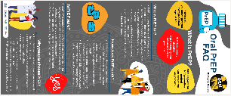


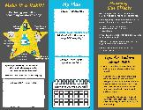




How it fits together: The socioecological model
Materials for Providers/ Counseling
Join the Gen-N Movement: New HIV narrative
Give basic information, address myths
Materials for AGYW
PrEP Plan Trifold
Bottle stickers
Community Engagement: Norm PrEP & support it as part of Gen-N
Introduce innovations in HIV prevention, testing & treatment
Introduce Gen-N
Community pledge
Social media posts
Reframes PrEP as contribution to a higher cause
Creates platform to talk about HIV innovations
TV, large print, popular media, influencers
Common concerns, “Pocket provider videos”
Counseling for continuation wheel
Requests commitment to support Gen-N
FAQ Infographic
Client-provider relationship
Empathways, Gen-N Manifesto
Notes:
Gen-N Addresses all players in the socioecological model.
It addresses clients, providers, and the community as a whole.
But it does more than intervene at each of these levels.
Gen-N recognizes that we have to create connections between and among these actors to truly support an individual’s journey to start and continue using HIV services.
Note: For the moment, in Nigeria, Gen-N has been focused on PrEP, but this campaign could be bigger.

Slide 108




Gen-N Emphasizes Togetherness:
Join the Gen-N Movement
Campaign: Join the Gen-N Movement
Reframes PrEP as contribution to a higher cause
Creates platform to talk about HIV innovations
TV, large print, popular media, influencers, Facebook

Slide 109
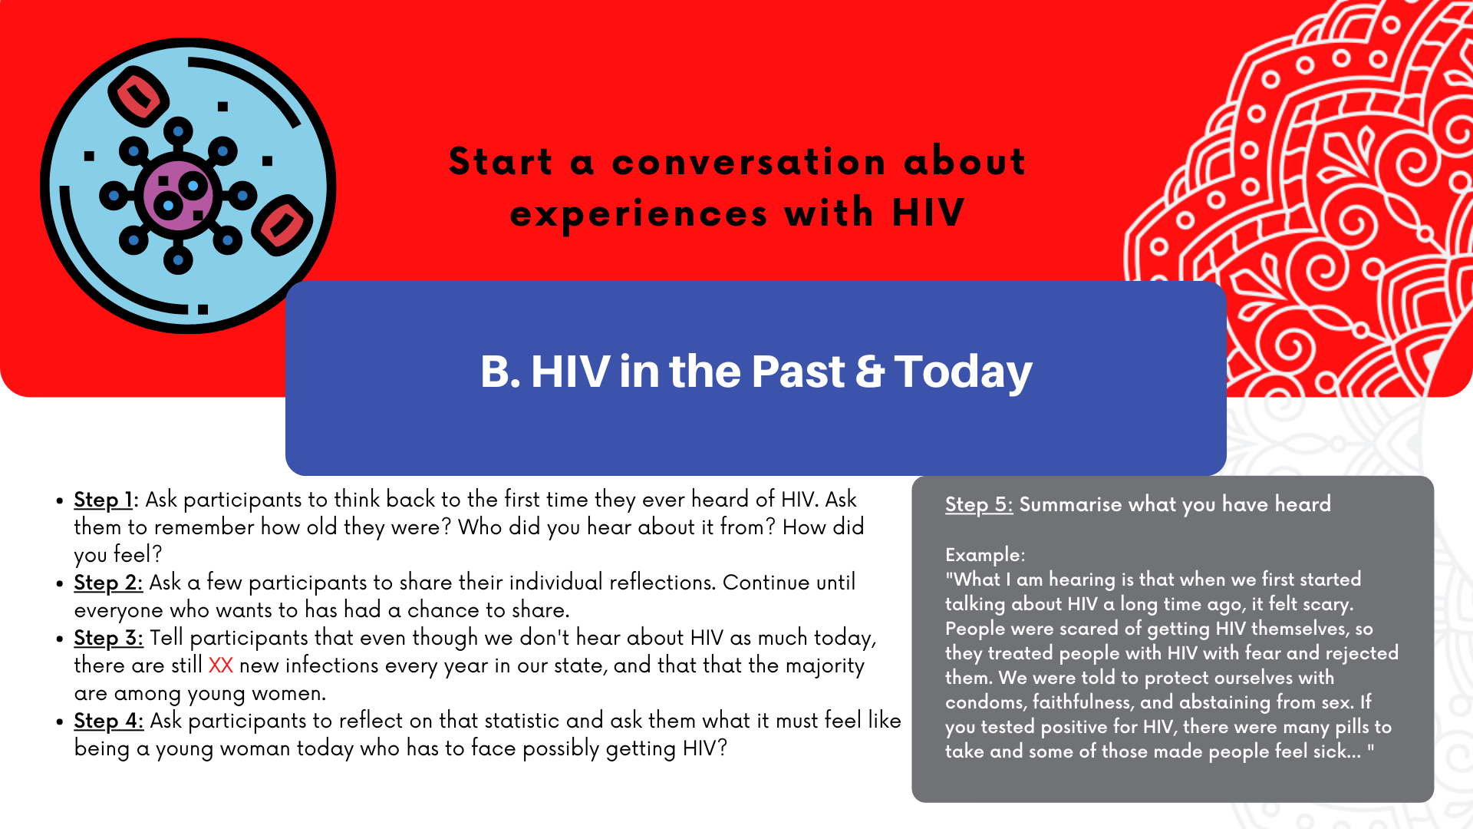
Gen-N Directly Engages Community

Slide 110
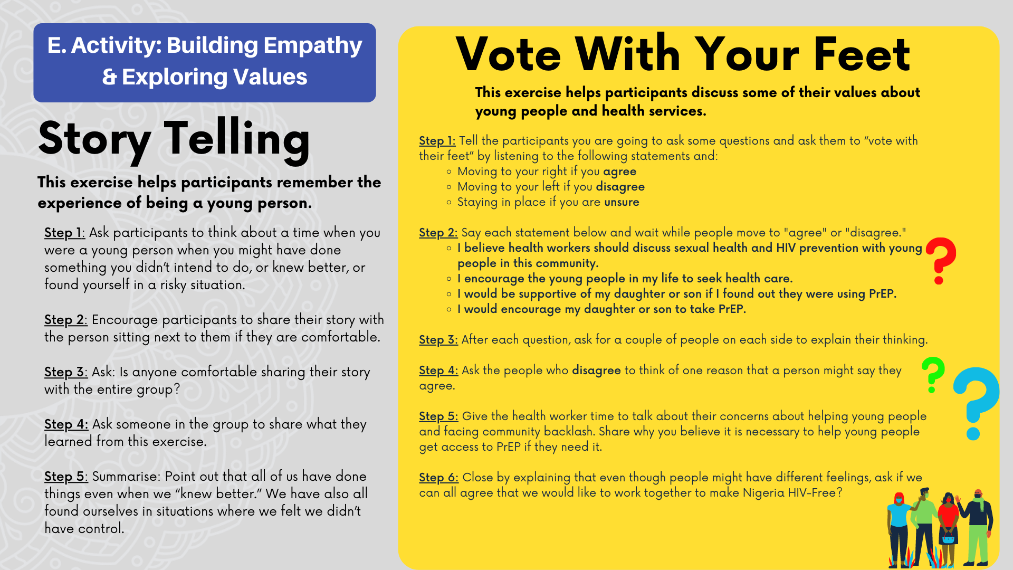
Gen-N Fosters Empathy and Builds a Values-case

Slide 111

Gen-N invites the community to be Heros!
Gen-N Community
Innovations in HIV prevention, testing & treatment
Requests commitment to support Gen-N/ Community pledge
Makes Gen-N hyper-local—links clinics + community

Slide 112
Plans for Rollout and Evaluation
Rolling out through RISE and EPIC in Nigeria
Will be monitored and evaluated through routine program data
Being tested in Lesotho through an HCD Lite process
  Co-design workshops with Parents + Young people together
  Live trial of community dialogue sessions
  Additional Element: Empathways Community (TOC: Increased empathy will lead to increased support of AGYW getting services)

Slide 113

Engaging parents to create an enabling environment for young people’s PrEP use
The CHOICE Parent Module
Morgan Garcia & Robyn Dayton, FHI 360

Slide 114

The CHOICE Parent* Module
Developed in response to AGYW and researcher requests for interventions that engage parents in PrEP programming
For use by implementers who want to introduce parents to PrEP as part of efforts to support young people to use PrEP, with an emphasis on cisgender AGYW
* “Parents” is used to describe parents, caregivers, and guardians in this presentation and the module itself

Slide 115


The CHOICE Parent Module
Informed by field dialogues and field tests in Zimbabwe and Kenya in 2021, and literature reviews of parent support. Currently in use in Zimbabwe and Namibia.
Developed by the CHOICE Collaboration – specifically PZAT, LVCT Health, and FHI 360
Designed to accompany existing parent and family strengthening training curricula, and to be complementary to the HIV Prevention Ambassador Training
Notes:
V/O
The training module was created by the CHOICE collaboration based on information gathered from field dialogues with AGYW and parents, supplemented with a literature scan of existing knowledge and efforts to improve parent engagement around SRH. Of note, while the field dialogues and lit review suggested that mothers typically do more to create an enabling environment for PrEP use than fathers do, we put consistent effort into showing fathers in a positive and supportive light.
The training is intended to accompany existing parent and family strengthening curricula and complement the HIV Prevention Ambassador Training for AGYW, rather than to be a standalone module that is disconnected from broader education and skills building around family dynamics.

Slide 116

The CHOICE Parent Module
Contents include
  Essential knowledge about PrEP methods
  Facilitation guidance and tips
  Instructions for 7 activities
  Additional resources (illustrations, scripts, pre/post-test, lit review and dialogue findings)
  Findings from literature scan & field dialogues
Intended for in-person use by trained facilitators, ideally in small groups
Notes:
V/O
The training is comprised of instructions for 7 activities, each building knowledge and skills that are directly related to requests shared by AGYW and parents during field dialogues, or findings from the literature review. As you can see, the first step in this activity is an example of how requests from AGYW are directly shared with parents as part of the activity.
Other resources in the module include scripts and illustrations to support the activities, as well as analyzed findings from the field dialogues and literature scan to build facilitator understanding of the needs identified and purpose of each activity.

Slide 117


A Flexible and Adaptive Module
To address feedback received during the process, the module includes suggested modifications for a variety of situations depending on context, type of parent, PrEP methods available, and more
Notes:
V/O
Feedback during the process highlighted the importance of a flexible module that could be adapted for multiple scenarios. To address this feedback, the module includes suggested modifications for a variety of situations (parents of cisgender adolescent boys and young men, parents of younger adolescents, if most parents are fathers, different PrEP methods available, etc.)

Slide 118
Intervention Theory of Change
Experience and literature reviews highlight the important role that parents can play in young people’s PrEP use directly and by increasing community acceptance. The module seeks to give parents the knowledge and skills – and the opportunity to practice skills – that young people want them to have to support their PrEP use.
Capability | Opportunity | Motivation
Example: Through the training, parents are able to build knowledge of PrEP methods and practice skills around sharing knowledge and supporting their AGYW’s decision making related to their own RH | Example: The setting of group learning for parents increases their feelings of support from their peers – for example, learning together with other parents highlights the shared responsibility for supporting young people and seeing peers support their children's PrEP use helps normalize this behavior among parents | Example: Pre- and post-tests for participants contribute to parents’ feelings of mastery and competency around the topic, and confidence in implementing what they have learned; they also work together to generate responses to any critiques of AGYW's PrEP use that may come from other adults in their communities, helping them feel confident in and inspired by this supportive approach to parenting

Slide 119

Plans for Rollout and Evaluation
The CHOICE Parent Module has been shared publicly on PrEPWatch and disseminated through CHOICE partners in multiple countries
No current plans for formal evaluation
  The module will be updated next year to include CAB PrEP and to respond to feedback from implementing groups
Gap/opportunity: efforts to engage fathers in improving the PrEP/SRH ecosystem for AYGW
Notes:
V/O
The module has been shared and is publicly available, and feedback will be gathered from the multiple implementing groups. While no formal evaluation is planned as yet, the module will be updated to include CAB PrEP next year and respond to the collected feedback. It is possible that formal evaluations will occur if the need is identified and resources are made available. Ideally, an evaluation would assess both parent response and perceived impacts on the lives of AGYW (those whose parents participated in the training, and in the broader community).
As mentioned earlier, we did identify a gap through this process – that fathers could have a bigger role to play in improving the ecosystem surrounding SRH and PrEP for young people and AGYW. While this was beyond the parent module’s mandate, it is an idea that could be considered by other implementers/programmers in the future.

Slide 120
This slide deck was developed by Morgan Garcia and Robyn Dayton, FHI 360

Slide 121
PARTNERS (2)
SECTOR-ADJACENT
Intervention deep dives
PARENTS & CAREGIVERS (2)
PEERS (1)

Slide 122
Summary of Sector-Adjacent Interventions
ummaries were developed for a sub-set of the identified sector-adjacent interventions. The selection of interventions for summaries based on the following considerations.
During the Action Tank, 5 of the identified sector-adjacent intervention were presented in detail, representing all influencer groups.
Husbands’ Schools (Passages; partners)
Kuwa Mjanja (PSI; parents/caregivers)
Ni Nyampinga
(Girl Effect; peers)
Programs H and P
(Promundo; partners)
Straight Talk
(Straight Talk Foundation; parents/caregivers)

Slide 123


Husbands’ Schools:
Fostering Change in Gender Dynamics to Improve Women’s Use of Reproductive Health Services in Niger
Mariam Diakité and Susan Igras, Georgetown University

Slide 124



Husbands’ Schools
A Strategy by UNPFA and the Government of Niger to Partner with Men in Promoting Reproductive Health
Schools were first developed and tested in the mid-2000s in Zinder, NIGER
Diversity of school membership: married, pro-RH, good citizens, whose spouses move outside the house
There are now thousands of Husbands Schools operating in rural communities around Niger
Some communities now link interventions – Husbands Schools, Safe Spaces for Adolescent Girls, and Future Husbands Clubs for Adolescent Boys

Slide 125

Foundations of Husbands' Schools
Schools initially tested in Zinder Region: Some of the worst reproductive health indicators
Common practice of koubli, the confining of women in their homes
Reduced and late-seeking of health services due to the dominant power and behaviors of men
Husbands reject women’s use of health services
Women are not consulted on decisions to bear children or the timing between pregnancies
Main obstacle identified
The power and behavior of men is one of the main obstacles to women's use of reproductive health services

Slide 126



NIGER HUSBANDS’ SCHOOLS
IMPROVING WOMEN’S USE OF REPRODUCTIVE HEALTH SERVICES
INTERVENTION COMPONENTS
Training Model Husbands: NGO coaches train on Leadership, citizenship, reproductive health and male engagement
Sensitization and One-on-One Outreach by Model Husbands: Model husbands support other husbands and community, with NGO coaching support
Linking to services: Schools coordinate and collaborate with health centers
Notes:
Set up by a coach with a support of the moderator(resource person health center leader, teacher, or others)
Step 1. Site identification
Choice based on the analysis of health center reproductive health indicators, with the weakest ones being prioritized
Collaboration with administrative authorities and health district officials
Step 2. Identify model husbands
Members select models according to 9 criteria identified in a participatory way with all stakeholders
Step 3. Train resource persons (coaches, health center leaders, communicators)
Train on strategies and on the 4 modules (Group Dynamics, Communication, Leadership, and Coaching)
Step 4. Resource persons train school members
Appropriation of the concepts, and member role and responsibilities
Step 5. Equip Schools
By school (1 equipped room, 2 mats, 1 megaphone, 1 lamp); by member (1 hat, 1 tee-shirt, 1 macaroon, 1 bag)
Step 6. Monitor implementation of actions and the capacity building of 4 modules and themes

Slide 127
Theory of Change – Husbands' Schools
Intermediate-Mediating Effects
Behavior & Normative Changes
Husbands' Schools
Men change attitudes about women’s RH
Individual
Change in behaviors and attitudes of men and women regarding RH
Change in behaviors and attitudes of men and women regarding roles/communication to improve RH
Environmental
Collaboration and trust between men and RH services
Changing gender roles and service expectations
RH awareness for other husbands
Trust in the community’s model husbands
Change relations between men and women for RH
Increased use of RH services by women
Awareness and discussions between men on RH themes and leadership
Public/private discussions between men about RH
Community dissemination of new ideas, behaviors, and expectations of husbands and wives regarding gender roles
Sensitization for shy or opposed husbands
Raise RH awareness for men
Increase links to RH services for men
Public services for health centers and the community
Increase approval of RH services
Notes:
TOC created in collaboration with Passages

Slide 128
OUR RESEARCH COLLABORATION
What is the Effect of the Husbands' Schools Intervention on Gender Dynamics? What is the Role of Diffusion of HS-generated Ideas and Beliefs to the Broader Community?

Slide 129
Description of Methods and Participants
Qualitative study employing participatory techniques
13 focus groups (average of 9 participants per group)
35 individual interviews
152 participants in total in the three regions of Niger
Direct beneficiaries
Indirect beneficiaries
Model husbands = Husbands who are members of Husbands' Schools
Wives of model husbands
Non-member husbands
Health workers, moderators, coaches, others
Wives of non-member husbands
Notes:
Protocol approved by the Ethics Committees in Niger and Georgetown University
Qualitative study employing participatory techniques
Recruitment of 2 Nigerian consultants under the technical supervision of IRH

Slide 130
RESULTS
Evidence of Effectiveness

Slide 131
Acceptability: Communities value Husbands' Schools contributions
Start of Husbands' Schools:
Mistrust, rejection, boycott
Husbands' Schools today:
Admiration, desire de join, Husbands' Schools members seen as references

Slide 132
Men’s Perception of RH Service Utilization Before and Currently
Start of Husbands' Schools:
Skepticism and mistrust, lack of information on RH services, prejudice and taboos
Husbands' Schools today:
Acceptance and admiration

Slide 133

Husbands' Schools Influence SBC Directly and Indirectly
Direct exposure
Those who participated in the meetings organized by the Husbands' Schools
(They know the objectives and desired effects perfectly well)
Indirect exposure
Wives and friends of model husbands learn and share further (diffusion)

Slide 134
Changes in Gender Dynamics
Change is visible in the relations between men and women with regards to
power, communication, husbands’ support to wives, mutual trust
          Greater couple and community communication, and RH is no longer a taboo topic
          A woman's decision-making power is more visible
          Women have more freedom of choice (FP method and pregnancy)
          Women participate in deciding where to deliver
          Men are playing expanded roles in their homes and in supporting services use
          Some husbands (both model and non-model husbands) help with housework
          More men accompany their wives to prenatal consultations and delivery
The man remains the final decision-maker (but is no longer the ONLY decision-maker)

Slide 135
DISCUSSION

Slide 136
Husbands School is a Norms-focused Intervention that creates environments that enable behavior change
National policies
Partner, family, peers
INDIVIDUAL one’s attitudes, beliefs, and behaviors
Community and health systems

Slide 137
Husbands’ Schools have these norms-shifting attributes
CHARACTERISTICS OF NORMS-FOCUSED INTERVENTIONS
(See Learning Collaborative to Advance Normative Change 2017 brief https://www.alignplatform.org/sites/default/files/2019-11/lc_nsi_attributes_brief_final_08262019_eng.pdf)
SEEKS COMMUNITY-LEVEL CHANGE Shifts social expectations, not just individual attitudes and behaviors and clearly articulates social change outcomes at the community-level. | ENGAGES PEOPLE AT MULTIPLE LEVELS ( Ecological Model ) Uses multiple strategies to engage people at different levels: individual, family, community, and policy/legal | CORRECTS MISPERCEPTIONS AROUND HARMFUL BEHAVIORS Individuals may engage in a harmful behavior because they mistakenly think it is common (“everyone does it,’ when in reality they don’t).
CONFRONTS POWER IMBALANCES, PARTICULARLY RELATED TO GENDER & OTHER SOURCES OF MARGINALIZATION Within sexual and reproductive health and programs focused on adolescent and youth development, usually of crucial importance | CREATES SAFE SPACES FOR CRITICAL REFLECTION BY COMMUNITY MEMBERS Deliberately promotes sustained, critical reflection that goes beyond trainings, one-off campaigns or ad-hoc outreach, often in small group settings. | ROOTS THE ISSUE WITHIN COMMUNITY’S OWN VALUE SYSTEMS Identifies how a norm serves or contradicts a community’s own values, rather than labeling a practice within a given community as bad.
ACCURATELY ASSESSES NORMS Identifies which norms shape a given behavior and which groups uphold the norm. Also the proper reference groups or influencers important to an individual when making a decision. | USES “ORGANIZED DIFFUSION” Sparks critical reflection to change norms first within a core group, who then engage others to have community-level impact. | CREATES POSITIVE NEW NORMS Creates new, shared beliefs when harmful norms have strong support within groups. Some focus on negative consequences of a behavior, but this can reinforce a behavior by making it seem widespread.

Slide 138
FOR MOSAIC COLLEAGUES
To use the Husbands School approach, you want to be clear on the goal: Do you seek a gender equity, or do you want to focus on men’s power, and male engagement, or a combination?
Note the importance HSs place on community and individual sensitization for gender and other social norms change
We assume that norms are influencing PrEP uptake in young girls and others, but need specificity to design norms-focused approaches that are relevant and resonate locally
Who are the influencers? Do they change over time? They may be peers, family members, and/or religious leaders, service providers.
Which norms are influencing the PrEP uptake? There are likely more than gender norms at play.
How are norms influencing the PrEP uptake and continuation? Social norms formative assessment can explain.
Consider using the Social Norms Exploration Tool (SNET) to identify quickly norms and people who influence the behavior of the primary group. http://irh.org/wp-content/uploads/2020/04/Social_Norms_Exploration_Tool_SNET-1.pdf

Slide 139
From Barriers to Allies
Supporting parents to create pathways to AYSRH in urban and peri-urban settings of Tanzania
Claire Cole, PSI

Slide 140

Intervention Overview
A360 used multi-disciplinary human centered design to develop three distinct interventions aimed at increasing voluntary, modern contraceptive use and reducing unintended pregnancy among adolescent girls aged 15-19-years-old in Ethiopia, Nigeria and Tanzania.
  As part of this effort, engagement of key influencers including parents and, in particular, mothers was found necessary
Target audience:
  Adolescent Girls aged 15-19 and their key influencers
Location:
  Implemented as part of A360’s footprint in Tanzania (see figure)
Timing & Funding:
  A360’s first phase was a 4.5 year project funded by BMGF and CIFF

Slide 141


Slide 142


Slide 143
Theoretical Domains Framework- Alignment
Capability:
  Knowledge– Mothers and Aunties’ knowledge of SRH and adverse effects of pregnancies that are too early or too soon
Opportunity:
  Social Influences— Group-based self-reflection exercises supported mothers and aunties to engage with their perspectives on SRH and contraceptive use first by considering their own adolescent SRH journeys, and the points at which they had required support and care.

Slide 144
Theoretical Domains Framework- Alignment
Motivation:
  Social role & identity-
    Workshops supported mothers and aunties to reflect on the role that their mothers and aunties played in their own adolescent SRH journeys. In turn, this helped them reflect on the role they could play now to support their own adolescent daughters and nieces
  Beliefs about consequences-
    Through group reflection, the consequences of adolescent early pregnancy and unsupportive parents and aunties is surfaced. These consequences were then further grounded in didactic delivery of global evidence.
  Intentions & Goals-
    Mothers and Aunties completed a “Commitment” card at close of each workshop, as a statement to themselves and each other, confirming their intention to support their daughters and nieces.
    Participants also had the option to complete a “Referral Card” to share with their daughters and nieces, as a formal statement of their support for attendance at A360 SRH events
  Emotion-
    Self-reflection on one’s own adolescent SRH journey, coupled with sharing of experiences between participants worked together to elicit emotional connection and empathy– both for one’s own adolescent self and, by connection, to the adolescents in their lives today.

Slide 145

Intervention Description

Slide 146


Slide 147
Additional Detail
Implementers:
  PSI-Tanzania staff and young designers
Frequency:
  Conducted as part of community engagement prior to each implementation “sprint”. Meaning: each new zone had a one-time “Parent Clinic” workshop.

Slide 148

Results and Implications for the Field

Slide 149

COST & PURSUIT OF A ‘MINIMUM VIABLE PRODUCT’

Slide 150

Lessons Learned | Invest in empathy

Slide 151

GER/Ni Nyampinga & Our Work in SBCC
Flavia Mutamutega, Girl Effect

Slide 152

PRESENTATION OUTLINE
Overview of Ni Nyampinga (NN), Girl Effect Rwanda’s youth brand
Our Theory of Change
Intervention Description
Change Outcomes
Impact of Ni Nyampinga
Learnings & Recommendations
The Road Ahead

Slide 153
OVERVIEW OF GIRL EFFECT/NI NYAMPINGA
Operating in Rwanda since 2011, we are experts in Social and Behavior Change Communication (SBCC) and Information Education Communication (IEC). Ni Nyampinga is our youth brand.
Throughout all of our work, our mission is to see a Rwanda where every girl, especially those from vulnerable communities, feels empowered to make informed choices about her health and well-being.
We have a large, primary audience of girls and young people, whom we target. The secondary audience are their peers (parents, caregivers and service providers).
Our partners range from government institutions, development partners and CSOs. Our funders include UNICEF, Mastercard Foundation, GAVI, Women Deliver, MTN, Care International, British High Commission,etc.
Notes:
As an organisations

Slide 154

GIRL EFFECT’S THEORY OF CHANGE
Girl Effect’s Theory of Change identifies 8 behavioural drivers that are the basis for how girls make decisions.
By programming towards these 8 drivers, we theorize that we will shift the underlying motivation, ability and identity-associations that enable girls to decide about their behaviours.
8 behavioural drivers:
Social identity: where do I want to fit in? What do I think my peers do, and expect I should do?
Self identity: who do I see myself as? Am I the type of girl who does this?
Outcome expectations: what will I gain if I do this? What will I lose?
Attitudes: what do I think about this behaviour? Is it good or bad?
Knowledge: what do I know about this (facts, how to)? What can I do (skills)?
Perceived control: is it up to me? What external to me might stop me?
Perceived social support: do I think others will support me and help me?
Self efficacy: do I have the confidence to do this?

Slide 155

NI NYAMPINGA: TAKING GIRLS ON A JOURNEY
As a well established brand in Rwanda, Ni Nyampinga is able to design for long term behaviour change.
Over the next 3-4 years Ni Nyampinga will be addressing multiple behaviours on the journey towards our ultimate goal of girls practicing safe sex when ready.
Recent programming (and this evaluation) focus on the first two behaviours in the journey; Speaking about sex and SRHR and Accessing SRHR services
SUB-
BEHAVIOUR 1
Girls speak about sex and SRHR
SUB-
BEHAVIOUR 2
Girls access SRHR services
SUB-
BEHAVIOUR 3
Girls access contraceptives
SUB-
BEHAVIOUR 4
Girls carry condoms
SUB-
BEHAVIOUR 5
Girls negotiate safe sex with their boyfriends
FINAL BEHAVIOUR
Girls practice safe sex when ready

Slide 156
INTERVENTION DESCRIPTION
We use an SBCC and gender transformative approach to provide relatable and inspiring information to adolescent girls to enhance their skills and self confidence.
Our content aims to increase knowledge, attitudes, behaviours and norms across the domains of health (including sexual & reproductive health), education, economic empowerment and safety.
We inspire the adolescent girl to put herself at the center of change.

Slide 157
GIRLS CENTERED CONTENT CREATION
NN is implemented through a systematically integrated and coordinated range of activities and platforms.
Content is evidence-based: We train girls (TEGAs) to use mobile phones to collect real time data from girls, which informs all of our SBC content.
We look at gender barriers blocking their confidence to strengthen their education and health.
NN content is then created by trained creative team of young women journalists to produce a tailored, comprehensive and age-appropriate content/ messages in a youth friendly language and tone which girls can relate to.
Brand ambassadors are trained to deliver our content and facilitate engagement with young people in clubs at school and in their communities.

Slide 158

All of Ni Nyampinga’s content and interventions are developed on-the-ground in Rwanda by a team of local content creators, researchers, ASRHR & gender experts.
To create Ni Nyampinga we partner with government institutions and a range of local media outlets, creatives and NGOS.

Slide 159









Our ecosystem of SBCC is maximized to drive demand
NN Radio talk show
NN Magazine
NN Sakwe fictional radio dama
IVR
Website
SMS1019
Ambassadors
Self starting clubs
Notes:
Includes REB e-learning platform

Slide 160

Ni Nyampinga content is also digitally accessed across all of Rwanda now!
In partnership with REB, our e-learning platform enables NN content to now be digitally and regularly uploaded into Smart Classrooms across the country.
This helps us to achieve 2 objectives: 1) sustainable access to our content; and 2) empower young people with user-friendly content that can be accessed at any time.
Notes:
Ilaria
16.38-16.40

Slide 161
WE LEVERAGE THE POWER OF THE BRAND
Content that’s targeted and tailored to the audience.
Girl-centered and gender transformative approach in everything we do.
Multi platform, high frequency.
Regular messaging delivered through diverse platforms, formats and ‘voices’. This results in deeper, longer lasting change.
Content appeals to the head and the heart.
We use factual and fictional formats to inspire engagement, deliver knowledge and shape beliefs in an engaging way for our audience.

Slide 162
INTERVENTION DESCRIPTION
We work on the demand side. We package content to encourage girls to demand access and use of existing services, and it is all done through the lens of creativity, locally grounded cultural nuance and entertainment.
Ni Nyampinga is flexible and adaptable to address emerging issues. For instance, during the COVID-19 pandemic, our content creators walked an extra mile in creativity to show girls what to do not to be idle or how to detect and avoid abuse.
We closely monitor and measure girls’ attitudes, confidence and skills to voice themselves, both in private and public domains. We also measure the attitudes of boys, families and decision makers towards a girl’s needs, concerns and innate values.

Slide 163
CHANGE OUTCOMES
HEALTH
Girls delay sex and use contraception when ready (eg. girls know about STIs, HIV, pregnancy prevention, etc.)
Girls manage their SRH (eg. girls know about body changes)
EDUCATION
Girls transition to and complete secondary school
ECONOMIC EMPOWERMENT
Girls are financially included and empowered
CROSS-CUTTING
Digital empowerment of girls

Slide 164
IMPACT OF NI NYAMPINGA
Data from our outcome evaluation shows that:
Over 80% of all Rwandans are now aware of the Ni Nyampinga brand, content reaches 4.5 million, incl. 680,000 girls.
Half of all Rwanda youth listen or read Ni Nyampinga regularly
48% of consumers have acted on our SBC messages
1 in 2 consumers would recommend Ni Nyampinga to a friend
And past research shows that Ni Nyampinga has positively changed girls’ attitudes and behaviours:
Consumers are 60% more likely to have high self-confidence and belief in their own potential
Notes:
Tiva
16.09-16.11
Source: Wave 4 (2016)

Slide 165


There is IMPROVED GIRLS’ KNOWLEDGE ABOUT ASRH ISSUES THAT AFFECT THEM.
APPROACH:
Age-appropriate ASRH information across all platforms
CONTENT:
Baza Shangazi format specifically focused on contraceptives, STI prevention and consent.
“Top-tips” and” how-to” guides in magazine and radio
IMPACT:
+66% of girls aware of STI symptoms
+8% of girls knowing that withdrawal is an inefficient method of contraception
+4% of girls knowing that condoms help to prevent STIs
+24%
Of girls at endline had high levels of knowledge across a range of ASRH issues
(pre 19%, post 43%).
To view content click here
Notes:
+66% of girls aware of STI symptoms (87% at endline)
+8% of girls knowing that withdrawal is an inefficient method of contraception (50% at endline)
+4% of girls knowing that condoms help to prevent STIs (96% at endline).

Slide 166


SOME OF THE GREATEST SHIFTS WERE SEEN IN GIRLS’ OUTCOME EXPECTATIONS :
Discuss issues, access services and do not fear being judged.
+13%
Of girls at endline had positive outcome expectations
(pre 15%, post 28%).
Notes:
+22% of girls with improved outcome expectations for discussing ASRH (65% at endline)
+29% of girls with improved outcome expectations for accessing Health Clinics (58% at endline)
+20% girls now having no fear of judgement by health professionals (66% at endline)

Slide 167


GIRLS ARE ENCOURAGED TO DISCUSS SEX AND ASRH WITH THOSE AROUND THEM.
APPROACH:
Encouraging discussions around ASRH and sex
Role modeling healthy discussions and information seeking.
Addressing the stigma around girls being informed and educated about sex and their bodies.
CONTENT:
Real life role models across radio and magazine
Radio Drama characters discussing sex and accessing services.
IMPACT:
Increase in the breadth of topics girls were discussing
+23%
Of girls at endline now discussing all ASRH topics measured
(pre 37%, post 60%).

Slide 168


Girls are MOTIVATED TO VISIT ASRH SERVICES.
APPROACH:
Addressing the fears and concerns that young people have around ASRH services, specifically around embarrassment, lack of confidentiality and judgement.
Promoting girls ASRH rights and MoH policy
CONTENT:
Radio Drama characters role modelling visiting a Youth Corner for contraceptives.
Real life role models across radio and magazine
Interviews with MoH and health workers reinforcing rights and ASRH policy.
IMPACT:
+36% of girls knew where to access ASRH services
+6% of girls visiting ASRH services
Of girls at endline …
+36%
knew where to access ASRH services
(pre 59%, post 95%).
+6%
had visited an ASRH service (pre 57%, post 63%)
To view content click here
Notes:
+36% of girls knew where to access ASRH services (95% at endline).
The number of girls visiting ASRH services had increased by +6% (63% at endline) despite restrictions in services affected by the COVID-19 pandemic.

Slide 169

AND GIRLS WHO REGULARLY INTERACT WITH MULTIPLE PLATFORMS HAD HIGHER UPTAKE OF POSITIVE ASRH BEHAVIOURS.
Girls who regularly
attended clubs and listened to the radio drama
as likely to discuss sex and SRH
3x
RADIO DRAMA
CLUB ACTIVITIES
Girls who regularly attended clubs, read the magazine and listened to the talk show
as likely to access services.
3.5x
RADIO SHOW
MAGAZINE

Slide 170
LEARNINGS AND OVERALL RECOMMENDATIONS
LONG-TERM, FLEXIBLE INTERVENTIONS MUST BE BUILT ON TRUST AND EXISTING ENGAGEMENT.
The relationship Ni Nyampinga had built - with girls and those around them - allowed us to take on specific and highly sensitive issues in a way that was trusted, accepted and resulted in significant outcomes across a short period of time.
IMPORTANCE OF A PARTICIPATORY APPROACH, WORKING WITH AND FOR GIRLS.
All content and interventions were developed with young people and created by a team of young Rwandans who have lived experiences of the issues.
This approach meant content reflected the real needs, questions and concerns of young people and empowered than to act.
RECOGNISING THE IMPORTANCE OF THOSE AROUND THE GIRL AND BRINGING THEM INTO THE CONVERSATION.
Some of the most significant barriers preventing girls accessing services are around fears of outcome expectation - judgement, by others.
By bringing in the voices of boys, parents, Healthcare Workers, and community leaders, we break down girls’ fears and provide essential support.
13

Slide 171

LEARNING FROM OUR AUDIENCE
Dismissing the myth help girls become more self-confident and act on key messages.
We discovered that both girls and parents fear that girls who receive the HPV vaccine could become unable to have children after getting the injection.
We brought in a testimony of a role model who had taken the shot in 2012, and when she married in 2020, had a child. In turn, we burst this myth through the trusted voice of Baza Shangazi (Agony Aunt) .
“Baza Shangazi told all Ni Nyampingas to receive HPV vaccine and I trust what she tells girls.”
Girl, NN consumer, age 12

Slide 172

LEARNING FROM OUR AUDIENCE
By disseminating messages through a combination of platforms, our messages are reinforced, which leads to greater impacts on behaviour change.
Girls discuss our content with their friends, seek services, and feel more confident about their journey with transitioning to safe adolescence.
Our reinforcing messages encourage girls to stay in school, to feel empowered to delay their first sex, and say no to harmful behaviours like drug/substance use.

Slide 173
THE ROAD AHEAD: ELEVEN YEARS ON…
Ni Nyampinga started a process to be locally-led with the aim to continue empowering and inspiring adolescent and young people, and take them on a sustainable journey.

Slide 174
THE ROAD AHEAD: TAKING GIRLS ON THE NN JOURNEY
Leveraging on its trust, expertise and well established audience, when locally led, NN will continue the change journey towards girls reaching their full potential. NN will continue to be at the center of decision that girls make on key issues affecting their lives.

Slide 175


Thank you
Notes:
Tiva
16.59-17.00

Slide 176

Programs H and P:
shifting inequitable gender norms for SRHR for all
Chris Hook, Promundo-US
Notes:
Thank Zoe, Donna, and Petra

Slide 177
Intervention Overview
Programs H (for young men) and P (for male caregivers of children) is composed of three interrelated parts:
A gender-transformative in-person and/or digital group education adapted curriculum that includes a manual and facilitator’s guide
Community campaigns that seek to change community norms related to what it means to be men and women vis-à-vis topics of interest; and
A culturally relevant, validated evaluation model (the Gender Equitable Men, or GEM, Scale) that seeks to measure the degree to which young men and women change their gender attitudes as a result of the interventions.
Notes:
Of the three components, the centerpiece of Programs H and P is the manualized curriculum of participatory group activities promoting critical reflection and discussion on gender and masculinities that are carried out in same-sex and/or mixed-sex groups. These group sessions are usually led by trained community facilitators, who serve as gender-equitable role models for young men. Activities include role-plays, brainstorming exercises, group discussions, and individual reflections about how boys and men are socialized to be men, the “costs” of manhood, and the benefits of becoming more gender-equitable men.

Slide 178


Program H/P Theory of Change
Notes:
Programs H/P are framed by the concept of “gender consciousness,” which originates from the idea of critical consciousness developed by Paulo Freire. The process of “conscientization,” according to Freire, links individuals’ capacity to pay attention (TDF) to the world around them and to choose (TDF) a given course of future action with goals (TDF) informed by and empowered by that critical reflection. This transforms their optimism foThis process of reflecting critically on the history of cultural conditions and class structures that support and frame experiences of gender inequality can help to promote personal growth, political awareness, and activism, which can create the structural conditions (TDF domain) to change gender role prescriptions in their peer groups (TDF) and broader environmental context (TDF). By questioning gender stereotypes, youth who already act as “voices of resistance” on rigid gender norms become further engaged and serve as role models for other youth.
The Program H theory of change is also informed by social norms theory, which states that our behavior is influenced by misperceptions of how our peers think and act the theory of reasoned action, which states that a person’s behavior is determined by their intention (TDF) to perform the behavior and that this intention is, in turn, a function of their attitude toward the behavior and subjective norms; and the theory of gender and power, which describes the structures that reinforce (TDF) and characterize men’s and women’s gendered relationships.

Slide 179
Intervention Description
Partnership-setting and buy-in
Adaptation of approach for content and delivery
Implementation
M&E
Notes:
Partnership-setting and buy-in
Partners are interested in leading the change and buy-in to a process of long-term change
They are willing to exchange capacity
They are located in countries where implementation is feasible and the environment enables the change and even scale-up
They have capacity to responsibly manage funds and other Operations considerations
They work cross-sectorally
Consider a TAG from the beginning
Multiple in-person touchpoints valuable
2. Formative Research
Essential question: what do you need to know about an environment to adapt it? Content AND delivery modality
Content: what is masculinity in this context? What are the most important institutions and influencers that define and maintain gender hierarchies?
Modality: how can your message come through?
Development and validation of approach
FGD/IDI, community mapping, ethnographies
Co-analyze data
Adapt, prototype, test, tweak, test, tweak, test
3. Implementation
Local partners in charge of recruitment, logistics, facilities, implementation
Facilitator very important
Consider the setting for reinforcement
Who else can you train? Who else can you influence?
4. M&E
Acknowledge limitations
Pre-post test
GEM-scale
Quasi-experimental
Retrospective
Qualitative as a complement

Slide 180
Review of the evidence
Program H: Program H can successfully contribute to increased condom use (India, Brazil, and Vietnam), reduced STI symptoms (Brazil), increased HIV testing and use of SRH services (Rwanda), greater communication with partners about HIV and contraceptives (Ethiopia and India), and improved SRH knowledge (the Balkans).
Program P Case Study: Rwanda RCT
  63-66% reduction in IPV
  50% boost in men’s antenatal care attendance
  53-65% increase in modern contraceptive use
  Increase in men’s unpaid care and quality child-father interactions
Notes:
H: To be included in the review, evaluations had to include boys and young men aged 12 to 24; assess interventions that have at least half of the group education sessions adapted from Program H, delivered over a minimum of three weeks; use a pre-post, quasi-experimental, or experimental study design; have a minimum sample size of 100; use the GEM Scale to assess changes in young men’s gender attitudes; and assess changes in young men’s attitudes or behaviors related to intimate partner violence (IPV) or SRH. Three randomized controlled trials, nine quasi-experimental designs, and two pre-post evaluations (without a comparison group).
P: We conducted a multi-site randomised controlled trial in four Rwandan districts with expectant/current fathers and their partners, who were randomised to the intervention (n = 575 couples) or control group (n = 624 couples). Primary outcomes include women’s experience of physical and sexual IPV, women’s attendance and men’s accompaniment at ANC, modern contraceptive use, and partner support during pregnancy. At 21-months post-baseline, 1123 men and 1162 partners were included in intention to treat analysis. Generalized estimating equations with robust standard errors were used to fit the models.
The Bandebereho intervention led to substantial improvements in multiple reported outcomes. Compared to the control group, women in the intervention group reported: less past-year physical (OR 0.37, p<0.001) and sexual IPV (OR 0.34, p<0.001); and greater attendance (IRR 1.09, p<0.001) and male accompaniment at antenatal care (IRR 1.50, p<0.001); and women and men in the intervention group reported: less child physical punishment (women: OR 0.56, p = 0.001; men: OR 0.66, p = 0.005); greater modern contraceptive use (women: OR 1.53, p = 0.004; men: OR 1.65, p = 0.001); higher levels of men’s participation in childcare and household tasks (women: beta 0.39, p<0.001; men: beta 0.33, p<0.001); and less dominance of men in decision-making.

Slide 181
Ongoing
Intergenerational approaches (e.g., combining P & H)
  Jordan
  Kurdistan, Iraq
Intersectoral approaches
  Program P-ECD in Bogota
Addressing sexual fluidity
  Program H in Washington, DC public schools (RCT by 2026)
Going to scale
  Bandebereho in Musanze District, Rwanda

Slide 182
Lessons Learned & Considerations for Adaptation
Hone your strategies for recruitment and retention
Understand the environment around the clients
Positive dose-response relationship
Address multiple/intersecting inequalities
Make group education a safe space
Notes:
Recruitment and Retention:
Creative recruitment and retention strategies are needed, and young men should be engaged early on to design the best ways to deliver the program, including the best times to hold the sessions.
Those programs that were implemented in schools, clinics and involved influencers from the beginning, particularly teachers and youth workers, had the highest attendance and retention rates.
Most organizations said it is difficult – or not within their program scope – to recruit the hardest-to-reach young men, such as out-of-school youth, young men in situations of economic stress, and youth experiencing homelessness
Implementation
Understand and engage the influencers around them who shape their gender attitudes and may perpetuate inequitable gender norms.
Many Program H implementing organizations find it challenging to implement sessions over a sustained period without sufficient support from decision-makers, financial resources, and staff capacity (i.e., time and training), and they often have to make decisions to cut content in order to accommodate young people’s availability, school schedules, and other limitations.
At the same time, some evidence suggests that a longer intervention implemented consistently over a longer duration is necessary to see significant change in gender-related outcomes
More can be done to adapt Program H in ways that reflect and address the multiple inequalities that young people face – including those based on income, ethnicity, and sexual orientation. Program H implementers in a few settings have engaged with or been part of advocacy efforts to question structural social injustices.
Program H serves as a space for belonging and emotional connectedness with others during the time the intervention is implemented and may also increase a sense of social support

Slide 183
THANK YOU
c.hook@promundoglobal.org
*

Slide 184
Empowering the Lives of Young People
Ronald Omara, Straight Talk Foundation
Notes:
Thank Zoe, Donna, and Petra

Slide 185


Slide 186
Who are we?
A Ugandan NGO established in 1997, having started as UNICEF funded Newspaper Straight Talk in 1993.
Our focus is on communication for social change
We use a multi-modal approach (Radio, print, social media and face-to-face programming and youth friendly service delivery )
STF approaches are audience driven
STF has nationwide coverage and currently has physical presence in Karamoja, Northern Uganda,West Nile, Eastern Uganda and Kampala.

Slide 187
Who are we ?
  Mission : To improve the Sexual and Reproductive Health and wellbeing of young people through advocacy, evidence based advocacy, communication and youth friendly service delivery .
  Vision : A world in which young people have access to information and services to enable them live healthy and productive lives.

Slide 188
Our Values
Teamwork: As a principle, we work in teams and encourage young people to work in teams.
Excellence: We value high quality standards in the work that we do.
Commitment: We seek to understand young people’s social, economic and health challenges, and commit to the development of sustainable solutions.
Integrity STF undertakes its obligations with transparency to inspire confidence and trust of others.
Resilience: We undertake our work with resilience and perseverance.

Slide 189
Our program focus
Sexual and Reproductive Health (Core)
Education
Gender and gender-based violence
Climate change /Environment
Agriculture & youth livelihoods
Youth friendly service delivery

Slide 190

STF Ecological Model

Slide 191

Why focus on adolescents /young people
Adolescence is a time of vulnerability to risky behaviors,
Many adolescents are poorly equipped to safely negotiate this life stage
Many programs have limited focus on young people

Slide 192


Print materials production

Slide 193

RADIO
To date STF has worked with up to 21 Ugandan languages including English
We have conducted business with over 50 radio stations

Slide 194

Outreach and training
Working with communities
School visits and sensitizations
Support to Straight Talk Clubs
Community dialogues
Teacher Training
Capacity building for health workers

Slide 195


Youth friendly service delivery

Slide 196
Youth friendly service provision
Youth friendly services clinic (STI diagnosis and management, treatment of ailments, HIV testing, Contraceptive services).
General counseling services
Programs for young people living with HIV
School and community outreach
Providing services to persons with disability
Collaboration with local government and other partners in the district
Health fairs and long-day events

Slide 197

Environmental Protection and Livelihoods
Establishment of woodlots to improve livelihoods; while addressing climate change
Enhancing agriculture through establishment of demonstration gardens
Support to school demonstration gardens
Seedling distribution

Slide 198
Intervention Overview
The project was located in Northern Uganda (Gulu, Kitgum and Omoro) working through 18 public and private health partner facilities
The project was funded by Planned Parenthood Global, Implemented by Straight Talk and 3 other like-minded local CSOs
https://youtu.be/uzh0y3JsybA

Slide 199
Intervention Overview
To contribute to the reduction of maternal mortality through the provision of quality facility based family planning and post abortion care services.
The project aimed at increasing access to sexual reproductive health services among young people of reproductive age group (15 – 24) anchored on the following pillars;
  Health systems strengthening
  Commodity security
  SRH service delivery
  Data management and documentation
  Demand creation on communities

Slide 200
What has worked for us with AGYW
Collaborations with local government, other CSOs in the SRH world which creates platform for acceptance
Ustilisation of existing structures such as government health facilities and staff
Capacity building for personnel involved such as VHTs, champion parents, YPPs, community health workers etc to raise demand for SRH information and services within communities
Multimedia approach to information sharing( print, radio, face-to-face etc.)
Direct work with parents as caregivers and gatekeepers through dialogues
Mentorship of service providers to improve quality of care
Working within legal frameworks and our core values

Slide 201
What worked for us with AGYW
Address structural issues such as girls’ education and access to resources
Champion parents trained on SRH matters act as peer educators of other parents
Support to facilities through establishment/maintenance of safe spaces and youth corners, provision of supplies
Integration with other SRH matters such as FP, MHM, WASH, GBV, forced and child marriages
Establishment of clubs for in and out of school adolescents emphasizing female adolescents and young people
Enhancing linkages between communities and health facilities for provision of information and services
Youth-friendly service delivery
Engaging Men and Boys in campaigns
Notes:
Champion parents earned something for their efforts. This was a motivating factor.

Slide 202
What worked for us with AGYW
System strengthening in terms of capacity building, health infrastructure improvement, and capacity building, mentorship, QoC procedures and clinical audit has all been very unique and well designed
Involvement of public facilities and district health officials in supporting CtG project goals brought in a lot of creativity among field based project coordinators and the team on the ground especially in working with district health officials, public and handling media to ensure continuation of service delivery to the vulnerable adolescents and marginalized women in communities.
Notes:
Champion parents earned something for their efforts. This was a motivating factor.

Slide 203
Programmatic Challenges
The long distance between some locations and health facilities affects the referral linkages for access to SRH services
Limited participation of parent volunteers and champions due to economic struggles
Limited facilities within communities to allocate suitable space for a youth corner, changing space for girls, among others
Insufficient staff and capacity to offer youth-friendly services
Biases and prejudices (cultural, social, religious, gender)

Slide 204
6
annex

Slide 205
Participant list

Slide 206
Action Tank Participant list (1/2)
First Name | Last Name | Organization
Taryn | Barker | CIFF
Richard | Borain | CIFF
Elmari | Briedenhann | Wits RHI
Chileshe | Bwalya | FHI 360
Mamati | Chabela | Jhpiego-Lesotho
Allison | Cole | FHI 360
Claire | Cole | PSI
Dinah | Kwarisiima | MOH-Uganda
Emily | Donaldson | FHI 360
Manya | Dotson | Jhpiego
Ginny | Fonner | FHI 360
Morgan | Garcia | FHI 360
Emily | Gwvava | PZAT
First Name | Last Name | Organization
Anita | Hettema | FHI 360 - Eswatini
Chris | Hook | Promundo
Susan | Igras | Georgetown University
Heather | Ingold | Unitaid
Elizabeth | Irungu | FHI 360
Patriciah | Jeckonia | LVCT Health
Amogelang Sasha | Kekana | Wits RHI
Ann Rose | Kibutha | LVCT Health
Millicent | Kiruki | LVCT Health
Caya | Lewis Atkins | Global Fund
Khatala | Liphoto | MOH-Lesotho
Nhlamulo Chantel | Maganye | Wits RHI
Siobhan | Malone | Bill & Melinda Gates Foundation
First Name | Last Name | Organization
Takudzwa | Mamvuto | PZAT
Featherstone | Mangunje | FHI 360 - Zambia
Chastain | Mann | MGH
Sarah | Masyuko | NASCOP
Sindy | Matse | MOH-Eswatini
Shaun | Mellors | ViiV
Nora | Miller | MGH
Giuliana | Morales | FHI 360
Polo | Motsoari | Jhpiego-Lesotho
Havana | Mtetwa | PZAT
Mary | Mugambi | NASCOP
Flavia | Mutamutega | Girl Effect
Shyla | Napier | FHI 360

Slide 207
Action Tank Participant list (2/2)
First Name | Last Name | Organization
Getrude | Ncube | MOHCC-Zimbabwe
Wendy | Ngcobo | IPM
Definate | Nhamo | PZAT
Njambi | Njuguna | FHI 360
Celimpilo Heather | Nkambule | Wits RHI
Wawira | Nyagah | AVAC
Ronald | Omara | Straight Talk Foundation
Brian | Pedersen | FHI 360
Udita | Persaud | USAID
Kate | Plourde | USAID
Michelle | Rodolph | WHO
Philip | Rosenberg | Wits RHI
Robin | Schaefer | WHO
First Name | Last Name | Organization
Heather-Marie | Schmidt | WHO
Nakita | Sheobalak | Wits RHI
Donna | Sherard | MGH
Matilda | Simpungwe | MOH-Zambia
Petra | Stankard | MGH
Hasina | Subedar | NDOH
Kaoma | Sumaili | FHI 360 – Zambia
David | Talima | Straight Talk Foundation
Sharyn | Tenn | IPM
Catherine | Todd | FHI 360 - Zambia
Kristine | Torjesen | FHI 360
Lilian | Tutegyereize | FHI 360 - Uganda
Nkunda | Vundamina | Wits RHI

Slide 208
Sources
Sources

Slide 209
Sections 1-3 sources (1/5)
Adeniyi, Oladele V., and Anthony I. Ajayi. "Level and determinants of postpartum adherence to antiretroviral therapy in the Eastern Cape, South Africa." PLOS ONE, vol. 15, no. 2, 2020, p. e0229592.
Akamike, Ifeyinwa C., et al. "Perception, pattern of use, partner support and determinants of uptake of family planning methods among women in rural communities in Southeast Nigeria." Contraception and Reproductive Medicine, vol. 5, no. 1, 2020.
Belus, Jennifer M., et al. "A Model of Heterosexual Adaptive Relationship Functioning in South Africa: Implications for HIV Prevention Interventions." International Journal of Sexual Health, vol. 30, no. 4, 2018, pp. 398-411.
Chapman, Jenifer, et al. "Role of Male Sex Partners in HIV Risk of Adolescent Girls and Young Women in Mozambique." Global Health: Science and Practice, vol. 7, no. 3, 2019, pp. 435-446.
Chirinda, Witness, and Karl Peltzer. "Correlates of inconsistent condom use among youth aged 18–24 years in South Africa." Journal of Child & Adolescent Mental Health, vol. 26, no. 1, 2014, pp. 75-82.
Gen-N: Creating Demand for PrEP among AGYW in Nigeria: Materials Developed through an HCD Lite Approach. CHOICE Collaboration for HIV Prevention Options to Control the Epidemic (CHOICE). Presentation to USAID. November, 2021
Corneli, Amy, et al. "Participants' Explanations for Nonadherence in the FEM-PrEP Clinical Trial." JAIDS Journal of Acquired Immune Deficiency Syndromes, vol. 71, no. 4, 2016, pp. 452-461.
Cornelius, Llewellyn J., et al. "A Socio-Ecological Examination of Treatment Access, Uptake and Adherence Issues Encountered By HIV-Positive Women in Rural North-Central Nigeria." Journal of Evidence-Informed Social Work, vol. 15, no. 1, 2017, pp. 38-51.

Slide 210
Sections 1-3 sources (2/5)
9. Crankshaw, T.L., et al. "Expanding the relationship context for couple-based HIV prevention: Elucidating women's perspectives on non-traditional sexual partnerships." Social Science & Medicine, vol. 166, 2016, pp. 169-176.
10. Engaging parents to create an Enabling Environment for young people’s PrEP use: Supplementary content for family strengthening programmes that support youth sexual and reproductive health. Durham (NC): FHI360; 2021.
11. Giovenco, Danielle, et al. "Experiences of oral pre-exposure prophylaxis (PrEP) use disclosure among South African adolescent girls and young women and its perceived impact on adherence." PLOS ONE, vol. 16, no. 3, 2021, p. e0248307.
12. Govender, Eliza, and Quarraisha Abdool Karim. "Understanding women and men’s acceptability of current and new HIV prevention technologies in KwaZulu-Natal, South Africa." AIDS Care, vol. 30, no. 10, 2018, pp. 1311-1314.
13. Harling, Guy, et al. "Sources of social support and sexual behaviour advice for young adults in rural South Africa." BMJ Global Health, vol. 3, no. 6, 2018, p. e000955.
14. HERA Right to Health and Development. End of Project Evaluation of the Ignite Project (2016-2020). Volume 2: Country Briefs. November 5, 2020.
15. “How Norms Shifting Interventions Foster Social Norms Change: A Realist Synthesis of Four Community Level Interventions.” September 2021. Washington, DC: Institute For Reproductive Health, Georgetown University for the U.S. Agency for International Development (USAID).
16. Jonas, Kim, et al. "Perceptions of contraception services among recipients of a combination HIV-prevention interventions for adolescent girls and young women in South Africa: a qualitative study." Reproductive Health, vol. 17, no. 1, 2020.
17. Kacanek, Deborah, et al. "A Qualitative Study of Obstacles to Diaphragm and Condom Use in an HIV Prevention Trial in Sub-Saharan Africa." AIDS Education and Prevention, vol. 24, no. 1, 2012, pp. 54-67.
18. Lanham, Michele, et al. "Engaging male partners in women's microbicide use: evidence from clinical trials and implications for future research and microbicide introduction." Journal of the International AIDS Society, vol. 17, no. 3(Suppl 2), 2014.
19. Lippman, Sheri A., et al. "Context matters: Community social cohesion and health behaviors in two South African areas." Health & Place, vol. 50, 2018, pp. 98-104.

Slide 211
Sections 1-3 sources (3/5)
20. Mantell, J. E., et al. "Everywhere you go, everyone is saying condom, condom. But are they being used consistently? Reflections of South African male students about male and female condom use." Health Education Research, vol. 26, no. 5, 2011, pp. 859-871.
21. Mason, Virgina, et al. "Association of Partner Support and Partner Communication with Provider Prescribed Contraceptive Method Use among Heterosexual Couples in Kisumu, Kenya." African Journal of Reproductive Health, pp. 40-47, doi:10.29063/ajrh2020/v24i2.4. Accessed June 2020.
22. Mbewe, Londeka, and Eliza Govender. "Male partners’ influence on women’s acceptance and use of PrEP products across two high HIV-burdened districts in South Africa." African Journal of AIDS Research, vol. 19, no. 2, 2020, pp. 93-100.
23. Muhumuza, Richard, et al. "Exploring Perceived Barriers and Facilitators of PrEP Uptake among Young People in Uganda, Zimbabwe, and South Africa." Archives of Sexual Behavior, vol. 50, no. 4, 2021, pp. 1729-1742.
24. Musheke, Maurice, et al. "A systematic review of qualitative findings on factors enabling and deterring uptake of HIV testing in Sub-Saharan Africa." BMC Public Health, vol. 13, no. 1, 2013.
25. Nakasone, Sarah E., et al. “They have this not care – don’t care attitude:” A Mixed Methods Study Evaluating Community Readiness for Oral PrEP in Adolescent Girls and Young Women in a Rural Area of South Africa." AIDS Research and Therapy, vol. 17, no. 1, 2020.
26. Nakigozi, Gertrude, et al. "A Qualitative Study of Barriers to Enrollment into Free HIV Care: Perspectives of Never-in-Care HIV-Positive Patients and Providers in Rakai, Uganda." BioMed Research International, vol. 2013, 2013, pp. 1-7.
Obare, Francis, et al. "Factors influencing women’s decisions regarding birth planning in a rural setting in Kenya and their implications for family planning programmes." Journal of Biosocial Science, vol. 53, no. 6, 2020, pp. 935-947.

Slide 212
Sections 1-3 sources (4/5)
28. Parker, Lisa, et al. "Concerns about partner infidelity are a barrier to adoption of HIV-prevention strategies among young South African couples." Culture, Health & Sexuality, vol. 16, no. 7, 2014, pp. 792-805.
29. Prata, Ndola, et al. "Partner Support for Family Planning and Modern Contraceptive Use in Luanda, Angola." African Journal of Reproductive Health, vol. 21, no. 2, 2017, pp. 35-48.
30. Rousseau, Elzette, et al. "Adolescent girls and young women’s PrEP-user journey during an implementation science study in South Africa and Kenya." PLOS ONE, vol. 16, no. 10, 2021, p. e0258542.
31. Sewnunan, A., and L.M. Modiba. "Influence of the home environment on the prevention of mother to child transmission of human immunodeficiency virus/acquired immune-deficiency syndrome in South Africa." SAHARA-J: Journal of Social Aspects of HIV/AIDS, vol. 12, no. 1, 2015, pp. 59-65.
Sofolahan, Yewande A., and Collins O. Airhihenbuwa. "Cultural Expectations and Reproductive Desires: Experiences of South African Women Living With HIV/AIDS (WLHA)." Health Care for Women International, vol. 34, no. 3-4, 2013, pp. 263-280.
The Dapivirine Ring Design Guide: Human Centered Design Research to Increase Uptake and Use. USAID, PEPFAR, Center for Accelerating Innovation and Impact. 2017
Holmes ah, et al. “ Qualitative characterizations of relationships among South African adolescent girls and young women and male partners.” Journal of the International AIDS Society 23(S3):e25521
Boyce (2020). Women’s and girls’ experiences of reproductive coercion and opportunities for intervention in family planning clinics in Nairobi, Kenya. Reproductive Health 17:96.
Abdi et al. (2020). “Children are a blessing from God” – a qualitative study exploring the socio- cultural factors influencing contraceptive use in two Muslim communities in Kenya. Reproductive Health, 17:44.
Mulongo et al (2017). Factors associated with uptake of dual contraception among HIV- infected women in Bungoma County, Kenya: a cross sectional study. Pan-African Medical Journal 28 (Supp 1):2

Slide 213
Sections 1-3 sources (5/5)
Osuafor et al (2018 ). Factors related to married or cohabiting women’s decision to use modern contraceptive methods in Mahikeng, South Africa. African Journal of Reproductive Health 10(1) a1431
Gombe et al (2020). Key barriers and enablers associated with uptake and continuation of oral pre-exposure prophylaxis (PrEP) in the public sector in Zimbabwe. PLoS One 15(1): eo227632
Pleasants et al. Relationship Type and Use of the Vaginal Ring for HIV-1 Prevention in the MTN 020/ASPIRE Trial. AIDS Behav, 24 (3), 2020: doi: 10.1007/s10461-019-02521-9
Milford C, Rambally Greener L, Malherbe M, Smit J, Nel A. Partners, peers and rumours as influencers of use and attitudes towards the dapivirine vaginal ring: qualitative data from The Ring Study (IPM 027). HIV Research for Prevention. Madrid, Spain. 21–25 Oct 2018: 25. 10.1089/aid.2018.5000.abstracts.
Dalberg. Dapivirine Ring Design Guide. 2019. https://www.usaid.gov/sites/default/files/documents/1864/V15_original_new.compressed_508_fixed_final.pdf
Route2Results. Understanding Consumer Preference for HIV Prevention Products. 2017. https://theimpt.org/documents/reports/Understanding-Consumer-Preferences-Prevention-Products-R2RQUAL.pdf
Montgomery, Elizabeth T., et al. ”Reasons for non-adherence to the dapivirine vaginal ring: narrative explanations of objective drug-level results" AIDS, 2018: doi: 10.1097/QAD.0000000000001868.
Govendor E. et al. “Understanding women and men’s acceptability of current and new HIV prevention technologies in KwaZulu-Natal, South Africa. AIDS Care, 30(1), 2018: 10.1080/09540121.2018.1488027
Irungu E. et al. “Multi-level Interventiosn to Promote Oral Pre-Exposure Prophylaxis Use Among Adolescent Girls and Young Women: a Review of Recent Research.” Curr HIV/AIDS Rep, 18(6), 2021: doi: 10.1007/s11904-021-00576-9
Baron D. et al. “You talk about problems until you feel free: South Africa adolescent girls’ and young women’s narratives on the value of HIV preventin peer support clubs” BMC Public Health, 20(1016), 2020: oi: 10.1186/s12889-020-09115-4

Slide 214
Section 4 sources (1/3)
Le Tape, André R., et al. "The relevance of the content of an HIV and AIDS social intervention programme for the youth in the Northern Cape, South Africa." African Journal of AIDS Research, vol. 18, no. 3, 2019, pp. 234-243.
Sorensen, Marit, et al. "Gender differences in HIV related psychological variables in a Tanzanian intervention using sport." International Journal of Sport and Exercise Psychology, vol. 14, no. 2, 2015, pp. 135-151.
Viitanen, Amanda P., and Christopher J. Colvin. "Lessons learned: program messaging in gender-transformative work with men and boys in South Africa." Global Health Action, vol. 8, no. 1, 2015, p. 27860.
Coates, Thomas J., et al. "Effect of community-based voluntary counselling and testing on HIV incidence and social and behavioural outcomes (NIMH Project Accept; HPTN 043): a cluster-randomised trial." The Lancet Global Health, vol. 2, no. 5, 2014, pp. e267-e277.
Kågesten, Anna E., et al. "Young People’s Experiences With an Empowerment-Based Behavior Change Intervention to Prevent Sexual Violence in Nairobi Informal Settlements: A Qualitative Study." Global Health: Science and Practice, vol. 9, no. 3, 2021, pp. 508-522.
Montgomery, Elizabeth T., et al. "Integration of a Relationship-focused Counseling Intervention with Delivery of the Dapivirine Ring for HIV Prevention to Women in Johannesburg: Results of the CHARISMA Pilot Study." AIDS and Behavior, 2021.
Shahmanesh, Maryam, et al. "Thetha Nami : Participatory development of a peer-navigator intervention to deliver biosocial HIV prevention for adolescents and youth in rural South Africa." 2021.
Jemmott, L. S., et al. "'Let Us Protect Our Future' a culturally congruent evidenced-based HIV/STD risk-reduction intervention for young South African adolescents." Health Education Research, vol. 29, no. 1, 2013, pp. 166-181.

Slide 215
Section 4 sources (2/3)
Wilson, Ellen K., et al. "Acceptability and feasibility of the CHARISMA counseling intervention to support women’s use of pre-exposure prophylaxis: results of a pilot study." BMC Women's Health, vol. 21, no. 1, 2021.
Nkwonta, and Messias. "Male Participation in Reproductive Health Interventions in Sub-Saharan Africa: A Scoping Review." International Perspectives on Sexual and Reproductive Health, vol. 45, 2019, p. 71.
Omonaiye, Olumuyiwa, et al. "Factors Associated With Success in Reducing HIV Mother-to-child Transmission in Sub-Saharan Africa: Interviews With Key Stakeholders." Clinical Therapeutics, vol. 41, no. 10, 2019, pp. 2102-2110.e1.
Omonaiye, Olumuyiwa, et al. "A meta-analysis of effectiveness of interventions to improve adherence in pregnant women receiving antiretroviral therapy in sub-Saharan Africa." International Journal of Infectious Diseases, vol. 74, 2018, pp. 71-82.
Pettifor, Audrey, et al. "Community mobilization to modify harmful gender norms and reduce HIV risk: results from a community cluster randomized trial in South Africa." Journal of the International AIDS Society, vol. 21, no. 7, 2018, p. e25134.
Abramsky, Tanya, et al. "Findings from the SASA! Study: a cluster randomized controlled trial to assess the impact of a community mobilization intervention to prevent violence against women and reduce HIV risk in Kampala, Uganda." BMC Medicine, vol. 12, no. 1, 2014.
Roberts, Sarah T., et al. "Impact of Male Partner Involvement on Women’s Adherence to the Dapivirine Vaginal Ring During a Phase III HIV Prevention Trial." AIDS and Behavior, vol. 24, no. 5, 2019, pp. 1432-1442.
Mwale, M., and A. S. Muula. "Systematic review: a review of adolescent behavior change interventions [BCI] and their effectiveness in HIV and AIDS prevention in sub-Saharan Africa." BMC Public Health, vol. 17, no. 1, 2017.

Slide 216
Section 4 sources (3/3)
Puffer, Eve S., et al. "A church-based intervention for families to promote mental health and prevent HIV among adolescents in rural Kenya: Results of a randomized trial." Journal of Consulting and Clinical Psychology, vol. 84, no. 6, 2016, pp. 511-525.
Armistead, Lisa, et al. "Preliminary results from a family-based HIV prevention intervention for South African youth." Health Psychology, vol. 33, no. 7, 2014, pp. 668-676.
Kuo, Caroline, et al. "Acceptability, Feasibility, and Preliminary Efficacy of a Resilience-Oriented Family Intervention to Prevent Adolescent HIV and Depression: A Pilot Randomized Controlled Trial." AIDS Education and Prevention, vol. 32, no. 1, 2020, pp. 67-81.
Jones, D. L., et al. "Reducing the risk of HIV infection during pregnancy among South African women: A randomized controlled trial." AIDS Care, vol. 25, no. 6, 2013, pp. 702-709
Bogart, Laura M., et al. "Let's Talk!, A South African Worksite-Based HIV Prevention Parenting Program." Journal of Adolescent Health, vol. 53, no. 5, 2013, pp. 602-608.
Visser, Maretha, et al. "Development and formative evaluation of a family-centred adolescent HIV prevention programme in South Africa." Evaluation and Program Planning, vol. 68, 2018, pp. 124-134.
Jones, Deborah, et al. "Risk Reduction Among HIV-Seroconcordant and -Discordant Couples: The Zambia NOW2 Intervention." AIDS Patient Care and STDs, vol. 28, no. 8, 2014, pp. 433-441.
Takah, Noah F., et al. "Male Partner Involvement in the Utilization of Hospital Delivery Services by Pregnant Women Living with HIV in Sub Saharan Africa: A Systematic Review and Meta-analysis." Maternal and Child Health Journal, vol. 23, no. 6, 2019, pp. 711-721.

