Slide 1
Overview of the 2023 Zambia Consolidated Guidelines for Treatment and Prevention of HIV
.
Dr Suilanji Sivile
National HIV Technical Advisor
Ministry of Health.

Slide 3
What is New?
DTG For Paediatrics Populations > 3kg and >4 weeks
DTG Transition without a viral load test
Injectable Cabotegravir for PrEP
Phasing out of EFV/NVP based regimen
DRV for Second Line
Use of baseline Viral load
Emphasis on HIV Prevention for Adolescents and young People
Care giver assisted HIV testing for children using self testing kits
Addition of the STI screening and treatment
Addition of guidelines for Migrant populations
Screening for TB using CRP
COVID-19 and HIV

Slide 4
Principles on the development of recommendations
Consensus by the guidelines development committee
Evidence based recommendations
Reference to international recommendations
Cost- effectiveness and Impact
Scalability
Equity

Slide 5
HIV Testing Services

Slide 6
Care-giver Assisted HIV self-testing for Children
Caregiver assisted screening for HIV infection in biological and non-biological children using self testing kits increase the uptake access to HIV testing for children
This should be done for biological and non-biological children 18 months to 14 years of an HIV positive caregiver.
The test will be done in the community following counselling of a caregiver at the facility distributing the self test kit.
Where possible, caregiver who received the test kits must be followed up for usage of the test kit and return of results

Slide 7
HIV Prevention

Slide 8
Emphasis on HIV Prevention for Adolescents and young People
Data has shown that new HIV infection are highest among the 18-24 years old and females are more than ten times more affected than males.
Recommendations
a) Social network testing and preventive messaging must be considered
b) PrEP should be promoted for older adolescents and young people
c) DREAMS (Determined, Resilient, Empowered, AIDS-free, Mentored and Safe) and DREAMS-like interventions must be promoted
d) Collaborations with other entities such as School to promote HIV preventive messaging
e) Fostering linkage to OVCs and other empowerment programmes for adolescents and young people to keep them off harmful
FINDING FROM ZDHS
low levels of comprehensive knowledge of HIV (38% for 15-19 year olds),
Early sexual debut (17% of women sexually active at 15 years old),
high levels of teen pregnancies,
High school dropout for girls
Low condom years (only 33.7% of 15-24 year olds use condoms with a non-regular partner).

Slide 10
ÉCLAIR, HPTN 084, HPTN 083, HPTN 077
A meta-analysis of the blinded phase of the two efficacy studies found a 79% reduction in risk of HIV acquisition among study participants receiving CAB-LA when compared with participants receiving TDF/ FTC as oral PrEP.

Slide 11
Advanced in Oral PrEP
No requirement for baseline creatinine testing
Pre loading for 7days for both males and females as opposed to 21 days in females
Emphasis on PrEP for AGYW and PBFW women

Slide 12
HIV Treatment and Care

Slide 13
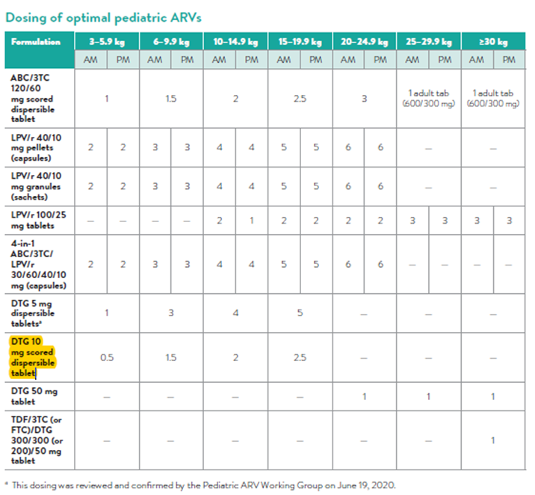
DTG for Children
Zambia recommended the use of Dolutegravir for children > 3kgs and >4weeks
The implementation has started in a phased approach

Slide 14
Transitioning to DTG without viral load testing
Based on the VISEND and NADIA trials finding. Zambia Has recommended the transitioning from TLE to TLD without a viral load test.
Recycling of the NRTI backbone could be efficacious

Slide 15
Phasing out of EFV and NVP based Regimen
Zambia recommends the phasing out of EFV and NVP based regimens based on the high pretreatment resistance found in the HIVDR survey
No new patient should be initiated on TLE
In exceptional situations, TLE can be continued based on side effects to DTG and patient preference

Slide 16
Introduction to DRV-r
Darunavir is a best-in-class protease inhibitor commonly used in high-income markets, and has recently been prequalified by the WHO as a fixed-dose combination with ritonavir for use in second-line adult treatment
What is Darunavir?
What is DRV-r (400/50 mg)
DRV/r (400/50 mg) is a new fixed-dose formulation of darunavir and ritonavir
It’s specifically for use in patients with no prior PI exposure or no confirmed DRV-associated mutations
Darunavir (DRV) is in the protease inhibitor (PI) class of ARVs
Like other PIs it must be boosted with ritonavir (RTV)
It is considered the best PI option
Key Benefits of DRV
High barrier to resistance
Improved viral suppression over LPV-r
Better tolerability than LPV-r or ATV-r
Less expensive than LPV-r
Can be reused in 3L at higher dose
Source: Orkin C et al. (2013) HIV Medicine,14:49-59, Link; Llennox J et al. (2014) Ann Intern Med, 161(7):461-471, Link.

Slide 17
DRV for Second Line
DRV/r 800mg/100mg combined tablet has been approved for use in second line for those failing DTG based first line

Slide 18
Optimisation of ART Regimens
Specific Populations | Description | Preferred 1st line ART | Alternative Regimen
Children (0-4 weeks) | All | AZT + 3TC + NVP | Get Expert Opinion or call 7040 for advice
Children (≥4weeks), adolescents and adults | 3 – 24.9kg | ABC + 3TC + pDTG* | ABC + 3TC + LPV-r
 | ≥ 25kg | TAF + FTC + DTG | ABC + 3TC + DTG
 | ≥ 30kg | TAF + FTC + DTG** | TDF + XTC + DRV-r ABC + 3TC + DTG TDF + XTC + LPV-r
 |  | TDF + XTC + DTG
Children, adolescents, and adults Co-infected with TB | 3 – 29.9kg | ABC + 3TC + DTG | ABC + 3TC + AZT ABC + 3TC + LPV-r
 | ≥ 30kg | TDF + XTC + DTG Increase the frequency of DTG to 50mg twice daily if on Rifampicin-based ATT (continue DTG bd for extra 2 weeks after ATT completion) | ABC + 3TC + DTG TDF + XTC + DRV-r

Slide 19
Optimising Second line treatment
Specific populations | Description | 1st line ART used | Preferred 2nd line ART | Alternative 2nd line ART
Children (0 – 4 weeks) | All | AZT + 3TC + NVP
Children (≥4 weeks), Adolescents and Adults | 3 – 24.9kg | ABC + 3TC + DTG | AZT + 3TC + LPV-r | AZT + 3TC + DRV-r
 |  | ABC + 3TC + LPV-r | AZT + 3TC + DTG | AZT + 3TC + DRV-r
 | ≥25kg | TAF + FTC + DTG³ | AZT + 3TC + LPV-r | AZT + 3TC + DRV-r
 | ≥40kg | TDF + 3TC + DTG | AZT + 3TC + DRV-r | AZT + 3TC + LPV-r TDF + XTC + DRV-r AZT + 3TC + ATV-r
 |  | TAF⁴ + FTC + DTG
 |  | TDF + XTC + EFV | TDF + 3TC + DTG² | AZT + 3TC + DRV-r AZT + 3TC + DTG AZT + 3TC + LPV-r TDF + XTC + DRV-r AZT + 3TC + ATV-r
 |  |  | TAF + FTC + DTG³

Slide 20
Monitoring of HIV on ART

Slide 21
Use of baseline Viral load
Baselien VL has been recommended based on the following;
Tracking silent transfers
Recency testing
Quality improvement
Clinical utility
Sample will be collected as part of ‘safety labs’
ART initiation will not be based on bVL

Slide 22
Continuity of Care

Slide 23
Recording of Trans Outs
High rates of trans-outs verses trans-ins
Recording of Trans out should be done at the time of confirmation of registration as trans-in
Formation of the national master registry

Slide 24
Commobidities

Slide 25
Computer Aided Diagnosis (CAD) and CRP for TB Screening
Digital CXR machines with artificial intelligence software often referred to as Computer Aided Diagnosis can analyse CXR images and generates a continuous score between 0-100 (Note this score is not a percentage). CXR images are scored as normal or abnormal based on a set and agreed upon threshold
• All patients with an abnormal score are presumptive TB patients (Positive screen)
• An abnormal CAD score should not be interpreted as TB diagnosis
• For diagnosis of TB, an experienced clinician or radiologist should read and interpret the image

Slide 26
CRP for Screening for TB
CRP is an acute phase protein and is a biomarker of conditions associated with inflammation.
This tool should only be used for TB screening among adults and adolescents living with HIV
• It should be used in combination with symptom screening • The turnaround time from testing to result with many points of care CRP test kits is 3–5 min, allowing a quick clinical decision to refer a patient for diagnostic evaluation for TB disease or initiation of TPT

Slide 27
COVID-19 and HIV
The following consideration on COVID-19 and HIV are made in the 2022ZCGs:
PLHIV with immunosuppression may be at a higher risk of COVID-19 outcomes.
Frequent visitation of PLHIV to hospital facilities may pose them a higher risk of acquiring COVID-19
COVID-19 may disrupt ART care and services
TB may have similar presentation as COVID-19

Slide 29
STI and HIV
Sexually transmitted diseases are common among people living with HIV.
They are also a risk factor for the acquisition of HIV.
The risk of STI among even higher among key populations including FSW.

Slide 30
STIs and HIV
The following recommendations should be done to address STIs in people living with HIV:
• Sexually transmitted infection and family planning services should be integrated within HIV care settings
• Assessment for high-risk sexual practises and symptomatic screening must be done on all clinical interaction
• Preventive strategies including condom distribution must be done for high-risk individuals
• Annual periodic serological testing for asymptomatic syphilis infection can be offered in high-risk population
• HIV positive female sex workers and other high-risk individuals, in settings with limited clinical services, may have periodic presumptive treatment for asymptomatic sexually transmitted infections
• All pregnant women must be screened for syphilis during the first antennal care visit

Slide 31
HIV and Migrant population
Zambia has identified population mobility and labour migration as among the key drivers of the HIV epidemic, including migrants and mobile populations among the key populations (NAC, 2017).
Following consideration must be considered.
Challenges of HIV Services among Migrant Population
Protecting the rights of migrants Living with HIV
Equitable health services for Migrants
Tailor made HIV Testing for Migrant populations
Tailor made HIV Prevention Services for Migrant Populations
Tailor made HIV Treatment for Migrant Populations

Slide 32
HIV Programming

Slide 33
Dissemination Plan of the 2023 ZCGs
Training of Trainers
First week of February 2023
Provincial Centers Trainings
2nd Week of February 2023
District and facility Training
Implementing partner driven
From mid February to end of April 2023

Slide 34
Thank you

