Slide 1
Injectable Cabotegravir for HIV Pre-Exposure Prophylaxis (CAB PrEP) Overview
CAB PREP Sensitization materials for providers involved in catalyst
9 February 2023

Slide 2
Introduction to CAB PrEP Sensitization Training Materials
Purpose: to sensitize providers to injectable cabotegravir for HIV pre-exposure prophylaxis (CAB PrEP) to better support meaningful conversations about CAB PrEP with clients.
Contents
Background on CAB PrEP
What do we know about CAB PrEP?
Looking ahead: Once CAB PrEP is approved in-country, providers will receive CAB PrEP implementation training, including details on drug delivery.

Slide 3
1
Background on CAB PrEP

Slide 4
What is CAB PrEP?
CAB PrEP (also known as CAB-LA or injectable CAB) is a new long-acting PrEP method. It is an injection of cabotegravir extended-release injectable suspension (3 mL) at a dose of 600 mg. It is an intramuscular injection injected into the gluteal muscle. CAB PrEP delivers cabotegravir systemically, so the drug is absorbed throughout the body.
CAB PrEP should be injected only into the gluteal muscle; the pharmacokinetics and efficacy of CAB PrEP, when injected in other sites, have not been studied.
The first two injections are four weeks apart, followed by an injection every eight weeks.
Cabotegravir belongs to a class of ARVs called Integrase Strand Transfer Inhibitors that reduce the ability of HIV to replicate itself inside a healthy cell.

Slide 5
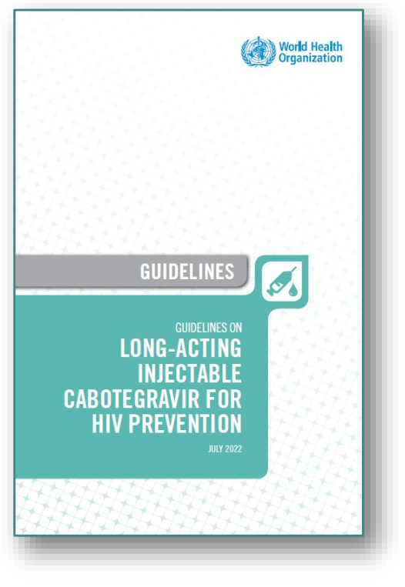
CAB PrEP Development, Recommendation and Approvals
Developed by ViiV Healthcare under the brand name Apretude
In July 2022, WHO recommended CAB for PrEP as an additional prevention option and released new guidelines for its use.
Currently, CAB PrEP is approved for use in Australia, USA, South Africa, and Zimbabwe, with additional registration submissions pending

Slide 6
Who is CAB PrEP for?
CAB PrEP is an HIV prevention option for anyone who wants to prevent HIV during sex and meets criteria for PrEP use
Three clinical trials (HPTN 077, 083, 084) established that CAB PrEP was well-tolerated among cisgender and transgender women and cisgender men
Studies of CAB PrEP among people under age 18 are ongoing
CAB PrEP may be particularly suitable for clients seeking less frequent dosing and/or increased privacy around PrEP use, and/or desiring HIV prevention from vaginal and anal sexual exposures.

Slide 7
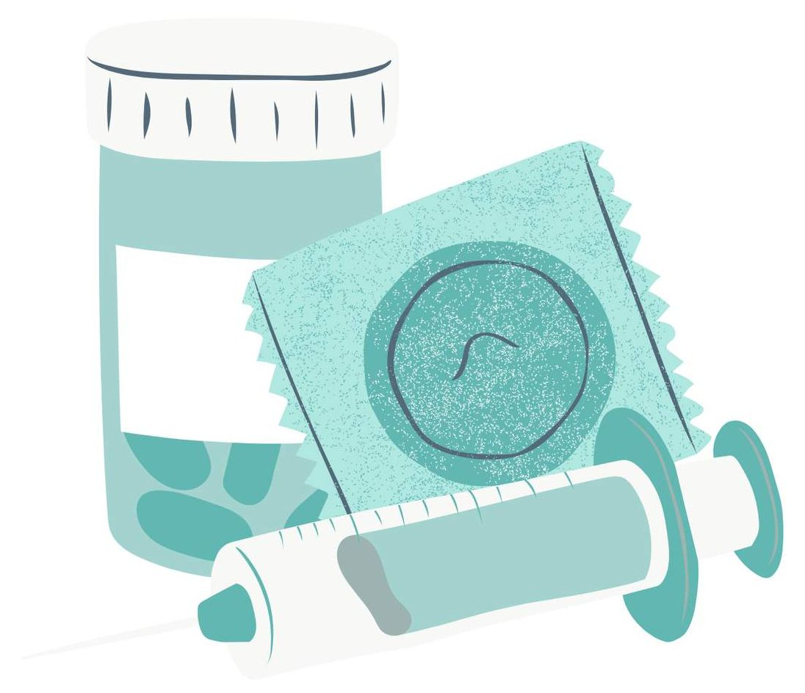
PrEP Method Choice
As more PrEP methods like CAB PrEP become available, informed choice is an important factor to consider in client-provider interactions and decision-making. Clients who can choose their preferred product may be more likely to use it effectively.
CAB PrEP provides an additional choice for PrEP and supporting clients to select their preferred methods offers the potential to increase uptake and effective use of PrEP methods overall.
WHO, 2022

Slide 8
2
WHAT DO WE KNOW ABOUT CAB PREP?

Slide 9
CAB PrEP Basics
CAB PrEP is for anyone who wants to prevention HIV during sex.
It has been shown to be highly effective in cisgender and transgender women and cisgender men
Although there is insufficient evidence among trans men and nonbinary people, CAB PrEP is likely to be effective for sexual exposures in these groups as well.
CAB PrEP should be injected only into the gluteal muscle (buttocks)
The first two injections are four weeks apart, followed by an injection every eight weeks.
It takes about one week after the first injection for drug concentrations to reach levels anticipated for CAB PrEP to be maximally effective
Clients should use another HIV prevention strategy during that time.
After a person stops using CAB PrEP, it takes time – up to a year or more – for the medication to be cleared from the body. During this time, which is called the tail period, cabotegravir remains in the body but at levels that may not prevent HIV
Additional for clinical guidelines can be found here.

Slide 10
Efficacy
In clinical trials, CAB PrEP has been shown to be highly effective at preventing HIV. With regular injections, CAB PrEP is the most effective PrEP method currently available.
In recent randomized controlled trials, CAB PrEP was shown to be more effective than oral PrEP, though it is likely due largely to better adherence to CAB PrEP.
HPTN 083, a Phase 2B/3 double blind study, among cisgender men and transgender women found a 66% reduction in risk of HIV acquisition as compared to oral PrEP.
In HPTN 084, a Phase 3 double blind study among people assigned female at birth, participants in the CAB PrEP arm were found to have an 89% reduction in risk of HIV acquisition as compared to the oral PrEP arm.
For more information on these trials, see the Annex

Slide 11
Side Effects
The most common side effects of CAB PrEP include:
Headache
Nausea
Diarrhea
Feeling fatigued or feverish
Injection site reactions (redness, pain, swelling, bruising at the injection site)
These side effects are usually mild or moderate.
Mild or moderate injection site reactions are more common than other potential side effects but become less frequent over time as clients get used to the injection.

Slide 12
Check for Learning - Question
Where should CAB PrEP be injected, when being administered?
Upper arm or bicep
Buttocks
Thigh
Any of the above
Notes:
Answer: B

Slide 13
CAB PrEP and Other Drug Interactions
Some anticonvulsants (carbamazepine, oxcarbazepine, phenobarbital, and phenytoin) and some antimycobacterial (rifampin, sometimes named rifampicin, and rifapentine) medications may interact with CAB PrEP and reduce its efficacy.
Available evidence suggests that use of gender-affirming hormones by transgender women does not affect drug levels of cabotegravir
There are no known interactions between
CAB PrEP and contraceptive hormones or other forms of contraception
CAB PrEP and recreational drugs or alcohol, but alcohol and drug use could affect the ability to attend necessary health appointments, potentially resulting in missed injections

Slide 14
CAB PrEP: Indications and contraindications
CAB PREP INDICATIONS FOR USE
CONTRAINDICATIONS TO CAB PrEP USE
CAB PrEP works for all sexual exposures in cisgender and transgender women and cisgender men
CAB PrEP may be particularly suitable for clients seeking less frequent dosing and/or increased privacy around PrEP use.
An HIV-positive test result according to the national HIV testing algorithm
Potential exposure to HIV in the past 72 hours (offer PEP)
Signs of acute HIV infection (AHI) AND potential exposure within the past 14 days
Some co-administered anticonvulsants (carbamazepine, oxcarbazepine, phenobarbital, and phenytoin) or antimycobacterials (rifampin, sometimes named rifampicin, and rifapentine)
Unwillingness or inability to commit to consistent use during periods of potential HIV exposure
Allergic or hypersensitivity reaction(s) with previous use of CAB or other integrase inhibitor medications
ADDITIONAL CONSIDERATIONS
The CAB PrEP does not prevent pregnancy or STIs other than HIV

Slide 15
Pregnancy and Breastfeeding and CAB PrEP Use
The safety of CAB PrEP use during pregnancy is not fully understood. Safety concerns have not been identified about CAB PrEP use during pregnancy at this time
Though the number of exposures to CAB PrEP during pregnancy is relatively small, no increase in birth defects has been observed.
Evidence about CAB PrEP use while breastfeeding is also limited
We will learn more about this through CATALYST!
CAB PrEP can stay in the system for 12 months or longer after a client stops injections, so it is important for clients using CAB PrEP to speak to a provider if they are thinking of becoming pregnant or do not want to use contraception during the tail period

Slide 16
Check for Learning - Question
True or False: CAB PrEP is a dual prevention method, preventing unintended pregnancy and HIV.
True
False
Notes:
Answer: B
CAB PrEP is not a contraceptive, so does not prevent unintended pregnancy. It can be used with hormonal contraceptives.

Slide 17
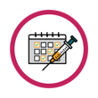
Starting CAB PrEP
Ideally, a client with ongoing exposures to HIV who is interested in CAB PrEP would have the following injection schedule (free of delays or discontinuations):
Initiation injection/Dose 1: (Day 1/Month 0)
Initiation injection/Dose 2: four weeks after initiation injection 1 +/- 7 days (Month 1)
Follow-up injections: eight weeks after initiation injection 2 +/- 7 days (Month 3), with continuing follow-up injections every eight weeks, continuing for as long as the client wants to remain on CAB PrEP and has potential exposures to HIV
CAB PrEP takes effect about one week after the first injection, so clients should make sure to use another prevention method or strategy during that time

Slide 18
Stopping CAB PrEP
If a client decides to stop using CAB PrEP, they may stop receiving injections
The amount of cabotegravir in the blood remains at effective levels for at least eight weeks after the final injection.
Once injections are stopped, clients will be in the “tail period”
If a client has a potential exposure to HIV during the tail period while not using an HIV prevention strategy, they should speak to a health care provider as soon as possible because PEP may be appropriate and ideally should be started as soon as possible within 72 hours of potential exposure
Client should be counseled to take PrEP or use another HIV prevention strategy for as long as they feel they may be exposed to HIV. Some people need to take PrEP only during certain times in their lives, while others have an ongoing need to use PrEP.

Slide 19
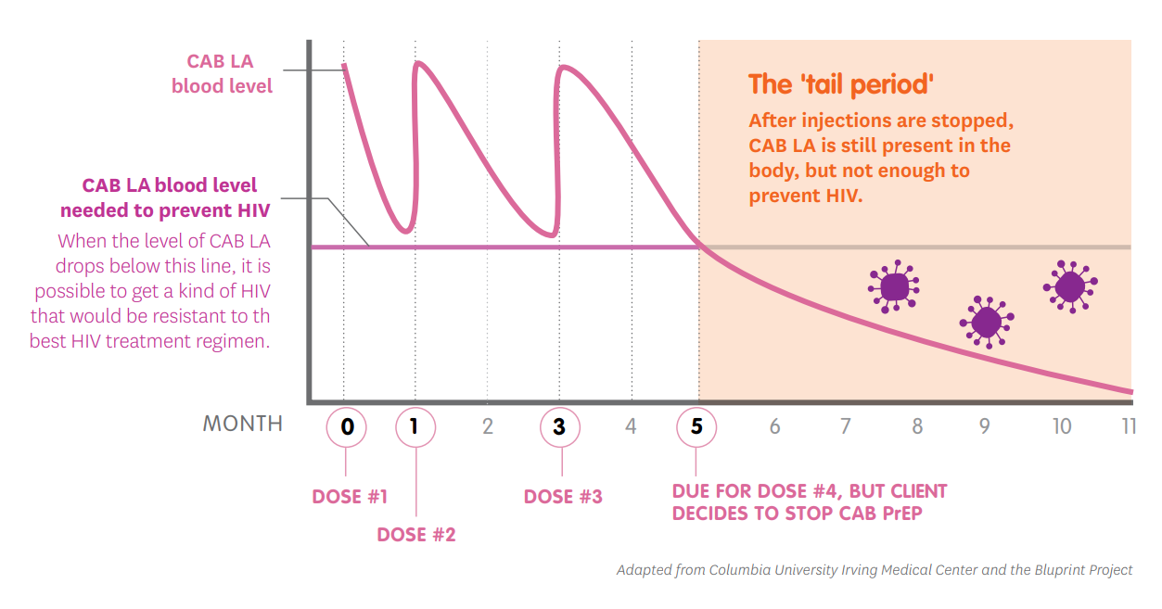
“Tail Period”
The “tail period” – when CAB PrEP remains in the body after injections are stopped, but not at high enough levels to prevent HIV – lasts for about one year.
At these levels, if a person gets HIV, they may develop drug resistance, meaning that medicines used to treat HIV may be less effective or not work at all.
As with any PrEP method, people who want to stop using CAB PrEP should continue to use another PrEP method or other HIV prevention strategy as long as they may be exposed to HIV.

Slide 20
Check for Learning - Question
How long does cabotegravir remain in a client’s system after they stop injections?
Four weeks
Eight weeks
One year or more
It does not remain in the client’s system after they stop injections
Notes:
Answer: C

Slide 21
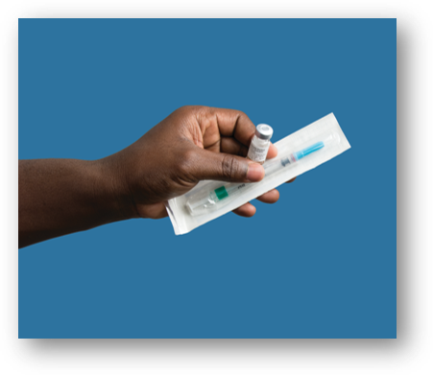
Restarting CAB PrEP
Clients who may have been on CAB PrEP at some point before stopping and wish to receive it again should contact their provider to discuss strategies for restarting CAB PrEP

Slide 22
Missed Injections
Adherence to the injection schedule is important to effective use of CAB PrEP.
A client who misses an injection should contact their health care provider immediately to get advice about how to continue using CAB PrEP or to talk about switching to a different HIV prevention strategy, which may include using another PrEP method.

Slide 23
4
Questions?

Slide 24
Thank you to Katie Williams for the development of this deck, and to all those who contributed to the following materials from which content was pulled: HIV Prevention Ambassador Training Package and Toolkit, PrEP template guidelines, and Provider Training Toolkit on use of Long-acting Injectable Cabotegravir for HIV PrEP

Slide 25
5
annex

Slide 26
EFFICACY STUDIES
 | Description | Countries Engaged | Participant sample | Status/results
HTPN 083 | A Phase 2B/3 double blind study to evaluate safety and efficacy study of CAB PrEP compared to oral PrEP in HIV-negative cisgender men and transgender women who have sex with men. | 43 sites in: Argentina, Brazil, Peru, South Africa, Thailand, United States, Vietnam | 4,570 HIV-negative cisgender men and transgender women who have sex with men, ages 18 and older, including 124 from Africa. | Active, currently in OLE Estimated completion date: TBD, ongoing Primary Paper-NEJM, Aug 2021.
HTPN 084 (LIFE Study) | Multi-site, Phase 3, double-blind, two-arm, randomized (1:1), controlled superiority trial to evaluate the safety and efficacy of the injectable agent, cabotegravir (CAB PrEP) compared to daily oral TDF/FTC, for pre-exposure prophylaxis (PrEP) in HIV-negative people | 20 sites in: Botswana, Eswatini, Kenya, Malawi, South Africa, Uganda, Zimbabwe | Approximately 3,200 HIV-negative people assigned female at birth who were mostly cisgender women aged 18 to 45 | Active, currently in OLE Estimated completion date: May 2022 Preliminary Study Results Webinar. HIV R4P 2021 Presentation

Slide 27
SAFETY STUDIES
 | Description | Countries Engaged | Participant sample | Status/results
HPTN 077 | A Phase 2A, randomized (3:1) controlled trial to evaluate the safety, tolerability, pharmacokinetics and acceptability of CAB PrEP. | 8 sites in: Brazil, Malawi, South Africa, United States | 199 HIV-negative cisgender men and women aged 18-65, including 52 cisgender women in South Africa and Malawi | Completed in July 2018 Manuscript-PLoS Med. 2018
HTPN 084-01 (LIFT Study) | A sub-study of HPTN 084. A Phase 2B single arm, open label safety, tolerability, and acceptability study of CAB PrEP in an adolescent population. | 3 sites in: South Africa, Uganda, and Zimbabwe | 55 HIV-negative people assigned female at birth under the age of 18 | Active, not recruiting Estimated completion date: May 2024 Results pending

