Slide 1
Dapivirine Vaginal Ring
“PrEP Ring”
Clinical training for providers
January 2023
Version 3.0

Slide 2

Training Overview
Vaginal rings + PrEP ring basics
PrEP ring research overview
PrEP ring implementation
PrEP ring counseling considerations
PrEP ring frequently asked questions

Slide 3
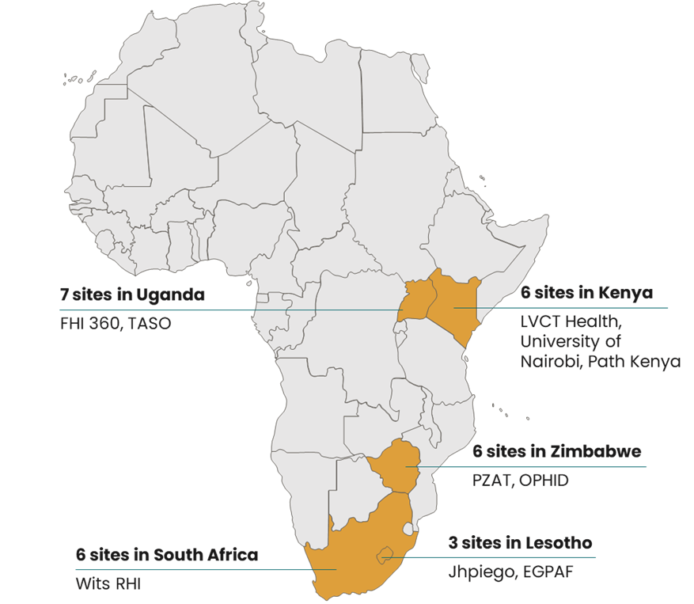
A note about this training…
Because PrEP ring guidelines differ by country, it is expected that this training will be adapted in each CATALYST/MOSAIC country to align with national guidelines.

Slide 4
1
Vaginal Rings + PrEP Ring Basics

Slide 5
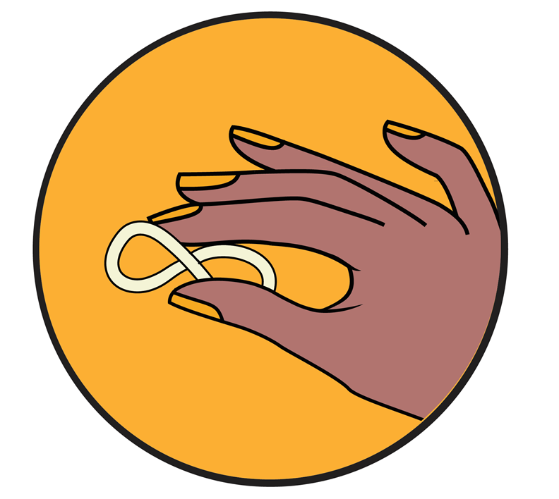
Vaginal rings – an overview
Vaginal rings have been used to safely and effectively address reproductive health needs, such as contraception and hormone management, for decades
Vaginal rings provide the opportunity for:
LOCALIZED, SUSTAINED ACTION
  Steady drug release
  Low systemic exposure
IMPLEMENTATION IN LOW-RESOURCE SETTINGS
  Relatively low manufacturing cost
  Stored at room temperature; no cold chain needed
POSSIBILITY FOR MULTI-PURPOSE TECHNOLOGIES
  Rings could be developed to treat or prevent multiple conditions at once
https://www.contraceptionjournal.org/article/S0010-7824(21)00410-8/fulltext

Slide 6
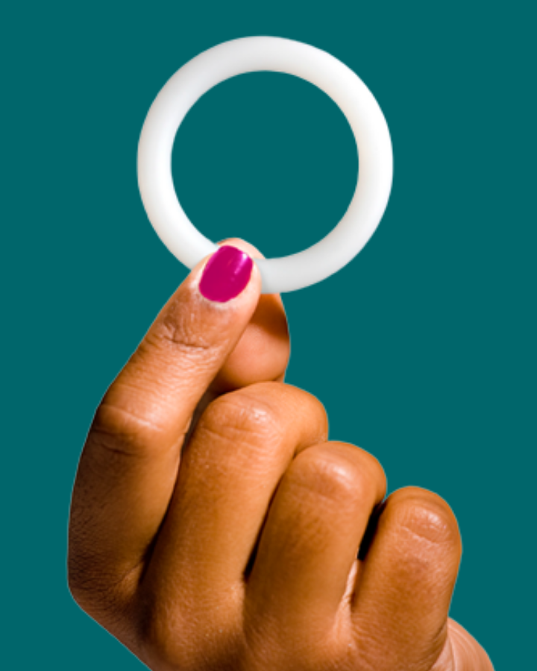
What is the PrEP ring?
The PrEP ring is a flexible vaginal ring made of silicone that slowly releases the antiretroviral drug dapivirine over the course of one month to reduce the risk of HIV-1 acquisition.
Developed by the nonprofit International Partnership for Microbicides (IPM)
Recommended by the WHO “as an additional prevention choice for women* at substantial risk of HIV infection as part of combination prevention approaches”
*assigned female at birth
https://www.who.int/publications/i/item/9789240031593

Slide 7
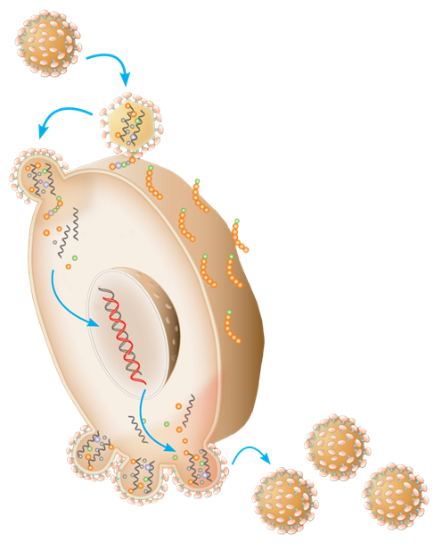
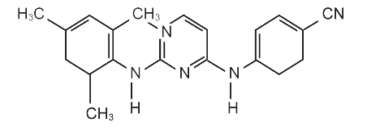
What is dapivirine?
Dapivirine is a highly potent ARV that acts inside cells to block the ability of HIV to multiply.
A non-nucleoside reverse transcriptase inhibitor (NNRTI)
Developed by Janssen and licensed to IPM in 2004
Dapivirine has a favorable safety profile in all clinical trials to date – oral and topical
Each PrEP ring contains about 25mg of dapivirine upon manufacturing, and about 4mg of the drug is released during one month of use
Dapivirine
Dapivirine molecular structure
Notes:
Dapivirine was originally developed for oral use, but oral dapivirine was discontinued due to poor bioavailability.

Slide 8
Part One Check-in: Ring Basics
The PrEP ring contains the drug dapivirine
1. How much dapivirine is in the ring?
2. What class of medicine is dapivirine?
3. How long is the ring intended to be left in place?
Bonus!
If you had to guess…..In clinical trials, how can researchers determine whether the ring was used as intended?
Notes:
Answers:
1. 25 mg of dapivirine
2. Dapivirine is an NNRTI
3. One month
Bonus: Researchers can measure the amount of drug left in the ring. If used for the whole month, there should be less than 21mg of drug left in the ring.

Slide 9
2
PrEP Ring Research Overview

Slide 10
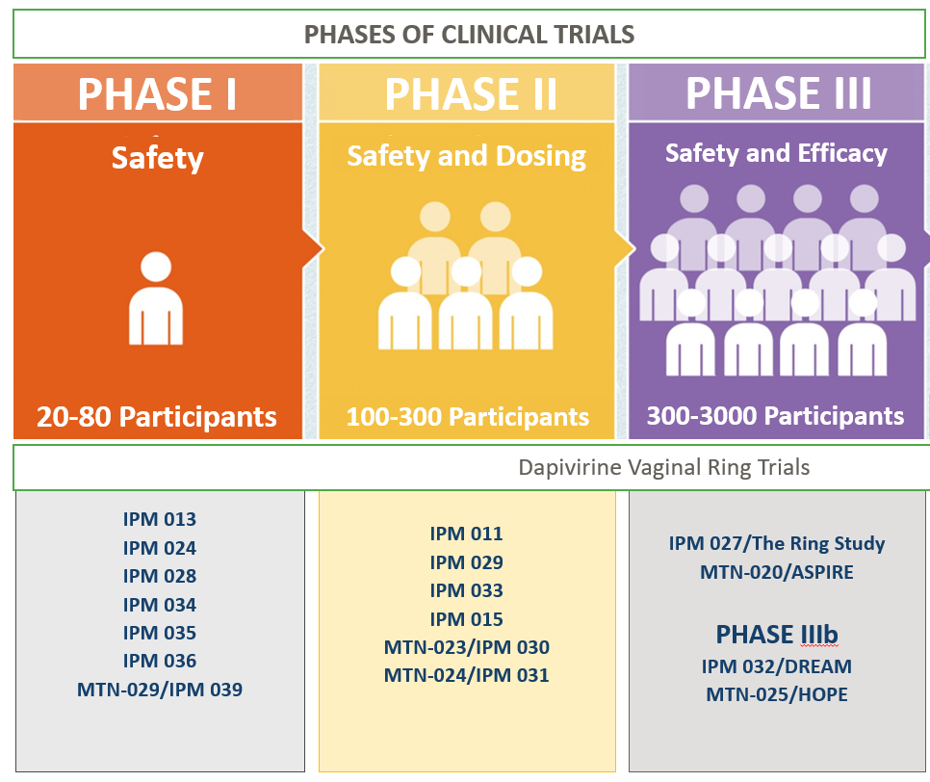
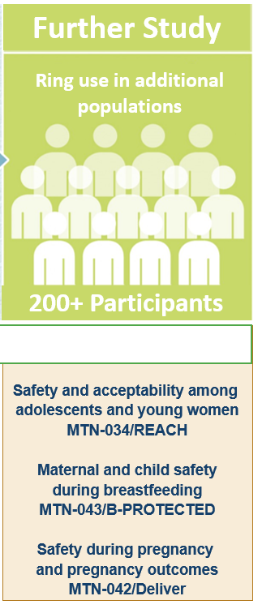
PrEP Ring Clinical Trials – Overview
Safety and acceptability among adolescents and young women MTN-034/REACH
Maternal and infant safety during breastfeeding
MTN-043/B-PROTECTED
Maternal and infant safety and pregnancy outcomes
MTN-042/Deliver

Slide 11


PrEP Ring Phase III Trials At-A-Glance
 | The Ring Study (IPM 027) | ASPIRE (MTN-020) | ASPIRE (MTN-020)
Objectives | Safety and efficacy | Safety and effectiveness | Safety and effectiveness
Study design | Double-blind, randomized (2:1), placebo-controlled | Double-blind, randomized (1:1), placebo-controlled | Double-blind, randomized (1:1), placebo-controlled
Enrollment | 1959 women* ages 18-45 Active arm: ~1300 | 2629 women* ages 18-45 Active arm: ~1315 | 2629 women* ages 18-45 Active arm: ~1315
Power | 81% power to detect 50% treatment effect | 90% power to detect 60% treatment effect | 90% power to detect 60% treatment effect
Regulatory requirement | 3000 women on dapivirine ring for at least 1-year follow-up 1500 women on dapivirine ring for 2-year follow-up
Participant follow-up | 2 years + 6 weeks following ring discontinuation |  | Minimum 1 year + 4 weeks following ring discontinuation
Research sites | 7 IPM research centers in South Africa and Uganda |  | 15 MTN research centers in Malawi, South Africa, Uganda, Zimbabwe
*participants in ring Phase III trials were assumed to be assigned female at birth and were not asked their gender identities. All participants underwent pelvic exams as part of enrollment procedures.

Slide 12
PrEP Ring Phase III Trials: Efficacy results
35%
reduction
27%
reduction
The Ring Study
ASPIRE
  HIV-1 incidence rates:
  4.23 per 100 PY
  95% CI, 3.31 to 5.16 100 PY (DVR)
  6.43 per 100 PY
  95% CI, 4.79 to 8.07 100 PY (placebo)
  P = 0.028, 95% CI: 9.0, 53.6%
  HIV-1 incidence rates:
  3.3 per 100 PY
  95% CI: 2.54 to 4.08 100 PY (DVR)
  4.6 per 100 PY
  95% CI: 3.64 to 5.45 (placebo)
    P = 0.046, 95% CI: 1.0, 46%
About 80% of rings returned in The Ring Study and ASPIRE showed indications of some use.

Slide 13
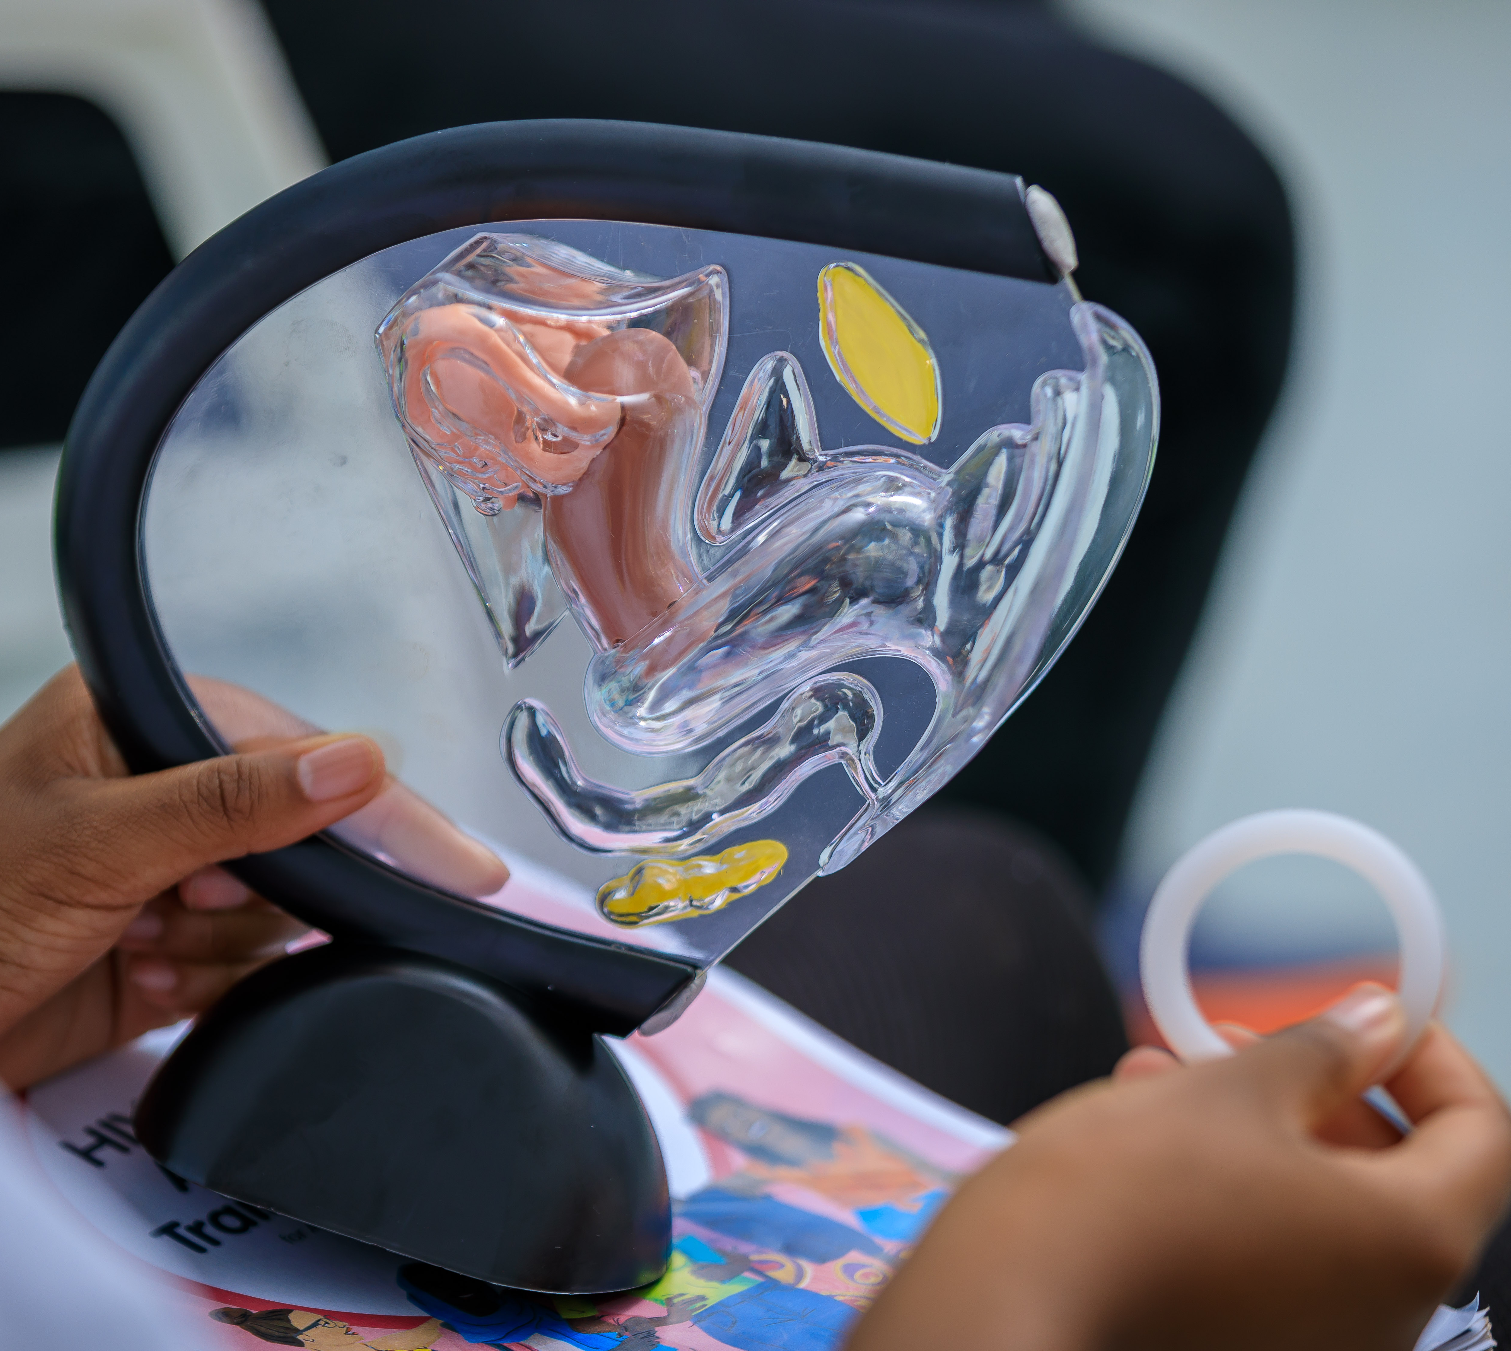
PrEP Ring Phase III Trials: Safety results
The PrEP ring was shown to have a strong safety profile with no safety concerns
No difference between dapivirine and placebo groups in:
  Number of side effects/health problems
  Number of pregnancies
  Number of STIs
No statistically significant HIV-1 drug resistance
Side effects were generally mild to moderate and resolved with no interruption in ring use
  Common side effects included UTIs, vaginal discharge, itching, and pelvic and lower abdominal pain

Slide 14

PrEP Ring Phase IIIB/Open-label Trials At-A-Glance
 | IPM 032/DREAM |  | MTN-025/HOPE
Primary Objective | Long-term safety and adherence
Design | Open-label
Number of participants | ≈ 950 former The Ring Study participants |  | ≈ 1,400 former ASPIRE participants
Follow-up regimens | Monthly for 2 months followed by quarterly visits |  | Monthly for 3 months followed by quarterly visits
Ring use requirements | Ring use REQUIRED |  | Ring use OPTIONAL
Treatment regimen | 1-monthly ring replacement; approx. 1-year follow-up
Launch date | July 2016
Completion date | January 2019 | October 2018

Slide 15
PrEP Ring Open-label Trials: Summary results
DREAM
Summary findings
Continued favorable safety profile, similar to Phase III trials
Modeling results are limited due to the lack of placebo comparison groups, but indicate an encouraging trend of increased HIV-1 risk reduction with open-label use
  Observed HIV-1 incidence:
  1.8 per 100 PY (95% CI: 1.0-2.6)
  Expected HIV-1 incidence based on The Ring Study placebo group:
  4.7 per 100 PY (95% CI: 3.4-5.4)
  Based on a bootstrap analysis of 10,000 samplings
62%
reduction
HOPE
  Observed HIV-1 incidence:
  2.7 per 100 PY (95% CI: 1.9-3.8)
  Expected HIV-1 incidence based on ASPIRE placebo group:
  3.9 per 100 PY (95% CI: 3.1-2.4)
  Based on a bootstrap analysis of 10,000 samplings
39%
reduction
About 90% of rings returned in DREAM and HOPE showed indications of some use.

Slide 16
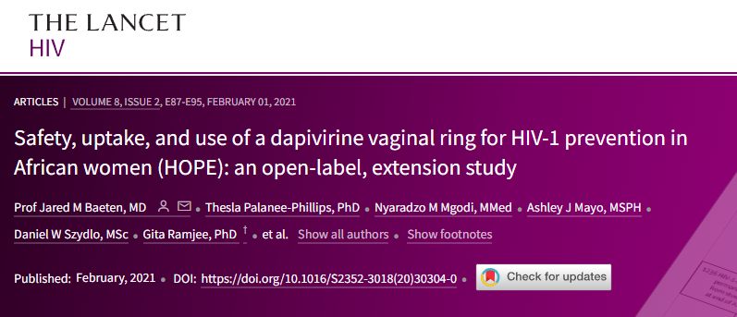
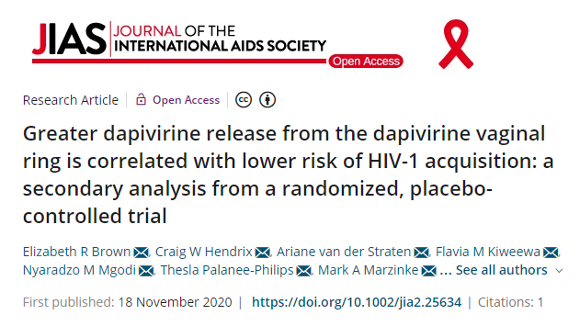
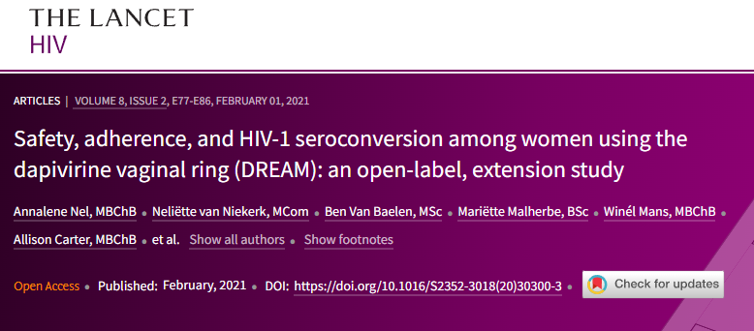
PrEP Ring: Efficacy summary
Open-label studies and adherence analyses suggest that the PrEP ring reduces the chance of acquiring HIV by 50% or more with consistent use.
https://onlinelibrary.wiley.com/doi/full/10.1002/jia2.25634
https://www.thelancet.com/journals/lanhiv/article/PIIS2352-3018(20)30304-0/fulltext
https://www.thelancet.com/journals/lanhiv/article/PIIS2352-3018(20)30300-3/fulltext

Slide 17



PrEP Ring Trials: Results in additional populations
 | REACH | B-PROTECTED | Deliver
Primary Objective | Safety and acceptability among adolescent girls and young women | Maternal and infant safety during breastfeeding | Safety during pregnancy and pregnancy outcomes
Design | Open-label, randomized, crossover | Open-label, randomized | Open-label, randomized
Enrolled participants* | 247 participants aged 16-21 | 197 breastfeeding parent/infant pairs | Target: 550 pregnant participants across 3 gestational age cohorts
Treatment regimens | 6 mos. oral PrEP, 6 mos. PrEP ring (randomized order) 6 mos. choice of either or no product | 3:1 assignment PrEP ring to oral PrEP | 2:1 assignment PrEP ring to oral PrEP in cohorts 1 & 2; and 4:1 in Cohort 3
Locations | South Africa, Uganda, Zimbabwe | Malawi, South Africa, Uganda, Zimbabwe | Malawi, South Africa, Uganda, Zimbabwe
Completion date | September 2021 | November 2021 | Anticipated in 2023 (pregnant participants) and 2024 (infants)
Results | Most participants found the ring to be acceptable. More than 50% of participants had high adherence to both study products. About 66% of participants chose the PrEP ring in the choice period, with those who had high adherence to oral PrEP in the randomization period more likely to select oral PrEP in the choice period. | Few side effects were seen for breastfeeding parents and infants in either the PrEP ring or oral PrEP arm. Products did not cause problems for infants of a breastfeeding parent. | Anticipated in 2024 Interim results suggest that adverse pregnancy outcomes and complications were uncommon among ring users, and were similar to rates observed in study communities
*participants in these trials were assumed to be assigned female at birth and were not asked their gender identities. All participants underwent pelvic exams as part of enrollment procedures.

Slide 18
Part Two Check-In: Research to Date
How many participants have participated in PrEP ring studies to date?
1. Fewer than 100
2. About 500
3. About 1000
4. About 2000
5. More than 5000
Notes:
Answer – 5
There were 4588 participants in the phase three trials alone

Slide 19
Part Two Check-In: Research to Date
Adherence analyses and open-label study findings suggest that HIV risk reduction among consistent ring users may be:
1. 27%
2. 39%
3. 50% or more
Take-home point!
Notes:
Answer: 3

Slide 20
3
PrEP Ring Implementation

Slide 21

PrEP Ring Implementation
Overview
PrEP ring indications and contraindications
Dispensing the PrEP ring
PrEP ring use instructions
PrEP ring insertion, removal, return & disposal
Side effects & discontinuation
PrEP ring use during pregnancy, postpartum, and while breastfeeding
PrEP ring use by trans and non-binary people
PrEP ring storage
The PrEP ring and intimate partner violence

Slide 22


PrEP Ring: Indications and contraindications
PREP RING INDICATIONS FOR USE
CONTRAINDICATIONS TO PREP RING USE
The ring is an additional option to prevent HIV during receptive vaginal intercourse for people who are unable or do not want to use oral PrEP, or when oral PrEP is not available
Requirements for age, gender identity, and sex assigned at birth may be determined by local guidelines
People with unknown HIV status or who are living with HIV
Potential exposure to HIV within the past 72 hours, and thus would benefit from post-exposure prophylaxis (PEP)
Unwillingness or inability to commit to consistent ring use during periods of potential HIV exposure
People with an allergy or hypersensitivity to the active substance or other substances listed on the product info sheet
Recent pregnancy and delivery (within 6 weeks post-partum)
ADDITIONAL CONSIDERATIONS
The PrEP ring does not prevent HIV during receptive anal intercourse
The PrEP ring can only be inserted vaginally, so it is not appropriate for people assigned male at birth
The PrEP ring does not prevent pregnancy or STIs other than HIV
https://www.ema.europa.eu/en/dapivirine-vaginal-ring-25-mg-h-w-2168

Slide 23
Dispensing the PrEP ring
Prior to dispensing the PrEP ring: REQUIREMENTS
Negative HIV test
Assessment of PEP need or acute HIV infection
*other testing requirements per national guidelines
Prior to dispensing the PrEP ring: RECOMMENDATIONS
Screening, testing, and treatment of other STIs
Pregnancy testing and provision of contraceptives, as needed
Provision of services for gender-based violence (GBV), including intimate partner violence (IPV)
Assessment and services or referral for mental health and substance use disorders
Screening and treatment of noncommunicable diseases
Dispensing the PrEP ring: CONSIDERATIONS
The PrEP ring can be dispensed monthly or quarterly (3 rings at a time) based on local guidelines
Clients may wish to schedule a one-month follow-up visit to assess for side effects and effective use support
https://www.who.int/publications/i/item/9789240031593

Slide 24
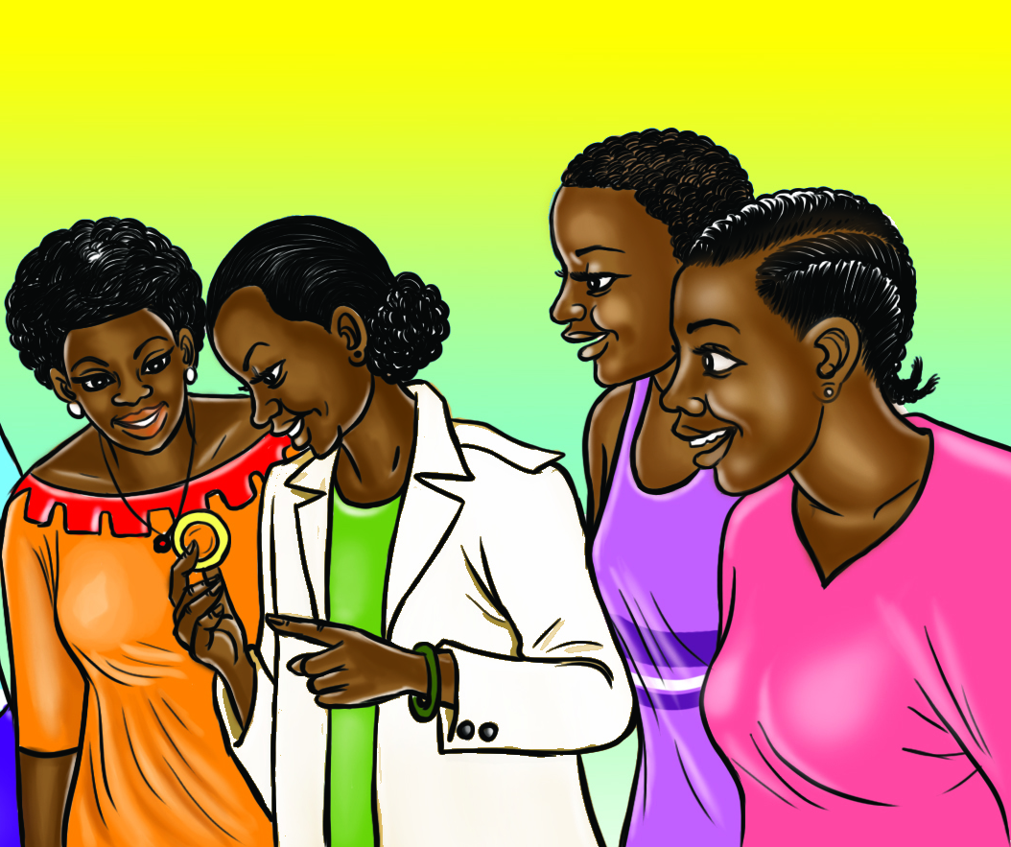
PrEP Ring Use Instructions
The PrEP ring must be inserted vaginally
Dapivirine concentrations to achieve maximum HIV prevention are reached once the PrEP ring has been in place for 24 hours
For maximum HIV prevention, the PrEP ring should be kept in place in the vagina for one full month
  The PrEP ring can be kept in place during sex and menses
The PrEP ring should be removed and replaced with a new ring immediately each month
https://www.ema.europa.eu/en/dapivirine-vaginal-ring-25-mg-h-w-2168

Slide 25
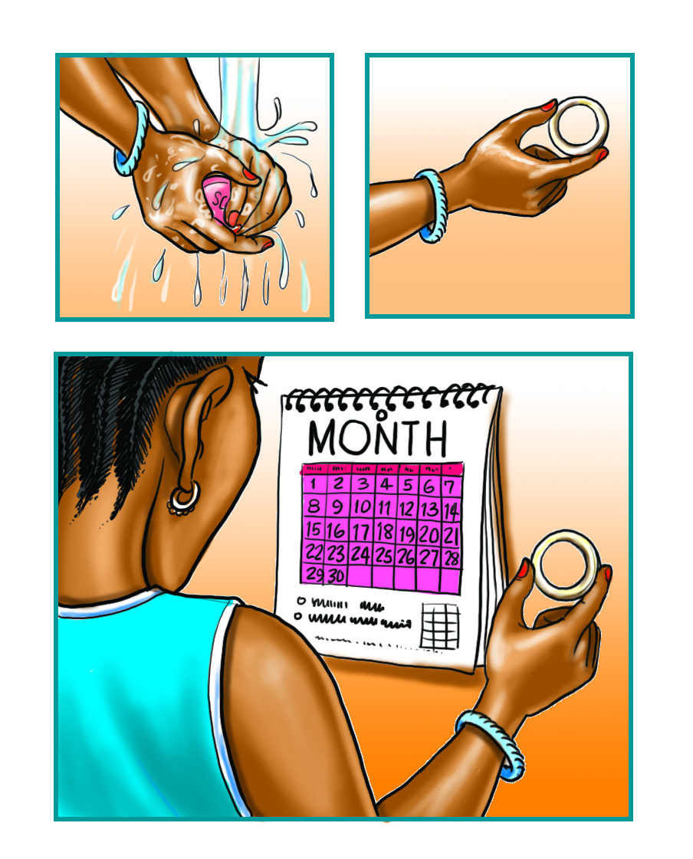
PrEP Ring: Intermittent use
Intermittent use of the PrEP ring has not been studied and is not recommended
The ring is designed to be used continuously for 28 days, or one month
  If the ring is removed for a brief period and kept somewhere clean, it can be rinsed and reinserted. If it has been more than one month since the ring was first inserted, clients should not replace this ring. They should use a new ring instead.
The PrEP ring must be in place for 24 hours to provide maximum HIV prevention

Slide 26
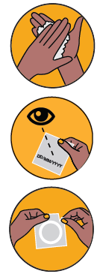


For Clients: Preparing to insert the ring
Clients can insert and remove the PrEP ring themselves. The below instructions outline the steps for ring insertion that the client will follow.
Explain preparation steps to the client:
  1. Wash your hands in clean water and dry them
  2. Check the expiry date on the package label
  DO NOT use if the ring is damaged or expired
  3. Tear package to open. DO NOT use scissors to open the package. Remove the ring from its package in a clean place. Keep the package for later
Click here or scan the code above for a video on ring insertion and removal.
Explain possible ring insertion positions to the client:
Possible insertion positions include: raising one leg, squatting or lying down. Encourage the client to choose a position that is most comfortable for them.

Slide 27
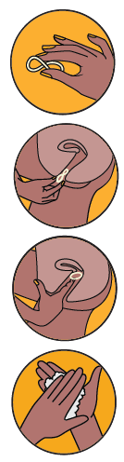
For Clients : Insertion instructions
The below instructions outline the steps for ring insertion that the client will follow. Wear gloves and use a pelvic model (if available) to demonstrate the insertion process to the client.
Insertion steps for the client:
Twist the PrEP ring into the shape of the number 8 or squeeze the sides of the ring together
Use your other hand and hold open the folds of skin around the vagina. Place the tip of the ring in the vagina opening and then use your index finger to gently push the folded ring in.
Push the ring into the upper vagina as far as you can
4. Wash your hands in clean water and dry them
Click here or scan the code above for a video on ring insertion and removal.
No special equipment is needed to insert the PrEP ring!
Notes:
If a pelvic model is not available, demonstrate the steps by miming how to separate the labia and insert the ring in the air.

Slide 28

For Clients : Removing the ring
The below instructions outline the steps for ring removal that the client will follow. Wear gloves and use a pelvic model (if available) to demonstrate the removal process to the client.
Explain possible ring removal positions to the client:
Possible removal positions include: raising one leg, squatting or lying down. Encourage the client to choose a position that is most comfortable for them.
Click here or scan the code above for a video on ring insertion and removal.
Explain ring removal steps to the client:
For clients who are continuing to use the PrEP ring as their HIV prevention method, a new ring should be inserted as soon as the old ring is removed to ensure adequate HIV prevention in case of exposure.
1. Wash your hands in clean water and dry them
2. Use your finger to hook the ring and gently pull it out of the vagina
Notes:
If a pelvic model is not available, demonstrate the steps by miming how to insert a finger, hook the ring, and gently remove it from the vagina.

Slide 29

For Clients : PrEP ring return and disposal
Explain ring return and disposal requirements to the client:
Used PrEP rings should be placed in the empty pouch or wrapped in tissue or toilet paper
Used PrEP rings should be placed in a rubbish bin out of reach of children and pets
Used rings should not be thrown into a toilet
Wash your hands in clean water after handling a used PrEP ring
NOTE: In CATALYST, some used PrEP rings will be collected as part of the study. See Study Specific Procedures for more information.

Slide 30
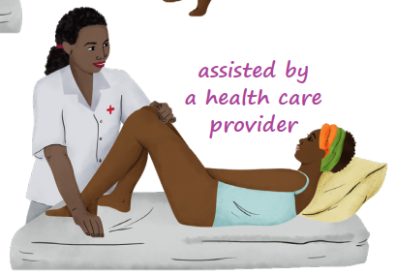
For Providers: PrEP ring insertion, removal & disposal
If desired, clients may request help from their provider to insert and remove the PrEP ring.
Steps for provider-supported PrEP ring insertion and removal are the same as for clients, except for:
  Clients should be lying down when providers insert/remove the ring
  The PrEP ring should only be inserted to past the introitus
  After ring insertion, ask the client if they can feel the ring. If “yes”, the provider should use an index finger to push the ring further.
Used PrEP rings that are returned to the clinic should be:
  Stored for study purposes per CATALYST SSPs
  or
  Disposed of with other medical waste, such as used gloves
Providers should always use soap and water to wash their hands after inserting or removing rings, or handling used rings

Slide 31
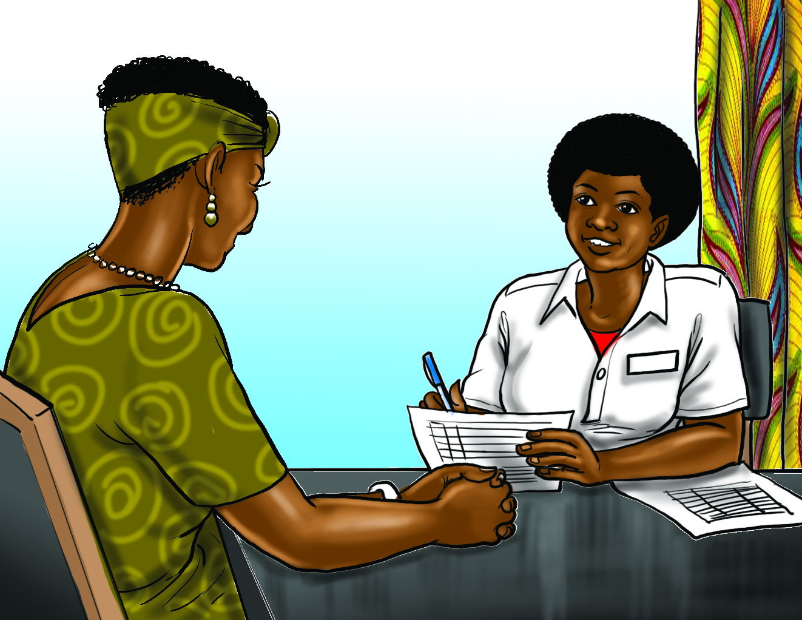
PrEP Ring: Managing side effects
The most commonly reported* adverse drug reactions in PrEP ring clinical trials included:
Urinary tract infections (15.2%)
Vaginal discharge (7.1%)
Vulvovaginal pruritis (6.5%)
Vulvovaginitis (6.4%)
Pelvic pain (6.2%)
Importantly, not all adverse reactions were determined to be product-related
*reported by ≥ 5% of participants in the active arm
https://www.ema.europa.eu/en/dapivirine-vaginal-ring-25-mg-h-w-2168
  Most side effects from the PrEP ring are mild or moderate in intensity, and often resolve on their own. Side effects from the PrEP ring that need treatment can typically be treated successfully without the need to remove the ring.

Slide 32
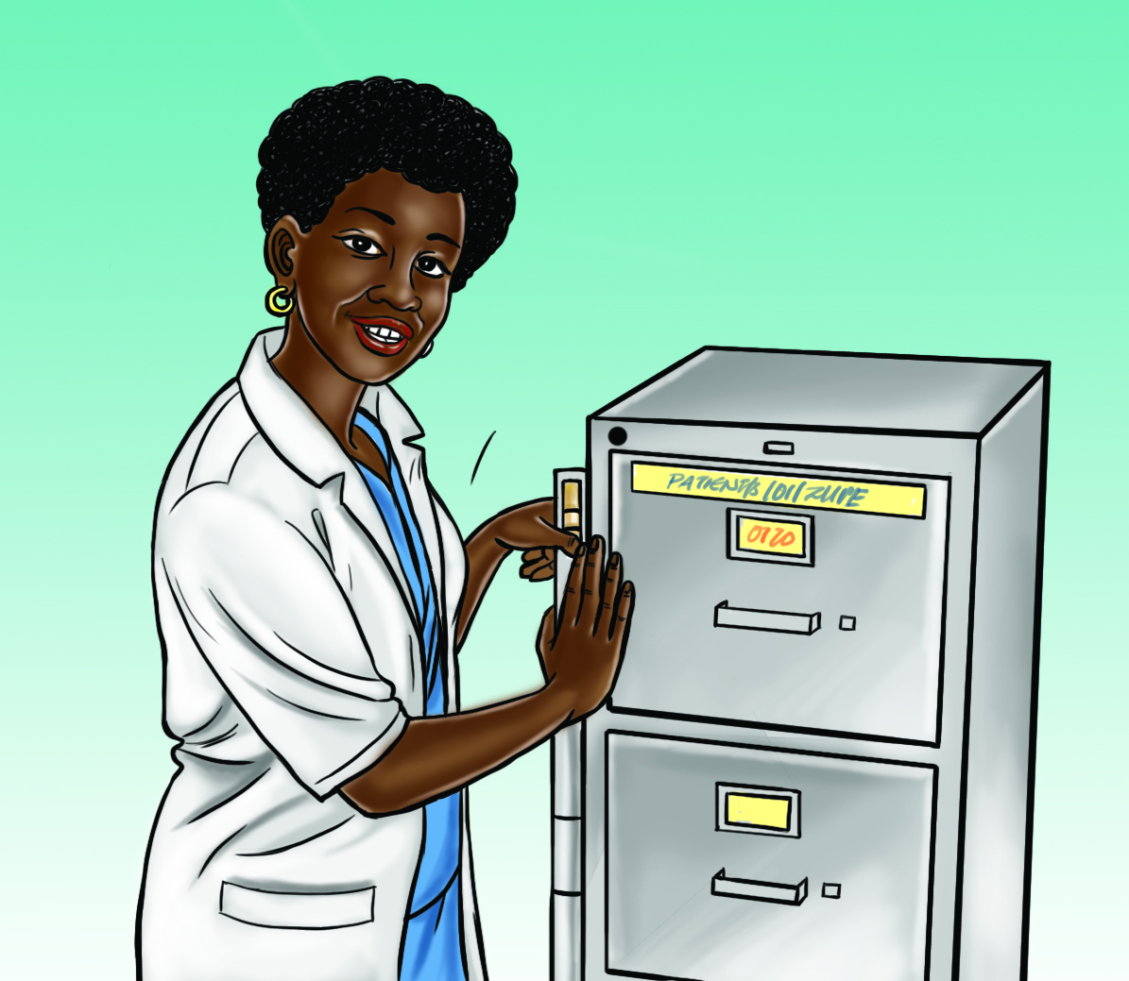
PrEP Ring: Managing side effects, continued
Vaginal and reproductive tract symptoms in PrEP ring users should be treated per local standard of care
Testing for STIs and/or reproductive tract infections should be done where indicated
Treatment of symptoms or identified infections and conditions should be provided per standard of care
  Because the PrEP ring acts locally, there are no systemic drug-to-drug interactions with the ring. However, clients should be counseled to use additional HIV prevention measures if prescribed vaginally inserted medications, such as vaginal suppositories for reproductive tract issues.
https://prepwatch.org/wp-content/uploads/2022/12/Oral-PrEP-ED-PrEP-Ring-CAB-PrEP-Template-Guidelines.docx

Slide 33
PrEP Ring: Pauses and discontinuations
PrEP ring use should be paused until symptoms resolve if the participant has:
  Deep epithelial disruption or ulcers on the cervix
  Cervicitis, including inflammation or friability of the cervix
PrEP ring use should be discontinued if the participant:
  Has an allergic reaction to the PrEP ring
  Has a reactive or positive HIV test
PAUSE
ring use until symptoms resolve. Offer alternative PrEP methods.
DISCONTINUE ring use.
  Pelvic exams are not required for PrEP ring provision and should only be done in response to participant complaints or as part of routine gynecological care.

Slide 34
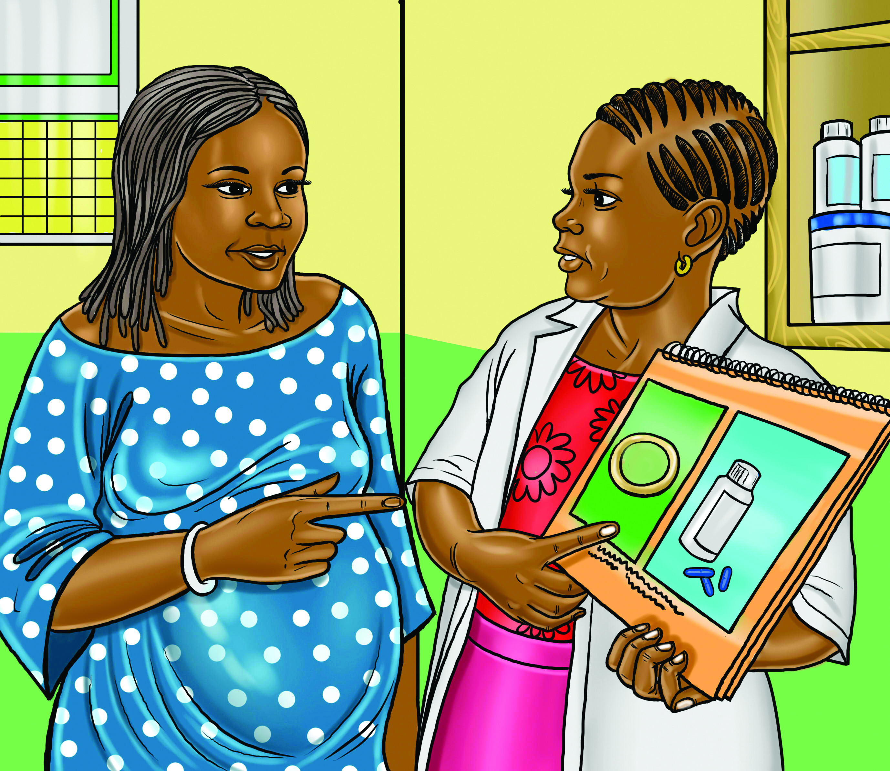
PrEP Ring: Use during pregnancy
Data are limited (fewer than 300 pregnancy outcomes) on PrEP ring use by people who are pregnant
So far, ring use in pregnancy appears to be safe and well tolerated
Interim results from a safety study showed that adverse pregnancy outcomes and complications were uncommon among ring users, and similar to rates observed in surrounding communities (final results expected in 2024)
Animal studies have not shown harmful reproductive health effects related to the PrEP ring
  Providers and clients should weigh client preferences and ability to effectively use HIV prevention methods when considering whether the ring or another HIV prevention method, such as oral PrEP, should be used during pregnancy. The PrEP ring should not be used by pregnant clients who are having vaginal bleeding or after the bag of waters breaks.

Slide 35

PrEP Ring: Removal during pregnancy
During pregnancy, the PrEP ring should be removed if a participant experiences:
  Active labor at any gestation (ring use can be restarted in cases of false labor)
  Vaginal bleeding
  Spontaneous or therapeutic abortion
  Suspected or confirmed rupture of amniotic membranes (bag of waters*)
  Cervical cerclage (treatment for cervical insufficiency)
  Suspected or confirmed intrauterine infection
The PrEP ring can be removed by the participant or provider. However, in some situations, (e.g., vaginal bleeding, suspected or confirmed ruptured membranes, intrauterine infection), it is ideal for removal to be carried out by a health care provider wearing sterile gloves. The PrEP ring has not been shown to cause such issues; rather, people experiencing them usually stop use of vaginally delivered medications.
*Please use locally relevant term as appropriate

Slide 36

PrEP Ring: Starting or re-starting after delivery
In general, encourage clients to wait until 6 weeks postpartum to resume or start PrEP ring use and vaginal intercourse
  Facilitates vaginal and cesarean scar healing, promotes maternal rest, allows for cervix to close, uterus to return to normal size, and vaginal bleeding to diminish
However, likelihood of HIV exposure should be considered and discussed with the participant
  Vaginal intercourse or sexual assault may occur prior to 6 weeks postpartum
Previous PrEP ring research did not include people less than 6 weeks postpartum, so evidence is limited
  However, the PrEP ring is unlikely to be problematic for pregnant people who are not experiencing vaginal pain or heavy vaginal bleeding in the postpartum period
Use clinical judgment, considering the above factors, when counseling participants
  Vaginal spotting may be normal in the postnatal period and is more common among those using progestin-only methods of family planning, such as DMPA-IM, DMPA-SC, NET-EN, or progestin-only oral contraceptive pills.

Slide 37

PrEP Ring: Starting or re-starting after pregnancy loss
Following pregnancy loss, use clinical judgement for when to resume PrEP ring. Factors to consider:
  Gestational age at time of pregnancy loss
  Whether client is experiencing any pain or heavy vaginal bleeding
  Likelihood of HIV exposure and whether client has resumed or expects shortly to resume vaginal sex
  Client's reproductive health priorities, including whether and when she may attempt conception again

Slide 38
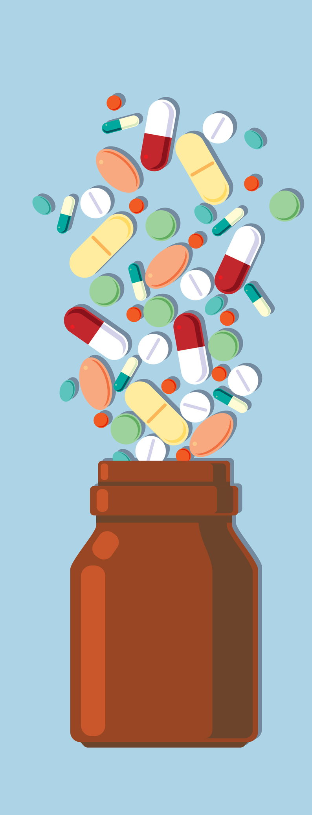
PrEP Ring: Compatibility with medicines commonly used in antenatal and postnatal periods
The PrEP ring is compatible with:
  Vaccines against COVID-19, tetanus, and pertussis
  Iron and folic acid tablets, multiple micronutrient supplements, prenatal vitamins, calcium supplements, and vitamin A
  Penicillin injection and other antibiotics for STI treatment
  Antibiotics for asymptomatic bacteriuria, UTI, respiratory infection, or other suspected bacterial infections
  Intermittent prophylactic treatment of malaria in pregnancy with sulfadoxine-pyrimethamine (in settings where this is used)
  Preventive chemotherapy (deworming), using single-dose albendazole (400 mg) or mebendazole (500 mg)
  Multiple micronutrient supplements, balanced energy and protein supplements
  Stool softeners such as docusate sodium
  Vaginally administered miconazole nitrate*
*Vaginally administered miconazole may reduce dapivirine concentrations within the vagina. Additional HIV prevention methods should be used.
Additional counseling considerations on PrEP ring use during pregnancy and breastfeeding are located in Annex 1

Slide 39
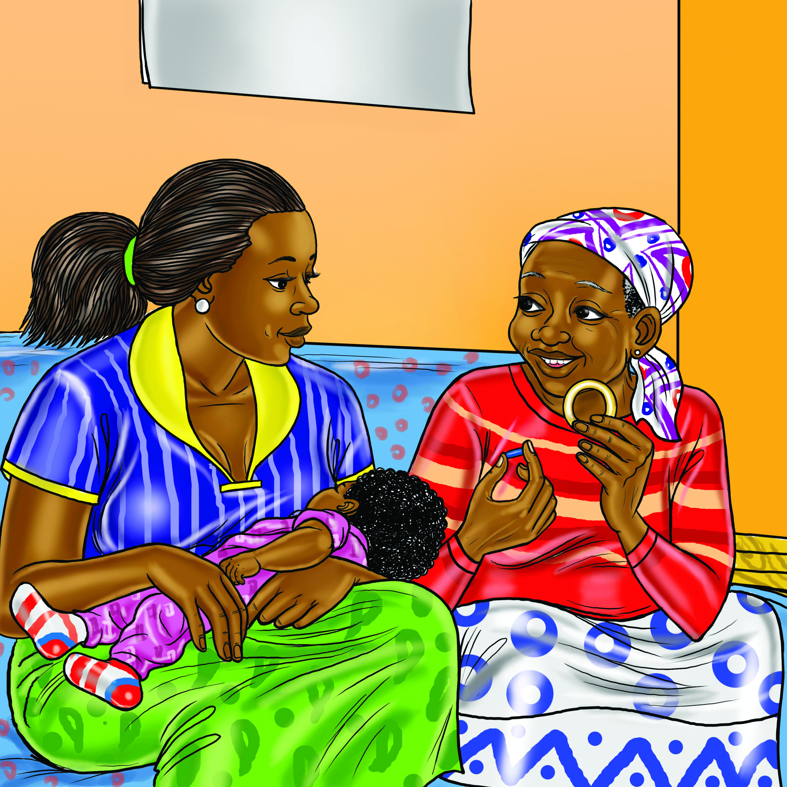
PrEP Ring: Use during breastfeeding
Results from a recent trial of PrEP ring use during breastfeeding have been released
Early results from this trial indicated that PrEP ring use was safe and well tolerated for breastfeeding people and their infants
PrEP ring use during breastfeeding appears to be safe for both the pregnant person and their infant
Dapivirine can pass into breast milk, but at very low levels that are very unlikely to affect infants
  Providers and clients should weigh the known benefits of breastfeeding for clients and their infants, and the risks associated with human milk substitutes. A shared decision-making process should guide the selection of HIV prevention options.
*Additional counseling considerations on PrEP ring use during pregnancy and breastfeeding are located in Annex 1

Slide 40

PrEP Ring: Use by trans and non-binary people
The PrEP ring has only been studied among people assigned female at birth.
  Participants in ring trials were not asked their gender identity
  All participants in ring clinical trials underwent pelvic exams during participation
  People assigned male at birth were not included as ring users during ring clinical trials
  Although data was collected on medications taken by ring users during the trials, there was insufficient evidence around gender-affirming hormone use
It is likely that the PrEP ring can be used by people assigned female at birth who would like to prevent HIV during receptive vaginal sex, regardless of their gender identity.
  Providers and clients should weigh the client’s lifestyle, HIV prevention needs and goals, and make the decision that best supports the client’s preferences for HIV prevention.

Slide 41
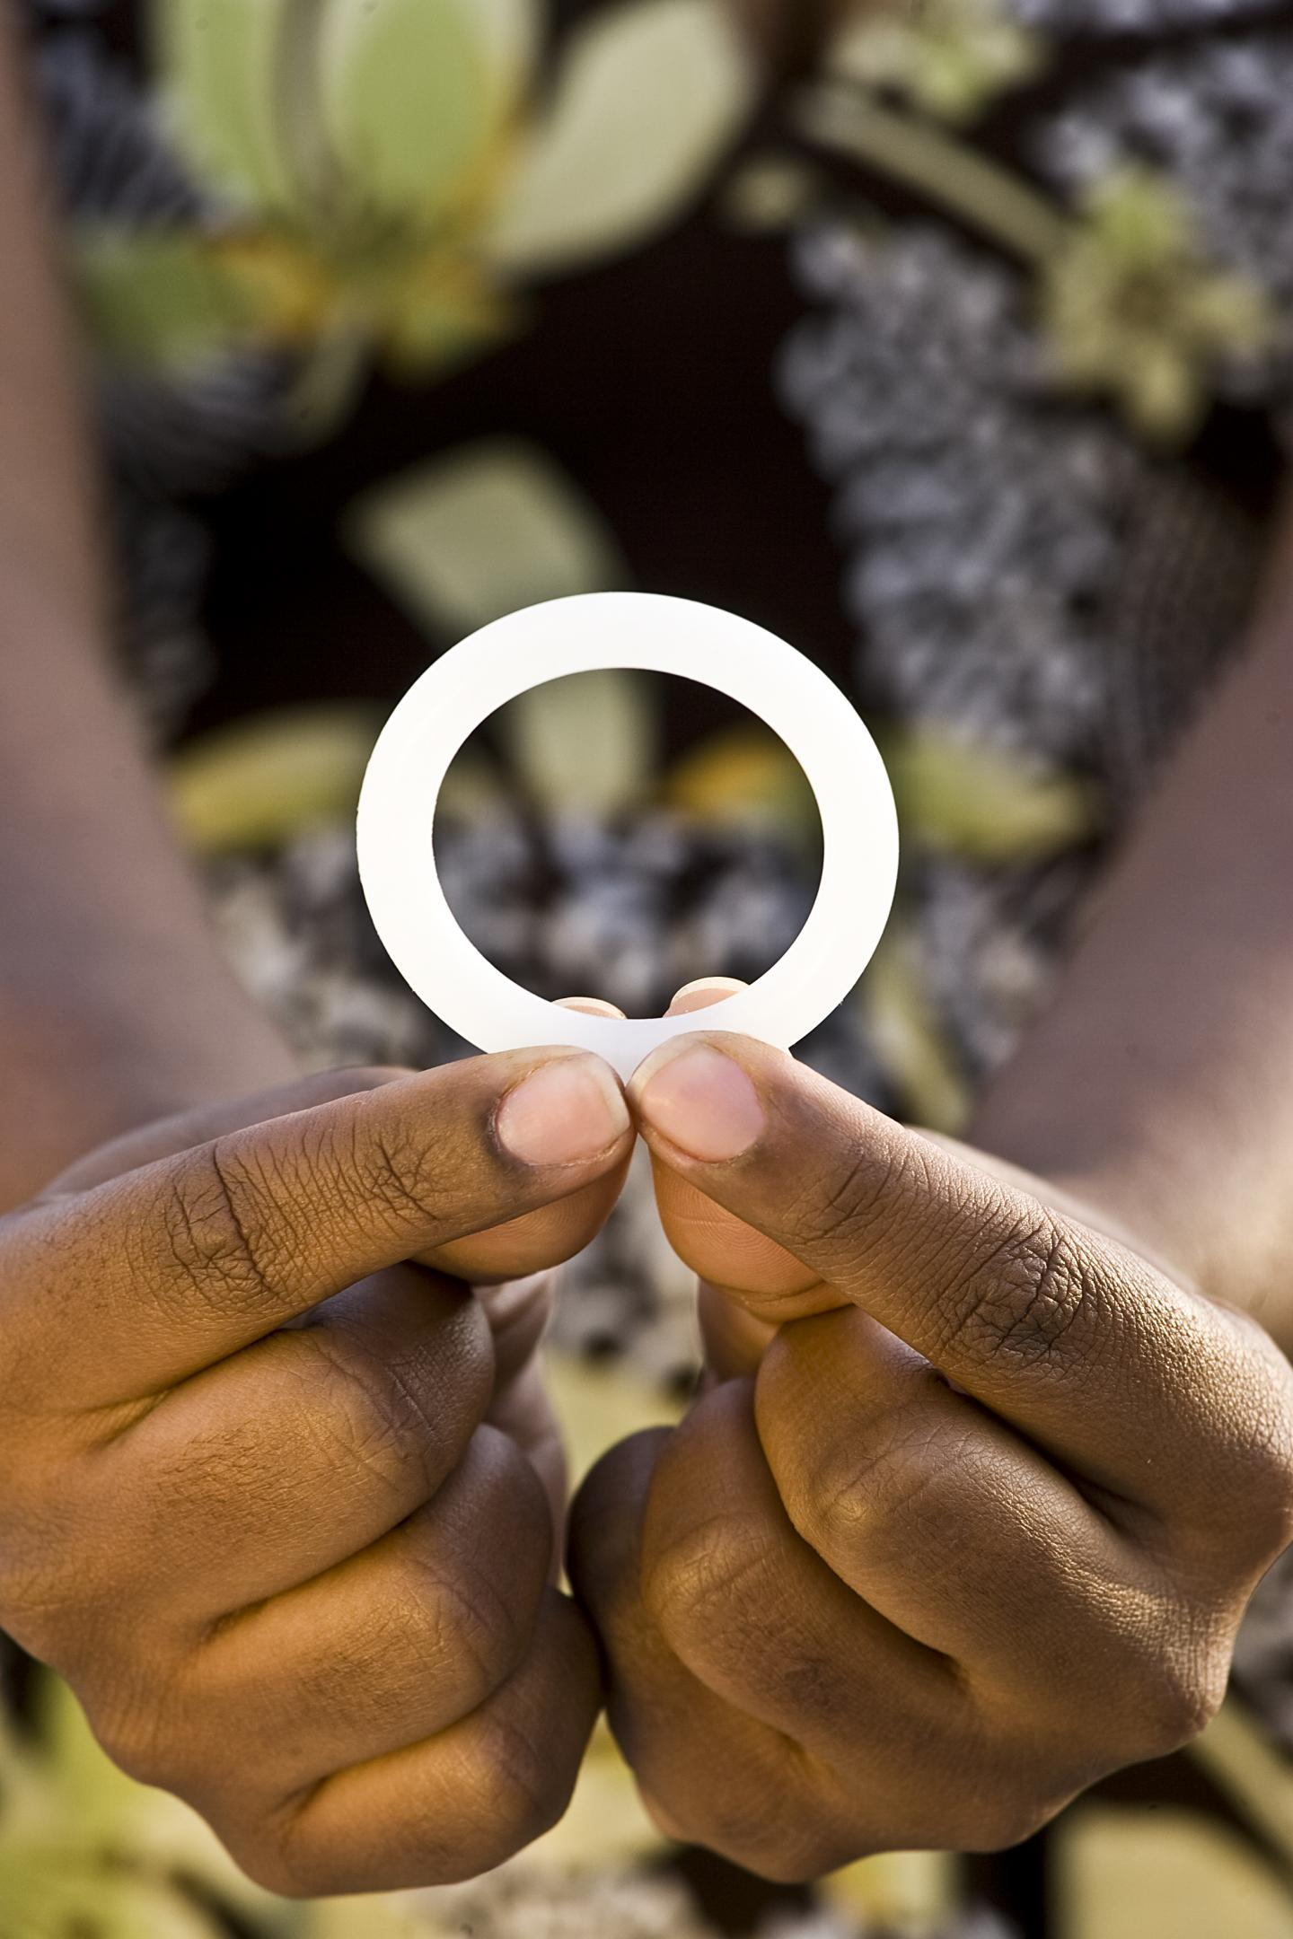
PrEP Ring: Storage
The shelf life of the PrEP ring is 5 years
Package labels include the expiry date
The ring does not require special storage conditions
Unused rings should be kept in a cool, dry place away from children and in the original package until it is time to be inserted
https://www.ema.europa.eu/en/dapivirine-vaginal-ring-25-mg-h-w-2168

Slide 42
The PrEP Ring and Intimate Partner Violence
Reports of social harms* related to intimate partner violence (IPV) during the PrEP ring clinical trials were low, and included:
  Male partner destruction of the ring
  Increases in an existing pattern of physical violence
  Increases or changes in existing patterns of control
Social harms and the PrEP ring: The ASPIRE experience
Among 2,629 women who participated in MTN-020/ASPIRE, 3.2% (n=85) reported 87 partner-related social harms during approximately 1.5 years of study participation.
Of these 87 instances of partner-related social harms, 44.8% (n=39) were related to the ring.
Common triggers of social harm included:
  Partner discovery of the PrEP ring during foreplay or sex
  Notifying the partner of a sexually transmitted infection
  Partners suspecting that the ring was associated with ill health, “promiscuity” or “witchcraft”
Experiences of social harm were associated with short-term decreased product adherence
Younger women (18–26 years old) were more than twice as likely to experience social harm as older women
Younger women were more likely to experience a social harm.
In PrEP ring studies and studies of other HIV prevention products, experiences of male-partner related social harms were associated with lower adherence to the product.
*nonmedical consequences of PrEP ring use or trial participation more broadly
https://pubmed.ncbi.nlm.nih.gov/30239426/

Slide 43
The PrEP Ring and Intimate Partner Violence
  It is imperative to provide clients with IPV screening and individualized counseling that emphasizes their relationship experience. Clients must be supported to choose products that best fit within their lifestyles without exacerbating risk.
  Remember that IPV is driven by gender norms, power, and control. No HIV prevention method causes IPV. Rather, a violent individual may seek power in the relationship by controlling the sexual and reproductive health choices of their partner.
There are many available trainings and tools related to identification and response of IPV and other forms of gender-based violence, including the WHO LIVES training. The LIVES response, with an offer of warm referrals, are required as part of standard PrEP services in PEPFAR programming. Speak to your supervisor to find out more.

Slide 44
Part Three Check-In: PrEP ring implementation
Explain this statement: “For maximum HIV prevention, the PrEP ring should be kept in place in the vagina for one full month”
Notes:
Answers:
The ring needs to be in place for at least 24 hours for the dapivirine concentrations to achieve maximum HIV prevention.
Research shows that the ring provides more HIV prevention with more consistent use. For maximum HIV prevention, the ring should be kept in place at all times.
If the ring is taken in and out, the likelihood of forgetting to place it back in the vagina or losing the ring is high.

Slide 45
Part Three Check-In: PrEP ring implementation
Regarding menses, the client should do which of the following?
Remove the ring during menses
Remove the ring after menses has stopped, wash the ring with water and reinsert
Leave the ring in place. Do not remove the ring
Notes:
Answer - 3
It is recommended to leave the ring in place despite menses. If a client is compelled to wash the ring (which is NOT necessary), the client should remove the ring, rinse with clean water, and reinsert immediately.

Slide 46
Part Three Check-In: PrEP ring implementation
True or False
As long as the ring is reinserted within 24 hours of receptive vaginal intercourse, the client will be protected from HIV
Sexual partners of clients using the ring will never know their partner is using the ring
The ring does not require special storage instructions
4. The ring should be removed as soon as a client is diagnosed with pregnancy
Notes:
Answers:
1. false. The ring needs to be in place for 24 hours to achieve sufficient levels for protective effects. It should not be intentionally removed during sex. Should it fall out during sex it should be rinsed and reinserted immediately.
2. false: Although it was not commonly reported, it is possible to feel the ring during intercourse and foreplay.
3. true: The PrEP ring should be kept in a cool, dry place away from children and pets, in its original packaging. It does not need to be stored in the refrigerator.
4. false: The client should be counseled on pregnancy and the PrEP ring.

Slide 47
Part Three Check-In: Ring Implementation
List three contraindications to initiating PrEP ring use:
-
-
-
Notes:
Answers:
People with unknown HIV status or who are living with HIV
Known exposure to HIV within the past 72 hours, and thus would benefit from post-exposure prophylaxis (PEP)
People with an allergy or hypersensitivity to the active substance or other substances listed on the product info sheet

Slide 48
Part Three Check-In: PrEP ring implementation
True or False
The PrEP ring reduces the risk of acquiring HIV through anal sex
Headaches are commonly reported by participants using the PrEP ring
Clients must be on contraceptives to be prescribed the PrEP ring
The PrEP ring also protects against herpes infection
Notes:
Answers:
1. false. The PrEP ring has only been shown to be effective at reducing HIV through receptive vaginal sex - not through receptive anal sex or oral sex
2. false
3. false
4. false: The PrEP ring does not prevent STIs other than HIV

Slide 49
4
PrEP Ring Counseling Considerations

Slide 50
PrEP Ring: Counseling considerations
Topic | Counseling key messages
Supporting effective PrEP ring use | The PrEP ring is designed to be in place for a full month without being removed. However, if you decide to remove the ring, it is important to rinse the ring with clean water and insert it again as soon as possible. Store the ring in a safe, dry place, away from direct sunlight. Since it needs to be changed monthly, setting a reminder may help you remember when to replace your PrEP ring. For example, an alert on your phone or a note in your diary. PROVIDER NOTE: Walk through insertion and removal instructions with the client What strategies do you think will help you to be successful in using the PrEP ring? What challenges do you anticipate? (Providers should explore and emphasize effective use and ring replacement reminders specific to everyone. This may be an appropriate time to explore gender and intimate partner violence.)
Cleaning the PrEP ring | The PrEP ring does not need to be removed and cleaned for any reason. However, if desired, it is acceptable to remove the ring, rinse it in clean water only, and then reinsert it immediately.

Slide 51
PrEP Ring: Counseling considerations
Topic | Counseling key messages
PrEP ring reinsertion | Although it is unlikely, it is possible that the ring may fall out. If this happens in a clean location, the ring should be rinsed in clean water and reinserted. If the ring falls out in a dirty location, the ring should be replaced with a new ring.
Using the PrEP ring during sex | The PrEP ring does not interfere with sexual intercourse and should be worn during sex to provide maximum HIV prevention. It can be used with condoms and water-based lubricant. Although it is unlikely, it is possible that your partner may feel the ring during sex. If this happens, you may need to confirm that the ring is in place correctly, because it may need to be pushed further up into the vagina. The ring will not harm your partner, but it only prevents the user from getting HIV – it will does not provide HIV prevention for the ring user’s partner.
The PrEP ring and douching | It is possible that flushing the vagina with water to clean it (or any form of douching) may dilute the concentration of dapivirine in the vagina. Douching is not recommended at any time, including while using the ring, because it may have a negative impact on the health of the vagina.

Slide 52
PrEP Ring: Counseling considerations
Topic | Counseling key messages
PrEP ring effectiveness | The PrEP ring is about 50% effective – or more, when kept in place for the full month – in preventing HIV acquisition.
The PrEP ring and STIs other than HIV | The PrEP ring does not prevent STIs other than HIV. You should always use a condom, with water-based lubricant if possible, to prevent STIs while using the PrEP ring.
Starting and stopping the PrEP ring | For the PrEP ring to be most effective, you must leave it in place for the full month. The PrEP ring reaches maximum effectiveness once it has been in place in the vagina for 24 hours. It is ok to stop using the PrEP ring if you decide you no longer need HIV prevention, or do not want to use it any longer. Simply remove the ring and dispose of it or return it to the clinic.
PrEP ring and trans and non-binary people | The ring has only been studied for use by people assigned female at birth. It is likely that the PrEP ring can be used by people assigned female at birth who are not taking gender-affirming hormones and wish to prevent HIV during receptive vaginal sex, regardless of their gender identity.

Slide 53
PrEP Ring: Counseling considerations
Topic | Counseling key messages
The PrEP ring and preventing pregnancy | The PrEP ring does not prevent pregnancy. If you do not wish to become pregnant, you should use an effective form of contraception while using the PrEP ring.
PrEP ring use during pregnancy and breastfeeding* | In general, the likelihood of getting HIV during pregnancy or postpartum is higher than at other times in people’s lives. Oral PrEP is already proven to be safe during pregnancy and breastfeeding and is a good option for these individuals to consider. Clinical trials on PrEP ring use during pregnancy and breastfeeding are limited, but studies are ongoing. Early results from an ongoing trial suggest that there was no impact of ring use on pregnancy outcomes. Very small amounts of dapivirine can pass to breast milk. One study has shown that ring use was safe and well tolerated for breastfeeding individuals and their babies. The PrEP ring should not be used by pregnant people who are having vaginal bleeding or after the bag of waters breaks.
*Complete counseling messages on PrEP ring use during pregnancy can be found in Annex 1

Slide 54
PrEP Ring: Counseling considerations
Topic | Counseling key messages
The PrEP ring – switching products | If you decide that you would like to switch to a new HIV prevention method after using the PrEP ring, that is ok. If you would like to switch to oral PrEP, you should start oral PrEP and keep the PrEP ring in place for 7 days to give the oral PrEP time to reach maximum effectiveness in your body.
The PrEP ring and menses | The ring should be worn for one month, including during menses, to be most effective. The ring does not cover the cervix and does not interrupt the flow of menstrual fluids. There are no safety concerns related to the use of tampons, menstrual pads, and most other menstrual products while using the ring. Menstrual cups are not recommended for use with the PrEP ring. If using a tampon, be careful not to accidentally remove the ring when removing the tampon. Although it is unlikely, it is possible that the ring may fall out. If this happens in a clean location, the ring should be rinsed in clean water and reinserted. If the ring falls out in a dirty location, the ring should be replaced with a new ring.

Slide 55
PrEP Ring: Counseling considerations
Topic | Counseling key messages
Sharing the PrEP ring | The ring should not be shared with others. If other people you know are interested in using the ring, they can come here.
PrEP ring storage | Store rings in their original packaging in a cool, dry place, away from children and direct sunlight, and secured from any pets or animals. The ring does not need to be refrigerated and can be safely stored at or around 25°C or 77°F for up to five years. The expiration date appears on the packaging for the PrEP ring.
Disposing of the PrEP ring | Used rings can be placed inside the original wrapper provided with the ring or wrapped in tissue or toilet paper and disposed of in a trash bin out of reach of children. If you prefer, you can return your used ring to your health care provider/service provision point.
The PrEP ring and partner disclosure | People have different reasons for sharing or not sharing their PrEP ring use with their partner(s). Generally, individuals who can disclose their PrEP ring use with their partners can use it more effectively. If you’d like, we can discuss your thoughts on sharing or not sharing your PrEP ring use together. If you choose not to tell your partner, it is still possible that your partner might feel the PrEP ring during sex. We can discuss your plan if your partner happens to learn about your PrEP ring use.

Slide 56
PrEP Ring: Counseling considerations
Topic | Counseling key messages
Contraceptives and other drug interactions | The PrEP ring can be used with any contraceptive method except contraceptive vaginal rings. Because the ring acts locally, there are no systemic drug-drug interactions with the ring. However, vaginally inserted medications, such as those used to treat reproductive tract issues, should not be used with the PrEP ring.
Side effects management | Side effects from PrEP ring use are typically mild or moderate, and include urinary tract infections (UTI), vaginal discharge, vulvar itching, and/or pelvic and lower abdominal pain. Side effects usually resolve without needing to remove the ring. Contact me if you experience any urinary or reproductive tract changes, as these could be a sign of an STI or UTI needing treatment.
The PrEP ring and vaginal, anal, and oral sex | The PrEP ring prevents HIV during receptive vaginal sex only. It does not provide protection during anal sex, or oral sex, and should not be inserted into the anus or mouth. Always use a condom and water-based lubricant during anal sex. Oral PrEP prevents HIV during vaginal, anal, and oral sex, so it may be a good option for you to consider if you have anal sex frequently.
The PrEP ring and alcohol or recreational drugs | Using the PrEP ring while you are using alcohol or other recreational drugs will not hurt you. However, alcohol or other recreational drugs may make it challenging to use the PrEP ring correctly. We can talk about planning together if that would be helpful.

Slide 57
Case Scenario: PrEP ring discoloration
A client has chosen the PrEP ring as their HIV prevention method. They return for a follow-up visit and upon removing the ring notice that the ring is yellowish and discolored. The client is alarmed.
Are you alarmed?
How do you proceed?
What, if any, additional procedures would you do?
How do you counsel the client about continued product use?
Notes:
Answer:
This can be very normal!
No need to be alarmed. No need to do additional evaluations.
Reassurance is all that is necessary.

Slide 58
Case Scenario: PrEP ring placement
A client chooses the PrEP ring as her prevention method. She elects to place the ring herself. After insertion she notes that she has significant vaginal pressure.
What do should you do?
Notes:
Answer:
Most likely the ring is not inserted beyond the introitus. You might suggest that the client try to push the ring up further into the vagina. If that doesn’t resolve the issue, you can try to do the same. While exceptionally rare, there a few (out of thousands of ring participants) who had difficult with the ring falling out on its own despite being in the right place. If inserted successfully, the client should not be able to feel the ring sitting in the vagina.

Slide 59
Case Scenario: PrEP ring size
A client takes one look at the ring and says, “There’s no way! The ring is too big!”
What can you tell the client to alleviate their fears?
Notes:
Answer:
The opening of the vagina is the narrowest part of the vagina. The vagina above the introitus is quite big. When the ring is folded, it is quite small and can fit through the opening.

Slide 60
Case Scenario: Cervicitis
A client who is using the ring for HIV prevention returns to the clinic complaining of purulent discharge and pelvic pain. On exam you diagnose a primary herpes outbreak. She has ulcers on her cervix, vaginal wall and labia.
How do you proceed?
Notes:
Answer:
You should institute a product hold because of the ulcers on her cervix.
You can reassure the participant that there has been no association between the ring and HSV infection in prior studies so once the ulcers have healed, she can resume ring use. This is a good time to remind the participant that the ring does not protect against STIs.
Of note, when evaluating vaginal complaints for participants using the ring, it is possible to do the speculum exam with the ring in place.

Slide 61
Case Scenario: Transgender clients
A client who was assigned female at birth and identifies as male has chosen the PrEP ring as his preferred HIV prevention method. He is planning to start testosterone hormone therapy.
How would you counsel him on his ring use?
Notes:
Answer:
Although data was collected on medications taken by ring users during clinical trials, there was insufficient evidence around gender-affirming hormone use. Because the ring acts locally, it is unlikely that testosterone would interact with the ring. However, the client should be made aware of this lack of evidence and may want to consider other PrEP methods while using gender-affirming hormones if he is not comfortable with this level of evidence.

Slide 62
Case Scenario: Pregnancy
A client has chosen the PrEP ring as her HIV prevention method. She falls pregnant. You counsel her about the pros and cons of continuing the ring during pregnancy.
1. What pros might you offer?
The client loves using the PrEP ring so would prefer to stay on it while pregnant but worries that the ring might interfere with the baby’s growth. Perhaps even wrap itself around the baby!
2. How might you reassure her that this is not a concern?
3. When do you advise the client to remove the ring during pregnancy if all is going normally?
Notes:
Answer:
1. Pros: to date, appears to be safe in pregnancy, offers HIV prevention for the user
2. You might use the pelvic model to explain that the vaginal compartment is different from the uterus.
3. The client should remove the ring with the start of labor

Slide 63
Case Scenario: Partner concerns
In reviewing the options for HIV prevention, the client tells you that she would be scared to use the oral PrEP because if her partner found out she was using PrEP he would be “incredibly angry.” She expresses interest in the PrEP ring.
How do you counsel her?
Notes:
Answer:
It would be important that the participant realize that the ring can be felt by a partner even when it is correctly placed in the vagina. Which PrEP method is most discrete for the client likely depends on her individual situation.
This would be a good opportunity to explore disclosure and non-disclosure options and IPV concerns with the client as well.

Slide 64
Case Scenario: Anal sex
A client who has chosen the PrEP ring as her preferred HIV prevention method returns to the clinic because of rectal pain and discharge. On exam, she has signs of an anal infection. She reports that her last receptive anal sex act was two weeks ago. She typically engages in receptive anal sex during her menses.
How do you counsel her with respect to product use?
Notes:
Answer:
The PrEP ring does not prevent HIV during receptive anal sex.
It may help the client to explore how often she has anal sex, whether she is able to use condoms in these instances, and if she would be interested in switching to a PrEP method that prevents HIV during anal sex.
Would also be worthwhile to discuss condom use/STI prevention with the client.

Slide 65
5
PrEP Ring Frequently Asked Questions

Slide 66


PrEP Ring: Providers’ frequently asked questions
Questions | Responses
Is there a lead-in time for the PrEP ring? | The PrEP ring provides a slow release of dapivirine. The ring must be in place for at least 24 hours to provide maximum HIV prevention. The manufacturer’s guidance does not recommend inserting the PrEP ring and then having sex immediately afterward.​
Is there a possibility for intermittent use of the PrEP ring? | Intermittent use of the PrEP ring has not been studied and is not recommended. The PrEP ring is designed to be used continuously for 28 days, or one month. It is not necessary to clean or remove the ring during or after menses or sex, and sexually transmitted infections (STIs) can be diagnosed and treated without removal of the ring. The PrEP ring must be in place to reduce the chances of HIV acquisition.
Is there an association with STI rates and use of the PrEP ring? | No association between STI rates and use of the PrEP ring were seen in the Phase III trials. Overall STI rates were similar among participants using the PrEP ring and those using the placebo ring in both trials, and there was also no evidence of an increase in STI incidence or prevalence over time in the trials.
Do STIs affect the efficacy of the PrEP ring? | Limited data are available on this topic. However, a post-hoc analysis suggests that STIs did not affect the PrEP ring’s efficacy in the Phase III trials. It is important that anyone using a biomedical HIV prevention method contact their healthcare provider if they experience any health changes to ensure that STI testing and treatment are provided when needed.

Slide 67
PrEP Ring: Providers’ frequently asked questions
Questions | Responses
How far along are the results for the ring that combines dapivirine with levonogestrel? | The dapivirine-levonogestrel ring completed its second Phase I trial in 2021, with results supporting further development of the product. Pending study results and regulatory approvals, it is hoped that the dual-purpose ring would be added to a future HIV prevention portfolio that also includes the monthly dapivirine-only ring.
Is it possible for a woman to use the dapivirine-only ring and levonogestrel-only ring at the same time? | The dapivirine ring may be used with most types of contraception but should not be used simultaneously with other types of vaginal rings such as the contraceptive vaginal ring.
Is the PrEP ring effective for cisgender women who have sex with cisgender women? | In most scenarios it is believed that HIV transmission between cisgender women during sex is quite unlikely. We don't yet have any data on PrEP ring use in these scenarios.
Can the ring cause cervical cancer in event of long-term use? Given the fact that it will be releasing the dapivirine in same general area over a period of time? | Use of the ring, with or without dapivirine, even over the long-term, is not associated with cervical cytology abnormalities that could lead to precancerous or cancerous lesions.
Does the color remain the same as when it was inserted? | The PrEP ring may be stained brown or yellow from menstrual blood, but this is ok. Otherwise the ring does not change color during use.

Slide 68

PrEP Ring: Providers’ frequently asked questions
Questions | Responses
Is any special equipment needed to insert the PrEP ring? | No. The PrEP ring can be inserted using the hands only. There is no need to use any insertion device, or to conduct any pelvic exam prior to ring use.
Can the PrEP ring be used during menses? | Yes. There is no need to remove the PrEP ring during menstruation. The ring should be kept in place for 28 days to ensure risk reduction and then replaced with a new one.
Does the PrEP ring protect against any STIs? | No. Condoms are currently the only product that can prevent HIV as well as other STIs
Will the PrEP ring slip if an individual uses lubricant during sex? | Although it is possible, there were few reports of the PrEP ring being displaced for any reason in studies on the use of the PrEP ring and condom (male and female) together during sex, in which participants could also use water-based lubricants.
What is the likelihood of drug resistance with use of the PrEP ring? | There is no evidence that clients who seroconverted during PrEP ring use had increased levels of HIV drug resistance related to PrEP ring use.
What if the client falls pregnant? Should the PrEP ring be removed? | The risks and benefits of different HIV prevention methods that are available to pregnant people should be discussed with the client. Depending on local guidelines and client preferences, some clients should be able to keep the ring in place.

Slide 69



PrEP Ring: Clients’ frequently asked questions
Should I remove the ring during my
period?
NO. The ring only reduces the chances of getting HIV during receptive vaginal sex. An alternate method of HIV prevention, such as condoms and water-based lubricant, should be used during anal sex.
Does the ring prevent
HIV during anal sex?
NO.
It is safe to use during your period. The ring should remain in the vagina during your period to reduce the chances of HIV-1 infection
Can I remove the
ring before sex?
NO.
The ring reduces the chances of getting HIV during receptive vaginal sex. It is possible that your partner may feel the ring during sex; the ring will not harm you or your partner
Can I use products to clean my vagina
while using the ring?
NO.
The vagina cleans itself naturally and cleaning inside of the vagina with soap or other products can cause harm
Does the ring prevent
me from getting
pregnant?
NO. The ring only reduces the chances of getting HIV during vaginal sex. It will NOT prevent you from getting pregnant
Can I use tampons with the ring?
Can the ring get lost
inside me?
YES. Tampons can be used with the ring. The ring should be in the vagina before inserting a tampon. Be careful when removing the tampon, in case the ring is accidentally pulled out. If this occurs, immediately reinsert the ring according to instructions
NO. The ring cannot be pushed up too far or get lost in the body
What do I do if I think I am pregnant?
Can I use the ring with
contraception/birth
control?
Contact your doctor immediately for advice. Practice safer sex if the vaginal ring is not being used.
You can use the ring with male/female condoms & all other forms of contraception except contraceptive rings.
DO NOT use the ring with other vaginal rings. If you are unsure, contact your clinic/doctor

Slide 70
WHO Consolidated Guidelines
PrEP Technical Guidelines and other resources
International Partnership for Microbicides
Microbicide Trials Network
PrEP Ring Evidence & Research
PrEP Ring Resources

Slide 71
Morgan Garcia and Ashley Mayo, FHI 360; Lisa Noguchi and Jason Reed, Jhpiego; Katie Bunge, University of Pittsburgh

Slide 72
Annex 1
PrEP Ring: Additional counseling messages regarding pregnancy and breastfeeding
In general, the chances of getting HIV are higher during pregnancy and in the postpartum period.
For most healthy people who live in areas where HIV is common, the potential benefits of oral PrEP and PrEP ring use during pregnancy and postpartum outweigh potential risks. Getting HIV is a greater health risk when compared to the potential risks of using either oral PrEP or the PrEP ring.
There is no evidence that either oral PrEP or the PrEP ring increase the chance of birth defects, miscarriage, or other complications during pregnancy, postpartum, or while breastfeeding for the parent or child.
Oral PrEP and the PrEP ring do not have any known negative interactions with the medications and supplements most commonly prescribed during pregnancy, postpartum, or while breastfeeding.
Research has shown that oral PrEP and the PrEP ring are generally safe and well tolerated when used during breastfeeding.
The amount of medication that may pass to the baby with oral PrEP or the PrEP ring during pregnancy and breastfeeding is very small and has not been shown to cause any serious health problems for babies.
Oral PrEP and PrEP ring use during pregnancy and breastfeeding have not been shown to cause the baby to be too big or too small.
Oral PrEP and PrEP ring use have not been shown to have any impact on a person’s ability to become pregnant in the future.

Slide 73
Annex 1
PrEP Ring: Additional counseling messages regarding pregnancy and breastfeeding (continued)
Some people using oral PrEP or the PrEP ring experience side effects, with some side effects (such as nausea) that may be similar to pregnancy discomforts; these side effects are generally mild, not dangerous, and resolve quickly.
The PrEP ring rests at the top of the vagina, right below the opening to the cervix, and in this position, it does not enter the uterus or touch the baby.
The PrEP ring should be removed before delivering the baby, ideally when contractions start or when arriving at the hospital for delivery.
It is recommended that individuals wait until 6 weeks after delivery to resume or start PrEP ring use and vaginal sex.
Neither oral PrEP nor the PrEP ring have been shown to affect milk production or the taste or quality of breast milk.
Even when using oral PrEP or the PrEP ring, exclusive breastfeeding for the first 6 months of life is still the recommended way of feeding infants, followed by continued breastfeeding with appropriate complementary foods for up to 2 years or beyond.
Health care providers should explore whether the pregnant client is experiencing violence, and if so, discuss ways they can help them and their baby stay safe.

