Slide 1
Empathways for LGBTQIA+ People
Facilitator’s guide

Slide 2
What is empathways?

Slide 3
Empathways is…
an empathy-building activity developed to support health care providers in their counseling interactions with their clients
a tool to be used to meaningfully engage clients in health care provider training
conducted with mixed groups of providers and “mock clients”
Empathways was originally developed to improve family planning services for adolescent girls and young women. This version of Empathways has been adapted for PrEP service delivery for lesbian, gay, bisexual, transgender, queer, intersex, asexual, and other people with diverse sexual orientations/gender identities (LGBTQIA+).

Slide 4
2
Facilitation

Slide 5
How to use this Empathways deck
This version of Empathways is intended for use in CATALYST provider trainings at sites that anticipate serving LGBTQIA+ clients.
To do Empathways, you will need to invite LGBTQIA+ people to participate in the session as mock clients; the goal is to have each provider have a mock client that they partner with to complete the exercise.
This card deck is designed to be used with LGBTQIA+ clients who are somewhat familiar with HIV prevention and family planning services and with providers who are interested in better understanding LGBTQIA+ clients.
When conducting Empathways with LGBTQIA+ clients, it is especially important to choose LGBTQIA+ participants who are comfortable sharing their identities as part of the activity, and who will be able to access support after the activity if needed.
It is recommended that you reach out to local organizations that work with LGBTQIA+ people to help you plan the activity and invite interested LGBTQIA+ program participants to take part, and even co-facilitate sessions with you.

Slide 6
How to use this Empathways deck
Light facilitation is recommended, particularly to ensure respectful conversations, keep the activity to time, introduce and conclude sessions, and share experiences between each of the three rounds.
It is recommended to allot at minimum 90 minutes for completion of the deck.
If you have the Empathways cards printed out (one set for each provider being trained), you can use this slide deck to guide the session.
If you do not have the Empathways cards printed out, you can project these slides and ask everyone to answer the questions as they are projected.
We recommend sending provider participants away with a copy of the "connect" cards and encourage them to use these questions as an icebreaker when counseling LGBTQIA+ clients.

Slide 7
Introduction
Empathways takes participants on a journey from thinking about their own experiences to understanding their partner’s experiences, and then working together to improve service delivery for lesbian, gay, bisexual, transgender, queer, intersex, asexual, and other people with diverse sexual orientations/gender identities (LGBTQIA+).
The objective is to forge greater empathy between providers and LGBTQIA+ clients, and then for providers to apply this empathy to improve PrEP and other sexual and reproductive health service delivery to clients, particularly those who identify as LGBTQIA+.
Notes:
Notes: Read this statement to participants

Slide 8
Informed Consent & Confidentiality
All information shared within the context of this activity will be kept confidential, between the facilitator and the participant(s).
You reserve the right to stop or pause your participation in this activity at any point. Your participation is voluntary and there will be no incentive for your time.
Your participation in this activity will help to improve service delivery in your area by establishing the importance of empathy in providing services which are authentically and wholly youth-friendly.
If you have understood the information above and voluntarily agree to participate in this activity, please confirm your participation by providing verbal affirmation (‘yes’) to the facilitator. Should you wish to discontinue your participation at this time, please let the facilitator know.
Notes:
Read this statement to participants and get their consent

Slide 9
How We Will Use Empathways
The deck includes three rounds with one card deck for each round.
Round 1 OPEN UP: We will ask and answer questions to get to know one another and develop rapport.
Round 2 DISCOVER: We will explore the factors that impact providers’ attitudes about service delivery for LGBTQIA+ clients.
Round 3 CONNECT: As pairs, we will reflect on service delivery scenarios and invite providers to commit to improving service delivery for LGBTQIA+ clients with practical ideas on how to achieve this.
Notes:
Present this slide to participants to orient them on the activity.

Slide 10
3
Let’s Get started!

Slide 11
Let’s Go!
Get into pairs: one health care provider and one LGBTQIA+ mock client
Turn off phones :)
Make sure you have the Empathways cards: one set for each provider/mock client pair
Notes:
Use this slide to form pairs of providers and mock clients. Make sure each pair has space to talk and hear each other.
If participants do not have cards, consider projecting the tool on a wall so everyone can see the same content at once.
If you are using a printed version of the deck, and if you removed any cards, make sure all participant and facilitator decks have the same cards, in the same order.

Slide 12
Instructions
The cards are in numbered order and should be discussed one at a time.
Each card indicates who should respond to the questions on the card.
Begin by taking the pledge to respect each other and to keep an open mind throughout the activity. This is key to establishing trust between partners.
Once the participants have completed Round 1, move on to Rounds 2 and 3.
After completing Round 3, consider inviting participants to share their thoughts as a group. Ask providers to write down how they will use Empathways experience to improve PrEP service delivery.
Notes:
Project this slide and go over the instructions. Pause and ask if there are any questions.

Slide 13
Round 1: Open Up
In this round, you will get to know your partner.
Each card is numbered; please use the cards in order.
Both the mock client and the provider should answer each question, taking just 1 or 2 minutes each.
Begin with the Pledge: both participants must read it aloud to one another.

Slide 14
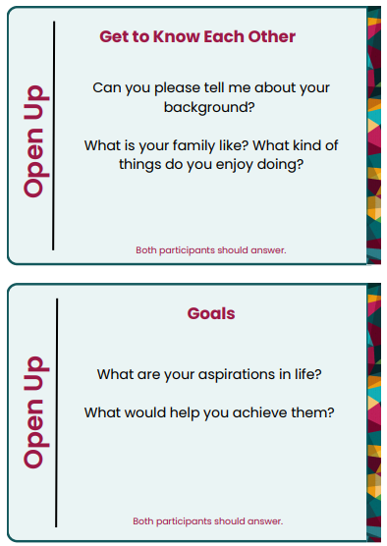
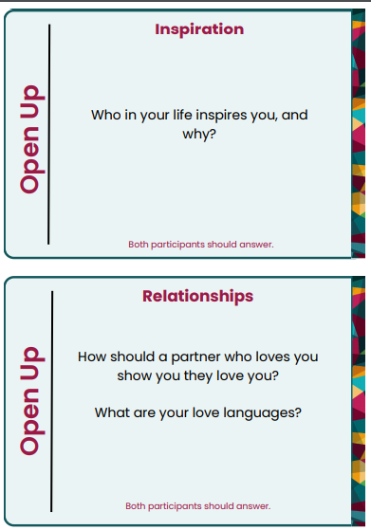
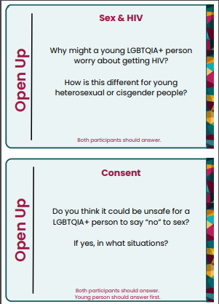
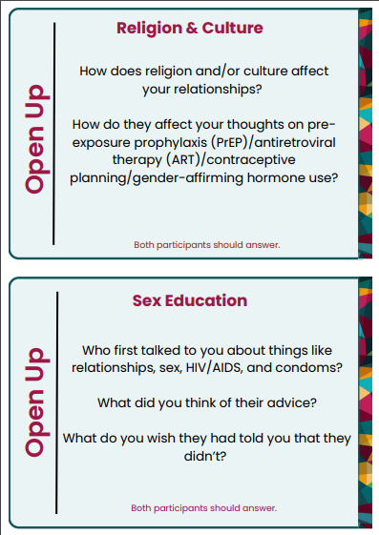
Notes:
Here are all of the questions, in case you don't have the cards. If you have limited time choose just 2-3 of the open up cards of your choice. If you have more time, use them all!

Slide 15
Round 2: Discover
In this round, please read each card. Each card will say who should answer the question.
Each card is numbered; please use the cards in order
Spend just 2-3 minutes on each card, which guides you on who should answer each question.
Notes:
READ ALOUD:
This round builds on Round 1 and invites you to discuss how your own experiences and relationships shape your HIV prevention needs, attitudes and preferences.
In this round, we’ll talk about “health services,” “health care providers,” and “HIV prevention interventions/innovations”
Who can help explain each of these terms, so we each understand them well? [allow time for participants to respond, validate correct responses]
Again, instructions are on each card, and you’ll have just a few minutes per card - off we go!

Slide 16
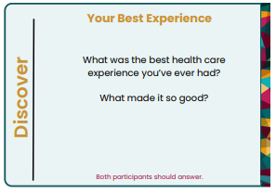
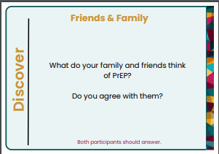
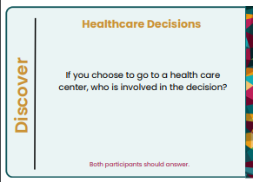
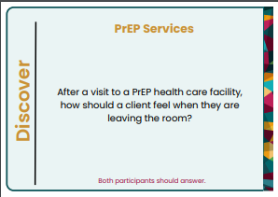
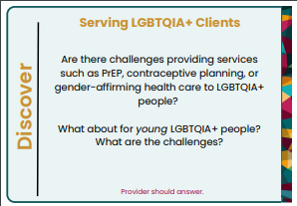
1.
5.
9.
2.
6.
10.
3.
7.
11.
4.
8.

Slide 17
Round 3: Connect
In this round, please read each scenario.
Spend 4 or 5 minutes per card.
Both participants should listen to the situation being described and respond to the questions.

Slide 18
Scenario 1
Hafsat, a genderqueer 19-year-old, goes to a health facility to learn about PrEP services. While in the waiting area, they hear a health care provider shouting at a client in the consultation room, saying the client must be “promiscuous” because they are gay and that they need religion to “fix them.” Hafsat decides to leave the health center.
How may Hafsat feel?
What might happen to Hafsat next?
What could have gone differently?
Both participants should answer.

Slide 19
Scenario 2
Sarah, 21, is a fun-loving and adventurous transgender woman. She usually goes to party with her friends, and recently she narrowly escaped being raped. Sarah doesn’t think that’s something to stop her from having fun and making the most of her life. However, she is now afraid of getting HIV and decides to go to a health center to seek advice.
What should the provider who meets with Sarah do?
How should Sarah feel leaving the health center?
Both participants should answer.

Slide 20
Scenario 3
Olu, a gay transgender man, celebrated his 18th birthday at a café with his friends. His friends encouraged him to be more adventurous now that he is an adult. That night, Olu decides he is ready to start having sex with his boyfriend. He calls his "Uncle" Ron, age 28, for advice. He feels he can confide in him more than anyone else he knows. But this time, Ron threatens to tell Olu's parents. ​Olu feels betrayed, but he remembers Ron telling him to at least go to the health center for condoms before making any decisions. Olu decides it is worth visiting the health center first.
How may Olu be feeling when entering the health center?
What should the provider who meets Olu do?
Both participants should answer.

Slide 21
Scenario 4
Wandillise is a 22-year-old transgender woman who uses oral contraception because she feels that the hormones in the pills affirm her gender identity , and gender-affirming health care (GAHC) is not provided where she lives. She normally accesses these services from private pharmacies, because they do not ask a of lot questions when she buys contraceptives. However, this time around, she does not have money and decides to visit the local government health facility, where services are free. When she enters the consultation room, the nurse addresses her using her dead name and uses male pronouns to address her. This feels offensive to her, but she continues the discussion because she has no other options. When the nurse hears that Wandillise wants to access family planning, she does not give her a chance to explain and shouts that “family planning is only meant for real women!” Wandillise leaves the health care facility feeling disappointed and offended.
What might Wandillise do to get the medication she uses for GAHC? How might this put her at risk of harm?
Do you think it would be easier for Wandillise to visit the facility if they respected her gender identity?
What can providers do to understand the needs of LGBTQIA+ clients?
What should the provider do to help Wandillise understand her gender-affirming healthcare options?
Both participants should answer.

Slide 22
End of Round 3

Slide 23
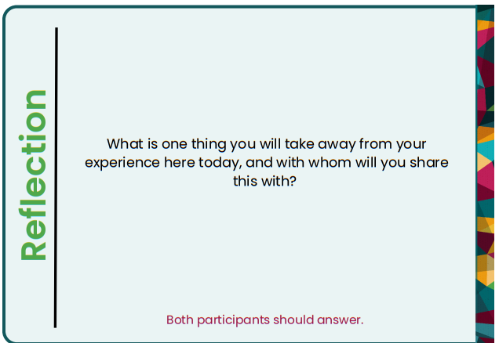
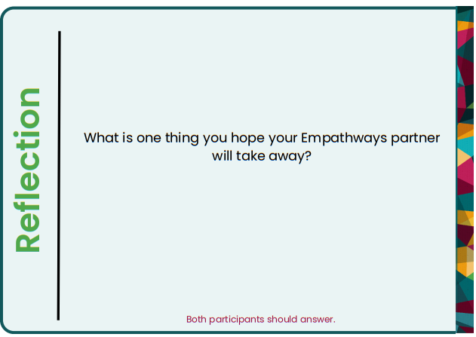
Reflections
Notes:
Partners should turn to each other and answer these questions.

Slide 24
Discussion & Reflection for Providers
Thinking about your conversations in Rounds 1, 2 and 3. Name 3 things that might impact LGBTQIA+ clients’ PrEP decisions.
What makes it difficult to understand or address LGBTQIA+ clients’ PrEP needs?
How can they be addressed, and what is your role in addressing them?
Considering today’s conversations, what LGBTQIA+ PrEP service delivery gaps have come up?
Notes:
FACILITATOR NOTE: After participants complete Round 3, we suggest allowing at least 20 minutes to ask providers to share their “commitments,” for LGBTQIA+ clients to react, and to conclude the session.
LGBTQIA+ clients should also share their reflections from the session.

Slide 25
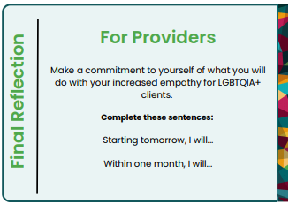
Final Reflection for Providers
Notes:
Facilitator notes: Let providers know if they get stuck, to ask their colleagues or reach out to a partner organization for help!

Slide 26
Special thanks to Tema Mkhonta, Bheki Sithole, Thabile Mdluli, Caleb Owino, Marie Merci Niyibeshaho, Margaret Akinyi Atieno, Nkunda Vundamina, Amogelang Sasha Kekana, Morgan Garcia, Allison Cole and those who participated in the discussions in Eswatini, Kenya and South Africa.

