Slide 1
Ruling Out HIV Infection
Clinical training for providers
March 2023

Slide 2
Training Overview
3 Steps to Ruling Out HIV Infection – in this order
HIV Testing
HIV Recent Exposure Assessment: Determining Need for PEP Instead of PrEP
Acute HIV Infection Assessment – Signs/Symptoms and Risks
Refer to the “Ruling Out HIV Infection Algorithm & Table” provided as job aids for this training

Slide 3
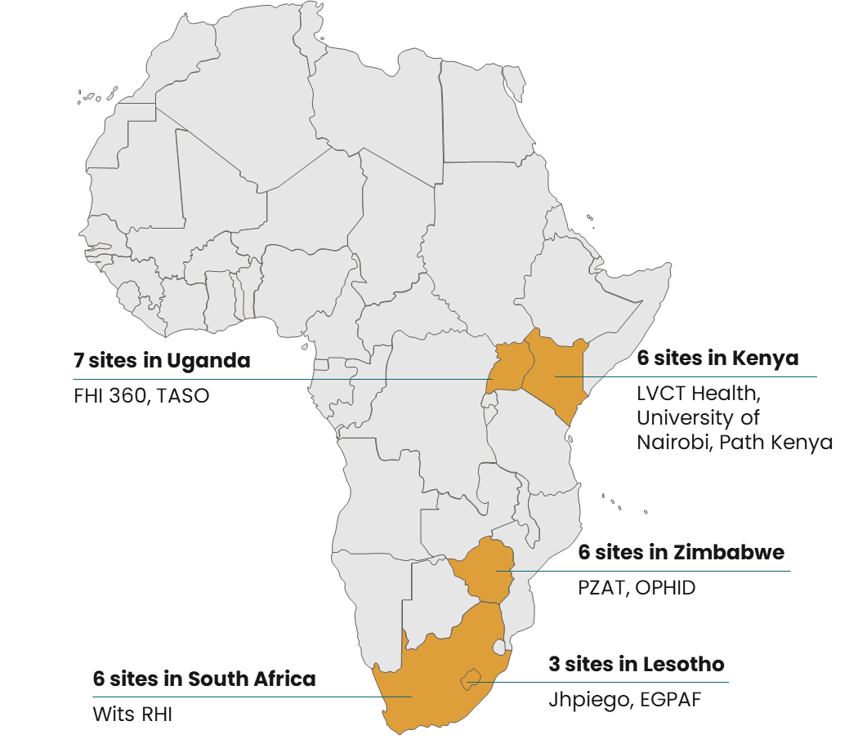
A note about this training…
Because HIV testing guidelines may differ by country, it is expected that this training will be adapted in each CATALYST country to align with national guidelines.
Slides where these adaptations are anticipated are marked with red text.

Slide 4
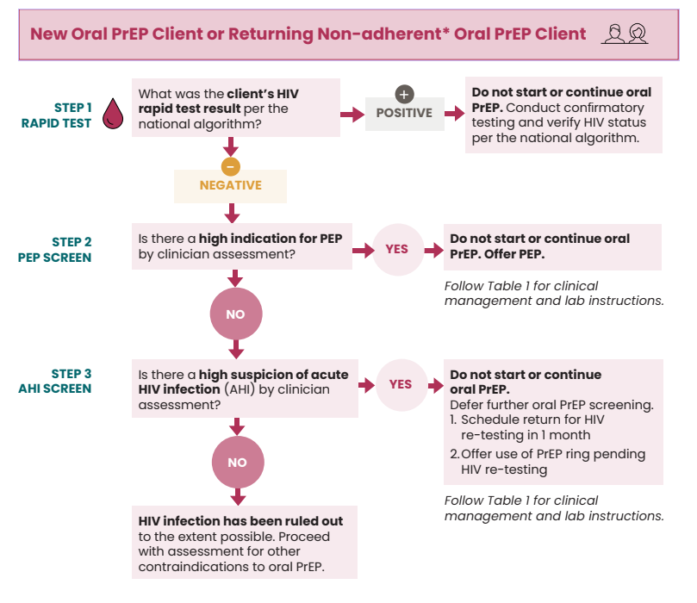
ALGORITHM: Ruling out HIV infection for new or returning non-adherent oral PrEP clients*
*Additional algorithm for returning adherent oral PrEP clients available

Slide 5
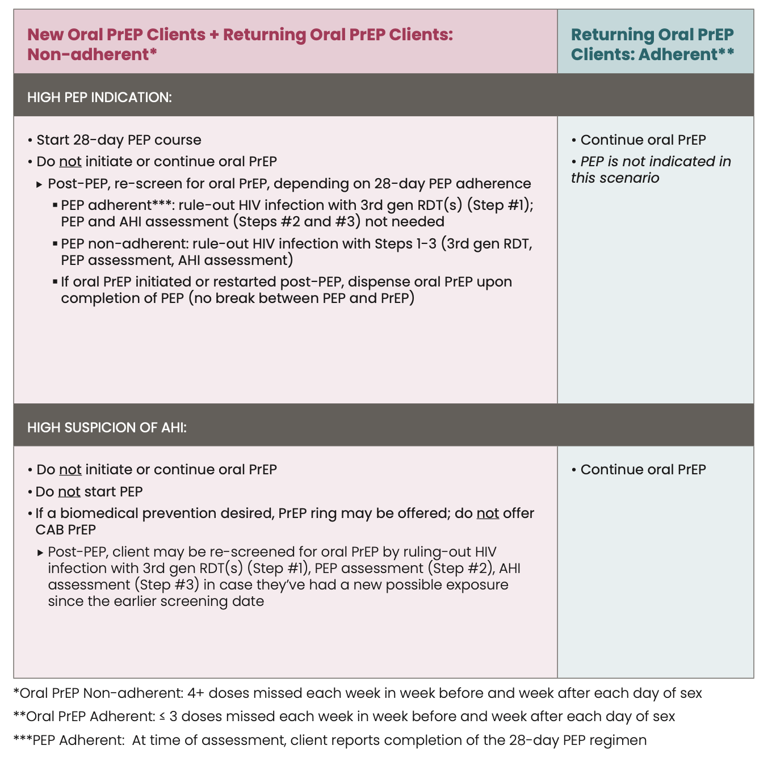
TABLE for Ruling Out HIV Infection for New or Returning Oral PrEP Client
Use this table to determine whether to start/continue oral PrEP, start PEP instead, or defer start of/pause oral PrEP in a client with a NEGATIVE 3rd generation rapid diagnostic test (RDT) AND clinically assessed as having PEP indication or suspected of acute HIV infection.
All notation of 3rd generation RDT is in accordance with RDTs specified in your national testing algorithm.

Slide 6
1
Step 1: HIV Testing

Slide 7
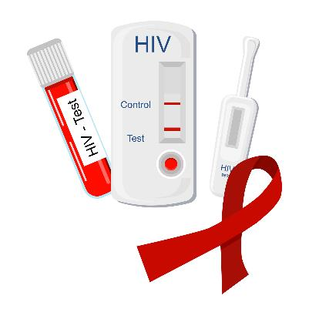
Step 1: HIV Testing
WHO recommends use of HIV rapid diagnostic tests (RDT) specified in the national HIV testing algorithm as part of determining PrEP eligibility
HIV testing should be performed :
By the CATALYST site only
On the same day as PrEP is dispensed
Using the 3rd Generation RDTs in your national HIV testing algorithm
No variation by PrEP method
Molecular testing, e.g., nucleic acid testing (NAT), is not required as part of eligibility assessment
4th Generation Ag/Ab RDT and NAT will be occurring as part of the nested HIV testing study in CATALYST
*Align with national guidance on testing

Slide 8
Step 1: HIV Testing
Determine HIV status according to the national algorithm:
RDT(s) Positive
Confirm HIV status using national guidelines
RDT(s) Negative
Continue ruling out HIV acquisition by proceeding to Step 2: HIV exposure assessment and PEP screen
RDT(s) Inconclusive
Confirm HIV status per national guidelines before proceeding*
*Including pausing product start or continuation until the client/participant can return for repeat testing if required
Notes:
Note to providers: if the HIV status is confirmed as negative after the initial inconclusive status, the algorithm can be restarted at step 1, with the answer to “what was the client’s HIV rapid test result per the national algorithm?” now being negative.

Slide 9
Step 1: HIV Testing – Initial Visit
Initial PrEP Visit
HIV testing should be completed before starting PrEP and on the same day PrEP dispensed for all methods
"Starting" PrEP also includes transitioning to a new PrEP method or restarting a method after having discontinued

Slide 10
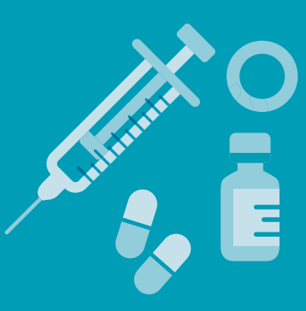
Step 1: HIV Testing – Follow-up Visits
Testing at follow-up visits for refills, new supplies, or reinjection varies by method:
Oral PrEP: at Month 1 then quarterly thereafter
CAB PrEP: at Month 1 then every 8 weeks thereafter (timed with regular follow-up injections); quarterly for one year after discontinuing/final CAB PrEP injections
PrEP ring: at least quarterly, per national guidelines

Slide 11
Following Step 1 with Steps 2 & 3
RULING OUT HIV INFECTION
STEP
HIV Testing
STEP
HIV Recent Exposure Assessment: PEP Screen
STEP
Acute HIV Infection (AHI) Assessment – Signs, Symptoms and Risks
Why is HIV testing alone insufficient to rule-out HIV infection?
A small number of CATALYST participants may receive false-negative 3rd Gen RDT result if they are newly infected with HIV and have not yet seroconverted ("window period")
Steps 2 & 3 will help to identify participants who may have been recently HIV infected and in the window period through further clinical and behavioral screening

Slide 12
2
Step 2: ASSESSING FOR PEP INDICATION (LIKELIHOOD OF RECENT EXPOSURE) - IN CASE PEP NEEDED instead of preP

Slide 13
Working definitions of adherence (relevant to Steps 2 & 3)
PrEP Method | Adherent | Non-adherent
CAB PrEP* | Prior injection was initiation injection 1 and < 2 months ago Prior injection was initiation injection 2 or follow-up and < 3 months ago | Prior injection was initiation injection 1 and > 2 months ago Prior injection was initiation injection 2 or follow-up and > 3 months ago
Oral PrEP | < 3 doses missed each week in week before and week after each day of sex | 4+ doses missed each week in week before and week after each day of sex
PrEP Ring | Ring in place continuously day before and day of sex for each day of vaginal sex | Ring not continuously in place the day before and the day of vaginal sex Any reported anal sex without a condom should be considered PrEP ring non-adherent
PEP | At time of assessment, client reports completion of the 28-day PEP regimen | At time of assessment, client reports inconsistent or incomplete use of 28-day PEP regimen
* Adherence depends on whether the prior injection was the initiation or follow-up injection and the duration since prior injection
As part of recent exposure/PEP and AHI assessments, clinicians need to determine method-specific adherence based on participant self-report.

Slide 14
Assessing for PEP—2 Components
All participants—regardless of method—should be assessed for HIV exposure during the past 72 hours, in case PEP is indicated instead of PrEP
PEP determination is a clinical judgment call based upon likelihood of exposure and elapsed time since exposure event
Likelihood of Exposure
Higher likelihood = more indicative of need for PEP
Timing
Shorter time since exposure = greater effectiveness of PEP

Slide 15
Likelihood of Exposure
LOWER ← LIKELIHOOD OF EXPOSURE → HIGHER
Condomless anal sex with HIV-positive non-consensual or casual partners not on ART
Vaginal sex with HIV-negative, regular consensual partner and consistent correct condom use
Combination of factors to be weighed – each with associated likelihood of exposure:
HIV status and viral suppression of partner(s)
Highest: unsuppressed HIV-positive partner(s)
Lowest/no possibility of exposure: HIV-negative partner(s)
Middle: partner(s) of unknown HIV status/unknown viral suppression level
Type of sex
Anal sex (higher); vaginal sex (lower)
Condom use
Highest: no condom use
Lowest: correct use throughout all sex acts
Middle: some condom use
Partner type and number
Multiple casual or non-consensual, including by needle stick (higher); single regular consensual (lower)
*example*

Slide 16
PEP Assessment: Time Since Possible Exposure
>72 Hours:
Not considered
effective
Clinicians to determine elapsed time since possible exposure
PEP most effective when started immediately
Ideally started within 0-24 hours of potential exposure; the earlier the better!
Should be started if < 72 hours since exposure
Not considered effective if >72 hours elapsed since exposure
24-72 Hours:
May still be effective
Within 24 Hours:
Most effective if started immediately

Slide 17
Intersecting likelihood of exposure and time since exposure: Is PEP indicated?
Use clinical judgement to carefully weigh pros and cons of starting PEP before PrEP
Excellent PEP Indication:
High likelihood of benefit (prescription recommended)
Moderate PEP Indication:
possibly beneficial
Moderate PEP Indication:
possibly beneficial
Low(er) ← Likelihood of exposure → High(er)
Poor PEP Indication:
Low likelihood of benefit
Use clinical judgement to carefully weigh pros and cons of starting PEP before PrEP
0 Hours ← Elapsed time since exposure → 72 Hours

Slide 18
Step 2: Initial Visit—all methods
PEP use can be an indicator of clients who may benefit from PrEP
Assess for PEP regardless of PrEP method being considered.
If high PEP indication:
CAB PrEP: Do not initiate CAB PrEP. Request expedited RNA PCR on sample collected same day as RDT (prior to PEP) through CATALYST. Do not wait for RNA PCR result to start PEP.
If RNA detectable, refer to HIV care and treatment for HIV confirmation
If RNA undetectable, complete 28-day PEP course
Oral PrEP: Do not start oral PrEP
PrEP ring: Do not start PrEP ring
Schedule follow-up in 28 days/after PEP
Re-test with 3rd Gen RDT
If HIV-negative and adherent to 28-day PEP course, transition to desired PrEP method (if otherwise clinically eligible)
CAB PrEP: Request expedited RNA PCR per CATALYST study requirements
If HIV-negative but not adherent to 28-day PEP course, re-screen for PEP indication and assess for AHI

Slide 19
Step 2: Follow-up Visits—all methods
Assess for PEP regardless of PrEP method being used.
If adherent to PrEP method:
CAB PrEP: continue method (don’t switch to PEP, but document timing and exposure details)
Oral PrEP: continue method (don’t switch to PEP, but document timing and exposure details)
PrEP ring: offer client choice to stop PrEP ring and switch to PEP, if particularly high indication for PEP. If client chooses to continue with the PrEP ring, document recent exposure. Continue PrEP ring if lesser PEP indication.
If non-adherent to PrEP, and PEP is indicated, take a similar approach as for new clients:
CAB PrEP: Stop CAB PrEP. Request expedited RNA PCR on sample collected same day as RDT (prior to PEP) through CATALYST. Offer PEP. Do not wait for RNA PCR result to start PEP.
If RNA detectable, refer to HIV care and treatment for HIV confirmation
If RNA undetectable, complete 28-day PEP course
Oral PrEP: Stop oral PrEP and offer PEP
PrEP ring: Stop PrEP ring and offer PEP
Schedule follow-up in 28 days/after PEP
Re-test with 3rd Gen RDT
If HIV-negative and adherent to 28-day PEP course, transition to desired PrEP method (if otherwise clinically eligible)
CAB PrEP: Request expedited RNA PCR per CATALYST study requirements
If HIV-negative but not adherent to 28-day PEP course, re-screen for PEP indication and assess for AHI

Slide 20
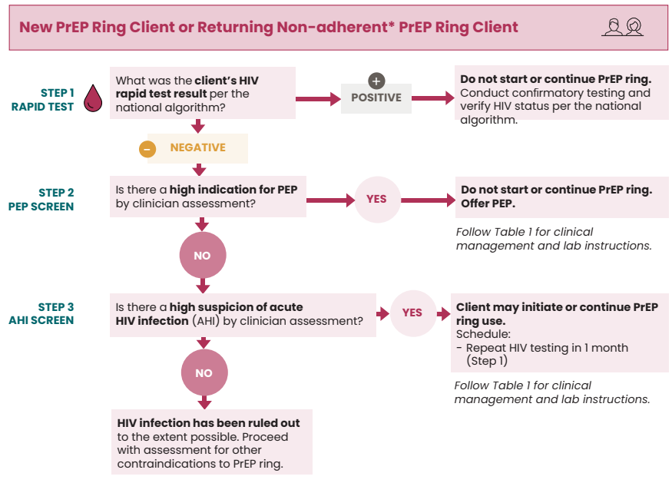
ALGORITHM: Ruling out HIV infection for new or returning non-adherent PrEP ring clients*
*Additional algorithm for returning adherent PrEP ring clients available

Slide 21
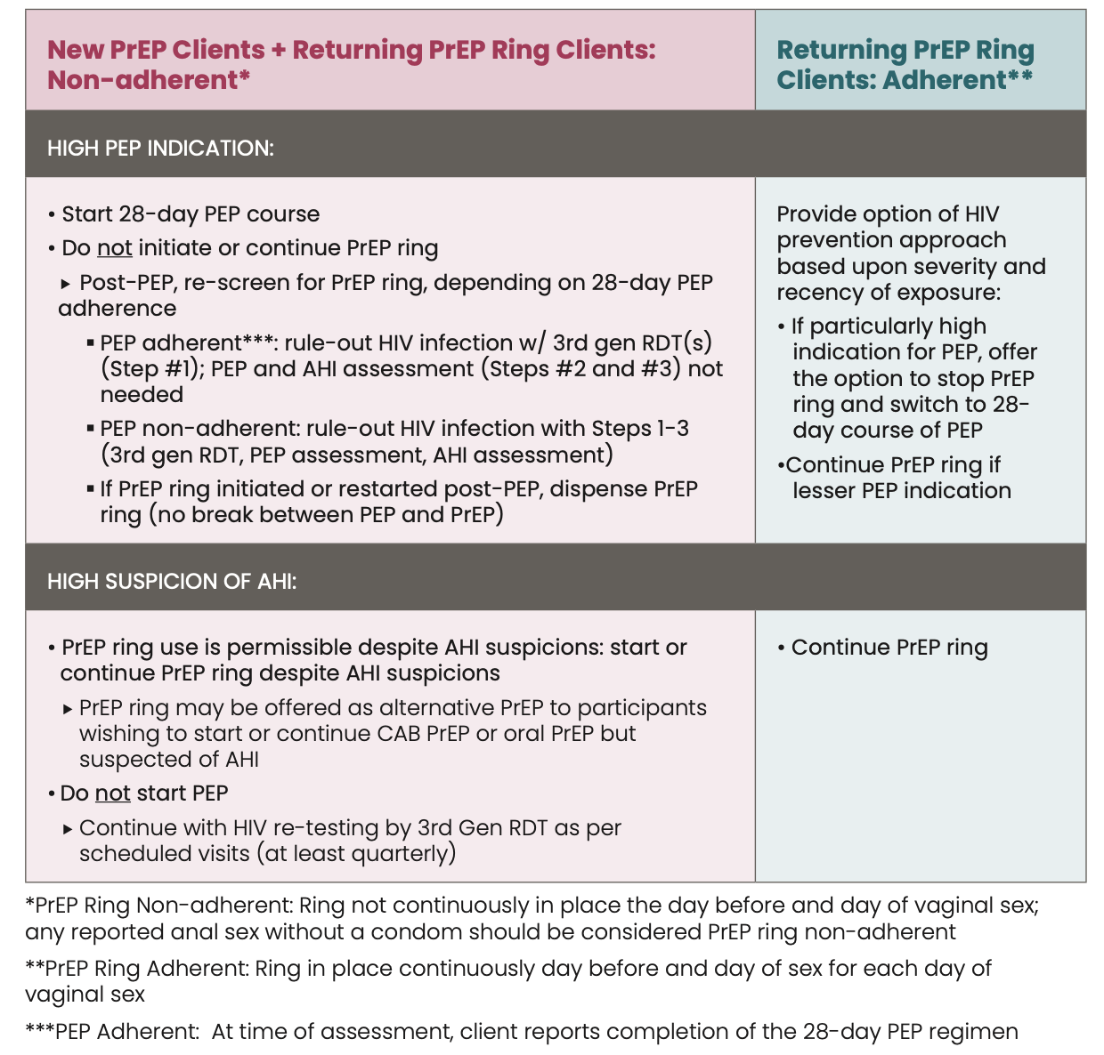
TABLE for Ruling Out HIV Infection for New or Returning PrEP Ring Clients
Use this table to determine whether to start/continue PrEP ring or start PEP instead in a client with a NEGATIVE 3rd generation rapid diagnostic test (RDT) AND clinically assessed as having PEP indication or suspected of acute HIV infection.
All notation of 3rd generation RDT is in accordance with RDTs specified in your national testing algorithm.

Slide 22
3
Step 3: acute HIV infection Assessment - SIGNS/symptoms and likelihood of exposure

Slide 23
Assessing Acute HIV Infection —2 Components
Signs/Symptoms
Greater number or severity = higher suspicion of AHI
Participants not in need of PEP should next be assessed for acute HIV infection (AHI), regardless of PrEP method, in case PrEP needs to be withheld or paused to reduce the possibility of drug resistance during seroconversion
Suspecting AHI is a clinical judgment call based upon signs/symptoms and possible HIV exposure in past 2 weeks
Likelihood of Exposure
Higher likelihood of exposure = higher suspicion of AHI

Slide 24
Signs and symptoms
Viral syndrome with non-specific signs/symptoms, meaning not exclusive to HIV. Most will have a flu or cold, not HIV.
Suspicion of AHI may be higher if there are multiple signs/symptoms.
Should also include history of symptoms reported by participant in past 2 weeks, which may have resolved
Signs & Symptoms of AHI
Fever
Swollen lymph glands
Skin rash
Headache
Sore throat
Aches and pains
Mouth sores

Slide 25
Likelihood of Exposure
LOWER ← LIKELIHOOD OF EXPOSURE → HIGHER
Condomless anal sex with HIV-positive non-consensual or casual partners not on ART
Vaginal sex with HIV-negative regular consensual partner and consistent correct condom use
Combination of factors to be weighed – each with associated likelihood of exposure:
HIV status and viral suppression of partner(s)
Highest: unsuppressed HIV-positive partner(s)
Lowest/no possibility of exposure: HIV-negative partner(s)
Middle: partner(s) of unknown HIV status/unknown viral suppression level
Type of sex
Anal sex (higher); vaginal sex (lower)
Condom use
Highest: no condom use
Lowest: correct use throughout all sex acts
Middle: some condom use
Partner type and number
Multiple casual or non-consensual, including by needle stick (higher); single regular consensual (lower)
*example*

Slide 26
Intersecting signs/symptoms & likelihood of exposure: Is there a clinical suspicion of AHI?
Use clinical judgement to carefully weigh pros and cons of withholding/pausing PrEP pending re-testing
Medium suspicion
High suspicion
(holding/pausing PrEP may be appropriate)
Low suspicion
Use clinical judgement to carefully weigh pros and cons of withholding/ pausing PrEP pending
re-testing
Low(er) ← Likelihood of exposure → High(er)
Medium suspicion
Single/lower ← Signs/Symptoms & Severity → Multiple/higher

Slide 27
Step 3: Initial Visit—all methods
Assess for AHI regardless of PrEP method.
If high AHI suspicion:
Oral PrEP: Do not start oral PrEP. Schedule return HIV re-testing withhold by 3rd Gen RDT in 1 month; offer use of PrEP ring pending HIV re-testing. If re-test result is negative, re-assess for PEP and AHI before initiating.
PrEP ring: Client may initiate PrEP ring use. Repeat HIV testing in 1 month; document signs and/or symptoms of AHI and possible exposures within 14 days of sign/symptom onset
CAB PrEP: Do not start CAB PrEP. Request expedited RNA PCR (blood sample collected today). Offer use of PrEP ring pending RNA PCR result
Schedule follow-up when RNA PCR result available
If RNA detectable, refer HIV confirmation, care and treatment
If RNA undetectable, client may be re-screened for CAB PrEP by ruling-out HIV infection with 3rd gen RDT(s) (Step #1), PEP assessment (Step #2), AHI assessment (Step #3) in case they’ve had a new possible exposure since the earlier screening date

Slide 28
Step 3: Follow-up Visits—all methods
Assess for AHI regardless of method.
If adherent to PrEP method, continue the method (don’t pause but document AHI signs/symptoms/risk).
If non-adherent to PrEP method and AHI suspected, take a similar approach as for new clients:
Oral PrEP: Do not start oral PrEP. Schedule return HIV re-testing withhold by 3rd Gen RDT in 1 month; offer use of PrEP ring pending HIV re-testing. If re-test result is negative, re-assess for PEP and AHI before initiating.
PrEP ring: Client may initiate PrEP ring use. Repeat HIV testing in 1 month; document signs and/or symptoms of AHI and possible exposures within 14 days of sign/symptom onset
CAB PrEP: Do not start CAB PrEP. Request expedited RNA PCR (blood sample collected today). Offer use of PrEP ring pending RNA PCR result
Schedule follow-up when RNA PCR result available
If RNA detectable, refer HIV confirmation, care and treatment
If RNA undetectable, client may be re-screened for CAB PrEP by ruling-out HIV infection with 3rd gen RDT(s) (Step #1), PEP assessment (Step #2), AHI assessment (Step #3) in case they’ve had a new possible exposure since the earlier screening date

Slide 29
Step 3: Resuming vs. Restarting CAB PrEP After Pause
If prior injection before pause was… | …and time elapsed since then has been… | … then injection today is… | …with next injection scheduled in:
Initiation Injection #1 | > 2 months | RESTART CAB PrEP | 1 month
Initiation Injection #1 | < 2 months | RESUME CAB PrEP | 2 months
Injection #2+ | > 3 months | RESTART CAB PrEP | 1 month
Injection #2+ | < 3 months | RESUME CAB PrEP | 2 months

Slide 30
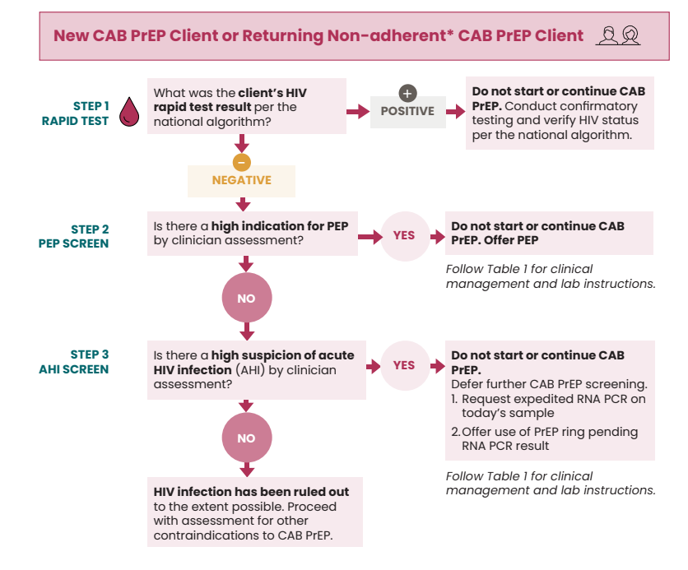
ALGORITHM: Ruling out HIV infection for new or returning non-adherent CAB PrEP clients*
*Additional algorithm for returning adherent CAB PrEP clients available

Slide 31
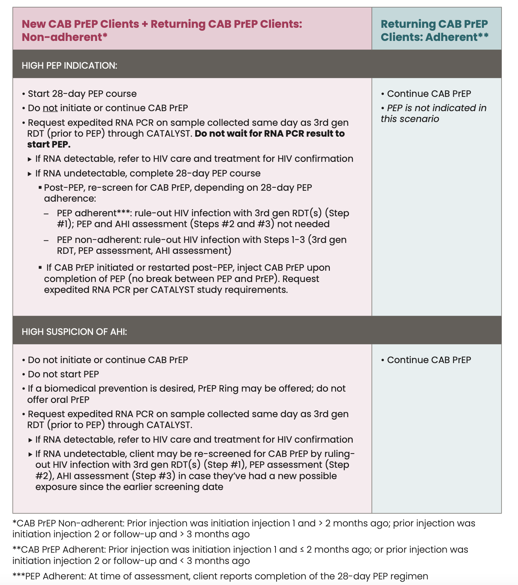
SAMPLE TABLE for Ruling Out HIV Infection for New or Returning CAB PrEP Clients
Use this table to determine whether to start/continue CAB PrEP, start PEP instead, or defer start of/pause CAB PrEP in a client with a NEGATIVE 3rd generation rapid diagnostic test (RDT) AND clinically assessed as having PEP indication or suspected of acute HIV infection.
All notation of 3rd generation RDT is in accordance with RDTs specified in your national testing algorithm.

Slide 32
Once criteria met for steps 1-3, HIV infection has been ruled out to the extent possible.

Slide 33
Jason Reed, Jhpiego
Urvi Parikh, University of Pittsburgh
Njambi Njuguna, Kristine Torjesen, Morgan Garcia, Katie Williams, and Katie Schwartz; FHI 360

