Slide 1






Situation Analysis for the Introduction of the PrEP Ring
PLAN 4 RING TOOLKIT
Overview and Instructions

Slide 3
Overview
Purpose of this tool
The monthly dapivirine vaginal ring (“PrEP ring” or “the ring”) is a new HIV prevention method for women. It can be integrated with much of the existing infrastructure, systems, and policies established for the introduction and scale-up of oral pre-exposure prophylaxis (PrEP) but also requires distinct consideration as a new method and a new product form.
This tool can be used by policymakers or others supporting policy development for the PrEP ring (e.g., nongovernmental organization [NGOs], donors) to conduct an analysis to assess the existing situation for the introduction of the ring.
This analysis will help identify opportunities or gaps that should inform planning for introduction and scale-up of the ring.
The analysis will be informed by secondary research and feedback from interviews with key stakeholders. These inputs will be analyzed using a structured, comprehensive framework developed based on the experiences of “early adopter” countries.

Slide 4
Situation Analysis
Overview of contents
This tool facilitates a structured process in three steps to support initial planning for ring introduction.
Data Collection
Stakeholder
Interviews
Analysis &
Synthesis
1
2
3
Step 1: Data Collection
Research the context of HIV prevention and oral PrEP rollout and map key stakeholders to identify interview targets.
Slides 4–12
Step 2: Stakeholder Interviews
Conduct interviews with a diverse set of stakeholders to inform an assessment of what is needed for ring introduction along the PrEP Ring Introduction Framework.
Slides 13–16
Step 3: Analysis & Synthesis
Synthesize interview findings to complete the situation analysis and establish a common understanding of what is needed to effectively introduce the PrEP ring.
Slides 17–30

Slide 5
Step 1
Data Collection

Slide 6
Step 1: HIV in [Country]
Step 1A: HIV prevention context
GOAL: Understand the HIV prevention context in the country relevant to the introduction of the PrEP ring.
INSTRUCTIONS
Collect data and summarize the current situation for HIV prevention using the templates on the following slides. Key topics include:
Indicators for HIV prevalence, incidence, and new infections for adults by age, gender, and population group (e.g., from PHIA surveys, UNAIDS estimates)
Indicators for HIV prevalence, incidence, and new infections for subnational regions (e.g., from PHIA surveys, UNAIDS estimates)
An overview of existing HIV prevention policies, systems, and delivery
Completed situation analyses from other countries can be found on PrEPWatch.

Slide 7
HIV in [Country]
High-level summary of HIV in country and general trends for new infections by population groups in recent years
KEY STATISTICS¹
HIV prevalence in adults (aged 15–49) and young people (aged 15–24)
National prevalence for adults, adolescents, and key populations
Data on the current state of and recent trends in prevalence
HIV incidence in adults (aged 15–49) and young people (aged 15–24)
National incidence for adults, adolescents, and key populations
Data on the current state of and recent trends in incidence
2
These data are commonly found on WHO/UNAIDS databases. If these data do not exist for the country of focus, you can flag here which data do not exist and advocate for greater data collection.
Note: WHO/UNAIDS categorizes adults as ages 15-49; other data sources may report adolescent and adult groups separately.
You can edit this graph and update the data with statistics for your situation analysis by clicking the chart, entering the Chart Design tab, and using “Edit Data in Excel” function.
Sources: (1) Source; (2) Source

Slide 8
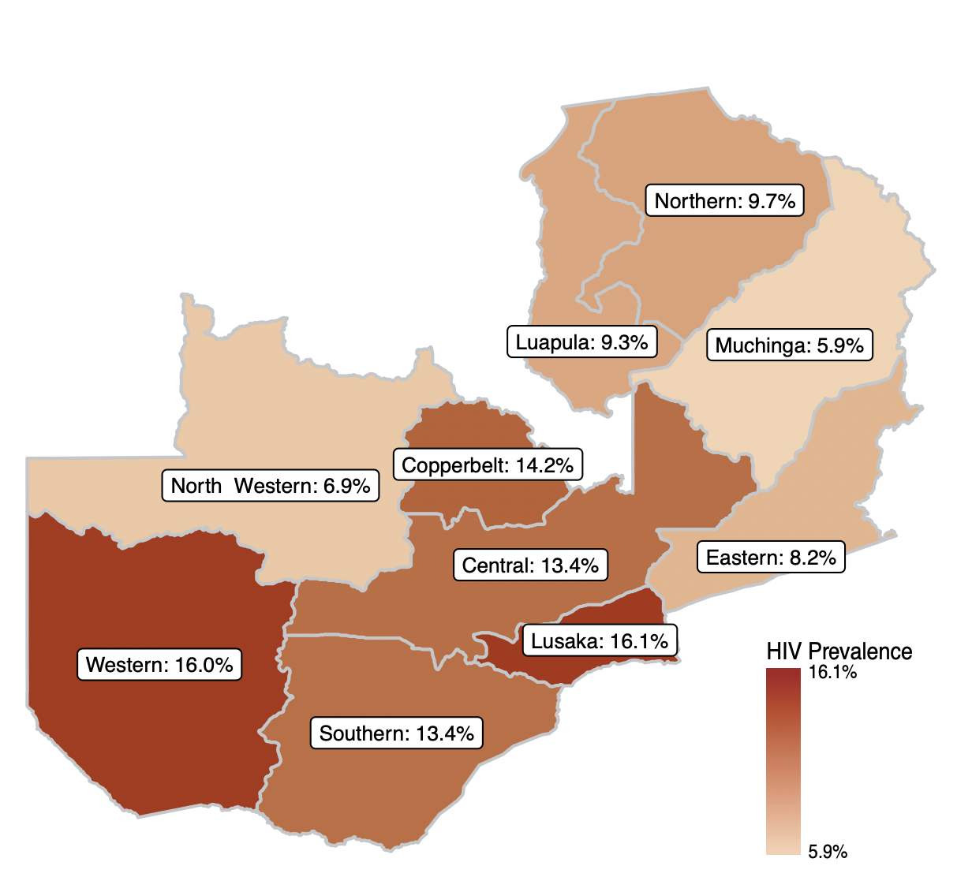
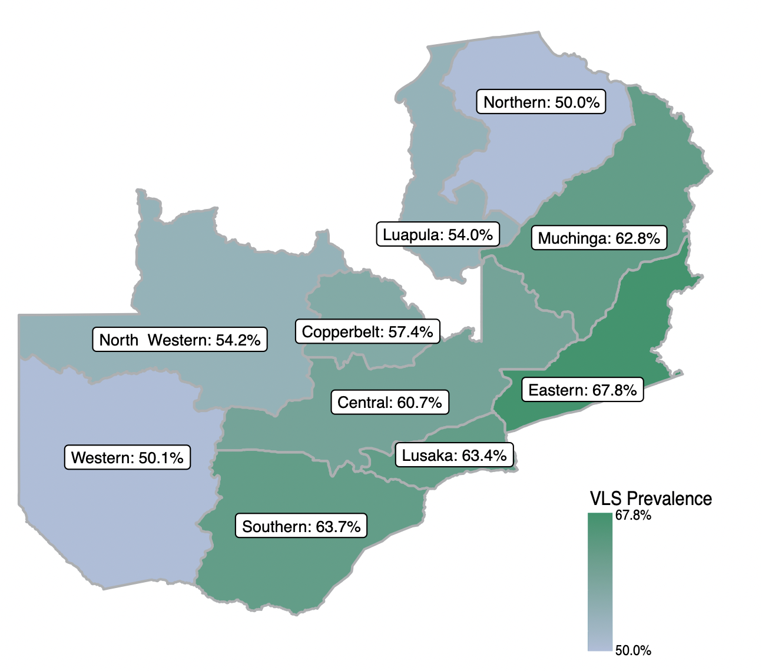
HIV in [Country]
HIV PREVALENCE BY GEOGRAPHY¹
Statistics on variations in HIV prevalence across subnational regions
HIV INCIDENCE BY GEOGRAPHY²
Statistics on variations in HIV incidence across subnational regions
EXAMPLE
EXAMPLE
Sources: (1) Source; (2) Source

Slide 9
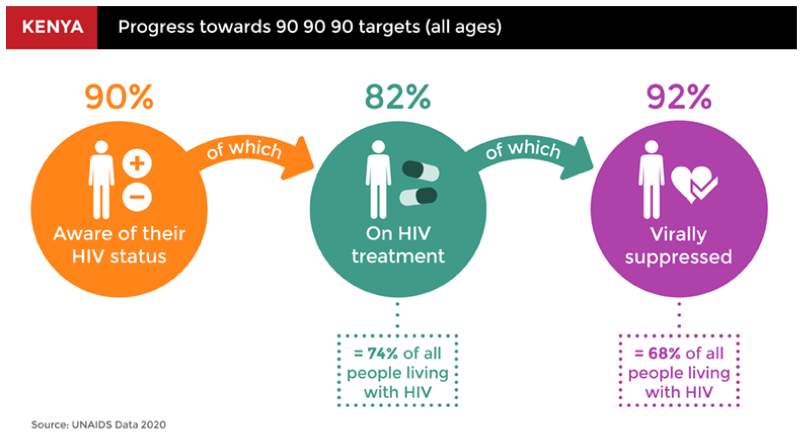
HIV in [Country]
National HIV Prevention Response
xxxxx
xxxxx
xxxxx
KEY STATISTICS (2021)¹
Statistics on 90:90:90 goals (or, if applicable, 95:95:95)
XX% of people living with HIV who know their HIV status
XX% of people living with HIV who know their status, are positive, and are on treatment
XX% of people on treatment who are virally suppressed
Summarize the national response to HIV in a few bullets. Information on this slide may include (but is not limited to) key stakeholders in HIV prevention, HIV policy frameworks, priority population groups, and history of national HIV prevention campaigns.
Sources: (1) Source

Slide 10
End-user Populations for the Ring
 | Adolescent girls (e.g., 10–19 years) | Young women (e.g., 19–24 years) | Serodifferent couples | Female sex workers | People who inject drugs | Other
Key indicators
Priorization
Quesitons
For each population, include:
Size
Contribution to new infections
Prevalence
Current access to HIV testing and counseling or other relevant health services
Population types are illustrative. Please complete for population types that align with your HIV strategy.
For each population, include:
Inclusion/exclusion as priority population in country’s national HIV plan
Inclusion/exclusion of this population as priority for oral PrEP and the PrEP ring
Demonstration projects currently working with this population
For each population, include:
Key questions that will need to be answered to guide implementation

Slide 11
Step 1: HIV in [Country]
Step 1B: Oral PrEP rollout
GOAL
Understand the current situation for oral PrEP rollout in country.
INSTRUCTIONS
Before conducting interviews, collect data and use secondary research methods to understand the situation for oral PrEP rollout.
For example, you can collect data on the oral PrEP rollout, build a timeline of rollout milestones, and/or pull together the key lessons learned through oral PrEP rollout that may influence how the PrEP ring should be introduced.
When information is limited, conducting interviews with key national stakeholders and implementing partners for oral PrEP programming will be a necessary starting point to understanding the situation for oral PrEP rollout.

Slide 12
Oral PrEP Rollout in [Country]
High-level summary or timeline of oral PrEP rollout
KEY MILESTONES FOR ORAL PREP INTRODUCTION¹
xxxxx
xxxxx
xxxxx
Number of PrEP users, 2017–2021
You can edit this graph and update the data with statistics for your situation analysis by clicking the chart, entering the Chart Design tab, and using the “Edit Data in Excel” function.
Summarize key milestones for oral PrEP rollout specific to your country of focus. Elements to include are key dates of regulatory approval, when a national PrEP task force may have been formed, when and where pilot studies may have taken place, as well as progress toward integration into national guidelines, national rollout or scale-up of PrEP, etc.
Sources: (1) Source

Slide 13
Oral PrEP Rollout — Lessons Learned
High-level summary of key lessons learned from stakeholders involved in oral PrEP rollout
What worked well
xxxxx
xxxxx
xxxxx
What was challenging
xxxxx
xxxxx
xxxxx

Slide 14
Selected Desk Review Sources
Sources
Track the secondary resources and documents you use for your research using your preferred citation style.

Slide 15
Step 2
Stakeholder Interviews

Slide 16
Step 2
Stakeholder interviews
GOAL: Gather input from key stakeholders to inform an assessment of the current situation for PrEP ring rollout in your country along a structured framework.
INSTRUCTIONS
Based on your research in Step 1:
Build a stakeholder map (see slide 17) to identify organizations and individuals who can provide informed perspectives on the past rollout of oral PrEP and potential future rollout of the PrEP ring on topics along the PrEP Ring Introduction Framework (see slides 22 and 23).
Customize interview guides for your interviews based on the Question Bank included in this tool; note it may be necessary to adapt questions to your context (see slide 19).
Conduct interviews and take notes as the primary method of collecting the data you will analyze in Step 3.

Slide 17





Stakeholder Map for the Ring
 | Currently involved
 | Potential/future involvement
Map stakeholders across the PrEP Ring Introduction Framework to plan for interviews that will inform the situation analysis.
Type | Organization(s) | Role in PrEP ring Introduction | Planning & budgeting | Supply chain mgmt | Ring delivery platforms | Uptake & effective use | Monitoring
Governmental organizations | Organization 1
 | Organization 2
 | Organization 3
Development and implementing partners
Civil society organizations and community-based organizations
Private sector and/or community-based providers
Bilateral organizations and funders
GOAL: Identify the organizations that are currently involved or should be involved in PrEP ring introduction along the PrEP Ring Introduction Framework. This will help you plan stakeholder interviews to build the situation analysis.
DIRECTIONS: Specify the name and describe the current or expected role of each stakeholder. You can categorize stakeholders by type, Framework component, and involvement status.

Slide 18
Interview Outreach List
DIRECTIONS: Track outreach for interviewees and plan which areas to ask questions about across the PrEP Ring Introduction Framework. Interviews may need to be planned in waves to identify remaining questions or missing information.
Organization | Interviewee(s) | Areas to probe across the PrEP Ring Introduction Framework | Status | Interview date
Organization 1 | Name | Planning & budgeting, supply chain management, monitoring | Outreach sent | Pending
Organization 2 | Name | Planning & budgeting, delivery platforms, uptake & effective use | Scheduling | Feb 2, 2022
Organization 3 | Name | Delivery platforms, uptake & effective use | Completed | Jan 5, 2022

Slide 19
Interview Questions
ADDITIONAL RESOURCE
INSTRUCTIONS
Download the Interview Questions Bank, which includes a list of questions that can be used in stakeholder interviews. These questions are aligned to the PrEP Ring Introduction Framework (see below) so that inputs from the interviews can be easily translated to the analysis templates (see slides 29–33).
Adapt the questions as needed so that they are tailored to your context.
Consider which questions are relevant for each stakeholder interview based on “areas to probe” on slide 18.
PrEP Ring Introduction Framework
See slides 22–23 for greater detail
Section in Interview Questions Bank
P1–P6
S1–S4
D1–D5
U1–U5
M1–M3
Corresponding slide for Step 3 data analysis
Slide 29
Slide 30
Slide 31
Slide 32
Slide 33

Slide 20
Step 3
Analysis & Synthesis

Slide 21
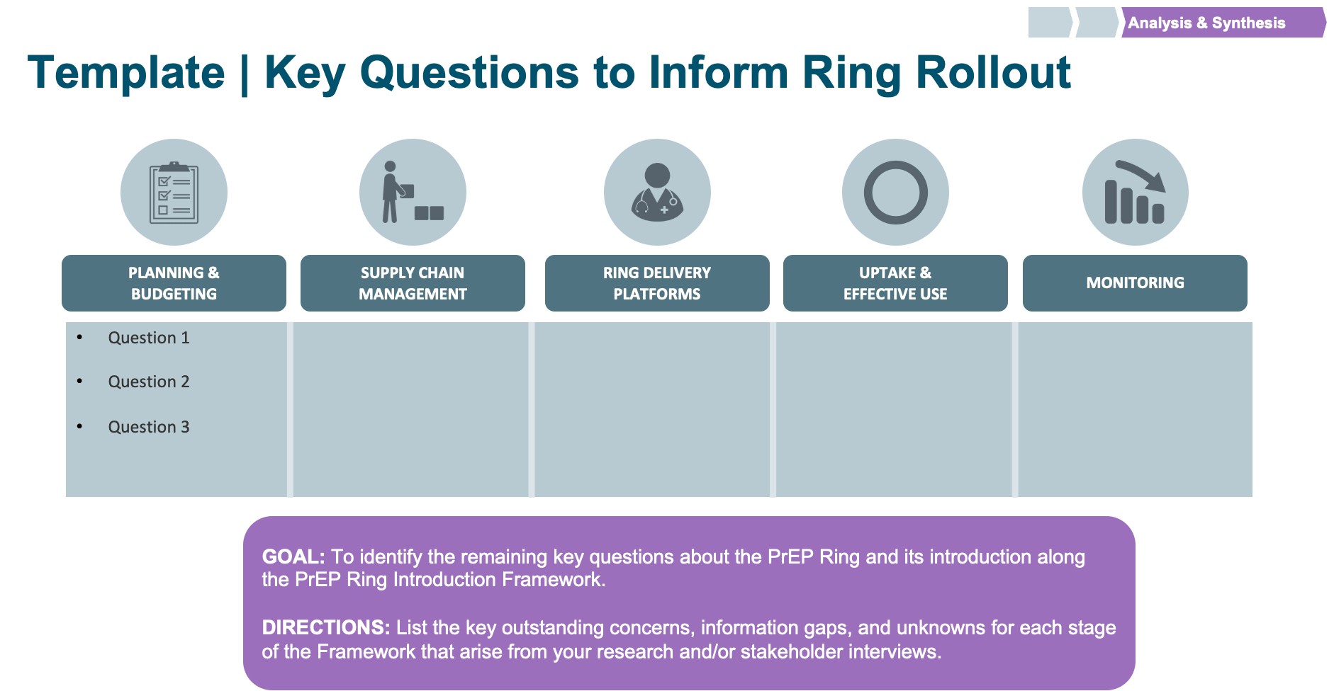
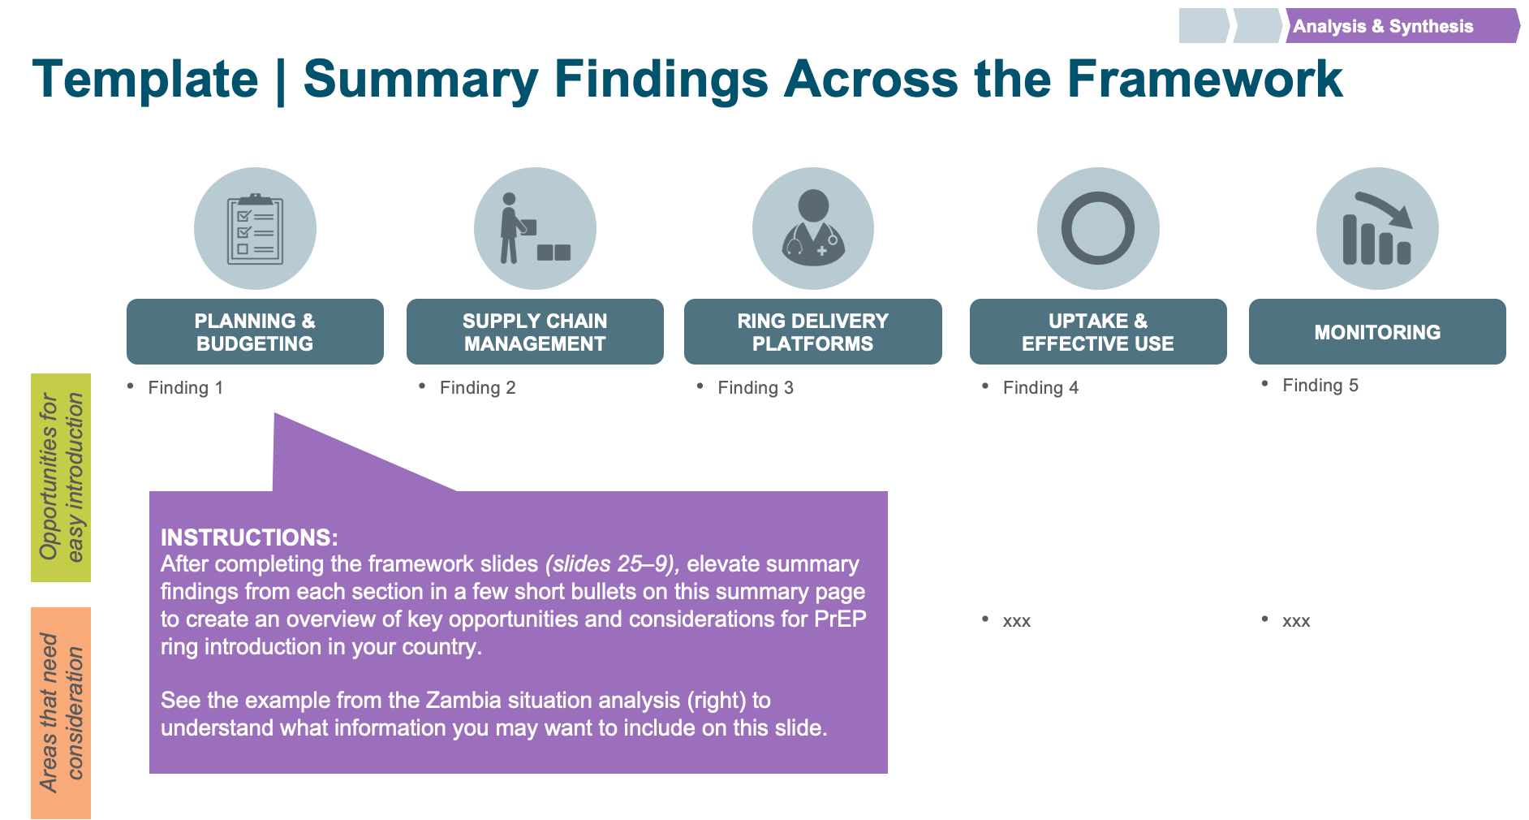
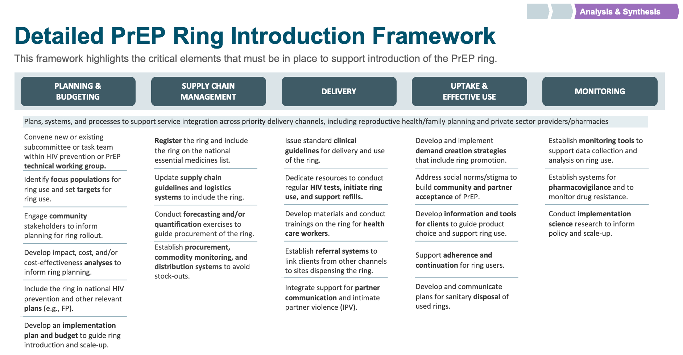
Step 3
Analysis & synthesis
GOAL: Synthesize interview inputs to assess the current situation for PrEP ring rollout in your country.
INSTRUCTIONS
Review the data you collected during the interviews to pull out the key findings for each element of the PrEP Ring Introduction Framework.
The following slides include templates for data analysis and synthesis across the Framework. Follow the directions on each slide and track where you may need to plan additional interviews to collect any missing information.

Slide 22





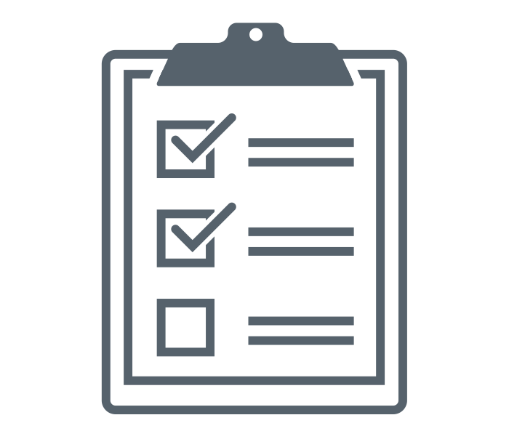
PrEP Ring Introduction Framework
This analysis is organized along the PrEP Ring Introduction Framework, which was developed based on experiences with the introduction of oral PrEP and has been adapted for the PrEP ring. It identifies necessary steps for ring introduction and scale-up across five major categories. It can also be used to track progress toward ring introduction by different partners.
National and subnational plans are established to implement ring guidelines for priority end-user populations. | The ring is available and distributed in sufficient quantity to meet projected demand via priority delivery channels. | The ring is delivered by trained health care workers in priority delivery channels to effectively reach end users. | End users know about and understand the ring and are able to seek, initiate, and effectively use it. | The ring is effectively integrated into national, subnational, facility, community, and program- level monitoring systems.
PLANNING &
BUDGETING
SUPPLY CHAIN MANAGEMENT
PrEP RING DELIVERY PLATFORMS
UPTAKE &
EFFECTIVE USE
MONITORING

Slide 23
Detailed PrEP Ring Introduction Framework
This framework highlights the critical elements that must be in place to support introduction of the PrEP ring.
PLANNING &
BUDGETING
SUPPLY CHAIN MANAGEMENT
PrEP RING DELIVERY PLATFORMS
UPTAKE &
EFFECTIVE USE
MONITORING
Plans, systems, and processes to support service integration across priority delivery channels, including reproductive health/family planning and private sector providers/pharmacies
Convene new or existing subcommittee or task team within HIV prevention or PrEP technical working group.
Identify focus populations for ring use and set targets for ring use.
Engage community stakeholders to inform planning for ring rollout.
Develop impact, cost, and/or cost-effectiveness analyses to inform ring planning.
Include the ring in national HIV prevention and other relevant plans (e.g., FP).
Develop an implementation plan and budget to guide ring introduction and scale-up.
Register the ring and include the ring on the national essential medicines list.
Update supply chain guidelines and logistics systems to include the ring.
Conduct forecasting and/or quantification exercises to guide procurement of the ring.
Establish procurement, commodity monitoring, and distribution systems to avoid stock-outs.
Issue standard clinical guidelines for delivery and use of the ring.
Dedicate resources to conduct regular HIV tests, initiate ring use, and support refills.
Develop materials and conduct trainings on the ring for health care workers.
Establish referral systems to link clients from other channels to sites dispensing the ring.
Integrate support for partner communication and intimate partner violence (IPV).
Develop and implement demand creation strategies that include ring promotion.
Address social norms/stigma to build community and partner acceptance of PrEP.
Develop information and tools for clients to guide product choice and support ring use.
Support effective use and continuation for ring users.
Develop and communicate plans for sanitary disposal of used rings.
Establish monitoring tools to support data collection and analysis on ring use.
Establish systems for pharmacovigilance and to monitor drug resistance.
Conduct implementation science research to inform policy and programs.

Slide 24
How to Use the Framework
For each element of the PrEP Ring Introduction Framework, you can assess ring introduction progress using the following categories:
Opportunity to easily build on oral PrEP rollout
Stakeholders anticipate relatively easy integration of the ring into existing systems and processes that were initially established for oral PrEP (e.g., existing task forces, provider training, and demand creation campaigns).
Will require new effort, but no anticipated challenges
Stakeholders recognize efforts to introduce the ring will be distinct and different from what was needed to introduce oral PrEP but do not anticipate any significant challenges.
Requires significant consideration specifically for the PrEP ring
Stakeholders expect introduction of the ring will require establishing new systems and/or overcoming significant challenges that are distinct from those encountered with the introduction of oral PrEP or are ongoing challenges with the scale-up of oral PrEP.
These categories were defined based on interviews and research on efforts to introduce oral PrEP and early work to introduce the PrEP ring.

Slide 25
How to Complete the Following Slides
For each section of the Framework, input the data you collected during the stakeholder interviews into the templates on the following slides.
These readiness factors correspond to each section of the Framework.
The components can be assessed according to the color key below. Ratings are meant to indicate relative progress. See slide 24 to guide your assessment.
This space provides room for a brief description of the current state of each component. Key points are included in the following slides to guide data synthesis. Also include key obstacles and/or considerations relevant to the readiness factors.
COLOR KEY
Opportunity
to easily
build on oral
PrEP rollout
Will require new effort, but no anticipated challenges
Requires significant consideration specifically for
the PrEP ring

Slide 26
Detailed PrEP Ring Introduction Framework
This framework can be used to provide a snapshot of the current situation for ring introduction.
PLANNING &
BUDGETING
SUPPLY CHAIN MANAGEMENT
PrEP RING DELIVERY PLATFORMS
UPTAKE &
EFFECTIVE USE
MONITORING
 | Plans, systems, and processes to support service integration across priority delivery channels, including reproductive health/family planning and private sector providers/pharmacies
 | Convene new or existing subcommittee or task team within HIV prevention or PrEP technical working group.
 | Identify focus populations for ring use and set targets for ring use.
 | Engage community stakeholders to inform planning for ring rollout.
 | Develop impact, cost, and/or cost-effectiveness analyses to inform ring planning.
 | Include the ring in national HIV prevention and other relevant plans (e.g., FP).
 | Develop implementation plan and budget to guide ring introduction and scale-up.
 | Register the ring and include the ring on the national essential medicines list.
 | Update supply chain guidelines and logistics systems to include the ring.
 | Conduct forecasting and/or quantification exercises to guide procurement of the ring.
 | Establish procurement, commodity monitoring, and distribution systems to avoid stock-outs.
 | Issue standard clinical guidelines for delivery and use of the ring.
 | Dedicate resources to conduct regular HIV tests, initiate ring use, and support refills.
 | Develop materials and conduct trainings for health care workers on the ring.
 | Establish referral systems to link clients from other channels to sites dispensing the ring.
 | Integrate support for partner communication and intimate partner violence (IPV).
 | Develop and implement demand creation strategies that include ring promotion.
 | Address social norms/stigma to build community and partner acceptance of PrEP.
 | Develop information and tools for clients to guide product choice and support ring use.
 | Support effective use and continuation for ring users.
 | Develop and communicate plans for sanitary disposal of used rings.
 | Establish monitoring tools to support data collection and analysis on ring use.
 | Establish systems for pharmacovigilance and to monitor drug resistance.
 | Conduct implementation science research to inform policy and programs.
INSTRUCTIONS:
Use the color key to update the progress bars based on the assessment made for your country in the PrEP Ring Introduction Framework slides 25-29.
COLOR KEY
Opportunity
to easily
build on oral
PrEP rollout
Will require new effort, but no anticipated challenges
Requires significant consideration specifically for
the PrEP ring

Slide 27
Summary Findings Across the Framework
PLANNING &
BUDGETING
SUPPLY CHAIN MANAGEMENT
PrEP RING DELIVERY PLATFORMS
UPTAKE &
EFFECTIVE USE
MONITORING
Finding 1 | Finding 2 | Finding 3 | Finding 4 | Finding 5
Opportunities for easy introduction
INSTRUCTIONS:
After completing the framework slides (slides 29–33), elevate summary findings from each section in a few short bullets on this summary page to create an overview of key opportunities and considerations for PrEP ring introduction in your country.
Areas that need consideration

Slide 28
Potential Delivery Channels for the Ring
The ring could be made available across a diverse range of channels, including the channels listed below. As you complete the following slides, consider what would be needed to introduce the ring across these diverse channels. To do a deeper dive on delivery channels for the ring, see the PrEP Ring Service Delivery Channel Analysis tool.
Women’s health delivery channels
Description
Public sector HIV services
Departments in public sector facilities offering HIV testing, oral pre-exposure prophylaxis (PrEP), and antiretroviral therapy (ART) services managed by national and subnational ministries of health (MoHs)
Public sector
Public sector FP services
Departments in public sector facilities offering family planning (FP) and other reproductive health services
Maternal & child health services (MCH)
Departments in public sector facilities offering antenatal care (ANC) services for pregnant women, postnatal care (PNC), immunizations, and other services, including prevention of perinatal HIV transmission (PMTCT)
Work/school-based services
Programs that offer HIV counseling and testing services (HTS) and/or antiretroviral therapy (ART) at selected worksites (e.g., at mining operations) or tertiary education institutions
Private for profit
Commercial health care
Private doctors, clinics, or hospitals that provide health services to individuals who pay out-of-pocket or use health insurance
Drug shops and pharmacies
Includes large pharmacy networks and smaller community-based pharmacies and drug shops; some are managed by trained health care workers (HCWs)
NGO clinics/social franchises
Private not-for-profit facilities, including clinics managed by nongovernmental organizations (NGOs) and social franchises offering sexual and reproductive health (SRH) services at subsidized rates*
Private not for profit
Private facilities affiliated with religious institutions, including church networks and mission hospitals that provide subsidized/free services
Faith-based organizations
NGO programs for AGYW
Donor-funded, NGO-led programs that provide HIV and other services to adolescent girls and young women (AGYW), including DREAMS and other programs (e.g., AGYW safe spaces)
* Major networks are often managed by global NGOs or local affiliates

Slide 29
Planning & Budgeting
PLANNING &
BUDGETING
Key steps and considerations
 |  | What is needed to introduce the PrEP ring & other key considerations
 | Convene a new or existing subcommittee or task team within the HIV prevention or PrEP technical working group. | Refer to P1a & P1b in the Question Bank and include details on: Plans for a task force or TWG to lead PrEP ring introduction Timelines and/or milestones for key decisions Plan for participation of stakeholders from other relevant areas (e.g., FP, MCH)
 | Identify focus populations for ring use and set targets for ring use. | Refer to P2a & P2b in the Question Bank and include details on: Plans for end-user populations for the ring (e.g., population groups, targets set, etc.)
 | Engage community stakeholders to inform planning for ring rollout. | Refer to P3a & P3b in the Question Bank and include details on: Key lessons on community engagement from oral PrEP rollout (e.g., effective ways to authentically engage community members and hear their perspectives) Plans for engaging community stakeholders on PrEP ring introduction
 | Develop impact, cost, and/or cost-effectiveness analyses to inform ring planning. | Refer to P4 in the Question Bank and include details on: Existing analyses for oral PrEP Plans for cost-effectiveness analyses for the ring rollout
 | Include the ring in national HIV prevention and other relevant plans (e.g., FP). | Refer to P5a & P5b in the Question Bank and include details on: Key HIV prevention strategies/plans that will need to incorporate the ring; how these strategies/plans currently incorporate oral PrEP Other strategies/plans that could include the PrEP ring (e.g., plans for SRH, adolescent health, or self-care)
 | Develop implementation plan and budget to guide initial ring introduction and scale-up. | Refer to P6a & P6b in the Question Bank and include details on: Plans/timelines for introduction and scale-up of the PrEP ring Integration of the PrEP ring in HIV prevention budgets and donor requests Sources of financial resources to support PrEP ring procurement and introduction activities
Text in light blue indicates key steps related to diverse delivery channels (e.g., non-HIV channels)

Slide 30
Supply Chain Management
SUPPLY CHAIN MANAGEMENT
Key steps and considerations
 |  | What is needed to introduce the PrEP ring & other key considerations
 | Register the ring and include the ring on the national essential medicines list. | Refer to S1a, S1b, & S1c in the Question Bank and include details on: Current situation/timeline for the regulatory approval of the ring Considerations for inclusion of the ring on national essential medicines lists and other key procurement and supply chain systems Considerations of how scheduling and/or classification of the ring upon approval may enable or inhibit delivery of the ring in nonclinical channels (e.g., pharmacies, community-based settings)
 | Update supply chain guidelines and logistics systems to include the ring. | Refer to S2 in the Question Bank and include details on: Existing systems, processes, and lessons learned from oral PrEP introduction Expected differences for the PrEP ring, as a new product form that has not previously been procured What is needed to include the PrEP ring in supply chain systems for other delivery channels (e.g., FP, MCH, private sector)
 | Conduct forecasting and/or quantification exercises to guide procurement of the ring. | Refer to S3 in the Question Bank and include details on: Plans for ring demand forecasting and quantification Key stakeholders engaged in demand forecasting and quantification Expected challenges and/or unknowns
 | Establish procurement, commodity monitoring, and distribution systems to avoid stock-outs. | Refer to S4 in the Question Bank and include details on: Plans for procurement, commodity monitoring, and distribution of the ring Relevant stakeholders involved Potential barriers and/or challenges to distributing the PrEP ring to non-HIV channels
Text in light blue indicates key steps related to diverse delivery channels (e.g., non-HIV channels)

Slide 31
PrEP Ring Delivery Platforms
PrEP RING DELIVERY PLATFORMS
Key steps and considerations
 |  | What is needed to introduce the PrEP ring & other key considerations
 | Issue standard clinical guidelines for delivery and use of the ring. | Refer to D1a and D1b in the Question Bank and include details on: Current state of and lessons learned from clinical guidelines for oral PrEP Plans/timelines for clinical guidelines for the PrEP ring
 | Dedicate resources to conduct regular HIV tests, initiate ring use, and support refills. | Refer to D2a, D2b, & D2c in the Question Bank and include details on: Lessons learned from oral PrEP rollout Potential opportunities/barriers for the introduction of the ring Required resources for successful ring rollout Considerations for other channels (e.g., access to HIV tests)
 | Develop materials and conduct trainings on the ring for health care workers. | Refer to D3a, D3b, D3c, & D3d in the Question Bank and include details on: Materials and models for provider training on oral PrEP and plans to integrate the PrEP ring Opportunities to train other health care providers on the PrEP ring Plans to engage and train health care providers on vaginally inserted methods and how to communicate and support decision-making about multiple methods Considerations to train health care providers in non-HIV channels
 | Establish referral systems to link clients from other channels to sites dispensing the ring. | Refer to D4a, D4b, & D4c in the Question Bank and include details on: Existing referral systems for oral PrEP (e.g., from non-HIV channels such as FP and/or from HTS)
 | Integrate support for partner communication and intimate partner violence (IPV). | Refer to D5 in the Question Bank and include details on: Existing screening and supportive services for oral PrEP users experiencing IPV and potential to extend services to PrEP ring users Opportunities to integrate considerations for vaginally inserted methods into existing IPV support
Text in light blue indicates key steps related to diverse delivery channels (e.g., non-HIV channels)

Slide 32
Uptake & Effective Use
UPTAKE & EFFECTIVE USE
Key steps and considerations
 |  | What is needed to introduce the PrEP ring & other key considerations
 | Develop and implement demand creation strategies that include ring promotion. | Refer to U1a and U1b in the Question Bank and include details on: Lessons learned from oral PrEP rollout Existing campaigns, materials, etc., developed for oral PrEP that could include the PrEP ring Plans for demand creation for oral PrEP or other SRH products that can be relevant for creation of materials for the ring (e.g., moon cup, diaphragm, internal condom, etc.)
 | Address social norms/stigma to build community and partner acceptance of PrEP. | Refer to U2a & U2b in the Question Bank and include details on: Key areas of concern for stigma/social norms Lessons learned from oral PrEP rollout or other SRH products Effective methods to address stigma/social norms for the PrEP ring
 | Develop information and tools for clients to guide product choice and support ring use. | Refer to U3a & U3b in the Question Bank and include details on: Existing information and tools for clients developed for oral PrEP that could include the PrEP ring Plan/timelines to adapt materials for ring introduction Need to create materials and/or approaches to supporting end-user choice among options
 | Support effective use and continuation for ring users. | Refer to U4a & U4b in the Question Bank and include details on: Lessons learned from oral PrEP adherence and continuation Key opportunities/challenges for the ring
 | Develop and communicate plans for sanitary disposal of used rings. | Refer to U5a & U5b in the Question Bank and include details on: Plans/timelines for communication on ring disposal

Slide 33
Monitoring
MONITORING
Key steps and considerations
 |  | What is needed to introduce the PrEP ring & other key considerations
 | Establish monitoring tools to support data collection and analysis on ring use. | Refer to M1a, M1b, & M1c in the Question Bank and include details on: Current systems and indicators for monitoring oral PrEP delivery at the facility, regional, and national levels Opportunities to include the PrEP ring in monitoring tools alongside oral PrEP Opportunities/barriers to integrating the ring into monitoring systems for FP and other non-HIV services and/or to linking private sector delivery to public sector monitoring systems
 | Establish systems for pharmacovigilance and to monitor drug resistance. | Refer to M2 in the Question Bank and include details on: Current plans for pharmacovigilance for oral PrEP and plans to integrate the PrEP ring Considerations for pharmacovigilance if the PrEP ring is approved for use without a prescription (e.g., need to create a hotline, include information with the PrEP ring package)
 | Conduct implementation science research to inform policy and programs. | Refer to M3 in the Question Bank and include details on: Plans for demonstration projects and/or key implementation science questions for initial, phased PrEP ring rollout Plans for ongoing implementation science research to inform programming of the PrEP ring in future years
Text in light blue indicates key steps related to diverse delivery channels (e.g., non-HIV channels)

Slide 34
Remaining Key Questions
Question 1 Question 2 Question 3
PLANNING &
BUDGETING
SUPPLY CHAIN MANAGEMENT
PrEP RING DELIVERY PLATFORMS
UPTAKE &
EFFECTIVE USE
MONITORING
GOAL: To identify the remaining key questions about the PrEP Ring and its introduction along the PrEP Ring Introduction Framework.
INSTRUCTIONS: List the key outstanding concerns, information gaps, and unknowns for each stage of the Framework that arise from your research and/or stakeholder interviews.

