Slide 1
CAB PrEP Introduction
Situation Analysis in [Country]
month year

Slide 2
Overview
Purpose of this tool
Injectable cabotegravir (CAB PrEP) is a new biomedical HIV prevention method that can be integrated with much of the existing infrastructure, systems, and policies established for the introduction and scale-up of oral pre-exposure prophylaxis (PrEP). However, there will be specific considerations for CAB PrEP, given it is a new method and a new product form.
This tool can be used by policymakers or others supporting policy development for CAB PrEP (e.g., nongovernmental organizations, donors) to conduct an analysis to assess the existing situation for the introduction of the new product.
The analysis will help identify opportunities or gaps that should inform planning for introduction and scale-up of CAB PrEP.
The analysis will be informed by secondary research and feedback from interviews with key stakeholders. These inputs will be analyzed using a structured, comprehensive framework developed based on the experiences from the rollout and scale up of other HIV prevention methods.
Format Notes
[Brackets]: Text in brackets are a description of the text to be added.
Italics: Text in italics are examples of the type of text to be added.
Regular text: Unformatted text are instructions. Text imposed in green boxes are also instructions.
Slides marked ‘TEMPLATE’ are to be filled in during steps 1-3. All other slides are instructive.

Slide 3
Situation analysis
Overview of contents
This tool facilitates a structured process in three steps to support initial planning for CAB PrEP introduction.
Data Collection
Stakeholder
Interviews
Analysis &
Synthesis
1
2
3
Step 1: Data Collection
Research the context of HIV prevention and oral pre-exposure prophylaxis (PrEP) rollout and map key stakeholders to identify interview targets.
Slides 4–14
Step 2: Stakeholder Interviews
Conduct interviews with a diverse set of stakeholders to inform an assessment of what is needed for CAB PrEP introduction along the PrEP Introduction Framework.
Slides 15–19
Step 3: Analysis & Synthesis
Synthesize interview findings to complete the situation analysis and establish a common understanding of what is needed to effectively introduce CAB PrEP.
Slides 20–34

Slide 4
Step 1
Data Collection

Slide 5
Step 1: HIV in [Country]
Data collection
Step 1A: HIV prevention context
GOAL: Understand the HIV prevention context in the country relevant to the introduction of the PrEP ring.
INSTRUCTIONS
Collect data and summarize the current situation for HIV prevention using the templates on the following slides. Key topics include:
Indicators for HIV prevalence, incidence, and new infections for adults by age, gender, and population group (e.g., from PHIA surveys, UNAIDS estimates, national policy documents)
Indicators for HIV prevalence, incidence, and new infections for subnational regions (e.g., from PHIA surveys, UNAIDS estimates)
An overview of existing HIV prevention policies, systems, and delivery
Completed situation analyses from other countries can be found on PrEPWatch.

Slide 6





HIV prevention response in [Country]
Data collection
TEMPLATE
[High-level summary/update on Country's progress on epidemic control]
[Key takeaway on why more focus is needed for HIV prevention efforts based on interviews/desk research], e.g.:
  An estimated XX million people live with HIV in [Country], with prevalence at about XX%.¹
  While [Country] has achieved a XX% reduction in new HIV infections and a XX% reduction in HIV-related deaths since 2021, an estimated XX,XXX new infections and XX,XXX HIV-related deaths still occur every year.²
  Scaled-up HIV testing and treatment services have moved [Country] closer to the 95-95-95 goals and toward epidemic control, but testing is still lagging, particularly among high-risk populations such as adolescent girls and young women (AGYW).³
HIV INCIDENCE AND AIDS RELATED DEATHS, ALL AGES, 2021
This is an example graph with HIV prevalence—you can update it with a graph from the national HIV prevention plans or other statistics.
PROGRESS TOWARD 95-95-95 GOALS, AGES 15–64, 2021
XX%
XX%
XX%
of which
of which
Aware of their status
On HIV treatment
Virally suppressed
UNAIDS 95-95-95 statistics can be used to complete this graphic.
XX% of all people living with HIV on treatment
XX% of all people living with HIV virally suppressed
Sources: (1) Source; (2) Source; (3) Source

Slide 7
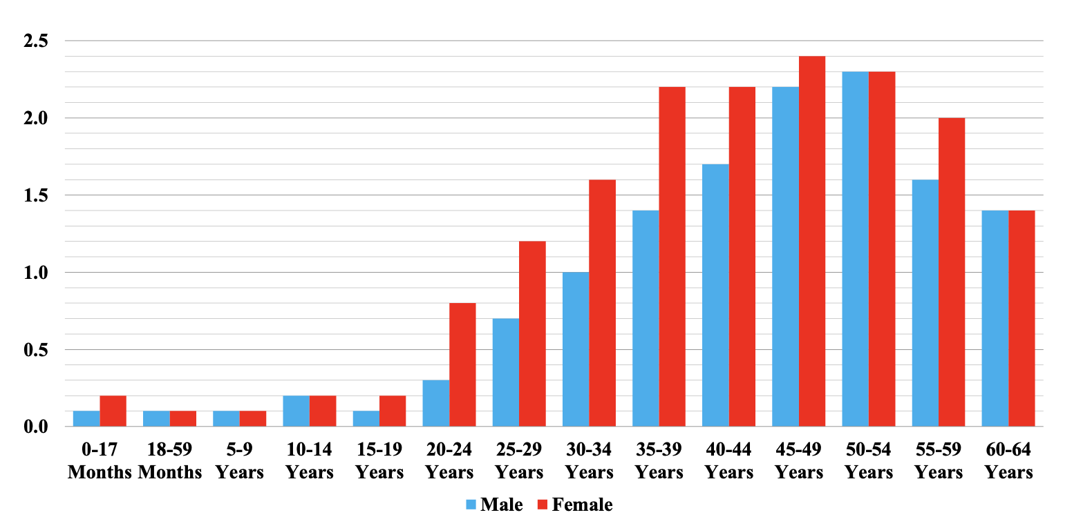
Adolescent girls and young women are disproportionately affected by HIV [Country]
Data collection
TEMPLATE
[High-level summary of HIV in country and general trends for new infections by population groups in recent years, with a focus on adolescent girls and young women] Adolescent girls and young women are disproportionally affected by HIV, especially high among XX-year-old women.²
KEY STATISTICS¹
HIV prevalence in adults (ages 15–49) and young people (ages 15–24)
National prevalence for adults, adolescents, and key/priority populations
Data on the current state of and recent trends in prevalence
HIV incidence in adults (aged 15–49) and young people (aged 15–24)
National incidence for adults, adolescents, and key/priority populations
Data on the current state of and recent trends in incidence
HIV PREVALENCE BY SEX AND AGE, 2021
This is an example graph with HIV prevalence— you can update it with a graph from the national HIV prevention plans or other statistics.
These data are commonly found in WHO/UNAIDS databases. If these data do not exist for the country of focus, you can flag here which data are not available and advocate for greater data collection.
Note: WHO/UNAIDS categorizes adults as ages 15–49; other data sources may report adolescent and adult groups separately.
HIV INCIDENCE BY SEX AND AGE, 2021
You can edit this graph and update the data with statistics for your situation analysis by clicking the chart, entering the Chart Design tab, and using the “Edit Data in Excel” function.
29%
Sources: (1) Source; (2) Source

Slide 8
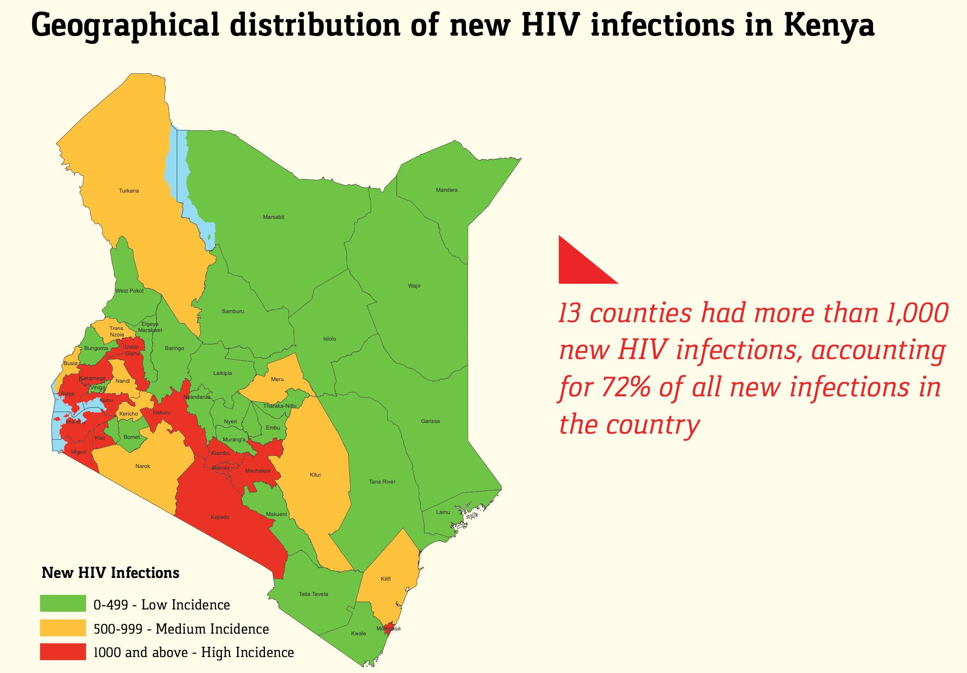
The HIV epidemic is concentrated in [geographic regions]
Data collection
TEMPLATE
[High-level summary of HIV prevalence statistics across regions, provinces, or counties:
Regions with the highest HIV incidence and/or prevalence
Areas that have been determined to be “hot spots” for HIV prevention programming
Trends in HIV incidence across rural vs. urban centers]
ESTIMATED HIV INCIDENCE BY COUNTY, 2021
This is an example graph with HIV prevalence—you can update it with a graph from the national HIV prevention plans or other statistics.
Sources: (1) Source; (2) Source

Slide 9
Step 1: HIV in [Country]
Data collection
Step 1B: Oral PrEP rollout
GOAL
Understand the current situation for oral PrEP rollout in country.
INSTRUCTIONS
Before conducting interviews, collect data and use secondary research methods to understand the situation.
For example, you can collect data on the oral PrEP rollout, build a timeline of rollout milestones, and/or pull together the key lessons learned through oral PrEP rollout that may influence how CAB PrEP should be introduced.
When information is limited, conducting interviews with key national stakeholders and implementing partners for oral PrEP programming will be a necessary starting point to understanding the situation for oral PrEP rollout.

Slide 10
[Country] has made progress on oral PrEP rollout
Data collection
TEMPLATE
[High-level overview of the timeline of events for Country’s national response for biomedical HIV prevention]. After oral PrEP was approved for use in [COUNTRY] in [YEAR] and demonstration projects showed high acceptability among priority populations, oral PrEP was quickly integrated in HIV prevention plans and began rollout in [YEAR].
Timeline of key milestones for [Country]’s biomedical HIV prevention response
YEAR
YEAR
YEAR
YEAR
YEAR
The [COUNTRY] recommended the use of oral PrEP and updated the National Guidelines for HIV Prevention, Treatment and Care.
Demonstration projects began to test the acceptability of oral PrEP in [COUNTRY] in XX states.
HIV self-testing (HIVST) was approved for use in [COUNTRY].
The Revised National AIDS and HIV Strategic Framework 2019–2021 was published to fast-track the national AIDS response.
The HIV Prevention Technical Working Group (TWG) was convened by the National Agency for the Control of AIDS (NACA). A subcommittee was formed to meet each quarter to lead the introduction of oral PrEP and develop the national guidelines.
The first national Training of Trainers on oral PrEP service delivery was conducted.
Scale-up of oral PrEP began in early 2020, primarily through donor-funded projects across [COUNTRY]. Integration of oral PrEP was informed by a value chain situation analysis.
A stakeholder mapping for oral PrEP implementation was conducted.
Several guidelines and policies were developed, including:
National HIV Self-Testing and Pre-Exposure Prophylaxis Communication Strategy
National Oral PrEP Implementation Plan
National Oral PrEP Training materials
The first harmonized national job aids and standard operating procedures for oral PrEP service delivery
Filling out this timeline may require pulling together key milestones across several resources and/or interviews with a national stakeholder leading on HIV prevention who would be familiar with key dates.
All current text in the timeline is example text.
Sources: (1) Source; (2) Source

Slide 11
Oral PrEP rollout in [Country]
Data collection
TEMPLATE
CURRENT SITUATION FOR ORAL PrEP
[Key statistics on initiation]
[Key successes and challenges as informed by interviews]
  Government buy-in, coordination from the PrEP TWG, and/or support from donor organizations for oral PrEP scale-up
  Integration into existing HIV prevention policies and plans and/or which focus populations oral PrEP rollout reaches
  Integration into supply chain and monitoring systems as well as service delivery channels
  Current situation for uptake and effective use amongst priority population groups and/or occurrences of social stigma or myths
NUMBER OF PREP USERS, 2017–2021
Information on oral PrEP rollout may not be well documented – key successes and challenges from oral PrEP rollout may be informed by the VCSA interviews in Step 2.
You can edit this graph and update the data with statistics for your situation analysis by clicking the chart, entering the Chart Design tab, and using the “Edit Data in Excel” function.
Sources: (1) Source; (2) Source

Slide 12
Oral PrEP Implementing Partners in [Country]
Data collection
TEMPLATE
Funding agency | Name of implementing organization | No. sites implementing PrEP | Region
E.g., National agency, Global Fund, PEPFAR (CDC, USAID), UN Agencies (WHO, UNICEF, UNAIDS) & other health development partners
You can fill out this chart, requesting data input from the national stakeholders who are leading on HIV prevention efforts.
Sources: (1) Source; (2) Source

Slide 13
CAB PrEP is an opportunity to expand the reach of HIV prevention to populations in need
Data collection
TEMPLATE
GOAL: Develop a high-level summary of [Country]'s priority populations for oral PrEP and outline considerations on how the addition of CAB PrEP will improve access to and/or acceptability of PrEP programming among end-user populations.
Priority groups | Who are they? | Considerations for the introduction of CAB PrEP
Key and vulnerable populations | Select priority groups: Female sex workers (FSWs) Men who have sex with men (MSM) Trans and nonbinary people (TNBP) People with disabilities (PWD) Long-distance truck drivers Men in confined spaces, e.g., prisoners and miners | [Key takeaways from stakeholder group interviews] [E.g., anticipated acceptability and/or potential reach for priority groups]
General population | Select priority groups: Adolescent girls and young women15–29 years) Pregnant and breastfeeding populations (PBFPs) Serodiscordant couples (SDCs) | [Key takeaways from stakeholder group interviews] [E.g., anticipated acceptability and / or potential reach to priority groups]
Please select the priority groups for CAB PrEP in your country, if already determined. You can add any population-specific considerations, such as anticipated acceptability or potential reach at delivery sites for these groups.
Sources: (1) Source; (2) Source

Slide 14
Selected desk review sources
Data collection
TEMPLATE
Sources
Track the secondary resources and documents you use for your research using your preferred citation style.

Slide 15
Step 2
Stakeholder Interviews

Slide 16
Step 2
Stakeholder Interviews
Stakeholder Interviews
GOAL: Gather input from key stakeholders to inform an assessment of the current situation for CAB PrEP rollout in your country along a structured framework.
INSTRUCTIONS
Based on your research in Step 1:
Build a stakeholder map (see slide 17) to identify organizations and individuals who can provide informed perspectives on the past rollout of oral PrEP and potential future rollout of CAB PrEP on topics along the PrEP Introduction Framework (see slides 22 and 23).
Customize guides for your interviews based on the Interview Question Bank included in this tool; note it may be necessary to adapt questions to your context (see slide 19).
Conduct interviews and take notes as the primary method of collecting the data you will analyze in Step 3.

Slide 17





Stakeholder map for CAB PrEP
Stakeholder Interviews
 | Currently involved
 | Potential/future involvement
TEMPLATE
Map stakeholders across the CAB PrEP Introduction Framework to plan for interviews that will inform the situation analysis.
Type | Organization(s) | Role in CAB PrEP Introduction | Planning & budgeting | Supply chain mgmt | Delivery platforms | Uptake & effective use | Monitoring
Governmental organizations | Organization 1
 | Organization 2
 | Organization 3
Development and implementing partners
Civil society organizations and community-based organizations
Private sector and/or community-based providers
Bilateral organizations and funders
GOAL: Identify the organizations that are currently involved or should be involved in CAB PrEP introduction along the PrEP Introduction Framework. This will help you plan stakeholder interviews to build the situation analysis.
DIRECTIONS: Specify the name and describe the current or expected role of each stakeholder. You can categorize stakeholders by type, framework component, and involvement status.

Slide 18
Interview outreach list
Stakeholder Interviews
TEMPLATE
DIRECTIONS: Track outreach to interviewees and plan which areas to ask questions about across the PrEP Introduction Framework. Interviews may need to be planned in waves to address remaining questions or missing information identified while completing the situation analysis.
Organization | Interviewee(s) | Areas to probe across the PrEP Introduction Framework | Status | Interview date
Organization 1 | Name | Planning & budgeting, supply chain management, monitoring | Outreach sent | Pending
Organization 2 | Name | Planning & budgeting, delivery platforms, uptake & effective use | Scheduling | Feb 2, 2022
Organization 3 | Name | Delivery platforms, uptake & effective use | Completed | Jan 5, 2022

Slide 19





Interview questions
Stakeholder Interviews
ADDITIONAL RESOURCE
INSTRUCTIONS
Download the Interview Questions Bank, which includes a list of questions that can be used in stakeholder interviews. These questions are aligned to the PrEP Introduction Framework (see below) so that inputs from the interviews can be easily translated to the analysis templates (see slides 29–33).
Adapt the questions as needed so that they are tailored to your context.
Consider which questions are relevant for each stakeholder interview based on “areas to probe” on slide 18.
CAB PrEP Introduction Framework
See slides 22–23 for greater detail
PLANNING &
BUDGETING
SUPPLY CHAIN MANAGEMENT
DELIVERY PLATFORMS
UPTAKE &
EFFECTIVE USE
MONITORING
Section in Interview Questions Bank
P1–P7
S1–S5
D1–D4
U1–U4
M1–M3
Corresponding slide for Step 3 data analysis
Slide 29
Slide 30
Slide 31
Slide 32
Slide 33

Slide 20
Step 3
Analysis & Synthesis

Slide 21
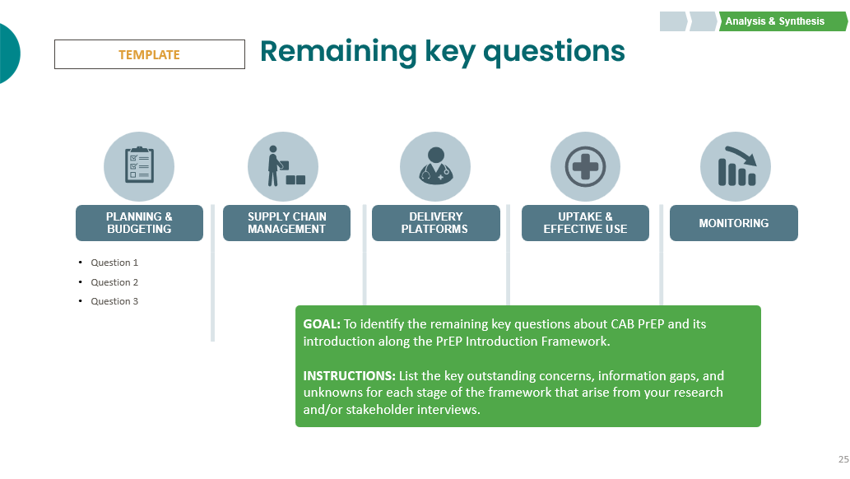
Step 3
Analysis & Synthesis
Analysis and synthesis
GOAL: Synthesize interview inputs to assess the current situation for CAB PrEP rollout in your country.
INSTRUCTIONS
Review the data you collected during the interviews to pull out the key findings for each element of the CAB PrEP Introduction Framework.
The following slides include templates for data analysis and synthesis across the framework. Follow the directions on each slide and track where you may need to plan additional interviews to collect any missing information.

Slide 22





CAB PrEP Introduction Framework
Analysis & Synthesis
This value chain framework has been used across countries to support planning for the introduction of PrEP products. It identifies necessary steps for PrEP introduction and scale-up across five major categories and across priority delivery channels. It can also be used to track progress toward introduction of various PrEP products by different partners.
Value Chain for PrEP
PLANNING &
BUDGETING
SUPPLY CHAIN MANAGEMENT
DELIVERY
PLATFORMS
UPTAKE &
EFFECTIVE USE
MONITORING, EVALUATION, & LEARNING
National and subnational plans are established to introduce and scale-up PrEP products. | PrEP products are available and distributed in sufficient quantity to meet projected demand via priority delivery channels. | PrEP products are delivered by trained providers in priority delivery channels to effectively reach end users. | End users know about and understand PrEP products and know how to access and effectively use them. | PrEP products are effectively integrated into national, subnational, facility, community, and program monitoring systems.

Slide 23
Detailed CAB PrEP Introduction Framework
Analysis & Synthesis
PLANNING &
BUDGETING
SUPPLY CHAIN MANAGEMENT
DELIVERY
PLATFORMS
UPTAKE &
EFFECTIVE USE
MONITORING, EVALUATION, & LEARNING
Plans, systems, and processes to support service integration across priority delivery channels, including reproductive health/family planning and private sector providers/pharmacies
Convene new or existing subcommittee or task team within HIV prevention or PrEP technical working groups.
Identify focus populations and set targets to inform CAB PrEP planning.
Engage community stakeholders to inform planning for CAB PrEP rollout.
Include CAB PrEP in national HIV prevention and other relevant plans and policies (e.g., HIV testing, family planning).
Issue standard clinical guidelines for delivery and use of CAB PrEP.
Develop an implementation plan and budget to guide initial introduction and scale-up of CAB PrEP.
Register CAB PrEP and include it on the national essential medicines list, if needed.
Update supply chain guide-lines and logistics systems to include CAB PrEP.
Conduct forecasting and/or quantification to inform procurement of CAB PrEP.
Establish procurement, commodity monitoring, and distribution for CAB PrEP and associated materials.
Establish storage and distribution systems that maintain temperature controls for CAB PrEP.
Dedicate resources to conduct regular HIV tests, initiate PrEP, and support ongoing CAB PrEP use.
Develop training and materials for health care workers on CAB PrEP.
Establish referral systems to link clients from other channels to sites providing CAB PrEP.
Integrate support for partner communication and services for intimate partner violence response.
Develop and implement demand generation strategies that include CAB PrEP promotion.
Address social norms/stigma to build community and partner acceptance of CAB PrEP use.
Develop information and tools for clients to support product choice.
Support effective use of CAB PrEP.
Update or establish integrated monitoring tools to support data collection and analysis on PrEP use across multiple products.
Establish systems for pharmacovigilance and to monitor drug resistance.
Conduct implementation science research to inform policy and scale-up.

Slide 24
How to use the framework
Analysis & Synthesis
For each element of the PrEP Introduction Framework, you can assess CAB PrEP introduction progress using the following categories:
Opportunity to easily build on oral PrEP rollout
Stakeholders anticipate relatively easy integration of CAB PrEP into existing systems and processes that were initially established for oral PrEP (e.g., existing task forces, provider training, and demand creation campaigns).
Will require new effort, but no anticipated challenges
Stakeholders recognize efforts to introduce CAB PrEP will be distinct and different from what was needed to introduce oral PrEP but do not anticipate any significant challenges.
Requires significant consideration specifically for CAB PrEP
Stakeholders expect introduction of CAB PrEP will require establishing new systems and/or overcoming significant challenges that are distinct from those encountered with the introduction of oral PrEP or are ongoing challenges will the scale-up of oral PrEP.
These categories were defined based on interviews and research on efforts to introduce oral PrEP and early work to introduce CAB PrEP.

Slide 25
How to complete the following slides
Analysis & Synthesis
For each section of the framework, input the data you collected during the stakeholder interviews into the templates on the following slides.
These readiness factors correspond to each section of the framework.
The components can be assessed according to the color key below. Ratings are meant to indicate relative progress. See slide 24 to guide your assessment.
The left column provides room for a brief description of the current state of each component for oral PrEP. The right column includes space for next steps and/or considerations for the introduction of CAB PrEP. Examples are included in the following slides to guide data synthesis.
COLOR KEY
Opportunity to easily build on oral PrEP rollout
Will require new effort, but no anticipated challenges
Requires significant consideration specifically for CAB PrEP

Slide 26
CAB PrEP introduction situation analysis summary
Analysis & Synthesis
TEMPLATE
PLANNING &
BUDGETING
SUPPLY CHAIN MANAGEMENT
DELIVERY PLATFORMS
UPTAKE &
EFFECTIVE USE
MONITORING, EVALUATION, & LEARNING
 | Plans, systems, and processes to support service integration across priority delivery channels, including reproductive health/family planning and private sector providers/pharmacies
 | Convene new or existing subcommittee or task team within HIV prevention or PrEP technical working groups.
 | Identify focus populations and set targets to inform CAB PrEP planning.
 | Engage community stakeholders to inform planning for CAB PrEP rollout.
 | Include CAB PrEP in national HIV prevention and other relevant plans and policies (e.g., HIV testing, family planning).
 | Issue standard clinical guidelines for delivery and use of CAB PrEP.
 | Develop an implementation plan and budget to guide initial introduction and scale-up of CAB PrEP.
 | Register CAB PrEP and include it on the national essential medicines list, if needed.
 | Update supply chain guide-lines and logistics systems to include CAB PrEP.
 | Conduct forecasting and/or quantification to inform procurement of CAB PrEP.
 | Establish procurement, commodity monitoring, and distribution for CAB PrEP and associated materials.
 | Establish storage and distribution systems that maintain temperature controls for CAB PrEP.
 | Dedicate resources to conduct regular HIV tests, initiate PrEP, and support ongoing CAB PrEP use.
 | Develop training and materials for health care workers on CAB PrEP.
 | Establish referral systems to link clients from other channels to sites providing CAB PrEP.
 | Integrate support for partner communication and services for intimate partner violence response.
 | Develop and implement demand generation strategies that include CAB PrEP promotion.
 | Address social norms/stigma to build community and partner acceptance of CAB PrEP use.
 | Develop information and tools for clients to support product choice.
 | Support effective use of CAB PrEP.
 | Update or establish integrated monitoring tools to support data collection and analysis on PrEP use across multiple products.
 | Establish systems for pharmacovigilance and to monitor drug resistance.
 | Conduct implementation science research to inform policy and scale-up.
INSTRUCTIONS:
Use the color key to update the progress columns boxes based on the assessment made for your country in the PrEP Introduction Framework slides 29–33.
COLOR KEY
Opportunity to easily build on oral PrEP rollout
Will require new effort, but no anticipated challenges
Requires significant consideration specifically for CAB PrEP

Slide 27
[Country] Situation analysis summary findings
Analysis & Synthesis
TEMPLATE
Findings from the [Country] situation analysis are summarized below, with details included on the following slides.
PLANNING &
BUDGETING
SUPPLY CHAIN MANAGEMENT
DELIVERY PLATFORMS
UPTAKE &
EFFECTIVE USE
MONITORING, EVALUATION, & LEARNING
Finding 1 | Finding 2 | Finding 3 | Finding 4 | Finding 5
Opportunities for easy introduction
INSTRUCTIONS:
After completing the framework slides (slides 29–33), elevate summary findings from each section in a few short bullets on this summary page to create an overview of key opportunities and considerations for CAB PrEP introduction in your country.
Finding 1 | Finding 2 | Finding 3 | Finding 4 | Finding 5
Areas that need consideration

Slide 28
Potential delivery channels for CAB PrEP
Analysis & Synthesis
TEMPLATE
CAB PrEP could be made available across a diverse range of channels, including the channels listed below. As you complete the following slides, consider what would be needed to introduce CAB PrEP across these diverse channels. To do a deeper dive on delivery channels for CAB PrEP, see the PrEP Service Delivery Channel Analysis tool.
Delivery channels
Description
Public sector HIV services
Departments in public sector facilities offering HIV testing, oral pre-exposure prophylaxis (PrEP), and antiretroviral therapy (ART) services managed by national and subnational ministries of health (MOHs). Can include specific adolescent and youth-friendly services or standalone ART clinics or outpatient departments where HIV testing and PrEP may be available.
Public sector
Public sector FP services
Departments in public sector facilities offering family planning (FP) and other reproductive health services
Maternal & child health services
Departments in public sector facilities offering antenatal care (ANC) services for pregnant women, postnatal care (PNC), immunizations, and other services, including prevention of perinatal HIV transmission (PMTCT)
Work/school-based services
Programs that offer HIV counseling and testing services (HTS) and/or ART at selected worksites (e.g., at mining operations) or tertiary education institutions
Private for profit
Commercial health care
Private doctors, clinics, or hospitals that provide health services to individuals who pay out-of-pocket or use health insurance
Drug shops and pharmacies
Includes large pharmacy networks and smaller community-based pharmacies and drug shops; some are managed by trained health care workers (HCWs)
NGO clinics/social franchises
Private not-for-profit facilities, including clinics managed by nongovernmental organizations (NGOs) and social franchises offering sexual and reproductive health (SRH) services at subsidized rates*
Private not for profit
Private facilities affiliated with religious institutions, including church networks and mission hospitals that provide subsidized/free services
Faith-based organizations
NGO programs for AGYW
Donor-funded, NGO-led programs that provide HIV and other services to adolescent girls and young women (AGYW), including DREAMS and other programs (e.g., AGYW safe spaces)
* Major networks are often managed by global NGOs or local affiliates.

Slide 29

Planning & budgeting
Analysis & Synthesis
TEMPLATE
PLANNING & BUDGETING
Key steps and considerations
 |  | What is needed to introduce CAB PrEP and other considerations
 | Convene new or existing subcommittee or task team within HIV prevention or PrEP technical working group. | Refer to P1 in the Question Bank and include details on: Plans for a task force or technical work groups (TWGs) to lead CAB PrEP introduction Timelines and/or milestones for key decisions Plan for participation of stakeholders from other relevant areas (e.g., FP, maternal and child health [MCH])
 | Identify focus populations and set targets to inform CAB PrEP planning. | Refer to P2 in the Question Bank and include details on: Plans for end-user populations for CAB PrEP (e.g., population groups, targets set, etc.)
 | Engage community stakeholders to inform planning for CAB PrEP rollout. | Refer to P3 in the Question Bank and include details on: Key lessons on community engagement from oral PrEP rollout (e.g., effective ways to authentically engage community members and hear their perspectives) Plans for engaging community stakeholders on CAB PrEP introduction
 | Include CAB PrEP in national HIV prevention and other relevant plans and policies (e.g., HIV testing, family planning, private sector). | Refer to P5 in the Question Bank and include details on: Key HIV prevention strategies/plans that will need to incorporate CAB PrEP; how these strategies/plans currently incorporate oral PrEP Other strategies/plans that could include CAB PrEP (e.g., plans for SRH, adolescent health, or private sector delivery)
 | Issue standard clinical guidelines for delivery and use of CAB PrEP. | Refer to P6 in the Question Bank and include details on: Current state of and lessons learned from clinical guidelines for oral PrEP Plans/timelines for clinical guidelines for CAB PrEP
 | Develop an implementation plan and budget to guide initial introduction and scale-up of CAB PrEP. | Refer to P7 in the Question Bank and include details on: Plans/timelines for introduction and scale-up of CAB PrEP Integration of CAB PrEP in HIV prevention budgets and donor requests Sources of financial resources to support CAB PrEP procurement and introduction activities
Text in pink indicates key steps related to diverse delivery channels (e.g., non-HIV channels)

Slide 30
Supply chain management
Analysis & Synthesis
TEMPLATE
SUPPLY CHAIN MANAGEMENT
Key steps and considerations
 |  | What is needed to introduce CAB PrEP and other considerations
 | Register CAB PrEP and include on the national essential medicines list, if needed. | Refer to S1 in the Question Bank and include details on: Current situation/timeline for the regulatory approval of CAB PrEP Considerations for inclusion of CAB PrEP on national essential medicines lists and other key procurement and supply chain systems Considerations of how scheduling and/or classification of CAB PrEP upon approval may enable or inhibit its delivery in nonclinical channels (e.g., pharmacies, community-based settings)
 | Update supply chain guidelines and logistics systems to include CAB PrEP. | Refer to S2 in the Question Bank and include details on: Existing systems, processes, and lessons learned from oral PrEP introduction Expected differences for CAB PrEP, as a new product form that has not previously been procured What is needed to include CAB PrEP in supply chain systems for other delivery channels (e.g., FP, MCH, private sector)
 | Conduct forecasting and/or quantification to inform procurement of CAB PrEP. | Refer to S3 in the Question Bank and include details on: Plans for CAB PrEP demand forecasting and quantification Key stakeholders engaged in demand forecasting and quantification Expected challenges and/or unknowns
 | Establish procurement, commodity monitoring, and distribution for CAB PrEP and associated materials. | Refer to S4 in the Question Bank and include details on: Plans for procurement, commodity monitoring, and distribution for CAB PrEP Relevant stakeholders involved Potential barriers and/or challenges to distributing CAB PrEP to non-HIV channels
 | Establish storage and distribution systems that maintain temperature controls for CAB PrEP, if needed. | Refer to S5 in the Question Bank and include details on: Current situation for temperature-controlled storage and distribution (e.g., refrigerators)
Text in pink indicates key steps related to diverse delivery channels (e.g., non-HIV channels)

Slide 31
CAB PrEP delivery platforms
Analysis & Synthesis
TEMPLATE
DELIVERY PLATFORMS
Key steps and considerations
 |  | What is needed to introduce CAB PrEP and other considerations
 | Dedicate resources to conduct regular HIV tests, initiate PrEP, and support ongoing CAB PrEP use. | Refer to D1 in the Question Bank and include details on: Lessons learned from oral PrEP rollout Potential opportunities/barriers for the introduction of CAB PrEP Required resources for successful CAB PrEP rollout Considerations for other channels (e.g., access to HIV tests)
 | Develop trainings and materials for health care workers on CAB PrEP. | Refer to D2 in the Question Bank and include details on: Materials and models for provider training on oral PrEP and plans to integrate CAB PrEP Opportunities to train other health care providers on CAB PrEP Plans to engage and train health care providers on intramuscular injection and how to communicate and support decision-making about multiple methods Considerations to train health care providers in non-HIV channels
 | Establish referral systems to link clients from other channels to sites providing CAB PrEP. | Refer to D3 in the Question Bank and include details on: Existing referral systems for oral PrEP (e.g., from non-HIV channels such as FP and/or from HTS)
 | Integrate support for partner communication and services for intimate partner violence response. | Refer to D4 in the Question Bank and include details on: Existing screening and supportive services for oral PrEP users experiencing intimate partner violence (IPV) and potential to extend services to CAB PrEP users Opportunities to integrate CAB PrEP into existing IPV response
Text in pink indicates key steps related to diverse delivery channels (e.g., non-HIV channels)

Slide 32
Uptake & effective use
Analysis & Synthesis
TEMPLATE
UPTAKE &
EFFECTIVE USE
Key steps and considerations
 |  | What is needed to introduce CAB PrEP and other considerations
 | Develop and implement demand generation strategies that include CAB PrEP promotion. | Refer to U1 in the Question Bank and include details on: Lessons learned from oral PrEP rollout Existing campaigns, materials, etc., developed for oral PrEP that could include CAB PrEP Plans for demand creation for CAB PrEP or other SRH products that can be relevant for creation of materials for CAB PrEP (e.g., injectable contraception, etc.)
 | Address social norms/stigma to build community and partner acceptance of CAB PrEP use. | Refer to U2 in the Question Bank and include details on: Key areas of concern for stigma/social norms Lessons learned from oral PrEP rollout or other SRH products Effective methods to address stigma/social norms for CAB PrEP
 | Develop information and tools for clients to support product choice. | Refer to U3 in the Question Bank and include details on: Existing information and tools for clients developed for oral PrEP that could include CAB PrEP Plans/timelines for adapting materials for CAB PrEP introduction Need to create materials and/or approaches to supporting end-user choice among PrEP options
 | Support effective use of CAB PrEP. | Refer to U4 in the Question Bank and include details on: Lessons learned from oral PrEP adherence and continuation Key opportunities/challenges for CAB PrEP

Slide 33
Monitoring, evaluation and learning
Analysis & Synthesis
TEMPLATE
MONITORING, EVALUATION, & LEARNING
Key steps and considerations
 |  | What is needed to introduce CAB PrEP and other considerations
 | Update or establish integrated monitoring tools to support data collection and analysis on PrEP use across multiple products. | Refer to M1 in the Question Bank and include details on: Current systems and indicators for monitoring oral PrEP delivery at the facility, regional, and national levels Opportunities to include CAB PrEP in monitoring tools alongside oral PrEP Opportunities/barriers to integrating CAB PrEP into monitoring systems for FP and other non-HIV services and/or to linking private sector delivery to public sector monitoring systems
 | Establish systems for pharmacovigilance and to monitor drug resistance. | Refer to M2 in the Question Bank and include details on: Current plans for pharmacovigilance for oral PrEP and plans to integrate CAB PrEP Considerations for quality assurance or quality improvement for HIV drug resistance monitoring with new injectable form
 | Conduct implementation science research to inform policy and scale-up. | Refer to M3 in the Question Bank and include details on: Plans for demonstration projects and/or key implementation science questions for initial, phased CAB PrEP rollout Plans for ongoing implementation science research to inform programming of CAB PrEP in future years
Text in pink indicates key steps related to diverse delivery channels (e.g., non-HIV channels)

Slide 34
Remaining key questions
Analysis & Synthesis
TEMPLATE
Question 1 Question 2 Question 3
PLANNING &
BUDGETING
SUPPLY CHAIN MANAGEMENT
DELIVERY PLATFORMS
UPTAKE &
EFFECTIVE USE
MONITORING
GOAL: To identify the remaining key questions about CAB PrEP and its introduction along the PrEP Introduction Framework.
INSTRUCTIONS: List the key outstanding concerns, information gaps, and unknowns for each stage of the framework that arise from your research and/or stakeholder interviews.

Slide 35
Thank you to Afton Bloom for the development of this tool. For questions about the tool, please contact the MOSAIC Consortium at info@prepnetwork.org

