Slide 1
Nigeria Oral PrEP
Situation Analysis
June 2020

Slide 2
Context for HIV Prevention & PrEP

Slide 3
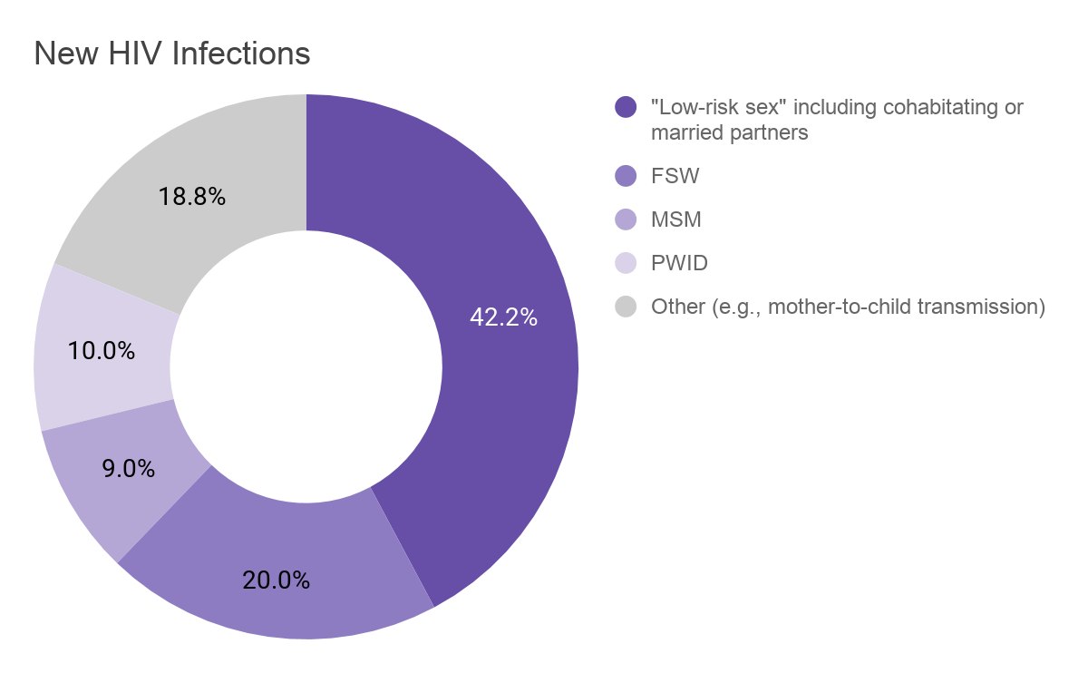
HIV in Nigeria
The HIV epidemic in Nigeria is the 2nd largest in the world, although Nigeria has low prevalence and incidence rates relative to other countries in the region.
KEY STATISTICS (2018)
Adult HIV prevalence (age 15 - 49) has remained largely steady for the past several years at ~1.5%^{1,3}
Prevalence for women is 1.9% and for young women is 1.3%
Prevalence for men is 1.1% and for young men is 0.4%
Prevalence among key populations (KPs) is significantly higher: 27.4% for brothel-based female sex workers (FSW), 21.7% for non-brothel based FSW, 17.2% for men who have sex with men (MSM), and 10.4% for people who inject drugs (PWID)
Adult HIV incidence (age 15 - 49) has remained steady for the past several years and is now 1%, with new infections rising slightly from 94K in 2010 to 100K in 2018²
²
Sources: (1) NAIIS 2018 Preliminary Findings (March 2019), (2) UNAIDS Estimates, (3) Nigeria Revised National HIV and AIDS Strategic Framework 2019 - 2021

Slide 4
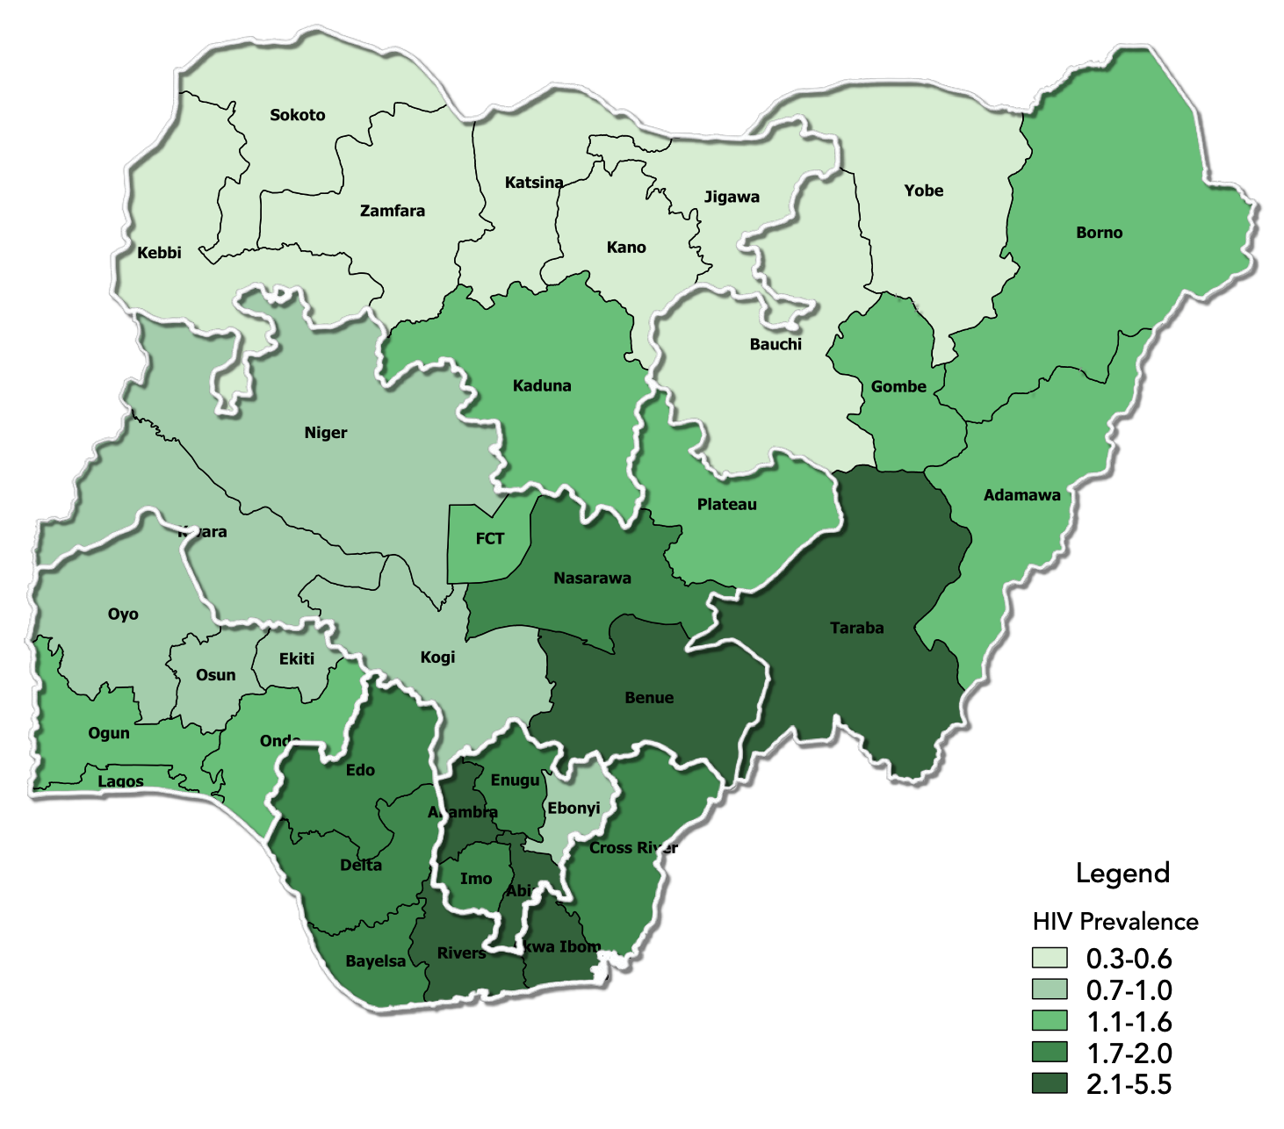
HIV in Nigeria
HIV BY GEOGRAPHY (2019)¹
Cluster | States | Prevalence
High Prevalence | 6 | 2.1% - 5.5%
Medium Prevalence | 16 | 1.1% - 2.0%
Low Prevalence | 15 | 0.3% - 1.0%
Prevalence in CHOICE Focus States
Akwa Ibom: 5.5%
Bayelsa: 1.9%
Cross River: 2.0%
Lagos: 1.4%
Niger: 0.7%
Rivers: 3.8%
Sources: (1) NAIIS 2018 Preliminary Findings (March 2019)

Slide 5
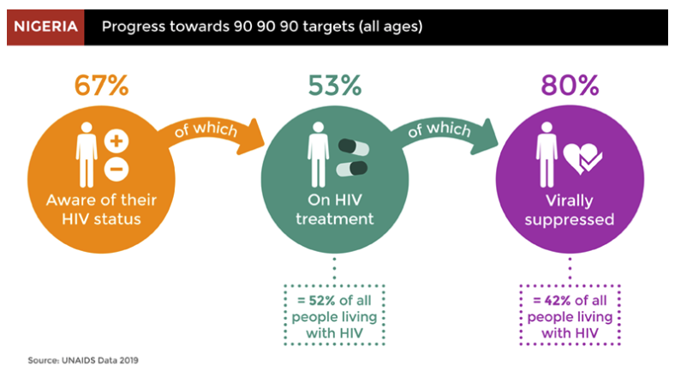
HIV Prevention in Nigeria
Nigeria’s HIV policy framework prioritizes progress in HIV testing and treatment and includes PrEP with a focus on key populations (KPs) and serodiscordant couples.
KEY STATISTICS (2018)
Nigeria is committed to achieving the 90-90-90 goals, however progress remains somewhat slower compared to other countries in the region, particularly for the first two goals.¹
National plans highlight several key challenges
While significant progress on HIV testing has been made, the current state is short of targets; HIV testing sites increased from 1K in 2010 to 8K in 2014 towards a target of 23K testing sites.¹ In 2019, the Ministry of Health launched guidelines for HIV self-testing.²
Knowledge of HIV and condom use remains low relative to other countries; condom shortages have been reported.³
Conflict in some regions in recent years has disrupted the HIV prevention and treatment response.³
Social and cultural factors, including weak legal protections for LGBTQ populations, gender inequality, intimate partner violence, and HIV stigma are challenges for an effective HIV response.³
Policymakers note that accelerating expansion of HIV testing and treatment has been a higher priority than PrEP rollout in recent years.⁴
Sources: (1) AVERT Nigeria profile, (2) Nigeria Ministry of Health announcement on self testing, (3) Nigeria Revised National HIV and AIDS Strategic Framework 2019 - 2021, (4) CHOICE interviews

Slide 6
Current State of Oral PrEP Rollout
Map of current PrEP implementation projects¹
A 2015 - 2016 demonstration project tested different models to deliver PrEP to serodiscordant couples
In FY19, there were 623 PrEP users; the FY20 target included in COP19 is 14.4K new PrEP users and 17.4K current PrEP users²
PrEP is primarily available for through donor-funded implementation projects across 26 states, including:
PEPFAR/USAID - FHI 360 EpiC, FHI 360 SIDHAS, Jhpiego RISE, Heartland Alliance, Chemonics SHARP
PEPFAR/CDC - IHVN, APIN, CIHP, and CCFN
DOD – Henry Jackson Foundation (military bases) and Population Council
Global Fund - FHI 360 Impact Project
Projects include a mix of service delivery models including one-stop-shops, facility-based, and community-based programming (focused on KPs)
Some projects include PrEP referrals from other services (e.g., index testing, PMTCT, family planning)
PrEP is available in the private sector, but is not tracked
SOKOTO
CHOICE focus states
BORNO
KEBBI
ZAMFARA
KANO
KANO
KADUNA
BAUCHI
NIGER
GOMBE
PLATEAU
ADAMAWA
KWARA
FTC
NASARAWA
FHI 360 (EpiC, Global Fund Impact, SIDHAS)
OYO
TARABA
EKITI
KOJI
Jhpiego (RISE)
OSUN
BENUE
OGUN
Heartland Alliance
EDO
ENUGU
LAGOS
EDO
Chemonics (SHARP)
ANAMBRA
CROSS RIVER
IHVN
ABIA
IMO
DELTA
APIN
Population Council
CIHP
BAYELSA
RIVERS
AKWA IBOM
Henry Jackson Foundation
CCFN
Sources: (1) CHOICE interviews, (2) Nigeria COP 2020 Planning Letter

Slide 7
Key Stakeholders for PrEP Introduction
Organization | Role in PrEP Introduction
NASCP | Manages the Federal MoH HIV/AIDS response and clinical guidelines and manages the HIV Treatment TWG
NACA | Ensures coordination across sectors in the national HIV/AIDS response and manages the HIV Prevention TWG
PEPFAR, CDC, DOD, Global Fund | Provide funding for current PrEP implementation programs with a current focus on KPs and serodiscordant couples, but planned expansion of PrEP for Adolescents and Young People in 2021
FHI 360 | Runs three HIV projects that include PrEP (SIDHAS, EpiC, and Global Fund Impact Project) for KPs in 14 states and a partner in the CHOICE project, providing technical assistance to support PrEP rollout across partners, funded by PEPFAR and Global Fund
Jhpiego | Runs the RISE project, supporting PrEP delivery to KPs in 4 states and a partner in the CHOICE project, providing technical assistance to support PrEP rollout across partners, funded by PEPFAR
Chemonics | Runs the SHARP TO project, supporting PrEP delivery to serodiscordant couples in 5 states with low HIV burden, funded by PEPFAR
Society for Family Health | Supports demand creation for PrEP programs, including FHI 360 Global Fund Impact Project
Institute for Human Virology (IHVN) | Runs a project to provide PrEP to KPs and serodiscordant couples in 3 states, funded by CDC
AIDS Prevention Initiative Nigeria (APIN) | Runs a project to provide PrEP to KPs and serodiscordant couples in 7 states, funded by CDC
Center for Integrated Health Program (CIHP) | Runs a project to provide PrEP to KPs in 2 states, funded by CDC
Catholic Caritas Foundation Nigeria (CCFN) | Runs a project to provide PrEP to KPs in 1 state, funded by CDC
Population Council | Runs a project to provide PrEP to KPs in 2 states, funded by DOD
Henry Jackson Foundation Medical Research Intern. | Runs a project to provide PrEP to general populations at military facilities across 19 states, funded by DOD
JSI / AIDSFree | Provides technical assistance to support PrEP rollout, including provider training and mentorship and demand creation strategy (pending in 2020)

Slide 8
PrEP Introduction Planning

Slide 9
PrEP Introduction Framework
This value chain framework has been used across countries to support planning for oral PrEP introduction. It identifies necessary steps for PrEP introduction and scale-up across five major categories. It can also be used to track progress towards PrEP rollout by different partners.
Value Chain for oral PrEP
PLANNING &
BUDGETING
SUPPLY CHAIN MANAGEMENT
PREP DELIVERY PLATFORMS
UPTAKE &
EFFECTIVE USE
MONITORING
National and state plans are established to implement WHO oral PrEP guidelines for priority end user populations | Oral PrEP is available and distributed in sufficient quantity to meet projected demand via priority delivery channels | Oral PrEP is effectively delivered by trained healthcare workers in priority delivery channels to effectively reach end users | End users know about and understand PrEP and are able to seek out, initiate and effectively use PrEP | PrEP is effectively integrated into national, state, program, and facility level monitoring systems

Slide 10
PrEP Introduction Framework – Nigeria Findings
Current progress
PrEP included in current HIV/AIDS guidelines and strategic plans as an HIV prevention tool
NACA and NASCP are committed to PrEP scale-up in 2020
Truvada and generic forms of TDF/FTC are approved and available for use in Nigeria
After initial challenges, implementation projects currently have sufficient PrEP stocks
PrEP currently provided primarily to KPs and some SDC through one-stop-shops and community programs in select states
Implementing partners have developed resources for PrEP implementation
Implementing partners have developed approaches to demand creation for PrEP that have been tested and refined
Implementing partners have developed M&E tools
PLANNING &
BUDGETING
SUPPLY CHAIN MANAGEMENT
PREP DELIVERY PLATFORMS
UPTAKE &
EFFECTIVE USE
MONITORING
No plan for PrEP scale-up in the public health system
Guidelines limit PrEP access to key populations (KP) and serodiscordant couples (SDC)
PrEP sub-committee of HIV Prevention TWG does not meet regularly
The drugs used for PrEP and treatment are different and maintaining sufficient stocks of PrEP may be an ongoing challenge
No consistent national resources for PrEP implementation (e.g., training, job aids)
Testing requirements limit channels for PrEP delivery
Few healthcare workers have been trained on PrEP
Low awareness and acceptance of PrEP among the general population
Significant stigma towards HIV and PrEP use
Low rates of uptake and continuation on PrEP, although uptake is increasing
Data on PrEP delivery is not currently collected on a national level
Some national indicators for PrEP delivery have been defined but are not included in national M&E system
Current challenges

Slide 11
Detailed PrEP Introduction Framework
PLANNING &
BUDGETING
SUPPLY CHAIN MANAGEMENT
PREP DELIVERY PLATFORMS
UPTAKE &
EFFECTIVE USE
MONITORING
Establishment of a cross- sector technical working group (TWG) for oral PrEP
Impact, cost and cost-effectiveness analyses for PrEP
Identification and quantification of target populations for PrEP
Inclusion of PrEP in national HIV prevention plans and guidelines
Timeline and plan for PrEP introduction and scale-up
A budget and sufficient funding for PrEP rollout to target populations
Regulatory approval of form(s) of oral PrEP by authorities
Manufacturer identification and contract negotiation to purchase PrEP
Development of distribution plan and supply chain for PrEP to reach priority facilities
Effective distribution mechanisms to avoid PrEP stock-outs in priority facilities
Issuance of clinical guidelines for PrEP and development of job aids for healthcare workers
Plan and curriculum to engage and train health care workers on PrEP and delivery to target populations
Tools to assess risk and understand who should use PrEP
Sufficient infrastructure and human resources to conduct HIV tests and prescribe PrEP in priority channels
Streamlined pathways between HIV testing and PrEP access
Integrated service delivery between HIV prevention, STI, family planning and GBV services for women and AGYW
Communications on PrEP for general public audiences
Demand generation strategies targeted to end user populations
Information for clients on how to effectively use PrEP
Support for adherence and continuation on PrEP for end users
Capacity to provide ongoing HIV and creatinine level testing for PrEP users accessible to target populations
Inclusion of PrEP in monitoring and reporting systems and forms

Slide 12
Detailed PrEP Introduction Framework – Nigeria Findings
PLANNING &
BUDGETING
SUPPLY CHAIN MANAGEMENT
PREP DELIVERY PLATFORMS
UPTAKE &
EFFECTIVE USE
MONITORING
Establishment of a cross- sector technical working group (TWG) for oral PrEP
Impact, cost and cost-effectiveness analyses for PrEP
Identification and quantification of target populations for PrEP
Inclusion of PrEP in national HIV prevention plans and guidelines
Timeline and plan for PrEP introduction and scale-up
A budget and sufficient funding for PrEP rollout to target populations
Regulatory approval of form(s) of oral PrEP by authorities
Manufacturer identification and contract negotiation to purchase PrEP
Development of distribution plan and supply chain for PrEP to reach priority facilities
Effective distribution mechanisms to avoid PrEP stock-outs in priority facilities
Issuance of clinical guidelines for PrEP and development of job aids for healthcare workers
Plan and curriculum to engage and train health care workers on PrEP and delivery to target populations
Tools to assess risk and understand who should use PrEP
Sufficient infrastructure and human resources to conduct HIV tests and prescribe PrEP in priority channels
Streamlined pathways between HIV testing and PrEP access
Integrated service delivery between HIV prevention, STI, family planning and GBV services for women and AGYW
Communications on PrEP for general public audiences
Demand generation strategies targeted to end user populations
Information for clients on how to effectively use PrEP
Support for adherence and continuation on PrEP for end users
Capacity to provide ongoing HIV and creatinine level testing for PrEP users accessible to target populations
Inclusion of PrEP in monitoring and reporting systems and forms
COLOR KEY
Significant progress and/or momentum
Early progress
Initial conversations ongoing

Slide 13
Detailed PrEP Introduction Framework – Nigeria Findings
PLANNING &
BUDGETING
PrEP is included in current national plans and guidelines (National HIV and AIDS Strategic Framework 2019 - 2021, National HIV/AIDS Strategic Framework 2017 - 2021, and 2016 National Guidelines for HIV Prevention and Treatment); 2016 guidelines are currently being revised by the Federal Ministry of Health - National HIV/AIDS and STI Control Programme (NASCP)
In plans and guidelines, PrEP is prioritized for key populations (FSW, MSM, and PWID) and serodiscordant couples with a particular focus on states with high HIV burden; there is a planned expansion of PrEP for Adolescent and Young People projects supported by PEPFAR and Global Fund for 2021
There are separate HIV Treatment and HIV Prevention technical working groups (TWGs) in Nigeria; the HIV Prevention TWG is convened by the National Agency for the Control of AIDS (NACA) and has a sub-committee focused on PrEP rollout, but the group has not met regularly due to capacity and resource constraints
There is no current plan, timeline or budget for national scale-up of PrEP although PrEP is a 2020 priority for both NASCP and NACA. Policymakers have expressed an interest in considering a range of delivery channels beyond KP-focused one stop shops, including traditional health facilities, SRH services, and decentralized services in the community
There are limited analyses (e.g., cost-effectiveness analyses, quantification or forecasting efforts) to inform national implementation planning
Establishment of a cross- sector technical working group (TWG) for oral PrEP
Impact, cost and cost-effectiveness analyses for PrEP
Identification and quantification of target populations for PrEP
Inclusion of PrEP in national HIV prevention plans and guidelines
Timeline and plan for PrEP introduction and scale-up
A budget and sufficient funding for PrEP rollout to target populations

Slide 14
Detailed PrEP Introduction Framework – Nigeria Findings
SUPPLY CHAIN MANAGEMENT
Both Truvada and generic forms of PrEP (TDF/FTC) have been approved for use in Nigeria
Nigeria does not use TDF/FTC as a treatment regimen. As a result, current PrEP implementation programs experienced early challenges to establish PrEP procurement processes. While these early challenges have been resolved, there is an ongoing concern with effectively forecasting and procuring sufficient PrEP supplies as PrEP stocks cannot be substituted with treatment stocks nor can excess PrEP stock be used for treatment
PrEP procurement and distribution is managed centrally for PEPFAR, CDC and DOD projects by Chemonics and is largely provided through one stop shops and select health facilities
Stakeholders note a shortage in the supply of condoms, which can prevent provision of comprehensive combination prevention even when PrEP is available
While PrEP is available in the private sector, it is unclear the extent to which it is available. Heartland Alliance is considering a total market approach, including the private sector, in their program (e.g., exploring pharmacy delivery for PrEP refills)
Regulatory approval of form(s) of oral PrEP by authorities
Manufacturer identification and contract negotiation to purchase PrEP
Development of distribution plan and supply chain for PrEP to reach priority facilities
Effective distribution mechanisms to avoid PrEP stock-outs in priority facilities

Slide 15
Detailed PrEP Introduction Framework – Nigeria Findings
PREP DELIVERY PLATFORMS
Implementing partners have developed tools to support PrEP delivery, including healthcare worker training curricula, standard operating procedures for PrEP delivery, job aids, risk assessments and screening tools, however these are not standardized across partners nor are there standard national tools to support provider training and PrEP delivery.
Across implementation programs, PrEP is primarily offered in one-stop-shops for key populations alongside other HIV, STI, and TB services (e.g., FHI 360 Global Fund, Heartland Alliance, APIN) and is also being offered in select healthcare facilities for general populations, with referrals from index texting, PMTCT, and FP (e.g., Chemonics SHARP). Some projects have implemented PrEP through mobile clinical teams (e.g., Heartland Alliance, FHI 360 Global Fund Project) that are able to reach KPs in the community.
PrEP clinical guidelines require prescription for PrEP by a healthcare provider and require testing for HIV, Hepatitis B, creatinine levels and urinalysis at PrEP initiation. Testing for HIV and pregnancy is required every 3 months and creatinine and urinalysis are required every 6 months for the first year of PrEP use and annually after the first year. Some programs are experimenting with conducting a urinalysis for all PrEP users and following-up with a creatinine test for those who need it to reduce testing burden. Implementing partners have noted that these stringent requirements for testing pose a challenge to PrEP delivery.
Provider training is currently being conducted primarily through implementation projects. Some provider training was conducted in 2018 by PEPFAR and ICAP, and a new project managed by JSI / AIDSFree is supporting additional training and mentorship for providers.
Issuance of clinical guidelines for PrEP and development of job aids for healthcare workers
Plan and curriculum to engage and train health care workers on PrEP and delivery to target populations
Tools to assess risk and understand who should use PrEP
Sufficient infrastructure and human resources to conduct HIV tests and prescribe PrEP in priority channels
Streamlined pathways between HIV testing and PrEP access
Integrated service delivery between HIV prevention, STI, family planning and GBV services for women/AGYW

Slide 16
Detailed PrEP Introduction Framework – Nigeria Findings
UPTAKE &
EFFECTIVE USE
Currently, demand generation activities are limited to PrEP implementation programs and largely focused on key populations. In those programs they are largely delivered separately from service delivery (e.g., by local implementing partners or Society for Family Health)
Each implementation program has developed its own demand generation approaches. For some programs, service delivery and demand generation are managed by different implementing partners, which can create some lack of continuity
Identified gaps include broader community engagement and communications around PrEP to build awareness and acceptance, materials with PrEP information tailored to specific target population groups, and the engagement and support of peer PrEP champions to encourage PrEP uptake and effective use among key populations
Implementing partners have also noted significant drop-off between PrEP initiation and continued use, and recognize a need to support continuation and adherence in addition to uptake
For MSM, partners also note that guidance on how long PrEP users should use PrEP and on event-driven PrEP would be helpful. For FSW, partners note that guidance to help FSW disclose PrEP use to partners is needed
Partners also note stigma around PrEP use (e.g., the pill bottle rattling) is a challenge to demand
Communications on PrEP for general public audiences
Demand generation strategies targeted to end user populations
Information for clients on how to effectively use PrEP
Support for adherence and continuation on PrEP for end users

Slide 17
Detailed PrEP Introduction Framework – Nigeria Findings
MONITORING
There is currently no national monitoring for PrEP implementation in Nigeria
The current National HIV and AIDS Strategic Framework recommends two indicators for PrEP - percent of key populations on PrEP and number of facilities providing PrEP - but they are not included in the national Measurement and Evaluation Framework
Individual implementation projects have developed their own M&E systems and PEPFAR-funded programs report on PEPFAR indicators for PrEP, including new and current PrEP users
National policymakers recognize an opportunity to review M&E tools from implementing partners to inform a national approach
Capacity to provide ongoing HIV and creatinine level testing for PrEP users accessible to target populations
Inclusion of PrEP in monitoring and reporting systems and forms

Slide 18
Interview List
Organization | Interviewees
NASCP | Nse Akpan, Zainab Abdullahi, Samson Omoighe, Deborah Odoh
NACA | Ezinne Okey-Uchendu, Yewande Olaifa, Funke Oki
DOD | Yakubu Adamu, Dooshima Uganden
USAID/PEPFAR | Dolapo Ogundehin, Abiye Kalaiwo
FHI 360 | Abutu Inedu, Godswill Agada, Chidubem Oraelosi, Olusola Sanwo, Helen Anyasi, Majeed Adisa
Jhpiego | Emmanuel Atuma
Heartland Alliance | Agboola Oguntonade
Chemonics | Ngozi Ajaero
Nigeria Sex Workers Association | Amaka Enemo
CDC | Jerry Gwamma and Victor Adamu
Center for Integrated Health Program (CIHP) | Ezine Akinola
APIN Public Health Initiatives | Olubunmi Amoo
Institute of Human Virology (IHVN) | Silas Gurumdi
Caritas Nigeria | Courage Ekejiuba
JSI / AIDSFree | Liz Gold, Olawale Durosinmi-Etti

