Slide 1
Provider Training
Informed Choice Counseling
TIME REQUIRED
60 minutes
August 2023

Slide 2
GOAL
This training is intended to help you understand how to communicate with your clients about choice of HIV prevention methods.
REQUIREMENTS
We recommend you complete this training after completion of trainings on specific HIV prevention methods.
This training is not intended to instruct on HIV prevention methods and assumes understanding of different methods available in your setting.
About this training

Slide 3
We have choice!
We have waited a long time to have choice of HIV prevention methods.
You have completed the trainings on each method (oral PrEP, PrEP ring, CAB PrEP) and understand the specific eligibility requirements of each method and how they work. Now we want to help you understand what choice means to your clients and how to talk to them about choice to help them select the method that best meets their unique lifestyle and needs.

Slide 4
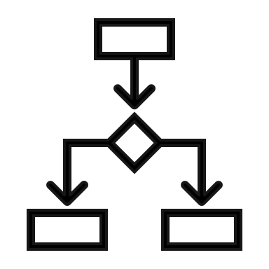
Learning objectives
Define what informed choice means in the context of counseling
Understand how to talk about choice with your client
Become familiar with the tools available to you for choice counseling

Slide 5
informed choice
Individuals have the autonomy, knowledge, and freedom from coercion at any given time to select the best method for them in a specific market.
First, let’s determine what is
Adapted from MOSAIC Choice Principles

Slide 6
Options refer to discrete HIV prevention methods
available in a specific market.
Choice is the autonomy, knowledge, and freedom from coercion at any given time to select the best method for them among options available in a specific market.
Options ALONE are not choice
Adapted from MOSAIC Choice Principles

Slide 7
In order to make an informed choice, an individual needs to know what options are available, have relevant information that is accurate and understandable about the options, and based on this, weigh up the benefits and suitability according to their needs and circumstances.
Options ALONE are not choice

Slide 8
Learnings from the Family Planning field show that when we focus on client needs and lifestyle, we increase consistent use.
*Among several studies, Dehlendorf et al. (2016) found that high quality interpersonal counseling can sustain patients continued use of contraception six months later. The research defines high quality interpersonal counseling as "grounded in the principles of patient-centered care, and a defining feature of patient-centered care is an emphasis on treating patients as individuals, including being responsive to their needs and preferences.
Dehlendorf, et al. Association of the quality of interpersonal care during family planning counseling with contraceptive use, American Journal of Obstetrics and Gynecology, Volume 215, Issue 1, 2016.

Slide 9
We need to ensure clients are aware of their HIV prevention choices and informed and supported to make choices that are relevant to their needs and lifestyle.
THINK & DISCUSS
What does choice in the context of HIV prevention mean to you?
Share examples where you have had to exercise choice (e.g., mobile phones, contraception, etc.). What factors did you consider?

Slide 10
Assisting the client in making an informed choice is part of the counseling process - whereby the provider and client explore the client's knowledge and needs in relation to the available options.
The provider needs to ask questions, provide information, and answer questions. Based on this process, the client is supported to make an informed decision.
Choice counseling is part of a conversation

Slide 11
The discussion needs:
Adequate time for the client to ask questions and take in the information
Be client-centered and client-led
A two-way conversation
Be flexible
Embracing both sexual reproductive health and HIV, as per the client's needs – especially issues such as contraception, planning for pregnancy, sexually transmitted infections (STIs), and gender-based violence (GBV)
Choice counseling is part of a conversation checklist

Slide 12
Tips for the counseling conversation
HIV-negative people interested in HIV prevention options should receive counseling prior to starting a method as well as at follow-up visits.
This ensures that clients understand how to use their method, are supported in effective method use, discuss challenges, and receive support should they wish to change to other prevention options.
HIV prevention is interrelated with sexual and reproductive health and rights, and as such, HIV prevention should always be discussed with the prevention of pregnancy, STIs and gender- and sexually-based violence.

Slide 13
Counseling Tips
Focus on the needs and lifestyle preferences of the client
Be non-judgmental, client-centered and sensitive
Respect the rights of the client to make an informed choice, and that this choice may change over time;
Create a safe space where their choices and opinions are valued
Encourage a journey to explore the behaviors that may expose clients to HIV
Recognize that sex is not always predictable nor planned
Understand that behavior change needs time and reinforcement
Open the conversation – about potential exposures to HIV, options, previous and current experience with HIV prevention methods, and sexual health protection plans
Explore prevention choices and solutions; identify small wins and achievable next steps in reducing a client’s likelihood of getting HIV
Provide the opportunity to jointly problem-solve and foster motivation, especially in relation to continuation and effective use of a specific method
Encourage your client to ask any questions, dispel myths and provide information that your client can understand
Ensure that clients have sufficient understanding so that they feel confident using their methods

Slide 14
Where does choice counseling fit into the conversation
I have a friend using the ring. I’d like to know more
I want to prevent HIV
I want something my partner doesn’t know about
What if I miss an injection?
Let’s talk about the CATALYST study and what’s offered here
Let’s talk about the HIV prevention options that are available to you
Let’s talk about which options are right for you based on your lifestyle
DISCUSSION PROMPTS
What is important to you in an HIV prevention method and why?
Why are you here today?
What do you know about HIV prevention?
Do you have any other questions?
Use the client’s needs and knowledge to determine the flow of the choice counseling conversation

Slide 15
Where does choice counseling fit into the conversation on switching
If your client is already on oral PrEP and wants to switch to another method
I am on oral PrEP and I might want to use something else.
DISCUSSION PROMPTS
Let’s talk about which options are right for you based on your lifestyle
How did you do with oral PrEP? Tell me about your experience
Let’s talk about the other HIV prevention options that are available to you
Why are you here today?
Let’s talk about the CATALYST study and what’s offered here
What is important to you in an HIV prevention method and why?
What do you know about other HIV prevention methods?
Do you have any other questions?
Use the client’s needs and knowledge to determine the flow of the choice counseling conversation

Slide 16
Tools to guide & support choice counselling
alongside clients

Slide 17
Tools to guide & support the choice counseling conversation
Suggested use for tools:
Pre-visit
Choice counseling conversation
Post-visit
Let’s talk about the HIV prevention options that are available to you
What is important to you in an HIV prevention method and why?
Let’s talk about which options are right for you based on your lifestyle
What do you know about HIV prevention?
Do you have any other questions?
HIV Prevention User Journey Digital Tool
Web-based tool to help clients (AGYW) select the most appropriate combination of HIV prevention methods. Available for AGYW to use prior to provider visit, they may bring in the knowledge from use of the tool to the conversation.
HIV Prevention User Journey Reference Manual
Flipchart style book holding information about all HIV prevention methods intended for provider use as background reference. Can be used during conversation or referred to as needed.
HIV Prevention User Journey Info-Map
Placemat or poster to use alongside your client to walk through their needs and preferences and different HIV prevention methods available. This tool will be available in local languages and should be provided to a client in their language.
HIV Prevention Method Factsheets
Short factsheets for clients holding detailed information on each prevention method for use after method has been selected to help answer specific questions. This tool will be available in local languages and should be provided to a client in their language.

Slide 18
Tools to guide & support the choice counseling conversation – additional information
Tool | HIV Prevention User Journey Digital Tool | HIV Prevention User Journey Reference Manual | HIV Prevention User Journey Info-Map | HIV Prevention Method Factsheets
WHAT IS IT? | Web-based tool to help clients select the most appropriate combination of HIV prevention methods. Clients may bring in knowledge from use of the tool to the conversation with a provider. | Flipchart style book to help with deciding which HIV prevention methods are most suitable for your client, containing information about all HIV prevention methods. | Placemat or poster to use alongside your client to walk through their needs and preferences and available HIV prevention methods. | Short factsheets containing detailed information on each prevention method for use after a method has been selected to help answer specific questions.
WHEN IS IT USED? | Intended use: Support client awareness Prior to a provider visit, either in the clinic waiting room or in the community. | Intended use: A reference manual for providers Read by provider prior to undertaking choice counseling, used as needed. | Intended use: Support choice counseling conversation with provider and client Used as needed during conversation to guide client through discussion of lifestyle and needs | Intended use: Support client knowledge on methods Can be used during or after conversations to share information or inform decision making on each method.
INSTRUCTIONS FOR USE: | QR code or card with the web link provided in the clinic or in community. (Your study site may have peer navigators to help with use) | Provider should become familiar with the content of the manual prior to starting choice counseling. | Provider should become familiar with the lifestyle questions to guide conversation with client. | Explained and provided to client by provider.

Slide 19
Putting it Together: Conversation tips & tools
Let’s talk about the CATALYST study and what’s offered here.
Let’s talk about the HIV prevention options that are available to you.
Let’s talk about which options are right for you based on your lifestyle.
DISCUSSION PROMPTS
What is important to you in an HIV prevention method and why?
Why are you here today?
What do you know about HIV prevention?
Do you have any other questions?
Let’s talk about the options and then see what is best for you
Let’s go through a journey together to see what’s right for you
We are a study…[provide clear explanation of what the study is and what it aims to do]
We are all different. Each of us has different needs and preferences
Our conversation is private and confidential
There are several different ways to prevent HIV
I understand talking about sex is difficult but please trust me and feel free to be honest
CONVERSATION STARTERS
Which HIV methods you have heard about?
TOOL: CATALYST Study Overview Factsheet
TOOL: HIV Prevention User Journey Reference Manual
TOOL: HIV Prevention User Journey Info-map
TOOL: HIV Prevention Method Factsheets
I am here to support you to make decisions

Slide 20
Info-map: to be used as a guide to support counseling conversation
INFO-MAP
Product icons are two colors, these colors are the same in the full reference manual in each product section and help you to find the section you’re looking for!

Slide 21
Manual: reference book for providers for “shelf” reference, can be used as flipchart if preferred
REFERENCE MANUAL
+
CONTRACEPTION
WHERE DESIRED

Slide 22
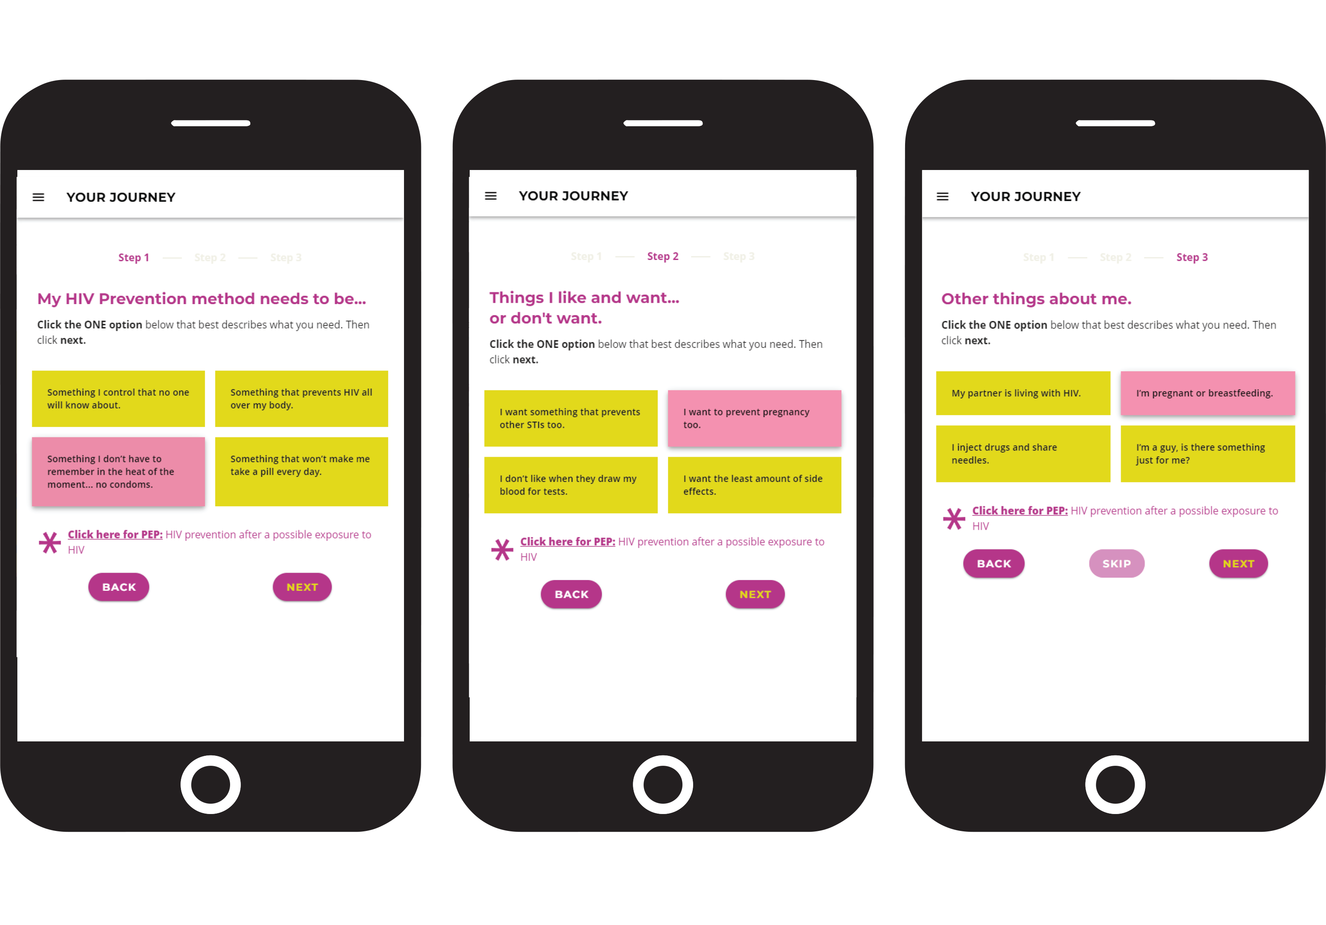
Digital Tool: Application for client use to support client’s informed choice
DIGITAL

Slide 23
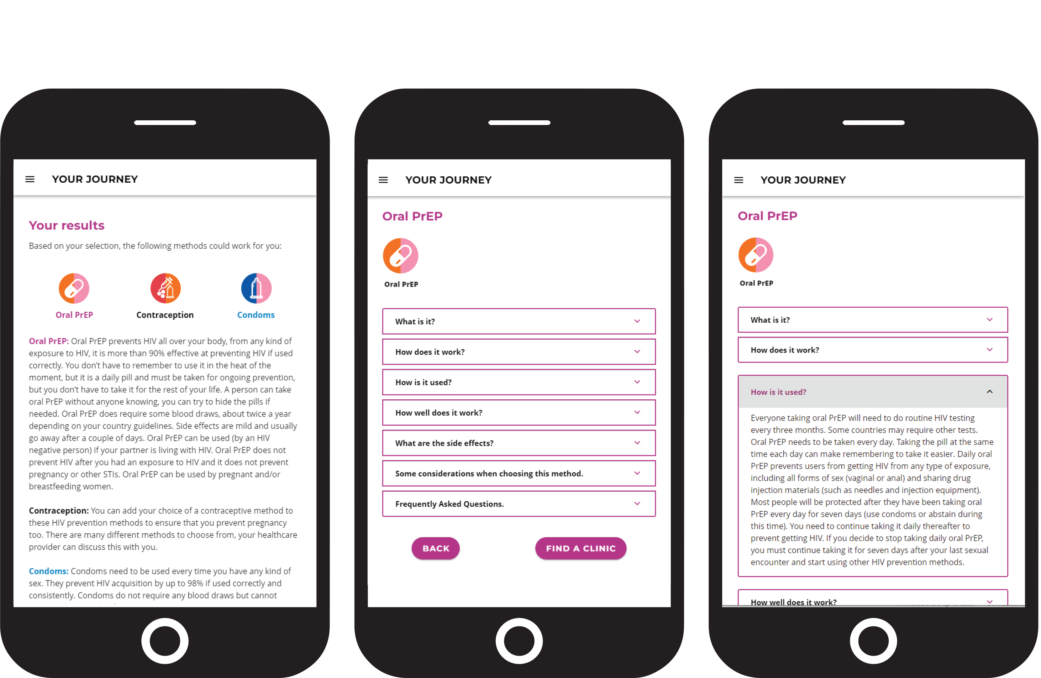
How to use this tool
DIGITAL

Slide 24
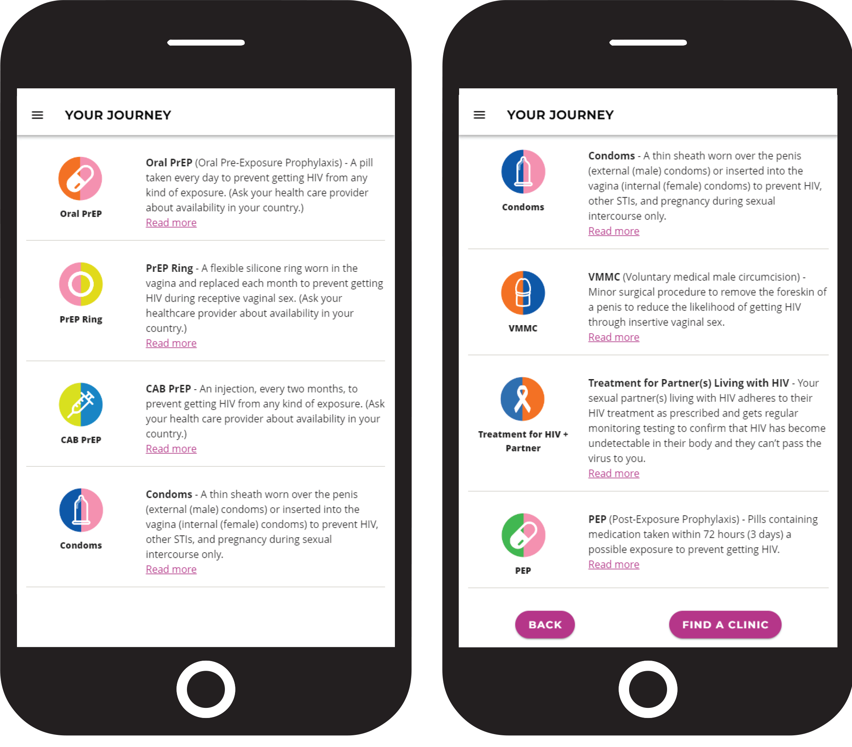
How to use this tool
DIGITAL

Slide 25
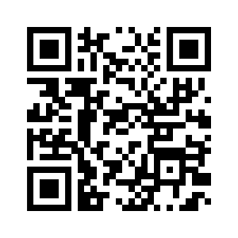
Give it a test drive!
https://journeytool.myprep.co.za/#/

Slide 26
Key Takeaways:
Options do not equal choice. Clients need accurate and understandable information on each available method.
Clients should be supported to make a choice based on their needs and lifestyle preferences, without judgement.
Adequate time is needed to have a conversation on choice counseling.
Choice counseling should be a client-focused and client-led conversation.
Choice counseling should happen at the initial visit AND at follow-up visits.
The Journey Tool Package & Factsheets are tools to support and guide choice counseling conversation, but they are not choice counseling alone.

Slide 27
Activity (15-20 mins)
Please note, study visits will be packed with information for the client, so the conversation on choice needs to be short, concise and comprehensive!
Turn to the person next to you, introduce yourself.
Choose one person to be the provider and one person to play the role of AGYW.
Using the discussion prompts and tools, initiate a conversation about choice.
Use one of the tools in your conversation, become familiar with the tool.
Now switch roles! (Spend 5-10 mins in each role)

Slide 28
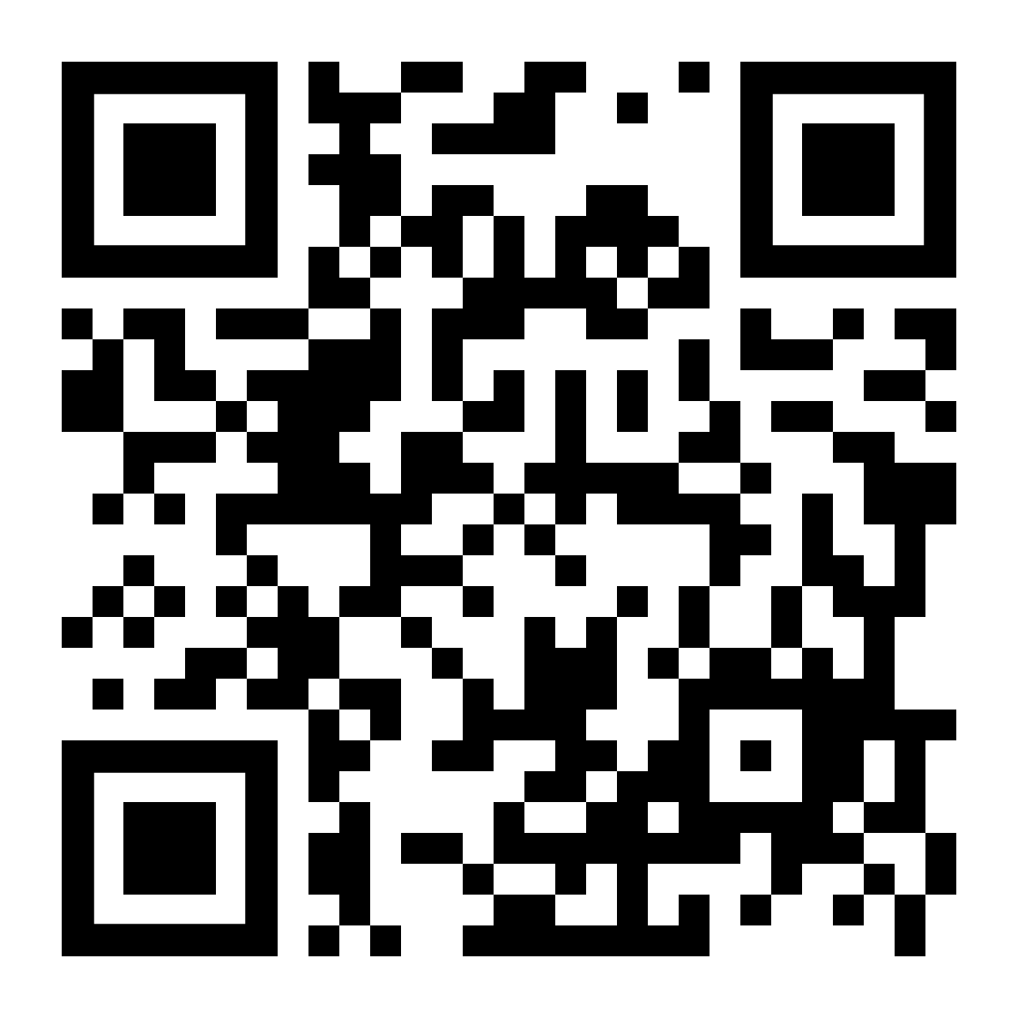
Journey Tool Pre-Use Questions
For use post choice counseling training with all providers
We want to understand if the tool supports the provider-client HIV prevention choice
counseling conversation.
At this time, please go to the link or scan the QR-code to answer 4 quick questions
https://forms.gle/qrJCVVwU614XkNPy6
Notes:
Facilitators: Please have each provider complete the Pre-Use questions via google forms on a computer, tablet, or their phone.

Slide 29
Elmari Briedenhann and Melanie Pleaner, Wits RHI; Allison Cole and Emily Donaldson, FHI 360

