Slide 1





Drug Resistance Testing
for PrEP Seroconverters
Dried blood spot collection from venipuncture
Notes:
This video will demonstrate how to collect a Dried Blood Spot, using a venipuncture blood draw, for HIV drug resistance testing.

Slide 2
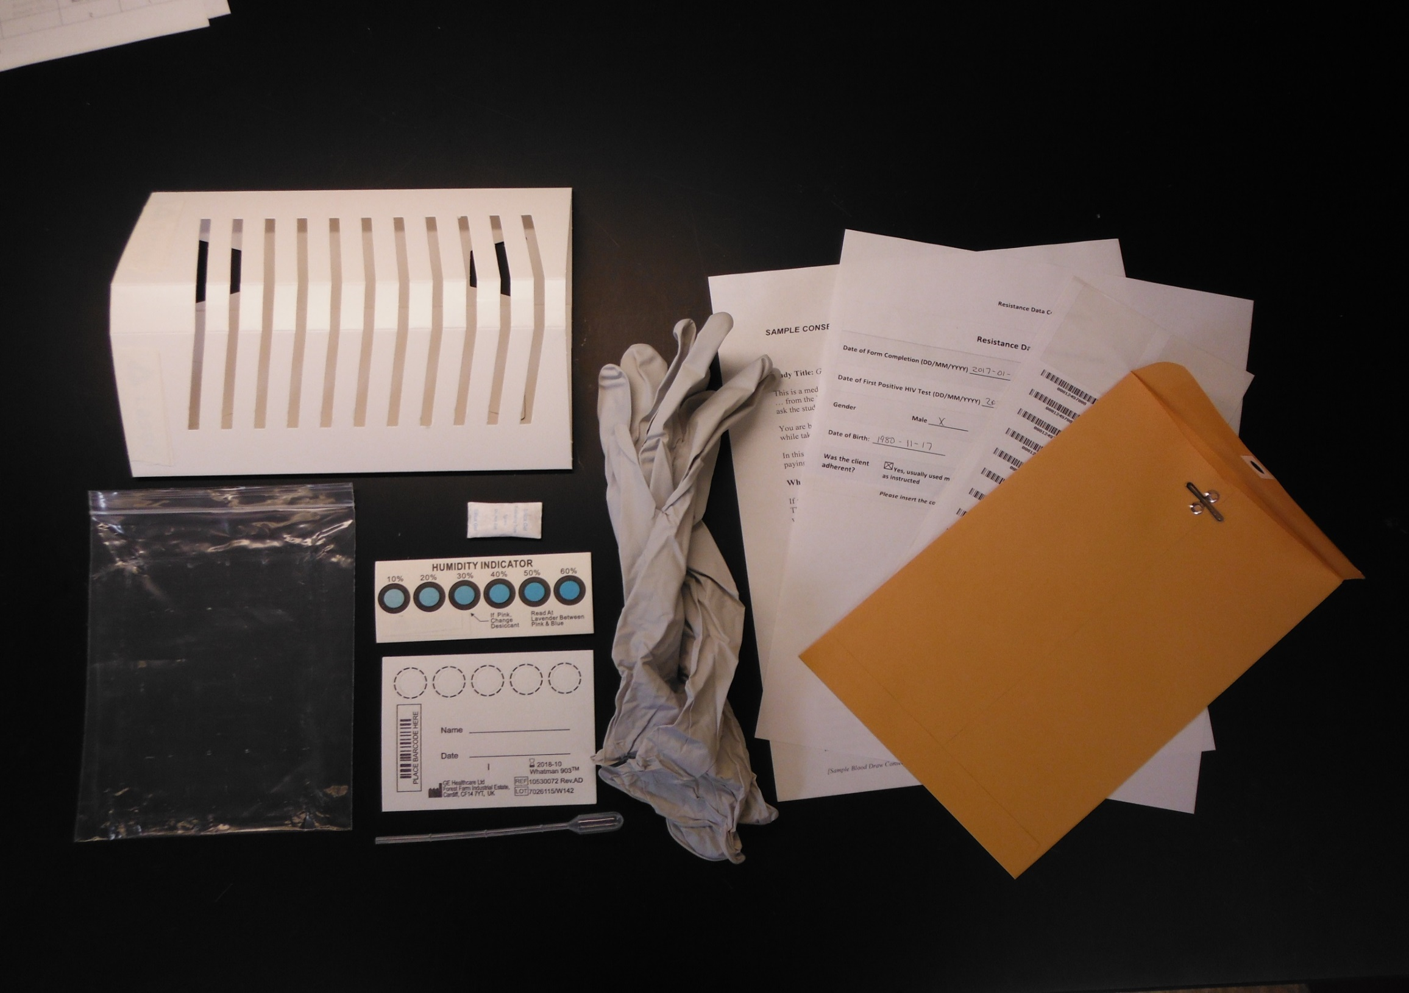
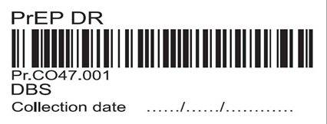
Materials Needed
Lab requisition form
Informed consent form
Case report form
Gloves
Alcohol wipe
Tourniquet
Blood collection needle
Gauze
Blood collection tube
Pipette
Dried blood spot cards
Drying rack
Sealable bag with desiccant and humidity indicator
Shipping envelope
Notes:
Before you begin, make sure you have all the necessary materials ready – including the lab requisition form, informed consent form, case report form, gloves, alcohol wipe, tourniquet, blood collection needle, gauze, blood collection tube, pipette, dried blood spot cards, drying rack, bag with desiccant and humidity indicator, and shipping envelope.

Slide 3
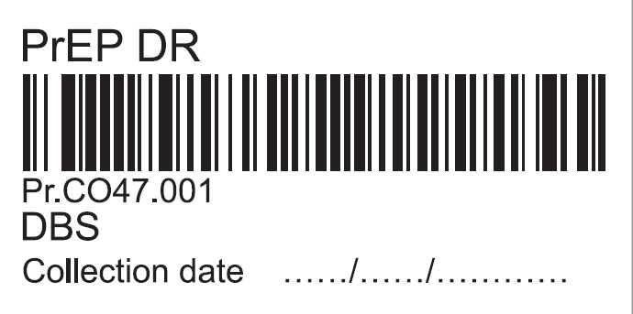
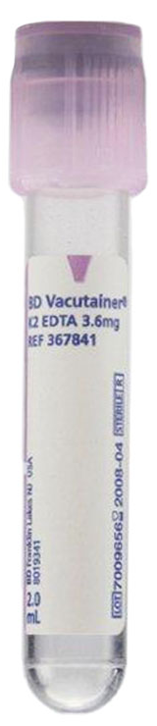
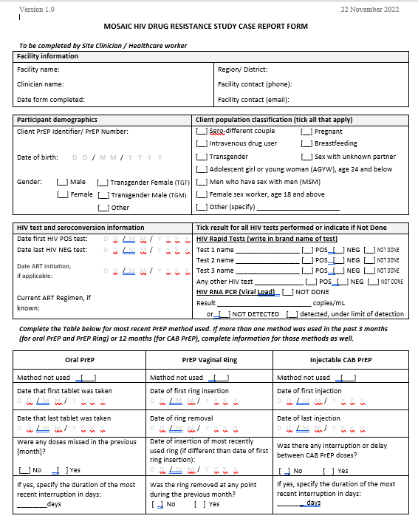
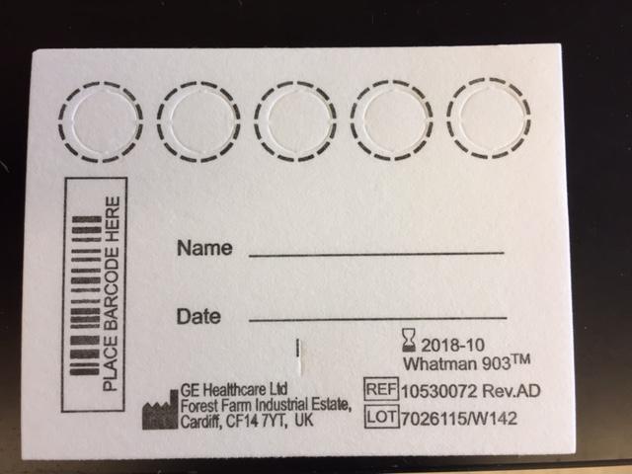
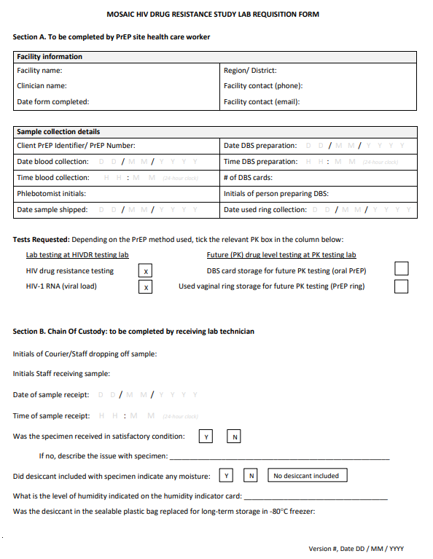
Place barcodes or write the PrEP ID number on documentation materials
1
2
3
4
5
Notes:
Write the participant’s PrEP ID number or attach the same numbered barcode stickers to the blood collection tube, the case report and lab requisition forms, 2 DBS cards, and the client’s file. Do not write the participant's name on the forms or DBS cards.

Slide 4
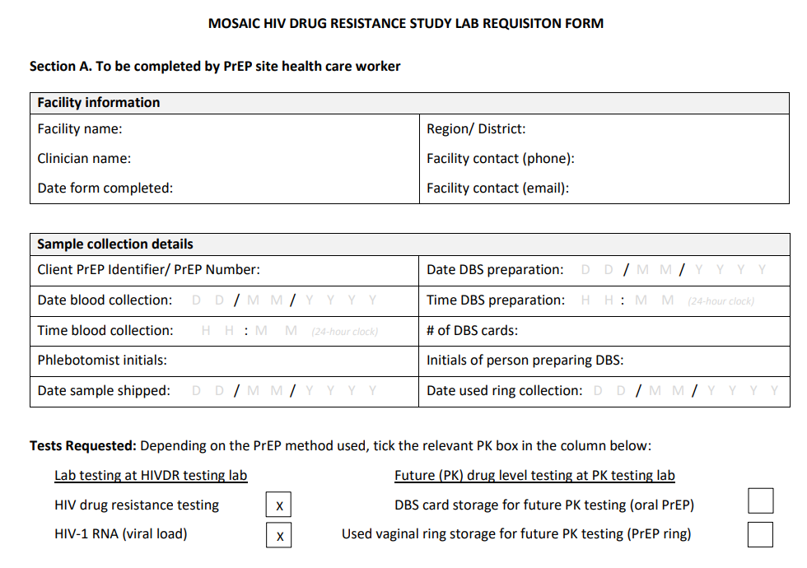
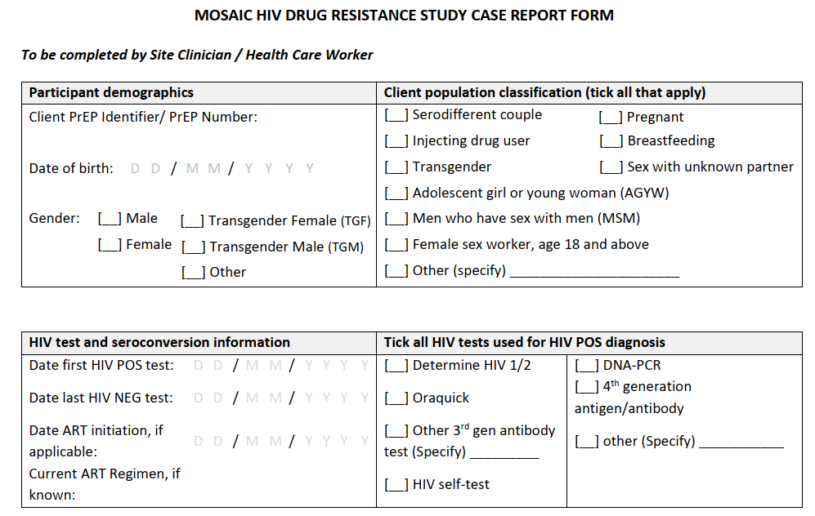
Fill out the case report form and the laboratory requisition form
Notes:
Once you’ve placed the stickers, fill out the case report form and lab requisition form.

Slide 5
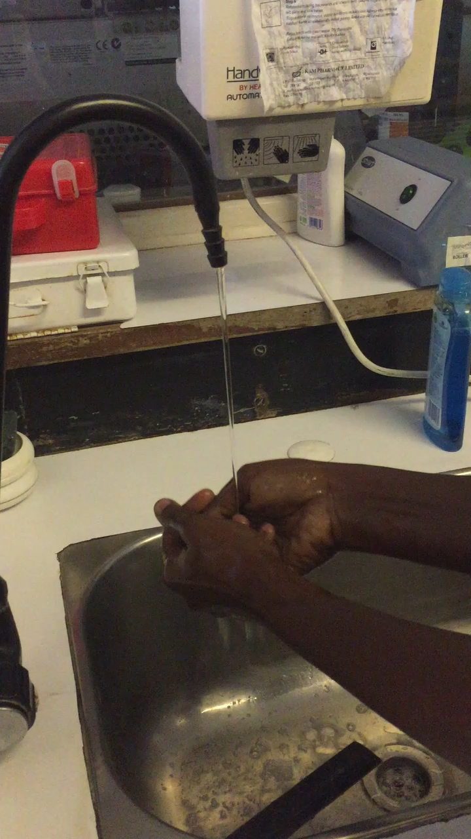
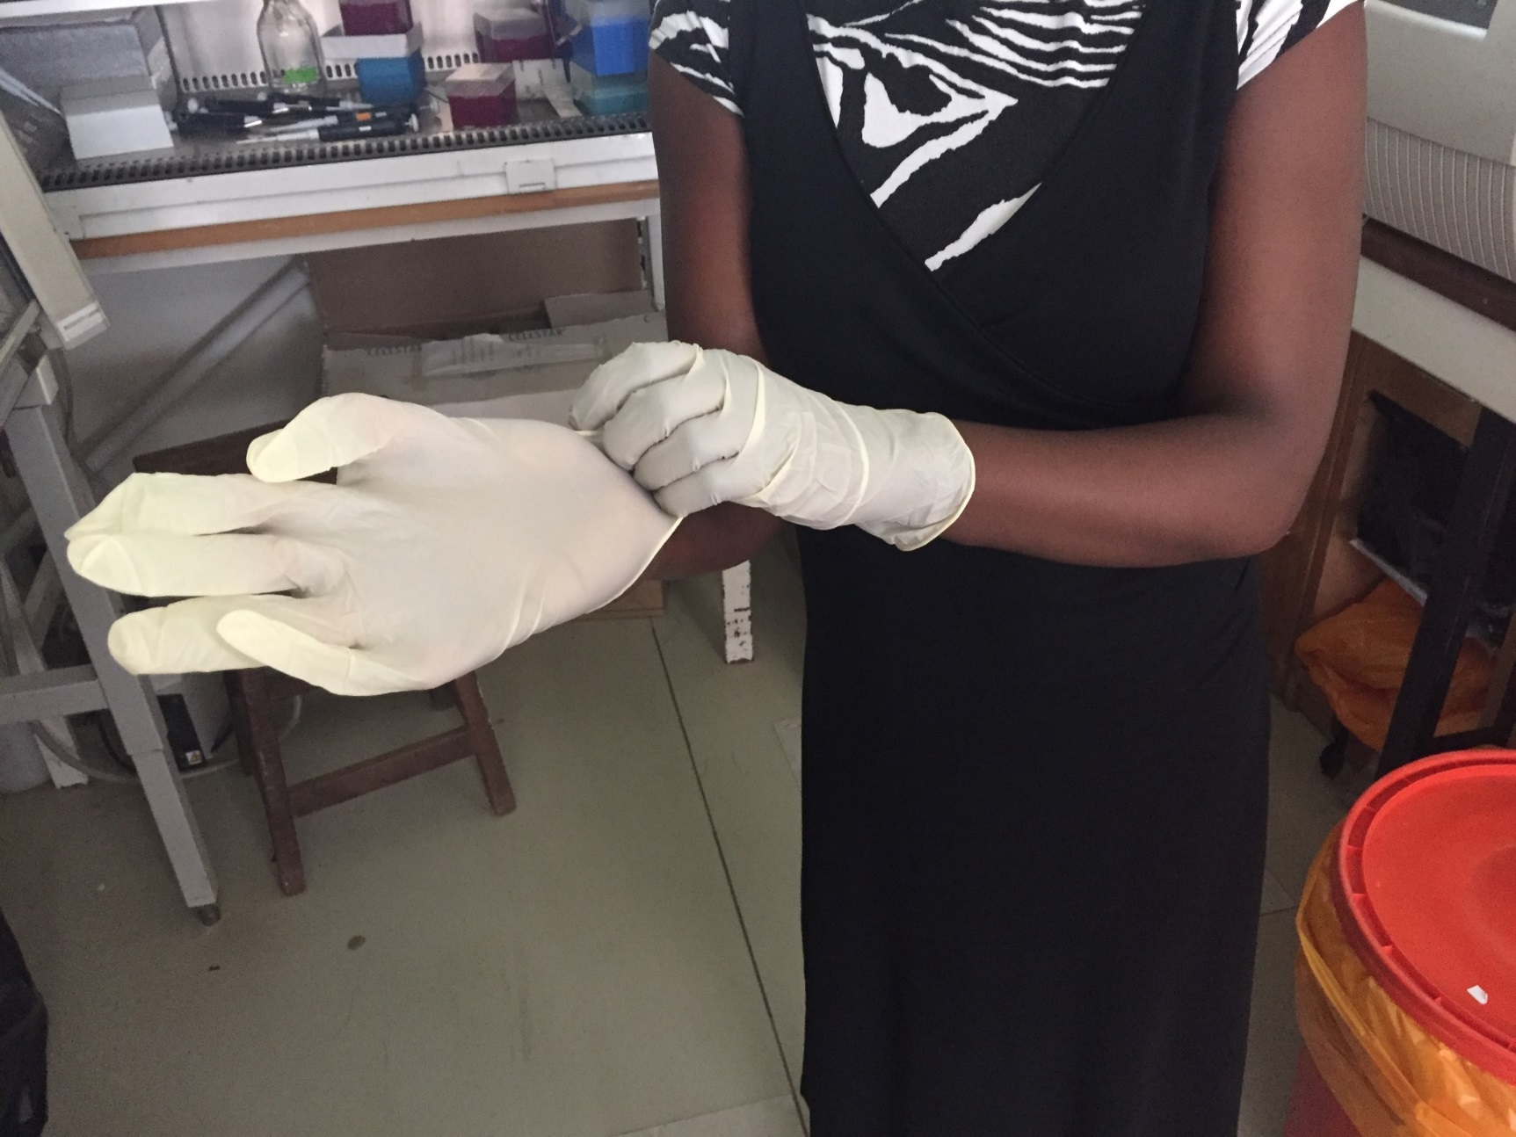
Make sure to wash hands, dry them and put on gloves.
Notes:
Make sure to wash hands, dry them and put on gloves.

Slide 6
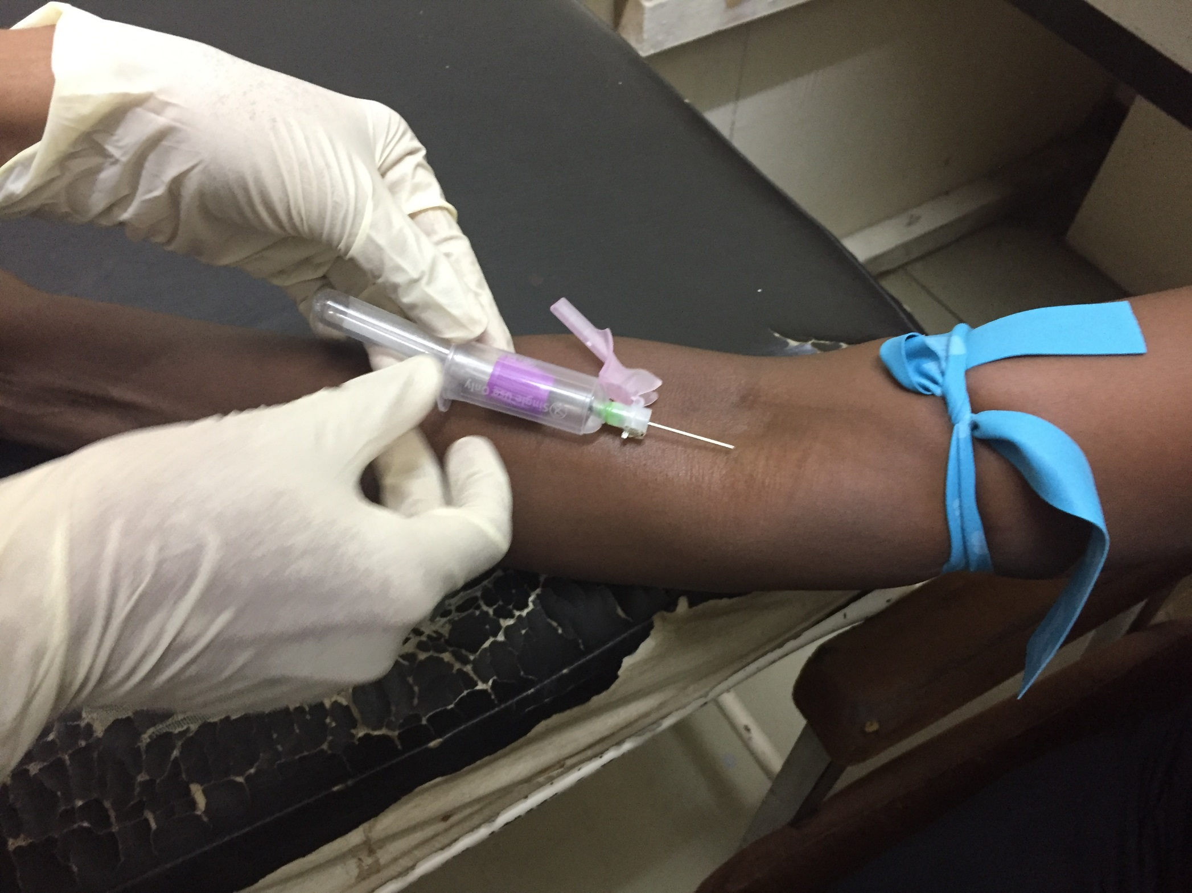
Collect venous blood according to your clinic’s Standard Operating Procedure
Notes:
Collect venous blood according to your clinic’s Standard Operating Procedure.

Slide 7
Spotting the Dried Blood Spot Card

Slide 8
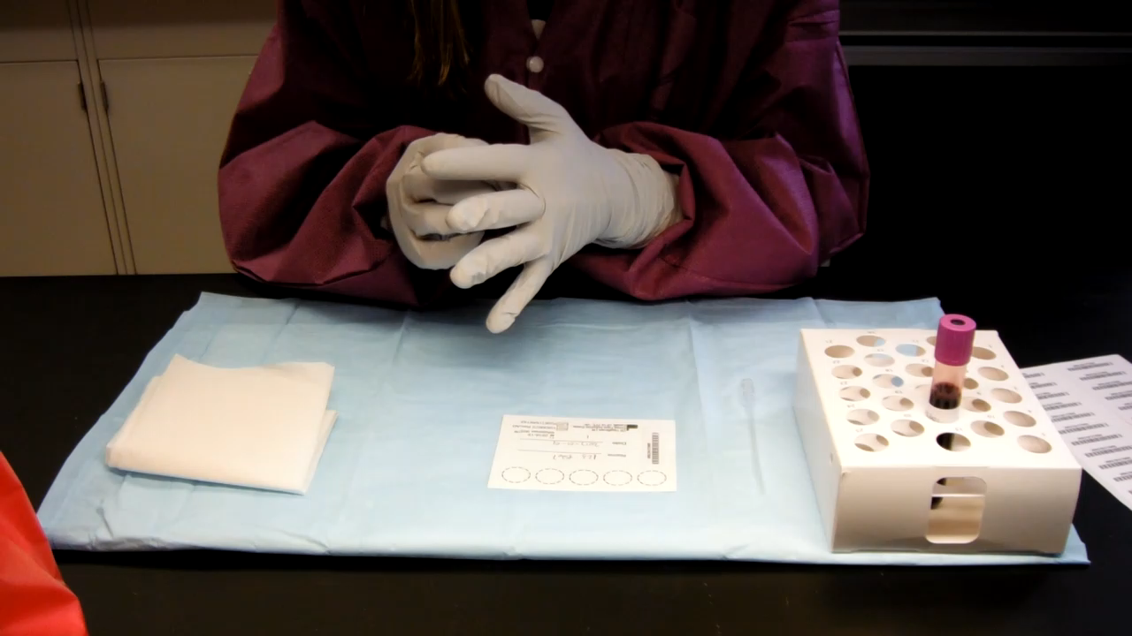
Use a transfer pipette to spot the card
Notes:
Gently invert the blood collection tube at least 5 times.
Afterward, open the stopper carefully and insert the pipette in the tube.
Aspirate the blood into the transfer pipette, avoiding air bubbles.
Using the pipette, transfer two drops of blood to the center of all the circles without touching the DBS card directly with the tip of the pipette.
Try to fully saturate the circle.
The blood should fill in the entire circle, and fill all five circles. Repeat this transfer process on a second DBS card

Slide 9

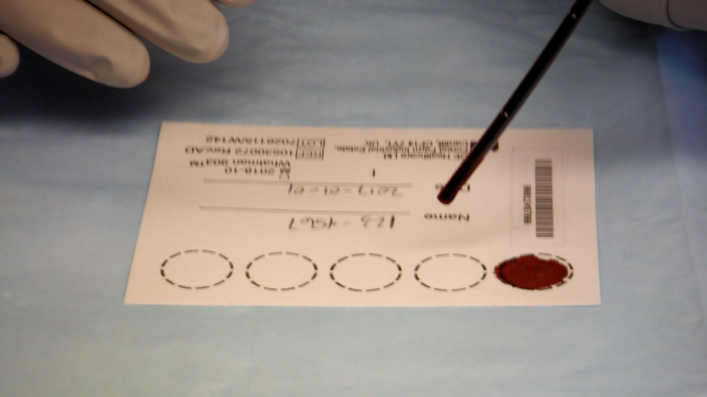
Notes:
Here is a closer look at how to spot the DBS card.

Slide 10
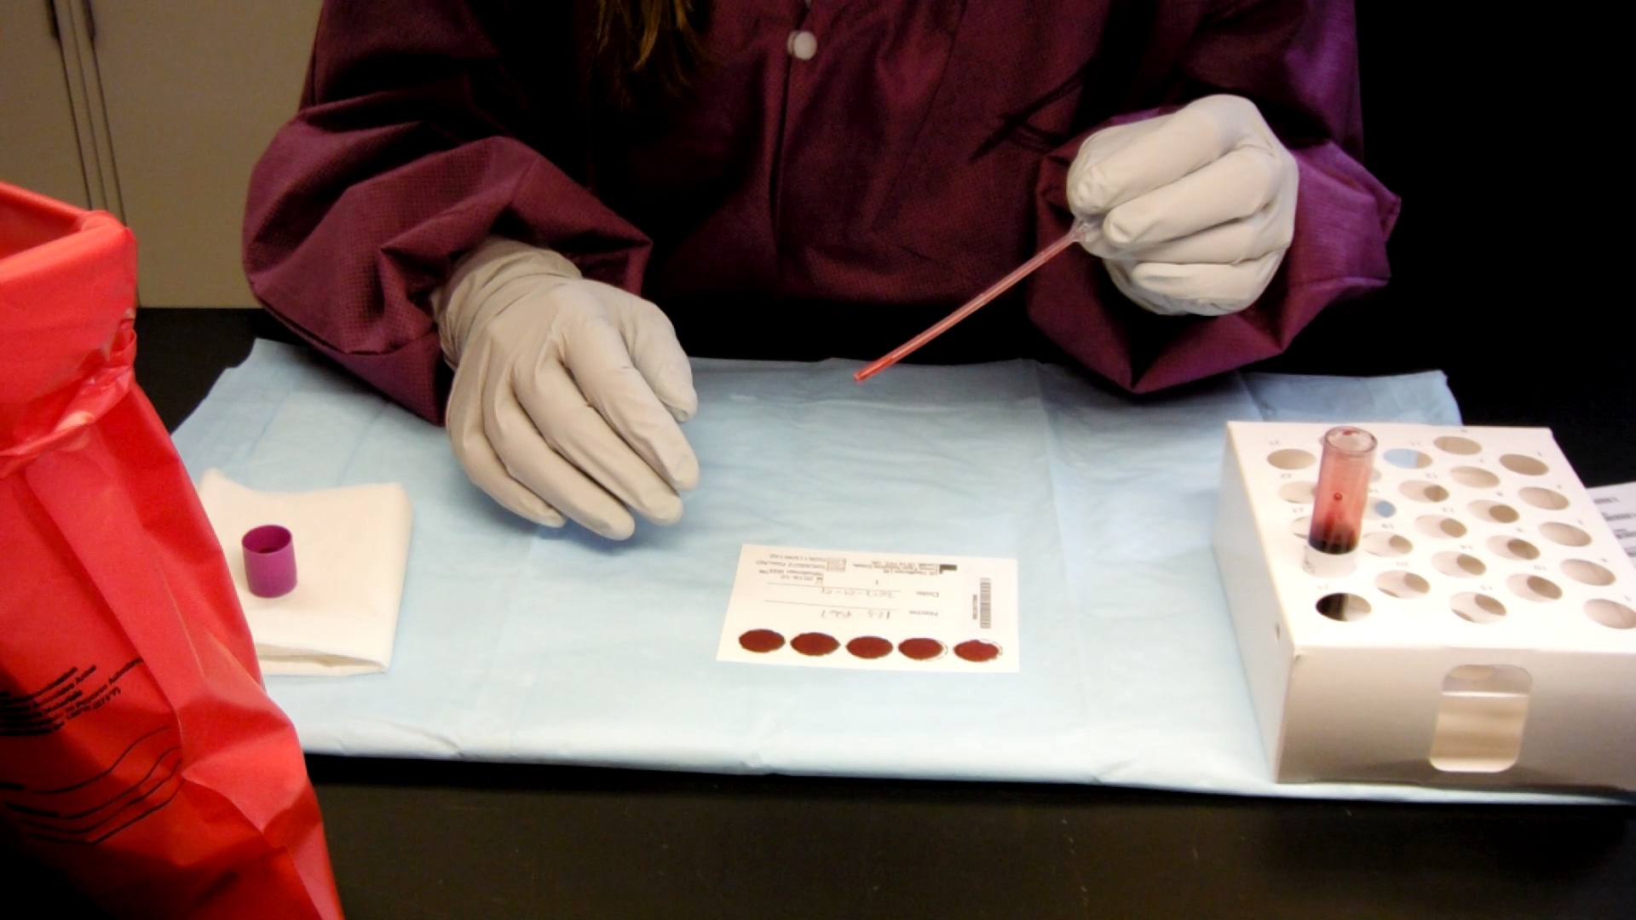
Spot the second card and cap the tube
Notes:
Repeat the procedure with a second card. After spotting the second card, discard the pipette and cap the tube.

Slide 11
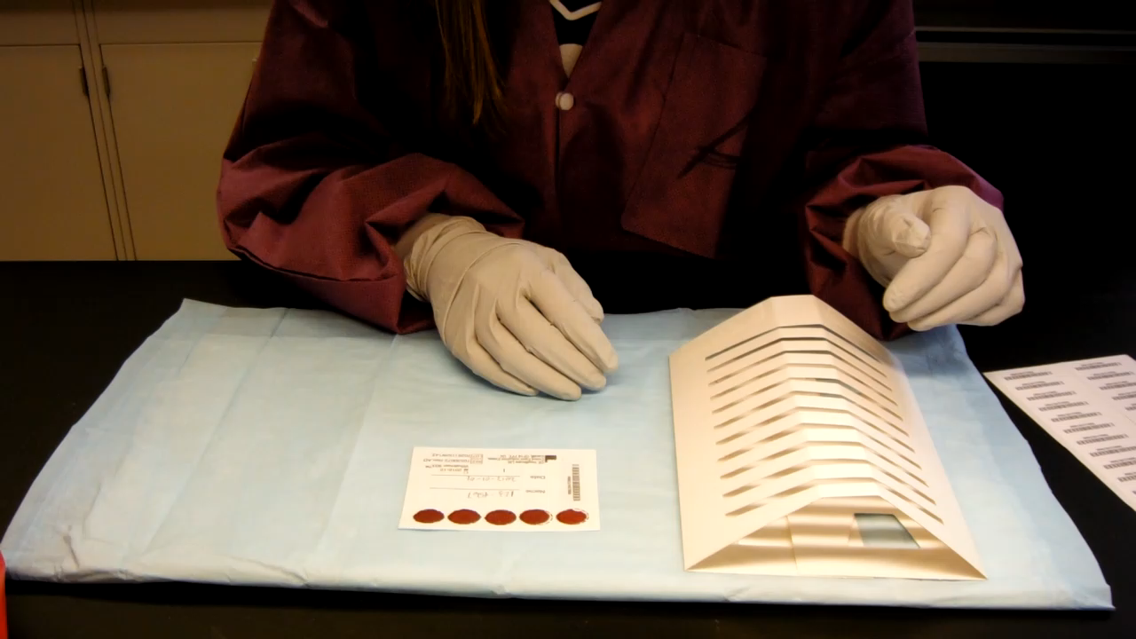
Dry the cards for at least 3 hours or overnight
Notes:
Once you’re done, store the DBS card on the drying rack and dispose of any used and leftover materials.
The card should dry for at least 3 hours, and preferably overnight.

Slide 12
Preparing for Shipment

Slide 13
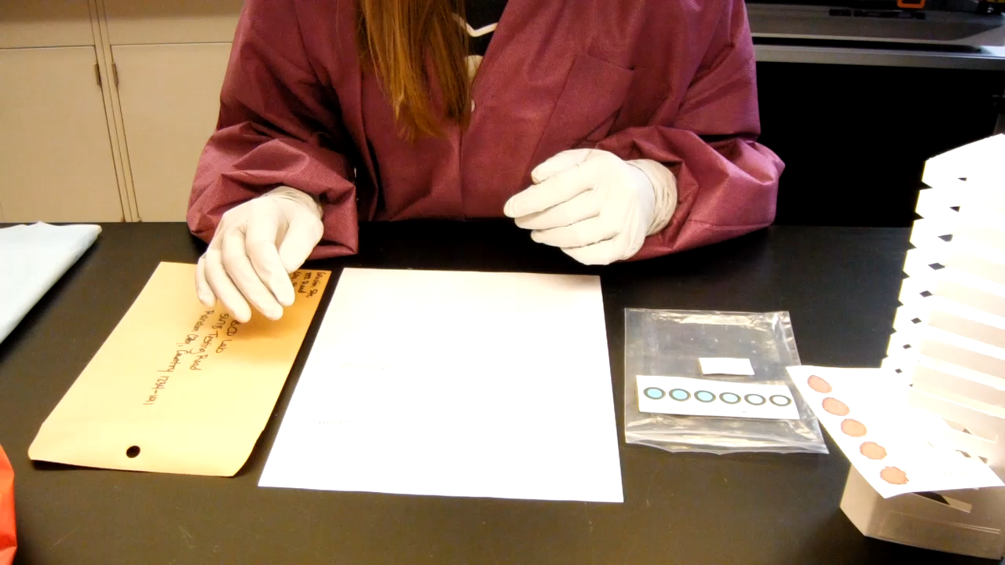
Items to Ship
Envelope includes:
  Sealed plastic bag with DBS cards, Desiccant, Humidity Indicator
  Case report form
  Lab requisition form
Mail the envelope immediately, or within 3 days.
Notes:
Once it dries, put the DBS card in the sealable plastic bag with the desiccant and humidity indicator.
Then put the sealed plastic bag with the DBS card, along with the case report form, and lab requisition form, in the envelope provided.
Remember to ship the envelope as soon as possible. If it’s a Friday, remember to ship on Monday.

Slide 14
Thank you!
For further information, please visit
www.prepwatch.org/mosaic-hiv-drug-resistance-monitoring-program/

