Slide 1
Pre-Exposure Prophylaxis (PrEP) and HIV Drug Resistance
Training materials for health care workers
Version 2; July 2023

Slide 2
Contents
Module | Training Topic | Slide Number
1 | HIV and Drug Resistance | 3
2 | Risk of Drug Resistance with PrEP | 9
3 | Overview of Study Procedures | 16
4 | Step-by-Step Study Procedures | 22
5 | Interpreting Drug Resistance Test Results | 42
6 | Counseling Participants about Drug Resistance | 55
7 | Good Clinical Practice Tips | 60

Slide 3
HIV and Drug Resistance

Slide 4
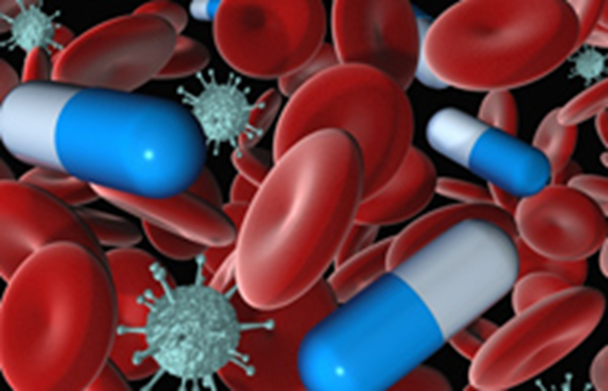
Antiretrovirals (ARVs) for Treatment
When someone acquires HIV, the virus begins to make copies of itself inside the body.
Antiretrovirals (ARVs) are drugs that stop the virus from making copies of itself.
A combination of three ARVs is usually needed to stop the virus from making copies.
Source: iStock/mipan

Slide 5
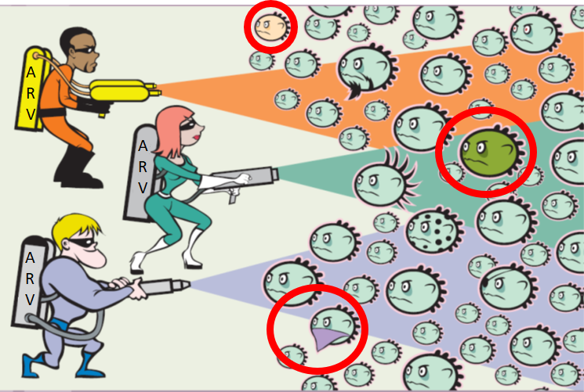
What Happens When HIV Mutates?
Sometimes, the genetic material in the virus changes; these changes are called mutations.
The mutated virus begins to make more and more copies of itself inside the person’s body.
ARVs work best to treat what is called the “wild-type” (or non-mutated) virus.
Source: www.thebody.com
Because ARVs are less effective at stopping mutated virus from making the copies of itself, the amount of virus in the body continues to increase; this is called treatment failure.

Slide 6
What Is HIV Drug Resistance?
The ability of HIV to continue making copies of itself in the presence of ARVs is called HIV drug resistance (HIVDR).
What does this mean?
The resistance will be to specific HIV drugs used for treatment (not all types of ARVs).
These specific drugs will not be able to stop all of the HIV viruses from making copies.
A different combination of three drugs may be needed to treat HIV.
If an individual develops resistance, they may have fewer choices of ARV drugs that they can use for treatment (but they will still have options).

Slide 7
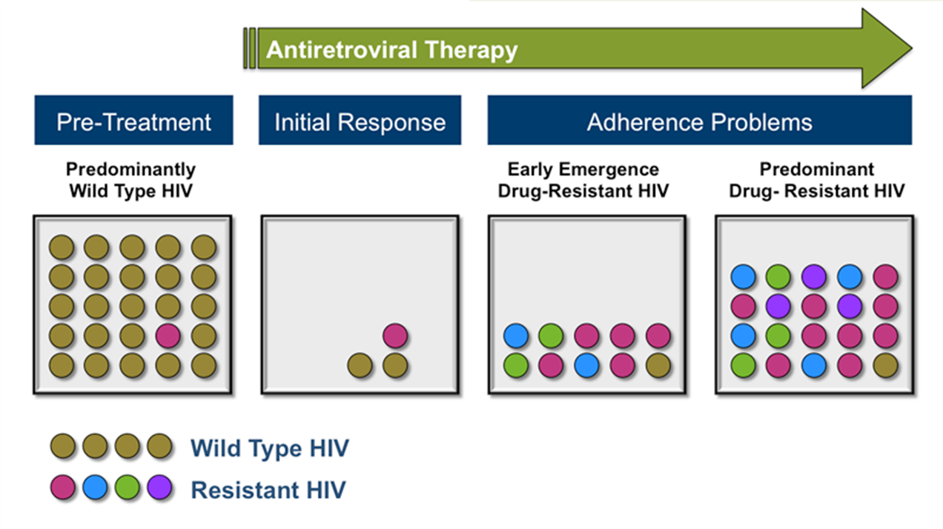
Impact of Adherence on HIVDR
Before a person with HIV starts ARV therapy (ART), they may have mostly “wild type” virus.
Once they start ART, the amount of virus in their body decreases.
If the person does not take their ARVs regularly, the amount of drug in the body begins to decrease and the virus in their body can mutate, grow, and become resistant to some ARVs.
If the drug-resistant virus continues to grow, the current ARV regimen will no longer be effective.
Source: David Spach, https://www.hiv.uw.edu/go/antiretroviral-therapy/evaluation-management-virologic-failure/core-concept/all
Notes:
Pretreatment drug resistance (PDR) is resistance transmitted at the time of infection or acquired due to prior ARV drug exposure (e.g., in women exposed to ARV drugs for the prevention of vertical transmission of HIV, in people who have received pre-exposure prophylaxis, or in individuals reinitiating first-line ART after a period of treatment interruption without documented virologic failure).
Acquired drug resistance is resistance that emerges after an individual starts ART.

Slide 8

Why Should We Monitor HIVDR with PrEP?
If an individual living with HIV develops resistance to the same medications used for HIV treatment, the provider must find another combination of ARVs that may be effective against the mutated virus.
The drugs, or classes of drugs, that are used for PrEP are also used in ART regimens; monitoring for HIVDR helps to preserve the effectiveness of both PrEP and ART.
It is important to reassure participants with resistant virus that they still have treatment options.

Slide 9
2
Risk of Drug Resistance with PrEP

Slide 10
Reminder
PrEP is effective and seroconversions are infrequent

Slide 11
Scenarios of HIVDR While on PrEP
Adherence Gaps (sub-optimal use of PrEP)
Initiating PrEP during Acute Seroconversion
Transmitted HIVDR
A person with HIV transmits drug-resistant virus to HIV-negative partner who takes PrEP.
A person starts taking PrEP during acute HIV infection (before HIV test turns positive).
HIV-negative person takes PrEP.
PrEP does not protect against the resistant virus in the partner that was HIV negative.
Becomes infected with HIV but keeps taking PrEP until she gets a positive rapid test result
Keeps taking PrEP until they get a positive rapid test result
PrEP user acquires drug-resistant HIV.
HIV becomes drug resistant.
HIV becomes drug resistant.
Notes:
The major factors influencing the selection or acquisition of resistance during PrEP use include the level and duration of ARV exposure during unrecognized acute infection, the occurrence of breakthrough infection due to suboptimal drug levels, and the prevalence of transmitted drug resistance (TDR) in the regions where PrEP rollout is implemented.

Slide 12

How Could Someone Take PrEP and Not Know They Had HIV?
If a person recently acquired HIV, the HIV test might not have detected the infection because of the window period of the test.
    This is why it is important for providers to assess for symptoms of acute HIV infection before providing PrEP.
    An example of an acute seroconversion checklist available here: Seroconversion Checklist.pdf (prepwatch.org).

Slide 13
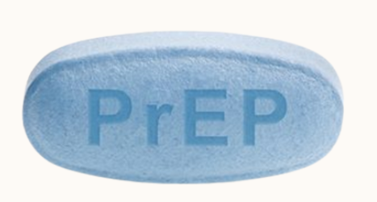
What Do We Know about HIVDR and Oral PrEP?
Efficacy and implementation studies demonstrated that HIVDR is infrequent if PrEP is started before HIV infection has occurred.
HIVDR is more likely to occur when PrEP is started during undiagnosed acute infection.
Notes:
Oral PrEP efficacy trials demonstrated that HIV drug resistance (HIVDR) is infrequently selected if PrEP is successfully started before HIV-1 infection has occurred and is more likely to occur when PrEP is inadvertently started during undiagnosed acute infection. Among the 348 reported individuals who seroconverted while prescribed oral PrEP, 35 occurred when PrEP was initiated during undiagnosed acute infection; of these, 18 of 35 (51%) had HIV-1 with mutations associated with resistance to tenofovir disoproxil fumarate (TDF) or emtricitabine (FTC) resistance (K65R and/or M184I or V). A total of 313 individuals became HIV positive after starting PrEP; of these, 19 of 313 (6%) had TDF- and/or FTC-associated mutations. Results from the Global Evaluation of Microbicide Sensitivity (GEMS) project further demonstrated the risk of HIVDR with oral PrEP use in a real-world setting across Eswatini, Kenya, South Africa, and Zimbabwe. Of the 118 seroconversions tested for HIVDR through GEMS, 23% had PrEP-associated resistance mutations, with the majority having TDF diphosphate levels associated with four or more doses per week.
Parikh UM, Mellors JW. How could HIV-1 drug resistance impact preexposure prophylaxis for HIV prevention? Curr Opin HIV AIDS. 2022 Jul 1;17(4):213-221. doi: 10.1097/COH.0000000000000746. PMID: 35762376; PMCID: PMC9245149.

Slide 14

What Do We Know about HIVDR and the PrEP Ring?
In clinical trials, rates of resistance did not differ between the placebo ring and PrEP ring arms.
The risk of transmission or selection of high-level non-nucleoside reverse transcriptase inhibitor (NNRTI)-resistant virus in rollout settings is not yet known.
Notes:
The PrEP ring efficacy trials (ASPIRE and The Ring Study) demonstrated that rates of resistance did not differ between the placebo ring and PrEP ring arms. Of 71 women from the PrEP ring arm who seroconverted in ASPIRE, 8 (10%) had one or more non-nucleoside reverse transcriptase inhibitor (NNRTI) resistance mutations; of the 77 women from the PrEP ring arm who seroconverted in The Ring Study, 14 (18%) had one or more NNRTI resistance mutations. Similar levels of drug resistance were observed in placebo arms. The risk of transmission or selection of high-level NNRTI-resistant virus in rollout settings is not yet known.
Parikh UM, Mellors JW. How could HIV-1 drug resistance impact preexposure prophylaxis for HIV prevention? Curr Opin HIV AIDS. 2022 Jul 1;17(4):213-221. doi: 10.1097/COH.0000000000000746. PMID: 35762376; PMCID: PMC9245149.

Slide 15
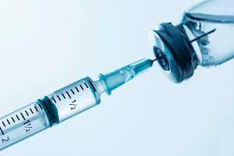
What do we Know about HIVDR and Injectable CAB PrEP?
Clinical trials demonstrated that diagnosis of HIV infection could be delayed for individuals who become HIV positive while taking CAB PrEP.
More research is needed to understand HIVDR risk with missed doses or discontinued CAB PrEP due to the long “tail” after the last injection.
Notes:
The CAB PrEP efficacy trials identified 20 seroconverters, five of which had integrase strand transfer inhibitor (INSTI) resistance. These trials demonstrated that diagnosis of HIV infection could be delayed for individuals who become HIV positive while taking CAB PrEP, and that there is a risk of CAB resistance selection during undiagnosed infection. More research is needed to understand the risk of resistance among individuals who acquire HIV after missing doses or discontinuing CAB PrEP. Resistance is a potential concern with CAB PrEP due to its long pharmacokinetic (PK) tail, which means that the drug remains at subtherapeutic concentrations for over a year after the last injection.
Parikh UM, Mellors JW. How could HIV-1 drug resistance impact preexposure prophylaxis for HIV prevention? Curr Opin HIV AIDS. 2022 Jul 1;17(4):213-221. doi: 10.1097/COH.0000000000000746. PMID: 35762376; PMCID: PMC9245149.

Slide 16
3
Overview of study procedures

Slide 17
HIVDR and PrEP Monitoring Study
Who
Study eligibility includes:
  Current PrEP user - defined as an individual who has collected a supply of oral PrEP or PrEP ring in the last three months or has received a CAB PrEP injection in the last 12 months
  Identified as living with HIV, per the HIV testing algorithm in national guidelines
  Willing to participate in the study and provide a blood sample
  Age ≥ [eligible age of PrEP users in country] years

Slide 18
HIVDR and PrEP Monitoring Study
What
Blood for a dried blood spot (DBS) or plasma sample will be collected using venipuncture for HIVDR and drug level measurements.
Used rings may also be collected to ascertain drug levels.
Participant’s demographic and PrEP use data will be collected using a brief data collection form.

Slide 19
HIVDR and PrEP Monitoring Study
When
Blood will be collected upon identification of seroconversion.
If a sample is not collected on the day of seroconversion confirmation, participant should be asked to return as soon as possible, and within five days of their HIV diagnosis, to complete the procedure.
Regardless of when the sample is collected, individuals should be referred immediately for treatment.
Results will be returned to the clinic as soon as possible (time will vary based on location).

Slide 20
HIVDR and PrEP Monitoring Study
Where
Blood collection will be done at the clinic.
Testing will be done at a centralized laboratory.
The centralized laboratory will not have any identifying information about the participant.
The sample and results will be tracked only by a barcode.
Results will be provided to the clinic that collected the sample.
Notes:
Trainers should be prepared to confirm which laboratory(ies) will conduct the testing — in country and/or out of the country.

Slide 21
HIVDR and PrEP Monitoring Study
Why
This information will help us better understand HIV drug resistance and how to ensure effectiveness of the ARVs used in both prevention and treatment.

Slide 22
4
Step-by-step procedures

Slide 23
Before Starting Study Procedures
Ensure the individual is receiving appropriate care and counseling.
Refer the individual to immediate ART, per country test-and-treat guidelines.

Slide 24
What Will Be Collected In This Study?
Informed Consent Form: to ascertain participant informed choice to join the study
Case Report Form: to collect demographic, HIV test, PrEP methods, and history information
Blood Samples: for HIV drug resistance and drug level testing
Used Ring (ring user only): for measurement of residual drug levels
Laboratory Requisition Form: to accompany and track samples sent to laboratories
Notes:
Note: Trainers to update first bullet based on currently approved protocol (oral vs. written).

Slide 25

Step 1: Obtain Informed Consent
After a health care worker confirms HIV infection, review consent with the potential participant in the institutional review board (IRB)-approved consent language of their choice.
Consent may be oral or written, depending on the IRB-approved protocol.
Deliver all required information in a manner that is understandable to the potential study participant.
Ensure that informed consent is obtained in a setting free of coercion and undue influence.
Confirm that the participant comprehends the information.
Documentation must be kept in participant file.
Offer a copy of the consent form to the participant.
If consent is obtained, continue with study procedures.
Notes:
Note: Trainers to update second bullet based on currently approved protocol (oral vs. written).

Slide 26
[Placeholder Slide for Informed Consent]
[Include image of IRB-approved consent form.]
[Highlight key aspects of consent on form, including signature requirement for participant (if written consent) or signature of clinic staff (if oral consent).]
[Include instructions for participant assent and parental permission if required per protocol.]

Slide 27
Step 2: Label Materials
Affix barcode labeled stickers or write the participant ID number on the following:
Blood collection tube and/or DBS cards
Case report form/lab requisition form
Participant’s medical file
Blood collection tube
Used ring storage bag (if applicable)
Reminder!
Do not write the participant’s name on any document leaving the clinic and being sent to the laboratory.
Notes:
Note for trainers: Adapt slide to indicate if barcode stickers or ID will be used; also, adjust first bullet as necessary (if study clinics will be creating DBS cards or sending whole blood).

Slide 28
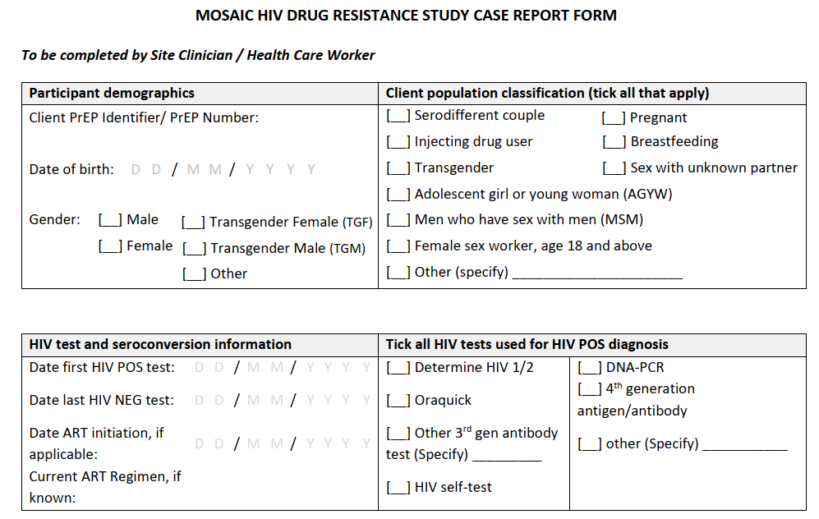
Step 3: Complete Case Report Form to Inform Data Analysis
Collect information on participant demographics, HIV test results, and methods.

Slide 29
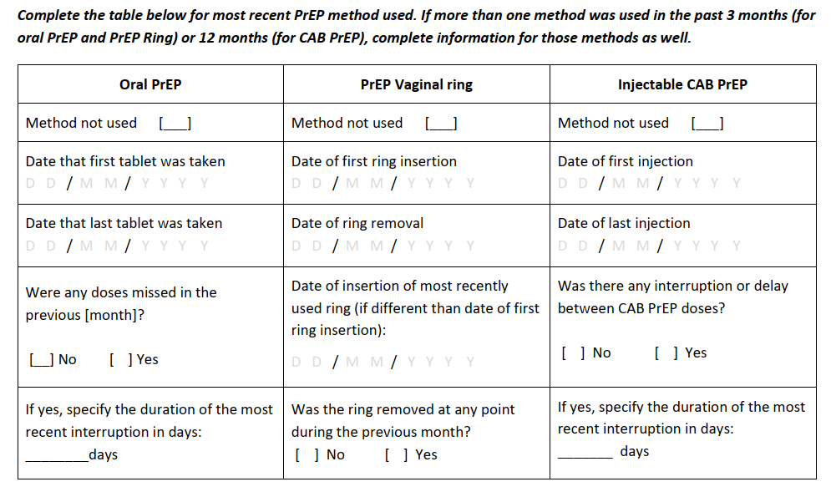
Step 3: Complete Case Report Form to Inform Data Analysis
Collect information on most recently used PrEP method. May be completed for more than one PrEP method.

Slide 30
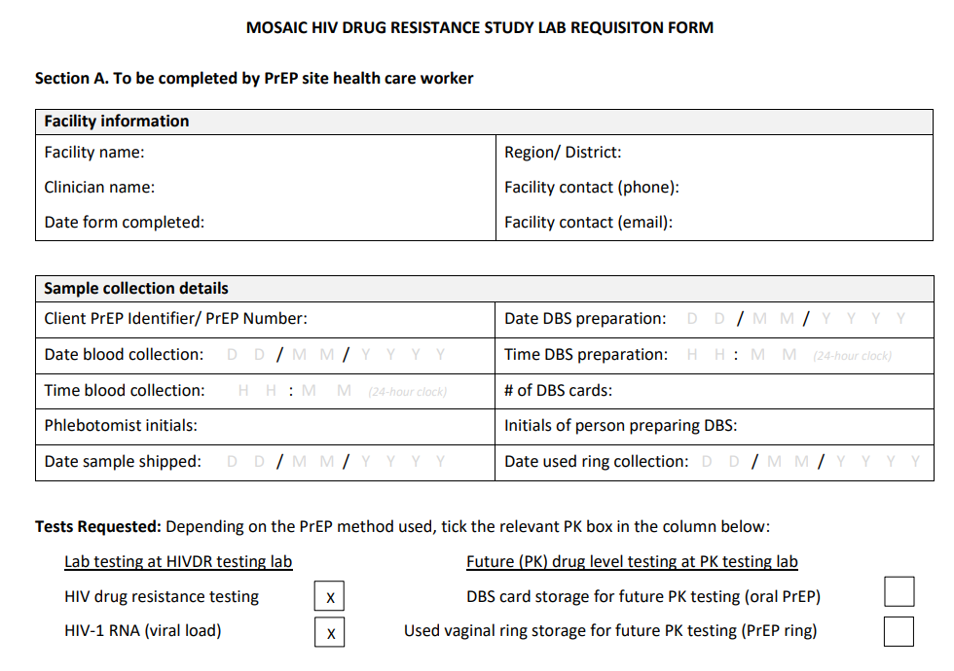
Step 4: Complete Lab Requisition Form to Track Samples
Clinic worker completes Section A of the form.
Laboratory completes Section B of the form.

Slide 31
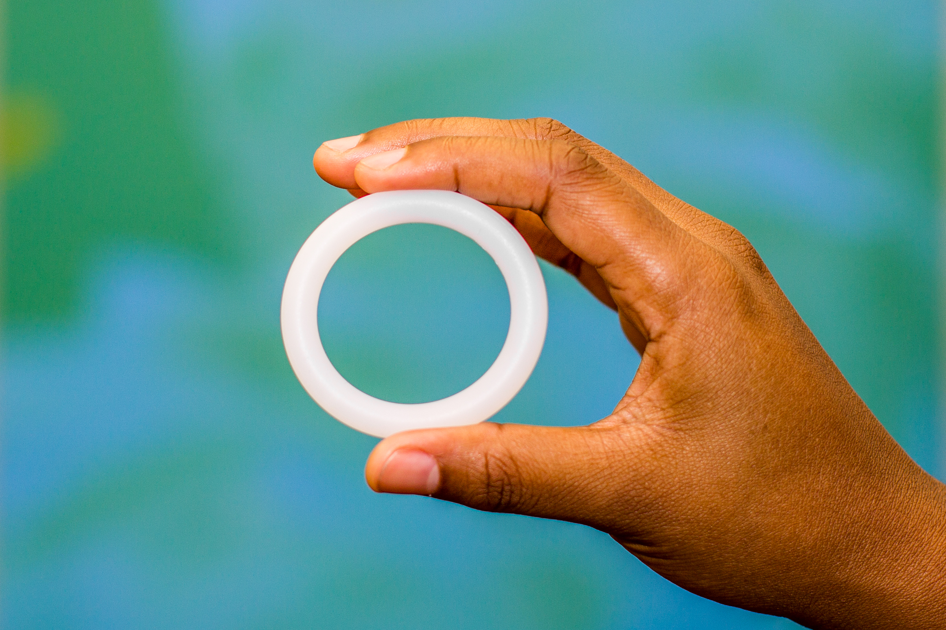
Step 5: Collect Used Ring to Understand Drug Levels (if applicable)
For PrEP ring users only:
Collect the most recently used ring.
Used rings may contain vaginal secretions and should be treated as a biohazard.
Place the ring in a clean container with tap water.
Move the ring around in the water or swirl the container to remove vaginal material.
Take the ring out of the water and blot it dry with paper towels or gauze; the ring should be dry before it is stored in a pouch.
Store the ring in the supplied storage bag.
Dispose of blotting materials and contaminated water according to your institution’s biohazard policy.
Source: Microbicide Trials Network, https://mtnstopshiv.org/node/8106

Slide 32
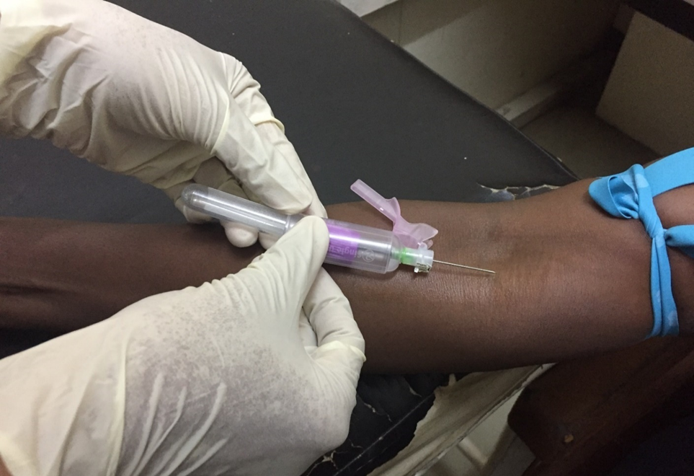
Step 6: Collect Blood
A trained phlebotomist will collect blood from the participant.
Collect venous blood in an EDTA tube per standard operating procedures.
Utilize universal blood collection precautions.
Source: Global Evaluation of Microbicide Sensitivity (GEMS)

Slide 33
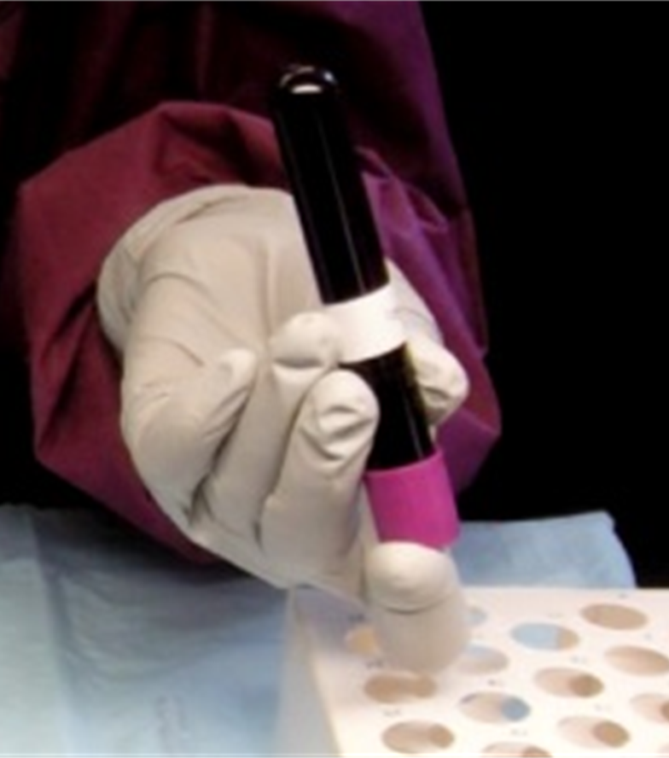
Step 7: Invert the Tube
Gently invert the blood collection tube at least five times to mix anti-coagulant (EDTA) additive with the blood.
Then, open the stopper carefully.
Source: Global Evaluation of Microbicide Sensitivity (GEMS)

Slide 34
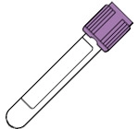
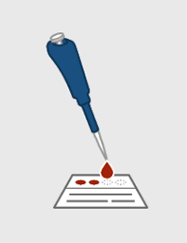
If whole blood is being shipped directly to a laboratory, prepare for shipment as soon as possible, per receiving laboratory guidance, and skip to Slide 41.
If preparing a DBS prior to shipment to the laboratory, proceed to Slide 35.

Slide 35
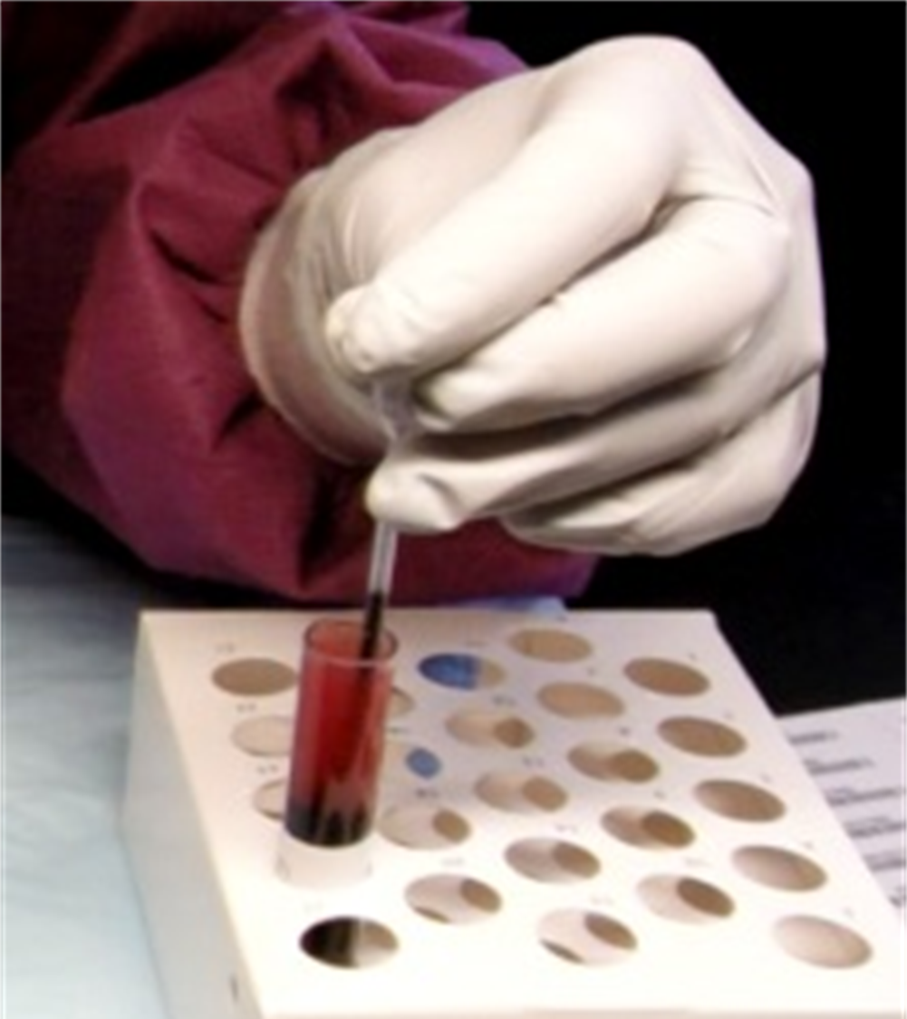
Step 8: Aspirate Blood
Aspirate whole venous blood using a transfer pipette.
Avoid air bubbles.
Source: Global Evaluation of Microbicide Sensitivity (GEMS)

Slide 36
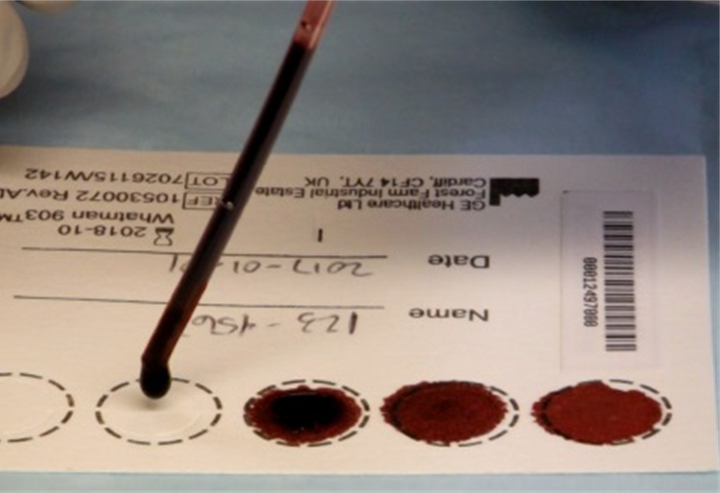
Step 9: Transfer Blood to DBS Cards
A DBS should be prepared as soon as possible, and ideally within one hour of collection.
  If there is going to be a delay, place the sample on wet ice or in a refrigerator for up to 24 hours until the DBS can be made.
Transfer one to two drops of the blood (50μL–100 μL) to the center of each circle without touching the filter paper directly with the tip of the pipette.
Fully saturate the entire circle.
Complete all five circles on each of the two DBS cards.
Avoid touching and smearing the blood spots.
Source: Global Evaluation of Microbicide Sensitivity (GEMS)
Training Video on DBS

Slide 37
Examples of Valid and Invalid Specimens
Valid DBS: circles are properly saturated.
Specimen appears scratched or abraded.
Specimen quantity is insufficient for testing.
Specimen is not dried properly.
Specimen appears clotted or layered.
Specimen appears diluted, discolored, or contaminated.
Specimen exhibits serum rings.
Source: GE Healthcare Life Sciences. 2010. Simple spot check. GE Document 28984392.

Slide 38
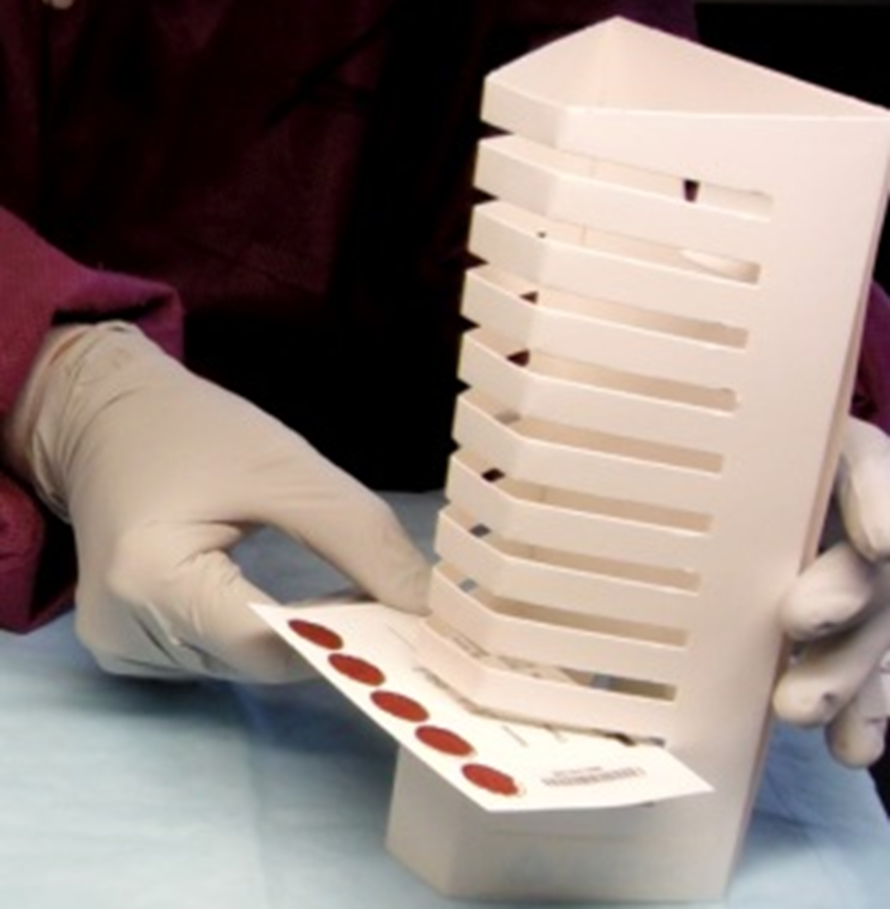
Step 10: Dry DBS Cards
Do not stack or allow the dried blood spots to touch other surfaces during the drying process.
Keep the DBS cards away from direct sunlight
Dry DBS cards, with the blood facing up, on a drying rack at room temperature for a minimum of four hours (preferably overnight).
The blood color on the DBS cards will change from bright red to dark red as it dries.
Source: Global Evaluation of Microbicide Sensitivity (GEMS)

Slide 39
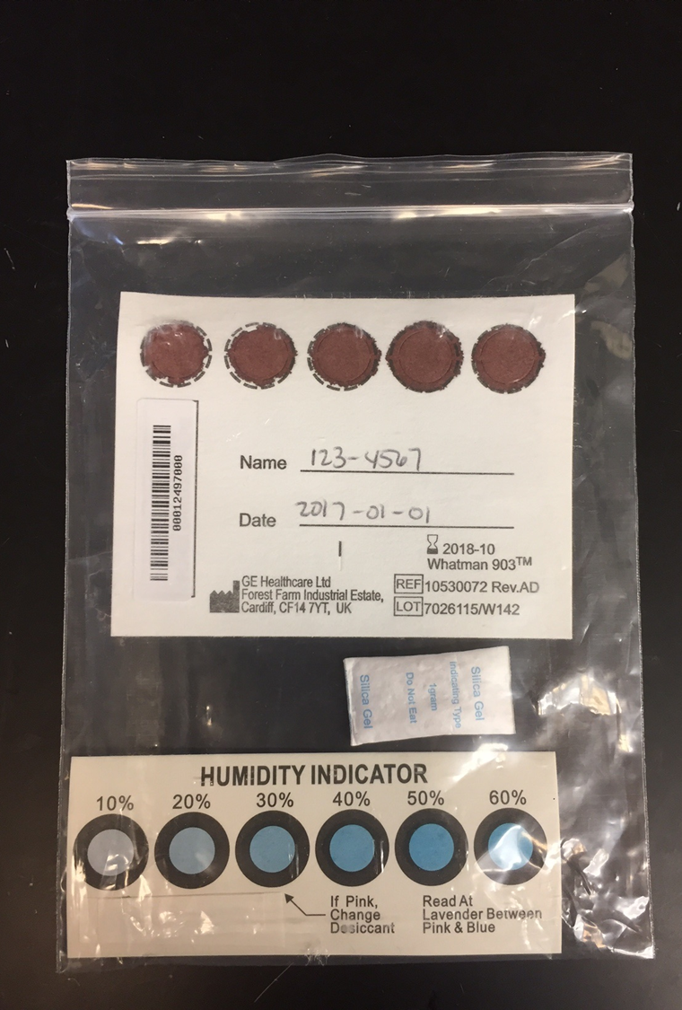
Step 11: Package DBS Cards
After the DBS cards dry, insert both into the sealable plastic bag with the desiccant pack(s) and humidity indicator.
Up to five desiccant packs may be needed, depending on environmental conditions.
Avoid using bags that are too big because the cards will shuffle inside a large bag.
Source: Global Evaluation of Microbicide Sensitivity (GEMS)

Slide 40
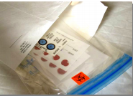
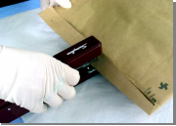
Step 12: Prepare DBS for Shipment
Place a label on the outside of the sealable plastic bag indicating bio-hazardous contents.
Put the sealable plastic bag and data collection form into a rip-resistant envelope, and then into a brown shipping envelope, and seal for shipment.
Mail the envelope as soon as possible, but within three days.
Shipments must meet the requirements for the receiving laboratory and local guidelines for potentially infectious human blood samples.
Source: Global Evaluation of Microbicide Sensitivity (GEMS)

Slide 41
Step 12: Prepare Whole Blood for Shipment
Whole blood must be received at the testing/processing laboratory within 24 hours of blood collection.
Shipments must meet receiving laboratory requirements and local guidelines for potentially infectious human blood samples.
  Packaging must be adequate to maintain specimen integrity.
  Labeling and paperwork must be adequate to route the sample to the testing/processing lab.
Contact the MOSAIC Project Manager for additional guidance.
Notes:
Note: Shipping procedures and requirements may vary by location; update slide as needed.

Slide 42
5
Interpreting Drug Resistance Test Results

Slide 43
Getting the Result Back from the Lab
The time to receipt of drug resistance test results may vary and could take approximately two months.
The participant should initiate ART immediately, per test-and-treat guidelines; do not wait for the drug resistance results.
Clinic staff will retrieve the resistance result and confirm participant identification using the ID number on the barcode sticker.
The clinician or other trained staff will either:
  Counsel the participant on their results and provide information about the virus at the time of diagnosis.
  Forward the results to the participant’s ART provider, with the participant’s permission.
NOTE: Results may have indication/warning that they are for “research use only”; in this case, they should not be used to inform treatment decisions.

Slide 44
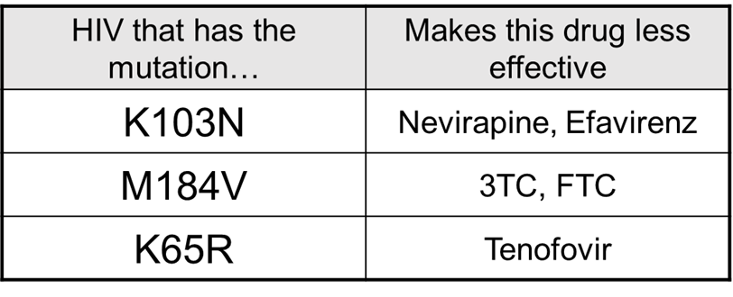
Why Is this Terminology Important?
These letters and numbers will be on the drug resistance report.
The mutation pattern will:
  Let the health care workers know which drugs the participant is resistant to
  May help the ART provider decide which drugs to prescribe to treat HIV infection

Slide 45
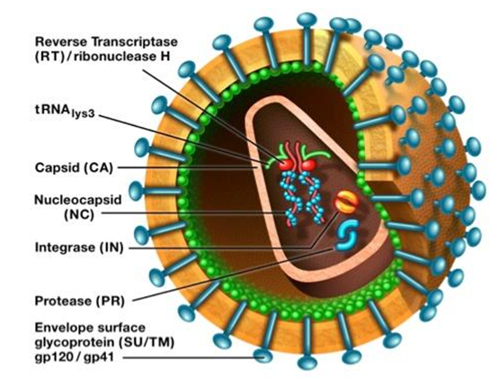
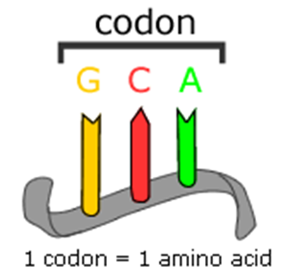
Understanding Terminology: Codon, RT, and PR
Codon: a sequence of three building blocks (nucleotides) that corresponds with a specific amino acid. A “chain” of codons makes up viral genetic code.
Reverse transcriptase (RT) and protease (PR): The genetic code of these viral enzymes is analyzed to detect mutations that are known to result in drug resistance.
Source: University of California Museum of Paleontology, www.understandingevolution.org
Notes:
Note: these enzymes are important for viral replication / life cycle.

Slide 46
Understanding Terminology:
Major vs. Minor Mutations
Major Mutations
Commonly occur during virologic failure (when ART fails to adequately suppress a viral load)
Located at structurally important parts of a viral protein
Reduce susceptibility to one or more ARV
Accessory Mutations
Commonly present in untreated patients as natural variants
Can contribute to reduced susceptibility to ARVs when in combination with major drug resistance mutations

Slide 47
Understanding How to Read Mutations
Scientists use a letter and number to describe HIV’s genetic material.
The NUMBER shows where the mutation occurred within the codon.
The LETTER shows how the amino acid changed.
Specific location or “codon” within HIV’s RNA/ gene where the mutation is located
M
1
8
4
V
Amino acid found in ‘wild-type’ HIV. In this example, M stands for methionine
New amino acid, which took methionine’s place at codon 184, producing a mutation. In this example, V stands for valine
M184V — a mutation in the reverse transcriptase (RT) gene that causes resistance to 3TC (lamivudine)

Slide 48
How to Interpret HIV Drug Resistance Results
The results will indicate which ARVs have reduced effectiveness.
Each HIV drug has its own resistance result, which can be:
  SUSCEPTIBLE
  POTENTIAL LOW-LEVEL RESISTANCE
  LOW-LEVEL RESISTANCE
  INTERMEDIATE RESISTANCE
  HIGH-LEVEL RESISTANCE

Slide 49
What Do the Drug Resistance Results Mean?
Susceptible
There is no evidence of resistance to this ARV.
Potential low-level resistance
There may be mutations associated with resistance only when they occur with additional mutations.
Low-level resistance
There is potential for reduced ARV susceptibility.
Intermediate Resistance
Mutations present may partially reduce ARV activity, but the ARV may still have sufficient remaining effectiveness.
High-level Resistance
This ARV’s effectiveness is significantly reduced.

Slide 50
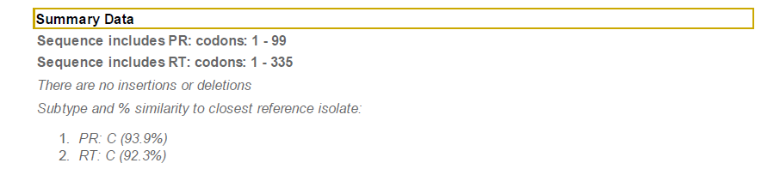
What Is in the Drug Resistance Report?
The percentage tells how closely the person’s virus matches a known subtype.
The Summary Data identify the subtype.
This individual has SUBTYPE C HIV-1.
Notes:
Presenter: Consider the audience and possibly remove or hide this slide if it is overly technical for training. Also, note that the summary would be similar for INSTI results.

Slide 51
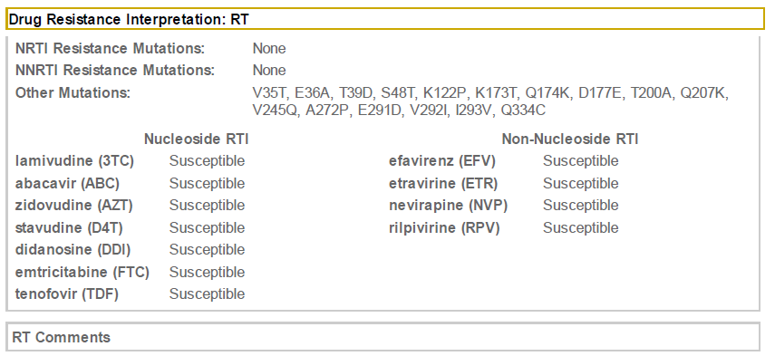
What Is in the Drug Resistance Report?
RT mutations affect resistance to drugs in the NRTI and NNRTI class.
The report shows this individual does not have RT-based drug resistance and can be treated with the first-line ARV regimen.

Slide 52
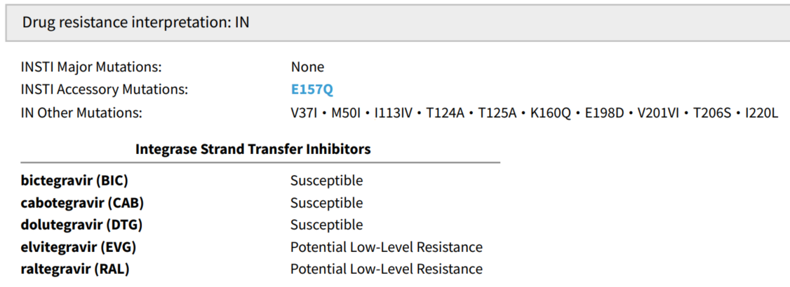
INSTI Drug Resistance Report Example
IT mutations affect resistance to drugs in the INSTI class.
The report shows this individual does not have any major IN-based drug resistance mutations.

Slide 53
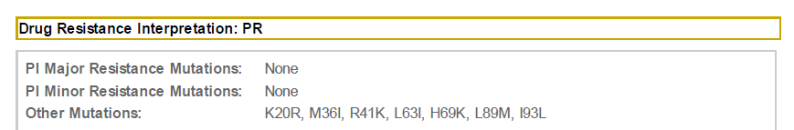
What Is in the Drug Resistance Report?
Protease inhibitors (PI) are usually part of the second-line ARV treatment regimen.
PI mutations may not be relevant as long as there are valid options for the first-line treatment regimens.
Knowing RT/IN and PI mutations is important when deciding if/when switching to a second-line ARV regimen is warranted.

Slide 54
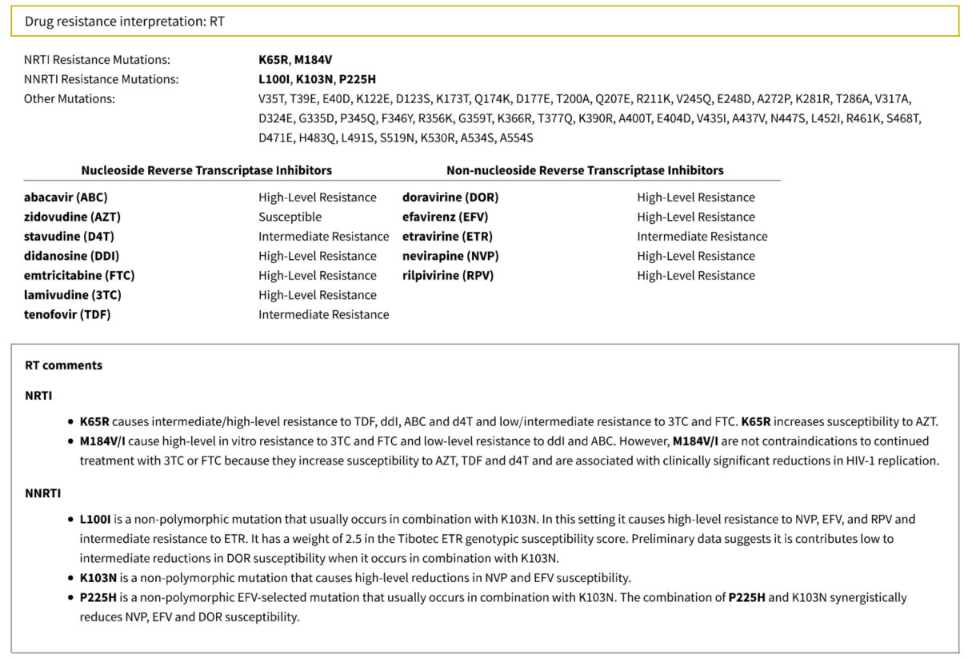
What If Resistance Is Found?
The specific mutations causing the resistance and what drugs are affected will be shown.
The comments may help the doctor who is prescribing therapy to have more information about the specific kind of resistance.
Only the clinician can decide which ARVs the individual should take.

Slide 55

Research Only Results
Some HIVDR results are for research use only, depending on how the resistance test was performed.
The results report will indicate if the result truly is for research use only, meaning results cannot be used to inform a comprehensive clinical treatment decision.
Notes:
“Research use only” results may be provided by a laboratory that tests specimens using a short amplicon assay, which covers the regions relevant for the drugs included in oral PrEP. Because the test does not cover all regions, it cannot be used for clinical care.

Slide 56
6
Counseling Participants About Drug Resistance

Slide 57
Minimizing Risk of Resistance:
Key Counseling Points for All PrEP Users
Avoid Getting HIV: Use PrEP, as part of combination HIV prevention, consistently and correctly while you may be exposed to HIV. Resistance to ARV drugs cannot occur in a person who does not have HIV.
Attend Clinic Visits: HIV testing will be done every three months. If testing shows that a person has acquired HIV, PrEP should be stopped immediately to avoid the development of drug resistance. ART should be initiated immediately.

Slide 58
Minimizing Risk of Resistance:
Key Counseling Points for All PrEP Users
Do Not Share PrEP: Sharing PrEP with other people, even with a partner, could be harmful. They could have HIV and not know it. If a person with HIV uses PrEP, this could cause resistance to ARV drugs.
PrEP Works If You Use It: The benefits of PrEP are greater than the risk of resistance. But minimizing the risk will help to limit the potential impact on HIV treatment.

Slide 59
Counseling Tips for Providing Results to Study Participants
Provide counseling on the outcome of participant’s resistance test and explain:
  What the test shows
  Information about the virus at the time of diagnosis
  Next steps
Maintain a respectful attitude and show acceptance
Avoid:
  Being judgmental or blaming the participant for not using PrEP correctly
  Arguing, confronting, and pressuring the participant into action
Employ good counseling skills, such as asking simple, open-ended questions, using active listening, paraphrasing, and reframing

Slide 60
Counseling Tips for Providing Results to Study Participants
Resistance can be hard to understand. It is important to:
  Assess the participant’s understanding
  Encourage the participant to ask questions
If a participant’s test results show resistance, explain:
  There are different degrees of resistance
  Resistance to a certain ARV does not automatically mean that one can no longer use it
  Even when a certain ARV is not effective due to resistance, other treatment regimens exist

Slide 61
7
Good Clinical Practice Tips

Slide 62
What Are Good Clinical Practices?
  Good Clinical Practices (GCP) are an international ethical and scientific quality standard for the design, conduct, performance, monitoring, auditing, recording, analyses, and reporting of clinical trials.
  GCP serves to protect the rights, integrity, and confidentiality of trial subjects.
  MOSAIC is committed to following GCP guidelines in HIV drug resistance research.
  Additional training available at:
    Good Clinical Practice (GCP) | CITI Program

Slide 63
Minimal Risk to Participants
This study does not involve investigational products
or procedures associated with significant risk to participants.
Clinic staff are responsible for safety monitoring of all study participants and alerting the MOSAIC Program Manager of any problems.
Clinic staff will provide drug resistance results to the participant and ART provider, as specified in the protocol and in accordance with national guidelines.
Clinic staff identifies safety concern or protocol deviation
Clinic staff informs MOSAIC Program Manager
MOSAIC Program Manager informs IRB/IEC as required

Slide 64
Documentation and Filing Requirements
  Document all participant observations in adequate and accurate source documents.
  Ensure information collected on case report forms (CRFs) and lab requisition forms (LRFs) is accurate, complete, legible, and timely.
  Date, initial, and (if necessary) explain any change or correction to a CRF or LRF; do not obscure the original entry.
  Maintain standard operating procedures (SOPs), package inserts, job aids, or other materials for easy reference.
  Document eligibility for study participation in a chart note in each participant’s medical file.
  Ensure the confidentiality of medical records, in a locked cabinet/room.

Slide 65
Quality Check Reminders
Is there a signed IRB-approved informed consent form (or information sheet) in the participant chart?
Was the participant referred to ART immediately, as per country test and treat guidelines?
Is the CRF or LRF legible and accurate?
Was the sample collected within five days after the HIV+ test?
Is the participant’s ID (not name) listed on all documents, including the DBS cards, leaving the clinic?
If the answer to any of the above questions is “no,” contact the MOSAIC HIVDR Coordinator.

Slide 66
For help with study procedures, counseling messages, or interpreting the drug resistance outcome report, contact: (insert appropriate contact information here)

