Slide 1
CAB for PrEP for Advocates
Basics of Injectable Cabotegravir
for HIV Prevention
AVAC
February 2023

Slide 2
Outline
What is cabotegravir (CAB)?
Treatment
Prevention
Clinical research
Regulatory and guideline status
Preparing for implementation
Collaboration
Delivery channels
Testing
Cost
Supply
Implementation Studies
Advocacy

Slide 3
What is Cabotegravir (CAB)?

Slide 4
What is Injectable Cabotegravir?
Quick look
Injectable form of an “integrase strand transfer inhibitor” anti-retroviral, and an analogue of dolutegravir
Nano-formulated, low-solubility crystalline drug suspended in an aqueous solution
Developed by ViiV Healthcare, pharmaceutical company specializing in HIV therapies founded in 2009 by GlaxoSmithKline & Pfizer
Used in combination with injectable rilpivirine from J&J as an HIV treatment (called Cabenuva)
Two HIV prevention efficacy trials, under the HPTN, compared CAB injections every two months to daily oral TDF/FTC
Shown to be very effective in men who have sex with men, transgender women and cisgender women

Slide 5
CAB for HIV Treatment: Summary
Effective with rilpivirine (RPV) as combination ART
Approved to maintain viral suppression in people who have already demonstrated viral suppression using oral ARTs
Delivered via two injections (one CAB and one RPV) in the buttocks every one or two months
Administered by health care professional
Injections begin after 1 month of daily oral cabotegravir/ rilpivirine to ensure no drug reactions
Approved by regulators in Canada, European Community, Australia, US, Switzerland, Botswana
Annual cost in US for both injections ~ US$50,000
Not yet in widespread clinical use, and not currently part of WHO guidelines or PEPFAR and Global Fund procurement for treatment
Required cold chain for rilpivirine and cost among the barriers in LMIC

Slide 6
CAB for Prevention: Summary
Effective in preventing HIV acquisition
Two clinical efficacy trials show that CAB is effective at substantially lowering risk of HIV acquisition in MSM, TGW and cisgender women
Study participants in control arm received daily oral TDF/FTC
Both injectable and oral PrEP were safe and effective in significantly reducing risk of HIV
Injections delivered every two months in buttocks by study nurses at research clinics
Longer acting than oral PrEP so may help improve adherence for some users but with limitations: requires health care provider and clinic visit, cannot discontinue right away
Open label extensions; safety studies in pregnant and breastfeeding people and young people ongoing
Implementation research studies being developed and approved
Global health actors coordinating efforts to speed delivery of CAB for PrEP

Slide 7
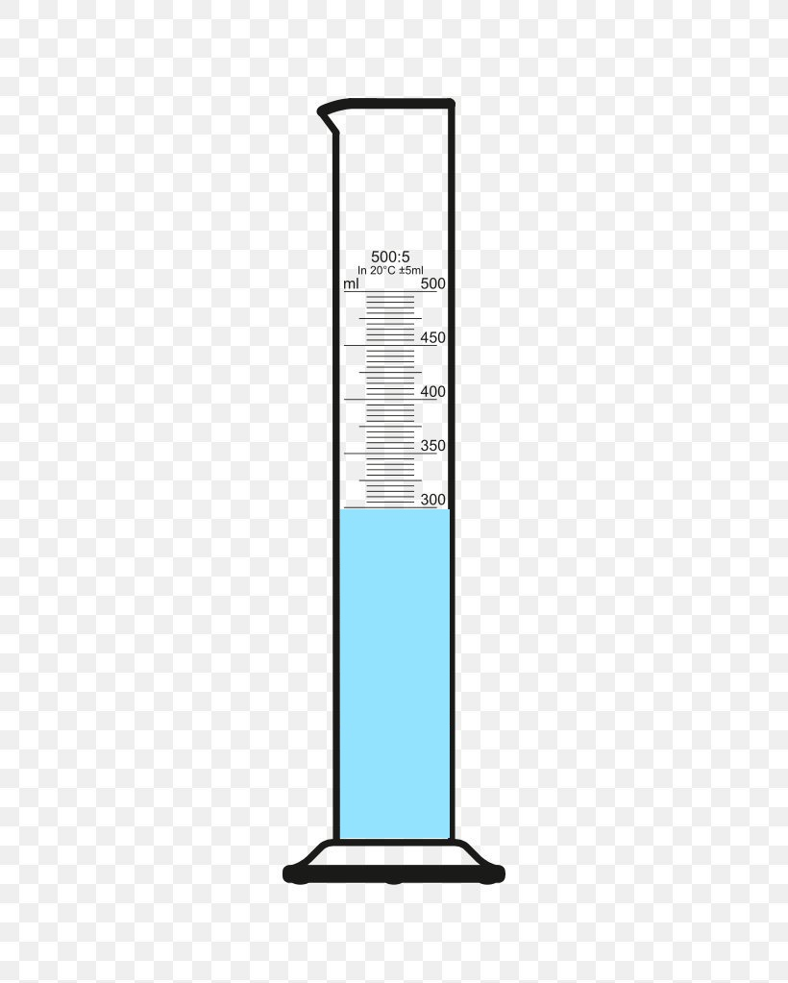
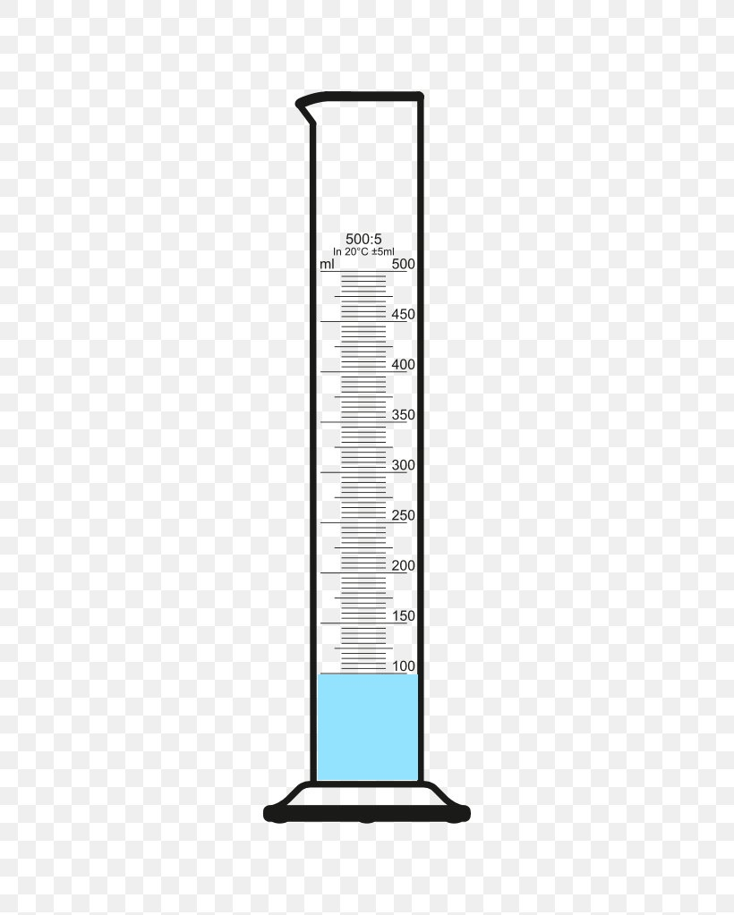
CAB for HIV PrEP Compared to Injectable Contraception
 | Injectable Cabotegravir for HIV PrEP | DMPA-IM for Contraception
Injection Location | Gluteal muscle (buttocks) | Upper arm or gluteal muscle (buttocks)
Frequency | Every 2 months | Every 3 months
Volume | 3 mL | 1ml
Notes:
St

Slide 8
Clinical Research

Slide 9
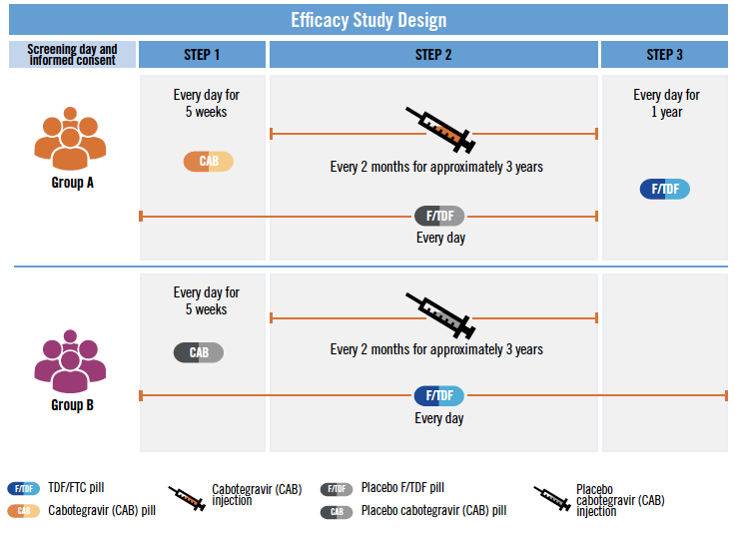
CAB for HIV PrEP Efficacy Trials Design
Two efficacy trials with similar designs
HPTN 083 enrolled MSM and TGW
HPTN 084 enrolled cisgender women
“Double dummy, double blind”
All participants receive injections AND oral tablets, and are randomly assigned to 1 of 2 groups:
Group A active CAB injection and placebo tablet
Group B placebo injection and active oral TDF/FTC tablet
Participants in active CAB arm take oral CAB for 5 weeks prior to injection to ensure no adverse reactions

Slide 10
Efficacy Trials: Summary
Trial | Design/ Trial Questions | Participants | Countries | Status (as of 2/23) | Key Results
HPTN 083 Started December 2016 Unblinded May 2020 following review by independent DSMB | Non-inferiority design; comparing daily oral TDF/FTC to bimonthly injectable cabotegravir | 4,570 Cisgender gay men and other men who have sex with men (MSM); transgender women, 18 years and older 12% TGW 67.4% age 18-29 | Argentina, Brazil, Peru, South Africa, Thailand, US, Vietnam | Open Label Extension Ongoing; participants can choose between active products: CAB for PrEP or oral TDF/FTC | CAB superior to oral TDF/FTC in preventing acquisition of HIV CAB reduced risk of infection by 66% compared with oral TDF/FTC
HPTN 084 Started November 2017 Unblinded Nov 2020 following review by independent DSMB | Superiority design; comparing daily oral TDF/FTC to bimonthly injectable cabotegravir | 3,200 Cisgender women 57% age 18-25 | Botswana, Eswatini, Kenya, Malawi, South Africa, Uganda, Zimbabwe | Open Label Extension Ongoing; participants can choose between active products: CAB for PrEP or oral TDF/FTC | CAB superior to oral TDF/FTC in preventing acquisition of HIV CAB reduced risk of infection by 89% compared with oral TDF/FTC
As of February 2023; additional data still to come

Slide 11
Efficacy Trials: Data
 | Total Infections | Infections in CAB-LA Arm | Infections in oral TDF/FTC Arm | Hazard ratio in CAB LA vs. FTC/TDF arm
HPTN 083 MSM and TGW | 51 Incidence 0.81% | 12 Incidence 0.37% | 39 Incidence 1.22% | 0.32 (95% CI 0.18-0.62) 66% risk reduction
HPTN 084 Cisgender women | 38 Incidence 1% | 4 Incidence 0.21% | 34 Incidence 1.79% | 0.11 (95% CI 0.04-0.32) 89% risk reduction

Slide 12
Efficacy Trials: Summary
Independent Data Safety and Monitoring Boards (DSMB) for both trials recommended unblinding early when scheduled data reviews found studies had reached a conclusion about CAB efficacy for HIV prevention
Placebo products dropped; participants could choose injectable CAB or oral TDF/FTC
Trials shifted to Open Label Extensions (see next slide)
Analysis of blood samples showed most people in oral PrEP group who became HIV+ likely were not taking tablets consistently enough for protection
Studies also showed that CAB is safe, with most reported side effects being reactions at the site of the injection
These results in 2020 came around two years ahead of schedule so the timeline for all other actions needed for product access and delivery accelerated

Slide 13
Ongoing Clinical Studies
Open Label Extensions (OLE)
Follow-on study with intervention available for a specific time to participants in the efficacy studies who know they are receiving active intervention with potential benefit
Participants can choose between injectable CAB or oral PrEP
Initial results show that participants are choosing both injectable and oral PrEP, underscoring importance of choice
Continue data collection on safety, acceptability, and estimate incidence of HIV
OLE to continue for maximum of 96 weeks, after which ViiV will continue to provide supply to study participants who choose to continue if in-country approvals or access is delayed
Sub-studies of the HPTN 084 OLE extended by 48 weeks to allow for inclusion of adolescents and pregnant and lactating people and their infants.

Slide 14
Ongoing Clinical Studies
Safety studies in different populations
Young people: Two studies assessing safety, tolerability and acceptability of CAB among adolescents – cisgender males and TGW in HPTN 083-01; cisgender females in HPTN 084-01
Pregnant and breastfeeding women: HPTN 084 participants who become pregnant can co-enroll in IMPAACT 2026, a study examining ARVs and anti-TB medications in women during and after pregnancy. Initial data presented at AIDS 2022 suggest high degrees of safety.
Dosing schedule for women
Women: study in cisgender women to determine if dosing could be extended from injections every 2 months to every 3 months; would reduce cost and align with schedule for DMPA-IM injectable contraception, meaning fewer clinic visits and thus more convenient and efficient for women who also use DMPA-IM. Preliminary findings from CROI 2023 showed protective levels with quarterly injections, and will need to confirmed in additional studies.
Transgender women: in a sub-analysis during the blinded phase of HPTN 083 presented at AIDS 2022, HIV incidence among trans women was lower in the CAB-LA group than in the TDF/FTC group. CAB-LA was well tolerated in trans women and, importantly, initial findings suggest there is no impact of gender-affirming hormonal therapy on CAB concentrations.
Acceptability and user perspectives
Sub-study to evaluate factors that support or inhibit adherence and clinic visits for CAB, preferences and decision-making about using oral or injectable PrEP, and participants’ experiences in efficacy trial

Slide 15
What Do Participants Think of Injectable CAB?
Overall most participants in the 083 and 084 studies were satisfied with CAB, willing to continue to use it and would recommend to others.
Earlier research comparing acceptability across different settings, and between men and women, found high overall acceptability, and in some contexts, a preference for injectable CAB based on convenience and lifestyle.
Other discrete choice experiments and user-centered design studies have explored product preference, but not with actual product use
Additional information forthcoming from efficacy trials, open label extensions and implementation research

Slide 16
Regulatory and Guideline Status

Slide 17
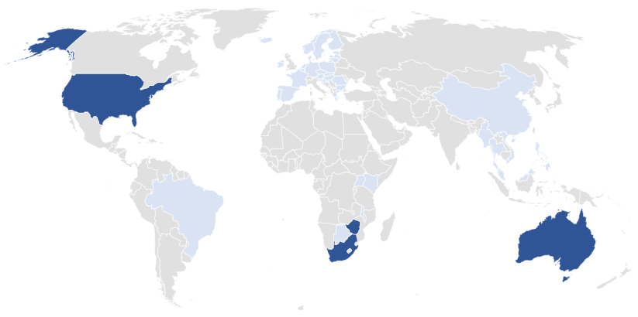
CAB for PrEP: Regulatory Approval Status
Approved
Australia
South Africa
USA
Zimbabwe
Submission Under Review
Botswana
Brazil
China
European Medicines Agency (EMA)
Kenya
Malawi
Malaysia
Myanmar
Philippines
Thailand
Uganda
Vietnam
The approval status was last revised by ViiV on Nov 29, 2022, and is updated on a quarterly basis. For the most up-to-date information on regulatory submissions, use this link:
https://viivhealthcare.com/content/dam/cf-viiv/viivhealthcare/en_GB/files/cab-prep-wwrs-29nov2022-for-external-use.pdf

Slide 18
Key Regulatory Decisions: Status and Implications
US Food and Drug Administration approved CAB for PrEP in December 2021
Label included stringent testing requirements centered on NAT testing not routinely available in services in LMIC
CDC later clarified that availability of NAT testing should not preclude access
Zimbabwe Medicines Control Authority first LMIC approval in October 2022
Fewer testing requirements; approved for use by anyone > 35kg
Australia Therapeutic Goods Administration approved in August 2022
Labeling included less restrictive testing recommendations
Regulatory approval from the Australia Therapeutic Goods Administration opens the door for review and approval by countries in similar geographic areas.
With approval from the FDA and the Australia Therapeutic Goods Administration, ViiV will move forward with WHO prequalification
South Africa Health Products Regulatory Authority (SAHPRA) approved in December 2022

Slide 19
Guidelines
US Centers for Disease Control and Prevention Guidelines
Recommendation and guidance for CAB as PrEP included in revised PrEP guidelines issued December 2021
World Health Organization Guidelines issued July 2022
Long-acting injectable cabotegravir may be offered as an additional prevention choice for people at substantial risk of HIV infection, as part of combination prevention
Re: testing recommend using current national testing strategy and algorithm, that countries consider the feasibility of using NAT, and ongoing monitoring to optimize testing approaches for CAB-LA.
Added to WHO’s list of Expressions of Interest for evaluation for prequalification 04/2022

Slide 20
Preparing for Implementation

Slide 21
Coalition to Accelerate Access to Long-Acting PrEP
Convened by Unitaid, WHO, UNAIDS, Global Fund, and PEPFAR; AVAC is Secretariat
Initiative officially launched in July 2022 to make longer-acting PrEP options, including CAB for PrEP, accessible as quickly and equitably as possible.
Objective is practical, to coordinate key stakeholder activities on PrEP access, including:
Building on lessons learned from oral PrEP
Coordinate key stakeholder activities on PrEP access
Jointly develop strategies to identify and overcome access challenges for new PrEP options in the near to medium term (as relates to ViiV’s injectable CAB, including generics, and dapivirine vaginal ring) and the medium to longer term (as relates to future PrEP products)
Ensure new, longer-acting PrEP options reaching the market will be available and equitably accessible to all who need them more quickly than ever before

Slide 22
Pathway to Access & Impact
Plan to Accelerate Access and Introduction of Injectable CAB for PrEP: Comprehensive view of actions needed to deliver CAB for PrEP drawing on lessons from oral PrEP and moving faster, more strategically and with greater coordination. Serves as a tool to monitor action and identify roadblocks.
Guiding Principles
Lead with Equity
Center the Community & Users
Accelerate Scale and Speed
Deliver Impact
Work With What We Know, While Continually Adding To The Evidence-Base

Slide 23
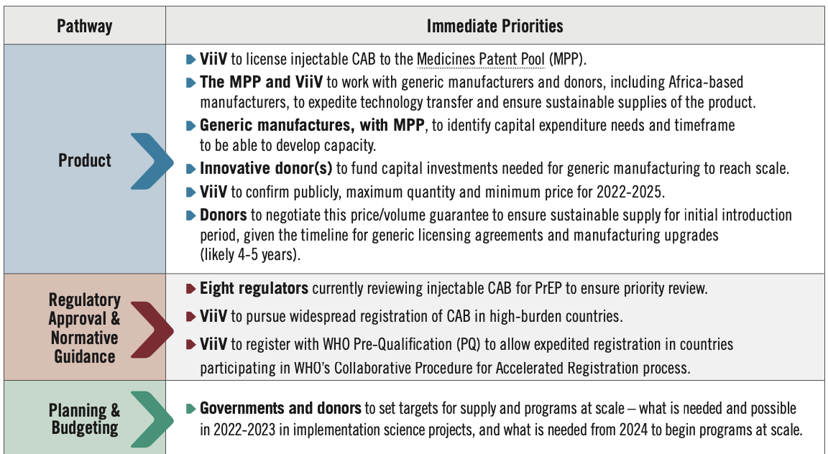
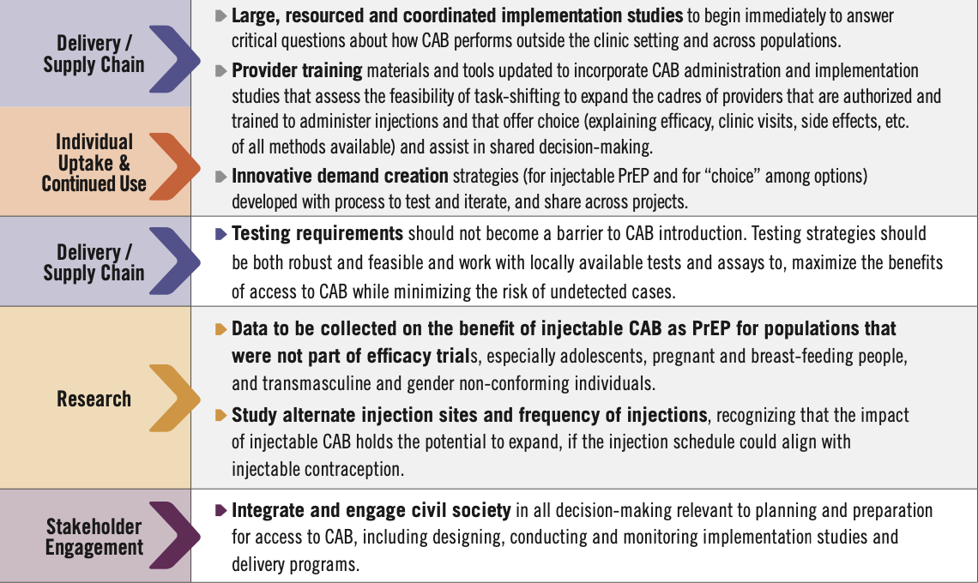
Pathway to Access & Impact

Slide 24
Key Issues: Delivery Channels
CAB is currently delivered in health clinics for treatment and study clinics for prevention
Administered by health care workers
Injection into the buttocks, requiring privacy within clinic
Build on lessons from oral PrEP
Simplify and de-medicalize delivery key to access and uptake
Provide in settings where clients – including young people, MSM, TGW, FSW – feel comfortable
Offer as an option in the context of informed choice, whereby people can choose among different methods (oral PrEP, condoms, dapivirine ring, CAB) to find what works best for them
Plan for clients to switch, stop or restart methods
Integrate HIV prevention with sexual and reproductive health services
Test and identify delivery innovations to increase access such as:
Engage potential users in places they prefer; explore delivering CAB in those settings
Injections by trained community health workers or self-injection by clients
Feasibility of other injection sites such as the thigh

Slide 25
Key Issues: HIV Testing
Throughout product development, there have been concerns about potential development of resistant virus. Some concern emerged on the potential for resistance arising acute (early) HIV infections in CAB for PrEP users that are not detectable by HIV tests in wide use in LMIC
US FDA and CDC guidance recommends NAT testing for PrEP initiation and continuation
Other regulatory agencies (e.g. Australia) have more recently approved labeling with less stringent testing requirements for CAB for PrEP
WHO guidelines recommend: using current national testing strategy and algorithm; that countries consider the feasibility of using NAT: ongoing monitoring to optimize testing approaches for CAB-LA
NAT testing is not widely available or in routine use in LMIC. Requiring NAT testing would add cost and complexity to CAB for PrEP, likely limiting or curtailing its availability in LMIC
Other HIV test strategies may address concern about resistance, such as testing pooled samples with NAT to determine whether resistance is emerging at a population level; and assessing performance of different 4th generation HIV tests in detecting acute infection
Regulators seem to be moving away from requiring complex and costly testing protocol that could effectively thwart availability of CAB in many settings with major equity considerations for access

Slide 26
Key Issues: Cost
Cost of product
Initial price of CAB for PrEP in the US over $22k/year, above price of branded oral PrEP
ViiV has stated a commitment to a non-profit price of approximately $250/year for public programs in low- and middle-income countries compared to oral PrEP currently $54/year
Generic manufacturing could drive down cost and price over time but impact unlikely in <5 years (see next slide on supply)
Cost of programs
Robust, well-designed PrEP programs need to include fully-costed and funded demand creation, provider training, testing and initiation, ongoing user support, M&E, etc.
Testing protocols and requirements could be a key driver of the cost and complexity of delivering CAB in programs
Programs need to invest in choice through offering multiple different product options, not only the lowest cost, easiest to deliver or perceived preference of the user, provider or system

Slide 27
Key Issues: Supply
ViiV has signed a voluntary license agreement with the Medicines Patent Pool to allow for manufacture of generics which should enable wider access
Licenses for 3 generic producers to be announced by March 2023
Agreement will allow these generic manufacturers to develop, manufacture and supply generic versions of CAB for PrEP in 90 countries subject to regulatory approvals
Generics generally help increase production and supply, foster competition and drive down cost and price
Manufacturing CAB requires specialized, expensive equipment which must be built to specifications so generic production will take time (~5 years) and significant investment
Cabotegravir is currently only produced by ViiV in one facility, limiting available supply
Additional production lines and facilities being explored
Coordination and managing use of limited available product among clinical and implementation studies, market building, and other uses is an urgent priority

Slide 28
Implementation Studies: Overview
Multiple implementation studies approved and being planned across countries, regions and populations (see slides that follow)
Choice: Many studies include CAB as part of a mix of HIV prevention options along with condoms, oral PrEP and/or the Ring to assess product delivery and use in the context of choice
Service delivery models are being explored in a wide range of settings: public clinics; women’s health services; primary care; mobile clinics; village health teams; private clinics, including KP-led; community organizations and centers; antenatal care; and pharmacies
Size: only 4 of the studies have samples > 5,000 leading to some concern that they are too diffuse and small to show impact and provide practical lessons for delivery at scale
Populations: studies in diverse populations critical to ensure broad access. Cis women, cis men, and GBMSM well represented; sex workers and gender non-conforming people less well represented; no studies planned with people who use drugs
Geography most concentrated in East and Southern Africa; far fewer in West Africa, Europe, Southeast Asia, and none in the Middle East/North Africa

Slide 29
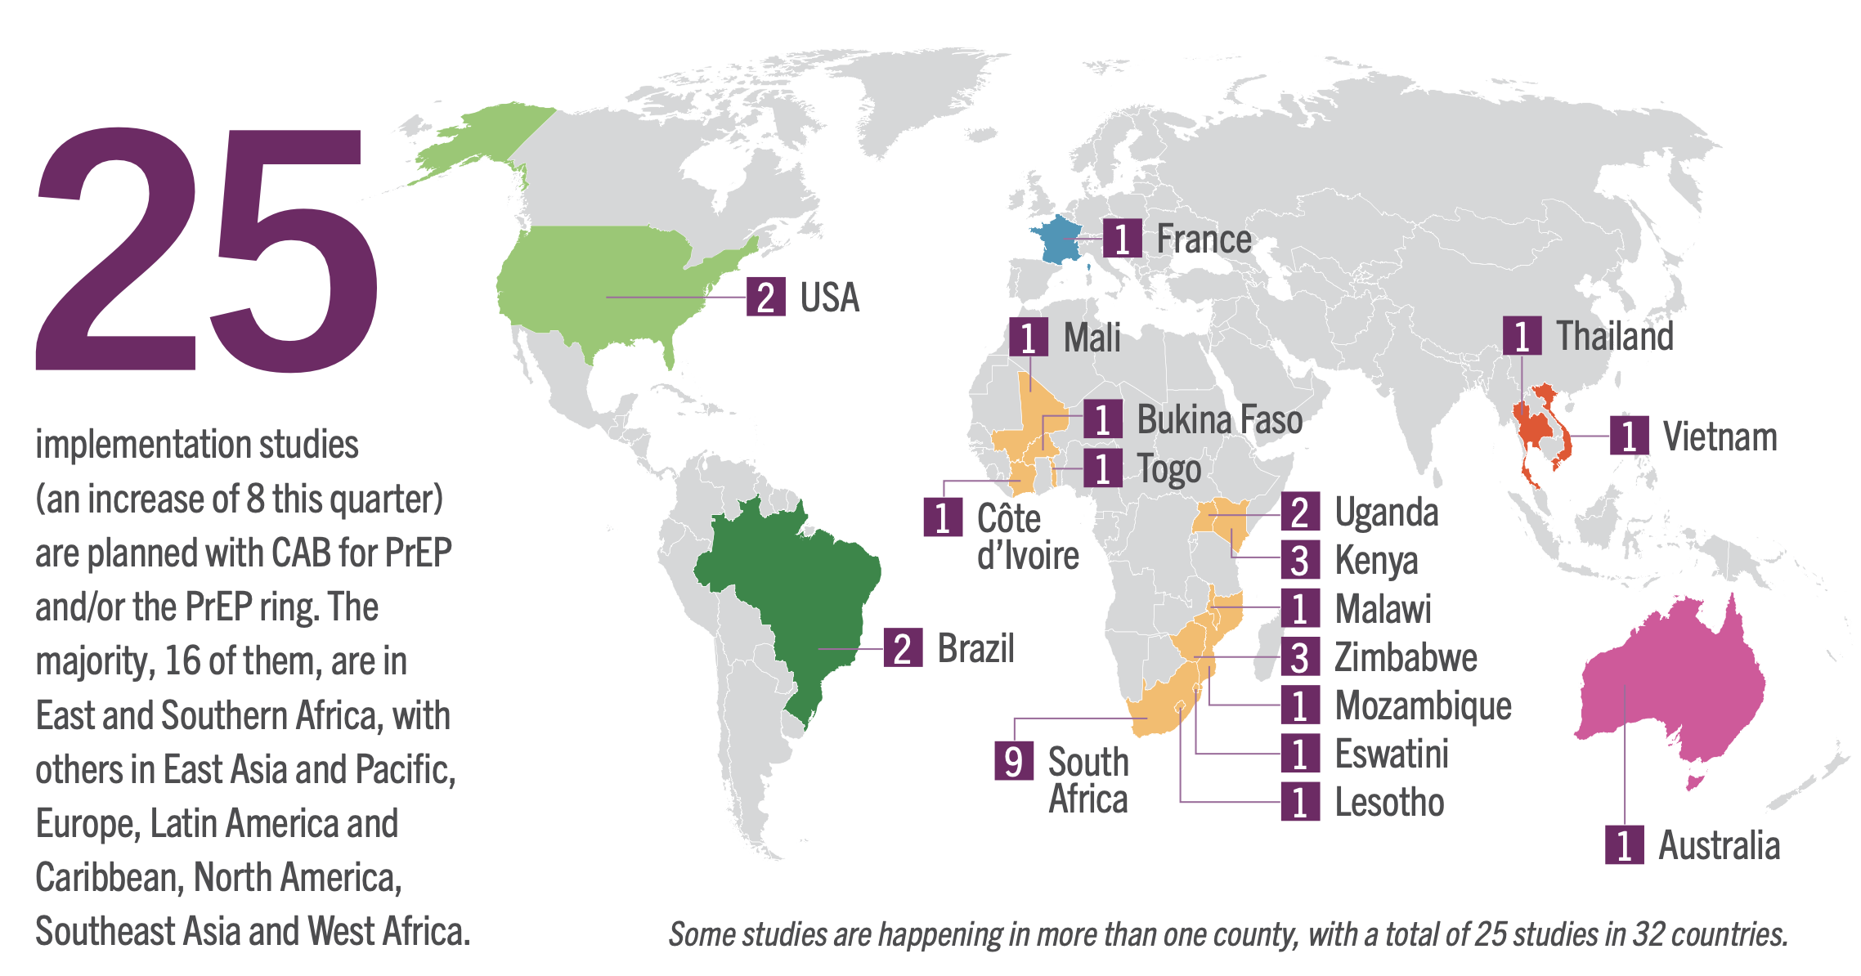
Implementation Studies: Geographically
For most up-to-date information, visit BioPIC Implementation Study Tracker at https://www.prepwatch.org/resources/implementation-study-tracker/

Slide 30
Implementation Studies: Geographically
BUT, significant questions remain about timing:
National regulatory approvals of product
ViiV internal approvals of protocols
Product supply – manufacturing capacity, timing, shipping
Actual product delivery to participants
Answers to critical questions to inform models, policies, program design, procurement, investment
For most up-to-date information, visit BioPIC Implementation Study Tracker at https://www.prepwatch.org/resources/implementation-study-tracker/

Slide 31
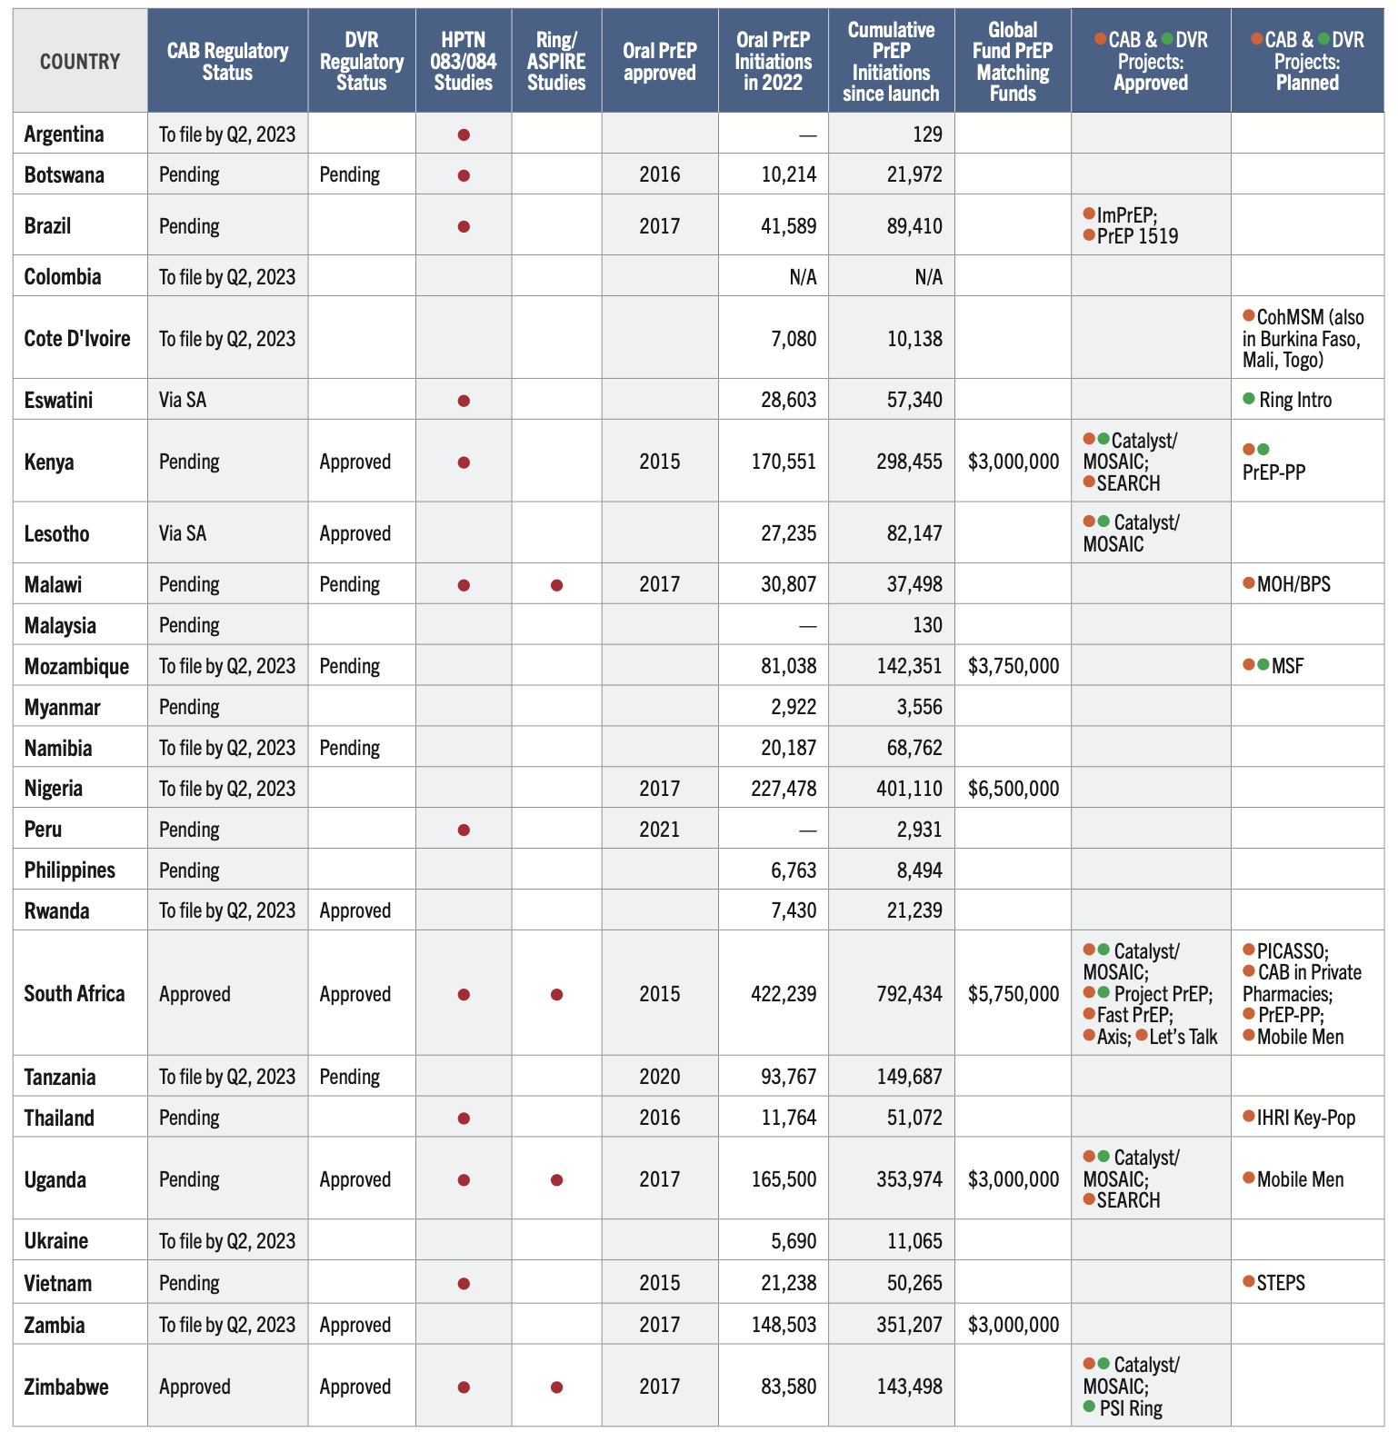
PrEP Implementation Studies, as of March 2023

Slide 32
Implementation Studies: Population
Cis men, cis women, and gay and bisexual men who have sex with men well represented
Sex workers and gender non-conforming people less well represented
No studies planned for people who use drugs
Inclusion of diverse populations is key to gather evidence around safety, adherence, etc.
Not all studies have established sample sizes
Only four studies with over 5,000 participants: CATALYST (MOSAIC), Project PrEP (Wits RHI), FASTPrEP (DTHF), and Theta Nami Ngithethe Nawe (“Let’s Talk”), AHRI

Slide 33
Advocacy

Slide 34
How are Advocates Involved?
Advocates and civil society are key actors in defining the evolving injectable CAB and comprehensive PrEP and prevention agendas by:
Participating in global efforts like the Coalition to Accelerate Access to Long-Acting PrEP to help drive access with equity and urgency
Providing expertise and consultation in priority setting and design of demonstration projects, policy strategies and implementation approaches
Engaging with ViiV to advocate for equitable and urgent product availability, pricing, manufacturing and licensing arrangements
Advocating with national health ministries and regulatory agencies for prompt action on product approvals and guidelines development
Demanding funding from global, regional and national funders to support introduction and programming at scale
Participating as key partners to help determine priorities and define the implementation agenda

Slide 35
Advocacy Priorities to Shape the CAB Agenda
Hold ViiV accountable for engaging with community and advocates, and responding to fair pricing, prioritization of supply and equitable access
Monitor and advocate to ensure PEPFAR, Global Fund, national governments and other key donors plan and budget for comprehensive prevention through demanding funding, targets and innovation
Work with WHO, UNAIDS and national health ministries and AIDS programs to ensure that guidelines are integrated for PrEP delivery across products, and CAB introduction plans are clear, include accountability and milestones, and have adequate funding to move forward with urgency
Ensure civil society are partners and experts in planning for CAB, designing programs and delivery strategies, monitoring roll out and adapting to experience and evidence
Apply learnings from oral PrEP: differentiated service delivery; ensure choice through training and robust supply chain; and research to ensure that CAB for PrEP can be delivered to and used by diverse populations
Track the use of limited available product among clinical and implementation studies, market building, and other uses

Slide 36
Additional Resources
New podcast: New Products are Needed & a New Paradigm is Essential: A new era in prevention?
AVAC’s Plan for Accelerating Access and Introduction of Injectable CAB for PrEP, and summary document
Advocates’ Primer on Injectable Cabotegravir for PrEP: Trials, Approvals, Rollout and More
Implementation Science Questions for CAB for PrEP
Implementation Study Tracker
Global PrEP Tracker (that includes DVR and CAB in addition to long-standing oral PrEP info)
Lessons Lessons From Oral PrEP Programs & Implications for Next Generation Prevention
BioPIC CAB-LA Initial Introduction Strategy
BioPIC Adaptable Framework for Product Introduction
Dual Prevention Pill Market Preparation and Introduction Strategy
HPTN 083, OLE and 083-01
HPTN 84, OLE and 084-01
Visit avac.org or e-mail at avac@avac.org for additional information

Slide 37
Thank You!
Coalition to Accelerate and Support Prevention Research (CASPR)
Cooperative Agreement No. AID-OAA-A-16-00031
HIV Vaccine and Biomedical Prevention Research Project—Objective 3
Notes:
Speaker: Yvette

