Slide 1
PrEP Ring Safety Data in Adolescent Girls and Young Women (AGYW)
March 2024

Slide 2
How to Use This Deck
Goal | This slide deck presents emerging evidence to support conversations on expanding pre-exposure prophylaxis (PrEP) ring access for adolescent girls and young women (AGYW) in policy and programmatic rollout.
Rationale | Recent studies on PrEP ring use by AGYW provide evidence of the safety, efficacy, and acceptability of the PrEP ring. Moreover, a recent study among AGYW in Africa found that individuals who chose the ring had moderately high adherence and would benefit from having a choice of PrEP options to best meet their needs and preferences. These studies could pave the way for the PrEP ring to be included in national guidelines and become a more accessible HIV prevention method for AGYW, a population with an already high likelihood of exposure to HIV.
Audience | Policymakers

Slide 3
Included Content
This deck includes the following information:
Rationale for why we need PrEP options for AGYW
Current ring evidence relevant to AGYW
High level overview of the MTN-043/REACH study
Summary and recommendations

Slide 4
1
Why we need options for agyw

Slide 5
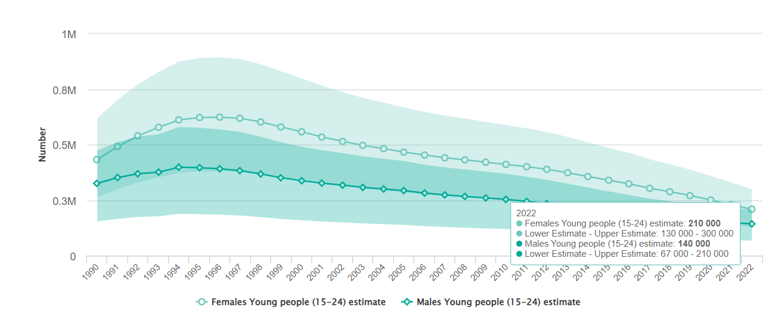
Women and girls and, in particular, AGYW have the highest likelihood of exposure to HIV.
Globally, almost half of new HIV acquisitions in 2022 occurred among women and girls, with around 210,000 new acquisitions among young females aged 15–24 years.¹
New HIV acquisitions among young people (15–24), by sex
¹ UNAIDS. Global factsheets. 2022.

Slide 6
In sub-Saharan Africa, AGYW disproportionately bear the burden¹
AGYW (aged 15–24) were more than three times as likely to acquire HIV than male peers
AGYW account for over 77% of new HIV acquisitions among young people
Weekly, ~4,000 AGYW acquired HIV globally. Of these acquisitions, 3,100 occurred in sub-Saharan Africa
¹ UNAIDS. Global factsheets. 2022.

Slide 7
Policy context
In 2021, the World Health Organization recommended the PrEP ring as an additional prevention option for women at substantial risk of HIV, noting some variability in effectiveness due to low use or adherence among young people.²
Several African countries have adapted national prevention guidelines to include PrEP ring, but all maintain restrictions on use by AGYW.
[Insert country specific policy context].
² WHO. WHO recommends the dapivirine vaginal ring. 2021.

Slide 8
Current PrEP ring guidelines limit use in many countries (as of February 2024)
Country* | Ring allowed <18 years old
Kenya | No
Lesotho | No
South Africa | No
Uganda | No
Zimbabwe | No
Eswatini | No
*MOSAIC countries

Slide 9
2
Current ring evidence

Slide 10
Current PrEP ring research and available data on AGYW in Africa: REACH Study
REACH is a Phase 2a, randomized, open-label, crossover study. Participants used the PrEP ring monthly for 6 months, oral PrEP (Truvada) for 6 months, and then chose the ring, Truvada, or neither for the final 6 months. The study will evaluate the safety and acceptability of and adherence to the ring and oral PrEP in users aged 16–21.
Study | Summary of Data Available | Published Results
MTN-034/REACH | Most (88% and 64%) of participants reported that the PrEP ring and oral PrEP were acceptable, respectively. More than 50% of participants had high adherence levels to both products. About two-thirds of participants chose the ring in the choice period, with those who had high adherence to oral PrEP in the randomization period more likely to select oral PrEP in the choice period. | Data collection completed in September 2021. Interim results presented at IAS 2021 (International AIDS Society Conference on HIV Science). Final results presented at CROI 2022 (Conference on Retroviruses and Opportunistic Infections), and final manuscript published in 2023.

Slide 11
Efficacy
Studies suggest that efficacy among AGYW increases with adherence,
In phase III trials, PrEP ring efficacy was lower among participants aged 18–21, likely due to lower adherence to the ring.^{3,4}
Results from two subsequent open-label extension studies showed increases in ring use, with modeling data from these and other studies suggesting greater risk reduction—by about 50 percent or more with consistent use—compared to the phase III trials.^{5,6}
³ Baeten JM, et al. Increased risk of HIV acquisition among women throughout pregnancy. 2018.
⁴ Nel A, et al. Safety and efficacy of a dapivirine vaginal ring . 2016.
⁵ Baeten JM, et al. Safety, uptake, and use. 2021.
⁶ Nel at al. Safety, adherence, and HIV-1 seroconversion. 2021.

Slide 12
Adherence
Adherence to the ring was moderately high among AGYW ages 16–21 who chose the ring and similar to adherence by those who chose oral PrEP.
Early clinical trials on PrEP ring use in Africa found lower adherence among women 18-21, inclusive.
In a more recent study, adherence to ring was moderately high among AGYW ages 16-21 who chose ring.
Participants chose PrEP ring regardless of previous adherence.
⁷ Nair G, et al. Adherence, safety, and choice. 2023.

Slide 13
Safety and acceptability
MTN-034/REACH, a safety and acceptability study of the PrEP ring among people aged 15–21 in Africa, highlighted:
No safety concerns; the safety profile of the PrEP ring among people younger than 18 was similar to the strong safety profile seen in adults.
PrEP ring acceptability was high among people under 18.
When given a choice of oral PrEP, the ring, or no PrEP method, nearly all participants chose to use PrEP, with two-thirds choosing the ring.
These results confirm earlier safety results of the ring among people aged 15–17 in the U.S.⁸
⁷ Nair G, et al. Adherence, safety, and choice. 2023.
⁸ Bunge KE, et al. Brief report. 2020.

Slide 14
3
MTN-034/REACH Study

Slide 15
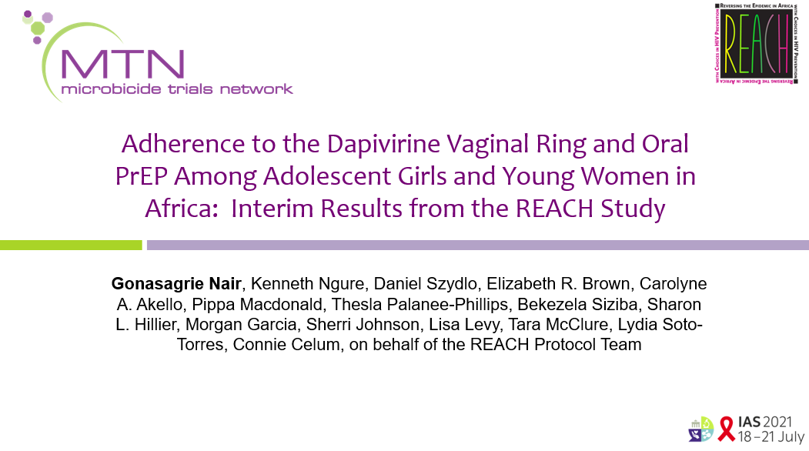
Background
The following slides (14–23) are adapted from presentations made at IAS 2021 and CROI 2022.

Slide 16
Introduction
Adolescent girls and young women (AGYW) account for most new HIV acquisitions in Africa
WHO recommends daily oral PrEP and the monthly dapivirine vaginal ring (ring) for women at risk of HIV acquisition
A safety study of the PrEP ring among AGYW demonstrated a similar safety profile among this group as among older trial participants⁸
Given low adherence among AGYW in efficacy trials, we assessed safety, product choice, and adherence to the ring and oral PrEP among African AGYW in the MTN-034/REACH trial
⁸ Bunge KE, et al. Brief report. 2020.
Notes:
As

Slide 17
Participant Baseline Characteristics
 | Cape Town, South Africa N=60 | Harare, Zimbabwe N=60 | Johannesburg, South Africa N=67 | Kampala, Uganda N=60 | Total N=247
Age | 18.3 | 17.9 | 18.3 | 18.2 | 18.2
Not married | 60 (100%) | 36 (60%) | 65 (97%) | 53 (88%) | 214 (87%)
Ever been pregnant | 5 (8%) | 41 (68%) | 21 (31%) | 32 (53%) | 99 (40%)
Contraceptive commenced in last 70 days | 17 (29%) | 28 (47%) | 22 (33%) | 26 (46%) | 93 (38%)
Secondary school | 55 (92%) | 55 (93%) | 57 (85%) | 22 (37%) | 189 (77%)
In school | 33 (55%) | 14 (23%) | 36 (54%) | 9 (15%) | 92 (37%)
Earns own income | 2 (3%) | 14 (23%) | 6 (9%) | 31 (52%) | 53 (21%)
At screening, participants were assumed to have been assigned female sex at birth and were not asked to report their gender identity. However, required safety pelvic exams that occurred during the screening process would later confirm sex at birth.
Notes:
REACH enrolled 247 HIV-negative, non-pregnant AGYW ages 16-21 from South Africa, Zimbabwe, and Uganda from February 2019 to April 2021.
Average age of participants enrolled was 18 years
The majority were unmarried and 40% had been pregnant at least once.
38% had not been on contraception at the time of screening.
Over three quarters had some secondary school education with over one-third still in school.
A small proportion (about 20%) were financially independent, indicating that they earned their own income.
Failing to ask sex assigned at birth and gender identity is not a recommended approach as it removes the ability of participants to identify themselves and limits our ability to report on findings by gender. In future similar studies, participants should be asked to report both their sex assigned at birth and their gender identity.

Slide 18
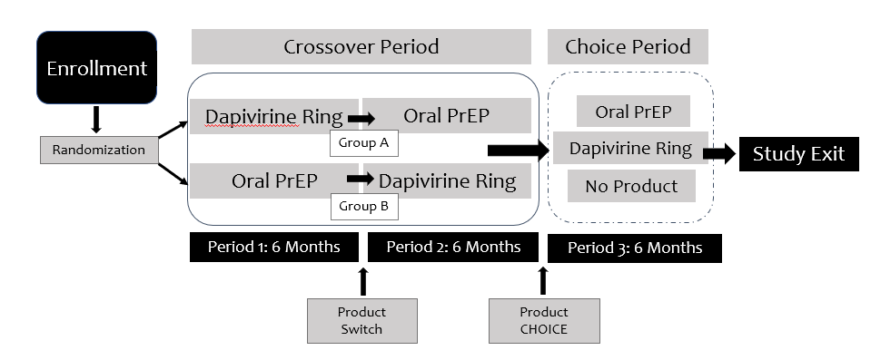
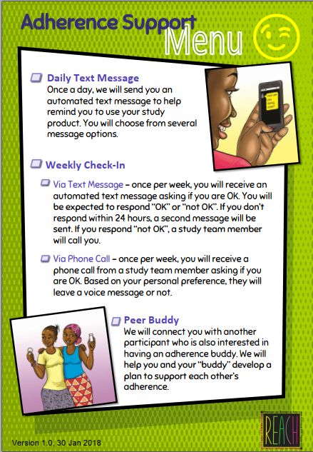
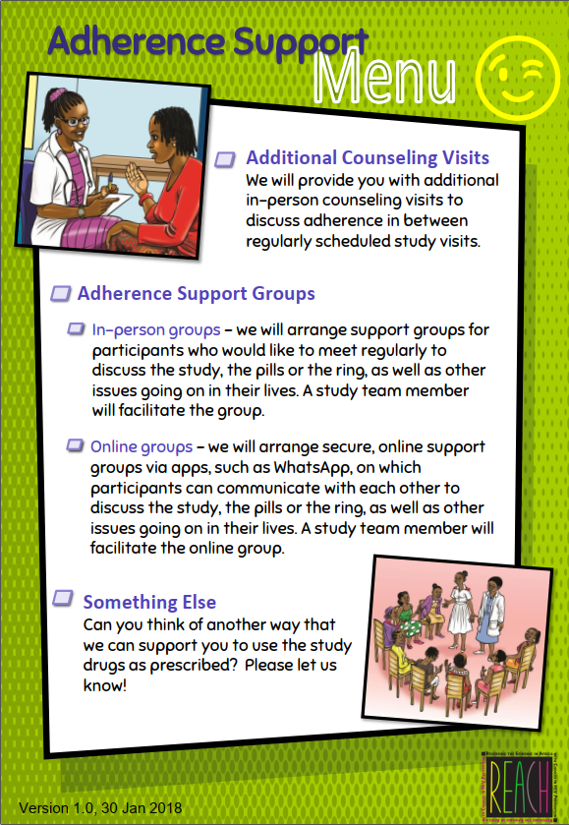
REACH study design
A randomized crossover study offering a diverse menu of adherence support options to all participants in South Africa, Uganda, and Zimbabwe.
Notes:
Participants were randomized to the monthly ring or daily oral tenofovir disoproxil fumarate/emtricitabine (TDF/FTC) for the first 6-month period (which was period 1), then switched on to the other product for the second 6-month period.
Participants were given a choice of ring, oral PrEP, or neither in the third 6-month period, which we are calling the choice period.
In the study, we provided a diverse menu of adherence support options for participants, this included daily text messages, adherence counseling messages, adherence support groups (in-person or virtual) and drug feedback. Participants visited the research clinic on a monthly basis.

Slide 19
Adverse events in REACH
 | Dapivirine Ring | Oral PrEP | Overall
At least 1 AE per participant | 211 (88%) | 222 (91%) | 234 (95%)
At least 1 related AE per participant | 79 (33%) | 131 (53%) | 133 (54%)
Average number of AEs per participant (SD) | 2.9 (2.3) | 3.5 (2.8) | 5.1 (3.6)
Average number of related AEs per participant (SD) | 0.5 (1.0) | 1.2 (1.6) | 1.3 (1.7)
54% of participants experienced at least 1 product-related AE
No difference in total number of reportable AEs experienced during ring use and oral PrEP use
No AE-related product holds, discontinuations, or related SAEs
Most commonly reported AEs across both study products/arms: decreased creatinine clearance, chlamydia, and headache
PrEP ring side effects in REACH were mild to moderate, and similar to those seen in the phase III trials.

Slide 20
Product choice in period 3
Randomization sequence in the crossover period was not associated with product choice
Of 227 (92%) participants who reached the choice period, more than two-thirds (152) chose the ring
Notes:
Here we report the results of product choice during period three. Overall, 92% of participants reached the choice period, and of those, over 2/3s chose the ring. About another third chose oral PrEP, and a small proportion chose no product (4 participants).
The randomization sequence in the crossover period was not associated with product choice.

Slide 21
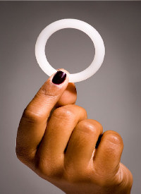
Evaluating adherence
Below is the how the REACH study categorized levels of adherence. A menu of adherence support, including weekly phone calls, daily SMS, in-person and remote support groups, and additional counseling sessions were offered. Preferences differed drastically by country, but the most popular strategies were in-person clubs and weekly calls. Preferences changed over time in the study as well (i.e., daily SMS to weekly calls) suggesting that participants felt less of a need for adherence support over time.⁹
Ring adherence
Oral PrEP adherence
Based on estimated dapivirine release calculated using residual drug (RD) levels in returned rings
Measured via tenofovir diphosphate (TFV-DP) levels in dried blood spots (DBS)
Non-use
RD levels showing release of <0.9mg
Some use
RD levels showing release of 0.9 to <4.0mg
Consistent with 28 days of use
RD levels showing release of ≥4.0mg
Non-use
TFV-DP levels of <16fmol/DBS punch
Some use
TFV-DP levels of 16 to 700fmol/DBS punch
High adherence
TFV-DP levels of ≥700fmol/DBS punch
We compared the proportion of visits with high adherence between the crossover and choice periods for each product.
⁸ Roberts at al. How a menu of adherence support strategies facilitated high adherence. 2023.
Notes:
We measured adherence for the ring based on estimating the dapivirine release calculated using residual drug levels in returned rings. We categorized these as follows: residual drug levels showing release less than 0.9mg as non-use, residual drug levels showing release from 0.9 to less than 4.0mg as some use, and residual drug levels showing release of at or above 4.0mg as consistent with 28 days of use.
For oral PrEP, measured adherence be tenofovir diphosphate levels in dried blood spots. TFV-DP levels of less than 16fmol per DBS punch were categorized as non-use, levels between 16-700fmol/DBS punch as some use, and levels at or above 700fmol/DBS punch as high adherence.

Slide 22
PrEP ring and oral PrEP adherence during the crossover and choice periods
Crossover Period
Choice Period
Oral
PrEP
Overall, participants used both the ring and oral PrEP consistently in the crossover and choice periods, with “some” to “high” adherence.
Fewer than 5% of visits were categorized as no or low adherence to study product.
Ring
Notes:
In comparing dapivirine ring and oral PrEP use during the crossover period, we have these data. The two graphs stacked on the left are from the crossover period, and the two on the right are from the choice period.
Residual DPV levels in used rings and TFV-DP levels in DBS showed participants had some to high use of the ring and moderate to high adherence to oral PrEP with <5% of visits with no adherence. High adherence to oral PrEP in the crossover period was strongly associated with choice of oral PrEP (p<0.001); an association was not observed for rings (p=0.85).

Slide 23
Adherence during the crossover period and subsequent product choice
Oral PrEP adherence | Chose oral PrEP | Chose ring/neither | p-value
Red/yellow at least once | 32 (20%) | 129 (80%) | <0.001
Always green | 39 (58%) | 28 (42%)
High adherence to oral PrEP in the crossover period was strongly associated with choice of oral PrEP (p<0.001)
No such association was observed for ring choice (p=0.85)
Non-use (red): TFV-DP levels of <16fmol/DBS punch
Some use (yellow): TFV-DP levels of 16-700fmol/DBS punch
High adherence (green): TFV-DP levels of ≥700fmol/DBS punch
Ring adherence | Chose ring | Chose oral PrEP/neither | p-value
Red/yellow at least once | 134 (67%) | 65 (33%) | 0.85
Always green | 19 (66%) | 10 (35%)
Non-use (red): RD levels showing release of <0.9mg
Some use (yellow): RD levels showing release of 0.9 to <4.0mg
Consistent with 28 days of use (green): RD levels showing release of ≥4.0mg
Notes:
Then evaluated adherence in the crossover period, and subsequent product choice – with the hypothesis that adherence in the crossover period could influence product choice. In the top table, we show adherence during the crossover period and subsequent product choice for oral PrEP where high adherence to oral PrEP in the crossover period was strongly associated with choice of oral PrEP (p<0.001); an association was not observed for rings (p=0.85).
A planned qualitative analysis should shed light on why we see this difference.

Slide 24
Conclusions
Both PrEP products were well-tolerated and highly acceptable
Among African AGYW who had experience with both ring and oral PrEP use, about two-thirds opted to use the ring when given a choice of products
Participants with high adherence to oral PrEP in the crossover period were more likely to choose oral PrEP when given a choice
Drug levels throughout the crossover and choice periods indicate partial to high adherence for both products – higher than in previous studies
AGYW can make informed choices about HIV prevention products and can use products effectively with proper support
When given a choice between oral PrEP, ring, or no product, most AGYW chose a PrEP method and continued to use a method for six months with limited switching

Slide 25
Acknowledgments
MTN-034/REACH Site staff and participants
The International Partnership for Microbicides developed the dapivirine ring and supplied rings for this trial. FTC/TDF tablets were supplied by Gilead Sciences, Inc.
The study was designed and implemented by the Microbicide Trials Network (MTN). From 2006 until November 30, 2021, the MTN was an HIV/AIDS clinical trials network funded by the National Institute of Allergy and Infectious Diseases through individual grants (UM1AI068633, UM1AI068615, and UM1AI106707), with co-funding from the Eunice Kennedy Shriver National Institute of Child Health and Human Development and the National Institute of Mental Health, all components of the U.S. National Institutes of Health.
The content is solely the responsibility of the authors and does not necessarily represent the official views of the NIH.
Desmond Tutu HIV Foundation (DTHF) Emavundleni Clinical Research Site
Wits Reproductive Health and HIV Institute (WRHI)
Makerere University-JHU Research Collaboration(MU-JHU)
University of Zimbabwe Clinical Trials Research Centre (UZ-CTRC) Spilhaus clinical research site
G. Nair, D. Szydlo, M. Garcia, C.A. Akello, P. Macdonld, B. Siziba, T. Palanee-Phillips, T. McClure, S. Johnson, L. Levy, K. Ngure, L.E. Soto-Torres, E.R. Brown, S. Hillier, C. Cellum, on behalf of the REACH Protocol Team
Authors (Final results)
K. Ngure, G. Nair, D. Szydlo, E.R. Brown, C.A. Akello, P. Macdonald, T. Palanee-Phillips, B. Siziba, S.L. Hillier, M. Garcia, S. Johnson, L. Levy, T. McClure, L. Soto-Torres, C. Celum, on behalf of the REACH Protocol Team
MTN-034/REACH Management team

Slide 26
4
Summary and recommendations

Slide 27
Summary and recommendations
The PrEP ring is safe, effective, and well tolerated by people under 18 years old
AGYW who choose the PrEP ring show moderately high adherence, similar to those who choose oral PrEP
When given a choice of PrEP methods, most AGYW choose to use PrEP rather than no method at all
AGYW who were able to use oral PrEP well are more likely to select oral PrEP when given a choice of methods
AGYW who have used oral PrEP and PrEP ring find both products highly acceptable
A growing body of evidence can inform updates to national PrEP guidelines on use of the PrEP ring by people younger than 18 years old.
Recommendation: PrEP ring should be made available to AGYW as an additional PrEP option.

Slide 28
References
UNAIDS. Global factsheets. Geneva (CH): UNAIDS; 2022. Available from: https://aidsinfo.unaids.org/
WHO. WHO recommends the dapivirine vaginal ring as a new choice for HIV prevention for women at substantial risk of HIV infection. Geneva (CH): WHO; 2021. Available from: https://www.who.int/news/item/26-01-2021-who-recommends-the-dapivirine-vaginal-ring-as-a-new-choice-for-hiv-prevention-for-women-at-substantial-risk-of-hiv-infection
Baeten JM, Palanee-Phillips T, Brown ER, Schwartz K, Soto-Torres LE, Govender V, et al. Use of a vaginal ring containing dapivirine for HIV-1 prevention in women. N Engl J Med. 2016 Dec 1;375(22):2121-32.
Nel A, van Niekerk N, Kapiga S, Bekker L.-G, Gama C, Gill K, et al. Safety and efficacy of a dapivirine vaginal ring for HIV prevention in women. N Engl J Med. 2016 Dec;375(22):2133-43. doi: 10.1056/NEJMoa1602046
Baeten JM, Palanee-Phillips T, Mgodi NM, Mayo AJ, Szydlo DW, Ramjee G, et al. Safety, uptake, and use of a dapivirine vaginal ring for HIV-1 prevention in African women (HOPE): an open-label, extension study. Lancet HIV. 2021 Feb;8(2): e87–e95.
Nel A, van Niekerk N, Van Baelen B, Malherbe M, Mans W, Carter A, et al. Safety, adherence, and HIV-1 seroconversion among women using the dapivirine vaginal ring (DREAM): an open-label, extension study. Lancet HIV. 2021 Feb;8(2):e77-e86.
Nair G, Celum C, Szydlo D, Brown ER, Akello CA, Nakalega R, et al. Adherence, safety, and choice of the monthly dapivirine vaginal ring or oral emtricitabine plus tenofovir disoproxil fumarate for HIV pre-exposure prophylaxis among African adolescent girls and young women: a randomised, open-label, crossover trial. Lancet HIV. 2023 Oct;10(12): E779-E789. doi:10.1016/S2352-3018(23)00227-8.
Bunge KE, Levy L, Szydlo D, Zhang J, Gaur AH, Reirden D, et al. Brief report: phase IIa safety study of a vaginal ring containing dapivirine in adolescent young women. J Acquir Immune Defic Syndr. 2020 Feb;83(2):135-139.
Roberts ST, Mancuso N, Williams K, Nabunya HK, Mposula H, Mugocha C, et al. How a menu of adherence support strategies facilitated high adherence to HIV prevention products among adolescent girls and young women in sub-Saharan Africa: a mixed methods analysis. J Int AIDS Soc. 2023 Nov;26(11):e26189.

Slide 29
Thank you to Ashley Mayo, Katie Schwartz, Morgan Garcia, Katie Williams, Rose Wilcher, and Stevie Daniels for the development, review, and edit of this deck. Special thanks to the MOSAIC country teams and NextGen Squad for their review, and REACH study team for the slides on study findings.

