Slide 1
PrEP Ring Safety Data in Pregnant and Breastfeeding Women
April 2024

Slide 2
How to Use This PowerPoint
Goal | This slide deck presents emerging evidence to support conversations on expanding pre-exposure prophylaxis (PrEP) ring access for pregnant and breastfeeding women (PBFW) in policy and programmatic rollout.
Rationale | Recent studies have published critical new data on use of the dapivirine vaginal ring (PrEP ring or ring) among pregnant and breastfeeding women in eastern and southern Africa, offering evidence that the PrEP ring is a safe and effective HIV prevention method for a broader population than was initially recommended. These studies could pave the way for the PrEP ring to be included in national guidelines and become a more accessible HIV prevention method for women during pregnancy or the postpartum period, which are times of increased risk of HIV acquisition.
Audience | Policymakers

Slide 3
Included Content
This deck includes the following information:
Rationale for why we need PrEP options for PBFW and high-level overview of available evidence
Overview of breastfeeding data from MTN-043/B-PROTECTED
Overview of pregnancy data from MTN-016/EMBRACE, MTN-020/ASPIRE, and MTN-042/DELIVER
Summary and recommendations

Slide 4
1
Why we need options for PBFW

Slide 5
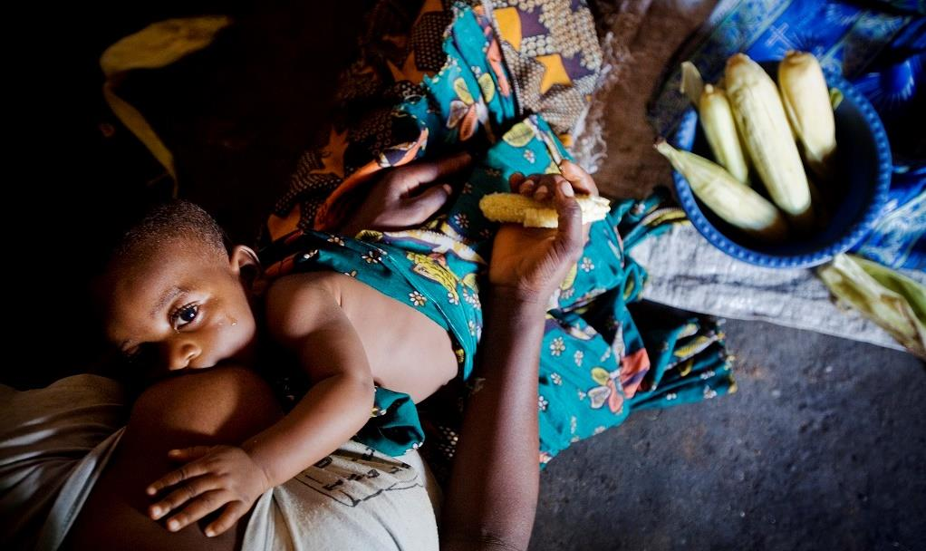
Childbearing individuals spend a significant part of their lifetime pregnant or breastfeeding¹
Pregnancy and postpartum are times of increased likelihood of HIV acquisition ^{2,3}
Incident HIV infection during pregnancy or breastfeeding increases likelihood of vertical transmission to infants^{4,5}
¹ MEASURE DHS. Demographic and Health Surveys. 2023
² Thomson KA, et al. Increased risk of HIV acquisition. 2018
³ Machekano R, et al. HIV incidence among pregnant and postpartum women. 2018.
⁴ Drake AL, et al. Incident HIV during pregnancy. 2014.
⁵ UNAIDS. Global factsheets. 2022.

Slide 6
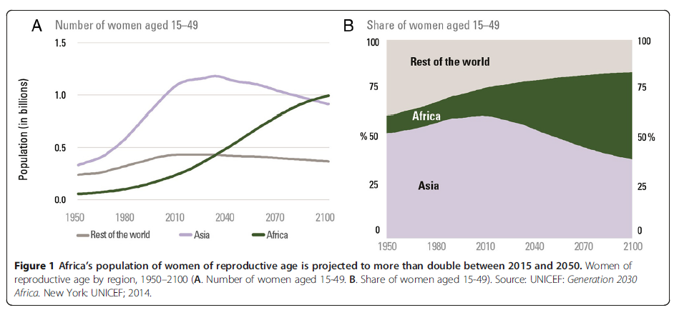
Women of reproductive age are a growing population in Africa, the continent most impacted by HIV transmission

Slide 7
 | Total fertility rate⁶ | Mean duration of breastfeeding¹ | Estimated total time pregnant or breastfeeding (years) | % time during reproductive age (age 15-49)
Kenya | 3.3 | 21 months | 6.6 | 25%
South Africa | 2.4 | 10.7 months | 4.8 | 12%
Uganda | 4.6 | 20 months | 9.2 | 34%
Zimbabwe | 3.5 | 18 months | 7 | 24%
Lesotho | 3 | 17.2 months | 6 | 20%
Eswatini | 3.2 | 14.7 months⁷ | 6 | 18%
Childbearing individuals spend a significant part of their lifetime pregnant or breastfeeding
¹ MEASURE DHS. Demographic and Health Surveys. 2023
⁶ World Bank. Fertility rate. 2022.
⁷ UNICEF. Eswatini Multiple Indicator Cluster Survey. 2022.

Slide 8
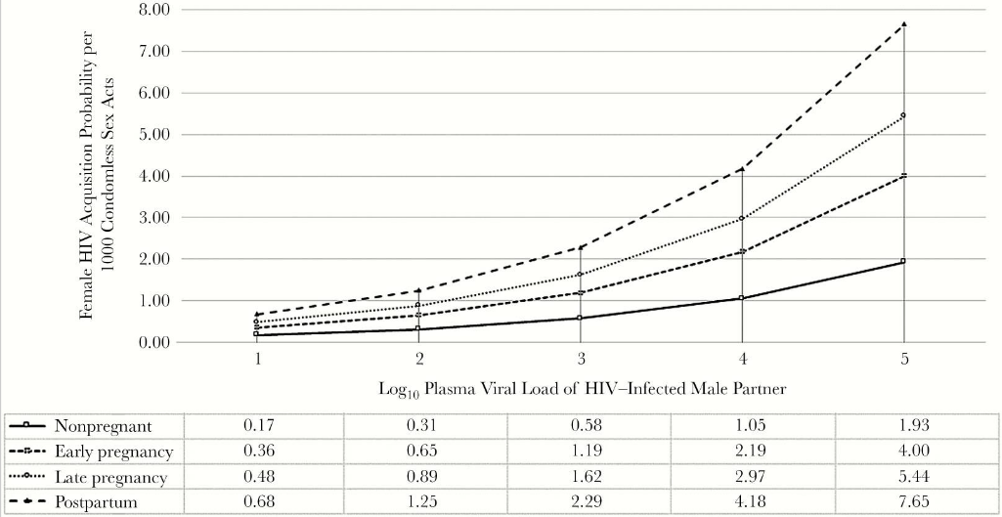
Pregnancy and postpartum are
times of increased HIV acquisition risk²
² Thomson KA, et al. Increased risk of HIV acquisition. 2018
Notes:
\

Slide 9
Incident HIV infection during pregnancy or breastfeeding increases risk of vertical transmission to infants
Incident HIV infections during pregnancy and breastfeeding responsible for about 30% of vertical transmissions in eastern and southern Africa

Slide 10
PrEP options currently vary in terms of safety data for pregnant and breastfeeding women
Largest amount of safety data for oral PrEP (TDF/FTC)
Oral PrEP
No evidence of negative impact on pregnancy or infant outcomes
Full WHO recommendation during pregnancy and breastfeeding in place
Strong safety data in pregnancy and breastfeeding
PrEP ring
No evidence of negative impact on pregnancy or infant outcomes
PrEP ring not yet recommended during pregnancy and breastfeeding in WHO guidelines, but with emerging evidence, WHO can respond favorably and will update WHO guidelines in the next year or two.
Limited but growing safety data
CAB PrEP
Least amount of safety data during pregnancy, but no concerns identified (more data needed). No published breastfeeding safety data.
WHO actively seeking review of pregnancy data.

Slide 11
Current PrEP ring guidelines limit use in many countries (as of February 2024)
Country | Ring allowed during pregnancy | Ring allowed while breastfeeding
Eswatini | No | No
Kenya | Yes | Yes
Lesotho | Yes | Yes
South Africa | No | No
Uganda | No | No
Zimbabwe | No | Yes

Slide 12
PrEP ring safety during breastfeeding: Summary of results from the B-PROTECTED Study
Study Design
Enrolled approximately 200 exclusive breastfeeding mother-infant pairs, randomized to PrEP ring or oral PrEP
Study product used for 12 weeks
Assessed maternal and infant safety, drug levels, acceptability and adherence
Key Results
Excellent safety profile for mothers and infants
No maternal or infant serious adverse effects (SAEs) were related to PrEP ring
Very little dapivirine passed to milk and even less to babies
Adherence and acceptability generally high

Slide 13
Sources of PrEP ring pregnancy safety data
Eighty-six incident PrEP ring pregnancies in the ASPIRE (Phase 3) trial
PrEP ring discontinued at time of pregnancy awareness
Infants followed through 1 year as part of EMBRACE/MTN-016
Enrolled approximately 550 participants total during different stages of pregnancy, randomized to PrEP ring or oral PrEP
PrEP ring used from enrollment through delivery
Infants followed through 1 year

Slide 14
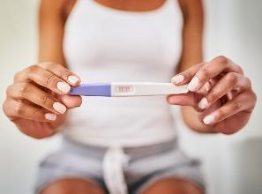
Key findings - PrEP ring safety during pregnancy
Pre-conception and early pregnancy exposure⁸
No impact on fertility rates
Not associated with preterm birth or pregnancy loss
Not associated with congenital anomalies or poor infant growth
Second and third trimester exposure⁹
Not associated with preterm birth or stillbirth
Pregnancy complications were uncommon, and similar to background rates observed in study communities
No maternal or infant SAEs were related to PrEP ring
No HIV seroconversions
⁸ Makanani et al. Pregnancy and infant outcomes. 2018
⁹ Bunge et al, A safety study. 2023

Slide 15
Ring is an appealing option for PBFW
97% of participants in B-PROTECTED found the PrEP ring to be acceptable and adherence was generally high¹⁰
Qualitative work showed participants found the ring to be acceptable and easy to use¹¹
High value was placed on the ability to protect oneself and one’s baby¹²
Provider approval and counseling support, especially around side effects is important
General sentiment on ease of use and acceptability
¹⁰ Noguchi et al. Results of a multi-country Phase 3B randomized trial. 2023
¹¹ Stoner et al. Acceptability and use. 2023
¹² Montgomery et al. Acceptability of the dapivirine vaginal ring. 2023

Slide 16
Male partner and provider perceptions are influential
In a study evaluating attitudes about PrEP use during pregnancy and breastfeeding (P/BF), participants that were either currently or recently P/BF, a male partner of a P/BF individual, or a mother of a P/BF individual reported that:^{13, 14}
Partners played the most important influencer role during pregnancy and breastfeeding
Health decisions during P/BF were typically made jointly,
Product choice was important to individuals potentially using PrEP
Healthcare providers’ approval of PrEP use during P/BF was important for product acceptability
¹³ Musura P, et al. Understanding the role. 2022.
¹⁴ van der Straten, A, et al. Influences on willingness. 2020.
Notes:
use PrEP, but were either currently or recently P/BF, a male partner of P/BF individual, a mother of a P/BF individual, or a key informant in the community

Slide 17
2
In-depth breastfeeding data

Slide 18
Results of a multi-country, Phase 3B randomized trial of dapivirine vaginal ring and oral pre-exposure prophylaxis use for HIV prevention during breastfeeding
L. Noguchi, M. Owor, B. Mirembe, E. Horne, N. Mgodi, F. Taulo, R. Scheckter, K. Bunge, H. Gundacker, B. Richardson, J. Piper, N. Chakhtoura, and J.E. Balkus on behalf of the MTN-043/B-PROTECTED Team
Interim results presented at AIDS 2022 and final results presented at CROI 2023 and FIGO 2023. Slides here adapted from conference presentations.

Slide 19
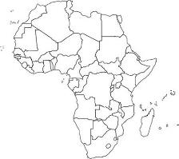
B-PROTECTED phase 3B randomized trial
Healthy, HIV-negative, breastfeeding mother-infant pairs, randomized 3:1
(PrEP ring: Oral PrEP)
Monthly dapivirine vaginal ring
(PrEP ring)
Daily oral 200 mg FTC/300mg TDF
(oral PrEP)
12-week exposure to study product

Slide 20
Objectives and Endpoints
Objectives | Objectives | Endpoints
Primary | Maternal safety | All serious adverse events (SAEs) and grade 3 or higher AEs
Primary | Infant safety | All SAEs and grade 3 or higher AEs
Primary | Study drug detection and concentrations | Maternal plasma dapivirine, dried blood spot (DBS), emtricitabine triphosphate (FTC-TP), and TFV-DP (tenofovir diphosphate) Maternal breast milk dapivirine or FTC-TP and TFV-DP Infant plasma dapivirine Infant DBS FTC-TP and TFV-DP
Secondary | Willingness to use Acceptability | During breastfeeding in the future Proportion who find product at least as acceptable as other HIV prevention methods
Secondary | Adherence | Reported frequency of study product use (e.g., missed doses, PrEP ring removal/expulsions) Residual drug levels in returned rings Maternal plasma dapivirine, DBS FTC-TP, and TFV-DP
Key questions: Was it safe for mom and baby? How much medication passed to babies? Did users like and use the products?

Slide 21
Study visit schedule
Serious adverse events (SAEs) and adverse events (AEs) collected
Drug concentrations in maternal blood/plasma, breast milk, infant blood/plasma; residual dapivirine in returned rings
Acceptability assessed via questionnaire
Adverse events defined by Division of AIDS (DAIDS) Table for Grading the Severity of Adult and Pediatric Adverse Events, Corrected Version 2.1, July 2017 and/or Addendum 1 (Female Genital Grading Table for Use in Microbicide Studies [Dated November 2007]) in both trial groups.

Slide 22
Why was exclusive breastfeeding important for MTN-043 objectives?
Safety
Risk of foodborne illness increases once complementary foods are started — can be confused with adverse events related to study product exposure
Impact on breastfeeding
More accurate estimate before starting complementary foods, which decrease milk supply (FDA requires drug label to summarize effect on milk production)
Pharmacokinetics
Understand likely maximum potential drug exposure for infant, and infant PK may vary with amount and type of complementary food(s), e.g., fat intake

Slide 23
Baseline Demographic Characteristics
 | PrEP ring group n=148 |  | Oral PrEP group n=49 |  | All participants N=197
Mothers
Age (years)* | 26 | (18, 43) | 25 | (18, 38) | 26 | (18, 43)
# of live births | 2 | (1, 6) | 2 | (1, 5) | 2 | (1, 6)
Has a primary partner | 144 | 97% | 48 | 98% | 192 | 97%
Infants
Age (weeks)
6 to 9 weeks | 87 | 59% | 34 | 69% | 121 | 61%
>9 to 12 weeks | 61 | 41% | 15 | 31% | 76 | 39%
Female sex at birth | 84 | 57% | 24 | 49% | 108 | 55%
On average, the groups of women who used the PrEP ring and who used oral PrEP were similar.

Slide 24
Excellent safety profiles for mothers and infants
 | Mothers |  |  |  | Infants
 | Serious adverse events |  | Grade 3 or higher adverse events |  | Serious adverse events |  | Grade 3 or higher adverse events
 | n/N | % (95% CI) | n/N | % (95% CI) | n/N | % (95% CI) | n/N | % (95% CI)
PrEP Ring | 2/148 | 1% (0, 5) | 3/148 | 2% (0, 6) | 4/148 | 3% (1, 7) | 10/148 | 7% (3, 12)
Oral PrEP | 0/49 | 0% (0, 7) | 2/49 | 4% (1, 14) | 0/49 | 0% (0, 7) | 1/49 | 2% (0, 11)
Uterine leiomyoma
Appendiceal abscess
Bronchiolitis (n=2)
Dysentery
Pneumonia
No SAEs or grade 3 or higher AEs were related to
study product for mothers and infants.

Slide 25
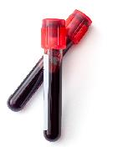
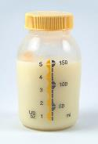
Drug-level concentrations in maternal plasma, breast milk, and infant plasma
Maternal drug levels
Most mothers had dapivirine detected in the blood, which helps to confirm that the rings were being used
Overall, the amounts of dapivirine that passed to blood were similar to other studies of ring use
Breast milk and infant drug levels
Dapivirine was detected in breast milk in very small amounts
Most babies did not have detectable dapivirine in their blood
Oral PrEP drug levels showed evidence of product use but no significant transfer of drug to infants through breast milk.

Slide 26
Adherence
Use category | PrEP ring n (%)* | Use category | Oral PrEP n (%)*
Month 1 | 141 (95) | Month 1 | 46 (94)
Low/No use | 16 (11) | Low/No use | 2 (4)
Some release | 108 (77) | Some use | 22 (48)
High release | 17 (12) | High use | 22 (48)
Month 2 | 143 (97) | Month 2 | 44 (90)
Low/No use | 28 (20) | Low/No use | 0
Some release | 99 (69) | Some use | 24 (55)
High release | 16 (11) | High use | 20 (46)
Month 3 | 132 (89) | Month 3 | 47 (96)
Low/No use | 29 (22) | Low/No use | 0
Some release | 89 (67) | Some use | 23 (49)
High release | 14 (10) | High use | 24 (51)
Drug levels were consistent with product use.
*rounded to the nearest percentage

Slide 27
High user acceptability for both products
Most found both products acceptable
Overall 97%
PrEP ring 97%
Oral PrEP 98%
Most willing to use assigned product when breastfeeding in the future
Overall 98%
PrEP ring 98%
Oral PrEP 100%
Most preferred study product to which they were assigned
No difference between acceptability of the two study products for both acceptability aspects above

Slide 28
First study of PrEP ring during breastfeeding
Both PrEP ring and oral PrEP have favorable safety profile among breastfeeding mother-infant pairs
Drug levels in breast milk and infant samples low
Expand HIV prevention choices during breastfeeding to include PrEP ring
Adherence and acceptability generally high
Ample evidence to warrant update of PrEP ring guidelines to include breastfeeding women

Slide 29
Thank you to all participants, communities, study staff, and funders
JOHNS HOPKINS
RESEARCH PROJECT
The study was designed and implemented by the Microbicide Trials Network (MTN) funded by the National Institute of Allergy and Infectious Diseases through individual grants (UM1AI068633, UM1AI068615, and UM1AI106707), with co-funding from the Eunice Kennedy Shriver National Institute of Child Health and Human Development and the National Institute of Mental Health, all components of the U.S. National Institutes of Health (NIH).
The content is solely the responsibility of the authors and does not necessarily represent the official views of the NIH.
Study products were provided by Gilead Sciences, Inc. and International Partnership for Microbicides.

Slide 30
3
In-depth pregnancy data

Slide 31
Pre-conception and early pregnancy exposure data
Pre-conception and early pregnancy exposure data for PrEP ring is from incident pregnancies in the ASPIRE (phase 3) trial
PrEP ring was discontinued at the time of pregnancy awareness
Pregnancy outcomes and congenital anomalies were collected as part of ASPIRE
Pregnant participants invited to enroll in EMBRACE/MTN-016, which followed infants through 1 year of life
Makanani B., Pregnancy and infant outcomes among women using the dapivirine vaginal ring in early pregnancy. J Acquir Immune Defic Syndr. 2018 Dec 15;79(5):566-572.
EMBRACE (MTN-016)

Slide 32
ASPIRE results—Pregnancy outcomes
PrEP ring had no impact on fertility rates
PrEP ring not associated with preterm birth or pregnancy loss
No difference in rates of congenital anomalies between arms

Slide 33
EMBRACE results — Infant outcomes
96% of infants were enrolled in EMBRACE and followed for one year
Retention rate was 92% at 12 months
Across all visits for the year, there were no differences in infant weight, height, or head circumference by study arm
Taken together, these data support the safety of
PrEP ring use in early pregnancy

Slide 34
A safety study of a dapivirine vaginal ring and oral PrEP for the prevention of HIV during pregnancy (MTN-042)
Bunge K, Balkus JE, Fairlie L, Mayo AJ, Nakabiito C, Mgodi N, Gadama L, Matrimbira M, Chappell CA, Piper J, Chakhtoura N, Szydlo DW, Richardson B, Hillier SL, on behalf of the DELIVER/MTN-042 team
Bunge, et al. DELIVER: A safety study of a dapivirine vaginal ring and oral PrEP for the prevention of HIV during pregnancy. JAIDS. January 2024. Slides adapted from presentation at CROI 2023 and CROI 2024

Slide 35
Study design
Enrolled one cohort at a time, beginning with later gestational age
Key eligibility criteria: 18–40 years old, singleton pregnancy, ultrasound confirmed gestational age, no history of pregnancy complications
Participants randomly assigned to use either the monthly PrEP ring or daily oral PrEP (TDF/FTC) until delivery
2:1 randomization for cohorts 1 and 2
4:1 randomization for cohort 3
Interim safety reviews by an independent panel conducted before moving to the next cohort
Cohort 1
36+ weeks pregnant
Used product
4-6 weeks
150
Safety review
2:1
Cohort 2
30-35 weeks pregnant
Used product
7-12 weeks
150
2:1
Safety review
Used product
up to 30 weeks
Cohort 3
12-29 weeks
pregnant
Study Complete
250
4:1
Notes:
Eligible pregnant individuals aged 18 to 40 in Malawi, South Africa, Uganda, and Zimbabwe were randomized 2:1 to monthly DVR or daily TDF/FTC. Participants in cohort 1 initiated product use between 36 0/7-37 6/7 weeks gestation while participants in cohort 2 initiated product use at 30 0/7- 35 6/7 weeks gestation. All participants continued product use until delivery or 41 6/7 weeks gestation.

Slide 36
Visit schedule and methods
Participants returned for in-person visits every 2-4 weeks alternating with telephone visits until delivery
A post-pregnancy outcome visit was scheduled in the clinic for both maternal and infant participants within two weeks of delivery
Mothers exited at six weeks post delivery; infants followed through one year
Pregnancy outcomes and complications reported up to six weeks post delivery and compared to local background rates obtained through a systematic chart review (MTN-042B)¹⁵
¹⁵Balkus et al. Assessing pregnancy and neonatal outcomes. 2021
Notes:
MTN-042B: Data from 10,138 records were abstracted across all four sites to provide background rates for the outcomes and complications of interest in the communities in which MTN-042 is conducted.

Slide 37
Study population and retention
Cohort 1
227 screened
150 enrolled
101 randomized to DVR
99 pregnancy outcomes available
49 randomized to TDF/FTC
49 pregnancy outcomes available
Cohort 2
218 screened
157 enrolled
106 randomized to DVR
104 pregnancy outcomes available
51 randomized to TDF/FTC
50 pregnancy outcomes available
Cohort 3
332 screened
251 enrolled
202 randomized to DVR
200 pregnancy outcomes available
49 randomized to TDF/FTC
48 pregnancy outcomes available
> 95% expected
maternal visits completed
Demographic and clinical characteristics similar by study arm for each cohort

Slide 38
Pregnancy outcomes
 | Cohort 1 (36+ weeks) |  | Cohort 2 (30-35 weeks) |  | Cohort 3 (12-29 weeks) |  | MTN-042B (Balkus 2021)
Study Product | PrEP ring | Oral PrEP | PrEP ring | Oral PrEP | PrEP ring | Oral PrEP | None
No. Pregnancy Outcomes | 99 | 49 | 104 | 50 | 200 | 48 | 10,426†
Live births | 99 (100%) | 48 (98%) | 103 (99%) | 51 (100%)** | 197 (99%) | 48 (100%) | 9,767 (93.7%)
Full term (≥ 37weeks) | 98 (99%) | 46 (96%) | 97 (94%) | 47 (92%) | 189 (95%) | 45 (94%) | 8448 (81%)
Premature (<37 weeks) | 1 (1%) | 2 (4%) | 6 (6%) | 4 (8%) | 8 (4%) | 3 (6%) | 1319 (12.7%)
Stillbirth/intrauterine fetal demise (>20 weeks)* | 0 (0%) | 1 (2%) | 1 (1%) | 0 (0%) | 2 (1%) | 0 (0%) | 413 (4.0%)
Spontaneous abortion (<20 weeks) | - | - | - | - | 1 (1%) | 0 (0%) | -
*Not related to study product
**51 live births among 50 participants due to an undiagnosed twin gestation
†246 records pregnancy outcome not documented
No difference in preterm labor or stillbirths between arms
Notes:
Two stillbirths—neither deemed related to study product.
In cohort 1—the participant presented at 37 weeks’ gestation at the local hospital where she was diagnosed with an intrauterine fetal demise by ultrasound and proceeded to spontaneous vaginal delivery of a macerated stillbirth of 3,000 grams. No other examination of the stillbirth was conducted, and no cause could be identified. The frequency of stillbirth in the Truvada arm (2%) and cohort as a whole (0.7%) was lower than was observed in MTN-042B (4.0%).
In cohort 2—There was one stillbirth experienced by a participant in the dapivirine arm. In brief, this participant presented to the local hospital at 41 weeks’ gestation with ruptured membranes for two days. The infant was noted to be breech, and she was admitted in latent labor. She subsequently developed chorioamnionitis and delivered via spontaneous vaginal delivery a fresh stillbirth approximately 7 hours later. The cause of the stillbirth was thought to be chorioamnionitis due to prolonged rupture of membranes. The frequency of stillbirth in the dapivirine arm (1%) and cohort as a whole (0.6%) was lower than was observed in MTN-042B (4.0%).
As expected, the frequency of preterm birth for cohort 1 was lower than the estimated background rate since participants were enrolled at 36 weeks or beyond. Similarly, the rates of stillbirth were lower in both cohorts likely reflecting the inclusion criterion of a healthy singleton pregnancy.

Slide 39
Pregnancy complications (1)
 | Cohort 1 (36+ weeks) |  | Cohort 2 (30-35 weeks) |  | Cohort 3 (12-29 weeks) |  | MTN-042B (Balkus 2021)
Study Product | PrEP ring | Oral PrEP | PrEP ring | Oral PrEP | PrEP ring | Oral PrEP | None
No. Pregnancy Outcomes | 99 | 49 | 106 | 51 | 200 | 48 | Frequency (95% CI)
Any hypertensive disorder of pregnancy | 3 (3%) | 4 (8%) | 9 (8%) | 5 (10%) | 19 (9%) | 7 (14%) | 10.5% (10.0,11.3)
Gestational hypertension | 3 (3%) | 2 (4%) | 6 (6%) | 5 (10%) | 15 (7%) | 6 (12%) | 4.4% (4.0,4.8)
Pre-eclampsia without severe features | 0 (0%) | 1 (2%) | 1 (1%) | 0 (0%) | 3 (1%) | 0 (0%) | 2.2% (1.9,2.5)
Pre-eclampsia with severe features | 0 (0%) | 1 (2%) | 2 (2%) | 0 (0%) | 1 (0.4%) | 1 (2%) | 2.1% (1.9,2.4)
Eclampsia | 0 (0%) | 0 (0%) | 0 (0%) | 0 (0%) | 0 (0%) | 0 (0%) | 0.6% (0.5,0.8)
Peripartum/Antepartum hemorrhage | 0 (0%) | 1 (2%) | 2 (2%) | 2 (4%) | 5 (3%) | 0 (0%) | --
Postpartum hemorrhage | 2 (2%) | 1 (2%) | 2 (2%) | 0 (0%) | 3 (1%) | 0 (0%) | 3.2% (2.9,3.6)
Pregnancy complications were uncommon, and similar to background rates observed in local communities.
Notes:
Peripartum/antepartum hemorrhage was not assessed in MTN-042B.
Participants may experience more than one form of hypertensive disorder in pregnancy, therefore the sum of the row below may be higher than the total number of participants in this row.
Abbreviations: CI = confidence interval

Slide 40
Pregnancy complications (2)
 | Cohort 1 (36+ weeks) |  | Cohort 2 (30-35 weeks) |  | Cohort 3 (12-29 weeks) |  | MTN-042B (Balkus 2021)
Study Product | PrEP ring | Oral PrEP | PrEP ring | Oral PrEP | PrEP ring | Oral PrEP | Frequency (95% CI)
No. Pregnancy Outcomes | 99 | 49 | 106 | 51 | 200 | 48 | 10,426†
Fever of unclear etiology | 0 (0%) | 0 (0%) | 0 (0%) | 0 (0%) | 0 (0%) | 0 (0%) | 0.1% (0.1-0.2%)
Chorioamnionitis | 0 (0%) | 0 (0%) | 1 (1%) | 0 (0%) | 0 (0%) | 0 (0%) | 0.2% (0.1-0.3%)
Postpartum endometritis | 0 (0%) | 0 (0%) | 0 (0%) | 1 (2%) | 0 (0%) | 0 (0%) | 0.4% (0.3-0.5%)
Puerperal sepsis | 0 (0%) | 0 (0%) | 0 (0%) | 2 (4%) | 0 (0%) | 0 (0%) | -
No difference in infectious complications between the arms.
Notes:
One of the biggest theoretical concerns about the ring is that this foreign body might cause an infection (like chorioamnionitis) that would lead to preterm delivery—this was not observed.
Puerperal sepsis were not assessed in MTN-042B.
Abbreviations: CI = confidence interval

Slide 41
Maternal and infant adverse events
Adverse Events | Cohort 1 (36+ weeks) |  | Cohort 2 (30-35 weeks) |  | Cohort 3 (12-29 weeks)
Study Product | PrEP Ring | Oral PrEP | PrEP Ring | Oral PrEP | PrEP Ring | Oral PrEP
No. Maternal Participants | 101 | 49 | 106 | 51 | 202 | 49
Maternal participants with ≥1 composite AE¹ | 1 (1%) | 4 (8%) | 14 (13%) | 5 (10%) | 24 (12%) | 4 (8%)
Maternal Death | 0 (0%) | 0 (0%) | 0 (0%) | 0 (0%) | 0 | 0
No. Infant participants | 99 | 48 | 102 | 51 | 196 | 48
Infant participants with ≥1 composite AE¹ | 12 (12%) | 6 (13%) | 17 (17%) | 7 (14%) | 32 (16%) | 2 (4%)
Congenital Anomalies | 2 (2%) | 2 (4%) | 7 (7%) | 3 (6%) | 9 (5%) | 2 (4%)
Infant Death | 0 (0%) | 1 (2%) | 1 (1%) | 0 (0%) | 2 (1%) | 0
No maternal or infant SAEs were deemed related to study product.
No maternal deaths
Rates of congenital anomalies were similar between arms.
Infant deaths rare, not related to study products
¹All serious adverse events (SAEs) and ≥grade 3 adverse events (AEs) as per DAIDS Table for Grading the Severity of Adult and Pediatric Adverse Events
Notes:
1 infant death in Cohort 1:
Infant of mother randomized to TDF/FTC
Maternal participant experienced a placental abruption
The infant was severely depressed at delivery
Ultimately passed from hypoxic ischemic encephalopathy
Deemed not related to study product
1 infant death in Cohort 2:
Infant of mother randomized to DVR
Born via cesarean section at 34 weeks and 6 days due to fetal distress
Noted to have multiple dysmorphic features involving the eyes, head shape, and tongue
Passed from multiple organ failure on day of life 1
Deemed not related to study product

Slide 42
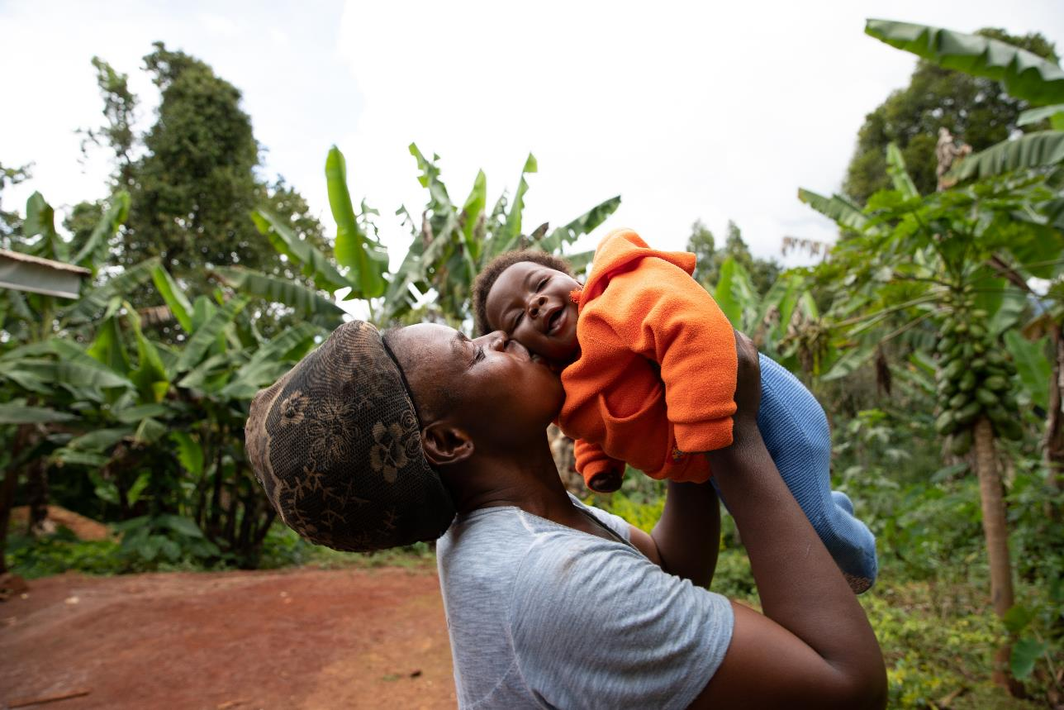
There were no HIV seroconversions

Slide 43
Acceptability and adherence
“…What I like most [about] prevention of HIV… even if he [partner] misbehaves [engages in sexual relations] out there it [HIV] will catch him alone. … Me and my child will be safe”
(Ring user, Chitungwiza)
“.. because when you stay with people for some time you develop the self-esteem driving away the fear. So, as I stayed with the service providers, they became my friends and had gone through for me, and I became an expert [in using the ring].”
(Ring user, Kampala)¹²
Pregnant people are like other people!
Similar to nonpregnant participants in other trials, study products were generally liked and described as easy to use.
Overarching maternal sentiment that being able to protect both oneself and their baby was highly valued
Education and counseling from providers and past ring users helped alleviate concerns
Preliminary adherence data are also encouraging
¹²Montgomery ET, et al. Acceptability of the dapivirine vaginal ring. 2023
Notes:
Acceptability of the Dapivirine Vaginal Ring and Oral Truvada Among African Users in Late-Stage of Pregnancy | AIDS and Behavior (springer.com)

Slide 44
Conclusions
The PrEP ring has a favorable safety profile
among pregnant women and their infants.
Both products were well-tolerated with no SAEs associated with either product when used during the second and third trimesters of pregnancy.
Adverse pregnancy outcomes, pregnancy complications, and adverse infant outcomes were uncommon and similar to background rates observed in the local communities.
These results, along with safety data during early pregnancy from ASPIRE/EMBRACE, support PrEP ring use for pregnant women.

Slide 45
Acknowledgments
Participants for their time, commitment, and trust
Study sites: Luis Gadama, MBBS, FCOG (SA), MMED UCT (IoR), Linly Seyama, Msc, RNM (Study Coordinator [SC]), Vitumbiko D. Mandiwa, MBBS (SC), Sufia Dadabhai, PhD (Clinical Research Site [CRS] Leader), and Taha E. Taha, PhD (Clinical Trials Unit Principal Investigator [CTU PI]), Johns Hopkins University (JHU) Research Project; Clemensia Nakabiito, MBChB, MMed (IoR), Phionah Bridget Kibalama Ssemambo, MBchB, MSc PH (SC), and Mary Glenn Fowler, MD, MPH (CTU PI), Makerere University - Johns Hopkins University (MU-JHU) Research Collaboration; Lee Fairlie, MBChB, FCPaeds (Protocol Co-Chair, IoR), Carlotta Mabuza, BS, PGDip, Dip (SC), Hermien Gous, PharmD (CRS Leader), and Ringson Ngozo, DipEd (Community Working Group [CWG] Representative), Wits RHI Shandukani Research Centre; Felix Mhlanga, MBChB, MMed (PC), Nyaradzo M. Mgodi, MBChB, Mmed, (IoR), Petina Musara, BSW (SC), and Z. Mike Chirenje, MD, FRCOG (CTU PI), University of Zimbabwe Clinical Trials Research Centre (UZ-CTRC)
Interim review panel: Deborah M. Money, MD, FRCSC; Annie Lyerly, MD, MA; Richard Adanu, PhD; Professor Ellen Chirwa, PhD MRNM; Paige Williams, PhD, MS; Charles Shey Wiysonge, MD, PhD; Dorothy Mbori-Ngacha, MBChB, MMed, MPH
Study products: The dapivirine vaginal rings used in this study were developed and supplied by the International Partnership for Microbicides (IPM). Oral tenofovir disoproxil fumarate/emtricitabine (TDF/FTC) was donated by Gilead Sciences.
Funders: The study was designed and implemented by the Microbicide Trials Network (MTN). From 2006 until November 30, 2021, the MTN was an HIV/AIDS clinical trial network funded by the National Institute of Allergy and Infectious Diseases (UM1AI068633, UM1AI068615, UM1AI106707), with co-funding from the Eunice Kennedy Shriver National Institute of Child Health and Human Development and the National Institute of Mental Health, all components of the U.S. National Institutes of Health (NIH). The content is solely the responsibility of the authors and does not necessarily represent the official views of the National Institutes of Health.

Slide 46
4
Summary and Recommendations

Slide 47
Summary and recommendations
Incident HIV infection during pregnancy and the postnatal period is high and associated with a higher likelihood of vertical transmission
Pregnant and breastfeeding women need and deserve more options for prevention, including the PrEP ring
Pregnant and breastfeeding women found the ring to be highly acceptable and easy to use.
The PrEP ring has a favorable safety profile among pregnant and breastfeeding women and their infants
Recommendation: PrEP ring should be made available to PBFW with appropriate risk/benefit counseling

Slide 48
Thank you to Lisa Noguchi, Katherine Bunge, Ashley Mayo, Katie Williams, Katie Schwartz, Rose Wilcher, and Stevie Daniels for the development, review, and edit of this deck. Special thanks to the MOSAIC country teams and NextGen Squad for their review, and B-PROTECTED and DELIVER study teams for the slides on study findings.

Slide 49
5
Slide Annex

Slide 50
References
MEASURE DHS. Demographic and Health Surveys. Rockville (US): ICF; 2023. Available from: https://dhsprogram.com/data/available-datasets.cfm
Thomson KA, Hughes J, Baeten JM, John-Stewart G, Celum C, Cohen CR, et al. Increased risk of HIV acquisition among women throughout pregnancy and during the postpartum period: a prospective per-coital-act analysis among women with HIV-Infected partners. J Infect Dis. 2018 Jun 5;218(1):16–25.
Machekano R, Tiam A, Kassaye S, Tukei V, Gill M, Mohai F, et al. HIV incidence among pregnant and postpartum women in a high prevalence setting. PLoS One. 2018 Dec 28;13(12):e0209782.
Drake AL, Wagner A, Richardson B, John-Stewart G. Incident HIV during pregnancy and postpartum and risk of mother-to-child HIV transmission: a systematic review and meta-analysis. PLoS Med. 2014 Feb 25;11(2):e1001608.
UNAIDS. Global factsheets. Geneva (CH): UNAIDS; 2022. Available from: https://aidsinfo.unaids.org/
World Bank. Fertility rate, total (births per woman). Washington, DC (US): World Bank. Available from: https://data.worldbank.org/indicator/SP.DYN.TFRT.IN
UNICEF. Eswatini Multiple Indicator Cluster Survey 2021-2022. Mbabane (SZ): UNICEF Eswatini; 2022. Available from: https://www.unicef.org/eswatini/reports/eswatini-multiple-indicator-cluster-survey-2021-2022
Makanani B, Balkus JE, Jiao Y, Nogushi LM, Palanee-Phillips T, Mbilizi Y, et al. Pregnancy and infant outcomes among women using the dapivirine vaginal ring among early pregnancy. J Acquir Immune Defic Syndr. 2018 Dec 15;79(6):566-572.
Bunge K, Balkus JE, Fairlie L, Mayo AJ, Nakabiito C, Mgodi N, et al. DELIVER: a safety study of a dapivirine vaginal ring and oral PrEP for the prevention of HIV during pregnancy. J Acquir Immune Defic Syndr. 2024 Jan 1;95(1):65-73.
Noguchi L, Owor M, Mirembe B, Horne E, Mgodi N, Taulo F, et al. Results of a multi-country, Phase 3B randomized trial of dapivirine vaginal ring and oral pre-exposure prophylaxis use for HIV prevention during breastfeeding [abstract]. In International Journal of Gynecology & Obstetrics Volume 163: Abstracts of the XXIV FIGO World Congress of Gynecology & Obstetrics. FIGO: 2023 Oct 9-11; Paris (FR).
Stoner MCD, Hawley I, Mathebula F, Horne E, Etima J, Kemigisha D, et al. Acceptability and use of the dapivirine vaginal ring and daily oral ore-exposure prophylaxis (PrEP) during breastfeeding in South Africa, Malawi, Zimbabwe, and Uganda. AIDS Behav. 2023 Dec;27(12):4114-4123.
Montgomery ET, Hawley I, Fairlie L, Bunge K, Mathebula F, Etima J, et al. Acceptability of the dapivirine vaginal ring and oral Truvada among African users in late-stage pregnancy. AIDS and Behavior. 2023 Nov 1;28:963-973.
Musara P, Hartmann M, Ryan JT, Reddy K, Ggita J, Mutero P, et al. Understanding the role of en in women's use of the vaginal ring and oral PrEP during pregnancy and breastfeeding: multi-stakeholder perspectives. Afr J AIDS Res. 2022 Dec;21(4):354-363.
Van Der Straten A, Ryan JH, Reddy K, Etima J, Taulo F, Mutero P, et al. Influences on willingness to use vaginal or oral HIV PrEP during pregnancy and breastfeeding in Africa: the multisite MAMMA study. J Intern AIDS Soc. 2020 Jun;23(6):e25536.
Balkus JE, Neradilek M, Fairlie L, Makanani B, Mgodi N, Mhlanga F, et al. Assessing pregnancy and neonatal outcomes in Malawi, South Africa, Uganda, and Zimbabwe: Results from a systematic chart review. PLoS One. 2021 Mar 31;16(3):e024823.

Slide 51
PrEP Ring – Available and Anticipated Data in PBFW
Study | Summary of Data Available | Available or Anticipated Data
MTN-020 (ASPIRE) and MTN-016 (EMBRACE) | 179 incident pregnancies from ASPIRE (of these, 86 pregnancies on PrEP ring, 93 on placebo ring) Ninety-six infants (48 born to participants who used PrEP ring) enrolled into MTN-016 and underwent assessments of growth through 1 year of age. | Pregnancy and Infant Outcomes among Women Using the Dapivirine Vaginal Ring in Early Pregnancy - PubMed (nih.gov) published in Dec 2018
MTN-042 (DELIVER) | Approximately 550 pregnant individuals in 3 gestational age cohorts randomized to use PrEP ring or oral PrEP through delivery: Cohort 1 (36-37 weeks), N=150 (101 PrEP ring, 49 Oral) Cohort 2 (30-35 weeks), N=157 (106 PrEP ring, 51 Oral) Cohort 3 (12-29 weeks), N=251 (202 PrEP ring, 49 Oral) | Interim results from Cohort 1 presented at IAS 2021, Cohort 2 presented at CROI 2023, and Cohort 3 presented at CROI 2024 Final safety manuscript from Cohorts 1 and 2 published in Sept 2023 in JAIDS. Final Cohort 3 paper in development, anticipate submission Q2 2024
MTN-029 | Phase I, open-label study to assess the presence of dapivirine in blood, breast milk, and cervicovaginal fluid when using PrEP ring continuously for 14 days. Enrolled 16 lactating individuals. | Final paper published in March 2019:AAC.01930-18.pdf (nih.gov)
MTN-043 (B-PROTECTED) | 197 breastfeeding parent/infant pairs enrolled 6-12 weeks after delivery randomized to use PrEP ring or oral PrEP for 12 weeks (148 PrEP ring, 49 Oral) | Interim results presented at AIDS 2022 and final results presented at CROI 2023 and FIGO 2023. Paper in development, anticipate submission Q1 2024

Slide 52
Dapivirine Quantification and Concentrations in Maternal Plasma, Breast Milk, and Infant Plasma
 | Maternal Plasma |  | Breast Milk |  | Infant Plasma
 | Quantification (%) | Median (IQR) pg/mL | Quantification (%) | Median (IQR) pg/mL | Quantification (%) | Median (IQR) pg/mL
Week 1 | 99% | 374.0 (285.0, 448.0) | 99% | 656.0 (407.0, 878.0) | -- | --
Week 2 | 98% | 388.5 (299.0, 469.0) | 99% | 611.0 (407.0, 877.0) | 15% | BLQ (BLQ, BLQ)
Month 1 | 99% | 326.0 (241.0, 402.0) | 99% | 559.0 (339.5, 811.0) | 14% | BLQ (BLQ, BLQ)
Month 2 | 96% | 316.5 (234.5, 428.0) | 97% | 545.0 (315.0, 719.0) | 10% | BLQ (BLQ, BLQ)
Month 3 | 98 % | 311.0 (212.0, 406.0) | 98% | 558.5 (282.0, 778.0) | 5% | BLQ (BLQ, BLQ)
2 weeks post-use | 34 % | BLQ (BLQ, 29.7) | 66% | 16.7 (BLQ, 49.1) | 0% | BLQ (BLQ, BLQ)
BLQ=below lower level of quantification; LLOQ=lower level of quantification. LLOQ of dapivirine in plasma and breast milk were 20 pg/mL and 10 pg/mL, respectively. Drug concentrations below LLOQ are identified as “BLQ”.
Very little dapivirine passed to milk and even less to babies.

Slide 53
TFV-DP and FTC-TP Quantification and Concentrations in Maternal and Infant Dried Blood Spots
 | Quantification and Concentrations of TFV-DP |  |  |  | Quantification and Concentrations of FTC-TP
 | Maternal DBS |  | Infant DBS |  | Maternal DBS |  | Infant DBS
 | Quantification (%) | Median (IQR) fmol/ punch | Quantification (%) | Median (IQR) fmol/ punch | Quantification (%) | Median (IQR) pmol/ punch | Quantification (%) | Median (IQR) pmol/ punch
Week 1 | 100% | 263 (193, 363) | n.a. | n.a. | 96% | 0.34 (0.27, 0.45) | n.a. | n.a.
Week 2 | 100% | 463 (270.5, 613) | 0% | BLQ (BLQ, BLQ) | 96% | 0.37 (0.26, 0.47) | 9% | BLQ (BLQ, BLQ)
Month 1 | 96% | 675.5 (380, 983) | 0% | BLQ (BLQ, BLQ) | 83% | 0.33 (0.19, 0.46) | 4% | BLQ (BLQ, BLQ)
Month 2 | 100% | 612.5 (327.5, 1041) | 0% | BLQ (BLQ, BLQ) | 77% | 0.30 (0.17, 0.41) | 4% | BLQ (BLQ, BLQ)
Month 3 | 100% | 777 (381, 1241) | 0% | BLQ (BLQ, BLQ) | 81% | 0.31 (0.19, 0.39) | 2% | BLQ (BLQ, BLQ)
2 weeks post-use | 98% | 410.5 (216, 674) | 0% | BLQ (BLQ, BLQ) | 2% | BLQ (BLQ, BLQ)a | 0% | BLQ (BLQ, BLQ)
BLQ=below lower level of quantification; DBS=dried blood spots; FTC-TP=emtricitabine triphosphate; TFV-DP=tenofovir diphosphate; LLOQ=lower level of quantification. LLOQ of TFV-DP and FTC-TP in DBS were 31.3 fmol/punch and 0.125 pmol/punch, respectively.
No significant transfer of oral PrEP medications to infants via breastfeeding.

