Slide 1

WELCOME TO THE
HIV PREVENTION AMBASSADOR
TRAINING OF TRAINERS!
We are happy you are here
SESSION 1
Notes:
Facilitator notes:
Ask participants to add to the chat box or share verbally: name, organization, country, and the reason they have decided to join this training.
Introduce yourself and any co-facilitators to the group.

Slide 2
Logistics & Quick Tips
Use the mute/unmute button.
If you have a question, comment, or contribution, use the raise-hand function or the chat box.
Take notes to keep track of your thoughts.
Keep our working agreements top of mind.
Prioritize your mental health. Some of our sessions cover difficult topics. If you need to step away, please know that we support you in doing so.
Notes:
Facilitator notes:
Edit or add logistic items in advance to be relevant to your context and training format.

Slide 3
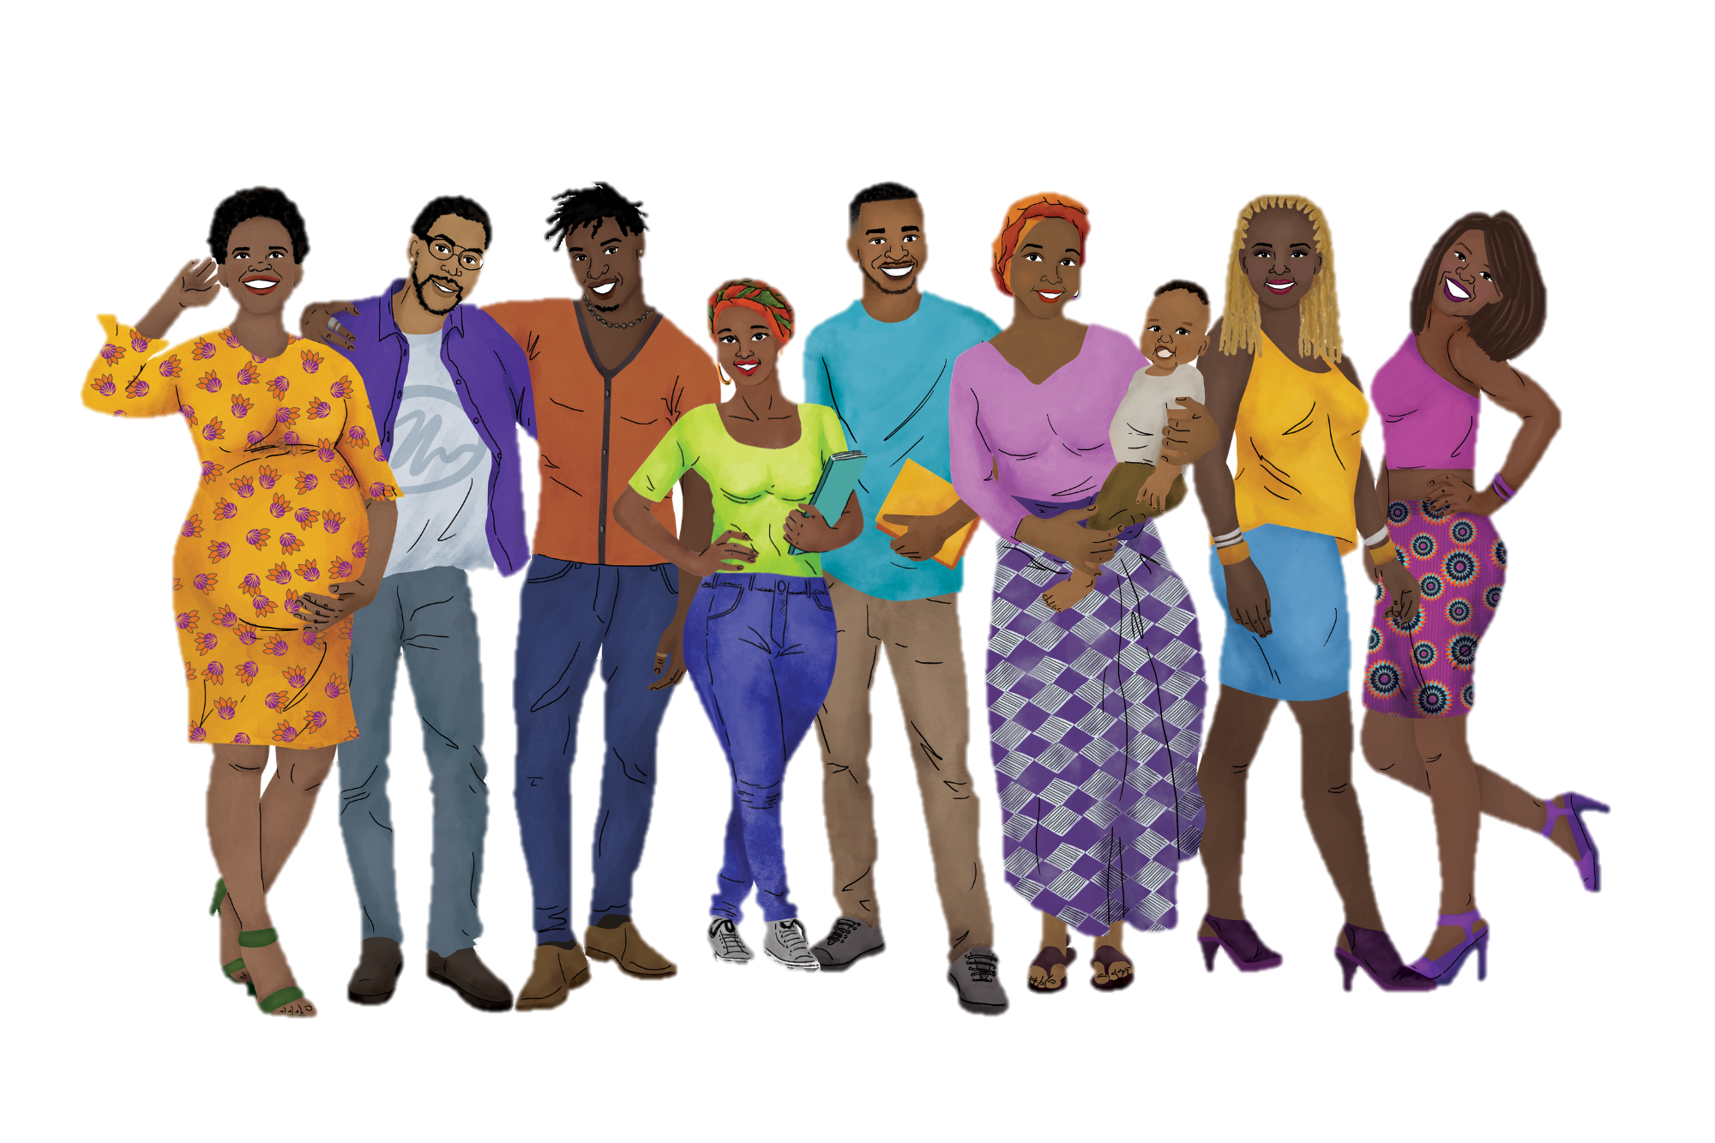
Our Working Agreements
Recognize that we are all teachers and learners.
Practice active listening and active participation.
Ensure that you minimize distractions. You will get out of the training what you put into it.
Be mindful and respectful of mind, body, spirit, and emotions – for ourselves and others!
Share the responsibility for success.
Remember that all contributions are valuable.
Be supportive of one another.
What else?
Notes:
Facilitator notes:
Review the working agreements with participants.
Ask participants to suggest other working agreements that would help them participate fully.

Slide 4

Roadmap to becoming a trainer
SESSION 1 | Module | Facilitator(s)
1 HOUR | WELCOME & INTRODUCTIONS ABOUT THIS TRAINING WHO IS AN AMBASSADOR? NAVIGATING THE HIV PREVENTION AMBASSADOR TRAINING
10 MINUTES | BREAK
50 MINUTES | FACILITATOR PREPARATION KEY ELEMENTS OF PLANNING YOUR TRAINING
SESSION 2
1 HOUR | FOUNDATIONAL KNOWLEDGE
10 MINUTES | BREAK
50 MINUTES | PrEP METHODS ESSENTIAL KNOWLEDGE
SESSION 3
50 MINUTES | PrEP METHODS SESSIONS
10 MINUTES | BREAK
1 HOUR | AMBASSADOR SKILLS
SESSION 4
1 HOUR | ROUNDING OUT YOUR TRAINING IDENTIFYING & SUPPORTING AMBASSADORS TAILORING YOUR TRAINING
10 MINUTES | BREAK
50 MINUTES | PREPARING FOR YOUR TRAINING CLOSING & NEXT STEPS
Notes:
Facilitator notes:
Review the multi-day overview agenda for participants
Ask if participants have any questions

Slide 5
Certification Requirements
Training HIV Prevention Ambassadors is a privilege and a responsibility. To become certified to lead the training, you will:
Attend all sessions, missing no more than 15 minutes of any session
Participate in each session either in the chat or verbally
Share your draft “Planning Your Training” document with the training team for review
Demonstrate a commitment to applying the facilitation tips through your participation and draft planning document.
Notes:
Facilitator notes:
Review the requirements for receiving a certification after the training. At your discretion, you may choose to be flexible with the certification requirements, but remember that your reputation is impacted by the level of training and quality of work performed by those you certify!

Slide 6
Session 1: Agenda
SESSION 1 | Module | Facilitator(s)
1 HOUR | WELCOME & INTRODUCTIONS ABOUT THIS TRAINING WHO IS AN AMBASSADOR? NAVIGATING THE HIV PREVENTION AMBASSADOR TRAINING
10 MINUTES | BREAK
50 MINUTES | FACILITATOR PREPARATION KEY ELEMENTS OF PLANNING YOUR TRAINING
Notes:
Facilitator notes:
Review the day’s agenda for participants

Slide 7
INTRODUCTION
Notes:
Facilitator notes:
Introduce the first module

Slide 8


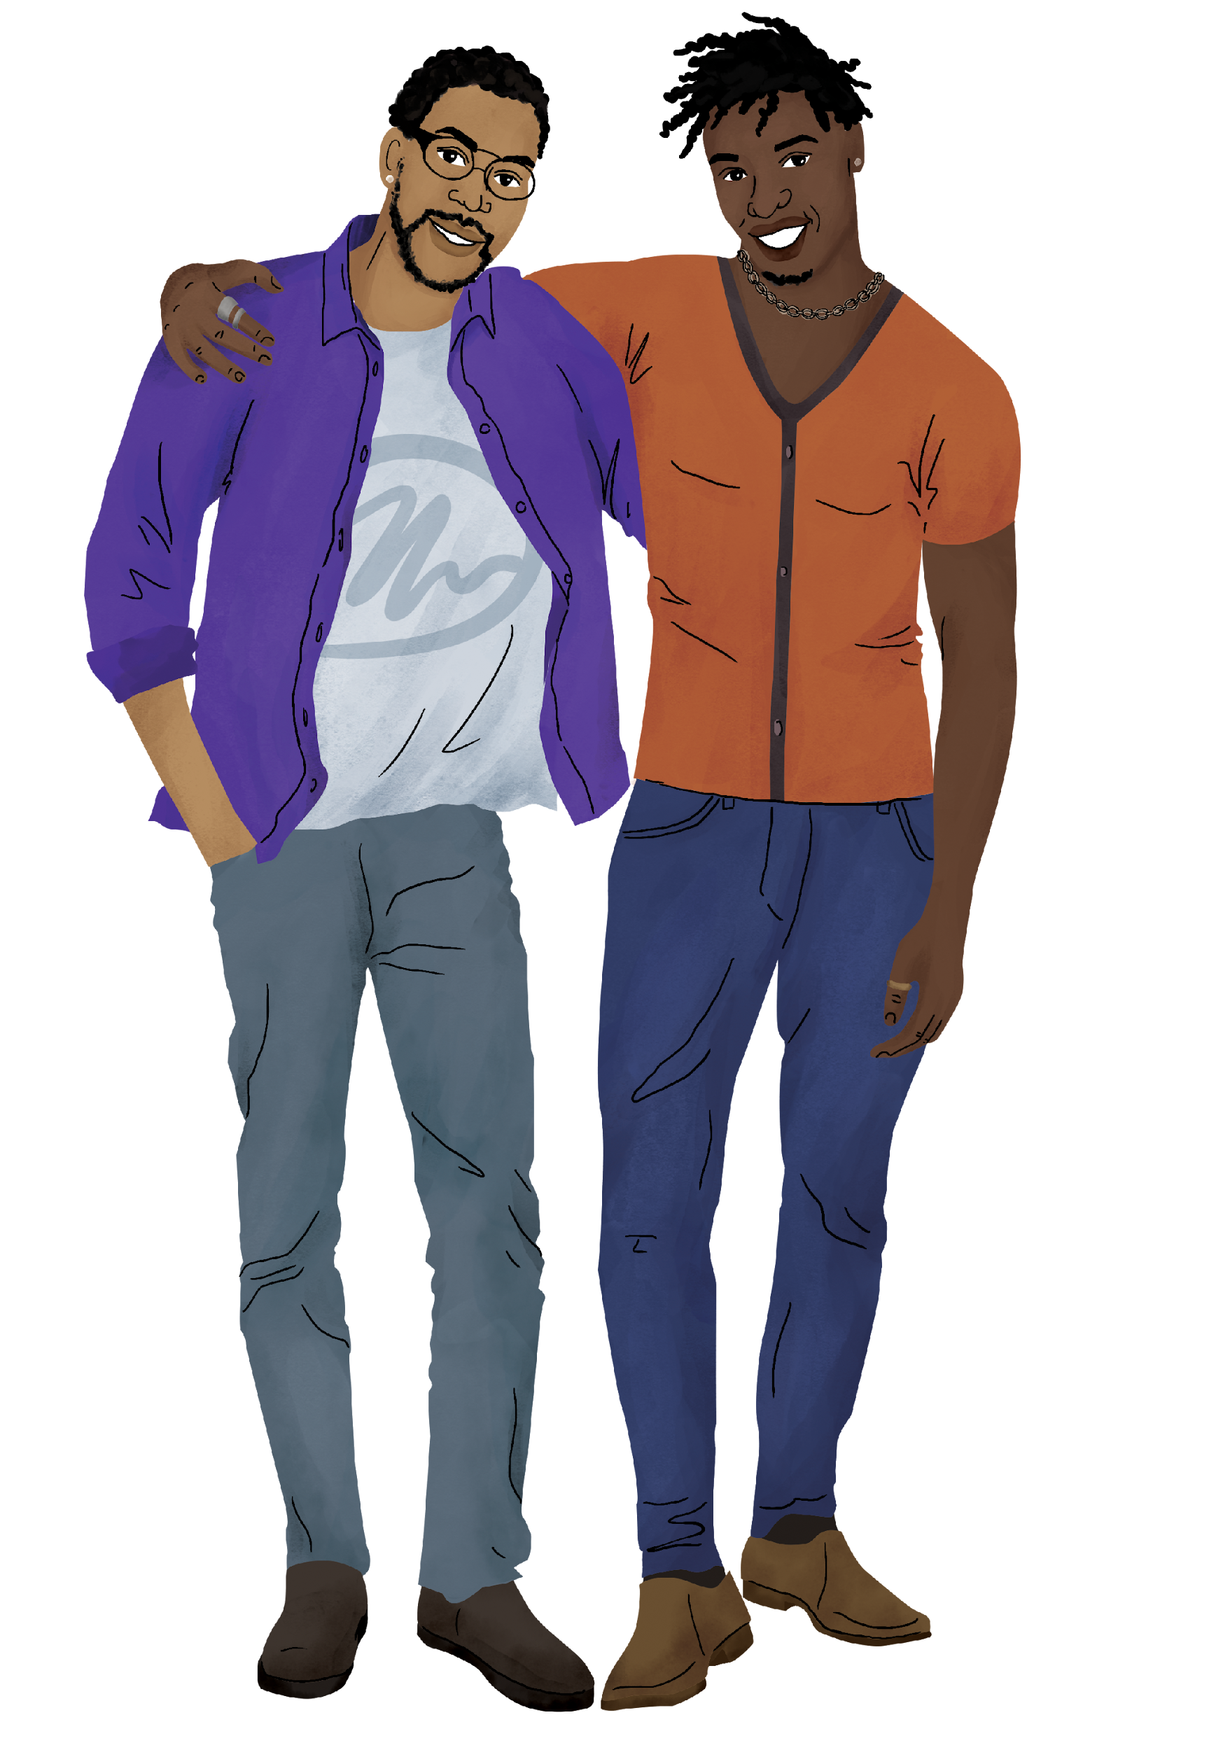
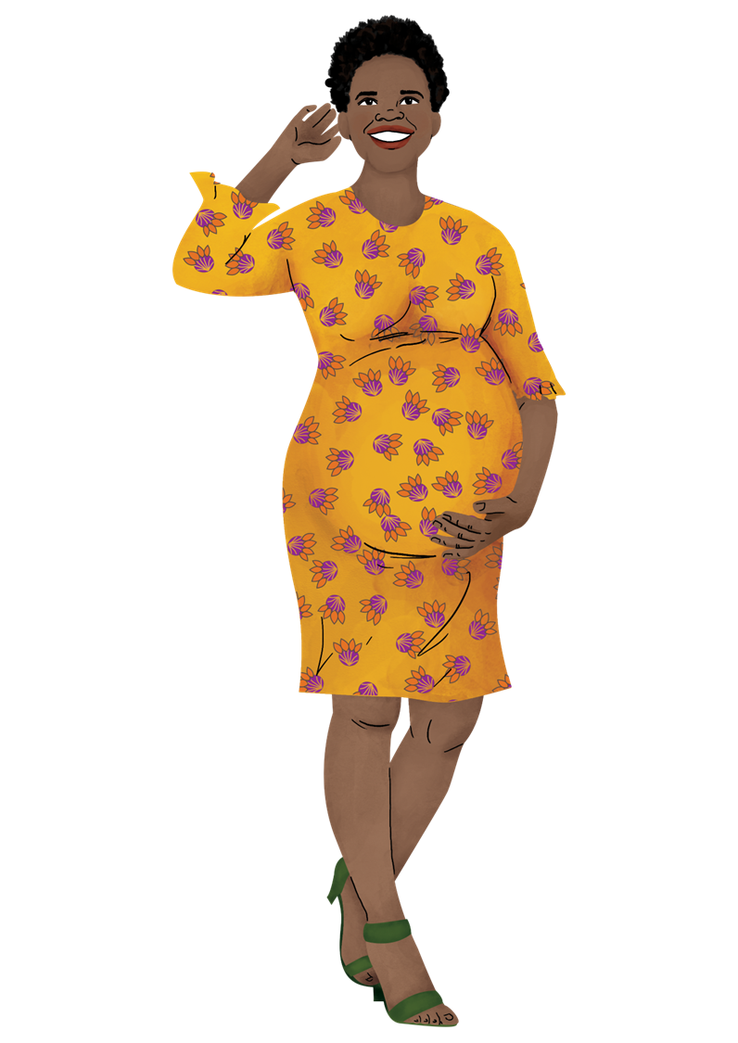


During this session, we will…
Lay out the learning objectives for the Training of Trainers.
Learn more about HIV Prevention Ambassadors and consider their possible support needs.
Become more familiar with the HIV Prevention Ambassador Training.
Notes:
Facilitator notes:
Review the session objectives for participants.

Slide 9






Learning Objectives
By the end of this training, participants will be able to…
Navigate the HIV Prevention Ambassador Training Manual and Toolkit
Effectively share information about foundational principles of human rights, sexual and reproductive health, gender, and HIV and AIDS with ambassadors
Review and share information about HIV pre-exposure prophylaxis (PrEP) methods with ambassadors, including where to look for the latest national and global guidance
Guide ambassadors through activities that build their skills and confidence to educate and support their peers to make informed decisions, access PrEP, and use it correctly for as long as they need HIV prevention
When relevant, prepare ambassadors to respond to disclosures of violence and support their peers through challenging situations
Support ambassadors to understand and reinforce their own boundaries and practice self-care
Create and implement an effective plan to select, train, and provide ongoing support to ambassadors
Notes:
Facilitator notes:
Review the learning objectives for participants.
Ask if participants have additional goals for themselves. Take note of anything added by participants and make a plan, if possible, to address their additional objectives.

Slide 10
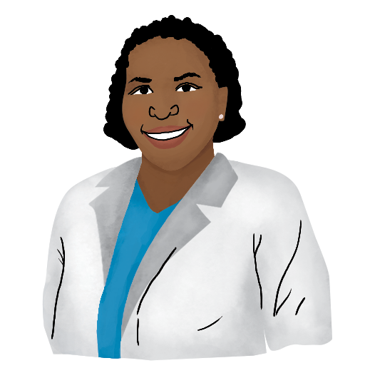
Remember…
This training does not cover the instructional content of this manual in-depth. This training also does not cover basic facilitation skills.
Before beginning to facilitate the HIV Prevention Ambassador Training, make sure you are well-informed about human rights, gender, and HIV transmission and prevention. You are also free to engage an expert in these topics to plan for or carry out your training.
We also recommend that you have experience with facilitating group discussion and activities on sensitive topics, or that you take a course on group learning and facilitation.
Notes:
Facilitator notes:
Remind participants that this training is not all-encompassing.
Review the slide content to share what other skills and training participants should have before facilitating the HIV Prevention Ambassador Training.

Slide 11
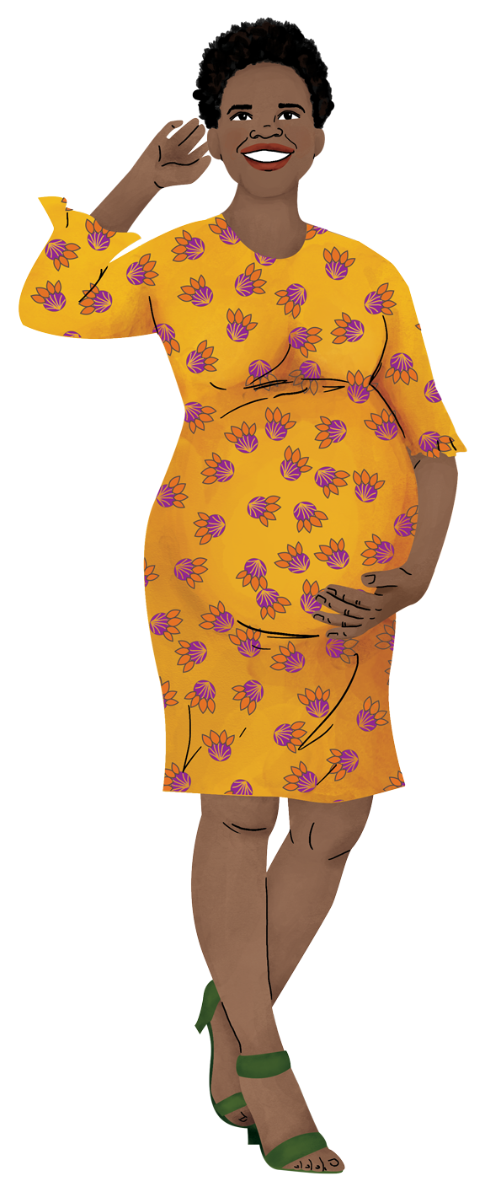
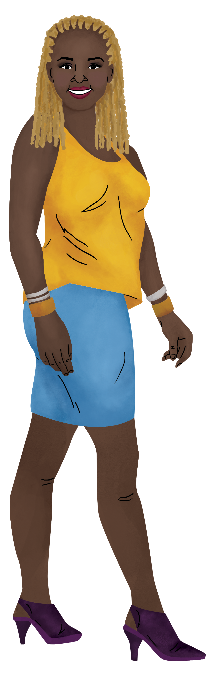
HIV Prevention Ambassador Training: Overview
Aim: Prepare PrEP end-users to share information about and advocate for PrEP and support their peers to learn about and use PrEP
Approach: Interactive activities, discussion, action planning, and a resource toolkit for each ambassador
Audience: There are two versions of the training, each for a specific audience
  Adolescent girls and young women (AGYW), including people assigned female at birth of any gender identity and trans AGYW
  Diverse populations, including men who have sex with men (MSM), trans people, sex workers, pregnant and breastfeeding people (PBFP), people who inject drugs, and serodifferent couples
Notes:
Facilitator notes:
Review the slide contents.

Slide 12

Who is behind the HIV Prevention Ambassador Training?
Since the first edition in 2019, adolescent girls and young women and members of diverse community have groups served as:
Leadership team members
Primary content reviewers
Technical reviewers
Facilitators
Pilot testers
Field test participants
…providing input from Eswatini, Kenya, South Africa, Uganda, the US, and Zimbabwe.
Notes:
Facilitator notes:
Review the slide contents.

Slide 13
About the HIV Prevention Ambassador
Notes:
Facilitator notes:
Introduce the second module

Slide 14
Who is an HIV Prevention Ambassador?
Typically has other responsibilities (e.g., a job, school, providing family support)
Some are closely tied to health facilities, while others operate on their own with little or no contact with a support organization
Some are trained by other ambassadors
Typical activities include one-on-one support, group education and sensitization, and accompaniment for PrEP services
Who might be an ambassador in your context?
Notes:
Facilitator notes:
Review the slide content
Ask participants to share who ambassadors might be in their context. Ask about their age, gender, and other demographics.
Ask participants to take note of what their ambassadors might look like. You can support their planning by also taking note of their responses to help prompt them in future discussions.

Slide 15
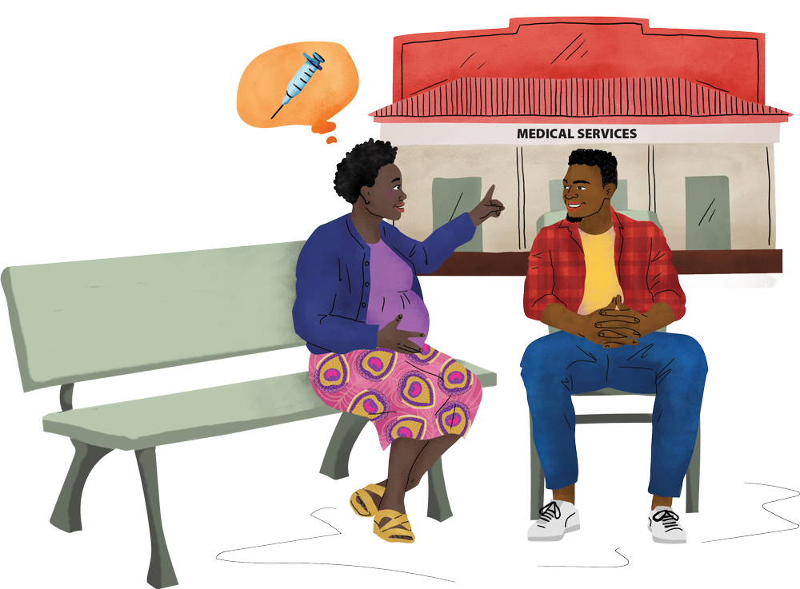
Ambassador Support
What kind of support does an ambassador need?
The training package includes recommended support for organizations to provide to Ambassadors, such as ongoing check-ins, connections to referral organizations, recognition of their work, and logistical support.
This support depends on ambassador roles and organizational capacity, and whether ambassadors are tied to an organization or facility, or not.
It is the job of HIV Prevention Ambassador Training Facilitators to co-design the ambassador role alongside your ambassadors.
Notes:
Facilitator notes:
Review the slide content

Slide 16

ACTIVITY: Ambassador Support Needs
In this activity, we will meet three Ambassadors and discuss their unique support needs. We will ask ourselves:
What support does this Ambassador need, and from whom?
What does a supportive environment look like to this Ambassador?
What would hinder this Ambassador’s ability to be successful?
Does this Ambassador have any unique support needs?
How might we, as implementers, best support this Ambassador?
Notes:
ADVANCE PREPARATION: Revise the characteristics of the ambassadors on upcoming slides to align with the types of ambassadors that your participants will be training.
Facilitator notes:
Review the slide content

Slide 17
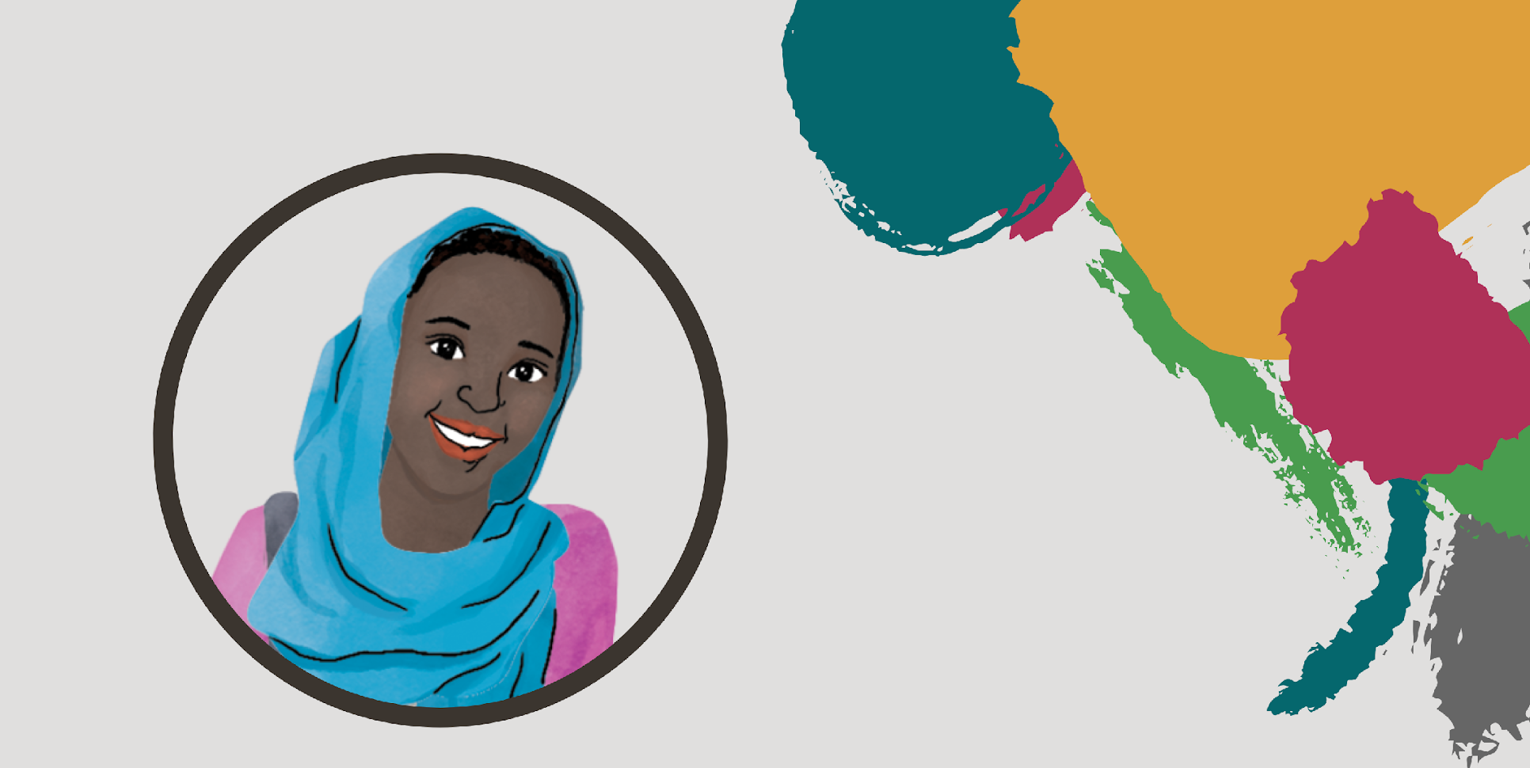





Amara
What support does Amara need, and from whom?
What does a supportive environment look like to Amara?
What would hinder Amara’s ability to be successful?
Does Amara have any unique support needs?
How might we, as implementers, best support Amara?
19-year-old young woman
Windhoek, Namibia
HIV Prevention Ambassador, primary caregiver for her youngest siblings (7-year-old brother and 5-year-old sister), part-time student, sometimes supports at her grandmother’s shop
Receives her PrEP from a local health clinic and has a good relationship with her clinician, Peggy
“I became an ambassador because I want to help others like me. I want to support young women the way Peggy has supported me.”
Notes:
Facilitator notes:
Review the information about Amara on the right side of the slide
Ask participants the questions on the left one at a time. Allow for about 5 minutes of discussion on the slide. Add anything the participants might have missed in their responses.

Slide 18
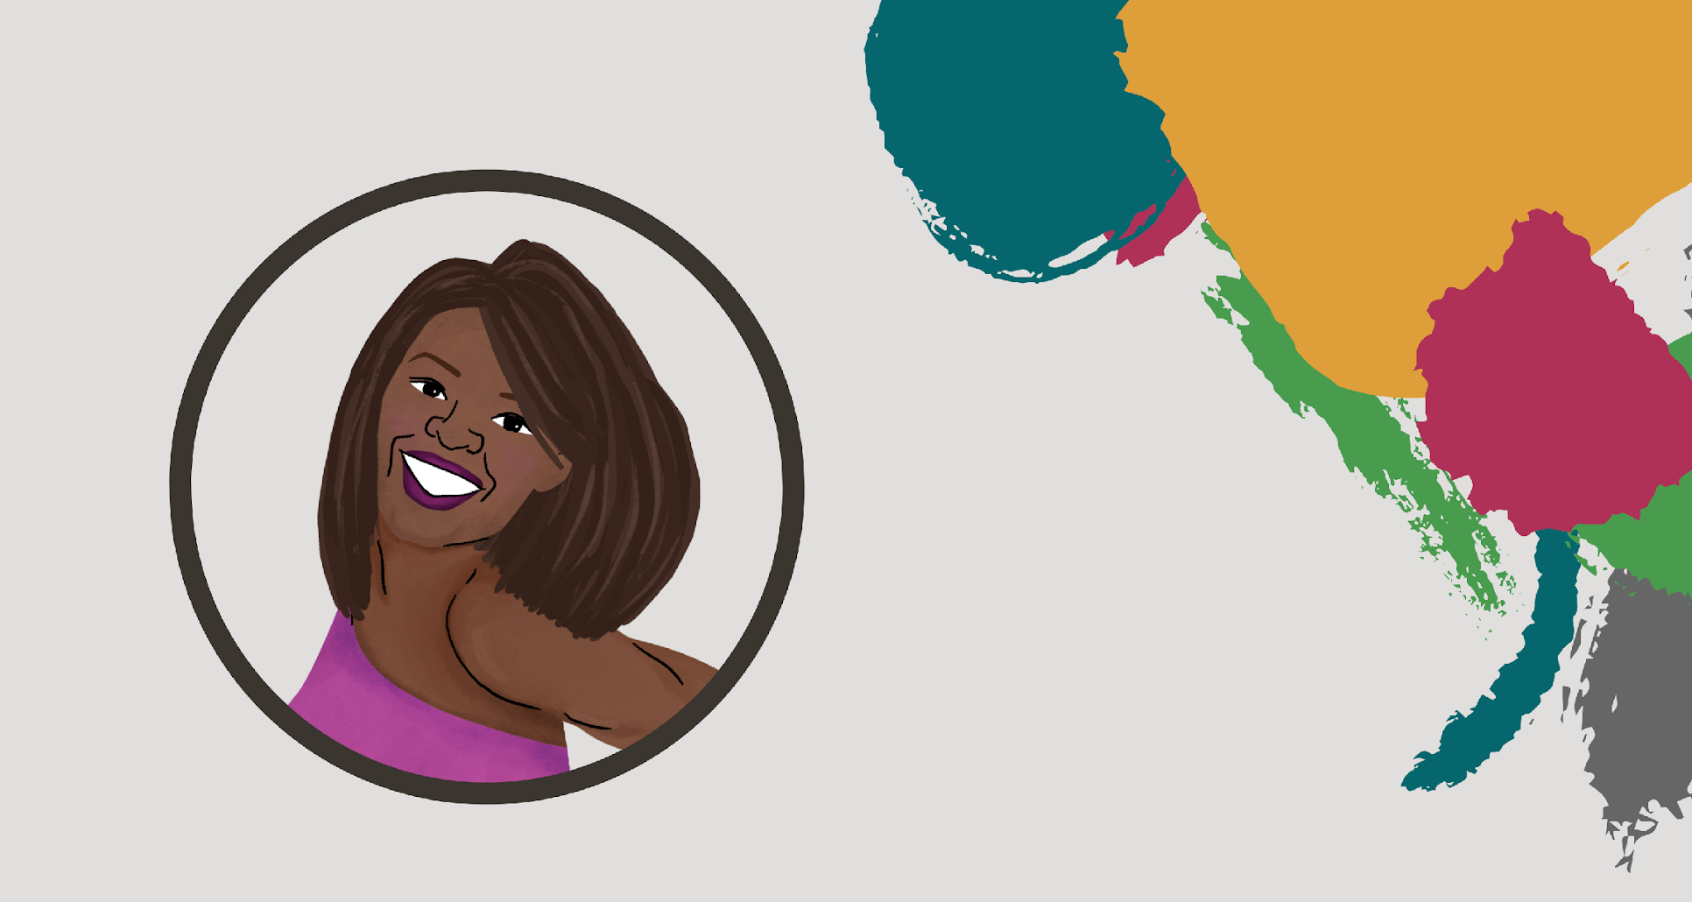
Sade
What support does Sade need, and from whom?
What does a supportive environment look like to Sade?
What would hinder Sade’s ability to be successful?
Does Sade have any unique support needs?
How might we, as implementers, best support Sade?
26-year-old transgender woman
Kampala, Uganda
HIV Prevention Ambassador, loving aunt to her five nieces and nephews, college graduate, founder and owner of a support organization and network for trans youth in Uganda
Operates on her own; has had negative experiences with stigma in health facilities
“I do this because I care. I do not want my sisters to go through what I have been through. We must break down the stigma and discrimination in health care.”
Notes:
Facilitator notes:
Review the information about Sade on the right side of the slide
Ask participants the questions on the left one at a time. Allow for about 5 minutes of discussion on the slide. Add anything the participants might have missed in their responses.

Slide 19
Caleb
What support does Caleb need, and from whom?
What does a supportive environment look like to Caleb?
What would hinder Caleb’s ability to be successful?
Does Caleb have any unique support needs?
How might we, as implementers, best support Caleb?
21-year-old young man
Abuja, Nigeria
HIV Prevention Ambassador, loving boyfriend to his partner Joseph, owner of a small business and night-time club that is popular with the gay community
Partner is living with HIV; he plays an active role in making sure that his partner is cared for and is always interested in the newest PrEP methods
“New HIV treatment and prevention methods have allowed me and my partner to live a healthy life together. I am an ambassador so that people in my community can live long, healthy, and happy lives.”
Notes:
Facilitator notes:
Review the information about Caleb on the right side of the slide
Ask participants the questions on the left one at a time. Allow for about 5 minutes of discussion on the slide. Add anything the participants might have missed in their responses.

Slide 20
Navigating the
HIV Prevention Ambassador Training
Notes:
Facilitator notes:
Introduce the third module

Slide 21
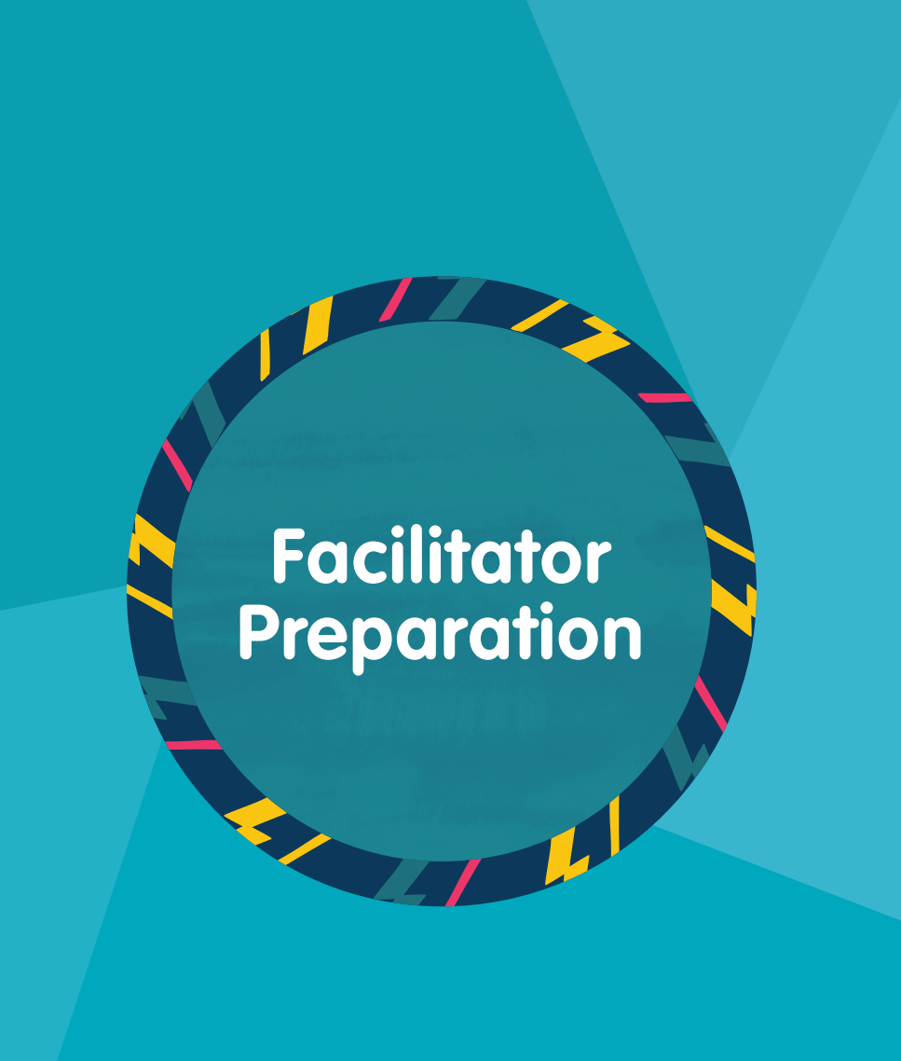
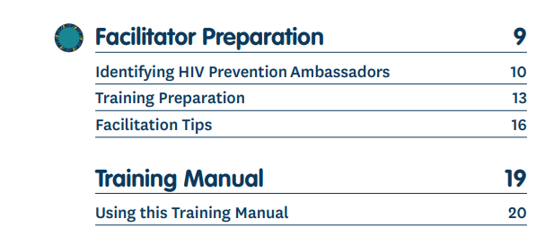
What is in the training package?
PART 1
Instructions for using the manual, selecting and supporting ambassadors, and tips for tailoring and conducting the training with your participant group
Notes:
Facilitator notes:
Review the slide contents. As you review, encourage participants to open their training manuals and toolkits to find the different components of the package for themselves.

Slide 22

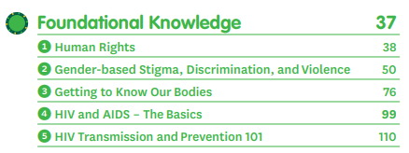
What is in the training package?
PART 2
The training sessions, separated into Foundational Knowledge*, PrEP Method Knowledge & Sessions, and Ambassador Skills
*There are slight differences in the AGYW and Diverse Version foundational knowledge order
Notes:
Facilitator notes:
Review the slide contents. Highlight for participants that the Foundational Knowledge for the AGYW and Diverse Versions have different orders. These differences will be outlined when you go over that section of the manuals.

Slide 23
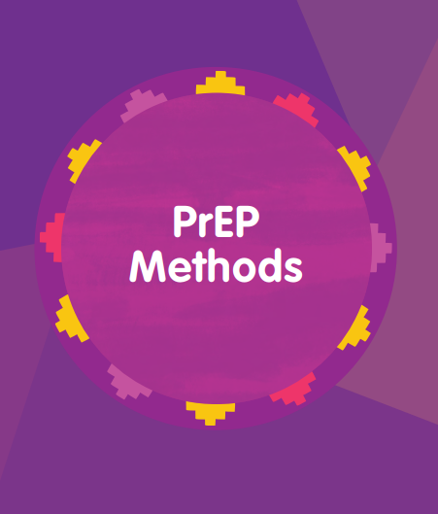
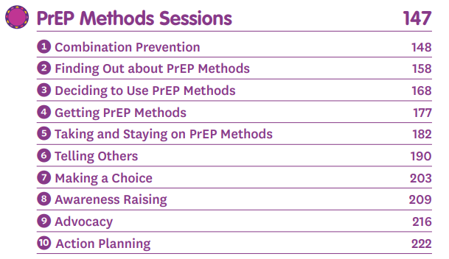
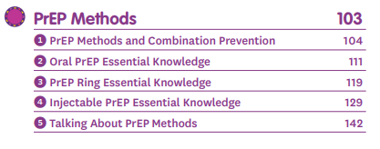
What is in the training package?
PART 2
The training sessions, separated into Foundational Knowledge, PrEP Method Knowledge & Sessions, and Ambassador Skills
Notes:
Facilitator notes:
Review the slide contents.

Slide 24

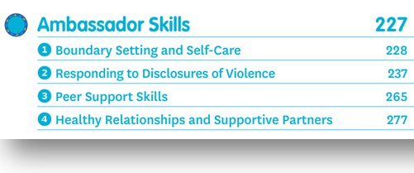
What is in the training package?
PART 2
The training sessions, separated into Foundational Knowledge, PrEP Method Knowledge & Sessions, and Ambassador Skills
Notes:
Facilitator notes:
Review the slide contents.

Slide 25
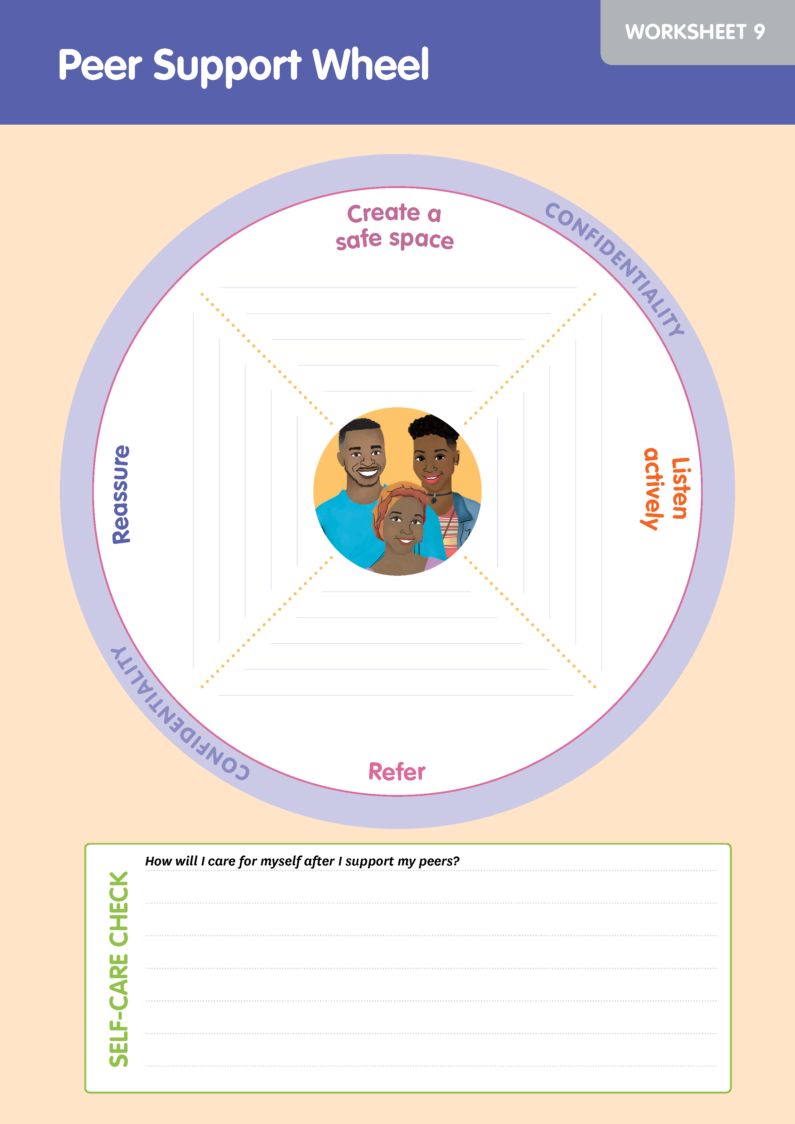
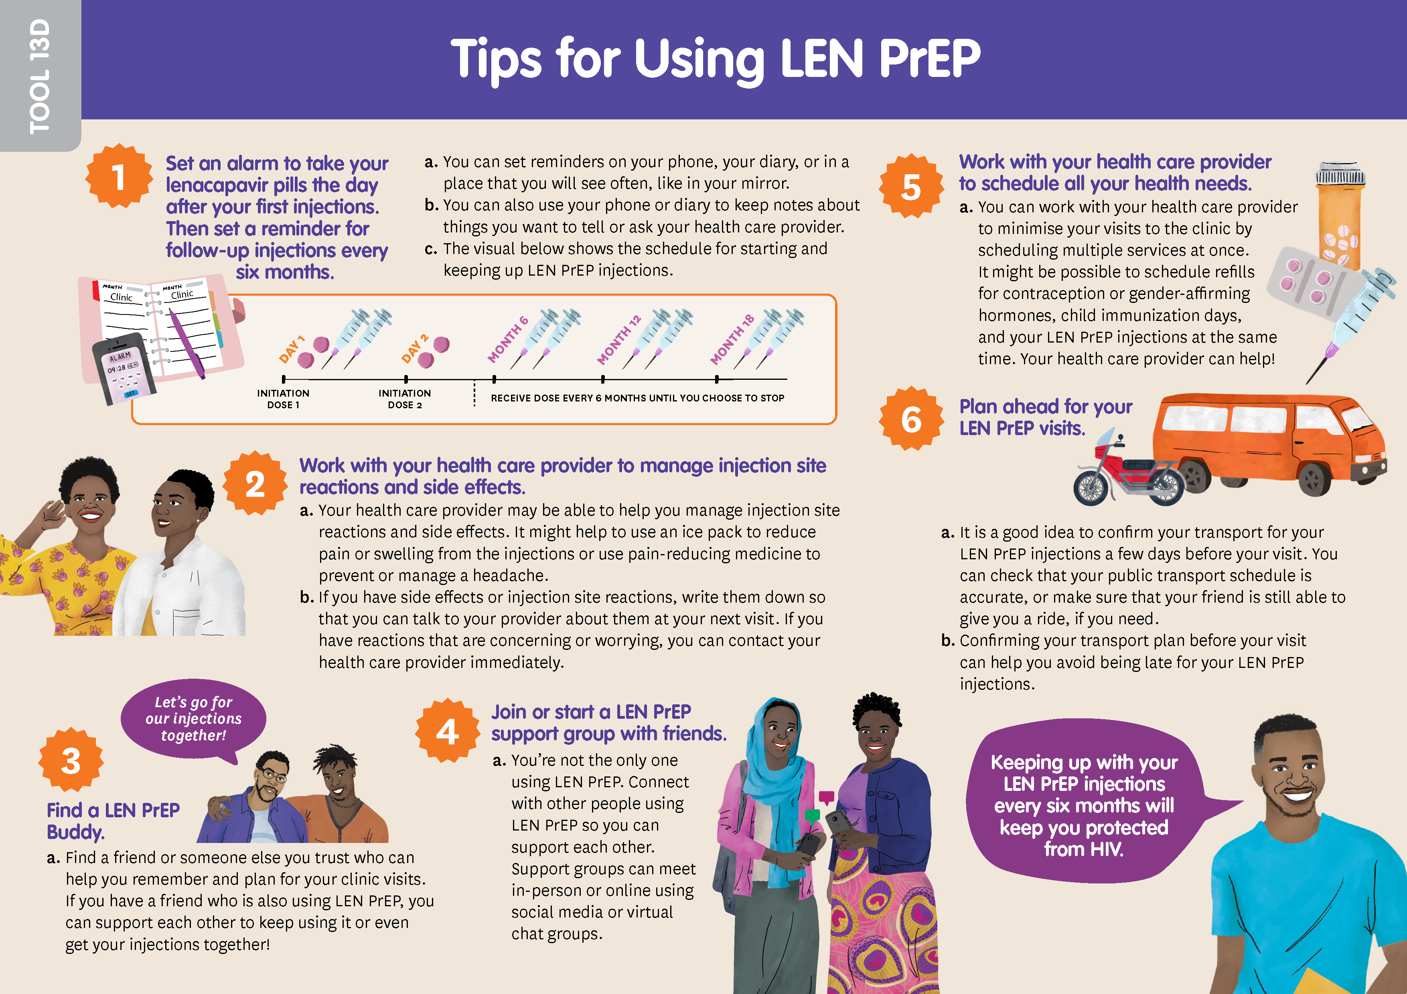
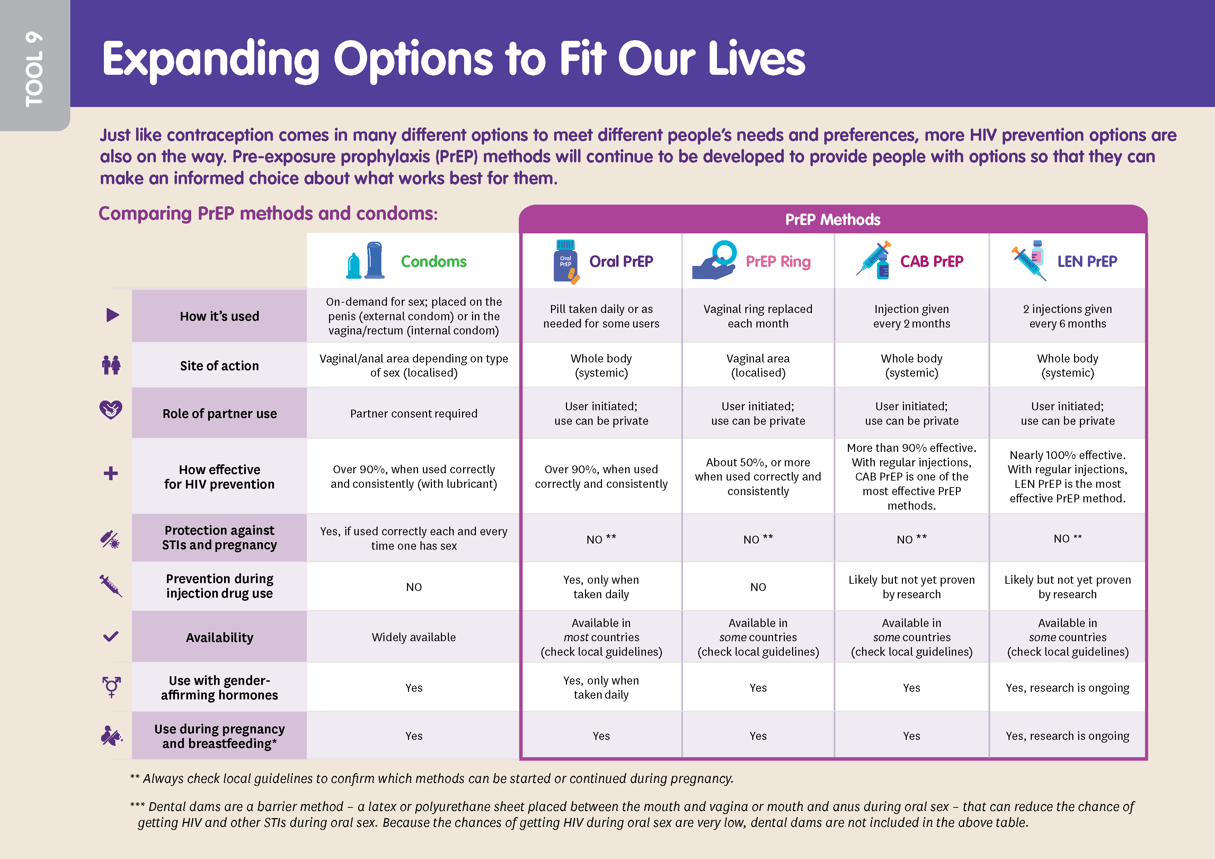
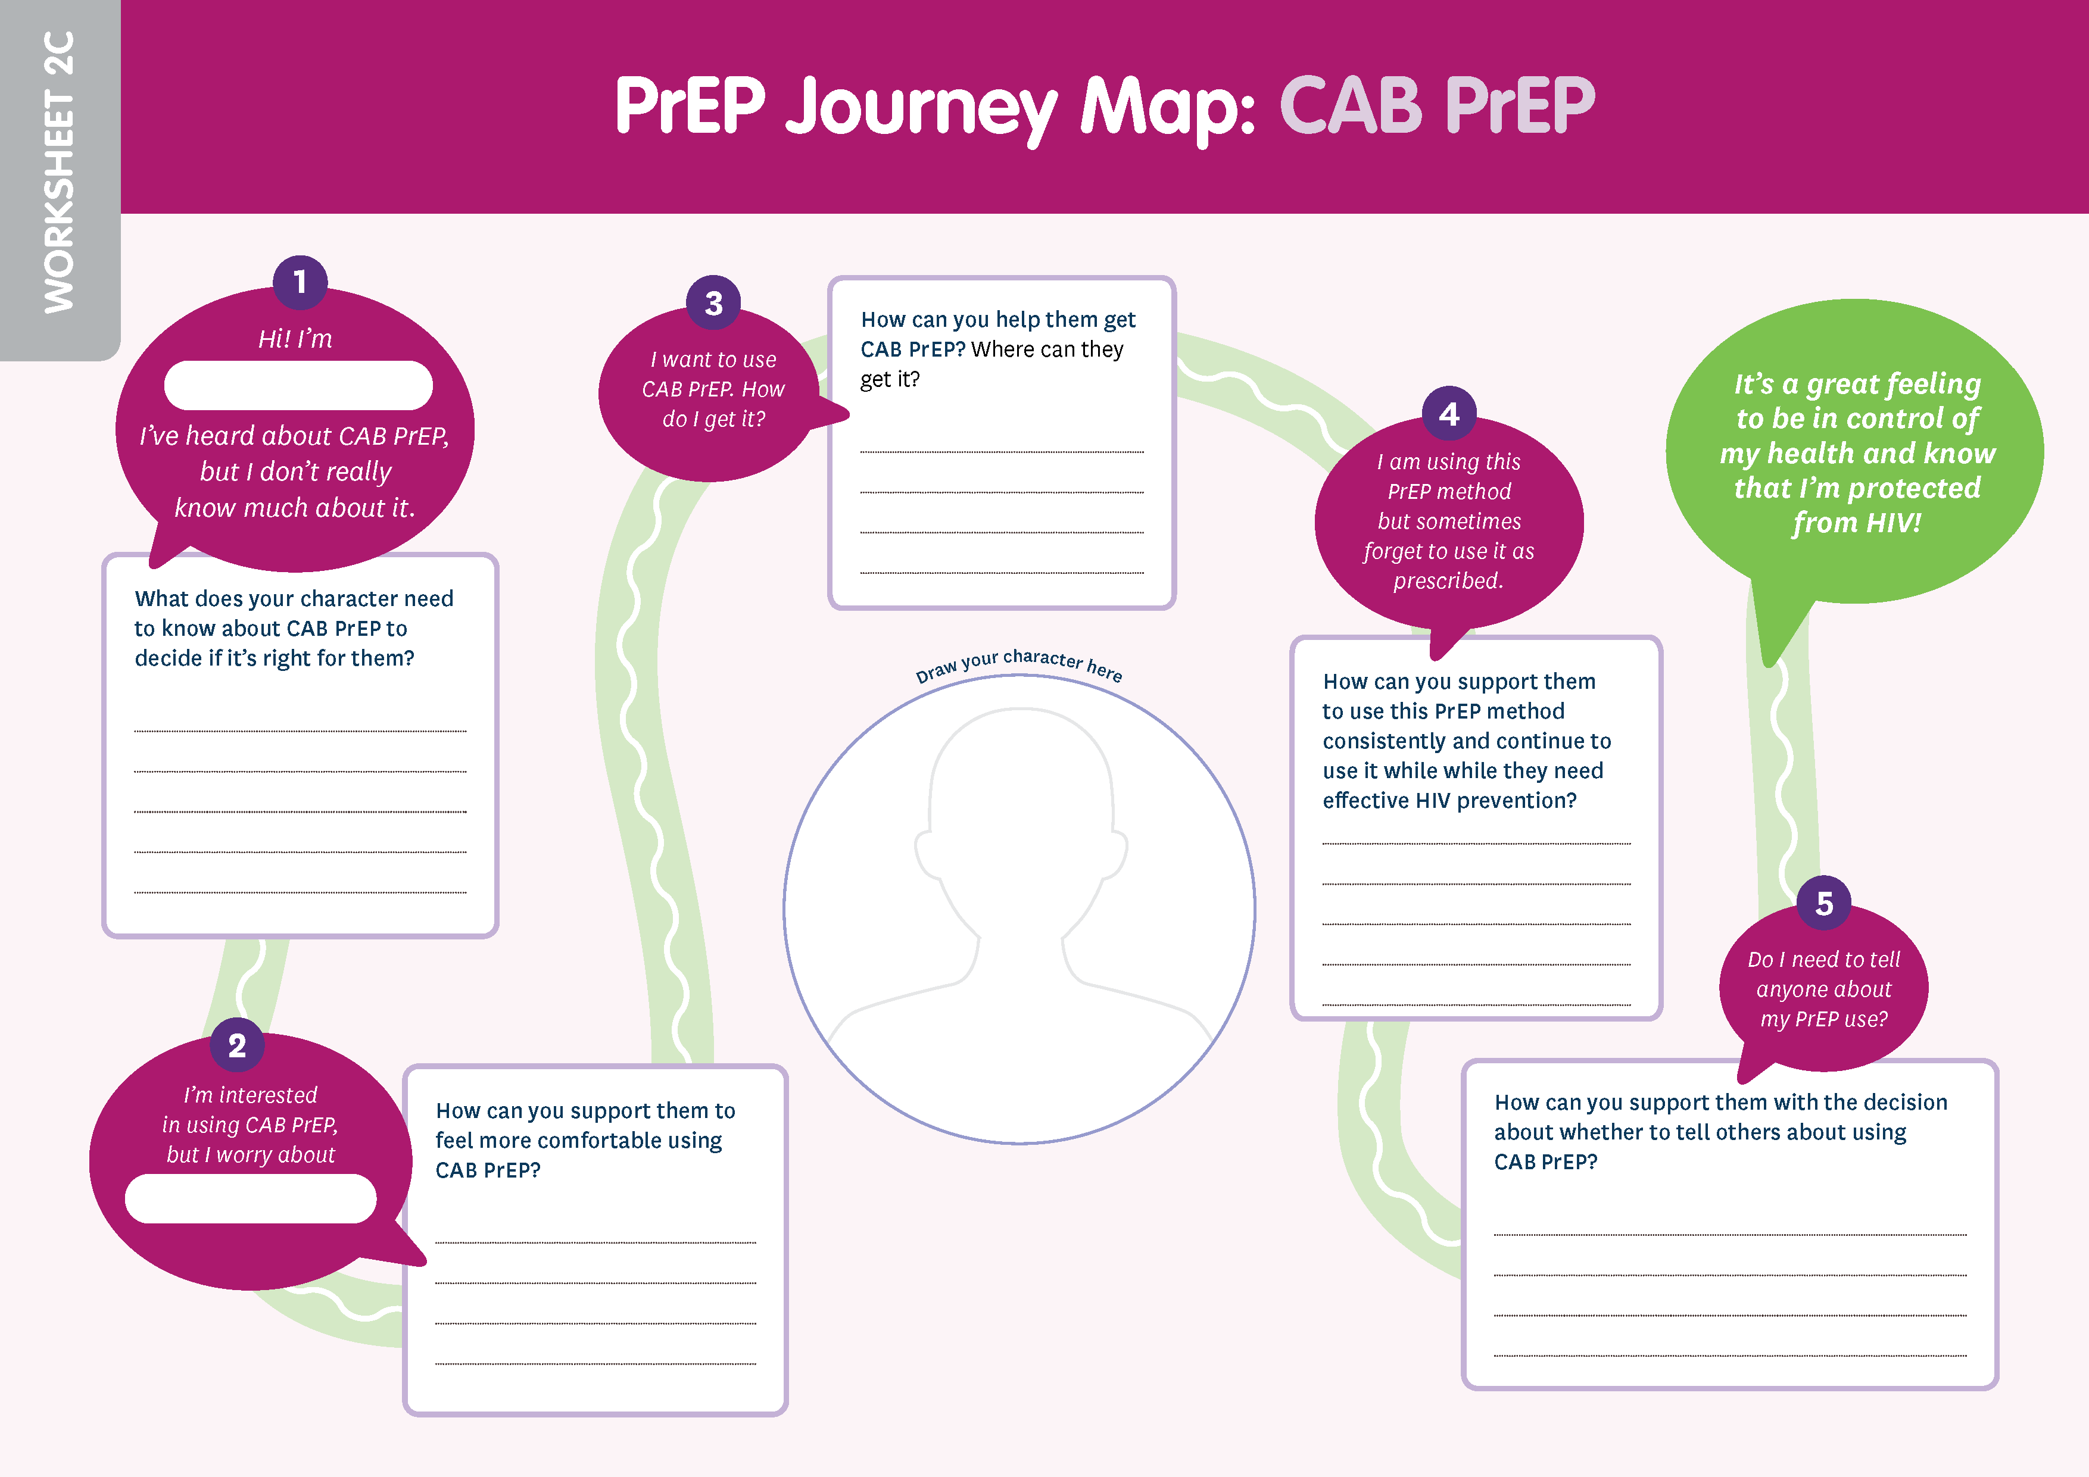
What is in the training package?
PART 3
A toolkit of resources and worksheets for ambassadors to use while working in communities
Notes:
Facilitator notes:
Review the slide contents.

Slide 26
Anatomy of a session: Standalone Sessions
Foundational Knowledge & Ambassador Skills
These sessions can be done individually and are not connected to other sessions. You can choose some or all of them, depending on the experience and knowledge of your participants.
Notes:
Facilitator notes:
Review the slide contents. Highlight that the STANDALONE SESSIONS can be done on their own and are not necessarily connected to other sessions.

Slide 27
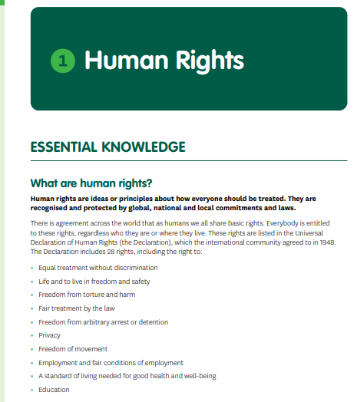
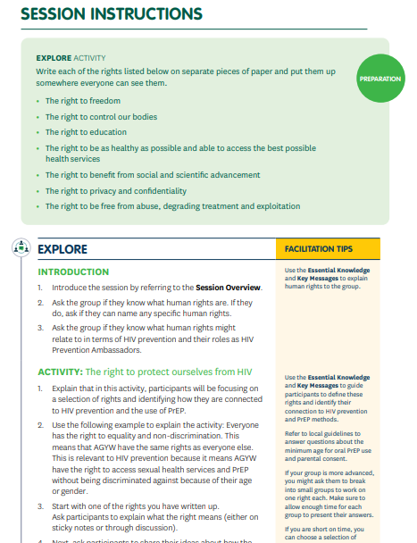
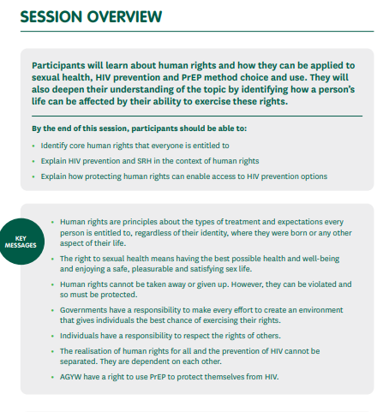
Anatomy of a session: Standalone Sessions
Standalone sessions include:
  Essential knowledge – key information for understanding the session content
  Session overview – key messages and goals of the session, plus any important facilitation tips
  Activities – a step-by-step guide to conduct the session, always including activities to EXPLORE, APPLY, and REFLECT
Notes:
Facilitator notes:
Review the slide contents.

Slide 28
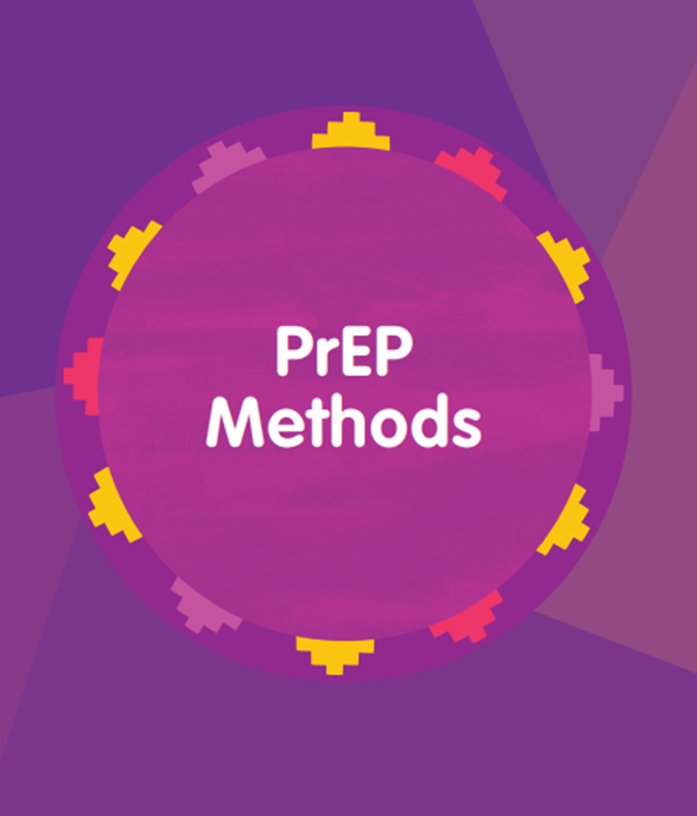
Anatomy of a session:
PrEP Methods
PrEP Methods content is broken into two parts:
  Essential knowledge about PrEP, combination prevention, and each PrEP method
  A series of interconnected sessions that build knowledge and skills on peer support for PrEP uptake and use
Notes:
Facilitator notes:
Review the slide contents.

Slide 29
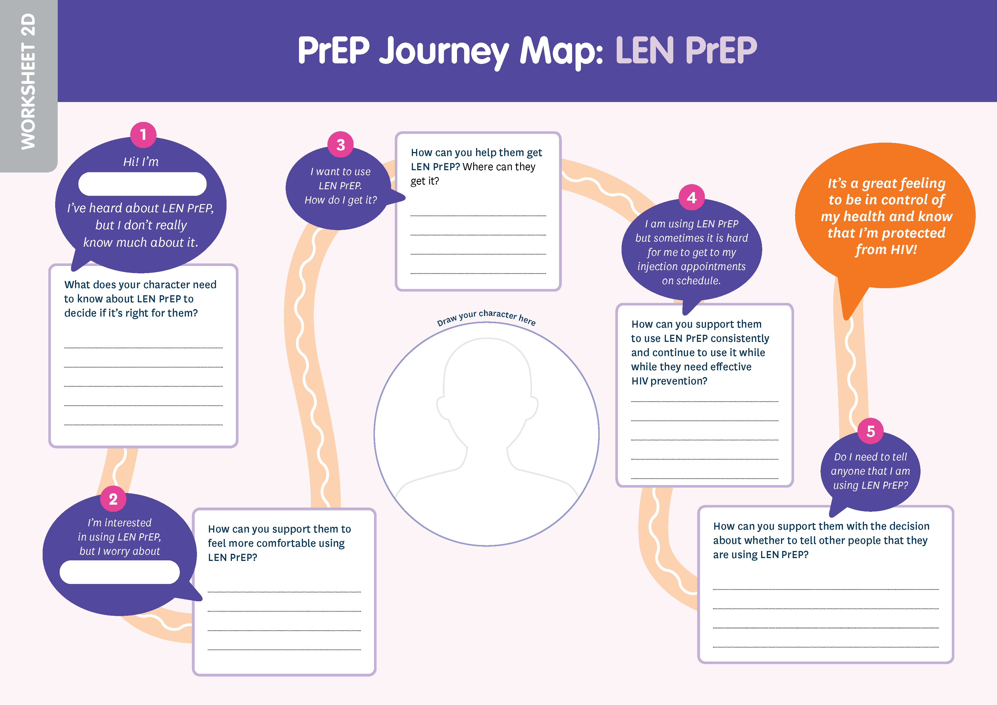
Anatomy of a session:
PrEP Methods
PrEP Methods sessions use journey mapping, role plays, and other activities, to explore:
  Finding out about PrEP, making a method choice, deciding to use PrEP, getting and staying on PrEP, and telling others
PrEP methods sessions can be done sequentially or simultaneously on multiple methods, depending on your needs.
Notes:
Facilitator notes:
Review the slide contents. Reassure participants that they will get to know the journey map more as this training goes on, and that they will have a chance to consider how they would like to organize their PrEP method sessions considering their ambassadors’ needs.

Slide 30
BREAK
See you in 10 minutes!
Notes:
Facilitator notes:
Give the participants a 10-minute break. Make sure to let them know the time they should be back before letting them step away.

Slide 31
Facilitation Tips
Notes:
Advance Preparation:
Brainstorm examples from your personal experience that highlight the importance of at least two of the facilitation tips. If you have time, you can share more than two – or ask for experiences from the audience. If possible, prioritize tips 2 and 5 for more discussion.
Facilitator notes:
Introduce the fourth module for the day.
Ask participants to turn to the “Facilitation Tips” section of their manuals. This is page 19 in the Diverse Version and page 16 in the AGYW version.

Slide 32
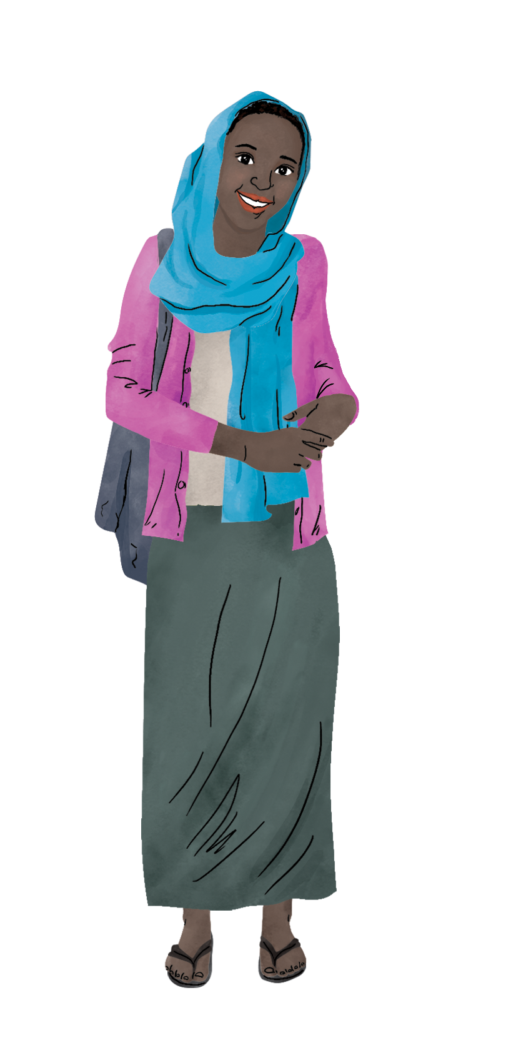
Facilitation Tip #1
Read the training manual in advance
This is key to making sure you understand the information and activities in the training. It will also help you choose the sessions you want to cover, the order you want to take, and decide which outside experts you will bring to help your participants get all the knowledge they need.
Notes:
Facilitator notes:
Review the slide content.
If time allows, share your personal experience or ask your audience if they have had an experience of leading a training without understanding the full resource.
Ask participants to read facilitation tip #1 in their manual to themselves, or you can choose to ask someone to read for the group.

Slide 33
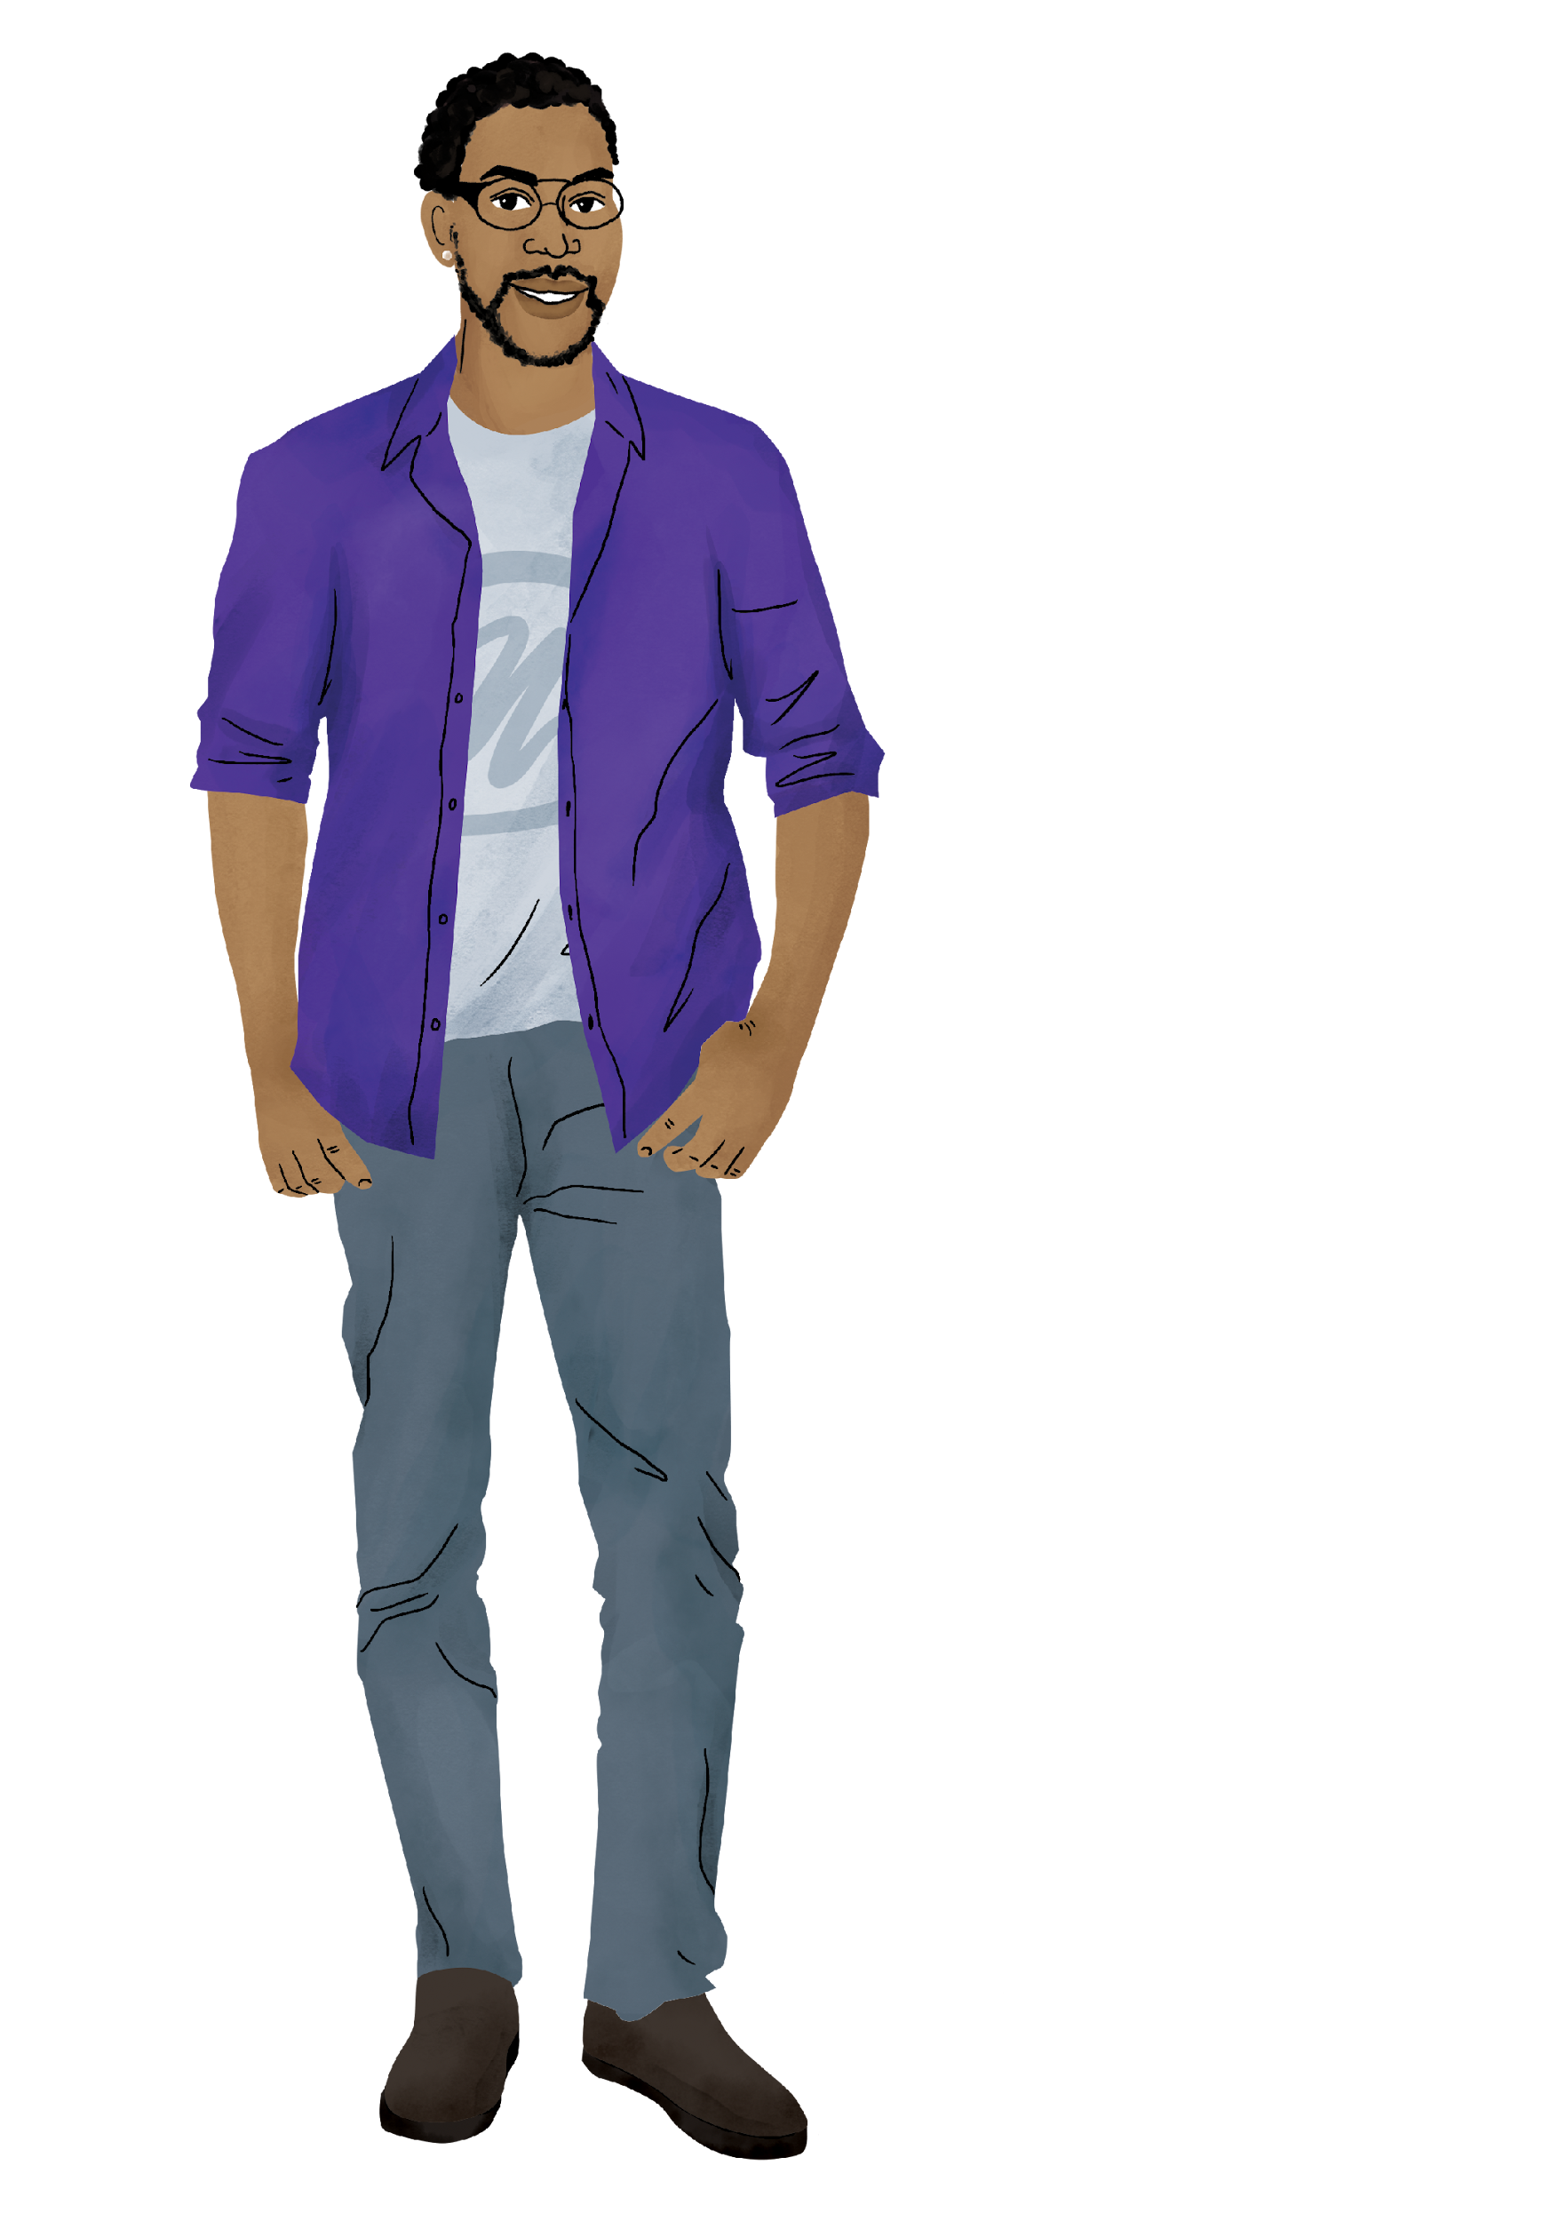
Facilitation Tip #2
Reflect on your own values, attitudes and beliefs, and how they might affect your work
As a facilitator, it is your responsibility to create a nonjudgmental space to discuss sensitive topics. Supporting participants to make their own choices sets an example that they can follow, which is an important ambassador skill.
Notes:
Facilitator notes:
Review the slide content.
If time allows, share your personal experience or ask your audience if they have had an experience of examining their values as a result of learning something new.
Ask participants to read facilitation tip #2 in their manual to themselves, or you can choose to ask someone to read for the group.

Slide 34
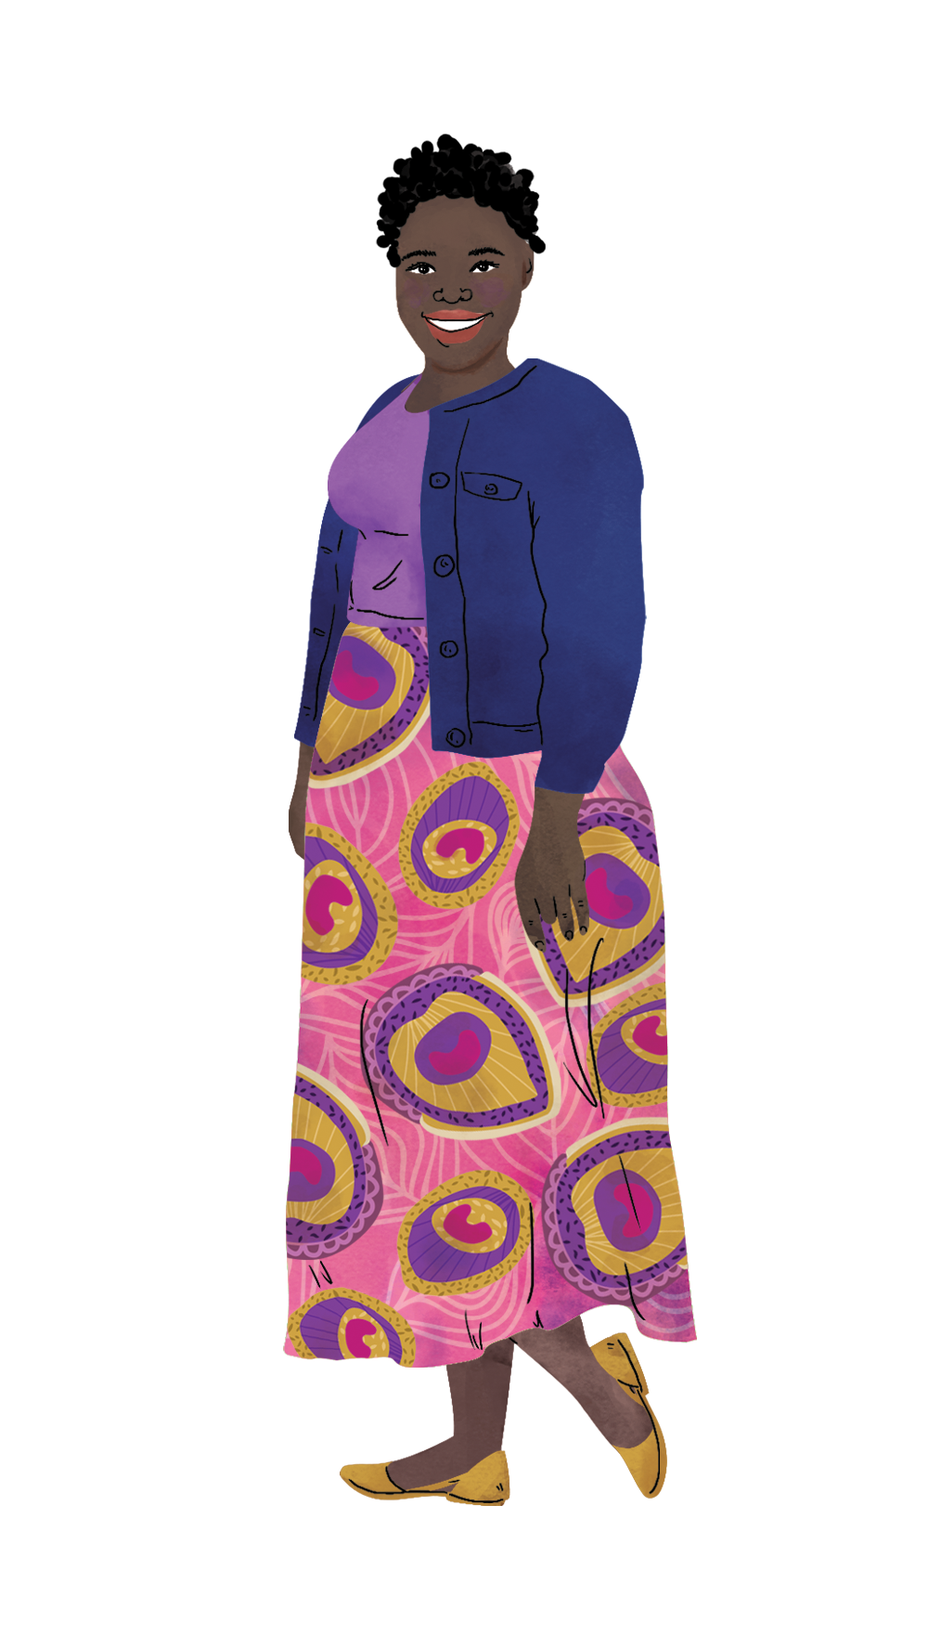
Facilitation Tip #3
Create a participatory learning environment
Effective facilitators empower participants to lead and learn from each other. Ambassadors will be teachers and facilitators in their communities – you are giving them a chance to practice in a safe space!
Notes:
Facilitator notes:
Review the slide content.
If time allows, share your personal experience or ask your audience if they have an inspiring story about being empowered by a facilitator.
Ask participants to read facilitation tip #3 in their manual to themselves, or you can choose to ask someone to read for the group.

Slide 35

Facilitation Tip #4
Make it a conversation
Connecting to lived experiences helps your participants engage deeply with the training. And it will help them connect to their peers!
Notes:
Facilitator notes:
Review the slide content.
If time allows, share your personal experience or ask your audience if they can give an example of why talking about lived experiences helps people connect to content.
Ask participants to read facilitation tip #4 in their manual to themselves, or you can choose to ask someone to read for the group.

Slide 36
Facilitation Tip #5
Create a safe space
When your participants feel confident that they will not be judged, they will be able to participate more fully.
Notes:
Facilitator notes:
Review the slide content.
If time allows, share how you create a safe space, or ask a participant to share how they create a safe space.
Ask participants to read facilitation tip #5 in their manual to themselves, or you can choose to ask someone to read for the group.

Slide 37
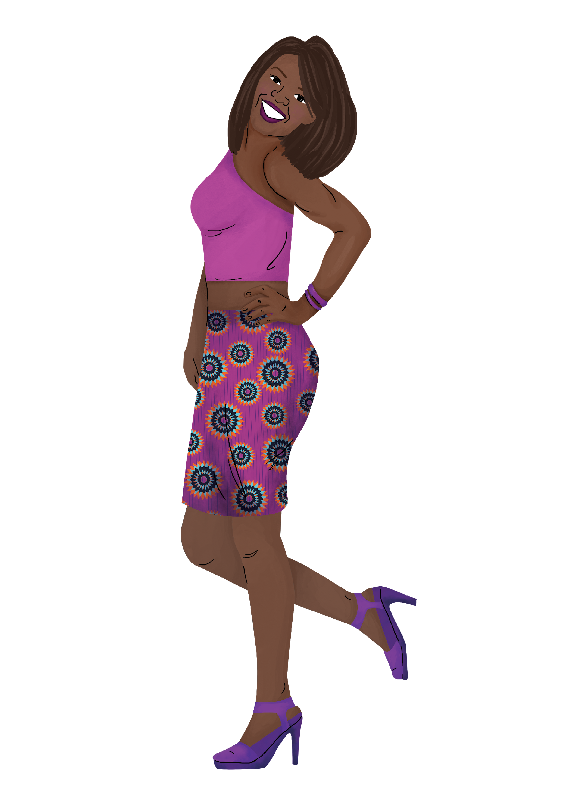
Facilitation Tip #6
Be inclusive and ensure that everyone can participate equally
Think ahead or consult your participants about what they might need to participate fully. This may mean providing childcare, supporting quieter participants to speak up, or making your training space (including restrooms) more accessible.
Notes:
Facilitator notes:
Review the slide content.
If time allows, share how you make your trainings inclusive, or ask a participant to share an example of a time when someone went out of their way to make them feel included.
Ask participants to read facilitation tip #6 in their manual to themselves, or you can choose to ask someone to read for the group.

Slide 38
Facilitation Tip #7
Encourage open and honest communication about sex
We cannot help anyone prevent HIV if we can’t speak openly and honestly about sex. Always emphasize confidentiality. And remember, it is ok to not know an answer!
Notes:
Facilitator notes:
Review the slide content.
If time allows, share your personal experience or ask your audience if they have an example of why open communication about sex is important for this training.
Ask participants to read facilitation tip #7 in their manual to themselves, or you can choose to ask someone to read for the group.

Slide 39

Facilitation Tip #8
Prepare to support participants through personal and difficult topics
It is likely that your participants will have had difficult experiences related to HIV, violence, or their sexual health. It will help to have counseling referral information ready. Take time to learn how to support your participants and consider if you want support for difficult topics yourself.
Notes:
Facilitator notes:
Review the slide content.
If time allows, share your personal experience or ask your audience how they have responded to participants who have struggled emotionally during trainings.
Ask participants to read facilitation tip #8 in their manual to themselves, or you can choose to ask someone to read for the group.

Slide 40
Facilitation Tip #9
Use active listening to validate participant contributions
Ask questions, use your body language, and summarize the discussion!
Notes:
Facilitator notes:
Review the slide content.
If time allows, share your personal experience or ask your audience how they validate the contributions of participants in other trainings they have led.
Ask participants to read facilitation tip #9 in their manual to themselves, or you can choose to ask someone to read for the group.

Slide 41
Facilitation Tip #10
Ask questions to encourage deeper thinking and challenge assumptions.
Ambassadors will be answering many questions in their communities. Help them build their knowledge and skills by asking meaningful questions.
Notes:
Facilitator notes:
Review the slide content.
If time allows, share your experience or ask an audience member to share theirs.
Ask participants to read facilitation tip #10 in their manual to themselves, or you can choose to ask someone to read for the group.

Slide 42
Facilitation Tip #11
Debrief with colleagues
Talking with your facilitation team after training sessions will help you improve your skills and make plans to improve your sessions. It will also help to debrief if you have had challenging or emotional conversations.
Notes:
Facilitator notes:
Review the slide content.
If time allows, share your personal experience or ask your audience to share how debriefing has been helpful for them in the past.
Ask participants to read facilitation tip #11 in their manual to themselves, or you can choose to ask someone to read for the group.

Slide 43
Key Elements of Planning Your Training

Slide 44
Planning your training
Before you begin creating your training agenda, you will need to decide on a few key elements:
Who your ambassadors are, what their roles might be, and what training they need
What local resources are available to make sure your ambassadors get the best training possible
Let’s review these key elements now!
Notes:
Facilitator notes:
Review the slide content.
Reassure participants that we are looking at the key elements of training now, so that they can think about them as we dive into the HIV Prevention Ambassador Training content. During our last session, we will look at all of the key elements together to begin your organization’s training plan.
Ask participants to get out their “Planning Your Training” worksheet to follow along.

Slide 45
Key element #1
Your Ambassadors
The first key element to planning your training is knowing who your ambassadors are. This includes:
Their age and key demographics
Their role in your program and their community
The support they will need to carry out their role
What training they have
What training they need
Answering these questions will help you decide if you should use the AGYW-focused or Diverse Version of the trainings.
Notes:
Facilitator notes:
Review the slide content.
Explain to participants that, at the end of todays’ session, they will have a few minutes to answer questions about who they envision their ambassadors to be, and what duties their role might include. These are the first two questions on the “Planning Your Training” worksheet.

Slide 46
Key element #2
Your Training Content
The next key element is deciding what to include in your training, and how you will organize the PrEP methods sessions.
What you include depends on your decisions on key element #1 and what PrEP methods are available in your context.
Notes:
Facilitator notes:
Review the slide content.
Explain that, depending on who your ambassadors are, who they are working with, and their expected role and previous training all determine which content you will include in your training plan. This is the second section of the “Planning Your Training” worksheet.
Let participants know that we will talk more about how the options for training on PrEP methods when we get to that session.

Slide 47
Key element #3
Your Local Resources
The final key element is understanding your local resources. This might include:
What are your local PrEP guidelines?
What local factsheets or resource guides are available?
What referral services can we rely on?
What experts can serve as special guests?
Answering these questions will ensure that your participants get the most up-to-date and accurate information, and the support they need to do their jobs.
Notes:
Facilitator notes:
Review the slide contents.
Reinforce the point that local resources, including local experts and counselors, are key to a successful training. This is the third section of the “Planning Your Training” worksheet.

Slide 48
Group work
Let’s review the first 3 questions under “Key Element I” of our worksheets together.
WHO are your ambassadors?
WHAT is THEIR ROLE?
WHAT kind of SUPPORT will they need?
Feel free to take notes on your worksheet. You will be able to update your answers as we go through our sessions.
Notes:
Facilitator notes:
Review the slide content.
Guide participants through a conversation where they share responses to these questions.
Encourage participants take notes, ask questions or make comments as they think through the first questions of Key Element I.

Slide 49

Closing Activity
ROSE
What bloomed in your mind during today’s session?
BUD
What are you looking forward to after today’s session?
THORN
What is feeling challenging or stressful about today’s session?
Notes:
Facilitator notes:
Review the ROSE/BUD/THORN activity.
Encourage participants share their thoughts about each prompt in the chat, or to come off mute and share verbally with each other. The amount of time you spend in discussion will depend upon the time you have remaining for the day.

Slide 50
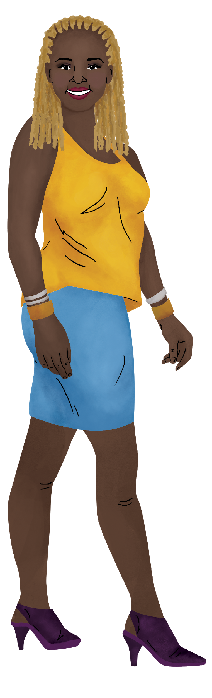
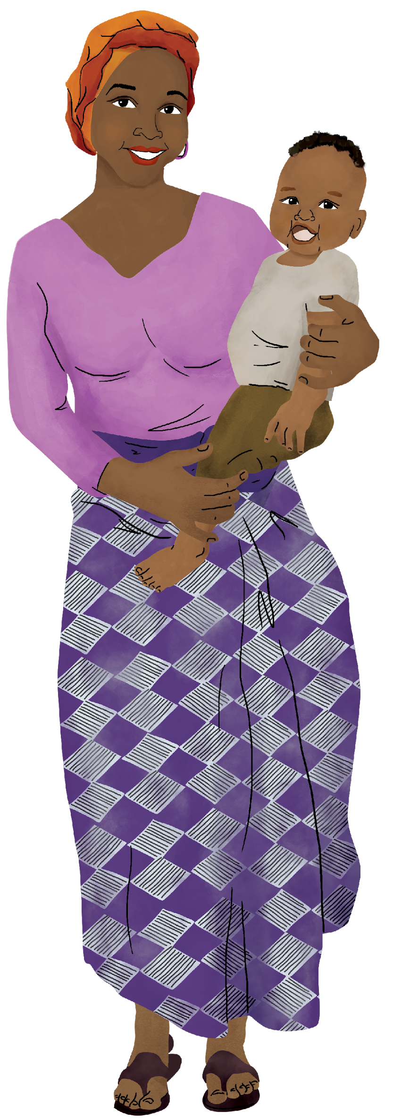
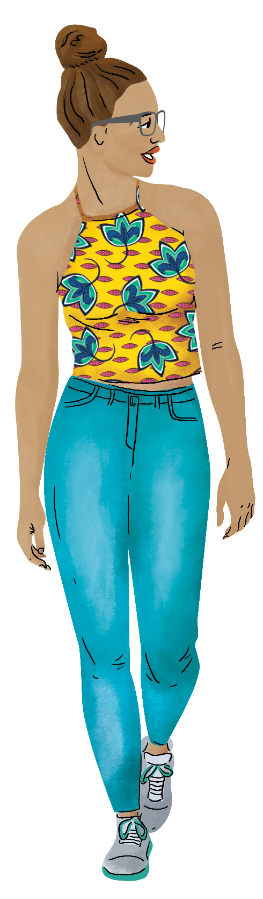
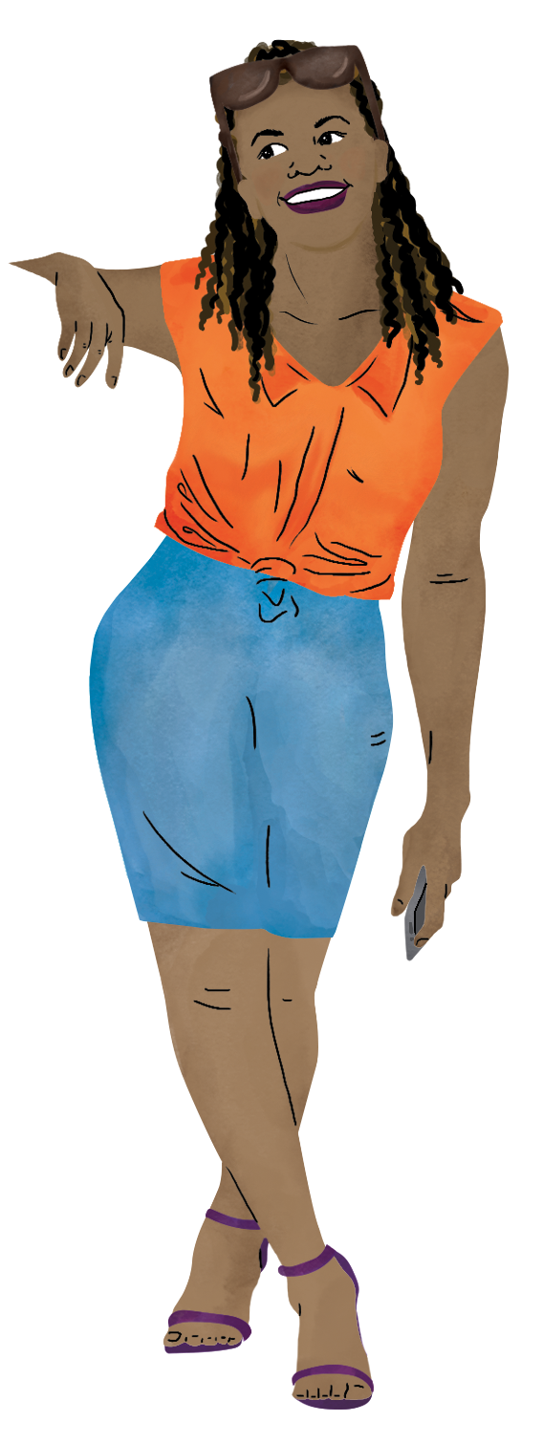
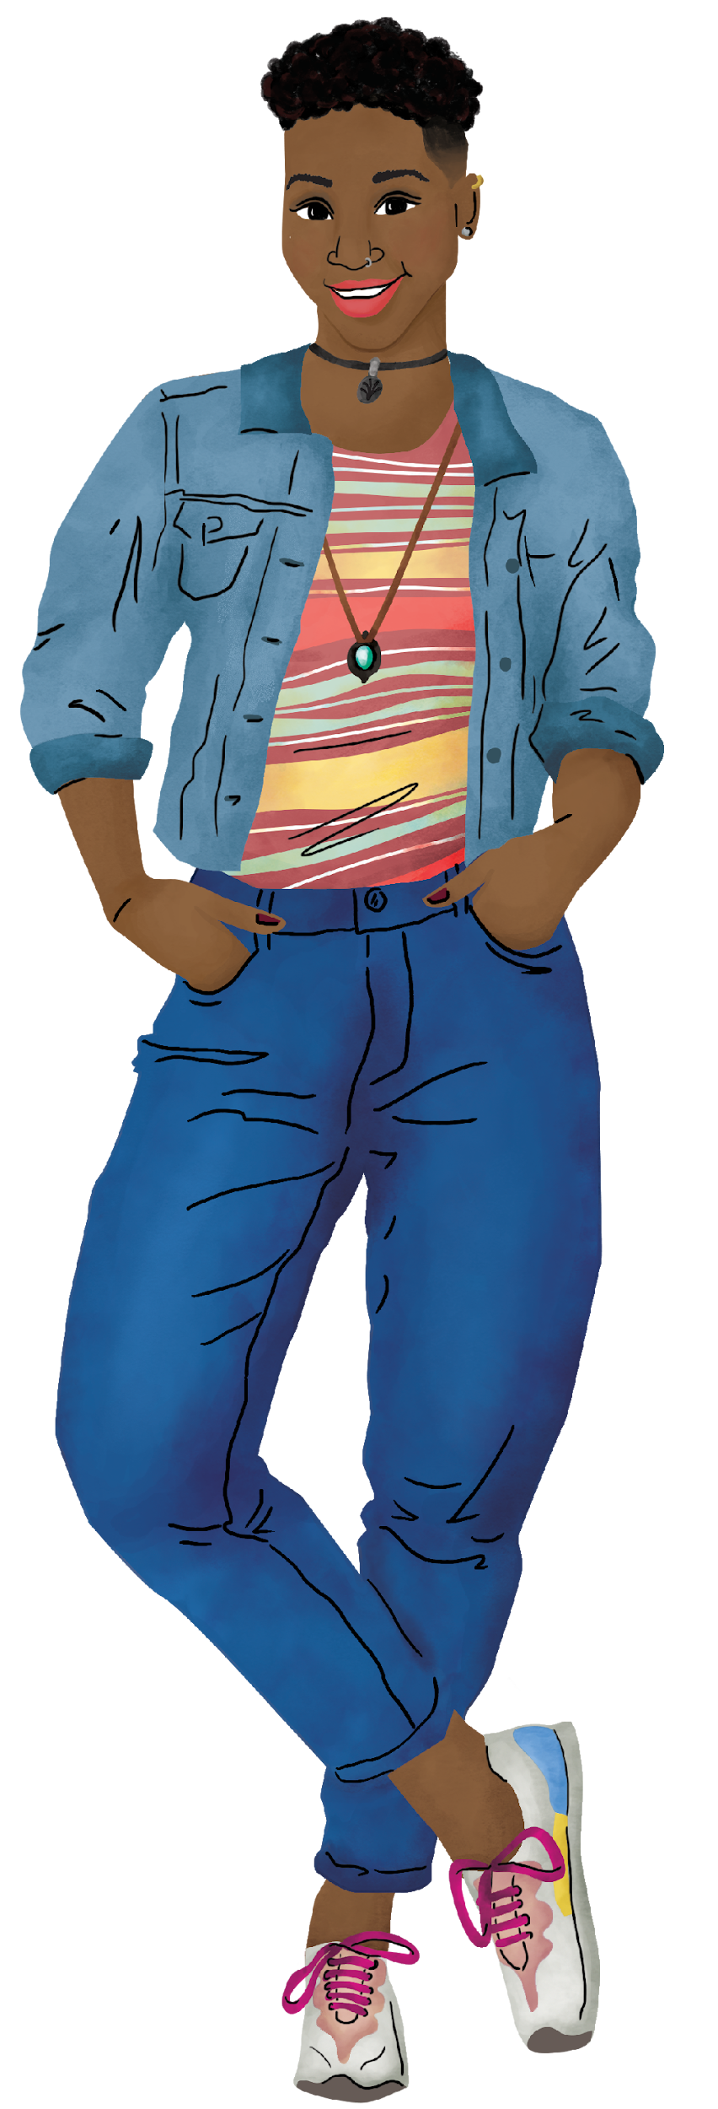
END OF SESSION 1 – THANK YOU!
See you at DAY / TIME for Session 2!
Notes:
ADVANCED PREPARATION:
Update the date and time for session 2 listed on the slide.
Facilitator notes:
Close out the session for the day.
Remind participants to come to the next session at the determined date and time.

