Slide 1
WELCOME TO THE
HIV PREVENTION AMBASSADOR
TRAINING OF TRAINERS!
Our last session together!
SESSION 4
Notes:
Facilitator notes:
Ask participants to add to the chat box or share verbally: what has been on their minds since the last session, and/or what they are looking forward to learning more about today.
Share anything in follow-up to the last session and note to the group that today is the last day!
Let the audience know that today, you will work together on comprehensive planning to conduct a tailored HIV Prevention Ambassador Training.

Slide 2
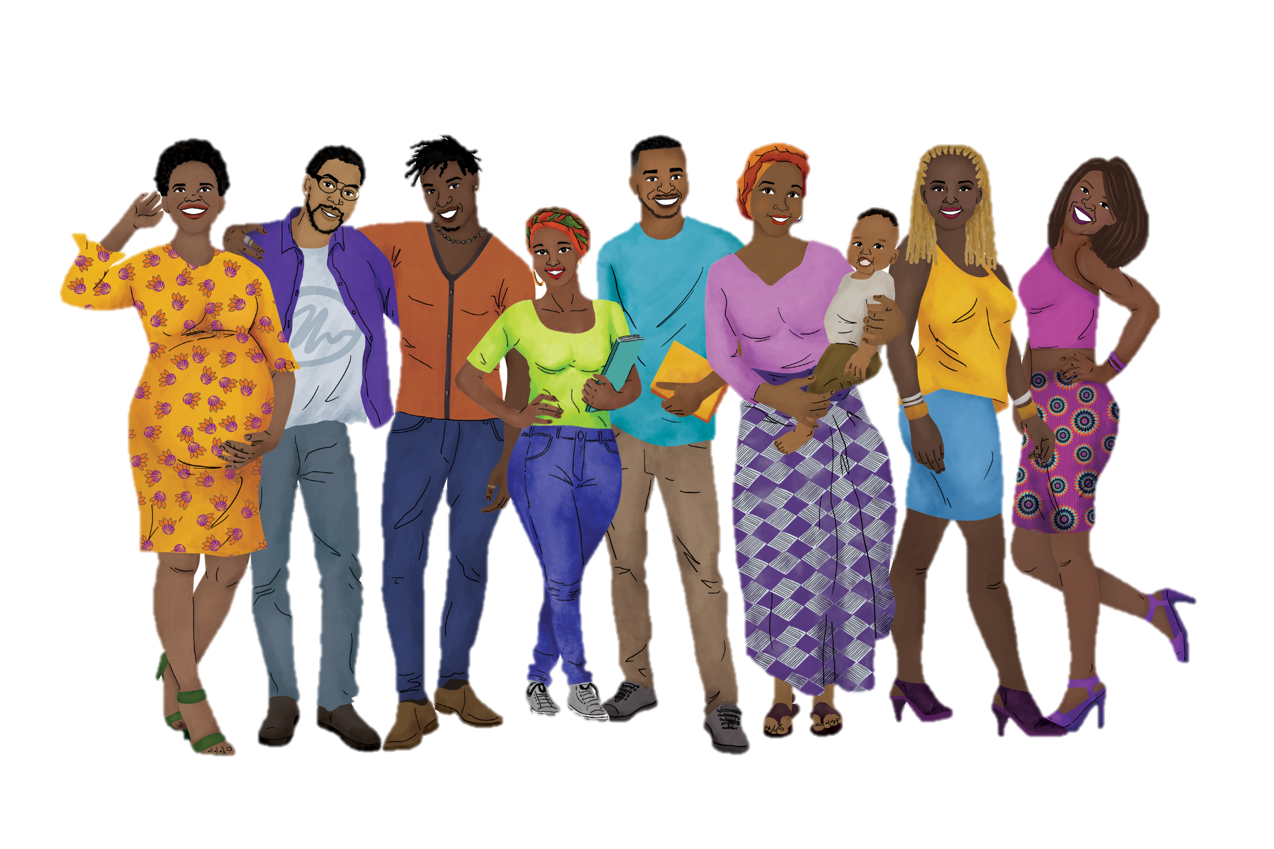
REMINDER: Our Working Agreements
Recognize that we are all teachers and learners.
Practice active listening and active participation.
Ensure that you minimize distractions. You will get out of the training what you put into it.
Be mindful and respectful of mind, body, spirit, and emotions – for ourselves and others!
Share the responsibility for success.
Remember that all contributions are valuable.
Be supportive of one another.
What else?
Notes:
ADVANCE PREPARATION
Add any additional working agreements decided upon previously
Facilitator notes:
Review the working agreements with participants.

Slide 3
Session 4: Agenda
SESSION 1 | Module | Facilitator(s)
1 HOUR | ROUNDING OUT YOUR TRAINING IDENTIFYING & SUPPORTING AMBASSADORS TAILORING YOUR TRAINING
10 MINUTES | BREAK
50 MINUTES | PREPARING FOR YOUR TRAINING CLOSING & NEXT STEPS
Notes:
Facilitator notes:
Review the day’s agenda for participants

Slide 4
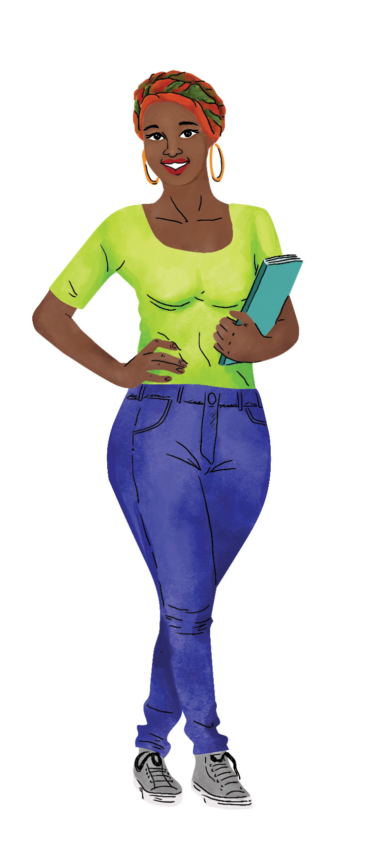
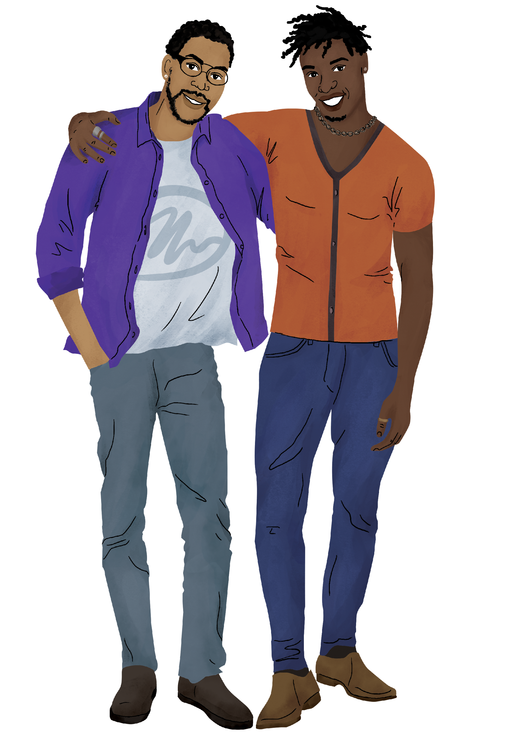

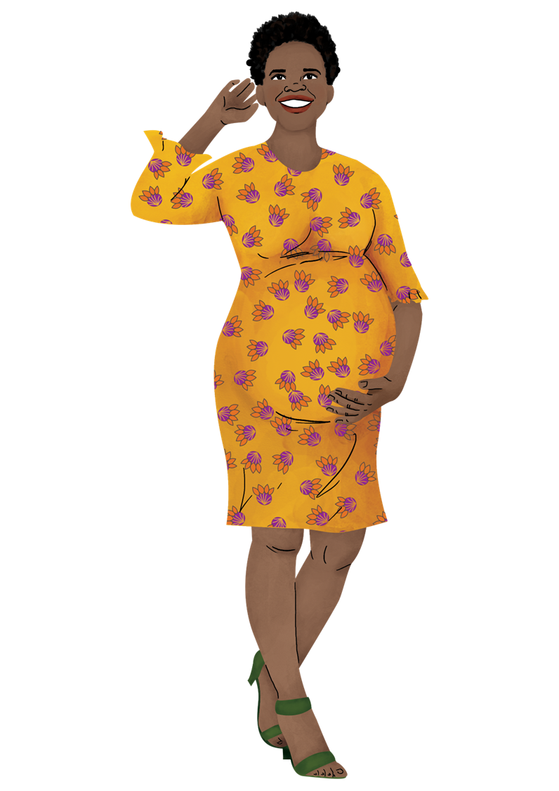



During this session, we will…
Review the Introductory & Closing Sessions of the training.
Consider who are ambassadors are and how we might support them.
Designing and preparing for our training, including action planning.
Wrap up our training-of-trainers!
Notes:
Facilitator notes:
Review the session objectives for participants.

Slide 5
ROUNDING OUT YOUR TRAINING
Notes:
Facilitator notes:
Introduce the first topic for the session: the introduction and closing sessions of the training

Slide 6
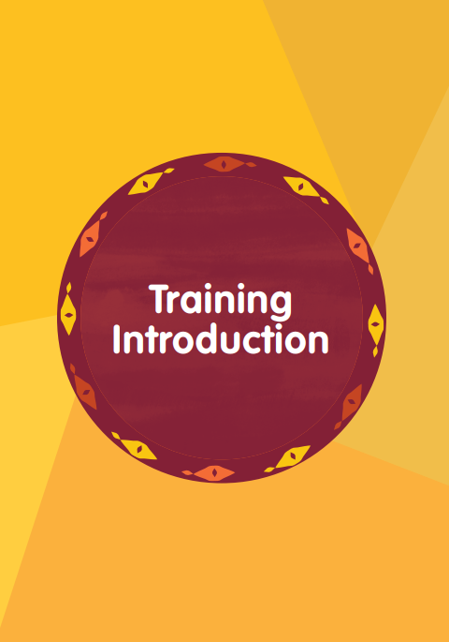
Training Introduction
The Training Introduction orients ambassadors to the training and helps everyone come together to create a brave and inclusive learning environment.
It is especially useful if not all participants know each other and the trainers.
We recommend completing this session to set the tone for your training!
Notes:
Facilitator notes:
Review the slide content.

Slide 7

Closing & Ambassador Graduation
The Closing Session supports ambassadors to plan for using their new knowledge and skills in their communities.
It also includes an ambassador graduation ceremony, during which ambassadors verbalize their commitment to being ambassadors.
Prepare graduation certificates in advance using resources found on the PrEPWatch Ambassador Webpage.
Notes:
Facilitator notes:
Review the slide content.

Slide 8
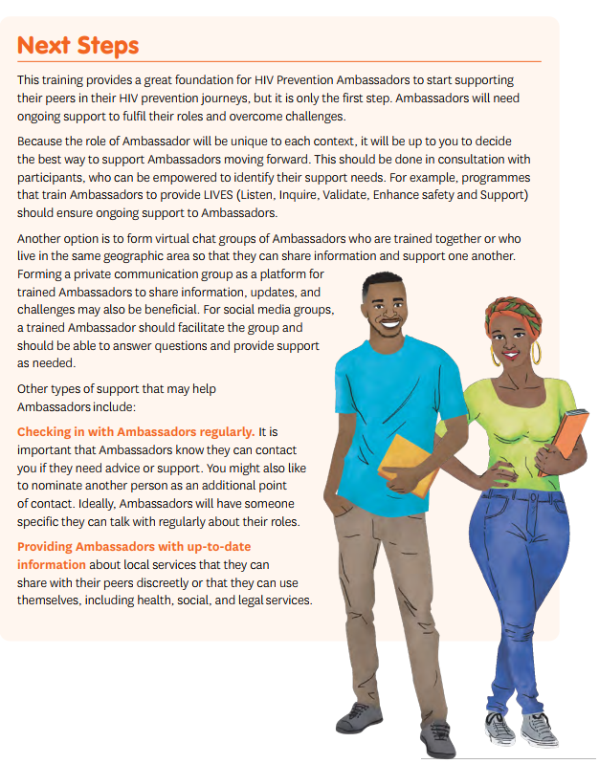
Next Steps
Finally, the training suggests next steps that your ambassador program can take to ensure the success of your ambassadors, including:
Ongoing training
Helping ambassadors to create a support network
Training to respond to critical incidents
Recognizing achievements
And more!
Ideally, you will work with ambassadors to plan out how you will support them in the long term.
Notes:
Facilitator notes:
Review the slide content.

Slide 9
Additional Resources
The HIV Prevention Ambassador Training Manual also includes:
Useful additional resources for each session and topic
A glossary of terms
On the HIV Prevention Ambassador Website, you will find:
Sample training agendas for the AGYW & Diverse trainings
Pre- and post-knowledge checks
Graduation certificates
Notes:
Facilitator notes:
Review the slide contents.
Let participants know that we will now spend some time together making an actionable plan for your own HIV Prevention Ambassador Training.

Slide 10
KEY ELEMENT I:
WHO ARE YOUR AMBASSADORS?
Notes:
ADVANCED PREPARATION
If your audience includes people from different organizations or programs, be prepared to put them into breakout groups for these portions of the training. They will need to collaborate with their colleagues to answer the questions together.
Facilitator notes:
Introduce the first module for the session: Key Element I of the “Planning Your Training” document.
Ask your audience to turn to the first page of their planning document and be ready to take notes either by hand or on their computer.

Slide 11
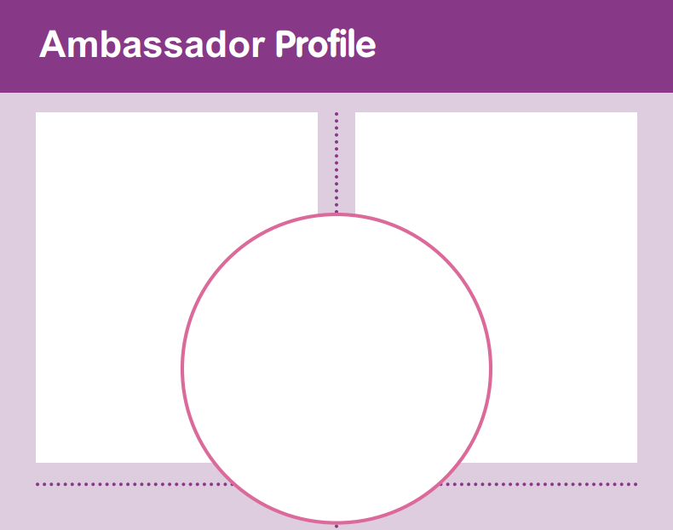
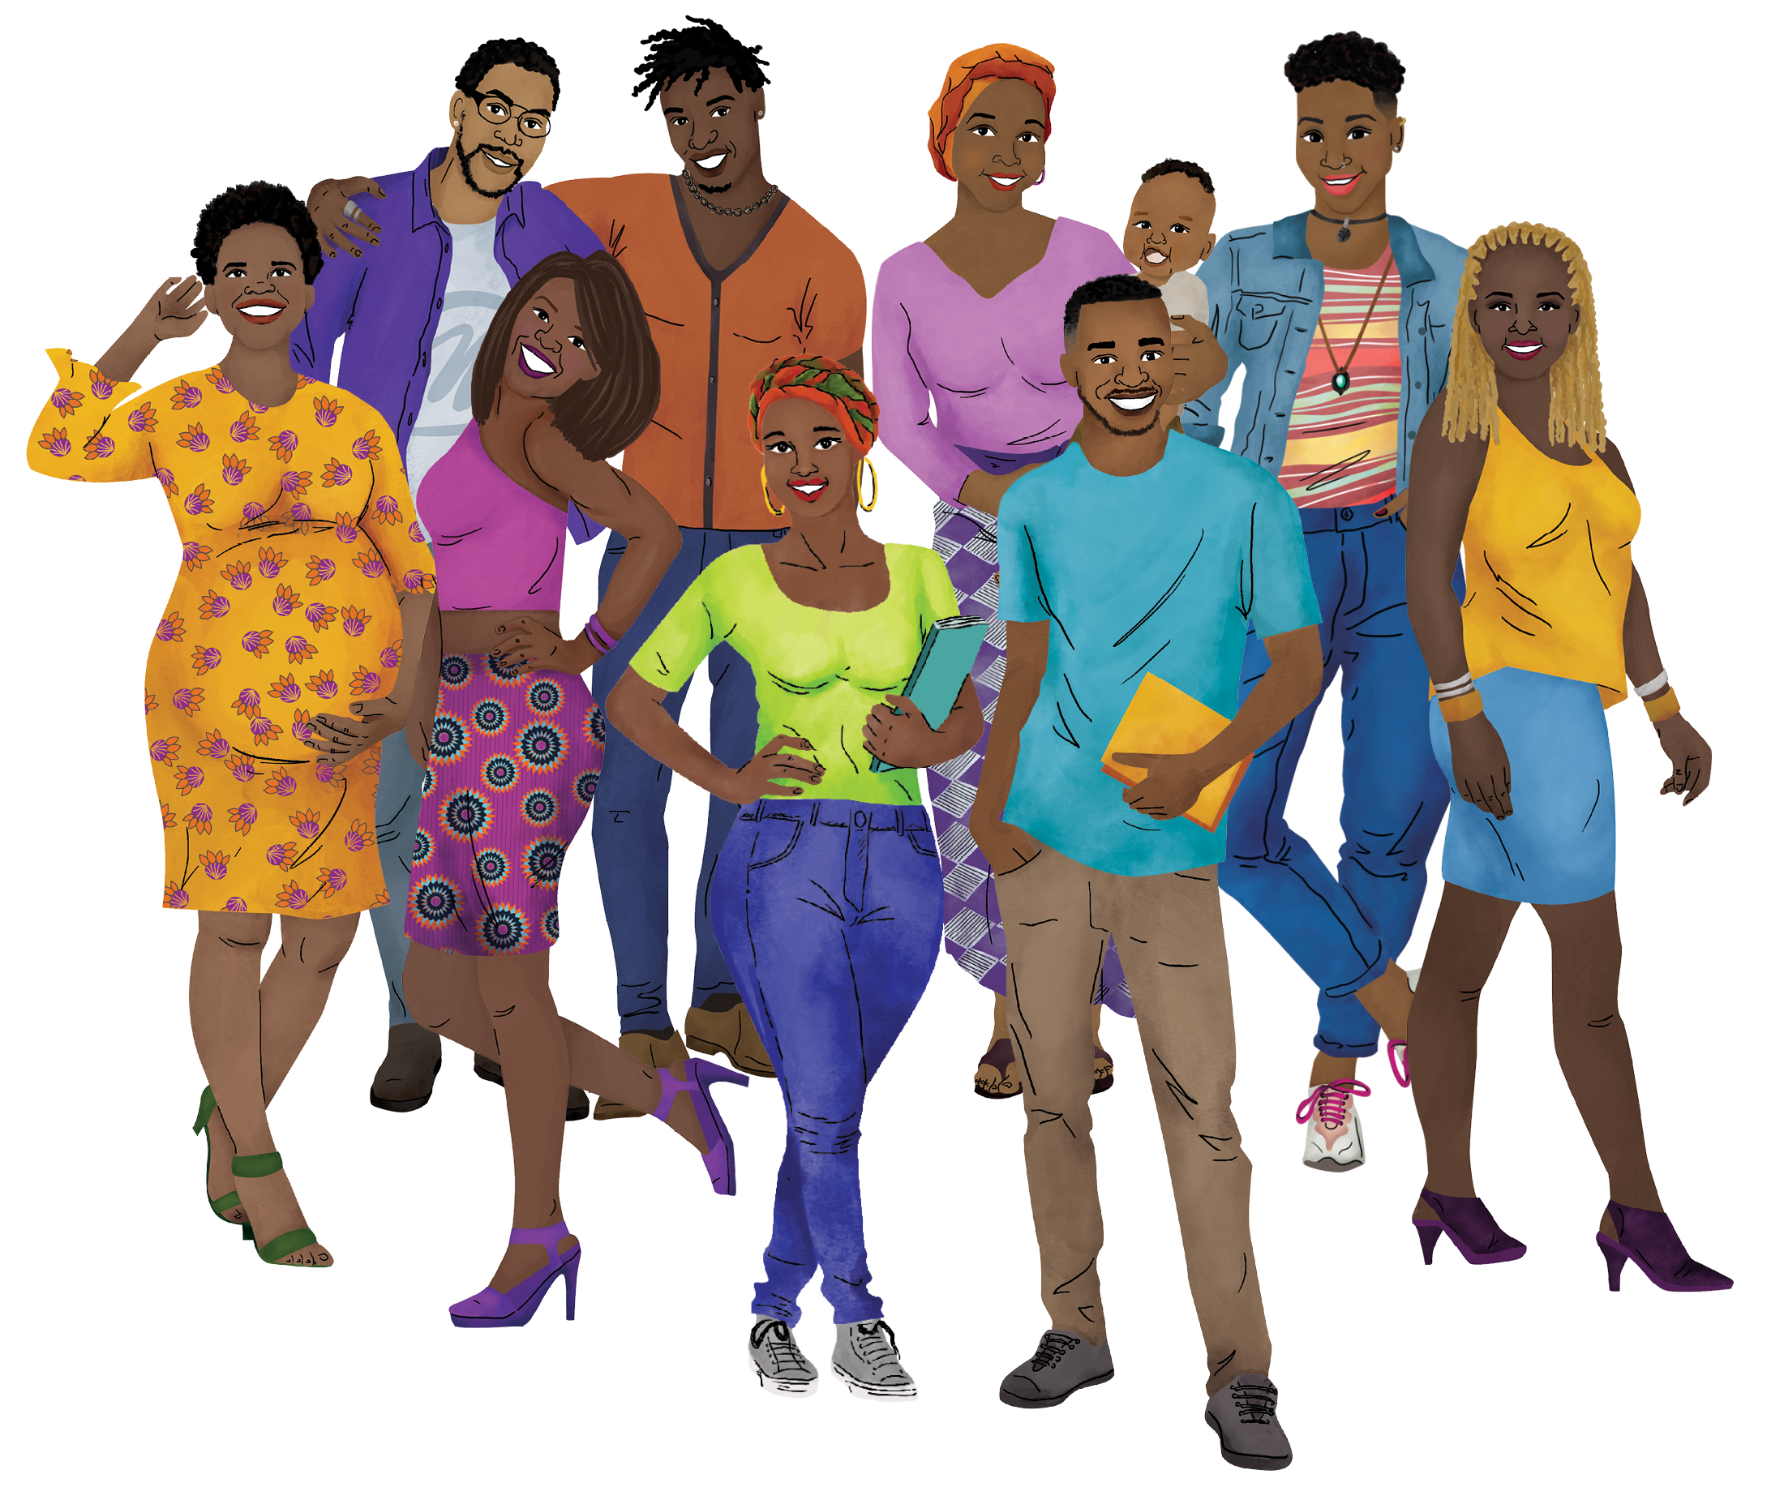
Turn to the first page of your “Planning Your Training” document.
Open your manuals to page 10 (AYGW Version) or page 12 (Diverse Version)
WHO are your ambassadors?
How old are they? Do they have families? Do they have jobs? Are they in
school? Are
they
criminalized
in society?
What is THEIR ROLE?
Will they do community outreach? Who do they work with? Are they connected to a
specific clinic?
Will they
provide
extensive
support to
peers who
experience
violence?
Notes:
Facilitator notes:
Instruct the group to turn to the first page of the planning document and the correct page of their training manuals.
Ask the key questions on the slide one at a time.
Facilitate discussion of each question using the prompts below each question.
If your audience says that their participants will provide extensive support to peers who experience violence, take note for the remaining discussions.
NOTE: Participants do not need to come to a full agreement on all of the answers. If they can agree on broad characteristics enough to move on to further planning, that is all you need. Our goal is to get them off to a good start, so that they are able to define their own details and exact path forward as a team or program.

Slide 12
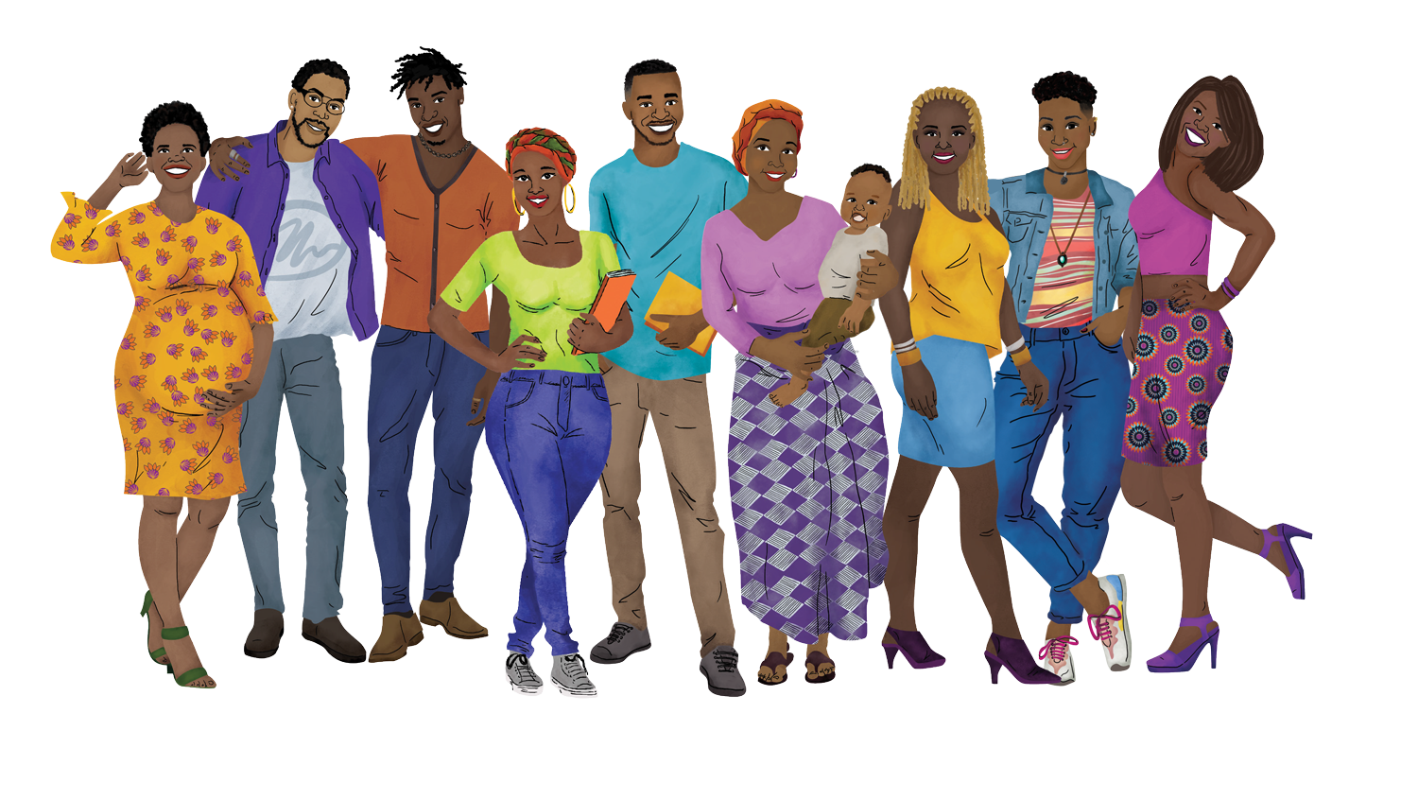
What kind of SUPPORT will they need?
Will they need compensation for airtime or transport? Do they need phones? Will they need time off? What other logistical support will they need?
Remember:
If your ambassadors will provide extensive support to peers who disclose violence, they will need more support from you!
See page 248-9 and 254-5 (AGYW Version) or 284 and 288-9 (Diverse Version) for more information.
Notes:
Facilitator notes:
Ask the key questions on the slide one at a time.
Facilitate discussion of each question using the prompts below each question.
Remember to highlight the additional support needed for ambassadors who will work with violence survivors.
If your audience will train ambassadors to respond to violence, and if there is time, ask your audience to read some of the key supports needed out loud to the group from page 248-9 (AGYW) or 288-9 (Diverse Version).
NOTE: Participants do not need to come to a full agreement on all of the answers. If they can agree on broad characteristics enough to move on to further planning, that is all you need. Our goal is to get them off to a good start, so that they are able to define their own details and exact path forward as a team or program.

Slide 13
What training do they HAVE?
What training do they NEED?
HIV prevention?
Human rights?
Peer support skills?
Specific PrEP methods?
Gender concepts?
The AGYW or Diverse Version?
Specific PrEP methods?
Disclosures of violence?
Foundational knowledge?
Ambassador skills?
Notes:
Facilitator notes:
Ask the key questions on the slide one at a time.
Facilitate discussion of each question using the prompts below each question.
Encourage the audience to continue taking notes on the different ideas that come up.
NOTE: Participants do not need to come to a full agreement on all of the answers. If they can agree on broad characteristics enough to move on to further planning, that is all you need. Our goal is to get them off to a good start, so that they are able to define their own details and exact path forward as a team or program.

Slide 14
TAILORING YOUR TRAINING
Notes:
ADVANCED PREPARATION
If your audience includes people from different organizations or programs, be prepared to put them into breakout groups for these portions of the training. They will need to collaborate with their colleagues to answer the questions together.
Facilitator notes:
Introduce the next module of the session.
Note to your audience to have their sample agenda handy for this module.
Ask your audience to turn to the first page of their planning document and be ready to take notes either by hand or on their computer.

Slide 15
What FOUNDATIONAL KNOWLEDGE will you include?
Human Rights
Gender-based Stigma, Discrimination, and Violence / Gender Inequality and Violence
Getting to Know Our Bodies
HIV and AIDS – The Basics
HIV Transmission and Prevention 101
Refer to your responses in
Key Element I to guide your choices!
Notes:
Facilitator notes:
Continue guiding your audience through the planning questions.
Remind your audience to refer back to their answers to previous questions (especially – what training do the ambassadors already have, and what their role will be) to help guide their responses.

Slide 16
What AMBASSADOR SKILLS will you include?
Boundary Setting and Self-Care
Responding to Disclosures of Violence
Peer Support Skills
Healthy Relationships and Supportive Partners
Refer to your responses in
Key Element I to guide your choices!
Notes:
Facilitator notes:
Continue guiding your audience through the planning questions.
Remind your audience to refer back to their answers to previous questions (especially – what training do the ambassadors already have, and what their role will be) to help guide their responses.

Slide 17
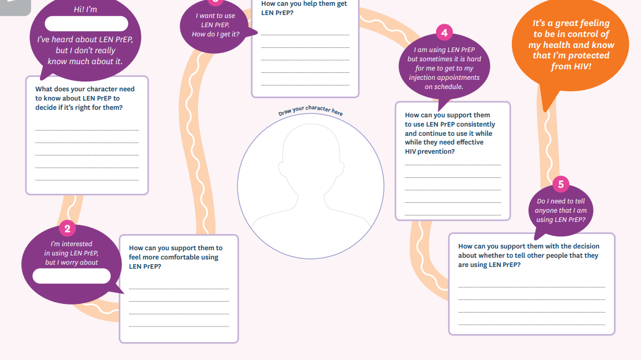
OPTION A:
      Guide all ambassadors as one group through the journey map for each method, one at a time.
OPTION B:
            Divide ambassadors into groups – one per method that you will train on – and allow each group to complete the journey map for one method. Have participants report back on their learnings to the full group.
Will we use OPTION A or OPTION B for our journey mapping sessions?
Your answer may depend on…
How much experience your ambassadors have with PrEP methods & whether they need a refresher
How many methods you will include
How many facilitators you have
How much time you have
Refer to your sample agenda for details about possible timing.
Notes:
Facilitator notes:
Guide your audience through a conversation about which option will work best for them.
Ask your audience to reference their sample agenda to see how each option impacts the potential timing of the training.

Slide 18
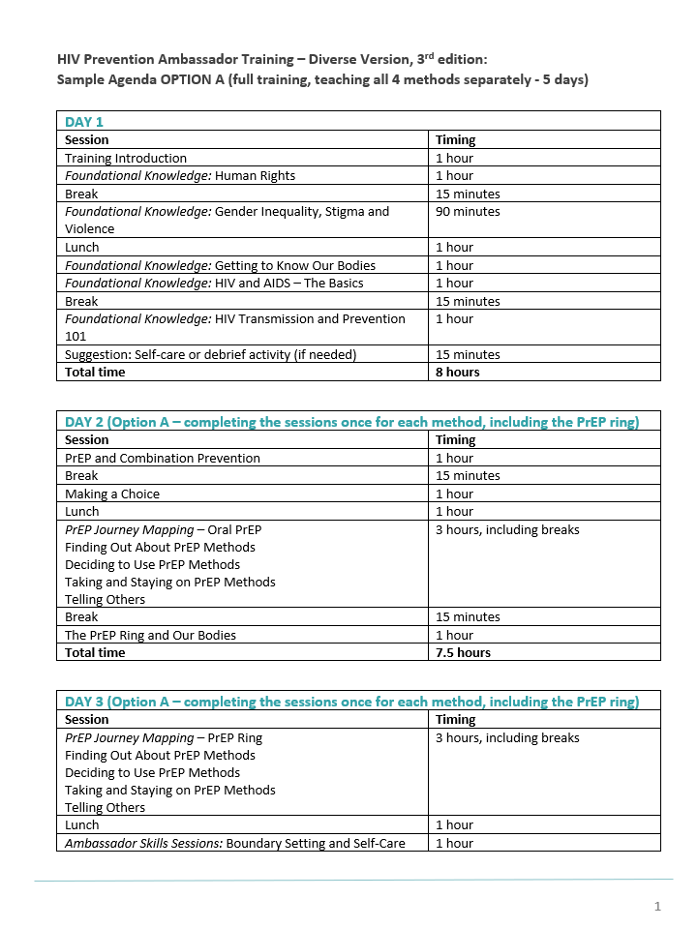
Adapting your sample agenda
Using a hard copy or soft copy of the SAMPLE AGENDA, remove the sections you will not need. For example, remove Foundational Knowledge Sessions that you will not include, and remove the option A or B that you will not use.
Now you have a version of the agenda that you can tailor to your situation!
*Remember – the Responding to Disclosures of Violence Session should be the last session of the day
Refer to pages 20-22 of the AGYW Version and 22-24 of the Diverse Version for more guidance.
Notes:
Facilitator notes:
Work with your audience to cut the sample agenda document down to fit their needs.
Remind your audience of key points – for example, a training that includes the PrEP ring should be sure to include “The PrEP Ring and Our Bodies” before completing the journey map for the PrEP ring, and the Responding to Disclosures of Violence Session should be the last session of the day so that ambassadors can decompress after.
Let the audience know that they can refer to pages 20-22 of the AGYW Version and 22-24 of the Diverse Version for more guidance as they continue to tailor their training after this TOT.

Slide 19
BREAK
See you in 10 minutes!
Notes:
Facilitator notes:
Give the participants a 10-minute break. Make sure to let them know the time they should be back before letting them step away.

Slide 20
PREPARING FOR YOUR TRAINING
Notes:
Facilitator notes:
Introduce the next module of the training

Slide 21
How will we prepare our MATERIALS for the training?
Do you need to modify the toolkit for ambassadors?*
How will you adapt the pre- and post-knowledge checks to fit your content? Will you use these resources?**
Who will prepare graduation certificates?
What other materials will you need? Flipcharts, markers, post-it notes, etc.
*If you will modify the toolkit, you may need support from a graphic designer or expert in PDF editing
**Available on the PrEPWatch ambassador page
Refer to pages 13-15 of the AGYW Version and 15-18 of the Diverse Version for more guidance.
Notes:
Facilitator notes:
Ask your audience to turn to Key Element IV on their worksheets and to pages 13-15 in the AGYW Version or 15-18 in the Diverse Version of their manuals.
Note that the pre- and post-knowledge check for each version of the training are available on the PrEPWatch ambassador page.
Guide your audience through a conversation about tailoring the materials (toolkit, pre- and post-knowledge checks, certificates, and other materials like flipcharts, markers, and post-it notes)
Reassure your audience that it is okay for organizations to add their own logos to the materials, if needed.
Reassure your audience that modifying the toolkit should be relatively simple for someone with a background in graphic design or the ability to edit a PDF document.

Slide 22
What about ICEBREAKER and ENERGIZER activities?
What ICEBREAKERS could we use during the training?
What ENERGIZERS could we use, and when will we use them?
Will we have extra icebreakers and energizers on-hand in case they are needed?
Refer to pages 13-15 of the AGYW Version and 15-18 of the Diverse Version for more guidance.
Notes:
Facilitator notes:
Support your audience to come up with a few icebreakers and/or energizers that they can call upon during their training. You do not need to list out all the energizers that might be used.

Slide 23
What OTHER ACCOMMODATIONS do we need to make?
Should we provide childcare? If so, what space can we use?
Do participants need a private space for breastfeeding?
How can we make our restrooms inclusive for all our participants?
What other accommodations should we make? What about participants with mobility, hearing, or visual needs?
Refer to pages 13-15 of the AGYW Version and 15-18 of the Diverse Version for more guidance.
Notes:
Facilitator notes:
Guide your audience through a conversation about making sure their training is inclusive of all participants.

Slide 24
CLOSING &
NEXT STEPS
Notes:
Facilitator notes:
Introduce the next module of the training

Slide 25
Closing activity
Take a moment to think of…
One thing you learned from this TOT that will support you to conduct your own HIV Prevention Ambassador Training
One principle you will take forward from this training to guide you as you support ambassadors
Notes:
Facilitator notes:
Introduce the closing activity.
Note that this activity is an adaptation of the activities in the closing session of the ambassador training.
Allow a few minutes for your audience to write down their responses to these prompts on the last page of their “Planning Your Training” worksheet.
Ask your audience to verbally share their answers to these questions one at a time by coming off mute.

Slide 26
A final note from ambassadors…
Being an ambassador allows me to engage my peers about issues that affect us such as gender-based violence. I love being an ambassador because I’m able to educate and empower my peers to make informed decisions about their sexual and reproductive health and self-care needs.
It helped build confidence because with the right information, you’re able to answer most of the questions. And also, you’re able to mobilize the people and actually refer them and also know your roles specifically
Notes:
Facilitator notes:
Share the slide contents.
Ask your audience to share any final reflections about what being an ambassador trainer means for them.

Slide 27
CONGRATULATIONS AMBASSADOR TRAINERS!
We are so excited to see how you will use what you learned in our sessions together.
Please tell us how you used this training! Email: hello@roottorise.org
Notes:
Facilitator notes:
Express your gratitude at the participation from your audience over the full 4 sessions of the training.
Thank them again for their time and attention.

Slide 28
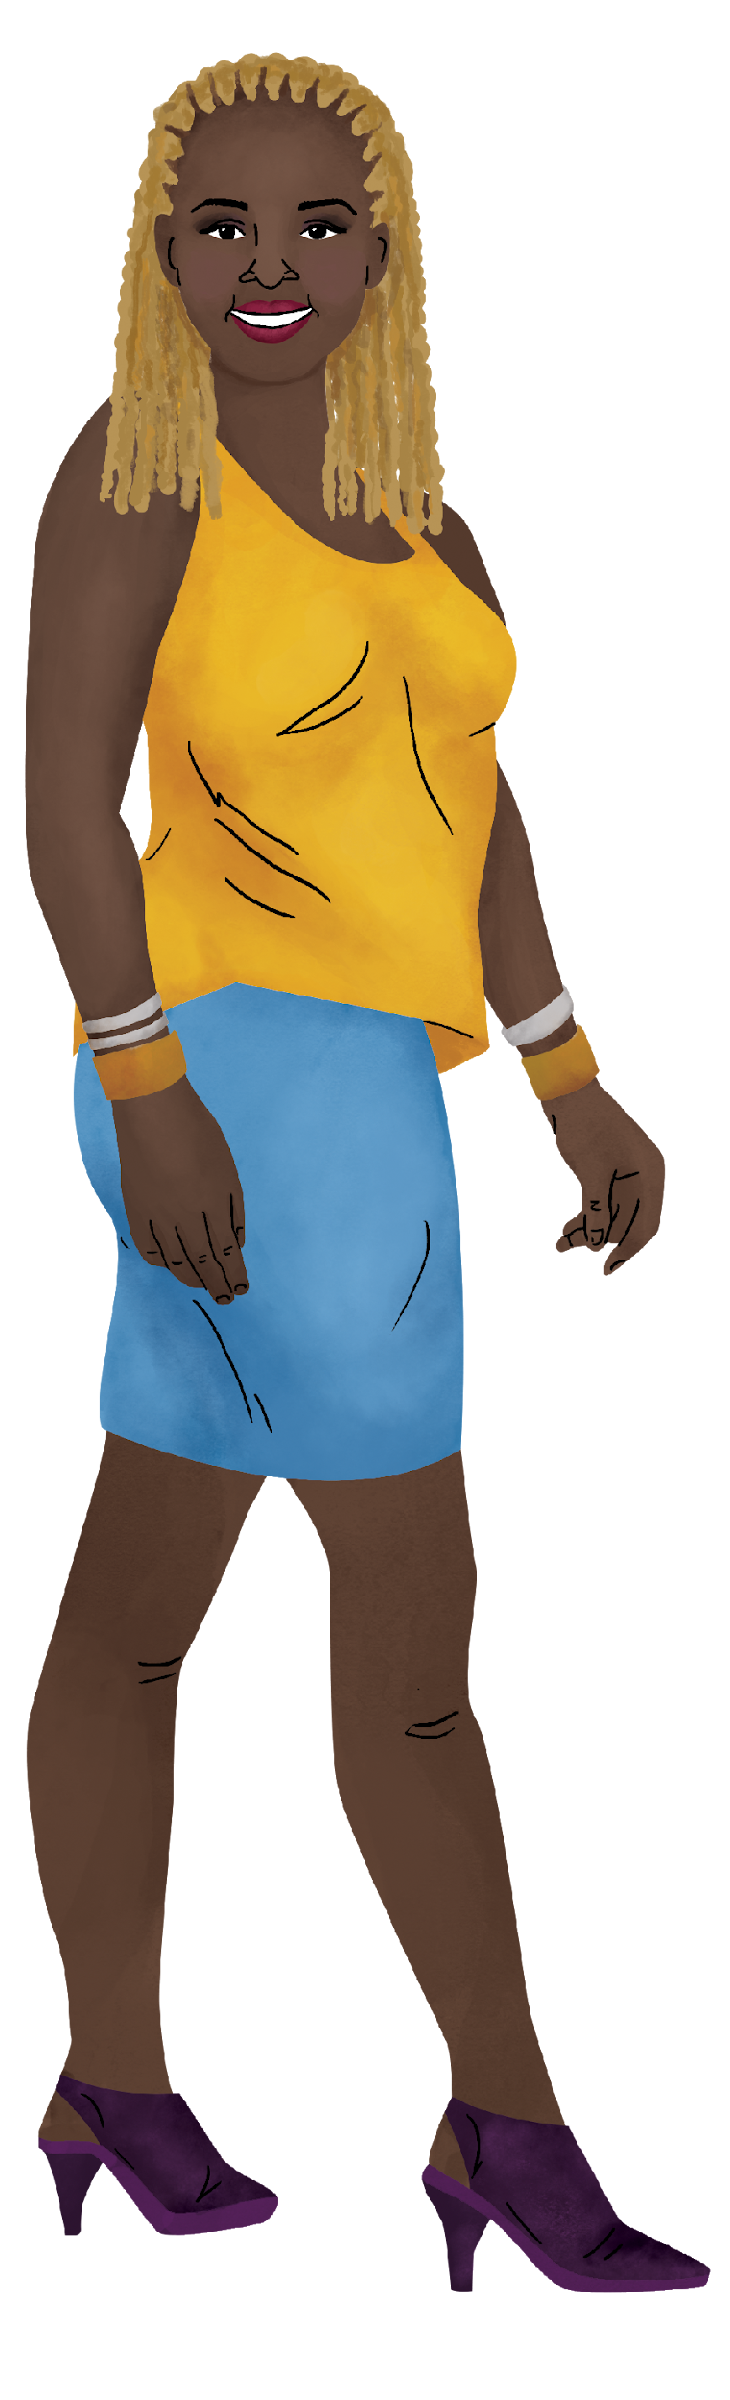
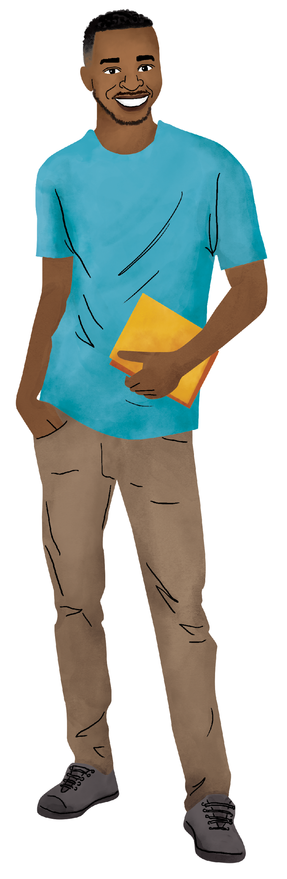
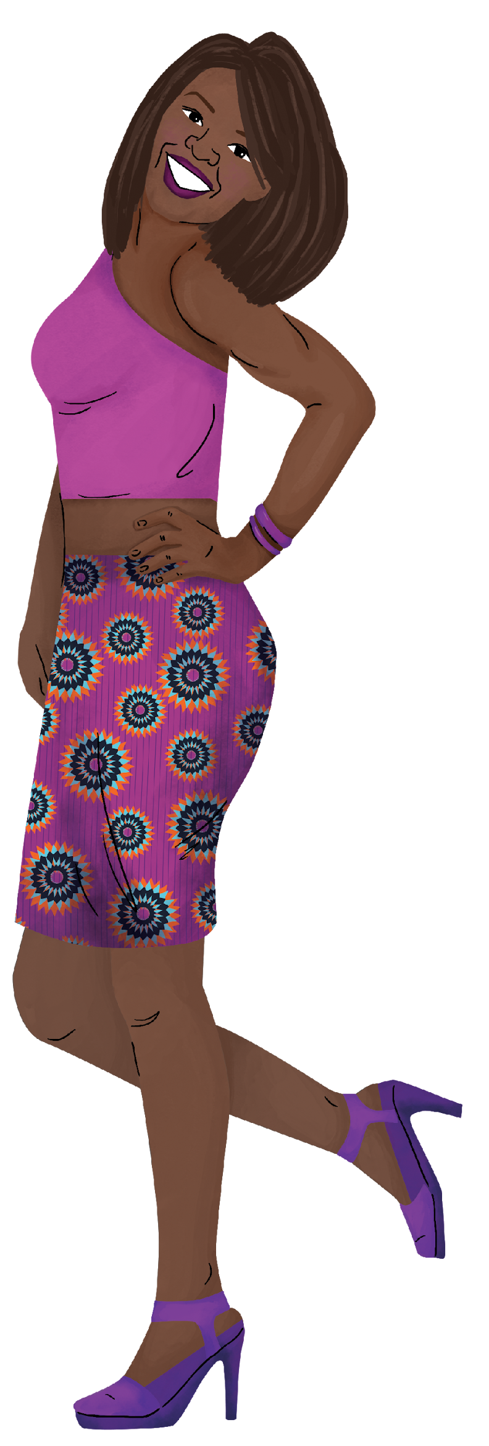
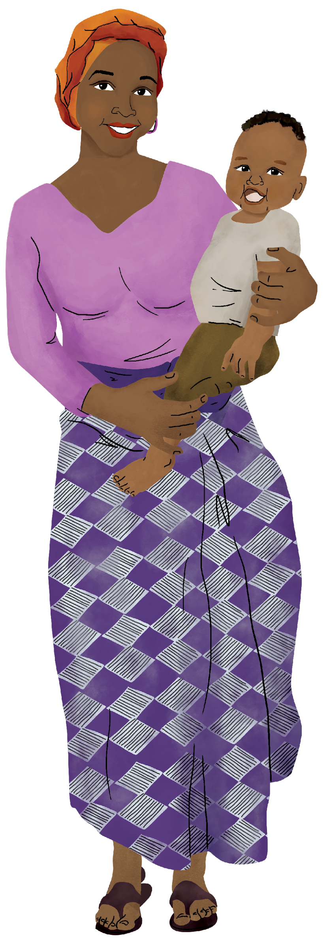

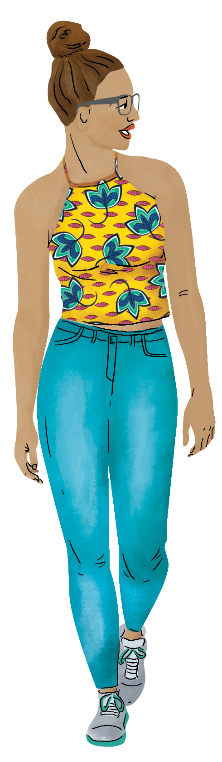
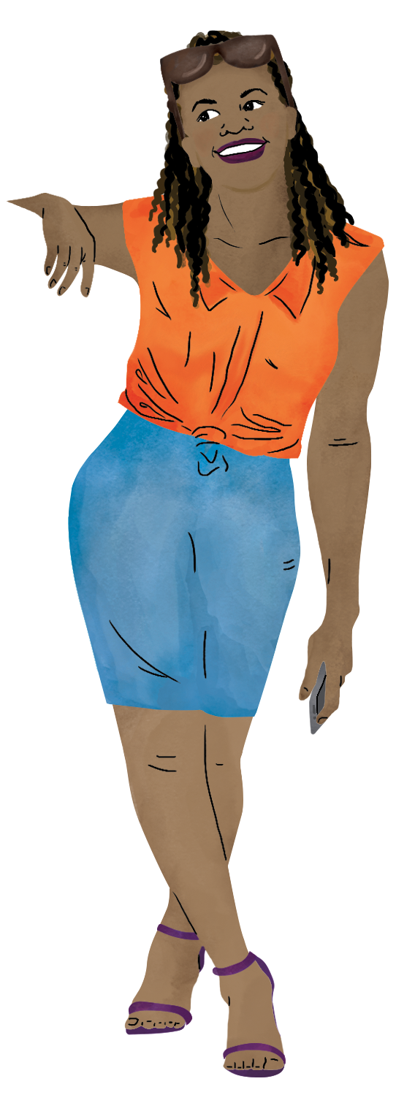
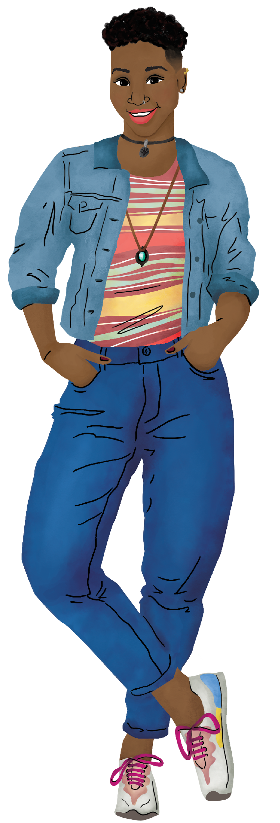
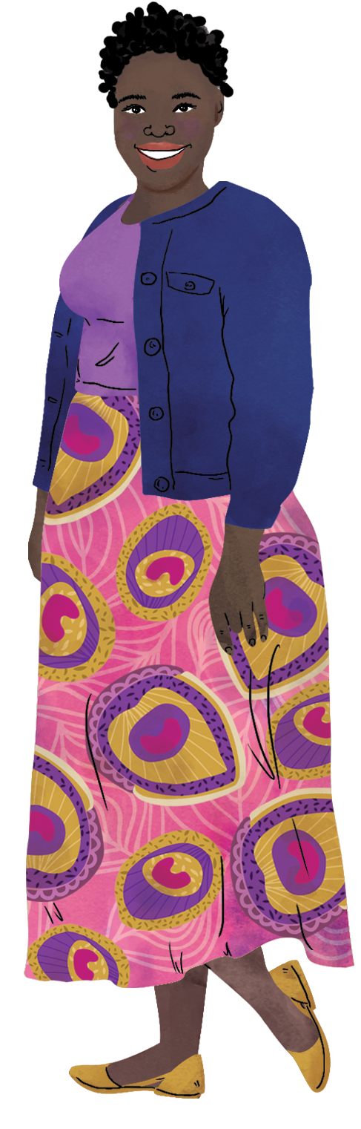
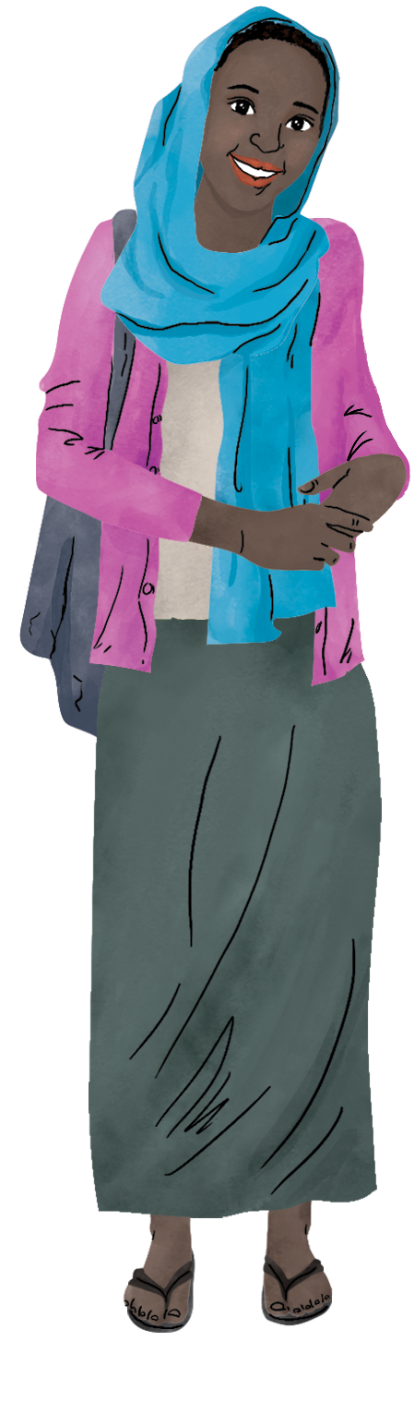
THANK YOU
Notes:
Facilitator notes:
Close out the training.

