Slide 1
WELCOME TO THE
HIV PREVENTION AMBASSADOR
TRAINING OF TRAINERS!
We are happy you are here
SESSION 2
Notes:
Facilitator notes:
Ask participants to add to the chat box or share verbally: what has been on their minds since the last session, and/or what they are looking forward to learning more about today.
Share anything in follow-up to the last session, and/or what you are excited to discuss during today’s session.

Slide 2
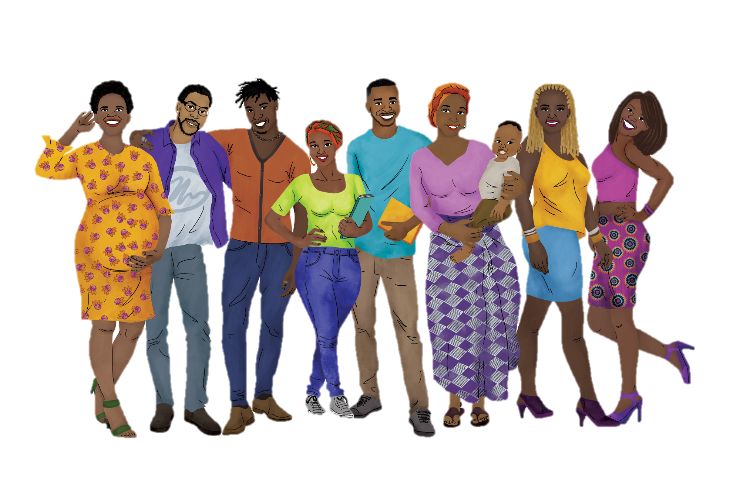
REMINDER: Our Working Agreements
Recognize that we are all teachers and learners.
Practice active listening and active participation.
Ensure that you minimize distractions. You will get out of the training what you put into it.
Be mindful and respectful of mind, body, spirit, and emotions – for ourselves and others!
Share the responsibility for success.
Remember that all contributions are valuable.
Be supportive of one another.
What else?
Notes:
ADVANCE PREPARATION
Add any additional working agreements decided upon previously
Facilitator notes:
Review the working agreements with participants.

Slide 3
Session 2: Agenda
SESSION 1 | Module | Facilitator(s)
1 HOUR | FOUNDATIONAL KNOWLEDGE: HUMAN RIGHTS, GENDER & VIOLENCE, GETTING TO KNOW OUR BODIES, HIV & AIDS BASICS, HIV TRANSMISSION & PREVENTION 101
10 MINUTES | BREAK
50 MINUTES | PrEP METHODS ESSENTIAL KNOWLEDGE: ORAL PrEP, THE DAPIVIRINE VAGINAL RING, INJECTABLE CABOTEGRAVIR & LENACAPAVIR
Notes:
Facilitator notes:
Review the day’s agenda for participants

Slide 4


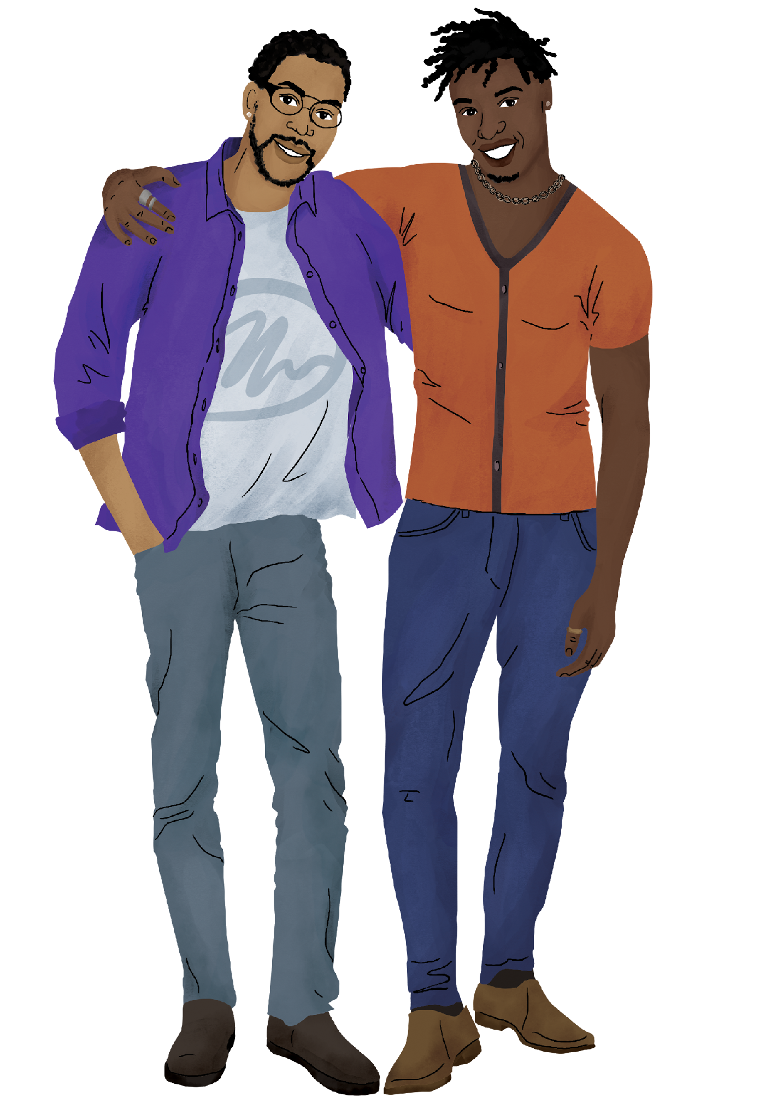



During this session, we will…
Get to know the topics covered in the Foundational Knowledge sessions in the HIV Prevention Ambassador Training.
Learn about the basic information on PrEP methods included in the training.
Start thinking about what Foundational Knowledge and which PrEP methods we will include in our own HIV Prevention Ambassador Training.
Notes:
Facilitator notes:
Review the session objectives for participants.

Slide 5
FOUNDATIONAL KNOWLEDGE
Notes:
Facilitator notes:
Introduce the first topic for the session: the Foundational Knowledge portion of the HIV Prevention Ambassador Training

Slide 6

Foundational Knowledge
This portion of the training covers basic topics that ambassadors need to be effective in their roles. Each session stands on its own, so you can choose to use one or all of these sessions at any point in your training.
Because these topics are so important for ambassadors, we recommend including all of these sessions unless your ambassadors already have a strong understanding of the topics.
Notes:
Facilitator notes:
Review the slide contents.
Reinforce the point that local resources, including local experts and counselors, are key to a successful training. This is the third section of the “Planning Your Training” worksheet.

Slide 7
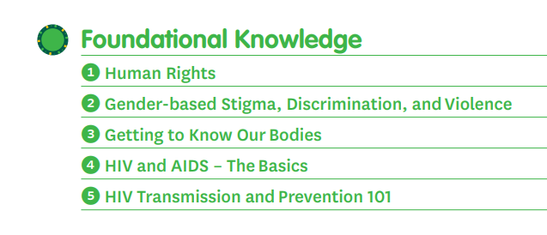
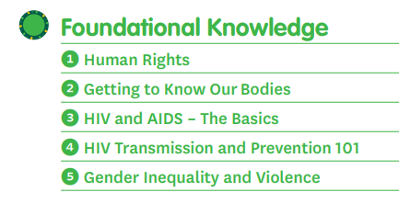
Foundational Knowledge - Contents
Diverse Version
AGYW Version
Due to feedback we received from workshop participants, the Foundational Knowledge in the Diverse Version includes more information about diverse gender identities and the trans experience. Based on this feedback, we also moved the “Gender-based Stigma, Discrimination, and Violence” session before “Getting to Know Our Bodies” so that biological information about the reproductive system could be presented in a more gender-inclusive way.
Notes:
Facilitator notes:
Review the slide content.
Highlight the difference between the AGYW and Diverse Versions.
Note to participants that, although much of the content in the two versions is similar, the Diverse Version includes more specific information on the transgender experience and transgender identities. If TOT participants will be working with transgender or gender-diverse ambassadors, or if their ambassadors regularly work with members of the transgender community, it is a good idea to consider using the Diverse Version of the training.

Slide 8

Human Rights
Session Goal:
Participants learn about human rights and how they can be applied to sexual health, HIV prevention, and PrEP method use. They will also deepen their understanding of the topic by identifying how a person’s life can be affected by their ability to exercise their rights.
Session Activities:
Discussion and sticky note brainstorming
Character exercise
Reflection circle
Notes:
Facilitator notes:
Review the slide contents.

Slide 9
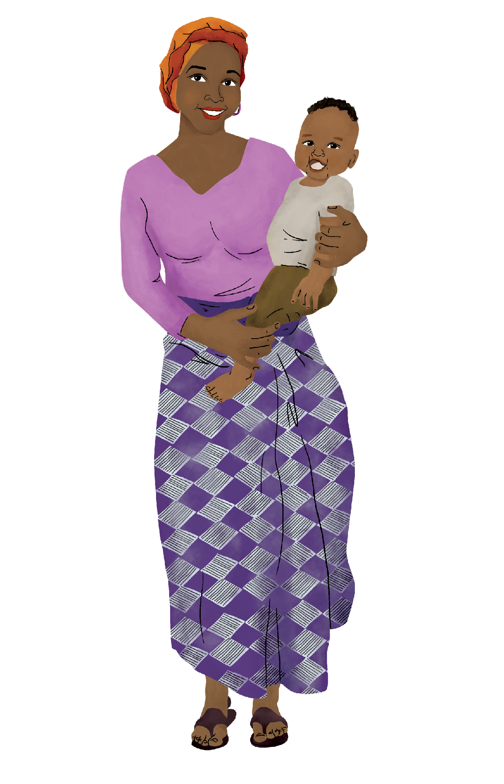
Human Rights – POP QUIZ!
How are HUMAN RIGHTS and HIV connected?
Notes:
Facilitator notes:
Ask your audience the POP QUIZ question and encourage them to add their responses in the chat or unmute and share verbally with the group. There are many correct answers, and many of these are listed on the next slide. When the discussion begins to slow down, move to the next slide.

Slide 10
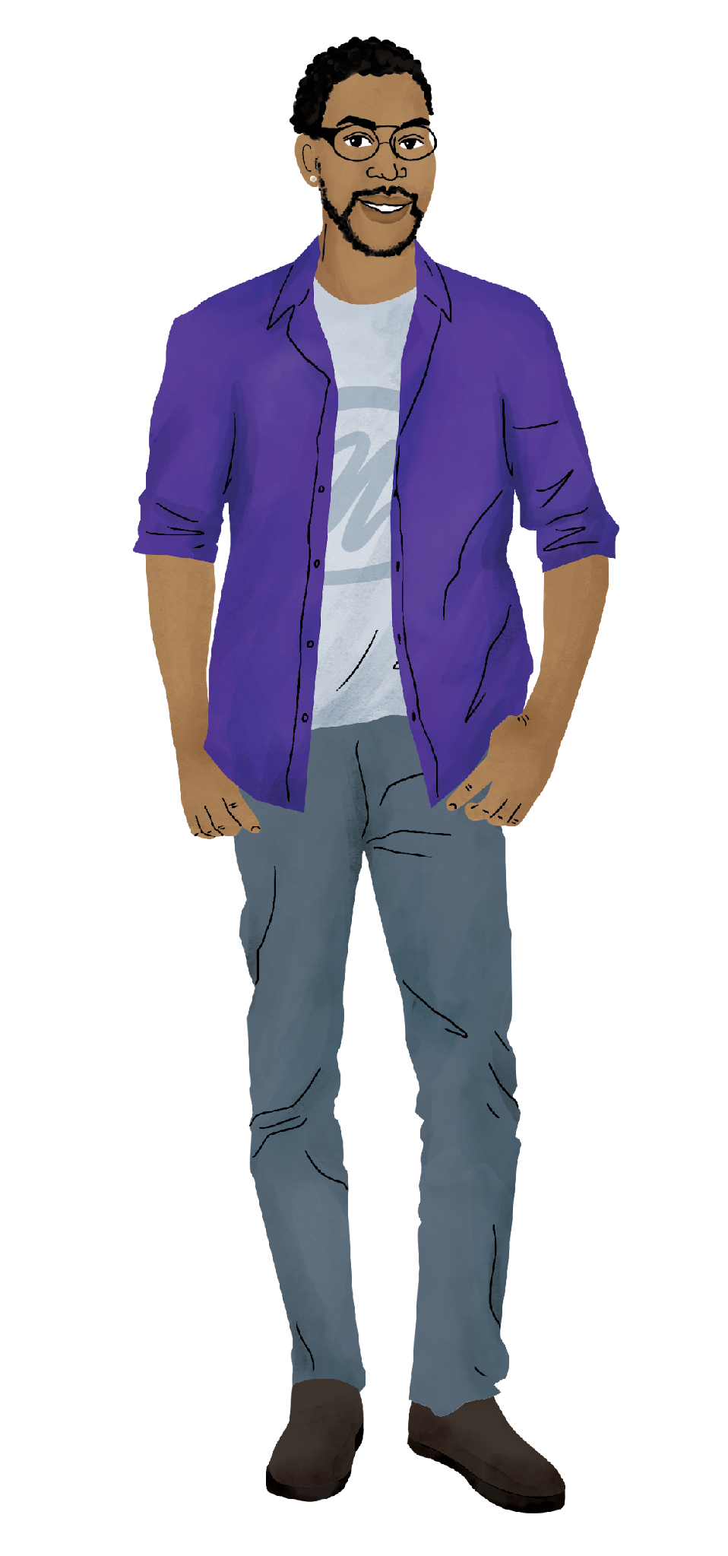
Human Rights & HIV
Human rights violations are a barrier to HIV prevention
When people can exercise their human rights, it is easier for them to prevent HIV
HIV creates a barrier to realizing a person’s human rights
HIV must be eradicated in order to achieve full human rights for everyone
Notes:
Facilitator notes:
Review the slide contents. Relate these statements back to the answers that your audience provided. If needed, further information about each of these statements is listed below:
The violation of human rights is a barrier to HIV prevention. Human rights violations, such as
sexual violence, can lead to situations where a person is exposed to HIV. Human rights violations can
also create barriers to HIV prevention, such as when discrimination stops someone from accessing
health services.
When people can exercise their human rights, it is easier for them to prevent HIV. A person’s
ability to prevent HIV depends on their ability to exercise many human rights, including the right to
have control over their bodies, the right to health services, and the right to information.
HIV creates a barrier to the realisation of human rights. HIV‑related illness, stigma, and
discrimination create barriers to education, employment, housing, and other rights for people living
with HIV.
The achievement of human rights for all is dependent on the eradication of HIV. HIV
undermines global progress towards the right to health and other rights. It also contributes
to poverty.

Slide 11

Gender-based Stigma, Inequality, and Violence*
/ Gender Inequality and Violence
Session Goals:
Participants in both versions learn about core concepts of sex assigned at birth, gender identity, gender expression, sexual orientation, and sexual partnerships. Participants also learn about gender inequality and violence, and how gender norms and gender-based violence make it more difficult to prevent HIV.
*The Diverse Version includes more facilitator-facing information to help include trans and nonbinary identities, as well as injection drug use, in the discussion, and the session may take 90 minutes to complete.
Session Activities:
Drawing activity
Persona discussion
Gender inequality problem tree
Notes:
ADVANCE PREPARATION
If you are training a group that will most likely be using the AGYW version of the training, move the slides on this session to the correct place in this slide deck – as the last session in the Foundational Knowledge section.
Facilitator notes:
Review the slide contents.

Slide 12
Gender Inequality – POP QUIZ!
Why do gender norms make it more difficult for some people to prevent HIV?
Notes:
Facilitator notes:
Ask your audience the POP QUIZ question and encourage them to add their responses in the chat or unmute and share verbally with the group. There are many correct answers, and many of these are listed on the next slide. When the discussion begins to slow down, move to the next slide.

Slide 13
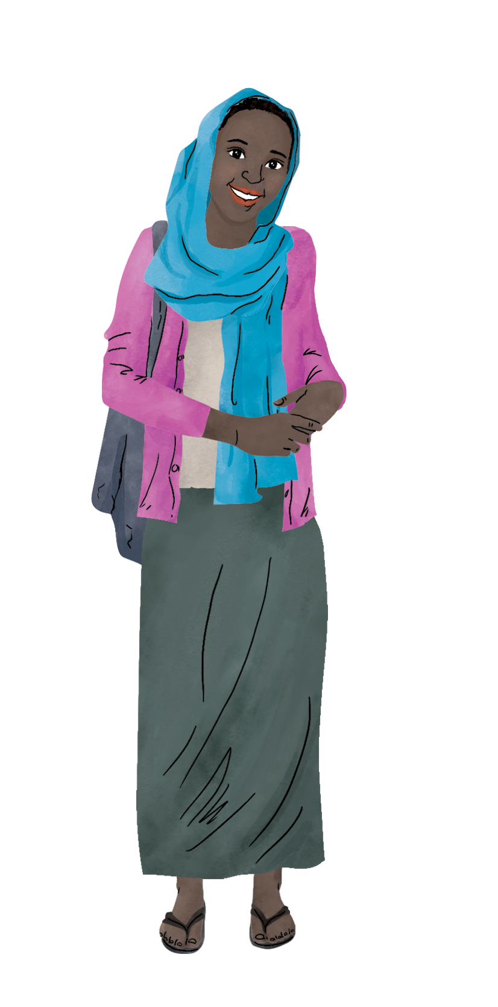
Gender norms & HIV
Gender norms that discourage women from talking about sex make it more difficult for women to learn about HIV prevention
Gender norms that encourage men to have many sexual partners may increase the possibility that men and women will be exposed to HIV
Gender norms encouraging the belief that only women and girls experience gender-based violence make it harder for men and LGBTQIA+ people to get HIV prevention after an experience of violence
Notes:
Facilitator notes:
Review the slide contents. Relate these statements back to the answers that your audience provided. There are many more answers to this question than are listed here, so encourage your audience to add anything else that comes to mind.

Slide 14

Getting to Know Our Bodies*
Session Goals:
Participants in both versions learn about menstruation and vaginal health as it relates to the dapivirine vaginal ring (the PrEP ring).
*The Diverse Version includes information on anatomy common to people assigned male at birth, intersex characteristics, hormones and PrEP, and medical transitions for transgender people.
This session does not include comprehensive information on pregnancy, breastfeeding, or hormonal transitions.
Session Activities:
Myths and facts
Role play
Notes:
Facilitator notes:
Review the slide contents.
Suggest that your participants turn to their toolkits to see the role play and anatomy tool(s) associated with this session.
Note that there are 2 of each of these tools included in the Diverse Version – one each for people assigned female at birth, and one additional tool each for people assigned male at birth.
Note that this is another piece of information important for deciding which version of the training your audience will use. If their ambassadors will work with young men or other people assigned male at birth, the Diverse Version includes information and tools that they might use in their work.

Slide 15
Our Bodies – MYTHS & FACTS!
Name one myth that you learned about the reproductive system growing up.
Notes:
Facilitator notes:
Ask your audience to share their answers to the myths and facts question. When the discussion begins to slow down, move to the next slide.

Slide 16

Our Bodies – MYTHS & FACTS!
We learn a lot of myths about our bodies as we grow up. Knowing the facts about our bodies and our reproductive systems empowers us to ask for what we need and set healthy boundaries – key steps to preventing HIV.
The ability to talk about the reproductive system and how it works is an important skill for ambassadors!
Notes:
Facilitator notes:
Review the slide contents.
Remind participants that being able to have an open and honest discussion about the reproductive system is a key skill for ambassadors, especially ambassadors who might help their peers use the PrEP ring.

Slide 17
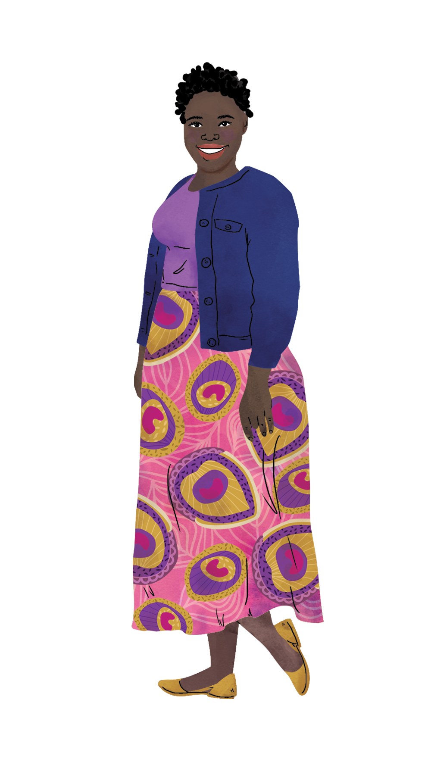
HIV and AIDS – The Basics
Session Goals:
Participants learn essential facts about HIV and AIDS. They will also practice identifying and correcting myths about HIV and AIDS.
Session Activities:
Vote with your feet
Myth-busting
Notes:
Facilitator notes:
Review the slide contents.

Slide 18
HIV and AIDS – POP QUIZ!
What are the three stages of HIV?
Notes:
Facilitator notes:
Ask your audience the POP QUIZ question and encourage them to add their responses in the chat or unmute and share verbally with the group. There are only three correct answers to this question – once your participants name the answers, or if they aren’t able to name all three, move on to the next slide.

Slide 19

HIV and AIDS – The Basics
Acute HIV
Chronic HIV
Acquired immunodeficiency syndrome (AIDS)
Notes:
Facilitator notes:
Review the slide contents. If your participants did not name these three stages, ask if they can explain what each stage is. The correct responses are listed below.
Acute HIV: Is the earliest stage of HIV, and it generally develops within two to four weeks after HIV has entered the body and started to make copies of itself. During this time, some people have flu‑like symptoms, such as fever, headache, and rash.
Chronic HIV: During this stage, HIV continues to multiply in the body but at very low levels. People with chronic HIV may not have any HIV‑related symptoms. Without antiretroviral therapy, chronic HIV usually advances to AIDS.
Acquired immunodeficiency syndrome (AIDS): Without treatment, HIV progresses to AIDS. AIDS is caused by HIV. A person develops AIDS when HIV has damaged their immune system so much that they are no longer able to fight off infections and illnesses. A person is considered to have AIDS when they have a CD4 count of less than 200 cells left to protect them from infections or when they frequently become sick with ‘opportunistic infections’, such as tuberculous (TB); pneumonia; and a range of skin, eye, and nervous system conditions. While healthy people can develop these illnesses as well, people with AIDS are at a very high risk of getting them and are more likely to get very sick when they do.

Slide 20
HIV Transmission & Prevention 101*
Session Goals:
Participants learn essential facts about HIV and AIDS. They will also practice identifying and correcting myths about HIV and AIDS.
*The Diverse Version includes information and activities on HIV transmission and prevention during pregnancy, breastfeeding, and injection drug use.
Session Activities:
Sticky note activity
HIV transmission continuum
Notes:
Facilitator notes:
Review the slide contents.
Highlight the additional content included in the Diverse Version. If your audience will be working with people who are pregnant, breastfeeding, or who use injection drugs, this session has important information for them to learn.

Slide 21


HIV Transmission Continuum
List these activities in order of least likely to transmit HIV to most likely to transmit HIV
Injecting drugs with a shared needle
Oral sex
Anal sex without PrEP or a condom
Notes:
Facilitator notes:
Read the slide contents.
Ask your audience for their response or guesses in answer to this question.

Slide 22
HIV Transmission Continuum
Injecting drugs with a shared needle
Anal sex without PrEP or a condom
Oral sex
Least likely to transmit HIV
Most likely to transmit HIV
Notes:
Facilitator notes:
Review the slide contents.
Note that, if a person is using condoms or a PrEP method, the likelihood of HIV transmission will be different and could change the order of this continuum. Part of the utility of this activity is considering ways to make these activities less likely to transmit HIV – such as using a new needle, using oral PrEP or injectable PrEP, or a condom.

Slide 23
Foundational Knowledge – Recap
How do you think
YOUR AMBASSADORS would do on these quizzes?
How did YOU do on the quizzes?
Foundational Knowledge sessions are intended to equip ambassadors to clearly and confidently answer questions like these – and be able to defend their answers to their peers and powerholders within their communities.
Notes:
Facilitator notes:
Guide your audience through a discussion about how they did on the quizzes, and how they think their ambassadors might do when answering the same questions.
Note that if your audience feels that their ambassadors would have trouble with the questions, that they could benefit from completing the sessions. In addition, if your audience struggled to answer the questions, suggest that it could be helpful for them to brush up on the session content as well.

Slide 24
Group work
Let’s review the first question under “Key Element II” of our worksheets together.
What FOUNDATIONAL KNOWLEDGE should we include in our training?
It may help think through this question by also looking at question 4 under Key Element I: What training do they already have?
Feel free to take notes on your worksheet. You will be able to update your answers as we go through our sessions.
Notes:
Facilitator notes:
Review the slide content.
Guide participants through a conversation where they share their responses to this question. It may be useful to remind participants of the difference between the Diverse and AGYW Foundational Knowledge to help with the discussion.
Encourage participants take notes, ask questions or make comments as they think through the first question of Key Element II.

Slide 25
BREAK
See you in 10 minutes!
Notes:
Facilitator notes:
Give the participants a 10-minute break. Make sure to let them know the time they should be back before letting them step away.

Slide 26
PrEP METHODS ESSENTIAL KNOWLEDGE
Notes:
Facilitator notes:
Introduce the second module for the day

Slide 27
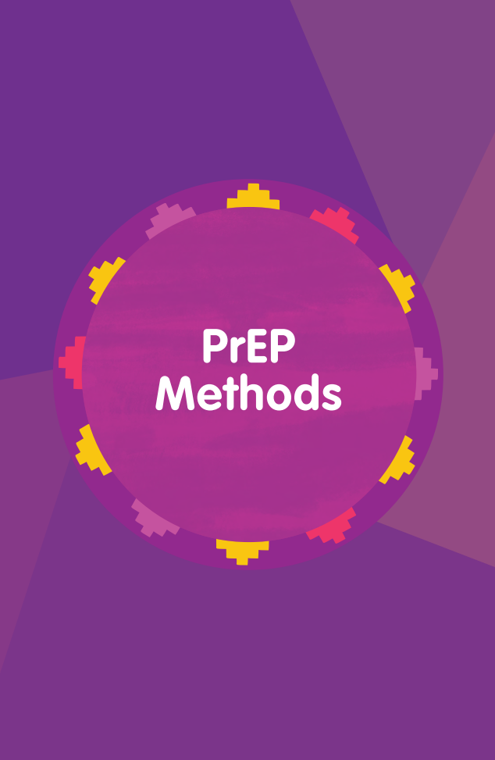
What’s in the PrEP Methods Essential Knowledge?
In-depth information on…
PrEP Methods & Combination Prevention
Oral PrEP
The PrEP Ring
Injectable PrEP
Talking About PrEP Methods
This section serves as a reference for facilitators of the training, alongside local guidelines and resources.
Notes:
Facilitator notes:
Review the slide content.
Let participants know that you will review some basic information about each PrEP method today, but in-depth information can be found inside their HIV Prevention Ambassador Training Manual.
Emphasize that the PrEP Methods Essential Knowledge is a comprehensive reference for facilitators as they lead ambassadors through the training. It is intended to have answers to the most common questions about PrEP and offer resources for answering additional questions or understanding the latest science.
Remind your audience that HPAT facilitators must also collect local guidelines and resources to supplement the Essential Knowledge. Local resources are key to answering detailed questions about required testing, PrEP use during pregnancy or breastfeeding, age and parental notification requirements, etc.

Slide 28
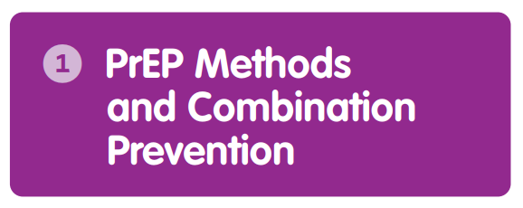
PrEP is something that works for me and it will work for others.
- Female sex worker
Topics covered:
What is PrEP and who is it for?
What is the difference between PrEP, PEP, and ART?
What are the ways to use PrEP?
Combining PrEP & other HIV prevention methods
Making a PrEP method choice
PrEP & HIV drug resistance
What real-life PrEP users have to say about PrEP
Notes:
Facilitator notes:
Review the slide content.

Slide 29
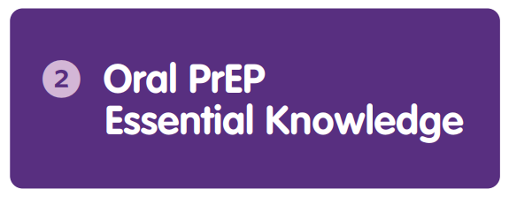
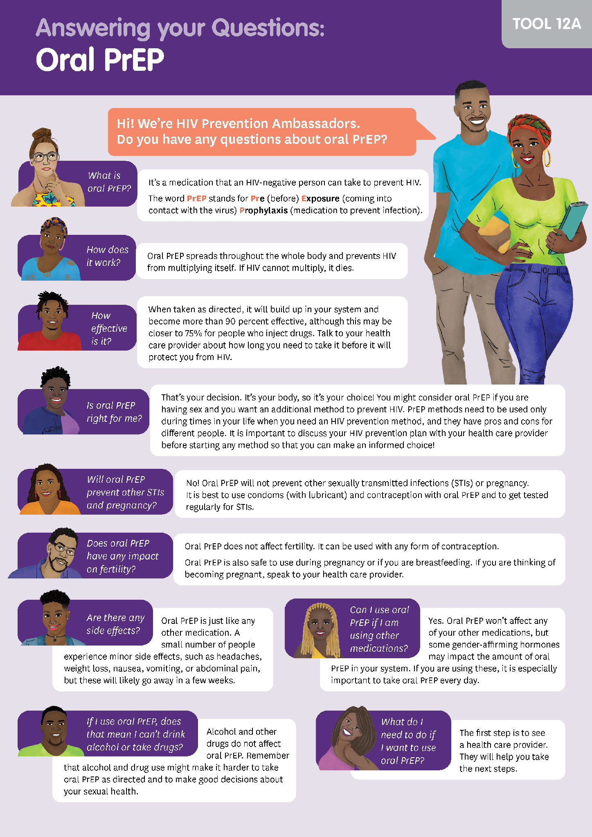
Topics covered:
What is oral PrEP and who is it for?
How does oral PrEP work?
Information on Event-Driven PrEP
What are the side effects of oral PrEP?
How to get oral PrEP and continue using it
Answers to key questions on oral PrEP and pregnancy, breastfeeding, contraception, hormones, STIs, and more
How ambassadors can help their peers get and use oral PrEP
Ambassador Tool
Notes:
Facilitator notes:
Review the slide content.
Highlight the ambassador tool on the right, from the Diverse Version of the training.
Note that the Essential Knowledge contains more detail than is available on this tool, so that facilitators of the training can support ambassadors to fully understand worksheets like this one. The tool will be used during the journey map / PrEP methods sessions activities.

Slide 30
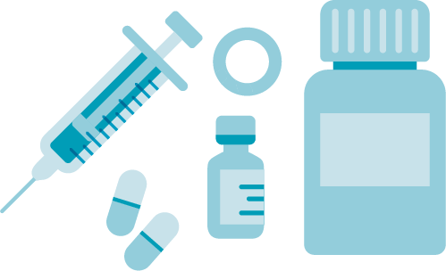
Oral PrEP:
What are our local resources?
Where can we find the local guidelines?
Do any oral PrEP providers have their own factsheets?
Where is oral PrEP available?
Are these locations youth-friendly and stigma-free?
Are there online links to local oral PrEP resources?
Does our organization have an oral PrEP factsheet?
What other resources are there?
Take notes in the “Planning Your Training” worksheet, under Key Element III, question 1
Notes:
ADVANCE PREPARATION:
If you already know that your audience for the TOT does not plan to train on oral PrEP, you can skip this slide.
Facilitator notes:
Ask your audience the question on the slide.
Use the prompts below the question to guide a conversation about what resources are available for your audience to use in their own training.
Encourage them to write down their answers in their “Planning Your Training” worksheet under Key Element III, question 1.

Slide 31
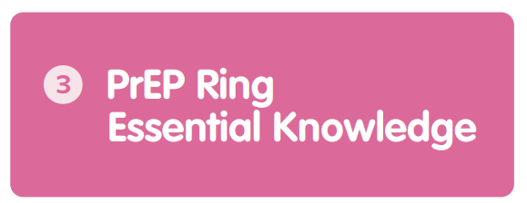
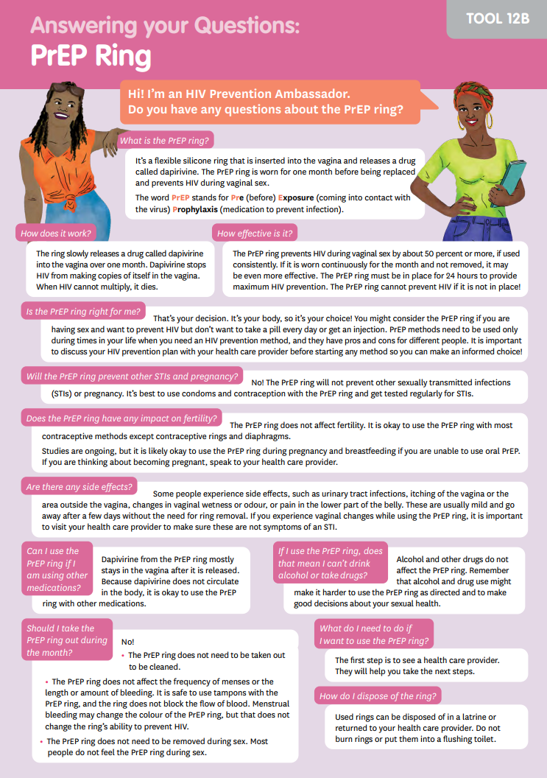
Topics covered:
What is the PrEP ring and who is it for?
How does the PrEP ring work?
What are the side effects of the PrEP ring?
How to insert, remove, and dispose of the PrEP ring
How to get the ring and continue using it
Answers to key questions on the PrEP ring and pregnancy, breastfeeding, contraception, hormones, STIs, and more
How ambassadors can help their peers get and use the PrEP ring
Ambassador Tool
Notes:
Facilitator notes:
Review the slide content.
Highlight the ambassador tool on the right, from the Diverse Version of the training.
Note that the Essential Knowledge contains more detail than is available on this tool, so that facilitators of the training can support ambassadors to fully understand worksheets like this one. The tool will be used during the journey map / PrEP methods sessions activities.

Slide 32

The PrEP ring:
What are our local resources?
Where can we find the local guidelines?
Do any PrEP ring providers have their own factsheets?
Where is the PrEP ring available?
Are these locations youth-friendly and stigma-free?
Are there online links to local PrEP ring resources?
Does our organization have a PrEP ring factsheet?
What other resources are there?
Take notes in the “Planning Your Training” worksheet, under Key Element III, question 1
Notes:
ADVANCE PREPARATION:
If you already know that your audience for the TOT does not plan to train on the PrEP ring, you can skip this slide.
Facilitator notes:
Ask your audience the question on the slide.
Use the prompts below the question to guide a conversation about what resources are available for your audience to use in their own training.
Encourage them to write down their answers in their “Planning Your Training” worksheet under Key Element III, question 1.

Slide 33
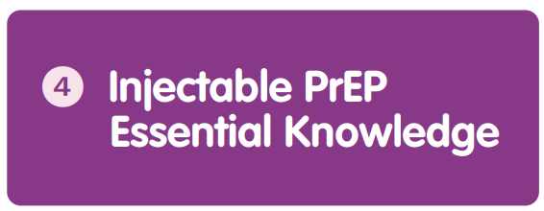
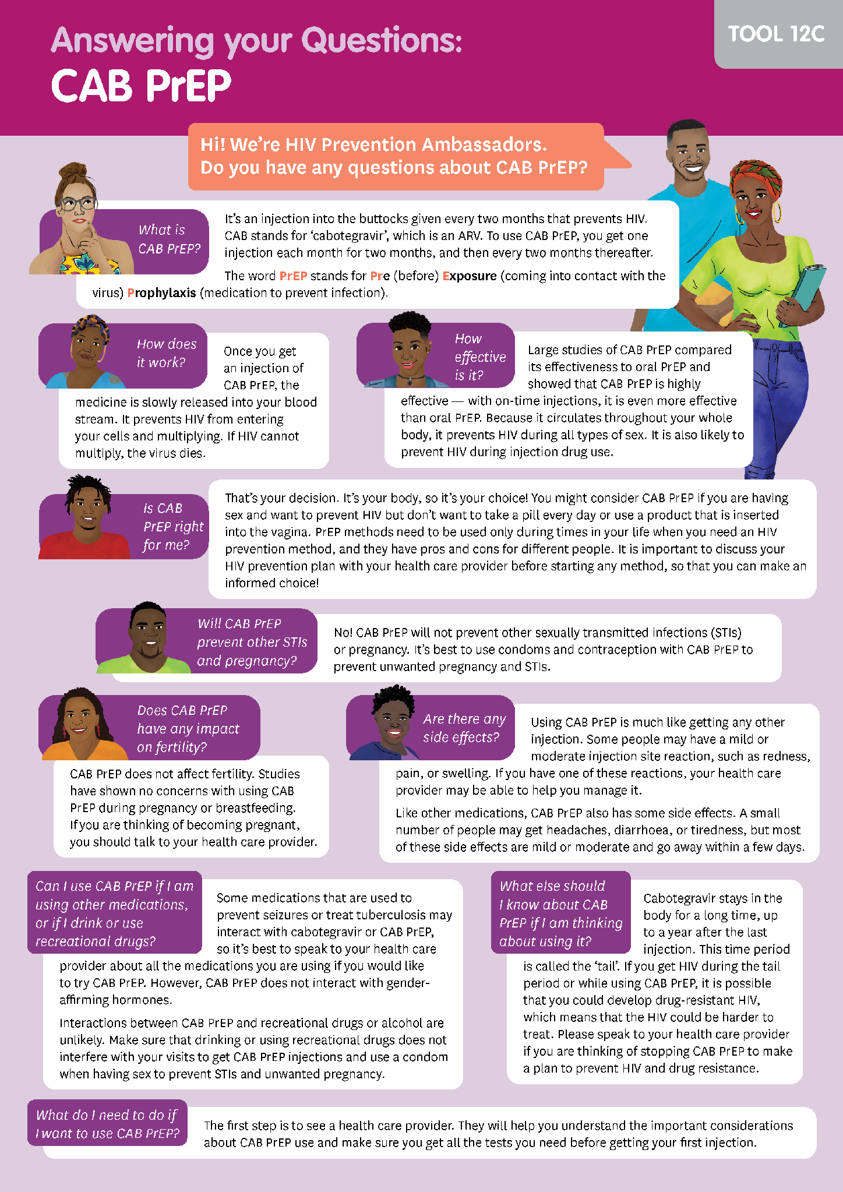
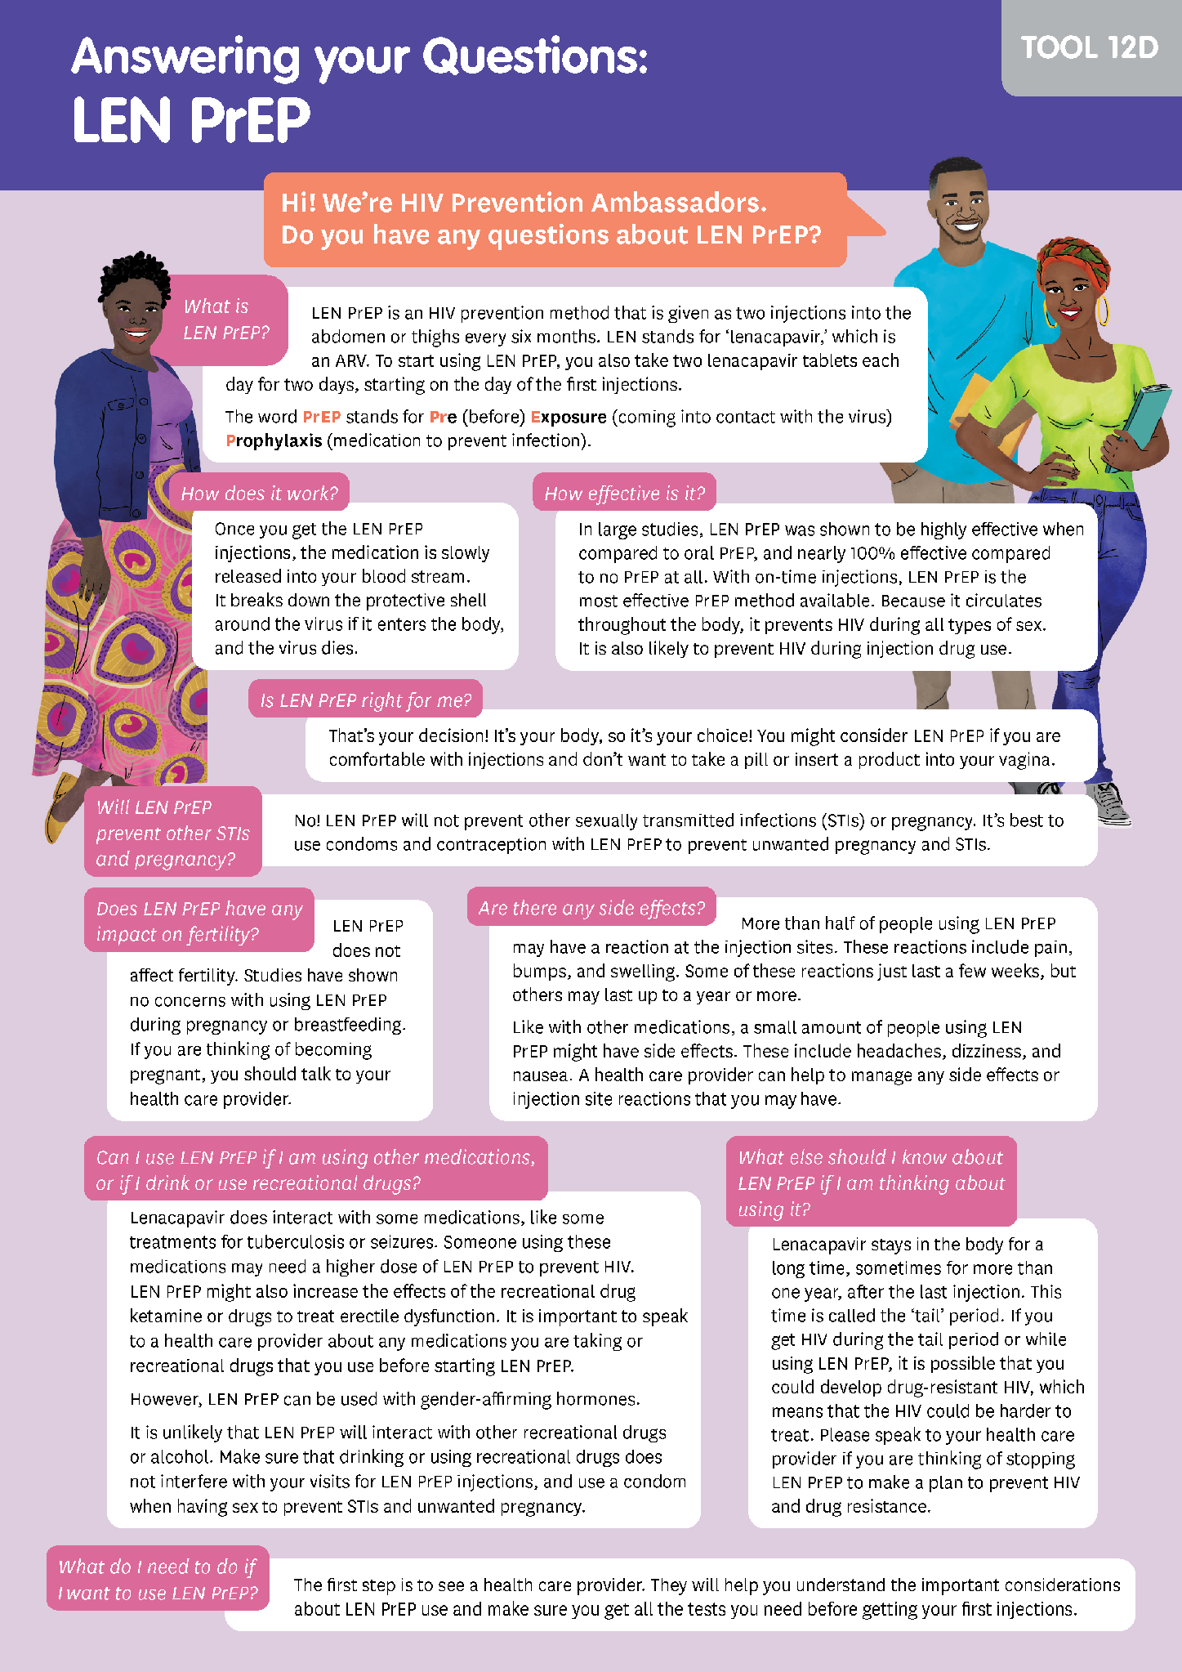
Topics covered:
What is injectable PrEP and who is it for?
Detailed information on injectable cabotegravir and lenacapavir
How does injectable PrEP work?
Injectable PrEP and HIV drug resistance
What are the side effects of injectable PrEP?
How to get injectable PrEP and continue using it
Answers to key questions on injectable PrEP
How ambassadors can help their peers get and use injectable PrEP
Notes:
Facilitator notes:
Review the slide content.
Highlight the ambassador tool on the right, from the Diverse Version of the training.
Note that the Essential Knowledge contains more detail than is available on these tools, so that facilitators of the training can support ambassadors to fully understand worksheets like this one. These tools will be used during the journey map / PrEP methods sessions activities.

Slide 34
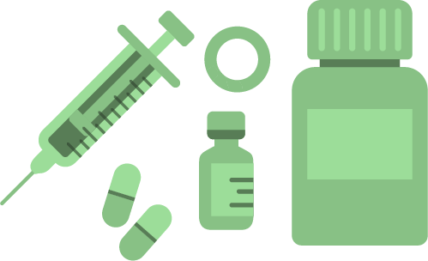
Injectable PrEP:
What are our local resources?
Where can we find the local guidelines?
Do any injectable PrEP providers have their own factsheets?
Where is injectable PrEP available?
Are these locations youth-friendly and stigma-free?
Are there online links to local injectable PrEP resources?
Does our organization have an injectable PrEP factsheet?
What other resources are there?
Take notes in the “Planning Your Training” worksheet, under Key Element III, question 1
Notes:
ADVANCE PREPARATION:
If you already know that your audience for the TOT does not plan to train on CAB or LEN PrEP, you can skip this slide.
Facilitator notes:
Ask your audience the question on the slide.
Use the prompts below the question to guide a conversation about what resources are available for your audience to use in their own training.
Encourage them to write down their answers in their “Planning Your Training” worksheet under Key Element III, question 1.

Slide 35
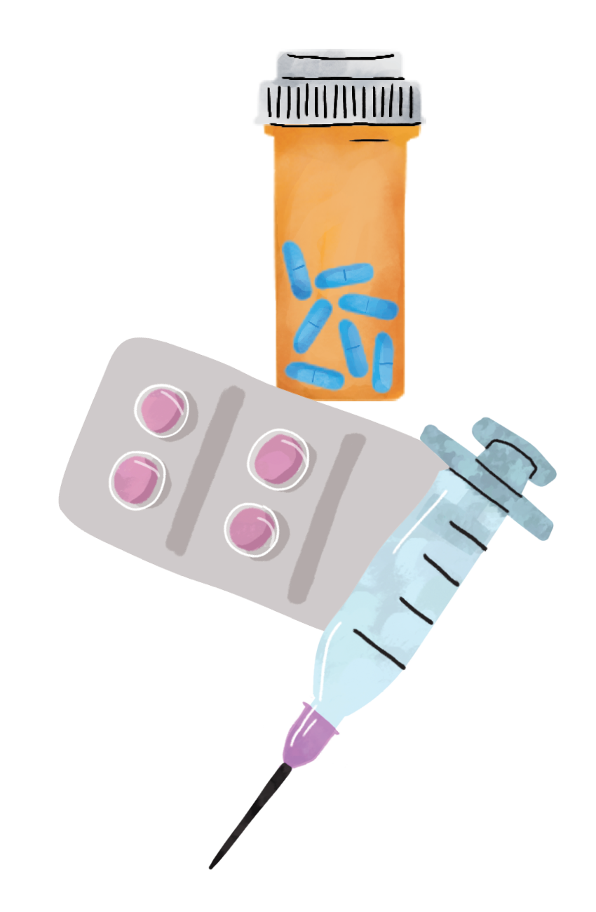
Injectable lenacapavir for HIV prevention:
INTRO
Injectable lenacapavir for HIV prevention – LEN PrEP – is a set of 2 1.5-mL injections given every 6 months to prevent HIV
Highly effective, up to 100% with on-time injections
Shown to be safe for people as young as 16, and for people of all gender identities
Likely to be safe and effective for pregnant and breastfeeding people
Can be used with all forms of contraception, and does not interact significantly with gender-affirming hormones
Training manual pages 129-141 (AGYW Version) and 155-167 (Diverse Version)
Also reference the Ambassador Toolkit!
Notes:
ADVANCE PREPARATION:
The slides on LENACAPAVIR are OPTIONAL. Use them if your audience plans to train on lenacapavir and is looking for a basic sensitization as part of this TOT.
If your audience will train on lenacapavir and work with ambassadors who support people who inject drugs, you can add the below note about injection drugs and lenacapavir: There was limited participation by people who inject drugs in the LEN PrEP clinical trials. However, because LEN PrEP is systemic, meaning that it is carried throughout the body, it is likely to be effective for HIV prevention during injection drug use. Studies of LEN PrEP among people who inject drugs are ongoing, with results anticipated in 2027.
Facilitator notes:
Review the slide contents. Include the slide note on injection drug use and LEN PrEP if relevant.
Ask if there are any questions – but refer your audience to the correct pages within the training manual to try to answer their own questions!

Slide 36
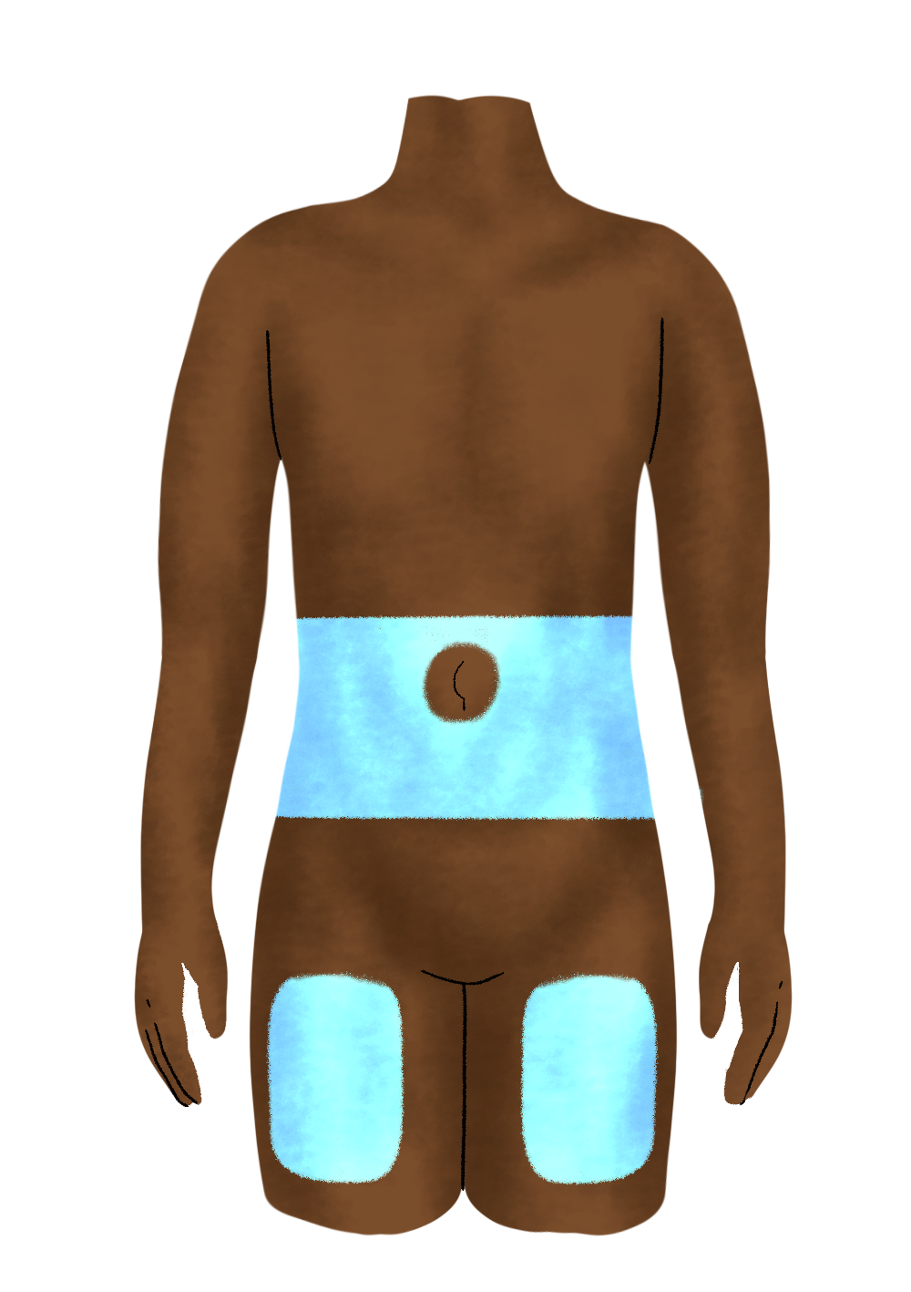
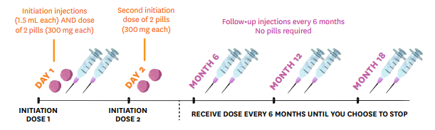
Injectable lenacapavir for HIV prevention:
THE BASICS
The first dose is given along with 2 lenacapavir pills (300mg) and then followed one day later with another dose of 2 more pills. After that, only injections are needed every 6 months – no pills.
Injections can be given in the belly or thigh
Training manual pages 129-141 (AGYW Version) and 155-167 (Diverse Version)
Notes:
ADVANCE PREPARATION:
The slides on LENACAPAVIR are OPTIONAL. Use them if your audience plans to train on lenacapavir and is looking for a basic sensitization as part of this TOT.
Review the slide contents.
Ask if there are any questions – but refer your audience to the correct pages within the training manual to try to answer their own questions!

Slide 37

Injectable lenacapavir for HIV prevention:
SIDE EFFECTS
LEN PrEP may cause injection site reactions, such as:
  Swelling
  Pain
  Thickening skin, or
  Bumps on the skin
Injection site reactions may last several months.
Side effects include headache, dizziness, nausea, diarrhea, and tiredness
Side effects and injection site reactions can be managed with help from a provider.
Training manual pages 129-141 (AGYW Version) and 155-167 (Diverse Version)
Notes:
ADVANCE PREPARATION:
The slides on LENACAPAVIR are OPTIONAL. Use them if your audience plans to train on lenacapavir and is looking for a basic sensitization as part of this TOT.
Facilitator notes:
Review the slide contents.
Ask if there are any questions – but refer your audience to the correct pages within the training manual to try to answer their own questions!

Slide 38
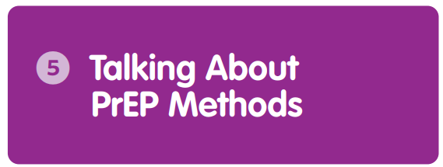
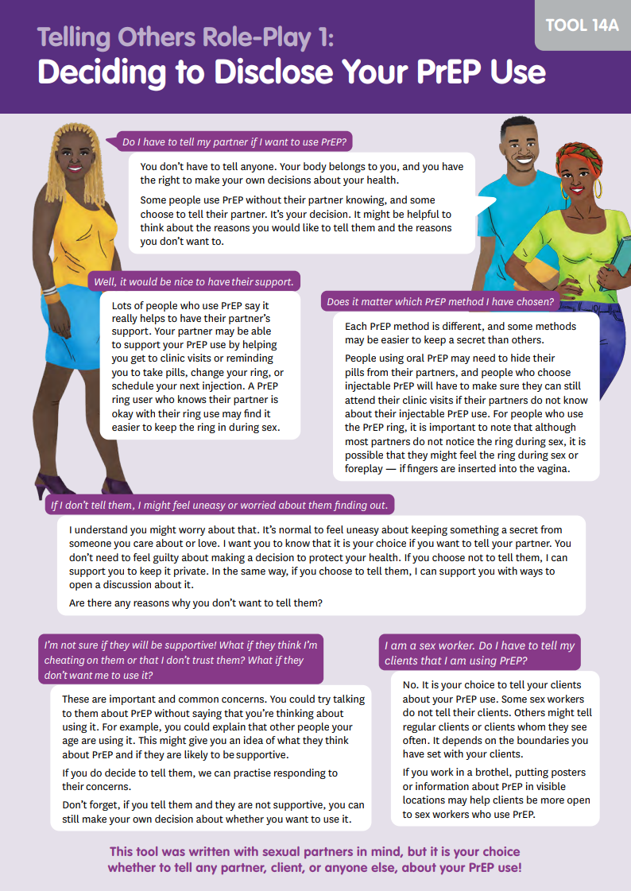
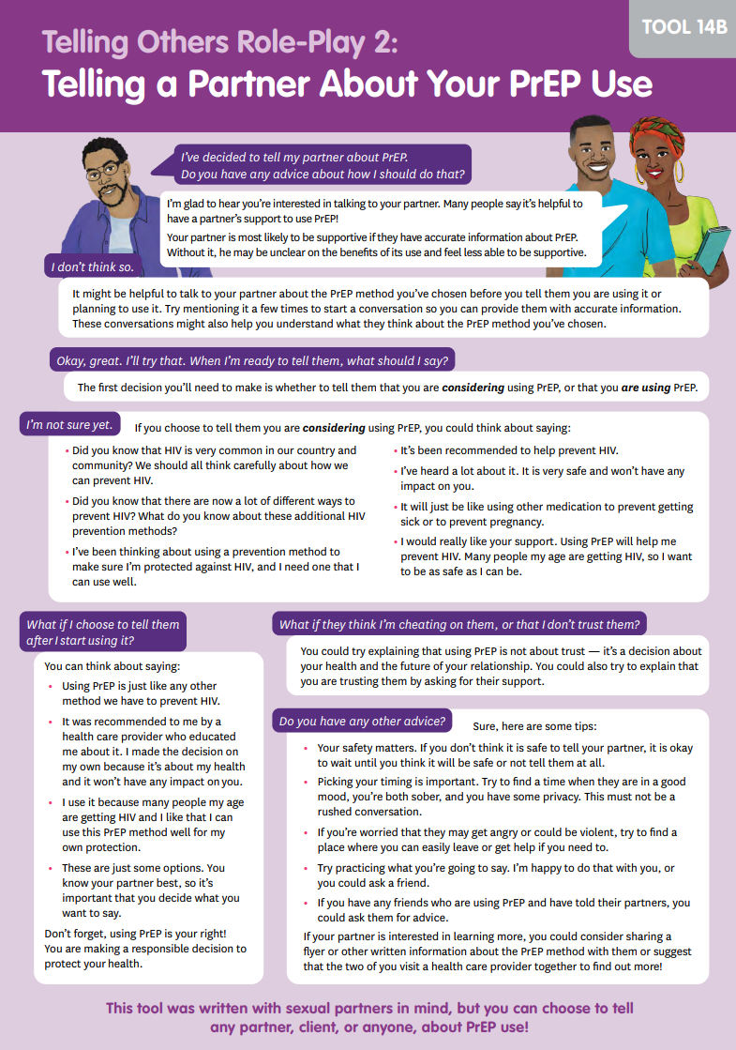
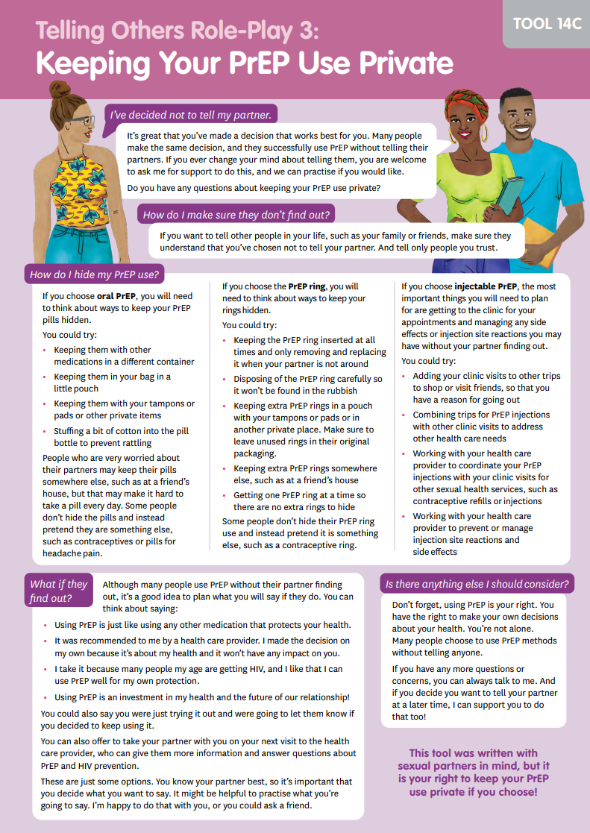
Topics covered:
Helping peers decide whether to tell others that they are using PrEP
Supporting peers to talk to their partners, parents, or other people in their lives about PrEP
Supporting peers to keep their PrEP use private
Awareness raising about PrEP
Advocating and organizing for PrEP in their communities
Ambassador Tools
Notes:
Facilitator notes:
Review the slide content.
Highlight the ambassador tool on the right, from the Diverse Version of the training.
Note that the Essential Knowledge contains more detail than is available on these tools, so that facilitators of the training can support ambassadors to fully understand worksheets like this one. These tools will be used during the journey map / PrEP methods sessions activities.

Slide 39
Group work
Let’s review question 3 under “Key Element II” of our worksheets together.
WHICH PrEP METHODS will we train on?
To answer this question, it may help to think about:
Which PrEP methods do your ambassadors ALREADY know about?
Which PrEP methods are AVAILABLE in your community?
Do your ambassadors need a REFRESHER on any PrEP methods? Do they need to learn UP-TO-DATE SCIENCE about any of available methods?
Feel free to take notes on your worksheet. Also note that the availability of PrEP methods in your context may mean updates are needed to your Ambassador Toolkit. We will discuss this in session 3.
Notes:
Facilitator notes:
Review the slide content.
Guide participants through a conversation where they share responses to these questions.
Encourage participants to take notes, ask questions or make comments as they think through which PrEP methods they will include in their training.

Slide 40

Closing Activity
ROSE
What bloomed in your mind during today’s session?
BUD
What are you looking forward to after today’s session?
THORN
What is feeling challenging or stressful about today’s session?
Notes:
Facilitator notes:
Review the ROSE/BUD/THORN activity.
Encourage participants share their thoughts about each prompt in the chat, or to come off mute and share verbally with each other. The amount of time you spend in discussion will depend upon the time you have remaining for the day.

Slide 41



END OF SESSION 2 – THANK YOU!
See you at DAY / TIME for Session 3!
Notes:
ADVANCED PREPARATION:
Update the date and time for session 3 listed on the slide.
Facilitator notes:
Close out the session for the day.
Remind participants to come to the next session at the determined date and time.

