Slide 1
WELCOME TO THE
HIV PREVENTION AMBASSADOR
TRAINING OF TRAINERS!
We are happy you are here
SESSION 3
Notes:
Facilitator notes:
Ask participants to add to the chat box or share verbally: what has been on their minds since the last session, and/or what they are looking forward to learning more about today.
Share anything in follow-up to the last session, and/or what you are excited to discuss during today’s session.

Slide 2

REMINDER: Our Working Agreements
Recognize that we are all teachers and learners.
Practice active listening and active participation.
Ensure that you minimize distractions. You will get out of the training what you put into it.
Be mindful and respectful of mind, body, spirit, and emotions – for ourselves and others!
Share the responsibility for success.
Remember that all contributions are valuable.
Be supportive of one another.
What else?
Notes:
ADVANCE PREPARATION
Add any additional working agreements decided upon previously
Facilitator notes:
Review the working agreements with participants.

Slide 3
Session 3: Agenda
SESSION 1 | Module | Facilitator(s)
50 MINUTES | PrEP METHODS SESSIONS
10 MINUTES | BREAK
1 HOUR | AMBASSADOR SKILLS
Notes:
Facilitator notes:
Review the day’s agenda for participants

Slide 4


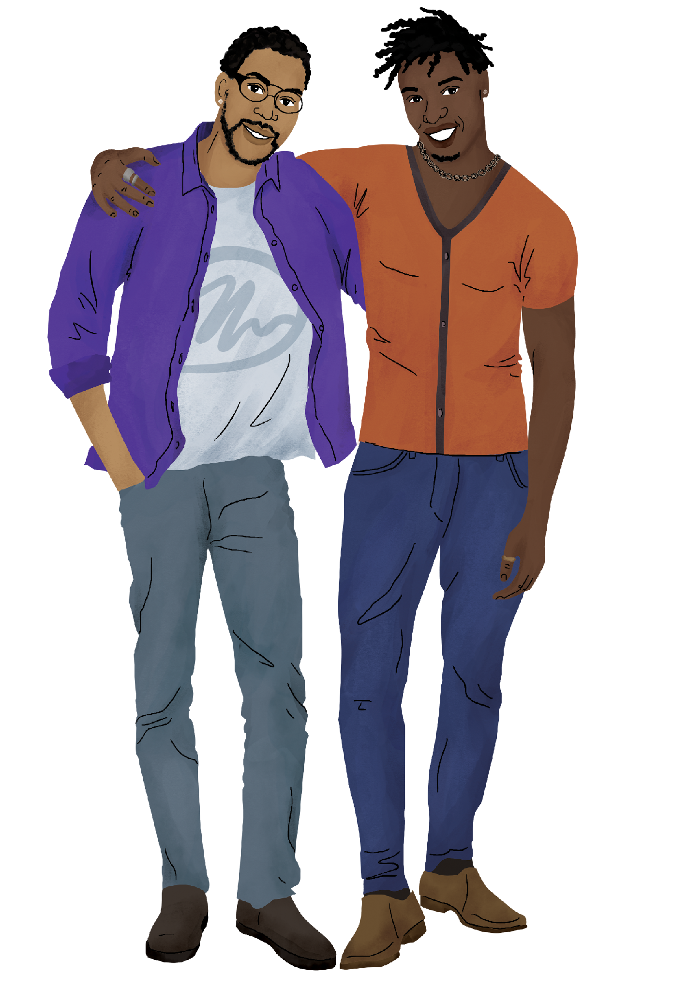



During this session, we will…
Review the PrEP Methods sessions of the HIV Prevention Ambassador Training and the two options for training on multiple methods.
Learn about the Ambassador Skills taught in the training.
Understand the Responding to Disclosures of Violence training session and consider whether it is appropriate for your setting.
Notes:
Facilitator notes:
Review the session objectives for participants.

Slide 5
PrEP METHODS
SESSIONS
Notes:
Facilitator notes:
Introduce the first topic for the session: the PrEP Methods Sessions of the HIV Prevention Ambassador Training

Slide 6
PrEP Methods Sessions
The PrEP Methods Sessions include the activities that ambassadors should complete to learn everything they need to know about each PrEP method and how to support their peers to get and use the methods.
All of the sessions should be done, in order, for ambassadors to be trained on a PrEP method. There are two options for completing the sessions when training on multiple methods, and we will look at these options at the end of this module.
Notes:
Facilitator notes:
Review the slide contents.
Highlight the fact that the PrEP methods SESSIONS are the activities that ambassadors will complete in order to learn about the PrEP methods ESSENTIAL KNOWLEDGE contained in the manual. Trainers should use the manual as a reference – reviewing it before conducting the sessions and referring to it during the sessions, along with the local resources they have sourced to support the training.

Slide 7
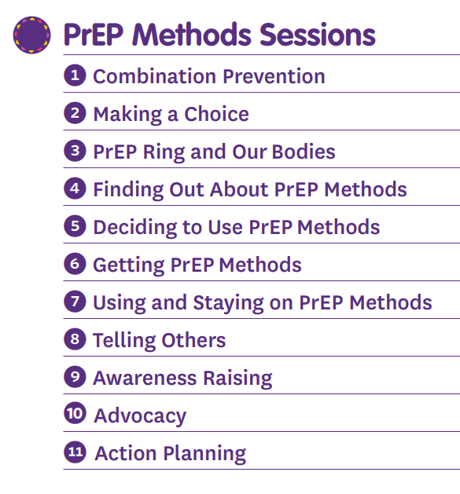
The PrEP Methods Sessions are active and, once participants learn about combination prevention and making a choice*, they take their own character through a series of activities on a journey from learning about PrEP to telling others.
Finally, participants get an opportunity to think about how they might work to make change in their communities to improve PrEP access and sexual and reproductive health for their peers.
*if your training includes the PrEP ring, participants should complete the PrEP Ring and Our Bodies session before beginning the journey map activities
Notes:
Facilitator notes:
Review the slide content.

Slide 8
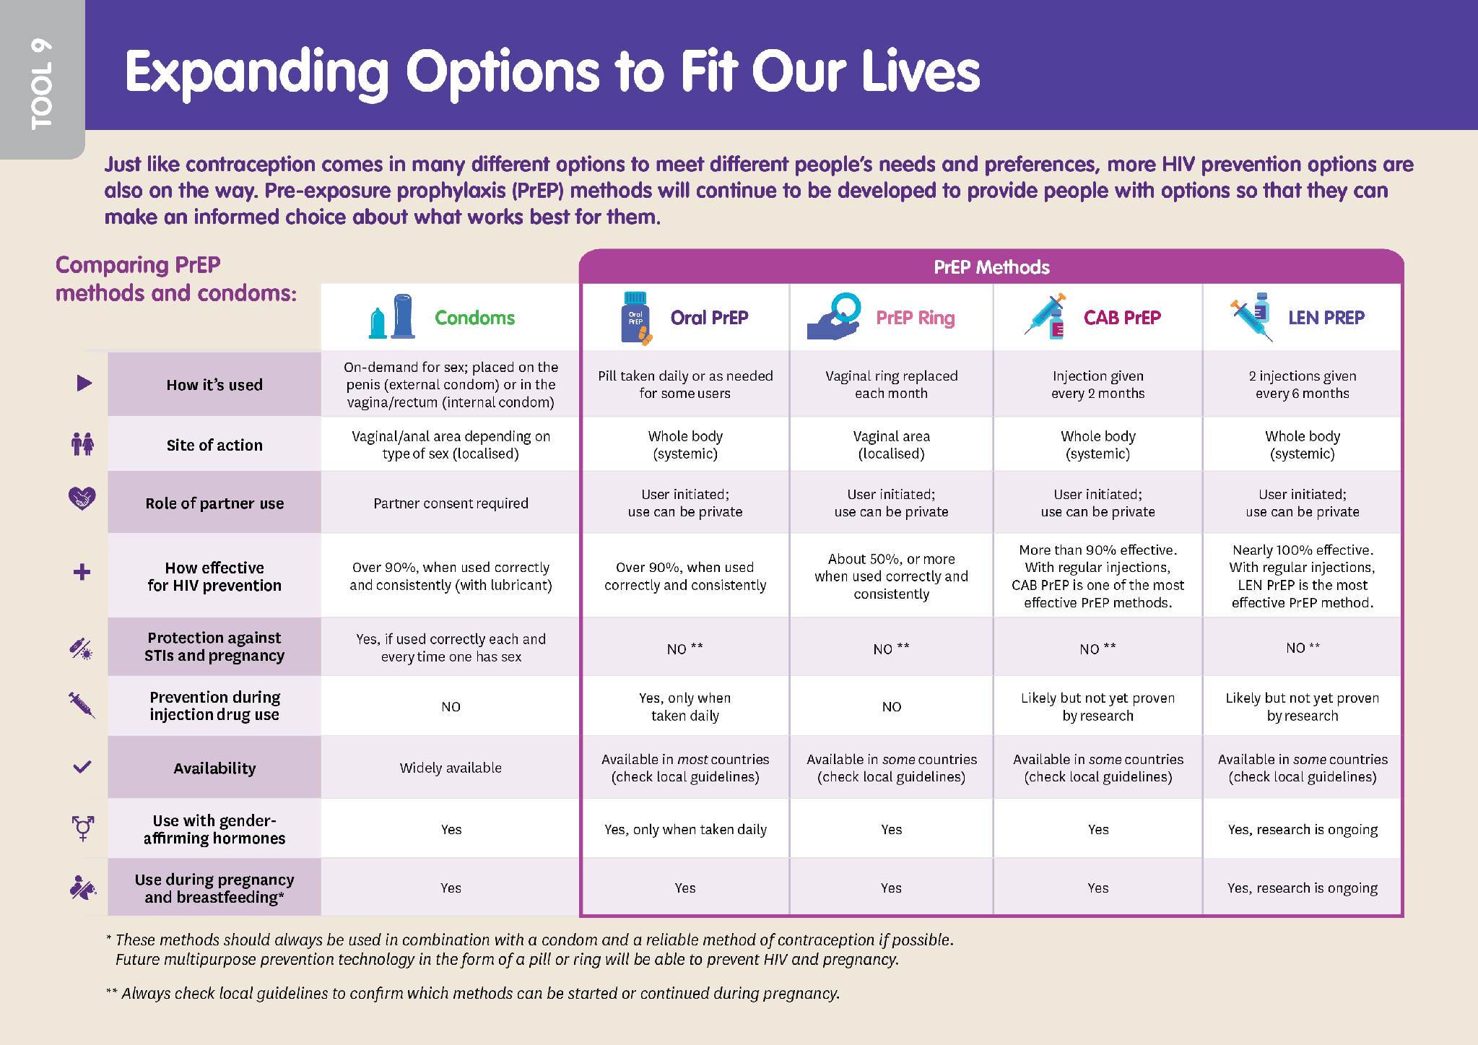
Combination Prevention
Session Goal:
Participants learn about PrEP methods and their role in preventing HIV alongside other HIV prevention methods. They will also practice correcting myths about PrEP.
Session Activities:
Myths & facts activity
Combination prevention competition*
Ambassador Tools & Worksheets:
HIV Transmission & Prevention
Test & Prevent
PrEP, PEP, & ART
Expanding Options to Fit Our Lives
Ambassador Tool
*Note: The Diverse Version includes Event-Driven (ED) PrEP in this activity, but the AGYW Version does not. Both toolkits include the ED-PrEP tool.
Notes:
Facilitator notes:
Review the slide contents.
Guide participants to open up their Ambassador Toolkits so that they can see the tools that support each session.
Highlight that ED-PrEP is explicitly included in the Combination Prevention Session in the Diverse Version, but not the AGYW Version. The ED-PrEP tool is included in both toolkits. Your audience can include this information when thinking of which training is appropriate for their ambassadors.

Slide 9
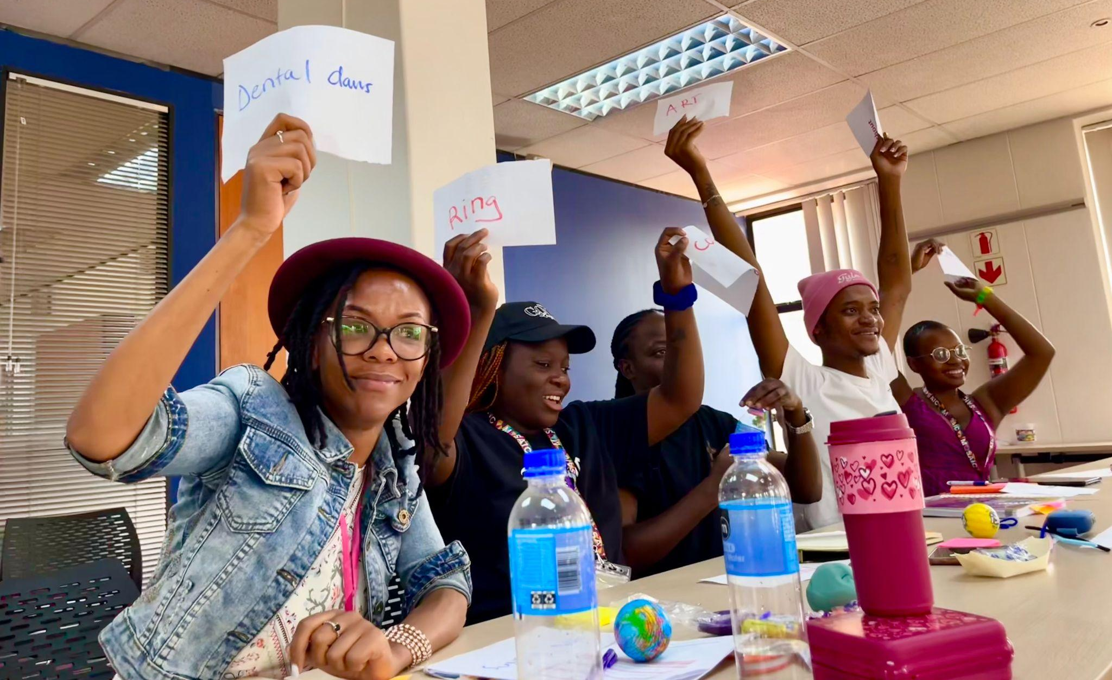
Combination Prevention Competition
Notes:
Facilitator notes:
Share this photo of one team doing their best in the “Combination Prevention Competition”. As the image shows, multiple answers can be correct, and participants get quite excited!

Slide 10
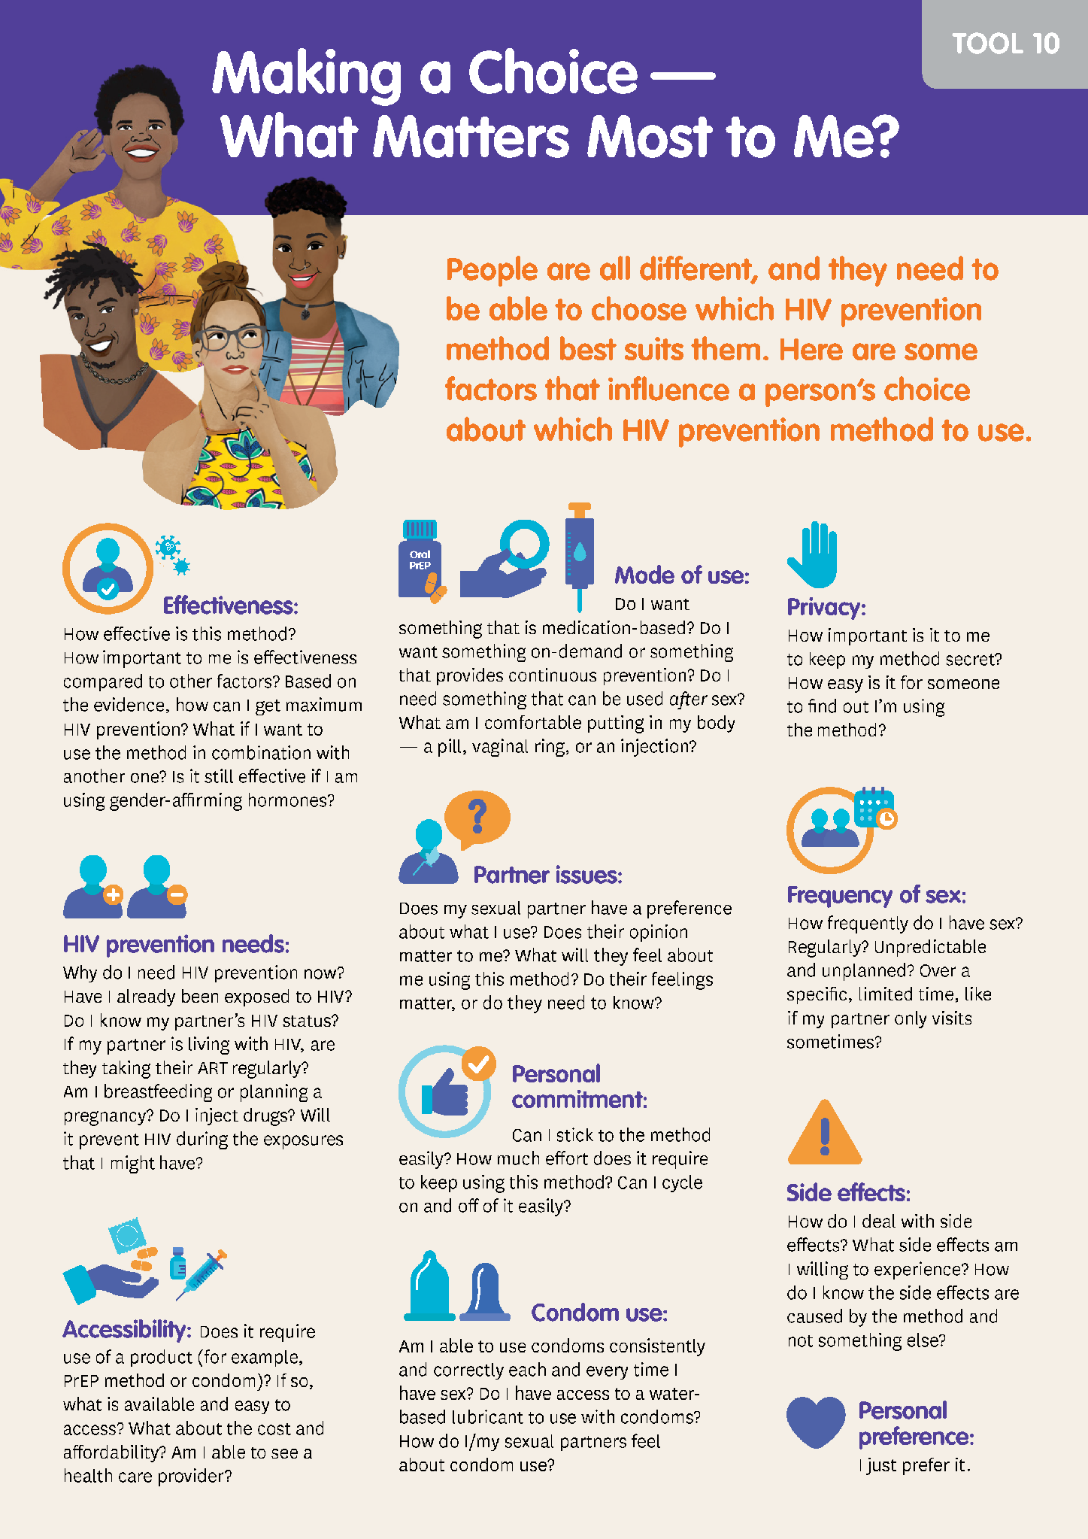
Making a Choice
Session Goal:
Participants learn how they can support their peers to make informed choices about which HIV prevention methods are right for them.
This session can be completed before or after the remaining PrEP methods sessions. If your participants are very new to PrEP, it is a good option to complete this session after the other PrEP sessions.
Session Activities:
Choice game
HIV prevention planning
Character profile creation
Ambassador Tools & Worksheets:
Making a Choice
Character Profile
Ambassador Tool
*Note: If you choose to do the Making a Choice Session after the other PrEP sessions, you will need to complete the character profile activity from this session before starting the journey map activities.
Notes:
Facilitator notes:
Review the slide contents.
Guide participants to turn to find the correct tools within their toolkits.
Highlight the point on the slide about the order of this session. Some new ambassadors may not have enough information about PrEP to feel comfortable with the activities – if your audience will train very new ambassadors who do not already have experience with PrEP, they should consider doing this session after the journey mapping activities. They will need to complete the character profile activity before completing the journey mapping.

Slide 11
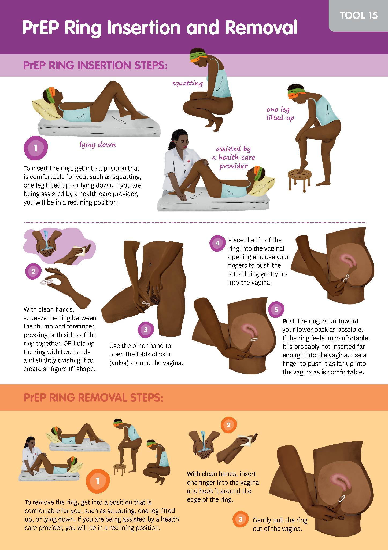
PrEP Ring and the Body
Session Goal:
Participants learn about the PrEP ring and how to insert and remove it. They will also practice explaining how to use the ring and responding to their peers’ concerns about a vaginally inserted device.
Session Activities:
Choice game
HIV prevention planning
Character profile creation
Ambassador Tools & Worksheets:
Answering Your Questions – PrEP Ring
Tips for Using the PrEP Ring
PrEP Ring Insertion & Removal
Ambassador Tool
Notes:
ADVANCE PREPARATION:
If you know your audience will not be training on the PrEP ring, you can simply let them know that they do not need to cover this session with their ambassadors.
Facilitator notes:
Review the slide contents.
Guide participants to turn to find the correct tools within their toolkits.

Slide 12
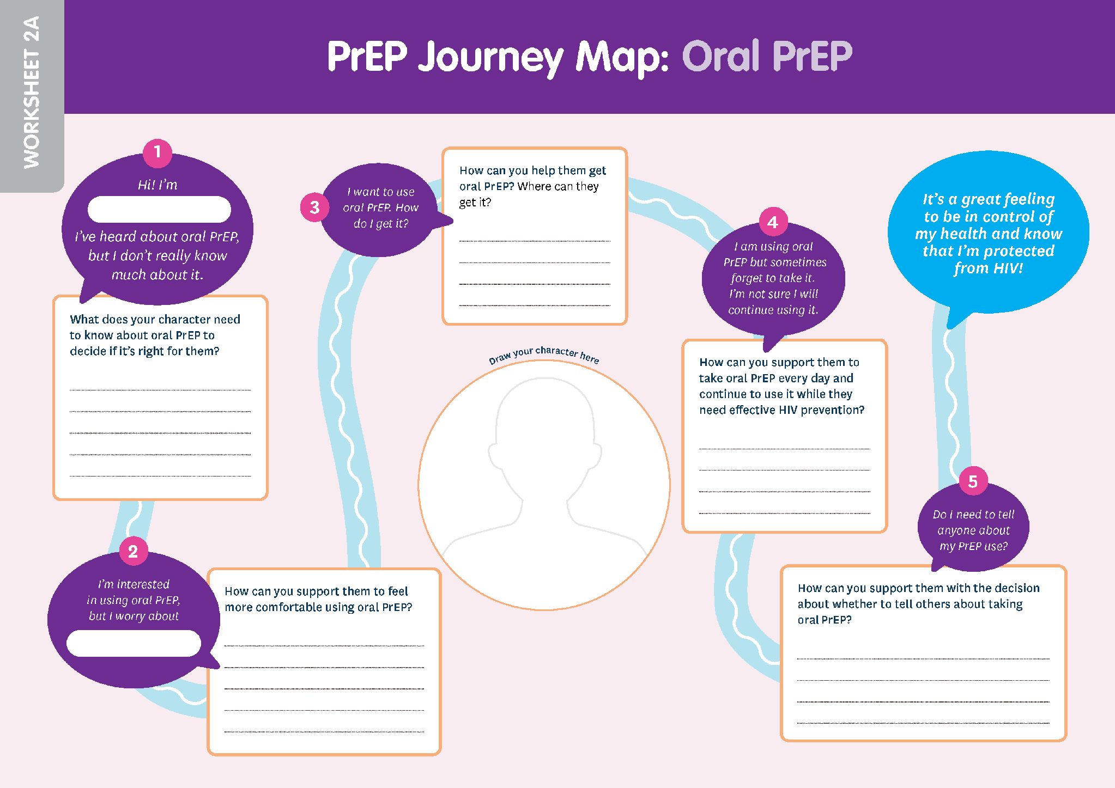
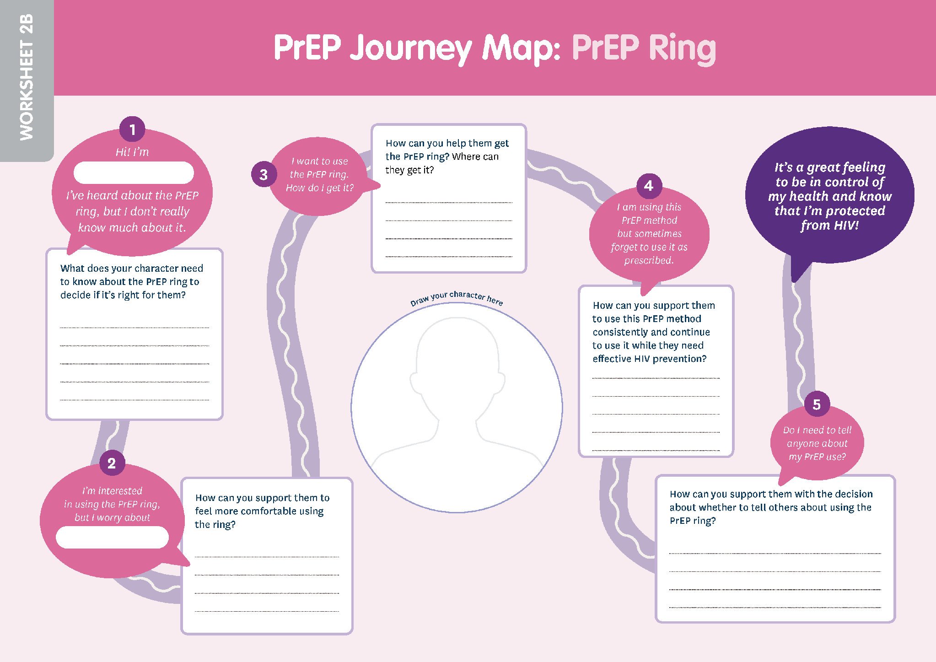
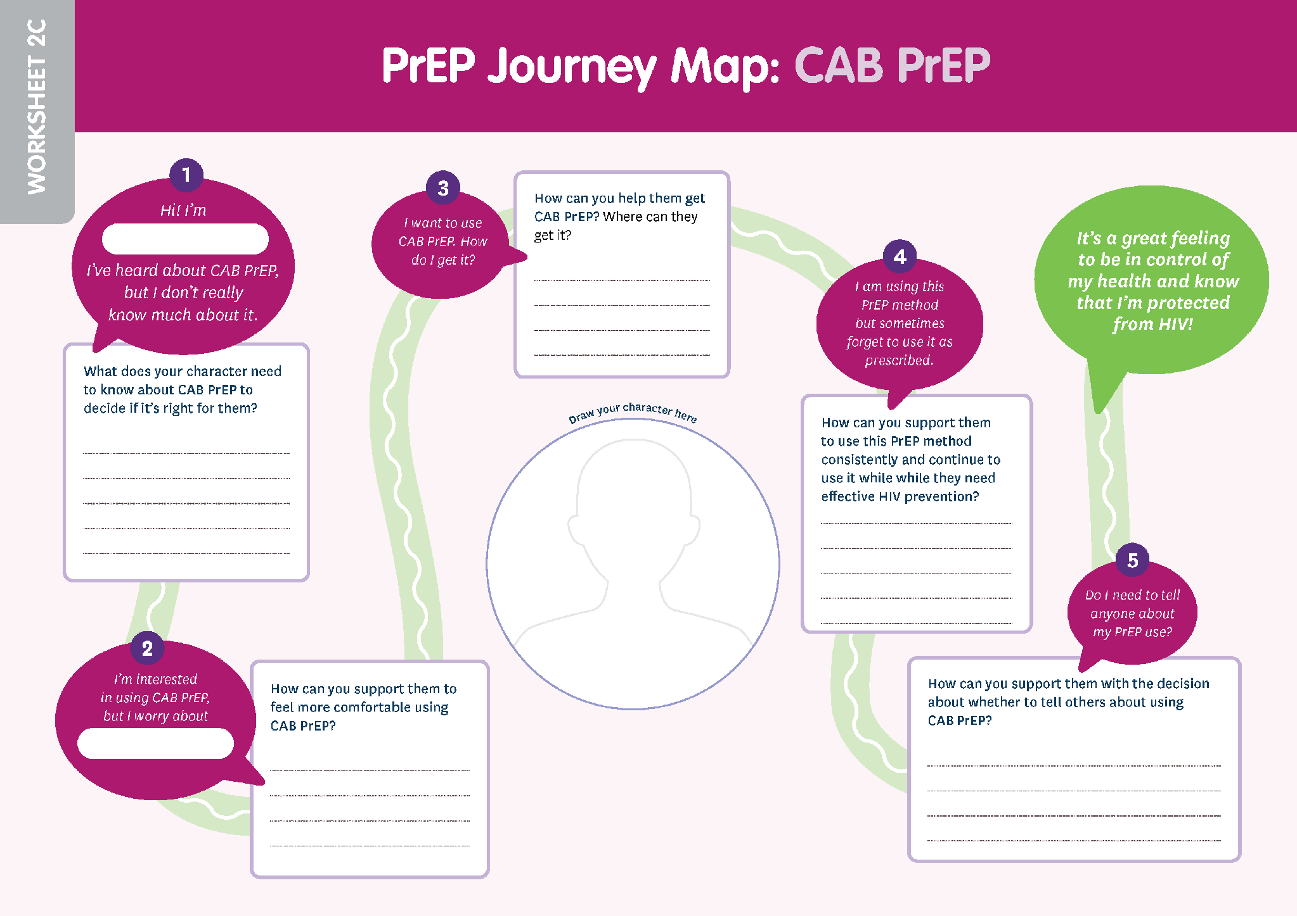
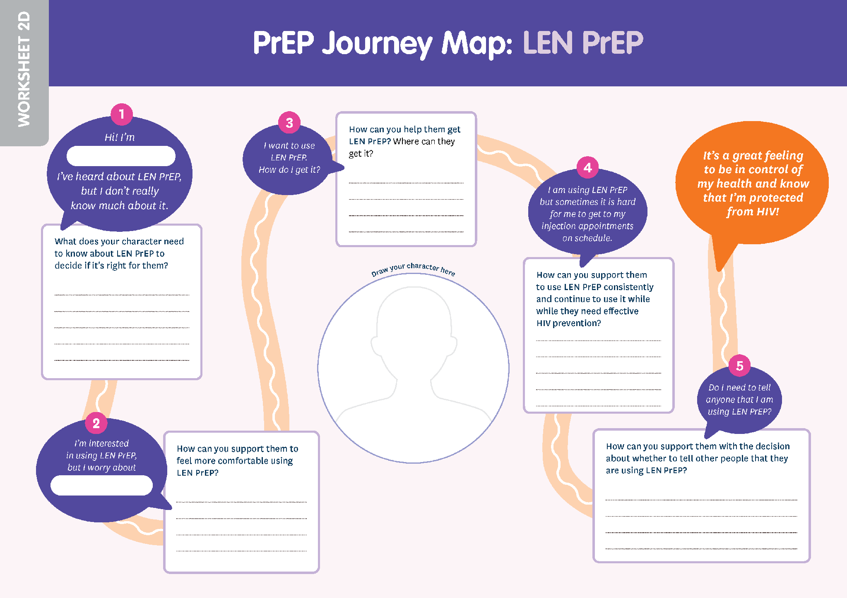
The PrEP Journey Map
The Journey Map Sessions should be completed once for each PrEP method that you are training on.
The full Journey Map activity (steps 1-5) may take 2-4 hours.
Notes:
Facilitator notes:
Review the slide contents.
Guide participants to turn to find the correct tools within their toolkits.

Slide 13
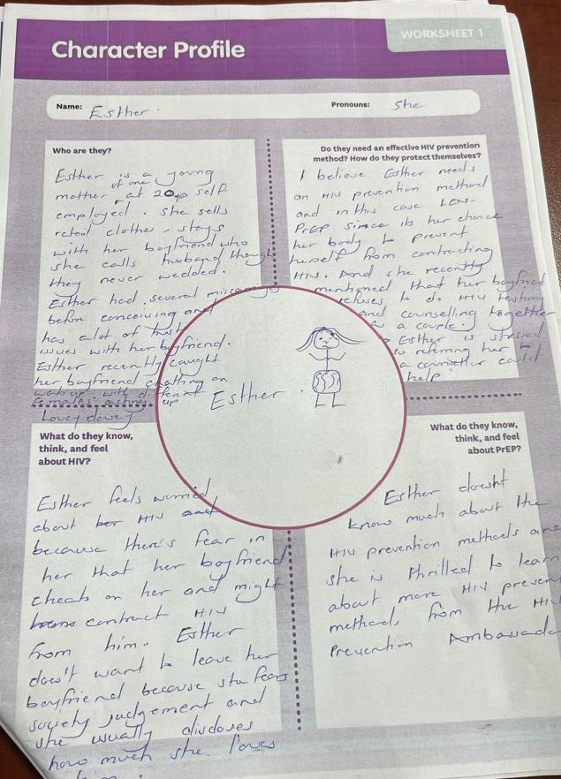
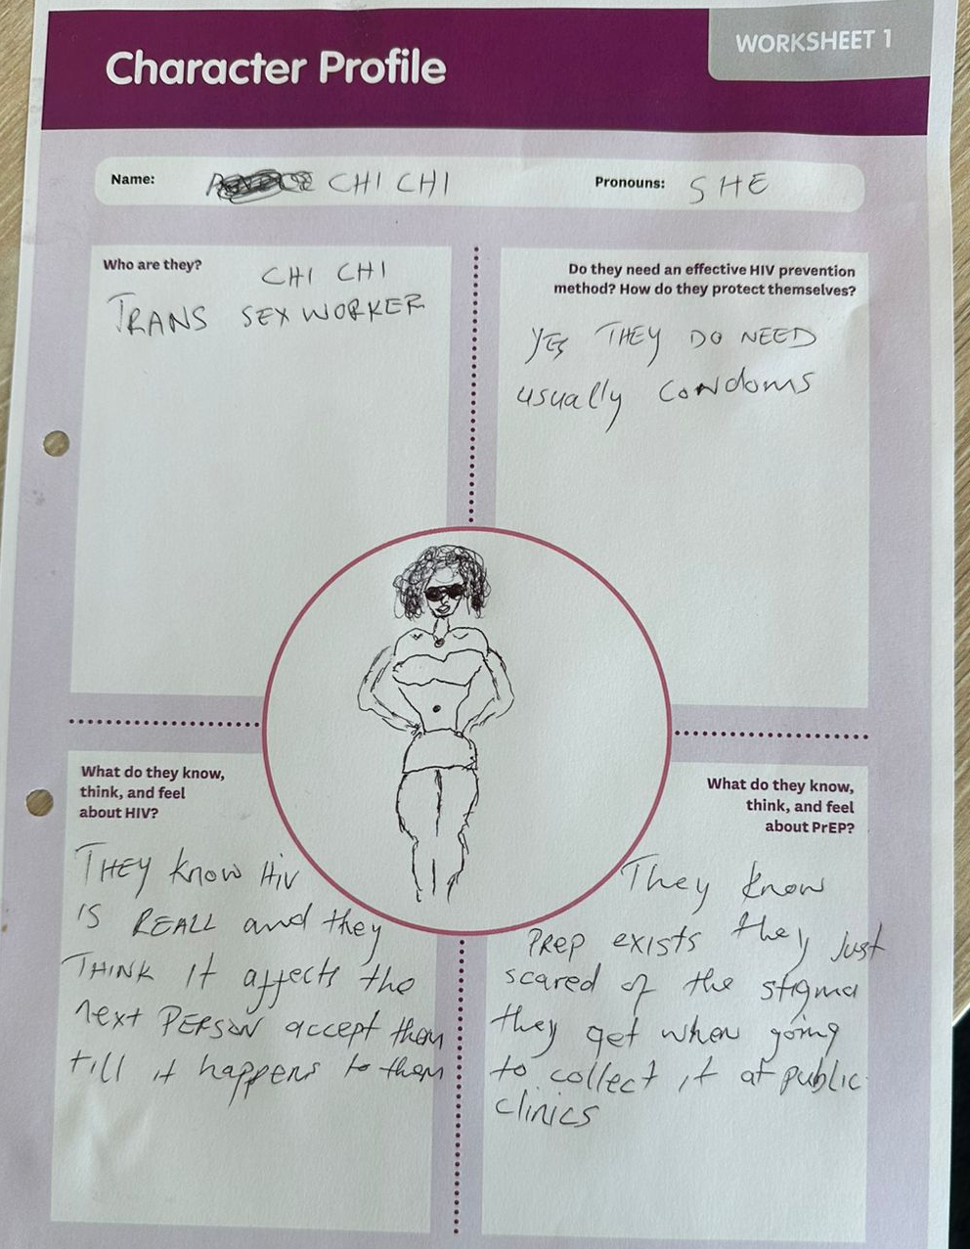
Finding Out About PrEP Methods
PrEP Journey Map Step 1
Session Goal:
Through supporting their character profile, participants learn about the PrEP method and practice explaining how it works. They will also practice communicating key information about the method.
Session Activities:
Journey Map Step 1
Ambassador Tools & Worksheets:
PrEP Journey Map
Notes:
Facilitator notes:
Review the slide contents.

Slide 14
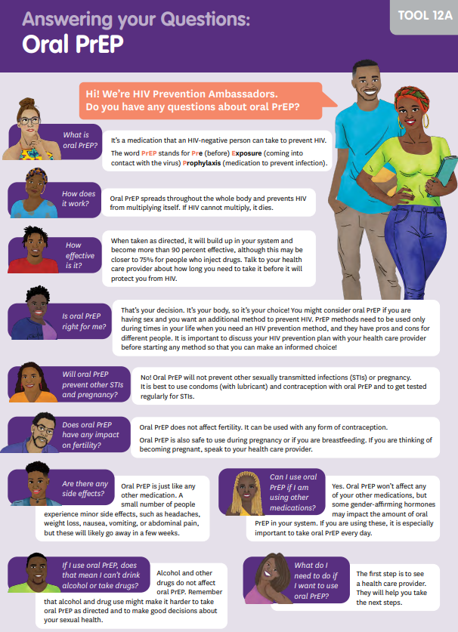
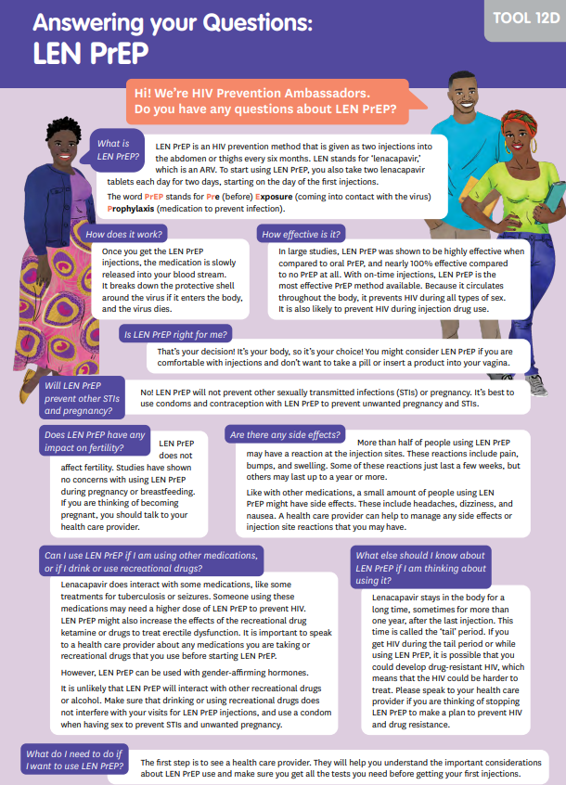
Deciding to Use PrEP Methods
PrEP Journey Map Step 2
Session Goal:
Through supporting their character profile, participants learn to identify and respond to concerns their peers may have about the PrEP method.
Session Activities:
Journey Map Step 2
Ambassador Tools & Worksheets:
PrEP Journey Map
Answering Your Questions tools
Ambassador Tools
Notes:
Facilitator notes:
Review the slide contents.

Slide 15
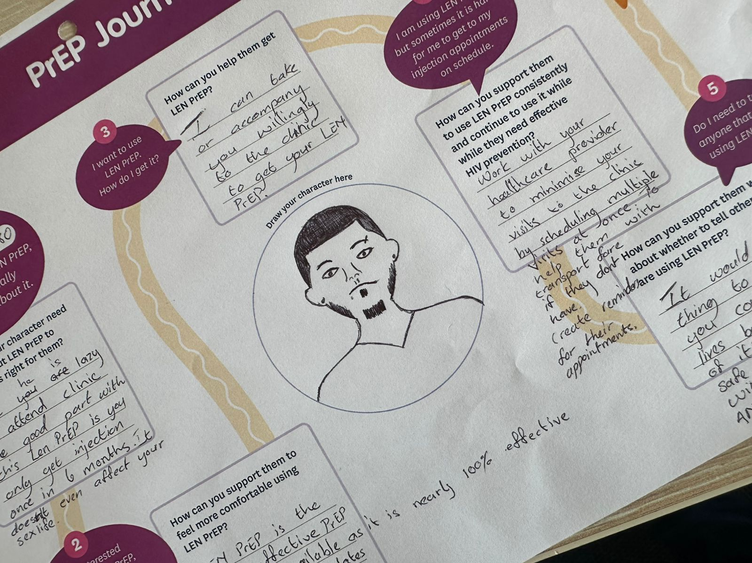
Getting PrEP Methods
PrEP Journey Map Step 3
Session Goal:
Through supporting their character profile, participants learn to identify barriers their peers may face when accessing the PrEP method and create strategies to support their peers to get PrEP.
Session Activities:
Journey Map Step 3
Ambassador Tools & Worksheets:
PrEP Journey Map
Notes:
Facilitator notes:
Review the slide contents.

Slide 16
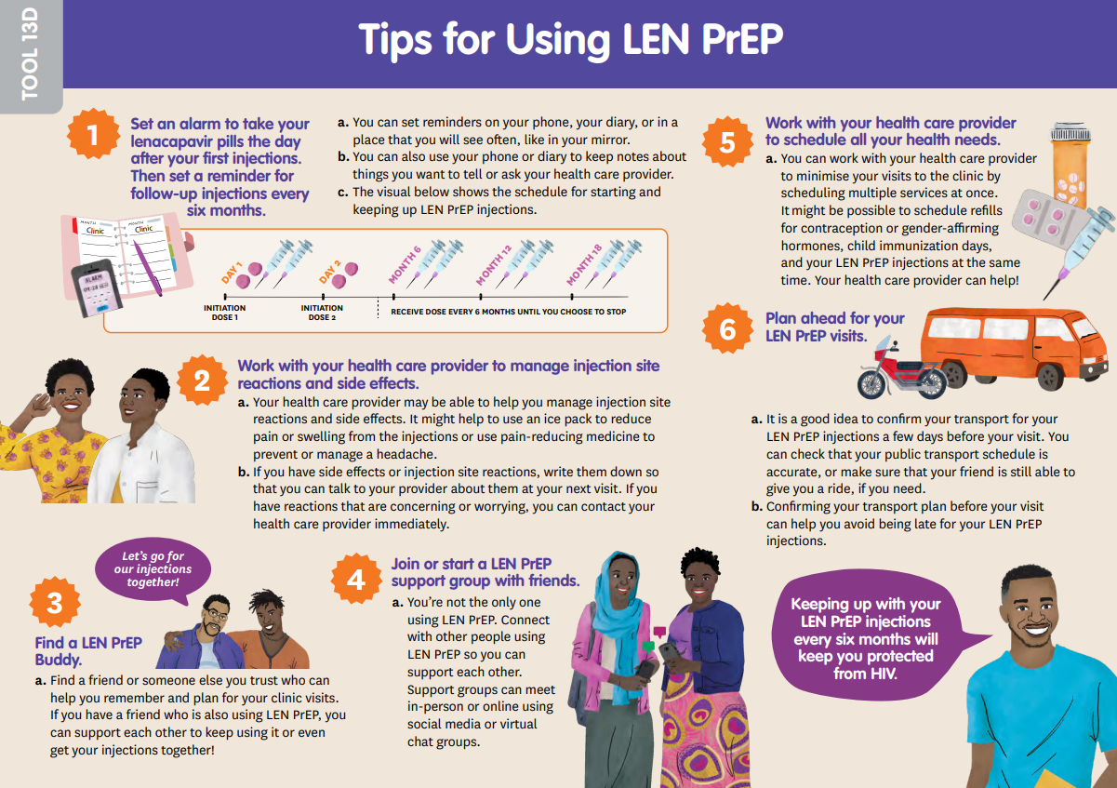
Using and Staying on PrEP Methods
PrEP Journey Map Step 4
Session Goal:
Through supporting their character profile, participants learn about reasons their peers may find it difficult to use a PrEP method consistently and identify strategies to support their peers to keep using their chosen PrEP method.
Session Activities:
Journey Map Step 4
Ambassador Tools & Worksheets:
PrEP Journey Map
Tips for Using PrEP tools
Ambassador Tool
Notes:
Facilitator notes:
Review the slide contents.

Slide 17
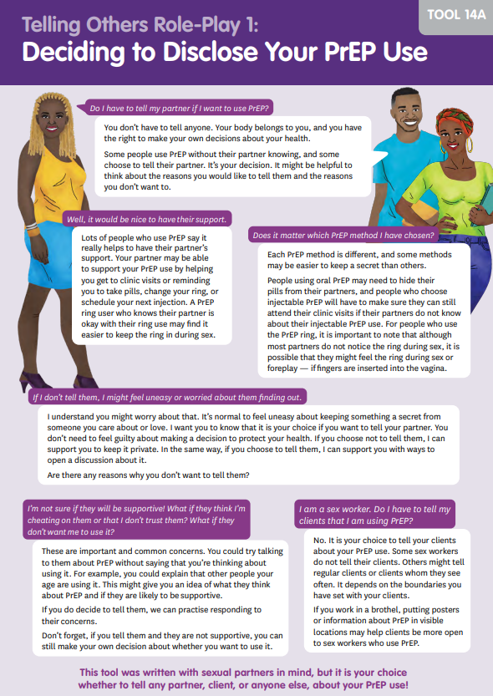
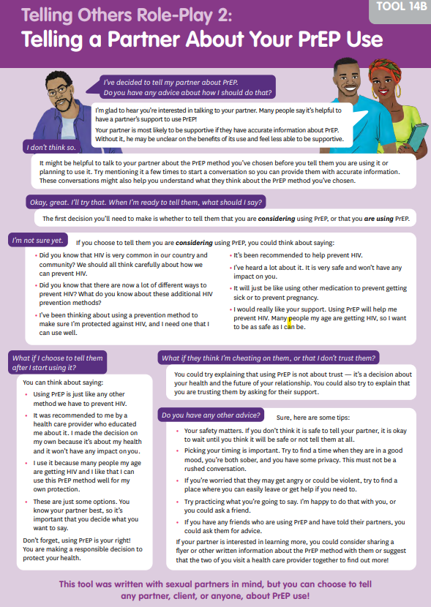
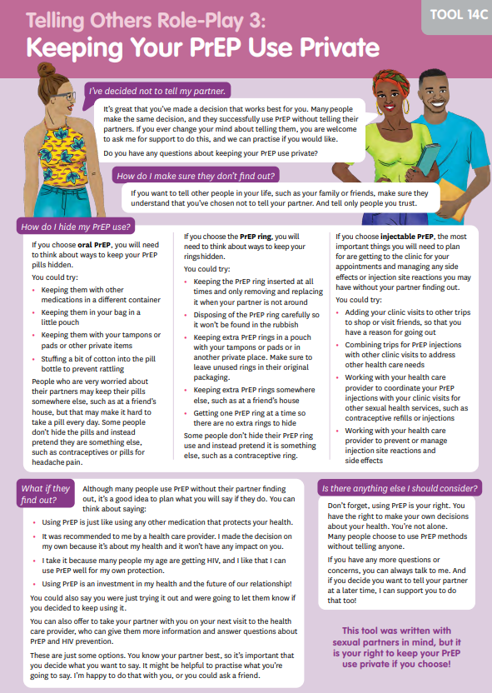
Telling Others
PrEP Journey Map Step 5
Session Goal:
Now that participants have learned about the PrEP method, they explore reasons their peers may or may not want to tell others about their PrEP use. They also practice supporting their peers to make this choice, tell others, or keep their PrEP use private.
Session Activities:
Journey Map Step 5
Ambassador Tools & Worksheets:
PrEP Journey Map
Telling Others Role-Plays
Ambassador Tools
Notes:
Facilitator notes:
Review the slide contents.

Slide 18







The PrEP Journey Map: Option A or B?
If you are training ambassadors on multiple PrEP methods, you have options!
OPTION A
Guide all ambassadors as one group through the journey map for each method, one at a time.
This is likely to take about 3 hours per method. It is a better option if your ambassadors are very new the PrEP methods, and if you have enough time.
OPTION B
Divide ambassadors into groups – one per method that you will train on – and allow each group to complete the journey map for one method. Have participants report back on their learnings to the full group.
This will take about 4 hours. It is a better option if your ambassadors have some experience with PrEP, and if you have enough facilitators to support them.
Notes:
Facilitator notes:
Review the slide contents. A key message is that completing the journey map with a single method from start to finish takes about 3 hours. HPAT facilitators can decide how they would like to complete the journey map with their ambassadors based on ambassador experience, refresher needs, the PrEP methods they will train on, and how much time they have available to them.
Allow the audience to ask questions. It is also possible to combine these approaches. For example, the group could do a refresher on oral PrEP and the ring using option B, and then come

Slide 19
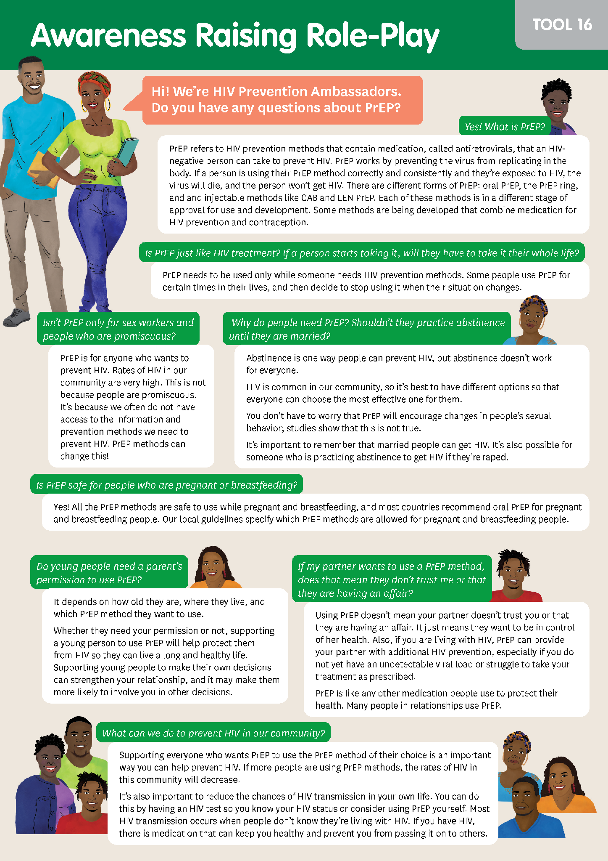
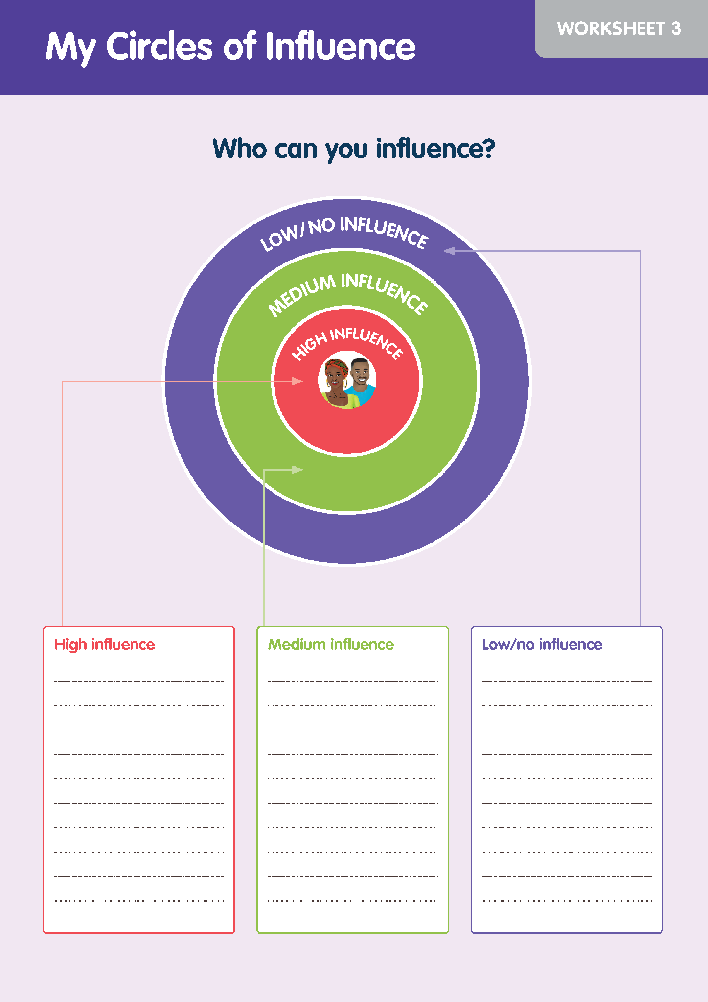
Awareness Raising
Session Goal:
Participants learn ways to build support for PrEP use in their communities. They will explore where they have the most influence, and practice responding to concerns about PrEP from community members.
Session Activities:
Circles of influence activity
Awareness raising role-play
Ambassador Tools & Worksheets:
Circles of Influence
Awareness Raising Role-Play
Ambassador Worksheets
Notes:
Facilitator notes:
Review the slide contents.

Slide 20
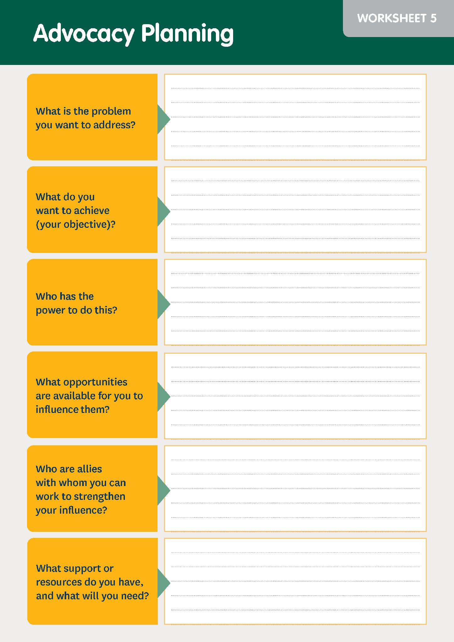
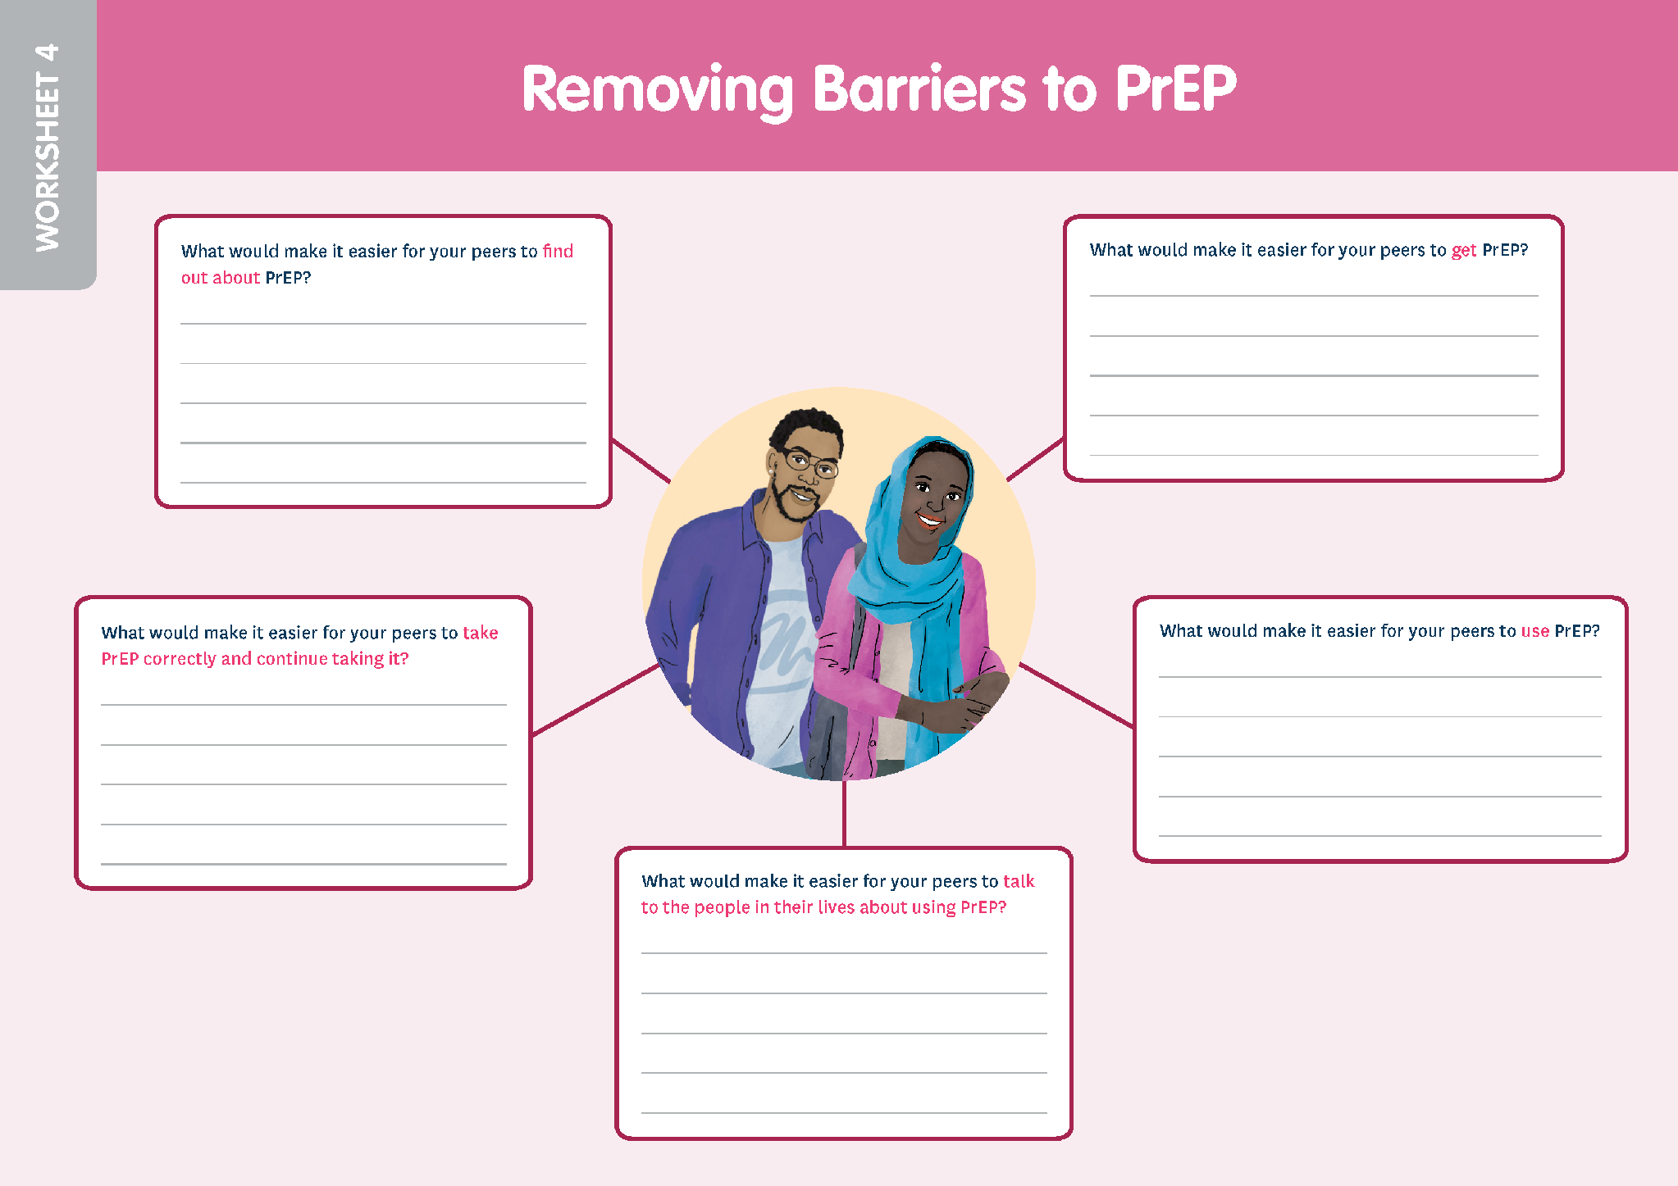
Advocacy
Session Goal:
Participants explore how their peers’ environment can influence their ability to use PrEP. They will also learn to plan an advocacy strategy to remove barriers to PrEP for their peers.
Session Activities:
Removing barriers
Planning for advocacy
Ambassador Tools & Worksheets:
Removing Barriers to PrEP
Advocacy Planning
The Advocacy and Action Planning Sessions may reveal useful information about how an ambassador program can support ambassadors to do their work. Be sure to take note of what your participants say!
Ambassador Worksheets
Notes:
Facilitator notes:
Review the slide contents.

Slide 21
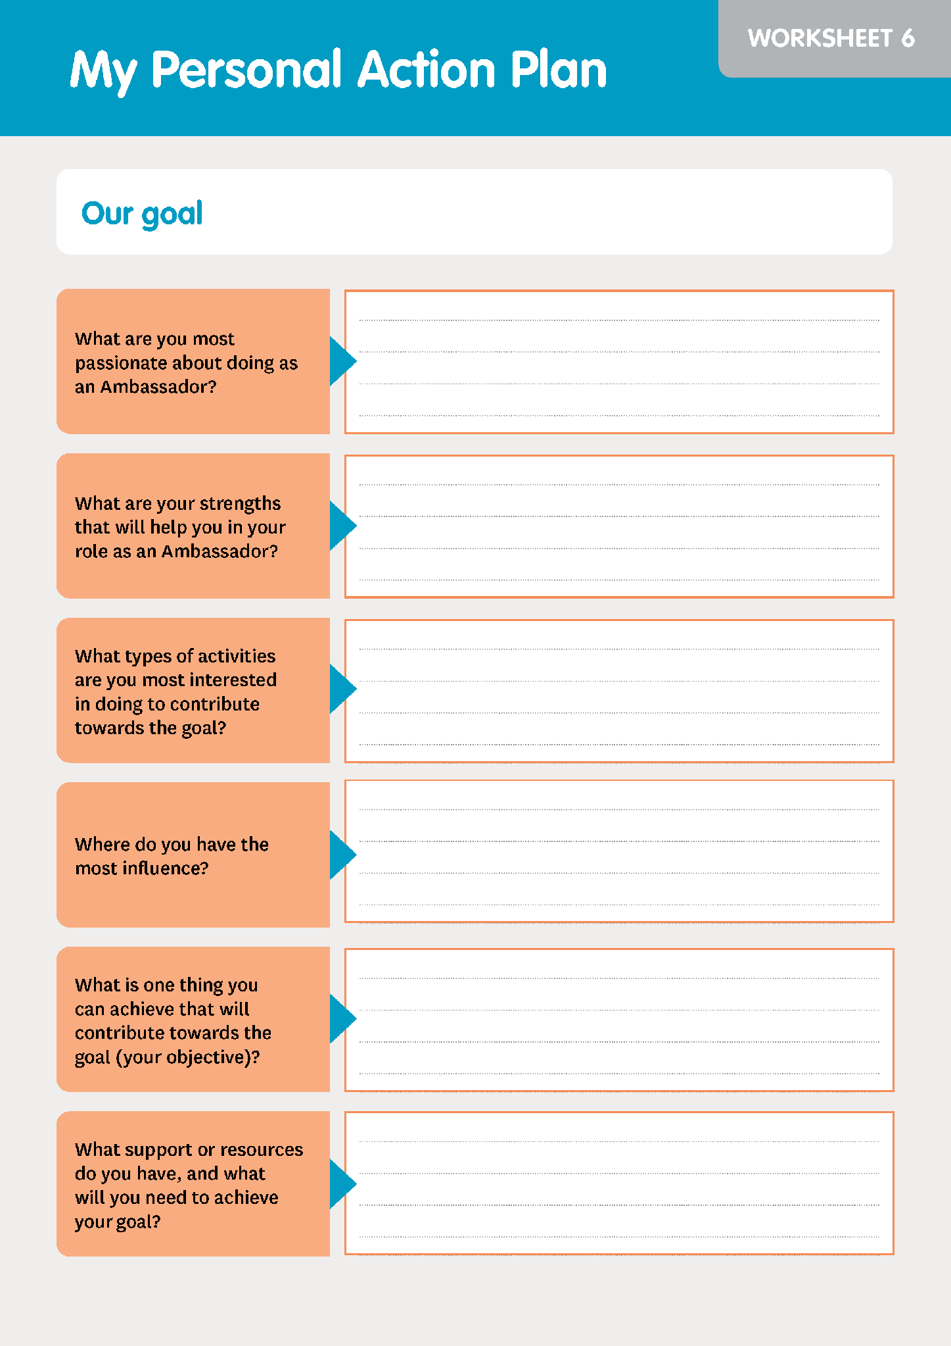
Action Planning
Session Goal:
Participants create a vision for their community and develop a shared goal together. Then they will explore how each ambassador can contribute toward achieving the goal and consider how they can support each other.
Session Activities:
Ideal community activity
Creating an action plan
Ambassador Tools & Worksheets:
My Personal Action Plan
With agreement from your ambassadors, you can use their action plans to inform your goals as a program or organization. If ambassadors agree, action plans can also serve as a tool to evaluate their progress.
Ambassador Worksheet
Notes:
Facilitator notes:
Review the slide contents.

Slide 22
Group work
Let’s review questions 4 under “Key Element II” of our worksheets together.
Will we use OPTION A or OPTION B for the journey mapping sessions?
Feel free to take notes on your worksheet. You will be able to update your answers as we go through our sessions.
Notes:
Facilitator notes:
Review the slide content.
Guide participants through a conversation where they share their responses to this question.
Encourage participants take notes, ask questions or make comments as they think through question 4 of Key Element II.

Slide 23
BREAK
See you in 10 minutes!
Notes:
Facilitator notes:
Give the participants a 10-minute break. Make sure to let them know the time they should be back before letting them step away.

Slide 24
AMBASSADOR SKILLS
Notes:
Facilitator notes:
Introduce the second module for the day

Slide 25

What’s in the Ambassador Skills Sessions?
The Ambassador Skills Sessions support ambassadors to understand and practice the skills they need to support their peers.
Boundary Setting & Self-Care
Responding to Disclosures of Violence*
Peer Support Skills
Healthy Relationships & Supportive Partners
We recommend including these sessions unless the ambassadors are experienced with peer support. They can also serve as a good skills refresher!
*There are additional considerations for the Responding to Disclosures of Violence Session. We will discuss these when we get to this session.
Notes:
Facilitator notes:
Review the slide content.
Let participants know that you will discuss the additional considerations for the Disclosures of Violence Session when we discuss that session.
Highlight the point that, even if ambassadors do have experience with peer support, we have gotten a lot of feedback from ambassadors that these sessions share new information and skills and serve as a useful refresher for ambassadors.

Slide 26
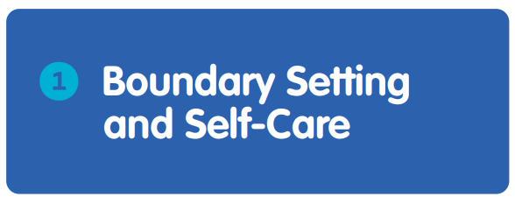

If you only do one Ambassador Skills Session, make it this one!
- Workshop participant
Session Goal:
Participants explore the impact that peer support work can have on their mental health and well-being. They learn about key concepts of compassion fatigue and vicarious trauma. They also learn how to set boundaries, understand their warning signs, and identify strategies for self-care and mutual support.
Notes:
Facilitator notes:
Review the slide content.

Slide 27
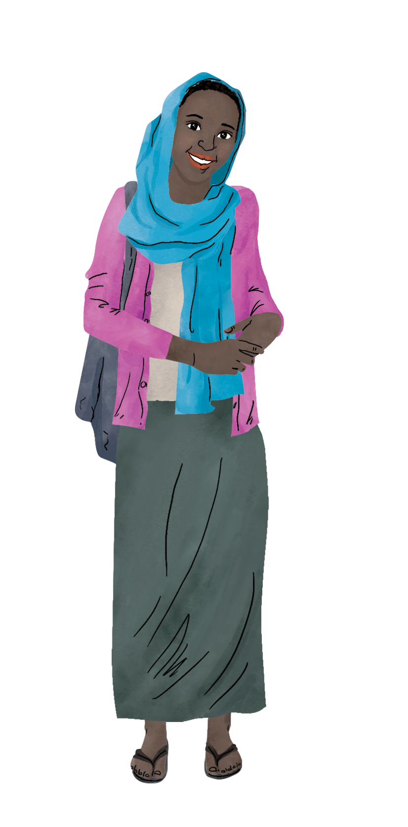
Boundary Setting Activity: It’s OK with me…
Imagine that you are an ambassador…
A peer wants to use PrEP but is worried about keeping it at her house. She asks if she can store her pills at your house.
Notes:
Facilitator notes:
Explain that you will now take your audience through a sample activity from the Boundary Setting and Self-Care Session.
Ask your audience to put themselves in the shoes of an ambassador.
Review the statement on the slide.
Give participants a few moments to think through whether this would be ok with them ALWAYS, NEVER, or SOMETIMES.

Slide 28

Discussion
A peer wants to use PrEP but is worried about keeping it at her house. She asks if she can store her pills at your house.
It’s OK with me…
ALWAYS
SOMETIMES
NEVER
Notes:
Facilitator notes:
Ask your audience to either come of mute or share in the chat whether this would be ok with them ALWAYS, NEVER, or SOMETIMES.
Encourage people who share their thoughts to also share why they came to the conclusion.
Support your audience to discuss their boundaries around this situation.
Wrap up the discussion by reinforcing that everyone has their own unique boundaries. The important piece is to understand what our boundaries are and to uphold them in our work.

Slide 29
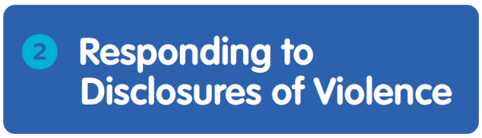
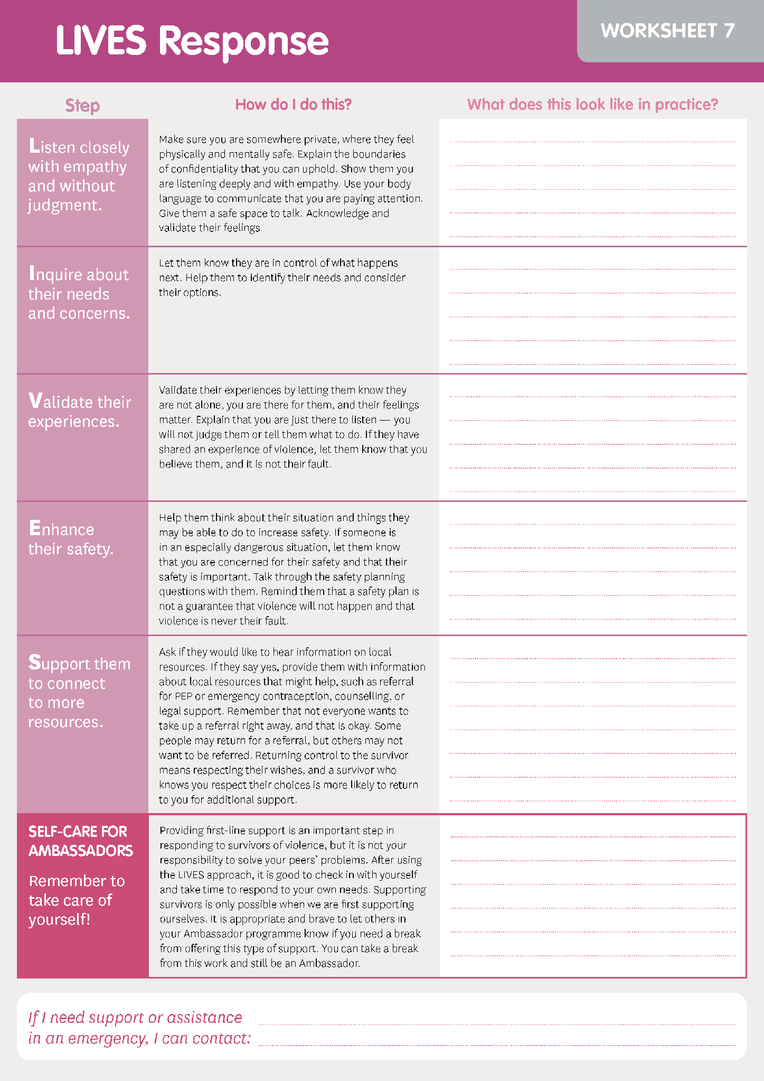
Session Goal:
Participants examine messaging about gender-based violence (GBV) and how to question messaging that excuses or justifies GBV. learn how to respond to their peers’ disclosures of violence using the LIVES method.
In this session, ambassadors complete small group activities to practice each step of the LIVES method. Because this can be an emotional topic, there are several breaks in the session.
This session may take up to 3 hours and should be done at the end of the day so that ambassadors can decompress after. It is not required, and important general skills covered in this session are also covered in the Peer Support Session.
Ambassador Worksheet
Notes:
Facilitator notes:
Review the slide content.

Slide 30
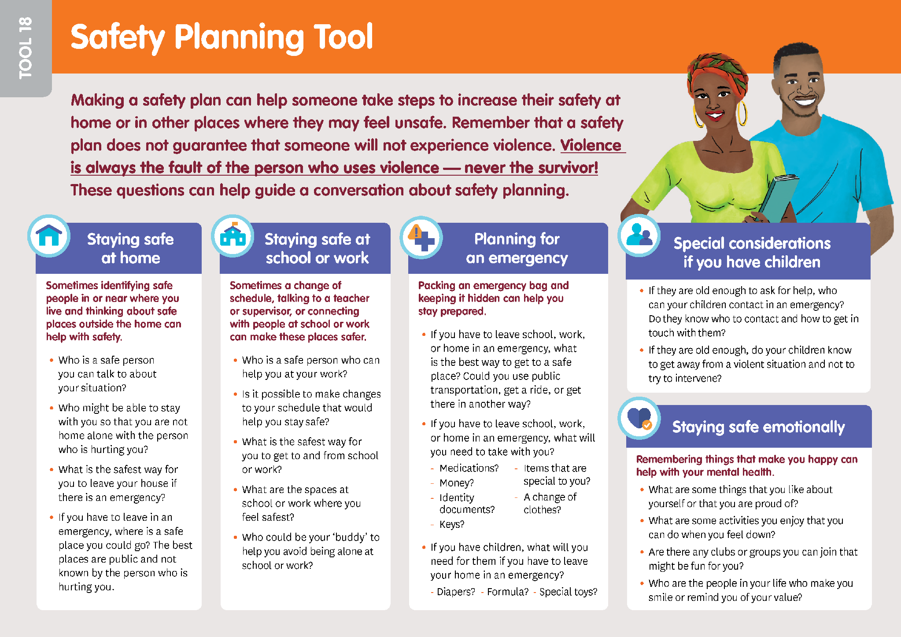

Responding to Disclosures of Violence
Special considerations
Responding to disclosures of violence can be challenging for ambassadors’ mental health and safety, especially when there are limited referral resources. Even participating in this session could cause emotional distress, even for ambassadors and facilitators who feel prepared to have these conversations.
If you will train ambassadors to respond to violence using the LIVES method…
You must provide additional support* for ambassadors
A professional counselor must be present for the session
Ambassadors must have the chance to choose not to take on this role
Ambassador Tool
*Additional support could look like more frequent check-ins, professional counseling services, a robust referral contact to handle emergency situations, etc. See pages 253-260 of the AGYW Version and 290-297 of the Diverse Version for more details.
Notes:
Facilitator notes:
Review the slide content.
Encourage participants to turn to the correct pages of their manuals to review the suggested support and methods for protecting ambassadors and facilitators and review the guidance.
Allow time for your audience to ask questions and get clarification on the information on this slide.
Remember that the important peer support skills practiced in this session are also practiced – related to non-violent situations – in the peer support session.

Slide 31
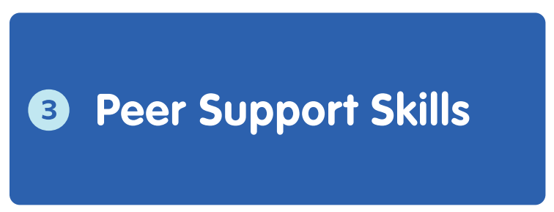
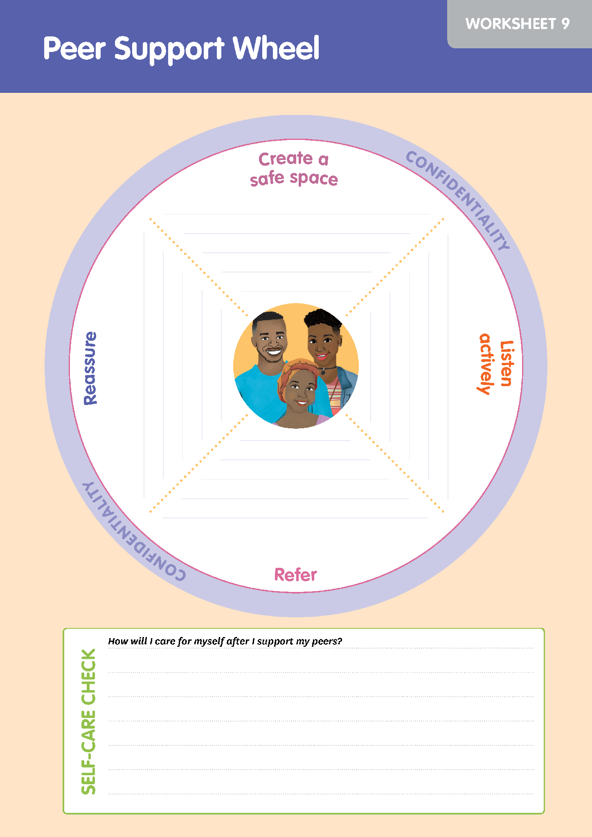
Session Goal:
Participants learn how to create a safe space and support their peers to talk about their experiences, feelings, and needs, and explore what they would like to do next. This session also explores the importance of confidentiality and self-care for ambassadors.
Session Activities:
Peer support wheel
Confidentiality exercise
Ambassador Tools & Worksheets:
Peer Support Wheel
Ambassador Worksheet
Notes:
Facilitator notes:
Review the slide content.
Note to the audience that this session covers responding to peers in crises or difficult situations and is intended to provide sufficient information on these topics for ambassadors who will not be responding to disclosures of violence and not completing the Responding to Disclosures of Violence Session. This is still a good session for participants who complete the Responding to Disclosures of Violence Session – it is not duplicate information.

Slide 32

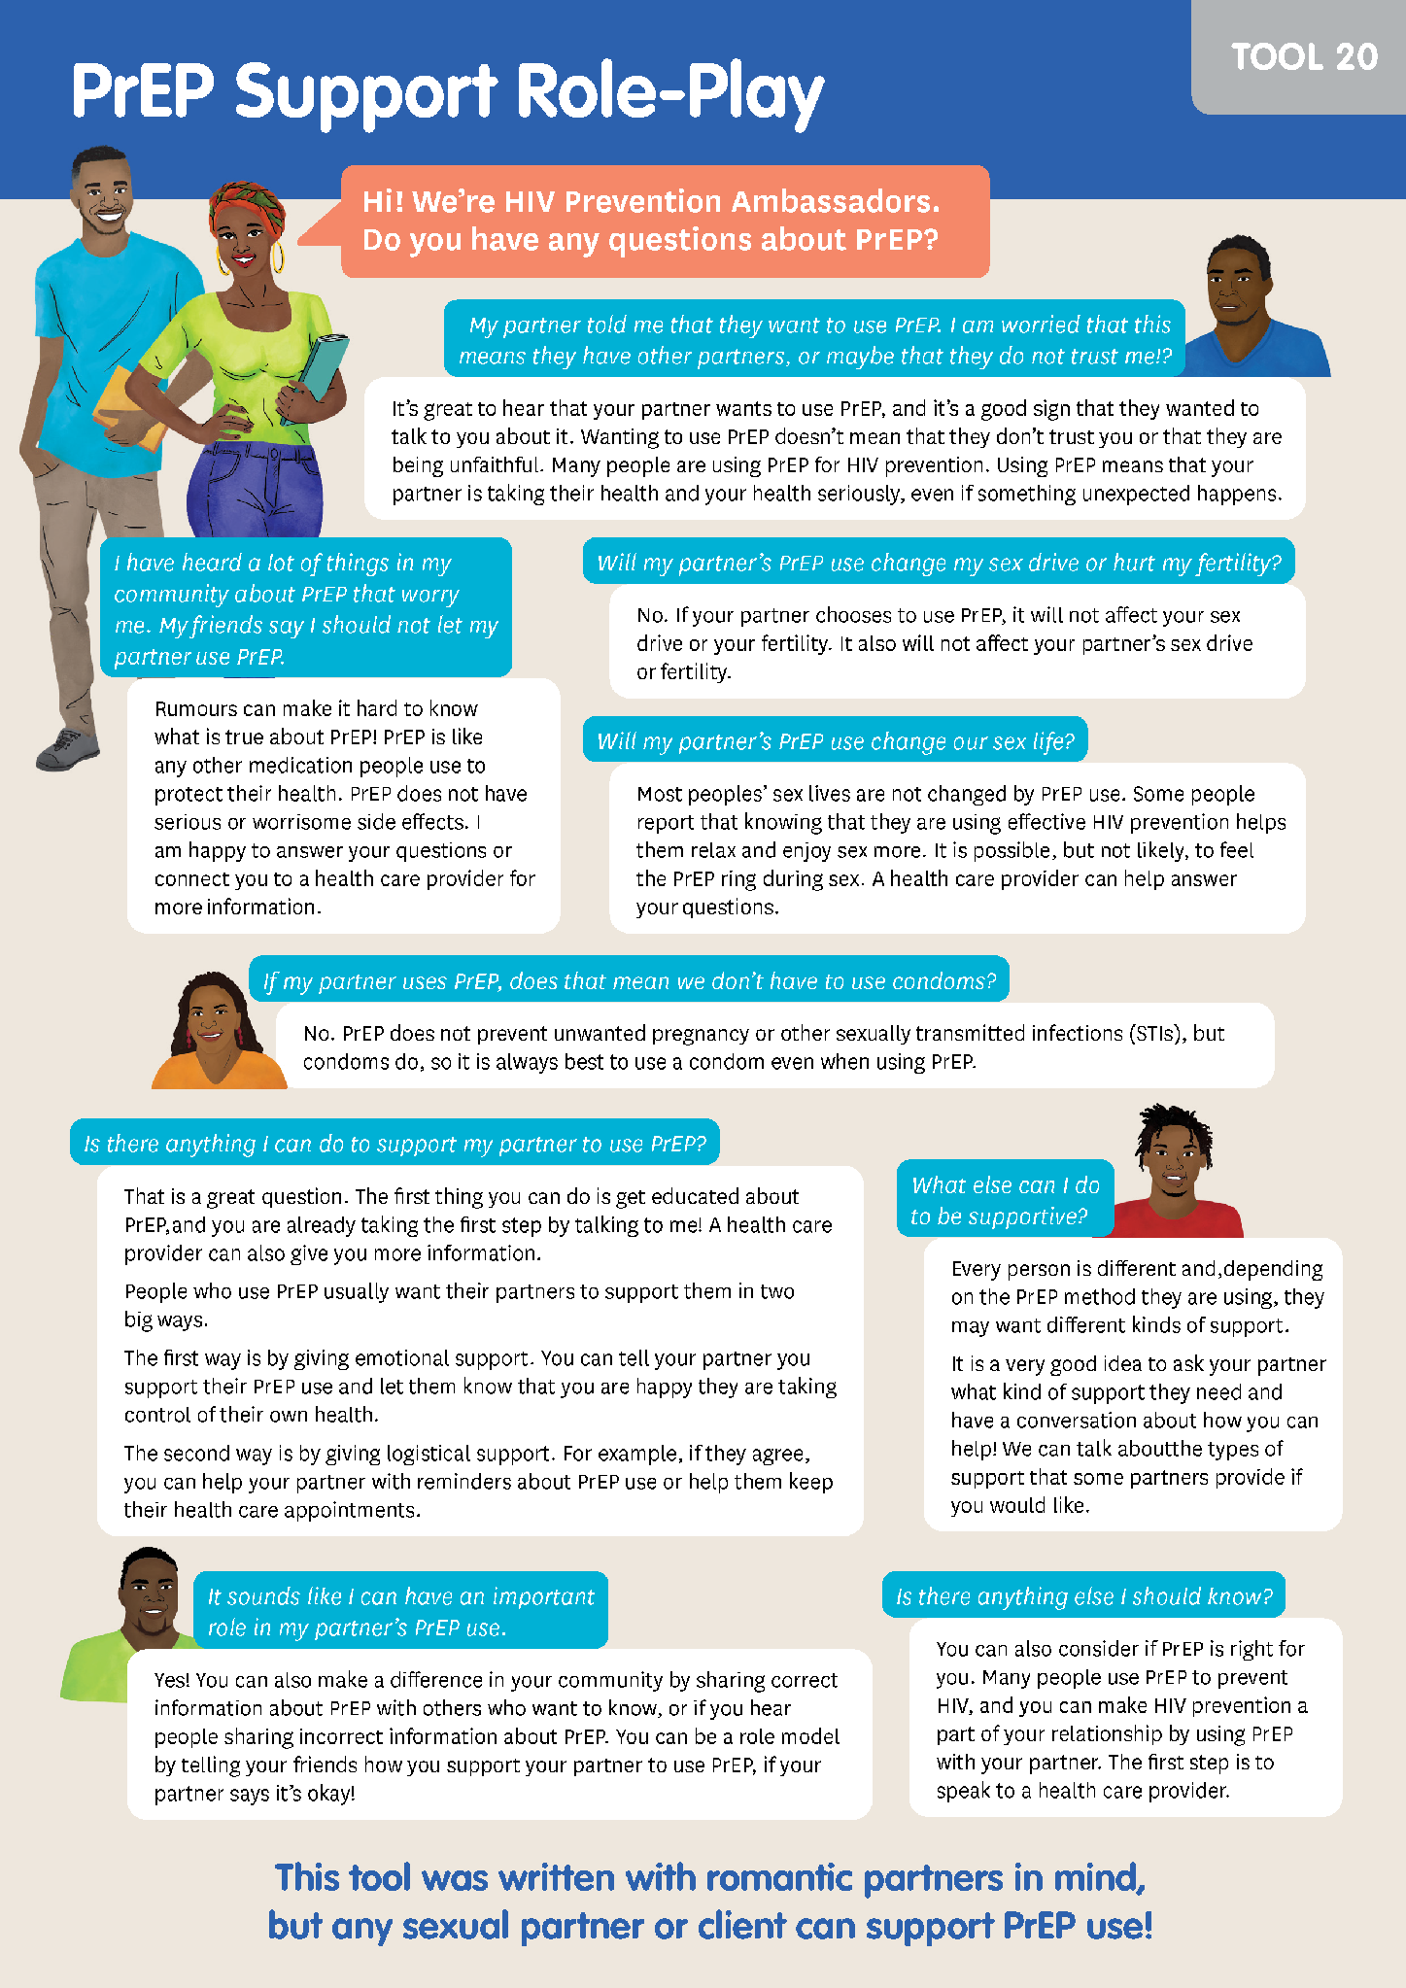
Session Goal:
Participants explore the dynamics of healthy relationships and healthy communication. They also learn how people can support their partner’s PrEP use and practice sharing information about healthy relationships and PrEP.
Session Activities:
Relationship scenes
Role-play
Ambassador Tools & Worksheets:
Tips for Supporting a Partner’s PrEP Use
Role-Play: PrEP Support
Ambassador Tool
Notes:
Facilitator notes:
Review the slide content.

Slide 33
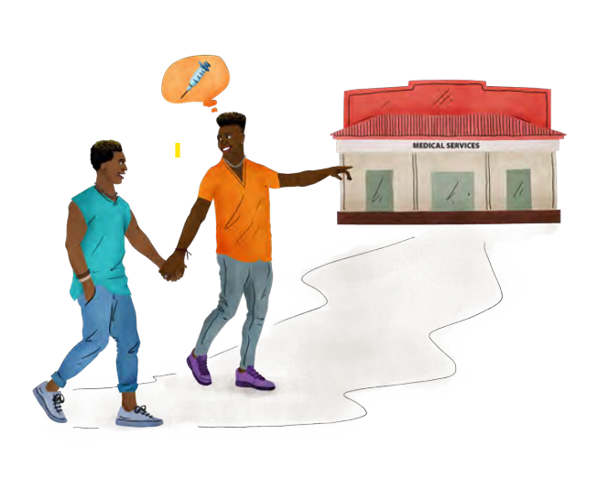

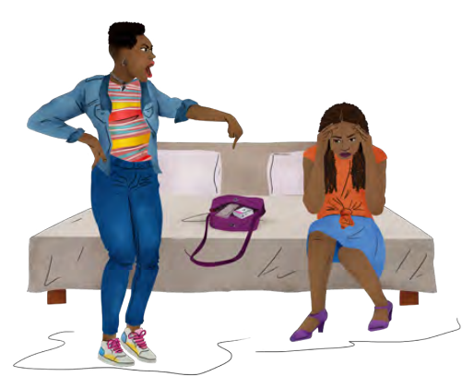
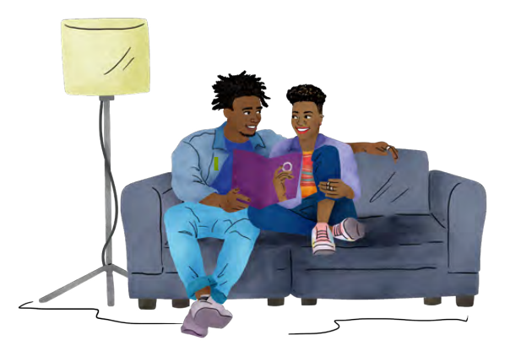
Healthy Relationships & Supportive Partners
Special considerations
This session discusses unhealthy relationship dynamics and may be challenging for some participants. We recommend…
Completing the Gender & Violence Foundational Knowledge & Responding to Disclosures of Violence Sessions (if you will include these sessions) before completing this session
Reinforcing to ambassadors that it is not their role to intervene in other peoples’ relationships
Facilitators tailor the session to fit your context – honor your ambassadors’ communities!
Relationships Activity
Notes:
Facilitator notes:
Review the slide content.
Allow time for your audience to ask questions and get clarification on the information on this slide.

Slide 34
Group work
Let’s review question 2 under “Key Element II” of our worksheets together.
WHICH AMBASSADOR SKILLS will you train on? Will your ambassadors respond to disclosures of violence? Are you able to provide them with the additional support?
Feel free to take notes on your worksheet. You will be able to update your answers on the last day of our training.
Notes:
Facilitator notes:
Review the slide content.
Guide participants through a conversation where they share responses to these questions.
Encourage participants take notes, ask questions or make comments as they think through which ambassador skills they will include in their training.

Slide 35

Closing Activity
ROSE
What bloomed in your mind during today’s session?
BUD
What are you looking forward to after today’s session?
THORN
What is feeling challenging or stressful about today’s session?
Notes:
Facilitator notes:
Review the ROSE/BUD/THORN activity.
Encourage participants share their thoughts about each prompt in the chat, or to come off mute and share verbally with each other. The amount of time you spend in discussion will depend upon the time you have remaining for the day.

Slide 36


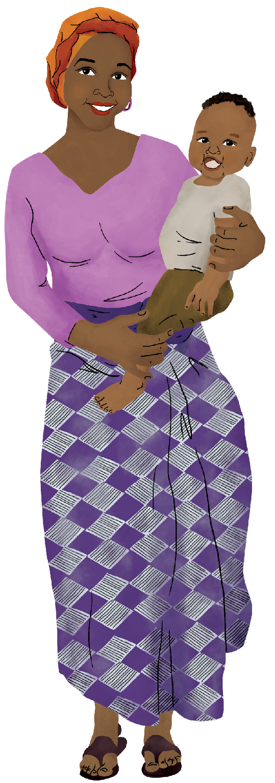

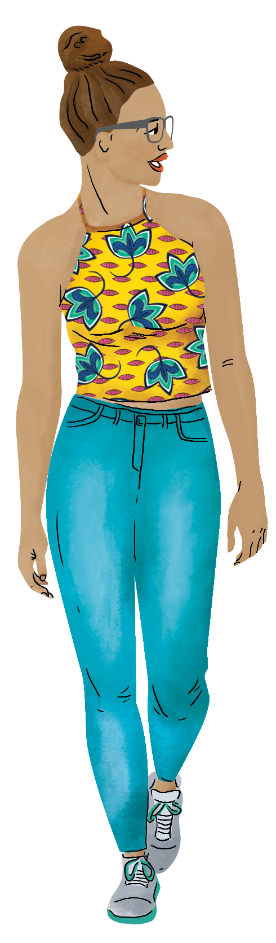
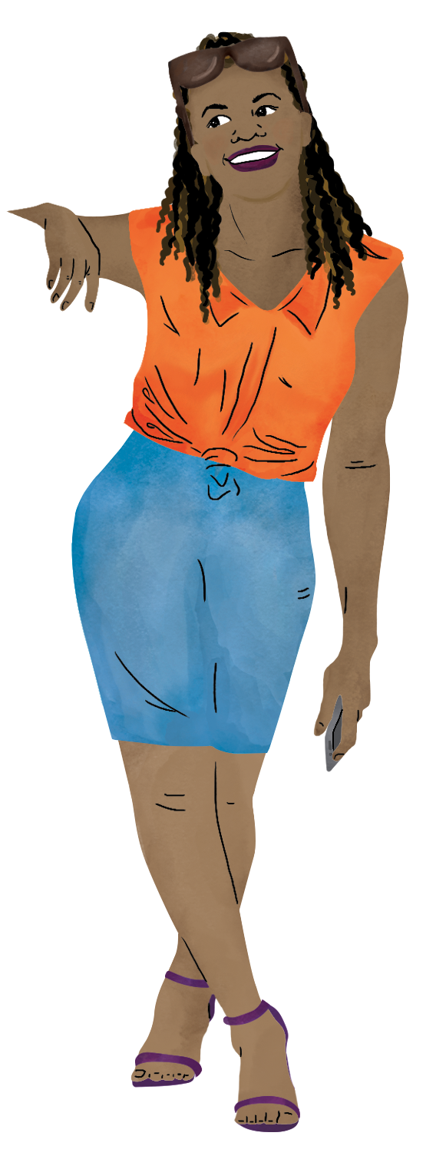

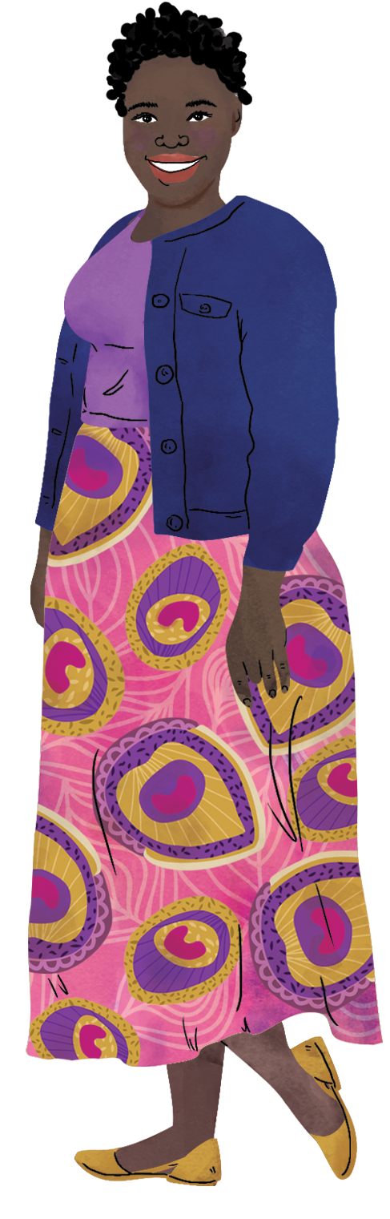
END OF SESSION 3 – THANK YOU!
See you at DAY / TIME for Session 4!
Notes:
ADVANCED PREPARATION:
Update the date and time for session 4 listed on the slide.
Facilitator notes:
Close out the session for the day.
Let participants know that they can reach out to you with questions that come up for them before the next session.
Remind participants to come to the next session at the determined date and time.

