Slide 1
How to use this template
Fonts
Headlines use Barlow SemiBold. Body copy uses Montserrat. Both are free. Install them before you edit, or PowerPoint will swap in another font and the layout will shift.
Barlow: fonts.google.com/specimen/Barlow
Montserrat: fonts.google.com/specimen/Montserrat
If you cannot install the fonts, use Bahnschrift SemiBold or Arial Bold for headlines and Century Gothic or Arial for body copy. To change the font, select the text, then choose the font from the Home tab.
Changing the text
Click any text on the card and type over it. The size, colour and position stay the same. If your translation is longer, shorten the text or reduce the font size slightly.
Choosing an image
Each slide after this one is the same card with a different image. Keep the slide that suits your audience and delete the others.
Changing the photo
Right-click an empty part of the card, away from the text, and choose Format Background. Under Fill, choose Picture or texture fill, click Insert and pick your photo. Use a portrait photo shaped like an A4 page so it is not stretched. In Google Slides, right-click and choose Change background. The shading, the My PrEP My Choice logo and the blue bar stay locked on top of your photo. The words inside the bar can be changed.
What must not change
The facts. Check the content against current national guidance before you publish.
Saving your version
Go to File, then Export, and choose PDF or PNG. Delete this instruction slide first, or export only the card slide.

Slide 2
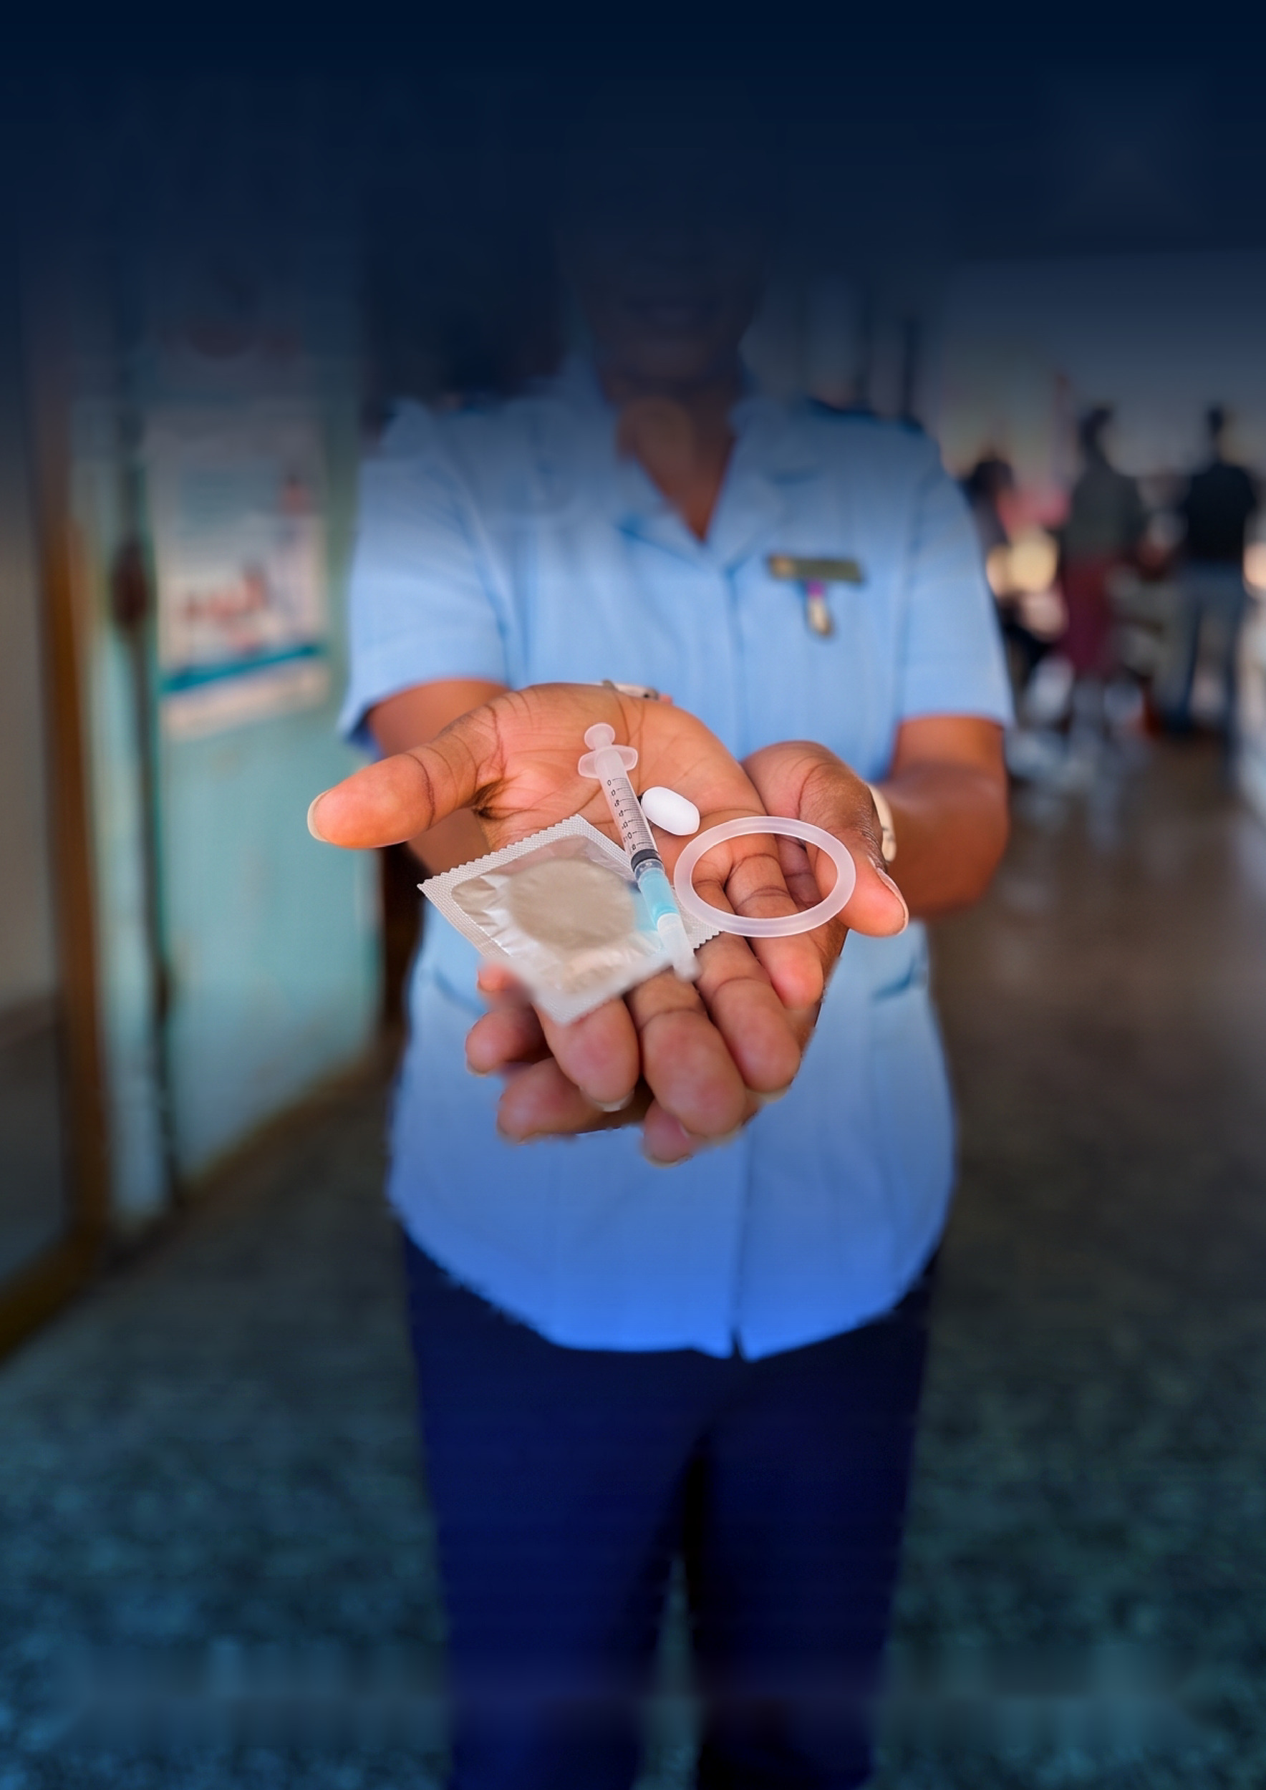
WHAT
DOES...
PrEP DO?
I heard PrEP doesn't work.
My friend took it and still got pregnant and got an STI.
Your friend's experience is real - but PrEP was not what failed her.
PrEP does one thing: it prevents HIV. It does not prevent pregnancy. It does not prevent other STIs. If someone told you it does all of those things, they were given wrong information.
#HealthMatters
For HIV prevention, when taken correctly, PrEP is highly effective. Long-acting options mean you don’t have to remember to take it daily, but all forms work.
There are different forms of PrEP. Speak to your health care provider or a peer educator about the one that is best for you. Always remember that PrEP only prevents HIV. Condoms can prevent STIs and pregnancy. If you want further methods to prevent pregnancy, there are a range of options - your health care provider can help you find the one that’s right for you. #MyPrEPMyChoice
P=P
PrEP=Prevention

Slide 3

WHAT
DOES...
PrEP DO?
I heard PrEP doesn't work.
My friend took it and still got pregnant and got an STI.
Your friend's experience is real - but PrEP was not what failed her.
PrEP does one thing: it prevents HIV. It does not prevent pregnancy. It does not prevent other STIs. If someone told you it does all of those things, they were given wrong information.
#HealthMatters
For HIV prevention, when taken correctly, PrEP is highly effective. Long-acting options mean you don’t have to remember to take it daily, but all forms work.
There are different forms of PrEP. Speak to your health care provider or a peer educator about the one that is best for you. Always remember that PrEP only prevents HIV. Condoms can prevent STIs and pregnancy. If you want further methods to prevent pregnancy, there are a range of options - your health care provider can help you find the one that’s right for you. #MyPrEPMyChoice
P=P
PrEP=Prevention

Slide 4
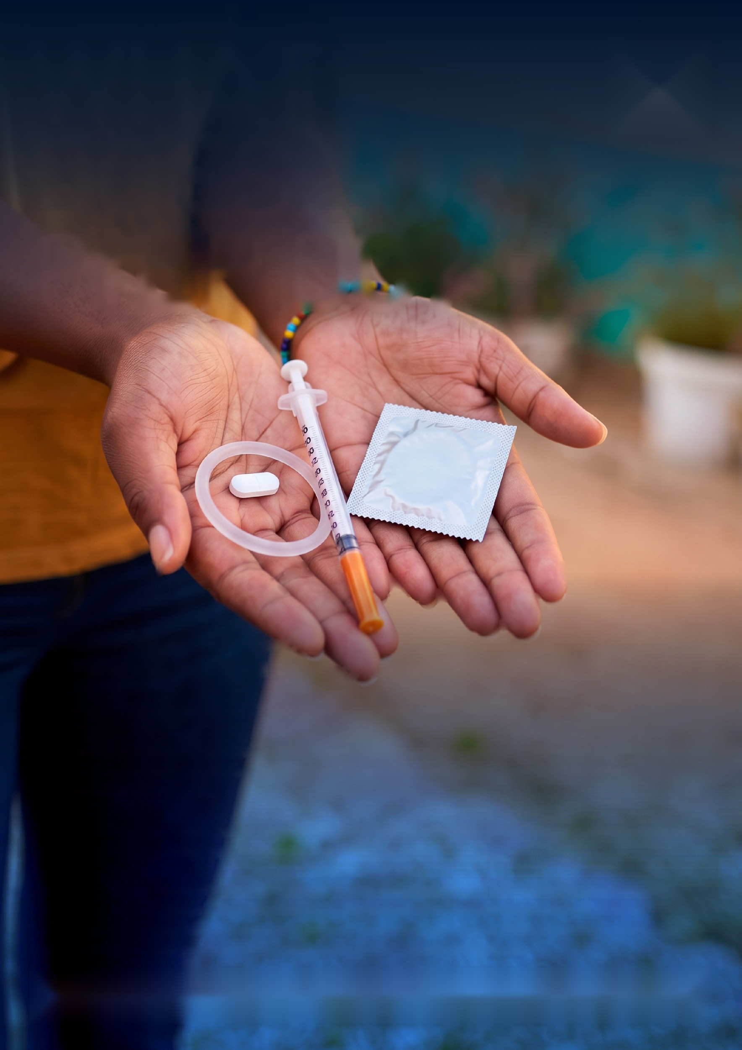
WHAT
DOES...
PrEP DO?
I heard PrEP doesn't work.
My friend took it and still got pregnant and got an STI.
Your friend's experience is real - but PrEP was not what failed her.
PrEP does one thing: it prevents HIV. It does not prevent pregnancy. It does not prevent other STIs. If someone told you it does all of those things, they were given wrong information.
#HealthMatters
For HIV prevention, when taken correctly, PrEP is highly effective. Long-acting options mean you don’t have to remember to take it daily, but all forms work.
There are different forms of PrEP. Speak to your health care provider or a peer educator about the one that is best for you. Always remember that PrEP only prevents HIV. Condoms can prevent STIs and pregnancy. If you want further methods to prevent pregnancy, there are a range of options - your health care provider can help you find the one that’s right for you. #MyPrEPMyChoice
P=P
PrEP=Prevention

Slide 5

WHAT
DOES...
PrEP DO?
I heard PrEP doesn't work.
My friend took it and still got pregnant and got an STI.
Your friend's experience is real - but PrEP was not what failed her.
PrEP does one thing: it prevents HIV. It does not prevent pregnancy. It does not prevent other STIs. If someone told you it does all of those things, they were given wrong information.
#HealthMatters
For HIV prevention, when taken correctly, PrEP is highly effective. Long-acting options mean you don’t have to remember to take it daily, but all forms work.
There are different forms of PrEP. Speak to your health care provider or a peer educator about the one that is best for you. Always remember that PrEP only prevents HIV. Condoms can prevent STIs and pregnancy. If you want further methods to prevent pregnancy, there are a range of options - your health care provider can help you find the one that’s right for you. #MyPrEPMyChoice
P=P
PrEP=Prevention

Slide 6
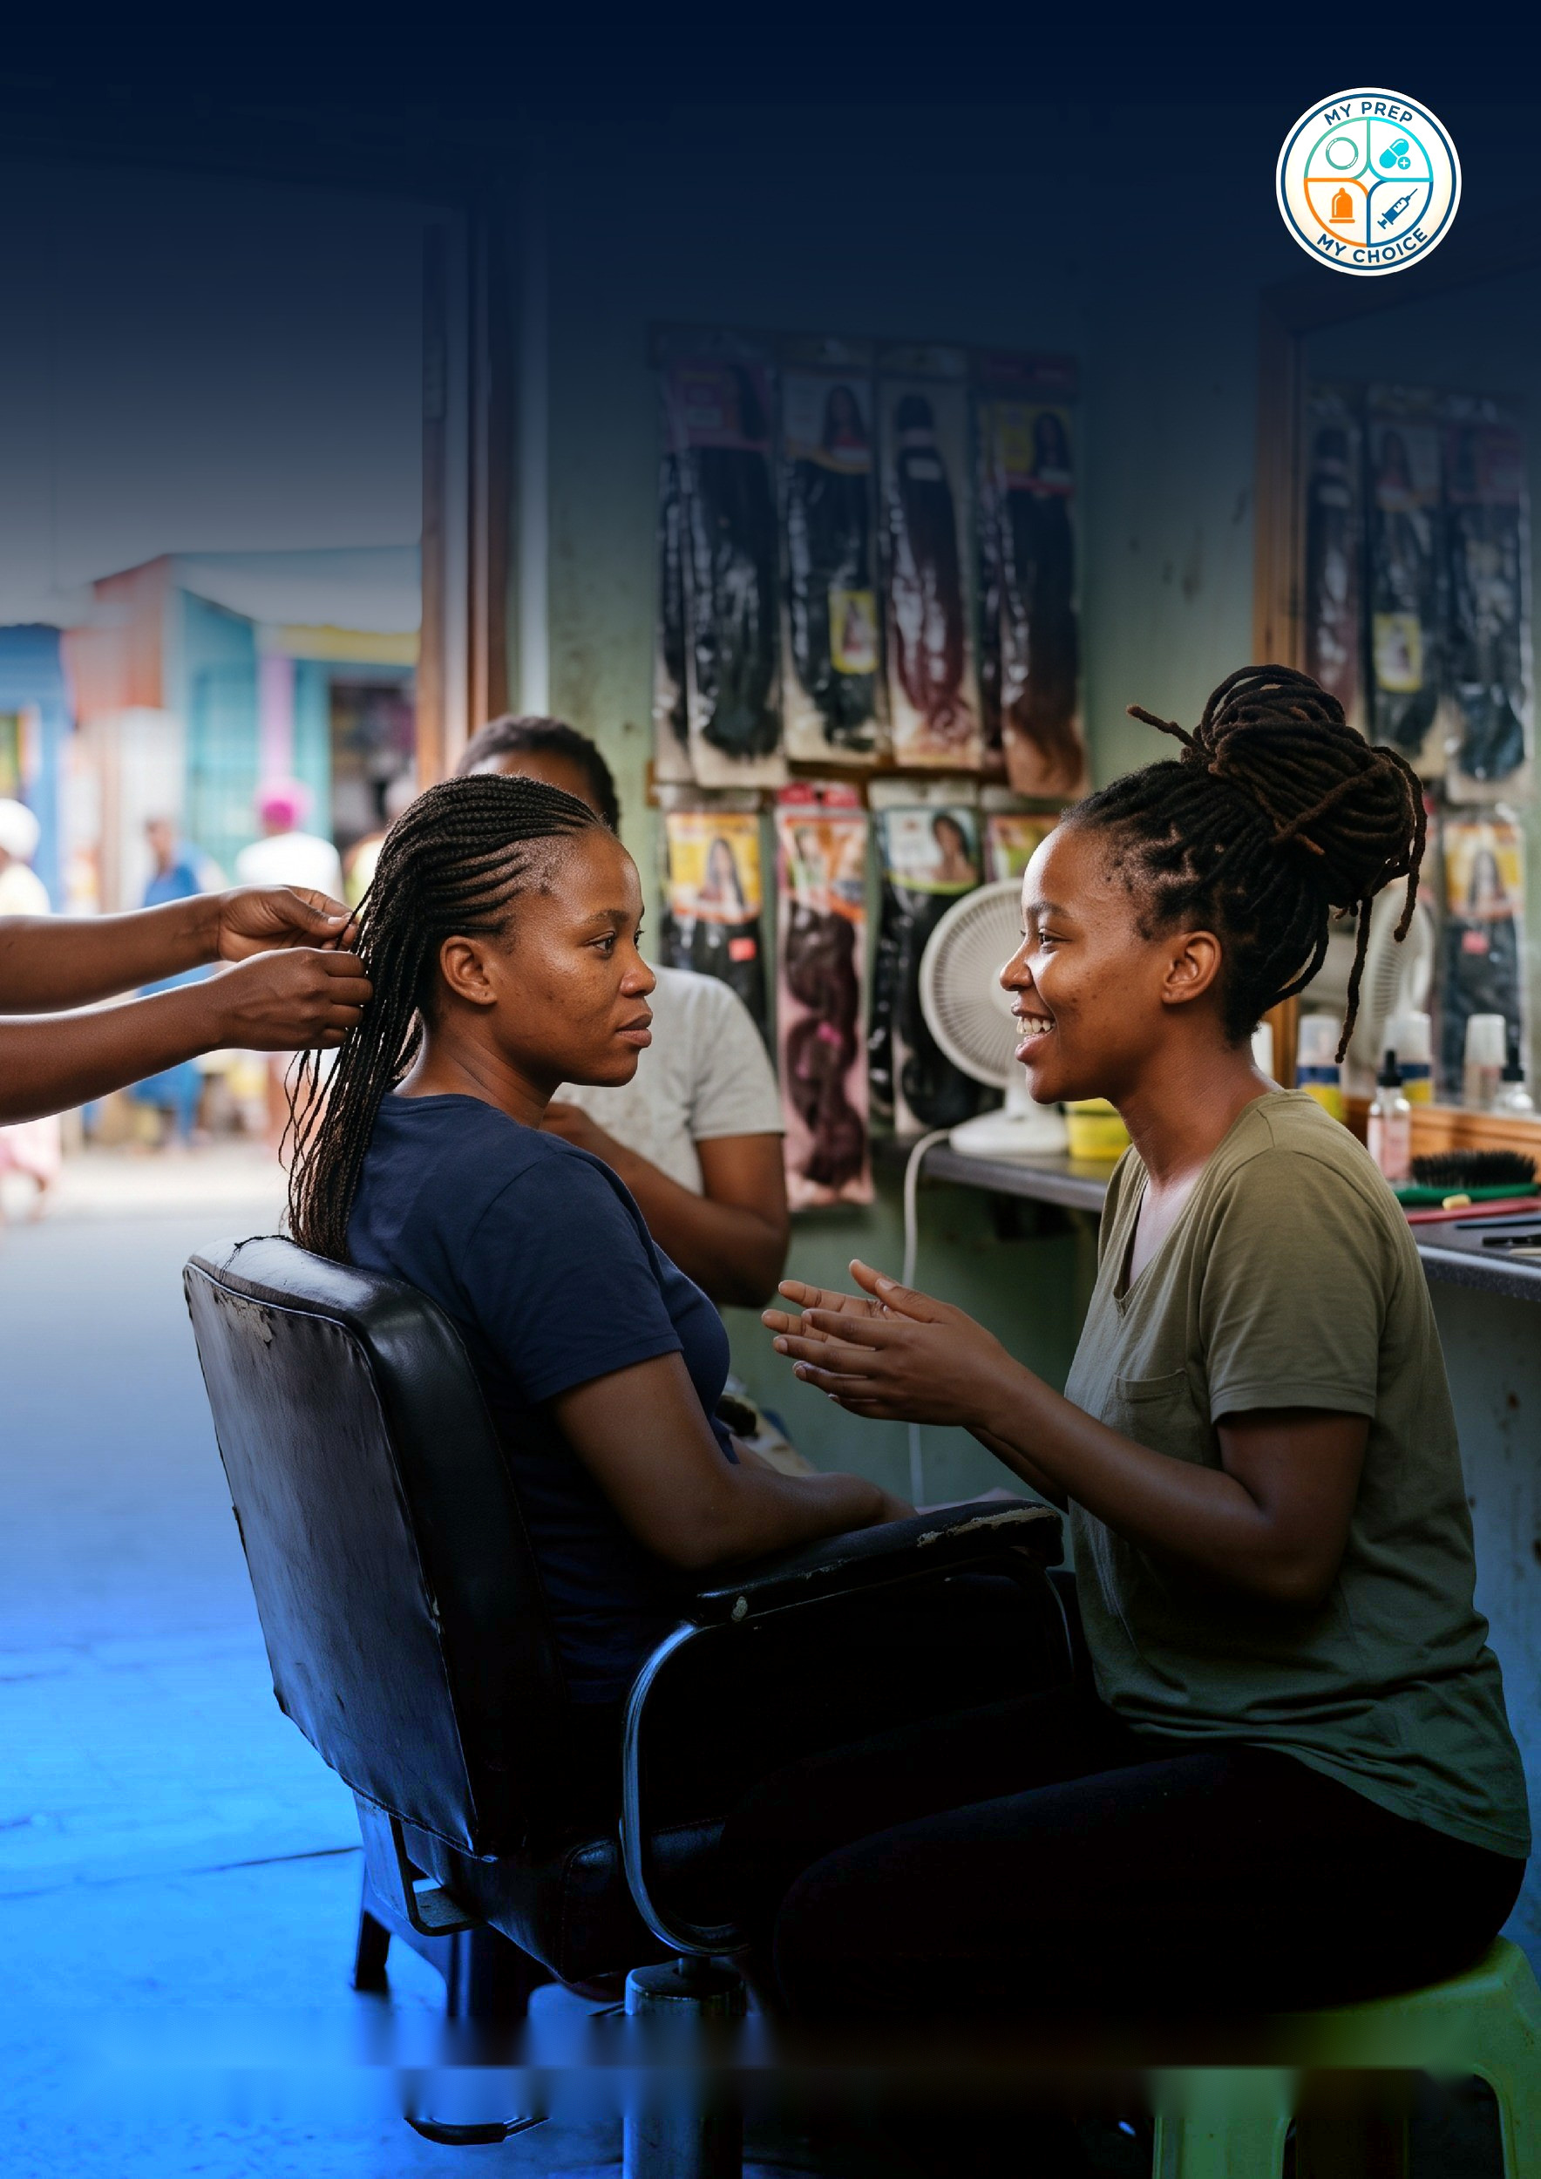
WHAT
DOES...
PrEP DO?
I heard PrEP doesn't work.
My friend took it and still got pregnant and got an STI.
Your friend's experience is real - but PrEP was not what failed her.
PrEP does one thing: it prevents HIV. It does not prevent pregnancy. It does not prevent other STIs. If someone told you it does all of those things, they were given wrong information.
#HealthMatters
For HIV prevention, when taken correctly, PrEP is highly effective. Long-acting options mean you don’t have to remember to take it daily, but all forms work.
There are different forms of PrEP. Speak to your health care provider or a peer educator about the one that is best for you. Always remember that PrEP only prevents HIV. Condoms can prevent STIs and pregnancy. If you want further methods to prevent pregnancy, there are a range of options - your health care provider can help you find the one that’s right for you. #MyPrEPMyChoice
P=P
PrEP=Prevention

